Slide 1
THE FUNDAMENTAL DATA TYPES

Slide 2
Declarations, Expressions, and Assignments
Variables and constants are the objects that a prog. manipulates.
All variables must be declared before they can be used.
  #include <stdio.h>
  int main(void)
  {
  int a, b, c; /*declaration*/
  float x, y = 3.3, z = -7.7; /*declaration with initialization*/
  printf(“Input two integers: “); /*function call*/
  scanf(“%d%d”,&b, &c); /*function call*/
  a = b + c; /*assignment*/
  x = y + z; /*assignment*/
  }

Slide 3
Declarations, Expressions, and Assignments
Declarations
  associate a type with each variable declared
  This tells the compiler to set aside an appropriate amount of memory space to hold values associated with variables.
  This also enables the compiler to instruct the machine to perform specified operation correctly.
    b + c (integer addition)
    y + z (real number addition)

Slide 4
Declarations, Expressions, and Assignments
Expressions
  Meaningful combinations of constants, variables, operators, and function calls.
  A constant, variable, or function call itself is also an expression
    a+b
    sqrt(7.333)
    5.0 * x – tan(9.0 / x)
  Most expressions have a value.
    i = 7 assignment expression
  <Examples of statements>
    i = 7;
    printf(“The plot thickens!\n”);
    3.777;
    a + b ;
Perfectly legal, but they are not useful

Slide 5
Declarations, Expressions, and Assignments
Assignments
  variable = expr ; assignment statement
  <Mathematical equation> <Assignment expression>
  x + 2 =0 x + 2 = 0 /*wrong*/
  x = x + 1 (meaningless) x = x + 1
!! Although they look alike, the assignment operator in C and the equal sign in mathematics are NOT COMPARABLE

Slide 6
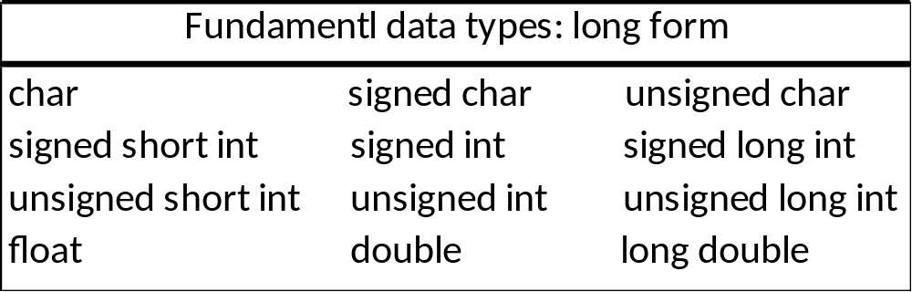
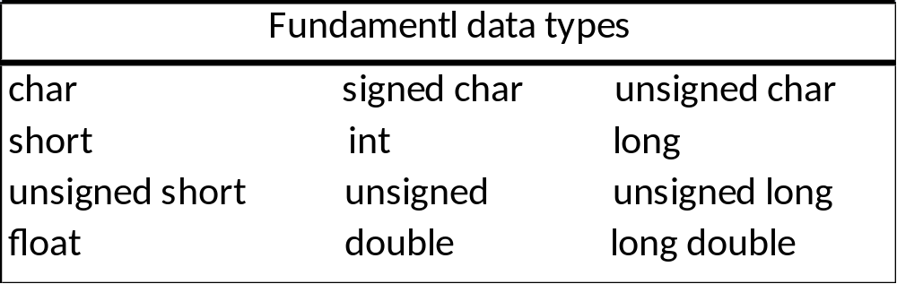
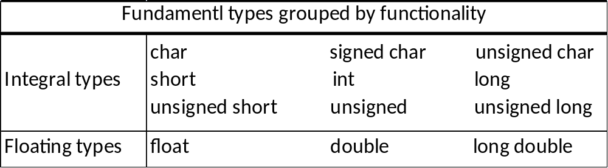
The Fundamental Data Types

Slide 7
Characters and the Data Type char
type char
  A variable of type char can be used to hold small integer values.
  1 byte (8 bits) in memory space
    2⁸, or 256, distinct values
      including lower- and uppercase letters, digits, punctuation, and special char.s such as % and +
      including white space blank, tab, and newline

Slide 8
Characters and the Data Type char
Most machines use either ASCII or EBCDIC character codes to represent a character in bits.
ASCII character code
  a character encoding-scheme
  A character constant has its corresponding integer value.
  ‘a’ (97) ‘b’ (98) ‘c’ (99) …
  ‘A’ (65) ‘B’ (66) ‘C’ (67) …
  ‘0’ (48) ‘1’ (49) ‘2’ (50) …
  ‘&’ (38) ‘*’ (42) ‘+’ (43) …
  No particular relationship btwn the value of the character constant representing a digit and the digit’s intrinsic integer value.
‘2’ ≠ 2

Slide 9
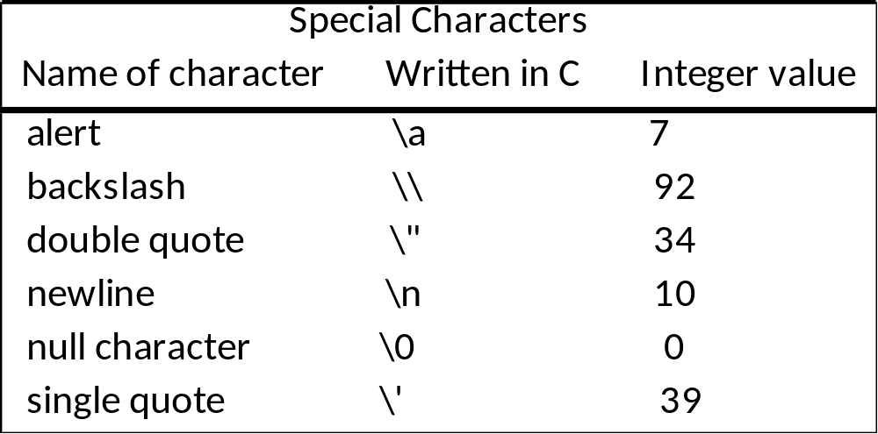
Characters and the Data Type char
Nonprinting and hard-to-print characters require an escape sequence.
\ (backslash character)
  an escape character
  is used to escape the usual meaning of the character that follows it.
printf(“%c”, ‘\a’); or putchar(‘\a’);
printf(“\”abc\””); /* “abc” is printed */
printf(“%cabc%c”, ‘\’’, ‘\’’); /* ‘abc’ is printed */

Slide 10
Characters and the Data Type char
Characters are treated as small integers
  char c = ‘a’;
  printf(“%c”, c); /* a is printed */
  printf(“%d”, c); /* 97 is printed */
  printf(“%c%c%c”, c, c+1, c+2); /* abc is printed */
  char c;
  int i;
  for ( i = ‘a’; i<= ‘z’; ++i )
    printf (“%c”, i); /* abc…z is printed */
  for ( c = ‘0’; i<= ‘9’; ++c )
    printf (“%d ”, c); /* 48 49 … 57 is printed */

Slide 11
Characters and the Data Type char
char c = ‘a’;
c is stored in memory in 1 byte as 01100001 (97)
The type char holds 256 distinct values
  singed char : -128 ~ 127
  unsigned char : 0 ~ 255

Slide 12
The Data Type int
type int
  the principal working type of the C language
  integer values
  stored in either 2 bytes (=16 bits) or in 4 bytes (=32 bits)
    64-bit OS: 4 bytes or 8 bytes
  holds 2³² distinct states (in case of 4 bytes)
    -2³¹, -2³¹+1, … , -3, -2, -1, 0, 1, 2, 3, … , 2³¹-1
  (-2,147,483,648) (2,147,483,647)
    #define BIG 2000000000 /* 2 billion */
    int main(void)
    {
    int a, b = BIG, c= BIG;
    a = b + c; /* out of range? */
    ……
integer overflow !!

Slide 13
The Integral Types short, long, and unsigned
The type int is “natural” or “usual” type for working with integers
The other integral types, such as char, short, and long, are intended for more specialized use.
  short (2 bytes)
    when the storage is of concern
  long (4 bytes or 8 bytes)
    when large integer values are needed
  short ≤ int ≤ long

Slide 14
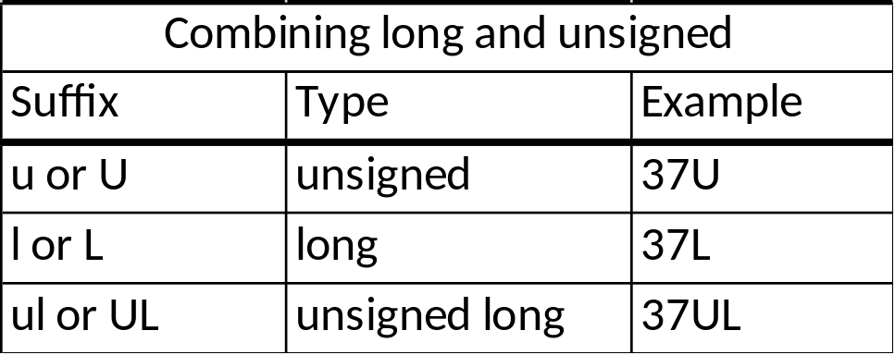
The Integral Types short, long, and unsigned
Type int and unsigned are stored in a machine WORD.
  2 bytes, 4 bytes (, or 8 bytes)
  unsigned u;
  0≤ u ≤ 2^{wordsize}-1
  0≤ u ≤ 2³²-1 (+4294967295 , 4 billion)
Suffixes can be appended to an integer constant to specify its type.

Slide 15
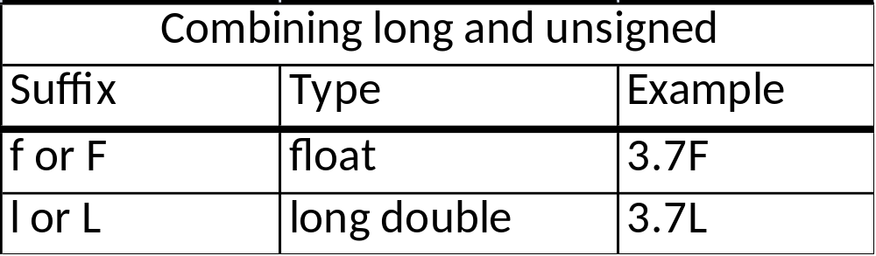
The Floating Types
3 floating types
  float, double, long double
  holds real values such as 0.001, 2.0, and 3.14159
  A suffix appended to a floating constant to specify its type
  The working floating type in C is double.
    the constants 1.0 and 2.0 : double
    the constant 3 : int

Slide 16
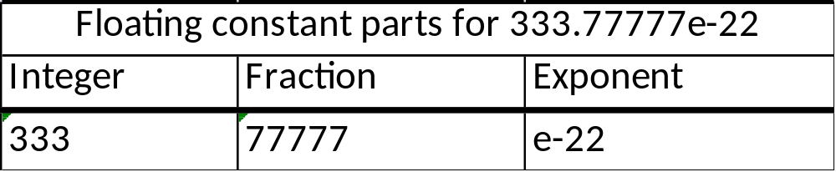
The Floating Types
Floating constant
  decimal notation: 123456.7
  exponential notation
    1.234567e5
    = 1.234567 × 10⁵
    = 123456.7 (decimal point shifted five places to the RIGHT)
    1.234567e-3
    = 1.234567 × 10⁻³
    = 0.001234567 (decimal point shifted three places to the LEFT)

Slide 17
The Floating Types
Floating constant
  may contain an integer part, a decimal point, a fractional part, and an exponential part.
  MUST contain either a decimal point or an exponential part or both.
  If a decimal point is present, either an integer part or fractional part or both MUST be present.
    <Examples> <NOT Examples>
    3.14159 3.14,159
    314.159e-2 314159
    0e0 (⇔ 0.0) .e0
    1. -3.14159 (floating constant expr.)

Slide 18
The Floating Types
Possible values of a floating type
  Precision
    the # of significant decimal places that a floating value carries.
  Range
    The limits of the largest and smallest positive floating values that can be represented in a variable of that type
type float
  stored in 4 bytes
  Precision of 6 significant figures & Range of 10⁻³⁸ to 10³⁸
    0.d₁d₂d₃d₄d₅d₆ × 10^{n}
    , where each d_{i} is a decimal digit, the first digit, d₁, is positive (i.e. non-zero), and -38 ≤ n ≤ 38

Slide 19
The Floating Types
type double
  stored in 8 bytes
  Precision of 15 significant figures & Range of 10⁻³⁰⁸ to 10³⁰⁸
    0.d₁d₂ … d₁₅ × 10^{n}
    , where each d_{i} is a decimal digit, the first digit, d₁, is positive,
    and -308 ≤ n ≤ 308
    x = 123.45123451234512345; /* 20 significant digits */
    0.123451234512345 × 10³ (15 significant digits)
  (1) NOT all real numbers are representable
  (2) floating arithmetic operations need not be exact

Slide 20
The Use of typedef
typedef
  allows the programmer to explicitly associate a type with an identifier
    typedef char uppercase;
    typedef int INCHES, FEET;
    typedef ungined long size_t;
    int main(void)
    {
    uppercase u;
    INCHES length, width;
    …
    }
abbreviating long declarations
having type names that reflect the intended use

Slide 21
The sizeof Operator
sizeof
  a unary operator to find the # of bytes needed to store an object
    sizeof(object)
    : object can be a type such as int or float, or an expression such as a+b.
    /* Compute the size of some fundamental types. */
    #include <stdio.h>
    int main(void)
    {
    printf(“The size of some fundamental types is computed.\n\n”);
    printf(“ char:%3u byte \n”, sizeof(char));
    printf(“ short:%3u bytes\n”, sizeof(short));
    printf(“ int:%3u bytes\n”, sizeof(int));
    printf(“ float:%3u bytes\n”, sizeof(float));
    printf(“ double:%3u bytes\n”, sizeof(double));
    }

Slide 22
The sizeof Operator
sizeof
  sizeof(char) = 1
  sizeof(char) < sizeof(short) ≤ sizeof(int) ≤ sizeof(long)
  sizeof(signed) = sizeof(unsigned) = sizeof(int)
  sizeof(float) ≤ sizeof(double) ≤ sizeof(long double)
  sizeof(…) looks that it is a function, but it is not. An Operator.
  The type returned by the operator sizeof is typically unsigned.

Slide 23
The use of getchar() and putchar()
getchar(), putchar()
  macros defined in stdio.h
  getchar()
    reads a character from the keyboard
  putchar()
    prints a character on the screen
    #include <stdio.h>
    int main(void)
    {
    int c;
    while ( (c = getchar()) != EOF) {
    putchar(c);
    putchar(c);
    }
    return 0;
    }

Slide 24
The use of getchar() and putchar()
the identifier, EOF
  #define EOF (-1)
  “end-of-file”
  What is actually used to signal an end-of-file mark is system-dependent.
  The int value -1 is often used.
int c;
  c is an int, it can hold all possible char. values as well as the special value EOF.
(c = getchar()) != EOF;
c = getchar();
  The subexpression c = getchar() gets a value from the keyboard and
  and assigns it the variable c,
  ,and the value of the subexpression takes on that value as well.
c = getchar() != EOF ⇔ c = (getchar() != EOF)
,in the header file, stdio.h

Slide 25
The use of getchar() and putchar()
‘a’ ⇔ 97
‘a’+1 ⇔ ‘b’
‘z’ – ‘a’ ⇔ ‘Z’ – ‘A’ ⇔ 25
A lowercase letter, c :
c + ‘A’ – ‘a’ has a value of the corresponding uppercase letter.
  #include <stdio.h>
  int main(void)
  {
  int c;
  while ( (c = getchar()) != EOF)
  if ( c>= ‘a’ && c<= ‘z’)
  putchar(c + ‘A’ – ‘a’);
  else
  putchar(c);
  return 0;
  }

Slide 26
General Conversion Rules
Data Types and Operators. <number>
For binary operations with operands f different types, the “lower” type is promoted to the “higher” type before operation proceeds.
For assignment operations, the value of the right side is converted to the type of the left, which is the type of the result.

Slide 27
Informal Conversion Rules
Data Types and Operators. <number>
If there is no unsigned operands,
If either operand is long double, convert the other to long double
Otherwise, if either operand is double, convert the other to double
Otherwise, if either operand is float, convert the other to float
Otherwise, convert char and short to int
Then, if either operand is long, convert the other to long

Slide 28
Usual Arithmetic Conversions
Data Types and Operators. <number>
If either operand is long double, convert the other to long double
Otherwise, if either operand is double, convert the other to double
Otherwise, if either operand is float, convert the other to float
Otherwise, the integral promotions are performed on both operands; then, if either operand is unsigned long int, the other is converted to unsigned long int
Otherwise, if one operand is long int and the other is unsigned int, the effect is system-dependent
Otherwise, if one operand is long, convert the other to long
Otherwise, if either operand is unsigned int, the other is converted to unsigned int
Otherwise, both operands have type int.

Slide 29
Usual Arithmetic Conversions
occurs when the operands of a binary operator are evaluated.
  int i = 3;
  float f = 3.0, g;
  i + f (the type float)
long double → double → float → Integral Promotion
unsigned long → [long op unsigned] → long → unsigned → int
  long (if long is long enough)
  or
  unsigned long (otherwise)
Automatic conversion
Implicit conversion
Widening
Promotion
coercion

Slide 30
Integral Promotions
A char, a short integer, or an integer bit-field, all either signed or not, or an object of enumeration type, may be used in an expression whenever an integer may be used.
If all the values of the original type in an expression can be represented by an int, then the value is converted to an int; otherwise the value is converted to unsigned int.
  short x, y;
  x + y (the type int, not short)
  char c = ‘A’;
  printf(“%c\n”, c); /* the type of expr. C is int, not char */

Slide 31
Informal Conversion Rules
Data Types and Operators. <number>
Comparisons between signed and unsigned values are machine-dependent because they depend on the sizes of the various integer types
if one operand is long int and the other is unsigned int, the effect depends on whether a long int can represent all values of an unsigned int in the system;
  if so, the unsigned int operand is converted to long int;
  if not, both are converted to unsigned long int.

Slide 32
Informal Conversion Rules
Data Types and Operators. <number>
float is not automatically converted to double
  float is for saving storage in large arrays, or less often, to save time on machines where double-precision arithmetic is particularly expensive.
double to float conversion is implementation-dependent (rounded or truncated)
float to int causes truncation of any fractional part

Slide 33
Informal Conversion Rules
Data Types and Operators. <number>
Longer integers are converted to shorted ones or chars by dropping the excess high-order bits (e.g. the value of c is unchanged)
  int i;
  char c;
  i=c;
  c=i;

Slide 34
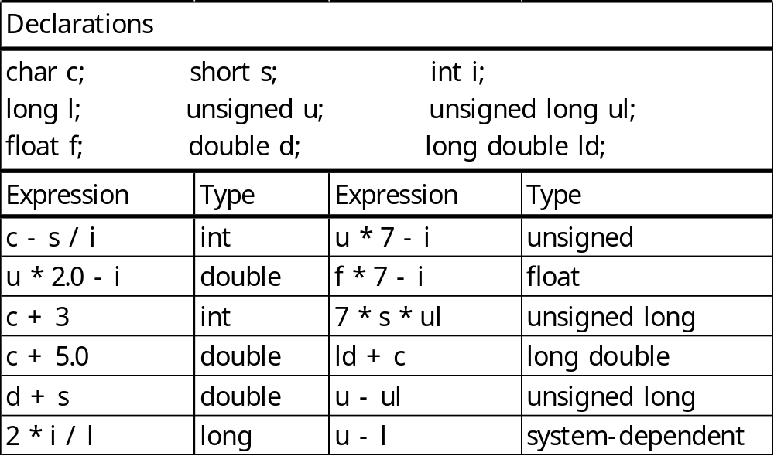
Conversions and Casts
  d = i; Widening
  The value of i is converted to a double and then assigned to d
  i = d; Narrowing
  Loss of Information. The fraction part of d will be discarded.

Slide 35
Conversions and Casts
Casts
  Explicit conversions
  (double) i
  casts, or converts, the value of i so that the expr. has type double
  The variable i itself remains unchanged.
    <Examples> <NOT Examples>
    l = (long) (‘A’ + 1.0); (double) x = 77; /* equivalent to ((double) x) = 77, Error*/
    f = (float) ((int)d + 1);
    d = (double) i / 3;
  The cast operator (type) is an unary operator.
    (float) i + 3 ⇔ ((float) i) + 3

Slide 36
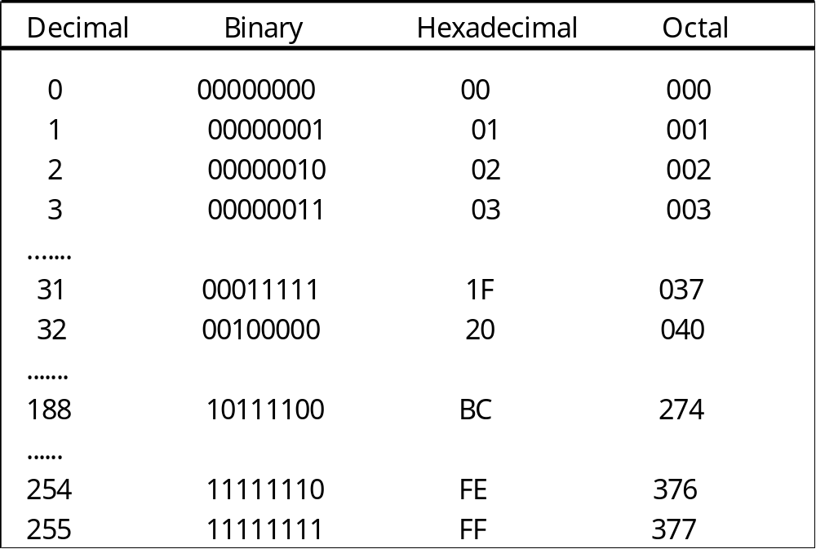
Hexadecimal and Octal Constants
Hexadecimal digits and their corresponding decimal values
Hexadecimal digit: 0 1 … 9 A B C D E F Decimal value: 0 1 … 9 10 11 12 13 14 15
Hexadecimal Constants:
2A ⇔ 2 × 16¹ + A × 16⁰= 2 × 16¹ + 10 × 16⁰ = 42
5B3 ⇔ 5 × 16² + B × 16¹ + 3 × 16⁰ = 5 × 16² + 11 × 16¹ + 3 × 16⁰ = 20659
Octal Constants:
75301
⇔ 7 × 8⁴ + 5 × 8³ + 3 × 8² + 0 × 8¹ + 1

Slide 37
Hexadecimal and Octal Constants
#include <stdio.h>
int main(void)
{
printf(%d %x %o\n”, 19, 19, 19); /* 19 13 23 */
printf(%d %x %o\n”, 0x1c, 0x1c, 0x1c); /* 28 1c 34 */
printf(%d %x %o\n”, 017, 017, 017); /* 15 f 17 */
printf(%d\n”, 11 + 0x11 + 011); /* 37 */
printf(%x\n”, 2097151); /* 1fffff */
printf(%d\n”, 0x1FfFFf); /* 2097151 */
return 0;
}

