Slide 1
FLOW OF CONTROL

Slide 2
Flow of Control
Sequential flow of control
  Statement in a program are normally executed one after another.
Often it is desirable to alter the sequential flow of control to provide for
  a choice of action
    if, if-else, switch
  ,or a repetition of action
    while, for, do

Slide 3
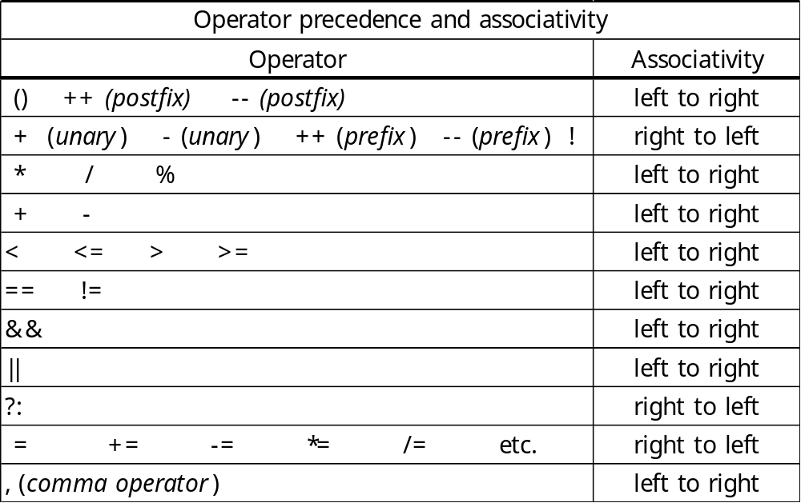
Relational, Equality, and Logical Operators
true: nonzero value
false: zero value

Slide 4
Relational Operators and Expressions
expr < expr
expr > expr
expr <= expr
expr >= expr
<Examples> <NOT Examples>
a < 3 a =< b /* out of order */
a > b a < = b /* space not allowed*/
-1.3 >= (2.0 * x + 3.3) a >> b /* shift expression */
a < b
  If a is less than b, then the expr. has the int value 1 (true).
  If a is not less than b, then the expr. has the int value 0 (false).

Slide 5
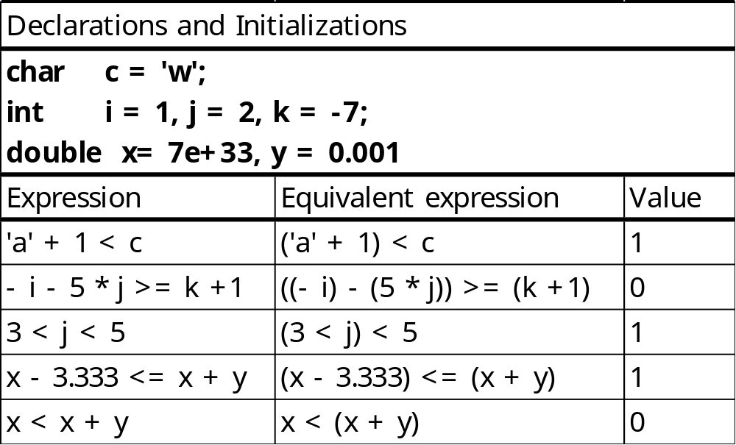
Relational Operators and Expressions
Arithmetic conversion
  On many machines, a < b is implemented as a – b < 0.
3<j && j<5 ⇔ (3<j) && (j<5)
x < x + y
(x – (x + y)) < 0.0
The values of x and x + y are equal, so the expr. will yield the int value 0.

Slide 6
Equality Operators and Expressions
expr == expr
expr != expr
<Examples> <NOT Examples>
c == ‘A’ a = b /* assignment */
k != -2 a = = b - 1 /* space not allowed*/
x + y == 3 * z – 7 (x + y) =! 44 /* (x + y) = (!44) */
a == b
  is either true or false
  is implemented as a – b == 0

Slide 7
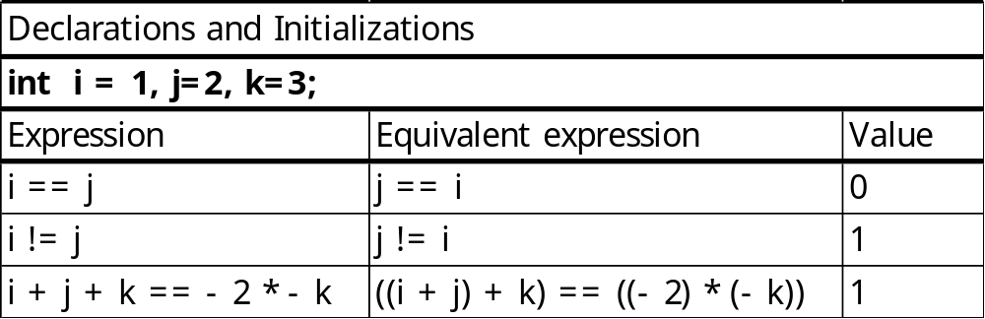
Equality Operators and Expressions
!! A common programming error
  if (a = 1)
  …
  if (a == 1)
  …

Slide 8
Logical Operators and Expressions
! expr (unary negation)
<Examples> <NOT Examples>
!a a! /* out of order */
!(x + 7.7) a != b /* “not equal” operator*/
!(a < b || c < d)
! expr
  If expr has value zero, ! expr has the int value 1 (true).
  If expr has nonzero value, ! expr has the int value 0 (false).
  !!5 ⇔ !(!5) has the value 1.

Slide 9
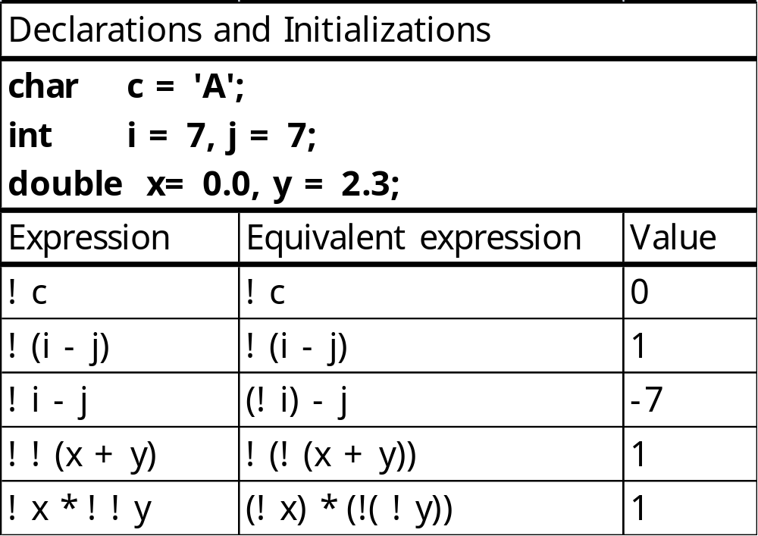
Logical Operators and Expressions

Slide 10
Logical Operators and Expressions
expr || expr (logical and)
expr && expr (logical or)
<Examples> <NOT Examples>
a && b a && /* missing operand */
a || b a | | b /* space not allowed*/
!(a < b) && c a & b /* bitwise operator */
3 && (-2 * a + 7) &b /* the address of b */
&& has higher precedence than ||.
Both of && and || are of lower precedence than all unary, arithmetic, equality, and relational operators.

Slide 11
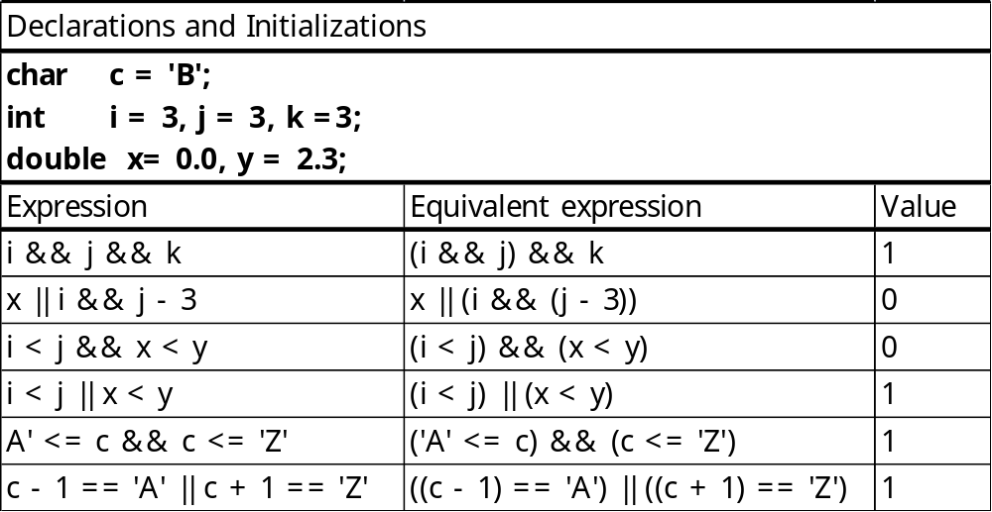
Logical Operators and Expressions
Short-circuit Evaluation
  In evaluating the expr.s that are the operands of && and ||, the evaluation process stops as soon as the outcome true or false is known.
  expr1 && expr2 , if expr1 has value zero
  expr1 || expr2 , if expr1 has nonzero value

Slide 12
Compound Statement
Compound statement
  a series of declarations and statements surrounded by braces
    block
  for grouping statements into an executable unit
  is itself a statement, thus it can be placed wherever a statement is placed.
  {
  a = 1;
  { /* nested */
  b = 2;
  c = 3;
  }
  }

Slide 13
Expression and Empty Statement
Expression statement
  an expression followed by ;
Empty statement
  written as a single semicolon
  useful where a statement is needed syntactically
  a = b; /* assignment statement */
  a + b + c; /* legal, but no useful work gets done */
  ; /* empty statement */
  printf(“%d\n”, a); /* a function call */

Slide 14
if and if-else Statements
if (expr)
  statement
If expr is nonzero, then statement is executed; otherwise, statement is skipped and control passes to the next statement.
if (j < k) {
min = j;
printf(“j is smaller than k\n”);
}

Slide 15
if and if-else Statements
  if (c >= ‘a’ && c <= ‘z’)
  ++lc_cnt;
  else {
++other_cnt;
printf(“%c is not a lowercase letter\n”, c);
}
if (expr)
  statement1
else
  statement2
  if (i != j) {
  i += 1;
  j += 2;
  };
  else
  i -= j; /* syntax error */

Slide 16
if and if-else Statements
  if (a ==1)
  if ( b == 2) /* if statement is itself a statement */
  printf(“***\n”);
dangling else problem
  if (a ==1)
  if ( b == 2)
  printf(“***\n”);
  else
  printf(“###\n”);
  if (a ==1)
  if ( b == 2)
  printf(“***\n”);
  else
  printf(“###\n”);
⇔
An else attaches to the nearest if.

Slide 17
if and if-else Statements
  if (c == ‘ ‘)
  ++blank_cnt;
  else if (c >= ‘0’ && c <= ‘9’ )
  ++digit_cnt;
  else if (c >= ‘a’ && c <= ‘z’ || c >= ‘a’ && c <= ‘z’ )
  ++letter_cnt;
  else if (c == ‘\n’)
  ++nl_cnt;
  else
  ++other_cnt;
  if (c == ‘ ‘)
  ++blank_cnt;
  else
  if (c >= ‘0’ && c <= ‘9’ )
  ++digit_cnt;
  else
  if (c >= ‘a’ && c <= ‘z’ || c >= ‘a’ && c <= ‘z’ )
  ++letter_cnt;
  else
  ….
⇔

Slide 18
while Statement
while (expr)
  statement
next statement
First expr is evaluated. If it is nonzero, then statement is executed and control is passed back to expr. This repetition continues until expr is zero.
  Its body gets executed zero or more times.
while ((c = getchar()) == ‘ ‘)
; /*empty statement*/
This code causes blank characters in the input stream to be skipped.

Slide 19
for Statement
for (expr1; expr2; expr3)
  statement
next statement
First, expr1 (initialization) is evaluated.
expr2 is evaluated. If it is nonzero, then statement is executed, expr3 is evaluated, and control is passed back to expr2.
  expr2 is a logical expression controlling the iteration.
  This process continues until expr2 is zero.
expr1;
while (expr2) {
  statement
  expr3;
}
next statement

Slide 20
for Statement
  for (i =1; i <= n; ++i)
  factorial *= i;
  sum = 0;
  i = 1;
  for ( ; i <= 10; ++i)
  sum += i;
  sum = 0;
  i = 1;
  for ( ; i <= 10; )
  sum += i++;
  sum = 0;
  for (i =1; i <= 10; ++i)
  sum += i;
⇔
⇔
  sum = 0;
  i = 1;
  for ( ; ; )
  sum += i++;
  for ( ……….. )
  for ( ……….. )
  for ( ……….. )
  statement
Infinite Loop !!

Slide 21
Comma Operator
expr1 , expr2
expr1 is evaluated, and then expr2.
  a = 0, b = 1
  for (sum = 0, i =1; i <= 10; ++i)
  sum += i;
  for (sum = 0, i =1; i <= 10; sum += i, ++i)
  ;
  for (sum = 0, i =1; i <= 10; ++i, sum += i)
  ;
=
≠

Slide 22
do Statement
do
  statement
while (expr);
next statement
First statement is executed and expr is evaluated. If the value of expr is nonzero, then control is passed back to statement . When expr is zero, control passes to next statement.

Slide 23
do Statement
  do {
  printf(“Input a positive integer: “);
  scanf(“%d”, &n);
  if (error = (n <= 0))
  printf(“\nERROR: Do it again!\n\n”);
  } while (error);
  For expressions of type float or double, an equality test can be beyond the accuracy of the machine.
  double sum = 0.0, x;
  for (x = 0.0; x != 9.9; x += 0.1)
  sum += i;
  do {
  a single statement
  } while ( …..);
Infinite Loop !!
⇒ Use a relational expression!

Slide 24
break and continue Statements
break;
  causes an exit from the intermost enclosing loop or switch statement
  while (1) {
  scanf(“%lf”, &x);
  if (x < 0.0)
  break; /* exit loop if x is negative */
  printf(“%f\n”, sqrt(x));
  }
  /* break jumps to here */

Slide 25
break and continue Statements
continue;
  causes the current iteration of a loop to stop and causes the next iteration of the loop to begin immediately
  for (i=0; i<TOTAL; ++i) {
  c = getchar();
  if (c >= ‘0’ && c <= ‘9’)
  continue;
  ….. /* process other characters */
  /*continue transfers control to here to begin next iteration*/
  }

Slide 26
switch Statement
switch statement
  a multiway conditional statement generalizing the if-else statement
  switch (c) { /* c should be of integral type */
  case ‘a’:
  ++a_cnt;
  break;
  case ‘b’:
  case ‘B’:
  ++b_cnt;
  break;
  default:
  ++other_cnt;
  }
  (1) Evaluate the switch expression.
  (2) Go to the case label having a constant value that matches the value of the expression in (1), or, if a match is not found, go to the default label, or, if there is no default label, terminate the switch.
  (3) Terminate the switch when a break statement is encountered, or terminate the switch by “falling off the end”.

Slide 27
Conditional Operator
expr1 ? expr2 : expr3
expr1 is evaluated.
  If it is nonzero(true), then expr2 is evaluated, and that is the value of the conditional expression as a whole.
  If expr1 is zero(false), then expr3 is evaluated, and that is the value of the conditional expression as a whole.
  if (y < z)
  x = y;
  else
  x = z;
⇔
  x = (y < z) ? y : z;

Slide 28
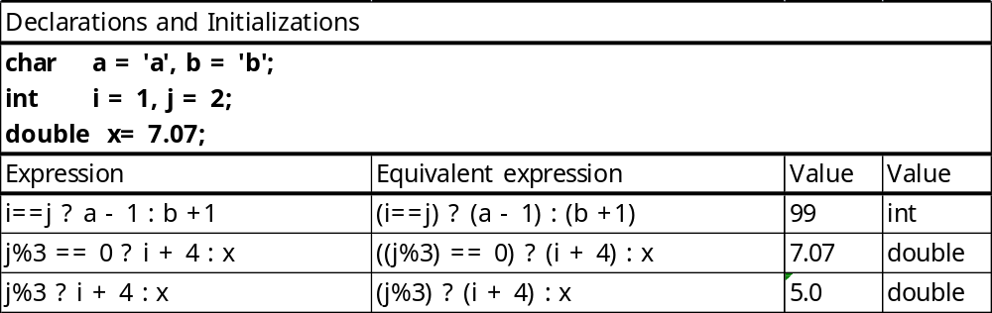
Conditional Operator
expr1 ? expr2 : expr3
Its type is determined by both expr2 and expr3
  is determined by both expr2 and expr3
  Different types ⇒ Usual Conversion Rules
  does not depend on which of expr2 or expr3 is evaluated.

