Slide 1
ARRAYS, POINTERS, AND STRINGS

Slide 2
One-dimensional Arrays
  int grade 0, grade1, grade3;
Array
  a simple variable with an index, or subscript, added
  The brackets [] are used for array subscripts.
    int grade[3];
  #define N 100
  int a[N];
  for (i = 0; i < N; ++i)
  sum += a[i]; /* process element a[i] */
The indexing of array elements always starts from 0.

Slide 3
One-dimensional Arrays
Array Initialization
  Array may be of storage class automatic, external, or static, but NOT register.
  Arrays can be initialized using an array initializer.
  float f[5] = {0.0, 1.0, 2.0, 3.0, 4.0};
  int a[100] = {0}; /* initializes all elements of a to zero*/
  int a[] = {2, 3, 5, -7}; ⇔ int a[4] = {2, 3, 5, -7};
  If there is fewer initializers for an array than the number specified, the missing elements will be zero for external, static, and automatic variables.
  external or static array
    If not initialized explicitly, then initialized to zero by default

Slide 4
One-dimensional Arrays
Array Subscripting
  a[expr]
  int i, a[N];
  The expression, a[i]
    refers to (i+1)^{th} element of the array a
    If i has a value outside the range from 0 to N-1, then Run-Time Error
The operators, () in function call and [] in array subscripting have
  the highest precedence
  left to right associativity

Slide 5
연산자 |  | 결합성
() [] -> . |  | left to right
! ~ ++ -- + - * & (type) sizeof |  | right to left
* / % | 산술연산자 | left to right
+ - |  | left to right
<< >> | 비트연산자(쉬프트) | left to right
< <= > >= | 관계연산자 | left to right
== != |  | left to right
& | 비트연산자 | left to right
^ |  | left to right
| |  | left to right
&& | 논리연산자 | left to right
|| |  | left to right
?: |  | right to left
= += -= *= /= %= &= ^= |= <<= >>= |  | right to left
, |  | left to right

Slide 6
Pointers
Pointers
  used to access memory and manipulate addresses
  If v is a variable, then &v is the location, or address, in memory space.
    &: unary address operator, right-to-left associativity
  Pointer variables
  int *p; /*declares p to be of type pointer to int */
  p = 0;
  p = NULL; /*equivalent to p = 0; */
  p = &i; /* int i; */
  p = (int *) 1776; /* an absolute addr. in memory */

Slide 7
Pointers
Pointers
  If p is a pointer, then *p is the value of the variable of which p is the address.
    *: unary “indirection” or “dereferencing” operator, right-to-left associativity
    The direct value of p is a memory location.
    *p is the indirect value of p-namely, the value at the memory location stored in p.

Slide 8
Pointers
int a = 1, b = 2, *p;
p = &a; “p is assigned the address of a”
b = *p; “b is assigned the value pointed to by p”
b = *p; ⇔ b = a;
a
b
p
1
2
?
a
b
p
1
2

Slide 9
Pointers
  /* printing an address, or location */
  #include <stdio.h>
  int main(void)
  {
  int i = 7, *p = &i;
  printf(“%s%d\n%s%p\n”, “ Value of i: “, *p,
  “Location of i: “, p);
  return 0;
  }
  Value of i: 7
  Location of i; effffb24

Slide 10
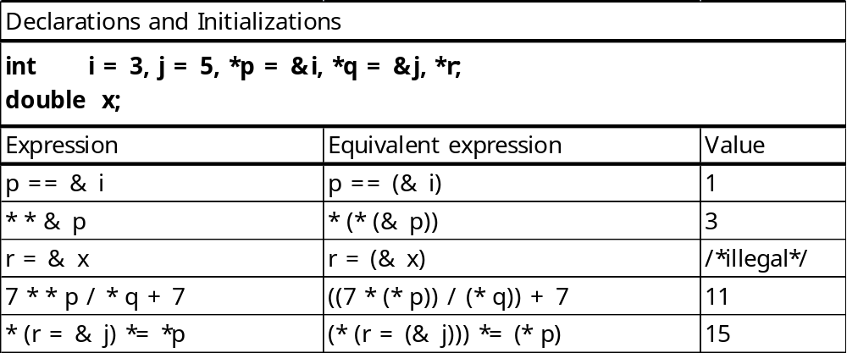
Pointers

Slide 11
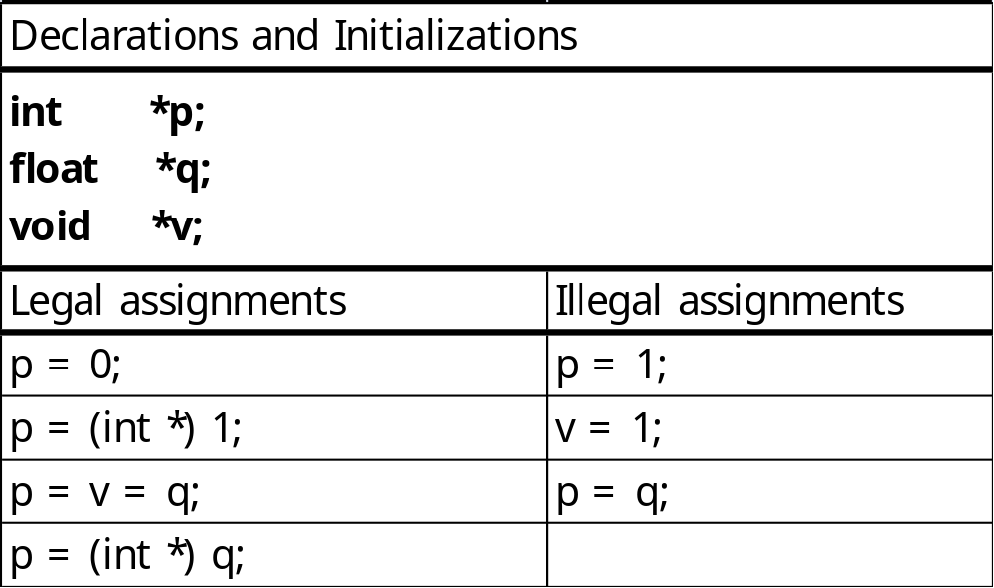
Pointers
Conversions during assignment between different pointer types are allowed
  when one of the type is a pointer to void
  when the right side is the constant 0

Slide 12
Pointers
Keep in mind the following prohibitions!
  Do not point at constants.
    &3 /* illegal */
  Do not point at ordinary expression.
    &(k+99) /* illegal */
  Do not point at register variable.
    register v;
    &v /* illegal */

Slide 13
Call-by-Reference
“Call-by-value” mechanism
“Call-by-reference” mechanism
  for changing the values of variables in the calling environment
  Pointers must be used in parameter list in the function definition.
  Declaring a function parameter to be a pointer
  Using the dereferenced pointer in the function body
  Passing an address as an argument when calling the function

Slide 14
Call-by-Reference
  #include <stdio.h>
  void swap(int *, int *);
  int main(void)
  {
  int i = 3, j = 5;
  swap(&i, &j);
  printf(“%d %d\n”, i, j); /* 5 3 is printed */
  return 0;
  }
  void swap(int *p, int *q)
  {
  int tmp;
  tmp = *p;
  *p = *q;
  *q = tmp;
  }

Slide 15
Arrays and Pointers
An array name
  by itself is an address, or pointer value
Arrays and Pointers
  can be subscripted.
  A pointer var. can take different addr. as values
  An array name is an FIXED address, or pointer.

Slide 16
Arrays and Pointers
  #define N 100
  int a[N], i, *p, sum = 0;
  a[i] ⇔ *(a+i) : the value of the i^{th} element of the array, a
  a + i
    A pointer arithmetic
    has as its value the i^{th} offset from the base addr. of the array, a
    points to the i^{th} element of the array (counting from 0)
  p[i] ⇔ *(p+i)
  p + i
    is the i^{th} offset from the value of p.
    The actual addr. produced by such an offset depends on the type that p points to
  p = a; ⇔ p = &a[0];
  p = a + 1; ⇔ p = &a[1];

Slide 17
Arrays and Pointers
  #define N 100
  int a[N], i, *p, sum =0;
  for ( i=0; i < N; ++i)
  sum += a[i];
Note that because a is a constant pointer, expressions such as
a = p ++a a += 2 &a
are illegal.
  for (i = 0; i < N; ++i)
  sum += *(a+i);
  for (p = a; p < &a[N]; ++p)
  sum += *p;
  p = a;
  for (i = 0; i < N; ++i)
  sum += p[i];

Slide 18
Pointer Arithmetic and
Element Size
Pointer arithmetic
  If the variable p is a pointer to a particular type,
  p + 1 p + i ++p p += i
  double a[2], *p, *q;
  p = a; /* points to base of array */
  q = p +1; /* equivalent to q = &a[1] */
  printf(“%d\n”, q-p); /* 1 is printed */
  printf(“%d\n”, (int) q – (int) p); /* 8 is printed */
q – p
  yields the int value representing the number of array elements between p and q

Slide 19
Arrays as Function Arguments
In a function definition, a formal parameter that is declared as an array is actually a pointer.
  When an array is passed as an argument to a function, the base addr. of the array is passed “call-by-value”
  double sum(double a[], int n)
  { /* n is the size of a[] */
  int i;
  double sum = 0.0;
  for ( i = 0; i < n; ++i)
  sum += a[i];
  return sum;
  }
⇔
  double sum(double *a, int n)
  {
  ….
Notes:
The value of a can be changed be cause it is a pointer. It is not a name of an array, just a pointer.

Slide 20
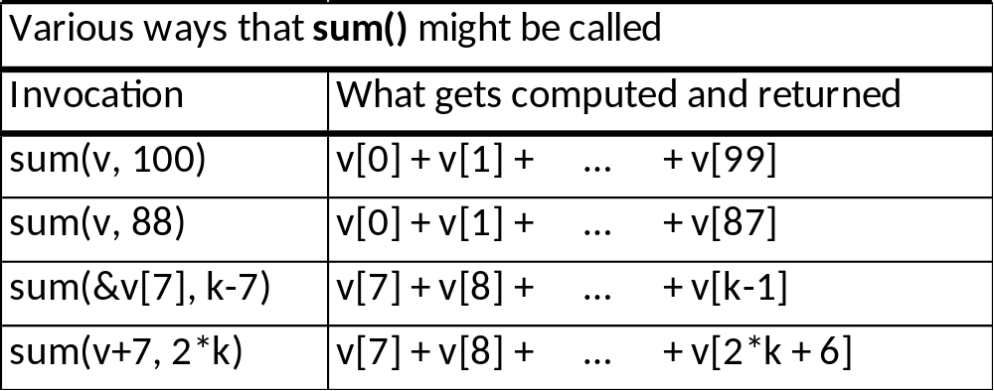
Arrays as Function Arguments

Slide 21
Dynamic Memory Allocation with calloc() and malloc()
calloc() and malloc()
  declared in stdlib.h
  calloc() : contiguous allocation
  malloc() : memory allocation
  #include <stdio.h>
  #include <stdlib.h>
  void swap(int *, int *);
  int main(void)
  {
  int *a; /* to be used as an array */
  int n; /* the size of the array */
  …… /* get n from somewhere */
  a = calloc(n, sizeof(int)); /* get space for a */
  ….. /* use a as an array */
  }

Slide 22
Dynamic Memory Allocation with calloc() and malloc()
calloc() and malloc()
  ptr = calloc(n, sizeof(int));
    The allocated memory is initialized with all bits set to zero.
  ptr = malloc(n * sizeof(int));
    does not initialize the memory space
  if( a != NULL)
    …
  Space having been dynamically allocated MUST be returned to the system upon function exit.
    free(ptr);
    ptr must be the base addr. of space previously allocated.

Slide 23
Strings
Strings
  one-dimensional array of type char
  terminated by the end-of-string sentinel ‘\0’, or null character (0x00)
  The size of a string must include the storage needed for the null character.
    “abc” : a char. array of size 4
  String constant, like an array name by itself, is treated as a pointer
    char *p = “abc”;
    printf(“%s %s\n”, p, p+1); /*abc bc is printed */

Slide 24
Strings
  char *p = “abcde”;
  allocates space in memory for p
  puts the string constant “abcde” in memory somewhere else,
  and initializes p with the base addr. of the string constant
  char s[] = “abcde”; ⇔ char s[]={‘a’, ‘b’, ‘c’, ‘d’, ‘e’, ‘\0’};
  allocates 6 bytes of memory for the array s.
p
a
b
c
d
e
\0
s
a
b
c
d
e
\0

Slide 25
Strings
  /*Count the number of words in a string */
  #include <ctype.h>
  int word_cnt(const char *s)
  {
  int cnt = 0;
  while (*s != ‘\0’) {
  while ( isspace(*s) ) /* skip white space */
  ++s;
  if( *s != ‘\0’) { /* found a word */
  ++cnt;
  while ( !isspace(*s) && *s != ‘\0’ ) /* skip the word */
  ++s;
  }
  }
  return cnt;
  }

Slide 26
String-Handling Functions in the Standard Library
A standard header file, string.h
  char *strcat(char *s1, const char *s);
  int strcmp(const char *s1, const char *s2);
    If s1 < s2, returns negative integer
    If s1 = s2, returns zero
    If s1 > s2, returns positive integer
  char *strcpy(char *s1, const char *s2);
  size_t strlen(const char *s);
    the number of char.s before ‘\0’
  size_t strlen(const char *s)
  {
  size_t n;
  for(n = 0; *s != ‘\0’; ++s)
  ++n;
  return n;
  }

Slide 27
String-Handling Functions in the Standard Library
  char *strcpy(char *s1, register const char *s2)
  {
  register char *p = s1;
  while (*p++ = *s2++)
  ;
  return s1;
  }
  char *strcat(char *s1, register const char *s2)
  {
  register char *p = s1; /* go to the end */
  while (*p)
  ++p;
  while (*p++ = *s2++) /* copy */
  ;
  return s1;
  }
*p++ ⇔ *(p++)
p itself is being incremented.
(*p)++
would increment what p is pointing to.
while (*p) ⇔ while (*p != ‘\0’)
!! Note carefully that it is the programmer’s responsibility to allocate sufficient space for the strings that are passed as arguments to these functions

Slide 28
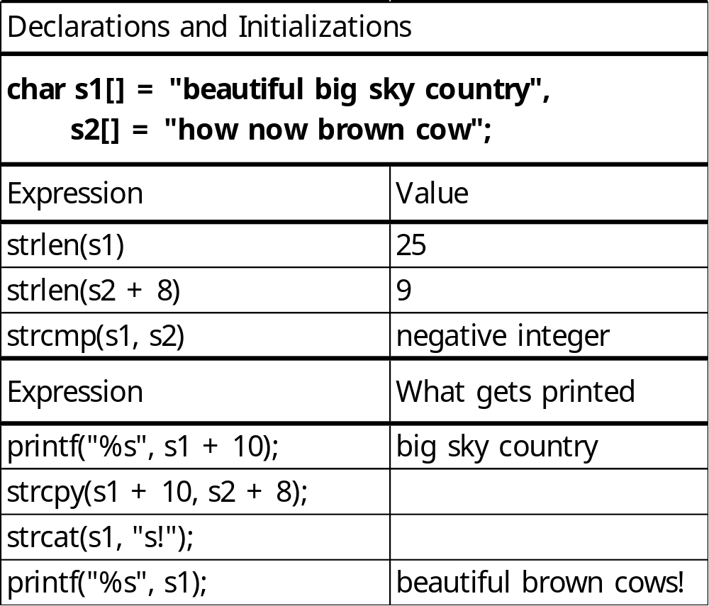
String-Handling Functions in the Standard Library

Slide 29
Multidimensional Arrays
C lang. allows arrays of any type, including arrays of arrays.
Two-dimensional array
  using two bracket pairs, [][]
    int a[100]; a one-dimensional array
    int b[2][7]; a two-dimensional array
    int c[5][3][2]; a three-dimensional array
k-dimensional array
  allocates space for s₁× s₂×… ×s_{k} elements, where s_{i} represents the size of ith dimension.
  Starting at the base addr. of the array, all the elements are stored contiguously in memory.

Slide 30
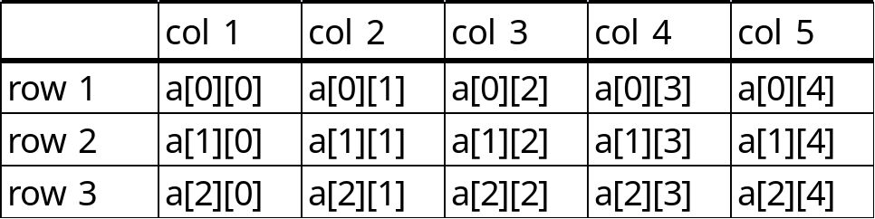
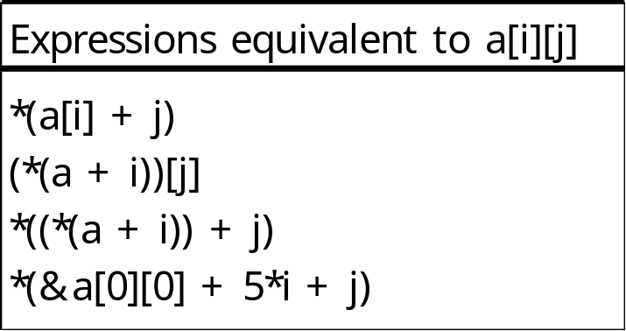
Multidimensional Arrays
Two-dimensional array
  int a[3][5];
  The array name a by itself is equivalent &a[0]; it is a pointer to an array of 5 ints.
  The base addr. of the array is &a[0][0], not a.
    Starting at the base addr. of the array, compiler allocate for 15 ints.
Notes:
int a[3][4][2]={0};
int *pp=&a[0][0][0];
int (*ppp)[4][2];
int (*t)[2];
ppp=&a[0];
t=&a[0][0];

Slide 31
Multidimensional Arrays
Formal Parameter Declarations
  When a multidimensional array is a formal parameter in a function definition, all sizes except the first must be specified
    so that the compiler can determine the correct mapping.
    int a[3][5];
    int sum(int a[][5])
    {
    int i, j, sum = 0;
    for(i=0; i<3; ++i)
    for(j=0; j<3; ++j)
    sum += a[i][j];
    return sum;
    }
int a[][5] ⇔ int a[3][5] ⇔ int (*a)[5]
int b[3];
int b[] ⇔ int b[3] ⇔ int *b

Slide 32
Multidimensional Arrays
Initialization
  The indexing is by rows.
  All sizes except the first must be given explicitly
  int a[2][3] = {1,2,3,4,5,6};
  int a[2][3] = {{1,2,3}, {4,5,6}};
  int a[][3] = {{1,2,3}, {4,5,6}};
  int a[][3] = {{1,0,0,}, {4,5,0}}; ⇔ int a[][3] = {{1}, {4,5}};
  int a[2][3] = {0};

Slide 33
Use of typedef
  void add(vector x, vector y, vector z)
  { /* x = y + z */
  int i;
  for (i = 0; i < N; ++i)
  x[i] = y[i] + z[i];
  }
  scalar dot_product(vector x, vector y)
  {
  int i;
  scalar sum = 0.0;
  for (i = 0; i < N; ++i)
  sum += x[i] * y[i];
  return sum;
  }
  void multiply(matrix a, matrix b, matrix c)
  { /* a = b * c */
  int i, j, k;
  for (i = 0; i < N; ++i) {
  for (j = 0; j < N; ++j) {
  a[i][j] = 0.0;
  for (k = 0; k < N; ++k)
  a[i][j] += b[i][k] * c[k][j];
  }
  }
  }
  #define N 3
  typedef double scalar;
  typedef scalar vector[N];
  typedef scalar matrix[N][N];

Slide 34
Arrays of Pointers
Array elements can be of any type, including a pointer type.
An array with elements of type char *
  an array of strings
  [input]
  A is for apple or alphabet pie
  which all gets a slice of, come taste it and try.
  [output]
  A
  a
  all
  alphabet
  …
  which

Slide 35
Arrays of Pointers
[sort.h]
  #include <stdio.h>
  #include <stdlib.h>
  #include <string.h>
  #define MAXWORD 50 /* max word size */
  #define N 300 /* array size of w[] */
  void error_exit_calloc_failed(void);
  void error_exit_too_many_words(void);
  void error_exit_word_too_long(void);
  void sort_words(char *w[], int n);
  void swap(char **p, char **q);
  void wrt_words(char *w[], int n);

Slide 36
[main.c] /*Sort words lexicographically. */
  #include “sort.h”
  int main(void)
  {
  char word[MAXWORD]; /* work space */
  char *w[N]; /* an array of pointers */
  int n; /* number of words to be sorted */
  int i;
  for (i=0; scanf(“%s”, word) == 1; ++i) {
  if (i >= N)
  error_exit_too_many_words();
  if (strlen(word) >= MAXWORD)
  error_exit_word_too_long ();
  w[i] = calloc(strlen(word) + 1, sizeof(char));
  if (w[i] == NULL)
  error_exit_calloc_failed();
  strcpy(w[i], word);
  }
  n = i;
  sort_words(w, n); /* sort the words */
  wrt_words(w, n); /* write sorted list of words */
  return;
  }
⇔ char *(w[N]);
w
0
A
\0
1
i
s
\0
2
3
f
o
r
\0
…
a
p
p
l
e
\0
…
17
t
r
y
.
\0

Slide 37
w
[sort.c]
  #include “sort.h”
  void sort_words(char *w[], int n)
  {
  int i,j;
  for (i=0; i<n; ++i)
  for (j=i+1; j<n, ++j)
  if (strcmp(w[i], w[j]) > 0)
  swap(&w[i], &w[j]);
  }
[swap.c]
  #include “sort.h”
  void swap(char **p, char **q)
  {
  char *tmp;
  tmp = *p;
  *p = *q;
  *q = tmp;
  }
i
f
o
r
\0
a
p
p
l
e
\0
j
w
i
f
o
r
\0
a
p
p
l
e
\0
j
The addr. of the pointers are passed so that the pointer values themselves can be changed in the calling environment by the function call.
an addr. of a pointer to char
⇔ a pointer to pointer to char

Slide 38
[wrt.c]
  #include “sort.h”
  void wrt_words(char *w[], int n)
  {
  int i;
  for (i=0; i<n; ++i)
  printf(“%s\n”, w[i]);
  }

Slide 39
Arguments to main()
Two arguments, argc and argv, can be used with main().
  /* Echoing the command line arguments. */
  #include <stdio.h>
  int main(int argc, char *argv[])
  {
  int i;
  printf(“argc = %d\n”, argc);
  for (i=0; i< argc; ++i)
  printf(“argv[%d] = %s\n”, i, argv[i]);
  return 0;
  }
  [Command]
  my_echo a is for apple
  [Output]
  argv = 5
  argv[0] = my_echo
  argv[1] = a
  argv[2] = is
  argv[3] = for
  argv[4] = apple

Slide 40
Ragged Arrays
Ragged array
  an array of pointers whose elements are used to point to arrays of varying sizes
  #include <stdio.h>
  int main(void)
  {
  char a[2][15] = {“abc:”, “a is for apple”};
  char *p[2] = {“abc:”, “a is for apple”};
  printf(“%c%c%d %s %s\n”, a[0][0], a[0][1], a[0][2], a[0], a[1]);
  printf(“%c%c%d %s %s\n”, p[0][0], p[0][1], p[0][2], p[0], p[1]);
  }
[output]
  abc abc: a is for apple
  abc abc: a is for apple
Notes:
Ragged, US.UK [|rӕgɪd]

Slide 41
Ragged Arrays
char a[2][15] = {“abc:”, “a is for apple”};
  Space for 30 chars is allocated
  Each of a[0] and a[1] is an array of 15 chars
  a[0] and a[1] are strings
  char a[2][15] = {{‘a’, ‘b’, ‘c’, ‘:’, ‘\0’}, {‘a’, ‘ ’, ‘i’, ‘s’, … ‘\0’}};
Compiler generates a storage mapping function for accessing array elements

Slide 42
Ragged Arrays
char *p[2] = {“abc:”, “a is for apple”};
  one-dimensional array of pointers to char
  It causes space for two pointers to be allocated.
  p[0] is initialized to point at “abc:”, a string constant of 5 chars, thus there is no way to modify “abc:” (e.g. p[0][3]=‘d’ is not allowed)
  p[1] is initialized to point at “a is for apple”, a string constant of 15 chars.
  p does its work in less space than a
  p[0][14] vs. a[0][14]
Compiler does not generate a storage mapping function for accessing array elements ⇒ faster working than 2D array a
p
0
a
b
c
:
\0
1
a
i
s
f
o
r
a
p
p
l
e
\0

Slide 43
Storage Mapping Function
mapping between pointer values and array indices
  int a[3][5]
    a[i][j] : *(&a[0][0] + 5*i + j)
  int a[7][9][2]
    a[i][j][k] : *(&a[0][0][0] + 9*2*i + 2*j + k)
all sizes except the FIRST must be specified so that the compiler can determine the correct storage mapping function

Slide 44
Function Pointers
pointers to functions
  arguments
  array elements
  return values
  double sum-square( double f(double), int m, int n)
  /* ⇔ double sum-square( double (*f)(double), int m, int n) */
  {
  int k;
  double sum=0.;
  for (k=m; k<=n; ++k) {
  sum+=f(k)*f(k); /* ⇔ sum+=(*f)(k) * (*f)(k); */
  }
  return sum;
  }
Notes:
f is a pointer to a function that takes a double and returns a double

Slide 45
연산자 |  | 결합성
() [] -> . |  | left to right
! ~ ++ -- + - * & (type) sizeof |  | right to left
* / % | 산술연산자 | left to right
+ - |  | left to right
<< >> | 비트연산자(쉬프트) | left to right
< <= > >= | 관계연산자 | left to right
== != |  | left to right
& | 비트연산자 | left to right
^ |  | left to right
| |  | left to right
&& | 논리연산자 | left to right
|| |  | left to right
?: |  | right to left
= += -= *= /= %= &= ^= |= <<= >>= |  | right to left
, |  | left to right

