Slide 1
BITWISE OPERATORS

Slide 2
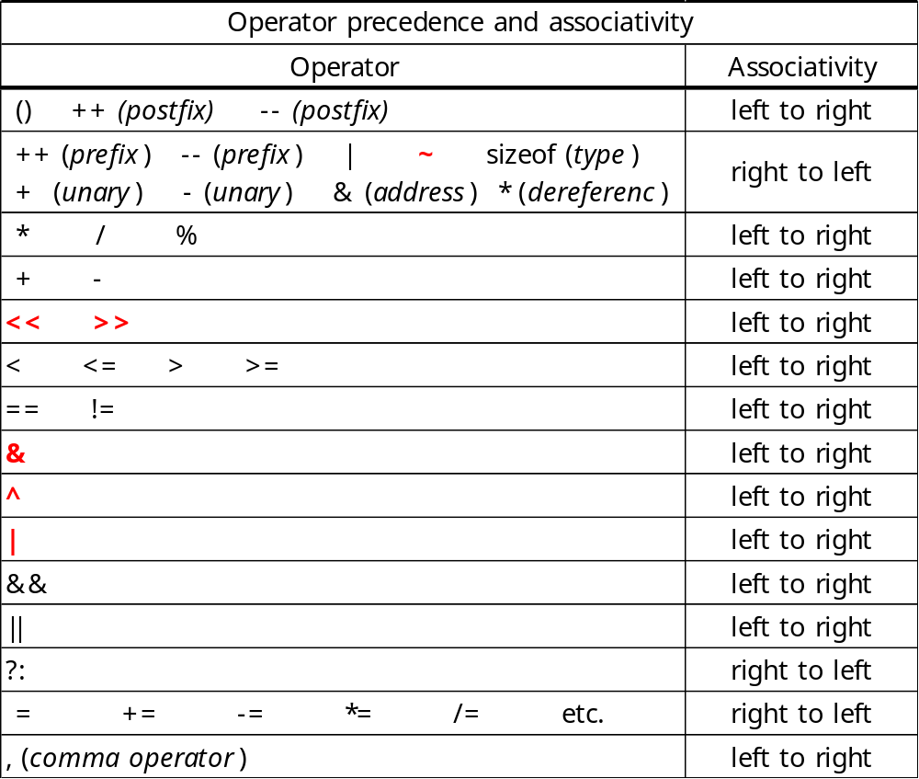
Bitwise Operators

Slide 3
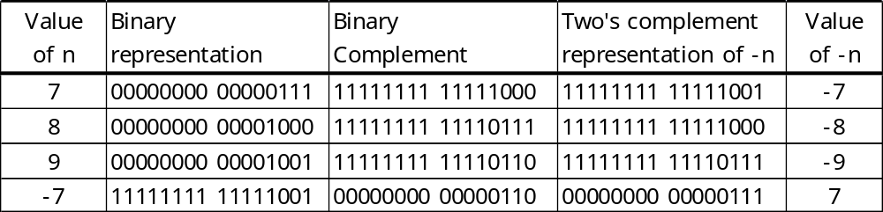
Bitwise Complement
int a = 70707;
00000000 00000001 00010100 00110011
~a
11111111 11111110 11101011 11001100 (-70708)
Two’s Complement
  -n: Take bitwise complement, and then add 1 to it
  0: 0x00000000 -1: 0xffffffff

Slide 4
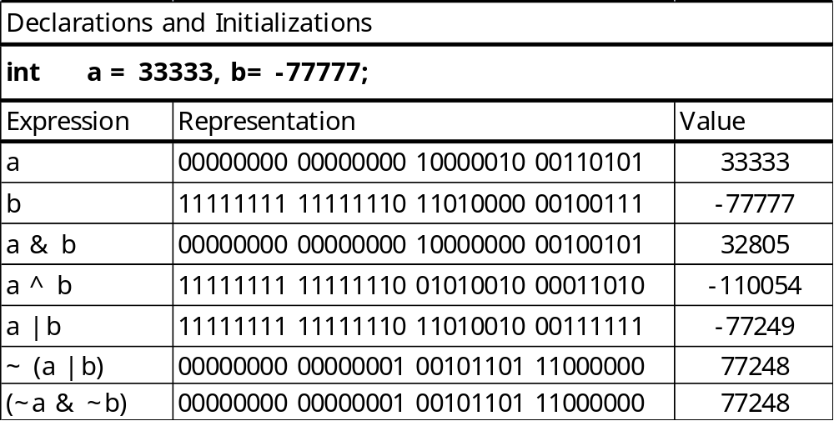
Bitwise Binary Logical Operators

Slide 5
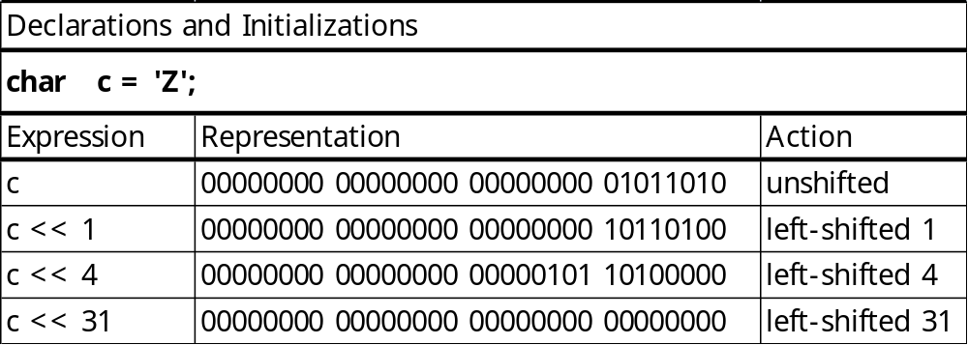
Left and Right Shift Operators
  expr1 << expr2

Slide 6
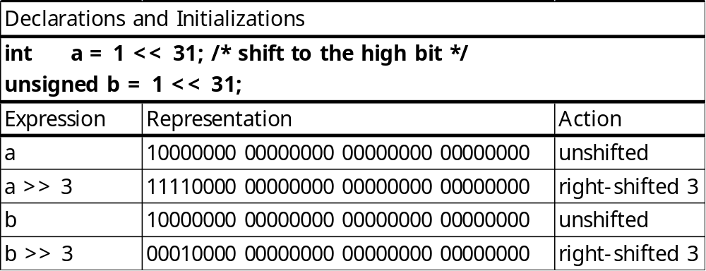
Left and Right Shift Operators
Right shift operator >> is not symmetric to <<.
  For unsigned integral expressions, 0s are shifted in at the high end.
  For signed integral expressions, some machines shift in 0s, while others shift in sign bits.
  Programmers often use unsigned types when using bitwise operators

Slide 7
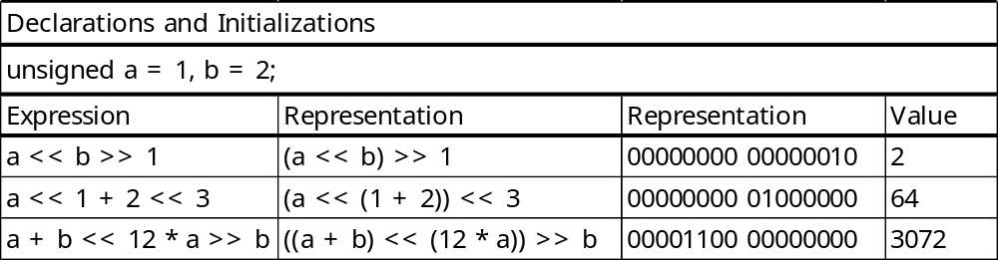
Left and Right Shift Operators

Slide 8
Masks
A mask
  a constant or variable that is used to extract desired bits from another variable or expression
  the constant value 1
    00000000 00000000 00000000 00000001
    : used to determine the low-order bit of an int expression
    int i, mask = 1;
    for ( i=0; i<10; ++i)
    printf(“%d”, i & mask);
  the constant value 255
    00000000 00000000 00000000 11111111
    : a mask for the low-order byte
    v & 255
  A mask for the 3rd bit
  (v & (1 << 2)) ? 1 : 0

Slide 9
Printing an int Bitwise
  /* Bit print an int expression */
  #include <limits.h>
  void bit_print(int a)
  {
  int i;
  int n = sizeof(int) * CHAR_BIT; /* in limits.h */
  int mask = 1 << (n – 1); /* mask = 1000…0 */
  for (i = 1; i <= n; ++i) {
  putchar(((a & mask) == 0) ? ‘0’ : ‘1’);
  a <<= 1; /* ⇔ a = a << 1; */
  if (i % CHAR_BIT == 0 && i < n)
  putchar(‘ ‘);
  }
  }
Notes:
CHAR_BIT: Length of a char variable

Slide 10
Packing and Unpacking
  [ In file pack_bits.c ]
  /* Pack 4 characters into an int. */
  #include <limits.h>
  int pack(char a, char b, char c, char d)
  {
  int p = a; /* p will be packed with a, b, c, d */
  p = (p << CHAR_BIT) | b;
  p = (p << CHAR_BIT) | c;
  p = (p << CHAR_BIT) | d;
  return p;
  }
  In main(),
  printf(“abcd = “);
  bit_print(pack(‘a’, ‘b’, ‘c’, ‘d’));
  putchar(‘\n’);
  abcd = 01100001 01100010 01100011 01100100

Slide 11
Packing and Unpacking
  /* Unpack a byte from an int */
  #include <limits.h>
  char unpack(int p, int k) /* k = 0, 1, 2, or 3 */
  {
  int n = k * CHAR_BIT; /* n = 0, 8, 16, or 24 */
  unsigned mask = 255; /* low-order byte */
  mask <<= n;
  return ((p & mask) >> n);
  }
  The int expression (p & mask) >> n gets converted to a char before it gets passed back to the calling environment.
  When an int is converted to a char, only the low-order byte is kept; other bytes are discarded.

