Slide 1

The Pack: Packs, No-Packs and The Engagement Zone

Slide 2
Pack it up, Pack it in, Let Me Begin
What is the Pack?
4.1.1 The pack is defined by the largest group of in bounds Blockers, skating in proximity, containing members from both teams.
4.1.1.1 The pack is comprised of the Blockers. The Jammer is not part of the pack.
4.1.1.2 Proximity is defined as not more than ten feet (as measured from the hips) in
front of or behind the nearest pack skater.
4.1.1.3 In order to form a pack, a team must have at least one Blocker on the track at
all times.
As a blocker you can either be:
In the Pack
In the Engagement Zone
Out of Play
Not On The Track(i.e. in the sin bin)

Slide 3
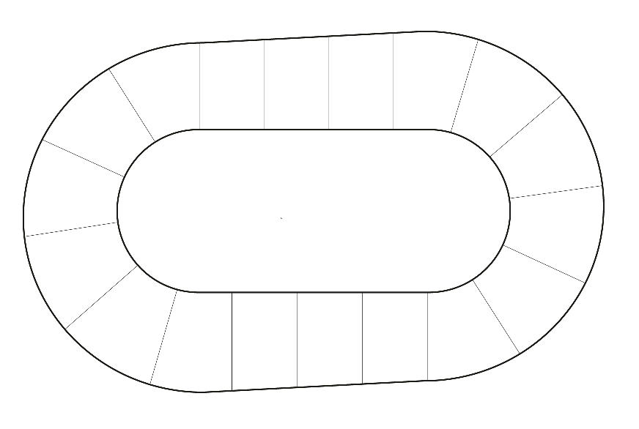
Pack Examples
Pack is Here!

Slide 4
Pack Examples
The pack is all players as they are all within
10 feet of each other
These players have split from the main body of the pack but are still within 10 feet so still count as pack players.

Slide 5
Pack Examples
Engagement Zone
These players are no longer part of the pack
but are still in the engagement zone which
stretches 20 feet from foremost and rearmost
pack player.

Slide 6
Pack Examples
Engagement Zone
The Engagement Zones will move with the
outermost blockers. As long as the blocker is
part of the pack the engagement zone extends
from her.

Slide 7
Pack Examples
Engagement Zone
The Engagement Zones will move with the
outermost blockers. As long as the blocker is
part of the pack the engagement zone extends
from her.

Slide 8
Pack Examples
Engagement Zone
Out Of Play!
When the Blocker moves out of 10 feet of the
Pack the engagement zone is recalculated.
And the blockers are given an out of play
warning by the referees.

Slide 9
Pack Examples
NO PACK!
The Blue blockers accelerate away from the
Red blockers. When they get beyond 10 feet
No Pack is called.
Produced in Accordance with WFTDA Rules 26/05/10 By Sven WillIBeFamous

Slide 10
Pack Examples
This Blocker Accelerates away from the pack and
catches up with the pack. The blocker will receive
an Out Of Play minor penalty.
Produced in Accordance with WFTDA Rules 26/05/10 By Sven WillIBeFamous
Produced in Accordance with WFTDA Rules 26/05/10 By Sven WillIBeFamous

Slide 11
Pack Examples
In this scenario a player at the back of the pack
is lapped by the pack. Again this blocker will receive
and Out Of Play penalty as you must re-enter the
engagement zone from the way you left.
Produced in Accordance with WFTDA Rules 26/05/10 By Sven WillIBeFamous
Produced in Accordance with WFTDA Rules 26/05/10 By Sven WillIBeFamous
Produced in Accordance with WFTDA Rules 26/05/10 By Sven WillIBeFamous

Slide 12
FIN

