Slide 1

Covid – 19 Data Analysis March 8, 2021
Jeff Bednar
Valeria Claros
Doug Moura
April Dominguez

Slide 2
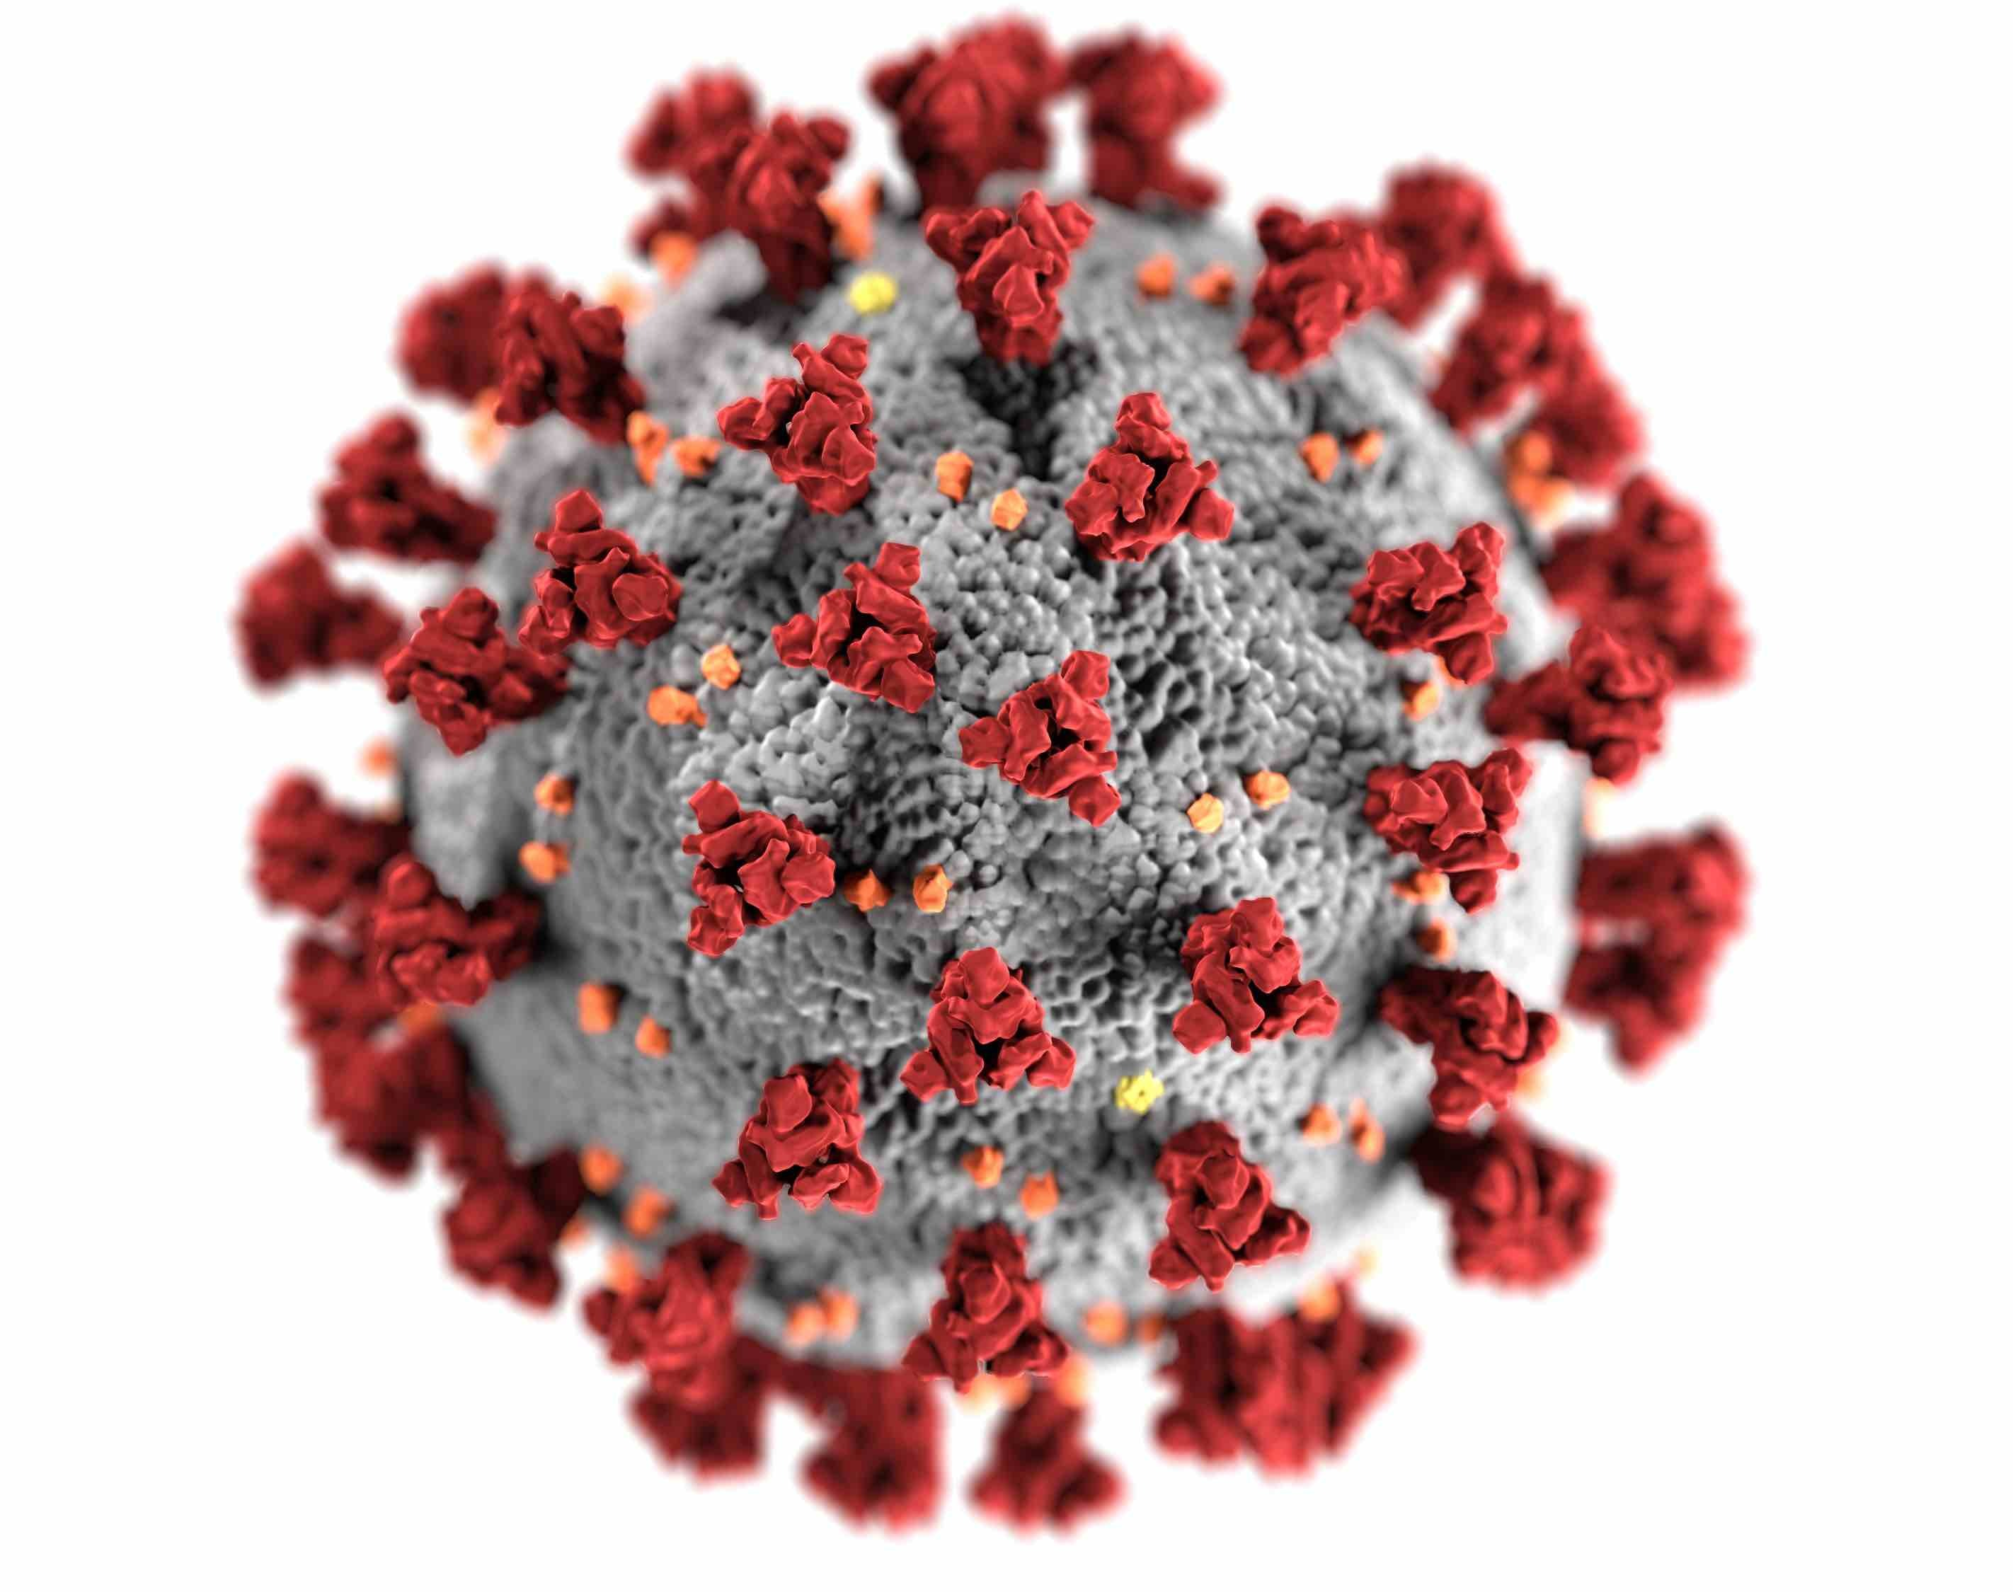
Covid 19 has impacted the world on many aspects of everyday life.
We decided to look at data to see if we could use machine learning to model and forecast vaccination and daily cases and deaths.
Our analysis is based off of 2 data sources (World Vaccination Progress and World Daily Cases and Deaths).

Slide 3
ETL
Extract – Collected CSV’s from Kaggle. Data is TimeSeries and based on Country.
Transform – Merged DataSets, dropped unnecessary columns, Filtered Top 10 Countries based on number of Data Points.
Load – Created new cleaned CSV.

Slide 4

Analysis
We choose Linear Regression because we wanted to model a target value based on predictors and historical data.
Throughout our analysis, we examined several target values.
We used Univariant model, Multi-variant model, and Facebook Prophet Time Series Model.

Slide 5
Conclusion
Outside factors play a huge part in our prediction from availability of vaccines, natural elements, government involvement, acceptance and preference of individuals, etc making it hard to forecast accurately.
Factors vary country to country and also time periods. Some countries started later in vaccinating individuals.
The Margin of Error increases as you look further into the future.

