Slide 1


Slide 2
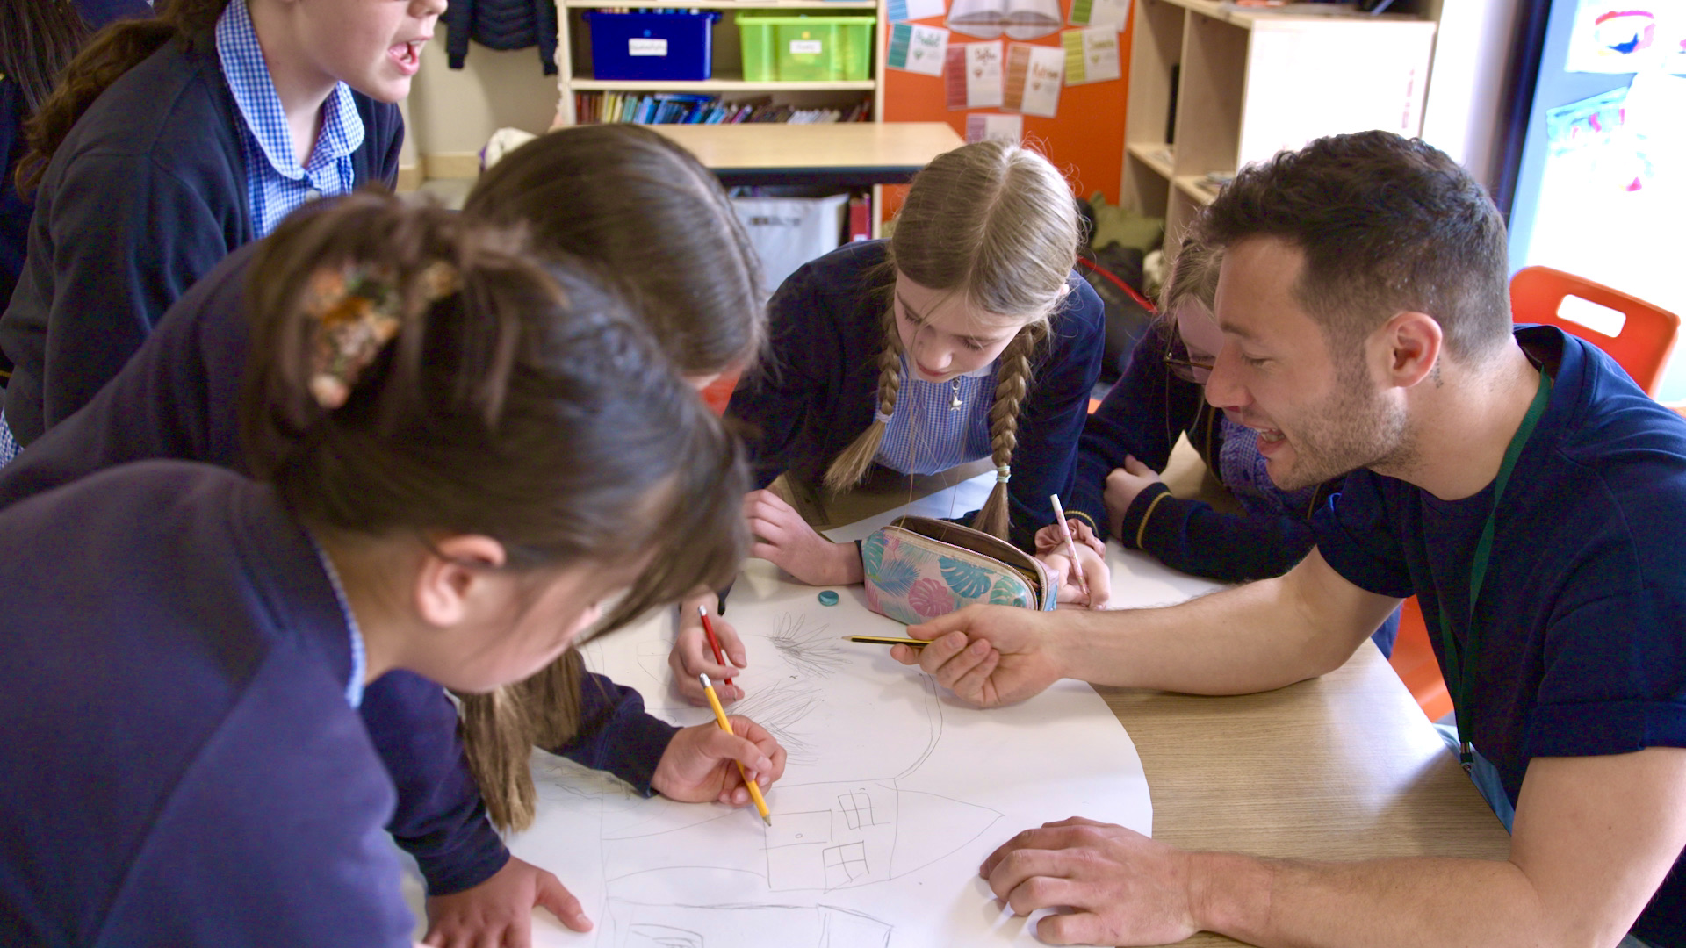
DESIGNERS’ TEACHING GUIDE

Slide 3
Before meeting the students
Make sure you’re prepared. Consider the following questions:
1. What skills do you think you bring to a primary classroom?
2. How do you think young children learn?
3. How do you want them to learn in your sessions?
Plan what materials you need when and make sure they are available
Ideally, at the end of the previous school year you will meet the Senior Leadership Team to discuss your topic, the learning objectives, and which classes/periods in the school’s curriculum will be dedicated to CCAC.
In the weeks leading up to meeting your students you will have met the class teachers and discussed learning objectives and lesson plans. The teacher will cover essential information, such as the school’s behaviour policy, the character of the class and any SEN requirements. Reassure teachers they are part of the process!

Slide 4
Meeting the students
You should have already been introduced to the students in a preliminary assembly, where the the Head teacher or Assistant Head teacher will outline what CCAC is and how your sessions relate to the Climate Science and What is Design taught in the first half of the term.
Take the opportunity to tell the students about your interests and career.
In preparation for teaching, shadow the teachers in the classroom to understand more about the nature of each class, your students’ abilities and how teachers keep discipline.
When you arrive in the classroom, the first steps are:
A short introduction of the CCAC programme. Who are we and what do we do?
Introduce yourself and your job. Ask the children if they’ve heard of your profession? What do they know about it? Can they think of real-world examples of the work you do?
Read out the objectives for that lesson so that the children have a clear idea of what they will be doing today.

Slide 5
During the lesson
Pace the activities
Engage the children with questions and ensure that all children can participate
Make sure the teacher is an active partner
Keep a good balance between presenting at the front of the class and convening activities or group work
Project your own personality, interests and view

Slide 6
Other considerations
We want you to really enjoy this project and make it your own. Consider (but please discuss with us/the teacher first):
The possibility of an outside visit and/or exploration of the school
The provision and use of work sheets
Samples brought in from outside
The possibility of incorporating a guest specialist
The possibility of enrolling assistants

Slide 7
Teaching tips
Learn about the children's prior knowledge and experiences
Think about adjusting the level of concepts and vocabulary
Consider what you would like the teacher to do
Plan realistic timings of activities
Allow space for children's questions and think about how to check their understanding
Consider how you will communicate with the teacher during sessions and what you will do if things don't go to plan

Slide 8
Ten teaching strategies
Setting goals
Structuring lessons
Explicit teaching (show children what it is you want them to learn – model)
Worked examples
Collaborative learning
Multiple exposures (same skills, new ways)
Questioning
Feedback
Metacognitive strategies
Differentiated teaching
Agree with the teacher how to form the small concept working groups (typically 3-4 students)
10 High Impact Teaching Strategies
Three effective teaching strategies

Slide 9
Safeguarding + essential information
CCAC will issue the school’s behaviour and safeguarding policy.
Remember to be Advanced DBS checked

Slide 10
Still have unanswered questions?
Try these helpful teaching resources
Three effective teaching strategies
Ten high impact teaching strategies
Or get in touch with CCAC here: info@cc-ac.org and linda@cc-ac.org

