Slide 1
Capstone Project Clustering top ten Indian cities based on venues and analyzing business scopes in each city
Author : Pitam Ganai
Email id : pitam.ganai08@in.ibm.com

Slide 2
Business Problem and introduction :
Business Problem: The business opportunities in the top ten populated Indian cities.
Introduction : The current GDP growth rate of India is 7.4 percent, so it is great opportunity of investors to invest in India and leverage the potential of Indian people.

Slide 3
Data
Data Sources :
I have collected the dataset containing the data of top populated cities in India from Internet sources like Wikipedia.
I have collected the data of postal codes of each city from "www.mapsofindia.com" website.
I have collected the data related to different places from foursquare.
The Cities has been considered are:
Ahmedabad
Bangalore
Chennai
Delhi
Hyderabad
Jaipur
Kolkata
Mumbai
Pune
Surat

Slide 4
Methodology:
We have collected top 10 most populated cities in India as per 2017 report published in Wikipedia.
We have created bar charts for each 10 cities which helps to have very detailed idea of investing in different cities.
We have depicted the top 20 categories of venues as per foursquare datasets which helps to have business decision.
We have created cumulative plot of these cities and plotted the numbers of the venues in a single bar plot which helps investors to choose business domain.
We have clustered these top 10 cities using k-means algorithm to know the difference among the cities and business distribution can done based on that report.

Slide 5
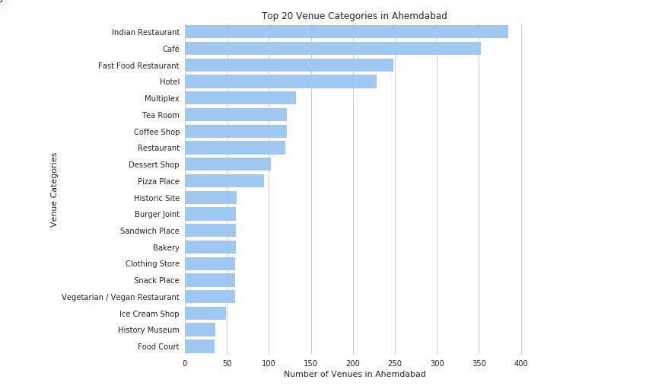
Results :
i) Statistical view of top 20 venues in Ahmedabad.

Slide 6
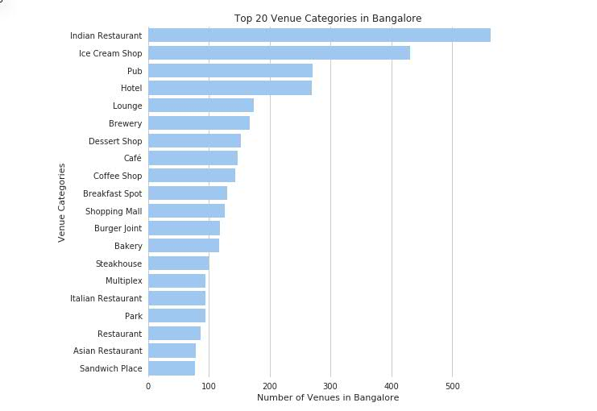
Results :
ii) Statistical view of top 20 venues in Bangalore.

Slide 7
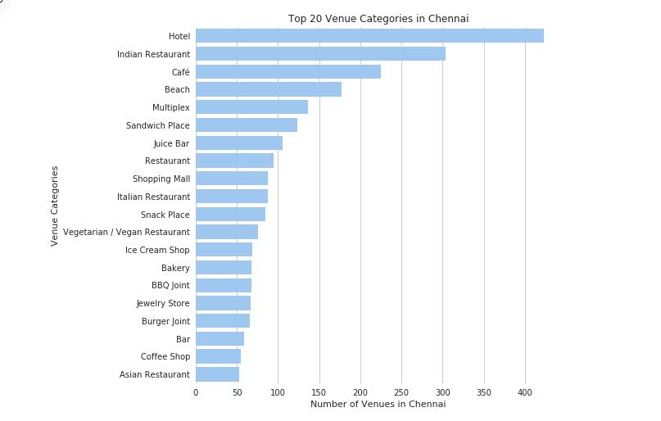
Results :
iii) Statistical view of top 20 venues in Chennai.

Slide 8
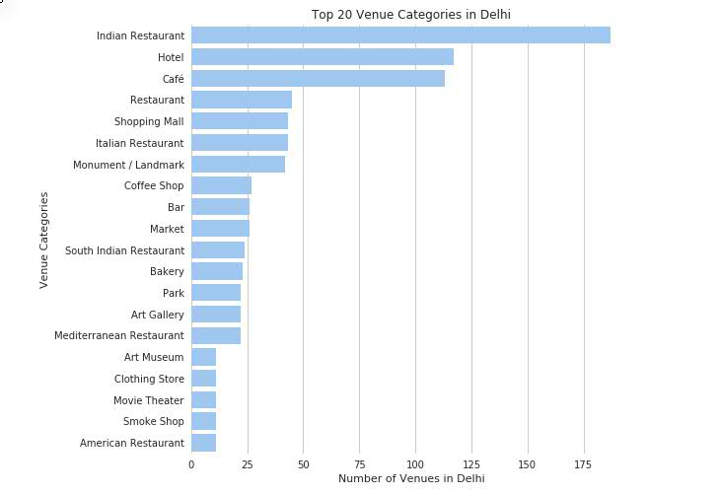
Results :
iv) Statistical view of top 20 venues in Delhi.

Slide 9
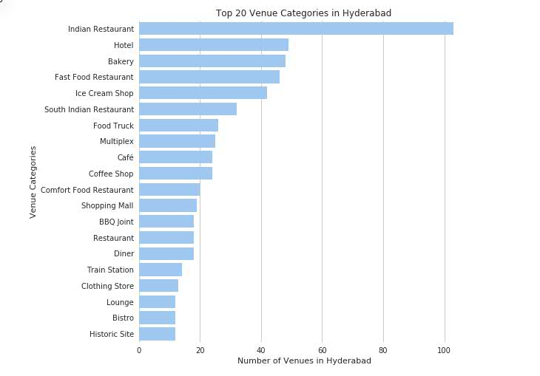
Results :
v) Statistical view of top 20 venues in Hyderabad.

Slide 10
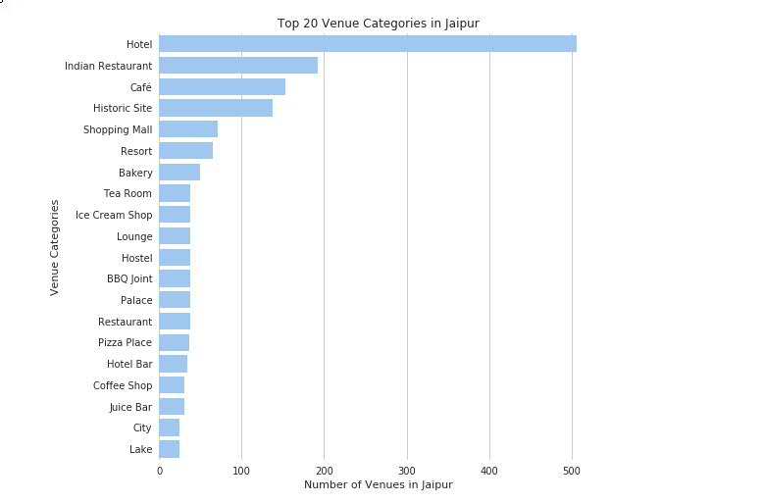
Results :
vi) Statistical view of top 20 venues in Jaipur.

Slide 11
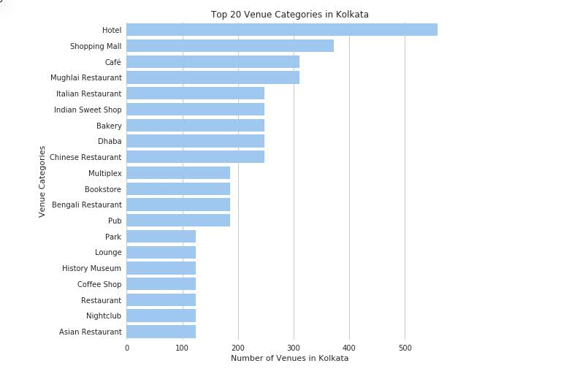
Results :
vii) Statistical view of top 20 venues in Kolkata.

Slide 12
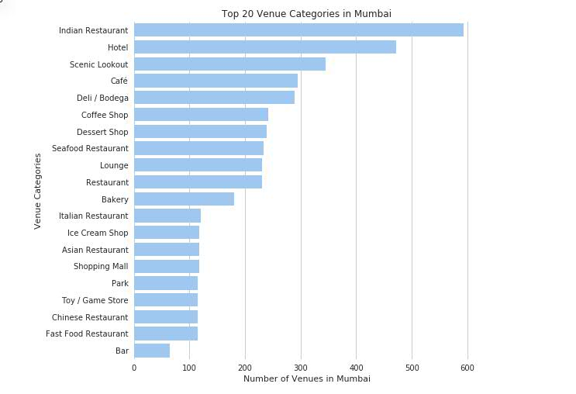
Results :
viii) Statistical view of top 20 venues in Mumbai.

Slide 13
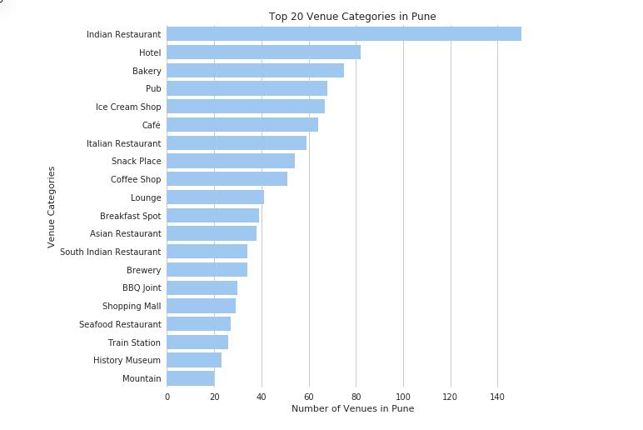
Results :
ix) Statistical view of top 20 venues in Pune.

Slide 14
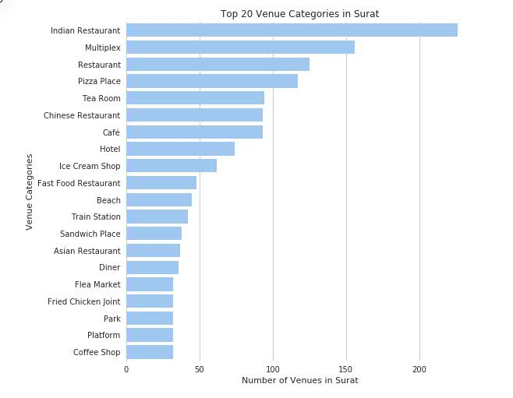
Results :
x) Statistical view of top 20 venues in Surat.

Slide 15
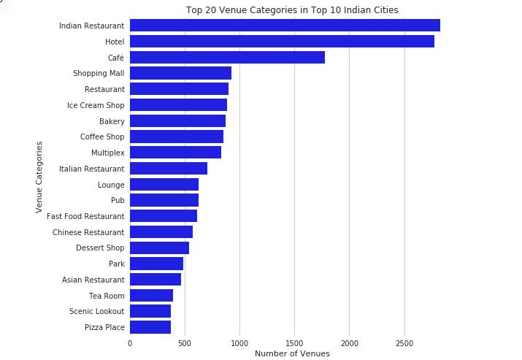
Results :
xi) Cumulative statistical view of top 20 venues.

Slide 16
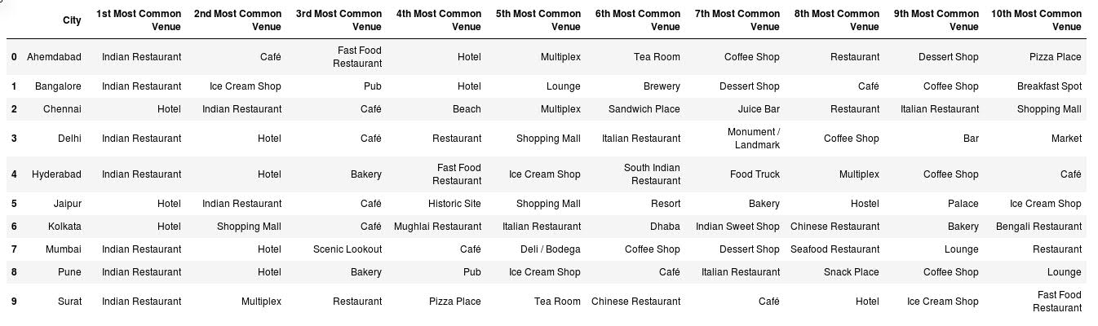
Results :
xii) Table containing top ten cities and top ten venues of each city.

Slide 17
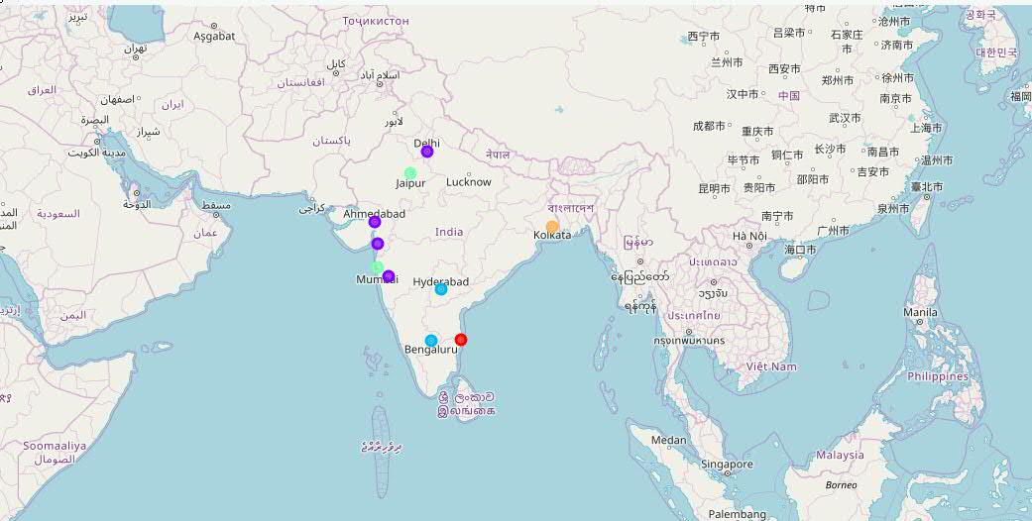
Results :
xiii) Top ten cities and how they are different as per foursquare dataset.

Slide 18
Thank you!
Notes:
In Slide Show mode, select the arrows to visit links.

