Slide 1
Agent Based Models
Yannik Pitcan
UC Berkeley

Slide 2
Prologue
With many calculations one can win; with few one cannot.
—Sun Tzu, The Art of War
Scientific laws have conventionally been constructed in terms of a particular set of mathematical functions and constructs, and they have often been developed as much for their mathematical simplicity as for their capacity to model the salient features of a phenomenon.
—Stephen Wolfram, “Computer Software in Science and Mathematics”

Slide 3
Outline
Introduction
Implementation
Example 1: Artificial Life
Example 2: Financial Crisis
Example 3: Schelling Model
Disadvantages and Advantages
Methodological Challenges

Slide 4

The World’s Favorite ABM: The Sims

Slide 5
What is an Agent Based Model?
Computer simulation of the global consequences of local interactions of members of a population
“Microscale model” – simulate interactions of multiple agents to re-create and predict complex phenomena
Types of agents:
  Plants and animals in ecosystems
  Vehicles in traffic
  Political actors

Slide 6
What is an Agent Based Model?
Agent Based Models (ABMs) aim to provide an in silico lab, where we can:
  1) Capture our understanding of systems.
  2) Test that understanding of the systems for coherence and comprehensiveness.
  3) See how theory at the individual level creates aggregate patterns.
  4) Validate that theory against real data at the aggregate and individual scale.
  5) Make predictions about the system.
  6) Test "what if?" scenarios to inform planning.

Slide 7
Purposes
Derive findings for the system’s behavior (“macro level”) from the agents’ behavior (“micro level”) (Bonabeau 2002; Epstein 2006a).
“Generative social science” (Epstein 2006a) or to “social science from the bottom-up” (Epstein and Axtell 1996).
Several purposes like, for example, predicting consequences, performing certain tasks (which is typically the case in the domain of artificial intelligence), or discovering theory.
Some regard simulation as a third research methodology which has in common with deduction the explicit set-up of assumptions (though it does not prove theorems by the “classical” mathematical techniques) and which generates data from a set of rules (rather than from measurement of real world data as it is typical for induction).

Slide 8
ABM Components
1. Agents specified at various scales (agent-granularity)
2. Decision-making heuristics
3. Learning rules or adaptive processes
4. Interaction topology
5. An environment

Slide 9
KISS and Gestalt
“Keep it simple, stupid.”
Tenet: Simple rules generate complex behavior
Tenet 2: Gestalt – the whole is greater than the sum of its parts
Core assumption: bounded rationality. Agents act in their own interests.

Slide 10
Modeling Process
Three core ideas: objects, emergence, and complexity
Emergence – generative. Potential to generate system equilibrium is the biggest benefit of ABM.
Inductive modeling process
  Modeler makes assumptions believed to be most relevant and observes behavior.

Slide 11
Implementation
Originally designed for serial von-Neumann computer architectures
Limits to speed and scalability
Recent development – data-parallel algorithms on GPUs for simulation

Slide 12
Artifiical Life
Studies fundamental processes of living systems in artificial environment
The modeling philosophy of artificial life strongly differs from traditional modeling by studying not only "life-as-we-know-it" but also "life-as-it-might-be".
A traditional model of a biological system will focus on capturing its most important parameters.
In contrast, an alife modeling approach will generally seek to decipher the most simple and general principles underlying life and implement them in a simulation.

Slide 13
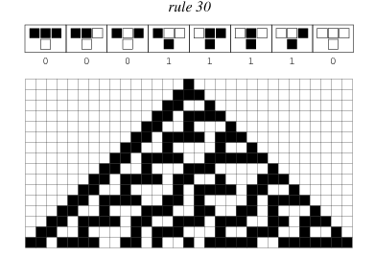
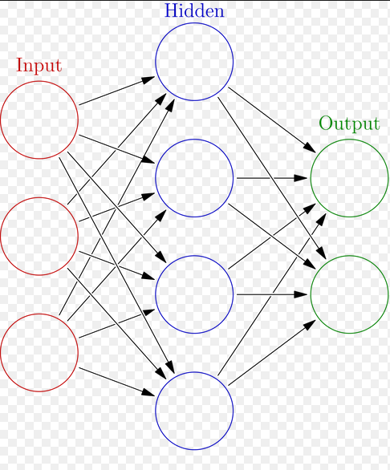
Alife Techniques
Cellular automata
Artificial neural networks

Slide 14
Cellular Automata
A collection of "colored" cells on a grid of specified shape that evolves through a number of discrete time steps according to a set of rules based on the states of neighboring cells. The rules are then applied iteratively for as many time steps as desired.
Von Neumann was one of the first people to consider such a model, and incorporated a cellular model into his "universal constructor."
Studied in the early 1950s as a possible model for biological systems.

Slide 15
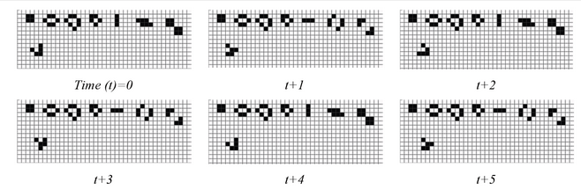
Comparison of CA vs ABM
CA and ABM are similar but not interchangeable!
In CA, cells do not move. ABM, they can.
The only requirement for an agent-based model is that the agents have individual properties that are tracked over time. Rules of interaction between agents and groups, inheritance of properties over time, or spatial context can vary over different types of agent-based models.

Slide 16
Criticisms of Alife simulation
Alife simulation – focuses on the investigation of emergent phenomena in the natural world.
Difficult to explain; simulation provides a means to view the origin of these phenomena from the behaviour of low-level component parts
Lacks in its ability to explain the overall behaviour of that higher-level emergent order.

Slide 17
A Novelty or a Copy?
Can a simulation create novel datasets which allow us to discover new things about natural systems, or are simulations based on the natural world destined to be mere facsimiles of the systems that inspire them?
"Life-as-we-know-it" or "life-as-it-might-be"?

Slide 18
Financial Crisis Example
The financial crisis, and the related real crisis, were unpredictable, and are only partially understood, using available economic models
Unpredictable refers to Knightian uncertainty, where risk cannot be measured (not a wrong guess on a probability distribution)
Why?
Some fundamental features of economic systems
  network structure – banks, users and countries
  individual’s beliefs and expectations – satisficing, partly adaptive, and heterogeneous
  interdependent behaviour – contagion
⇒ Features of a complex system

Slide 19
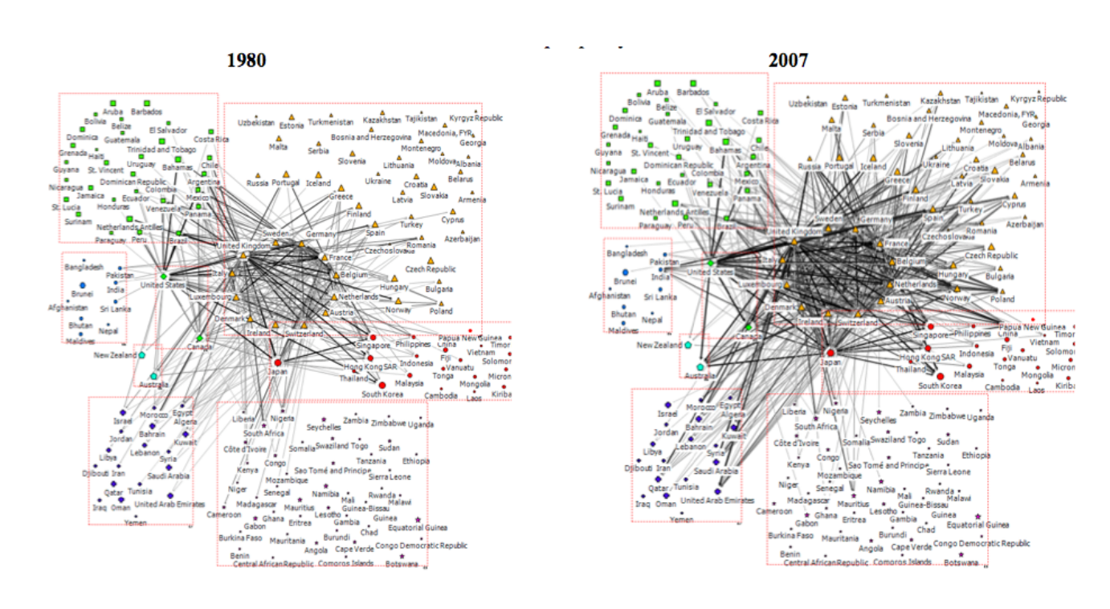
Network: Cross-border Banking Network

Slide 20
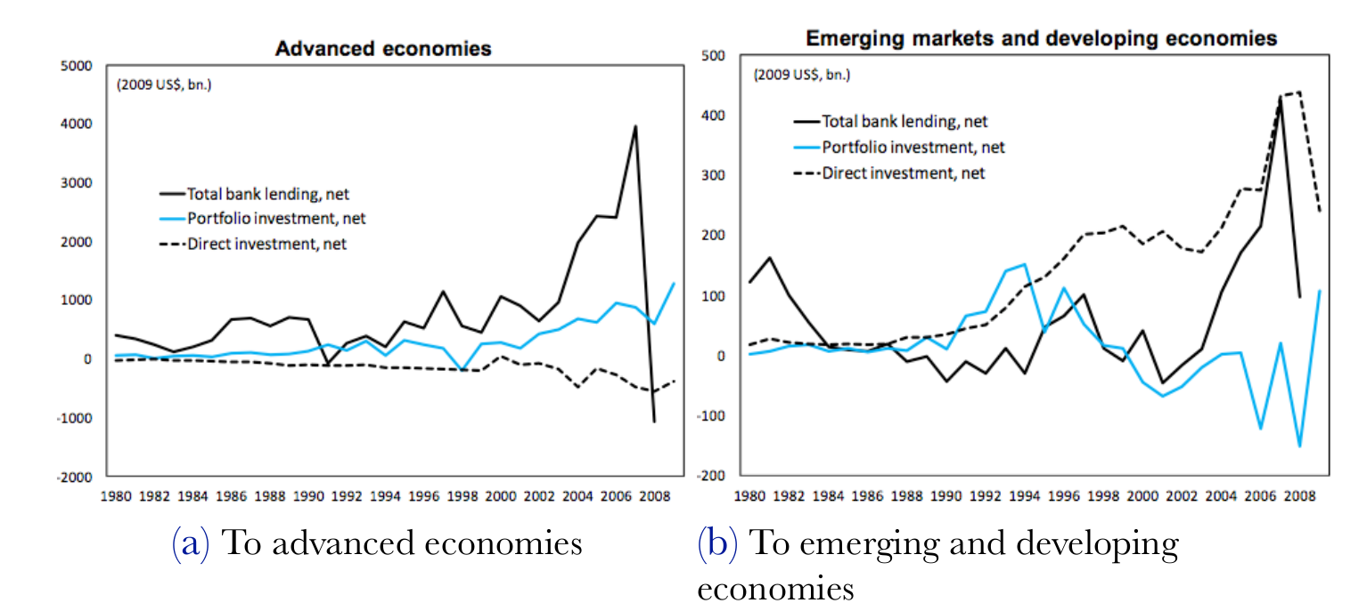
Network: Cross-border Flows

Slide 21
Contagion in Financial Crisis Model
Market signals adjust through time.
Information mediated by other actors locally.
Cumulative actions of others contain so much information that individuals ignore his own information (“information cascade”).

Slide 22
Schelling’s Model
Demonstrates individual tendencies regarding neighbors can lead to segregation. The model is especially useful for the study of residential segregation of ethnic groups where agents represent householders who relocate in the city.
In the model, each agent belongs to one of two groups and aims to reside within a neighborhood where the fraction of 'friends' is sufficiently high: above a predefined tolerance threshold value F. It is known that depending on F, for groups of equal size, Schelling's residential pattern converges to either complete integration (a random-like pattern) or segregation.
Reality is more complicated than this simple integration-segregation dichotomy: some neighborhoods are ethnically homogeneous while others are populated by both groups in varying ratios.

Slide 23
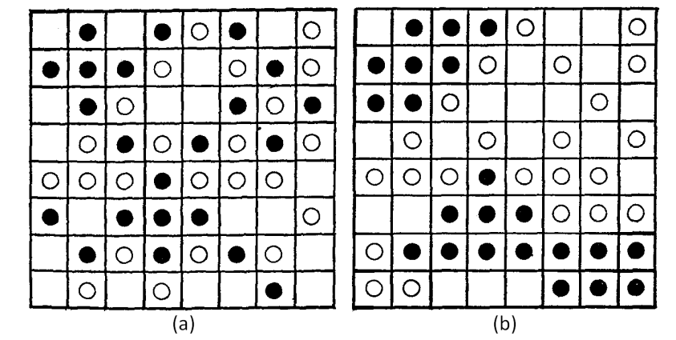
Schelling’s Model
(a) initial condition of one of Schelling's experiments;
(b) stable segregated pattern obtained in several iterations

Slide 24
Why not a formal or statistical model?
Comparison with formal models:
Same mathematical abstraction of a given problem, but uses simulation rather than mathematics to “solve” model and derive comparative statistics
Comparison with statistical models:
Same attempt to analyze data, but uses simulation data rather than real data

Slide 25
Advantages of Agent Based Models
Formal – assumptions laid bare
Flexible – agents can be rational or adaptive
Tractable – easier to deal with complexity
Generative – can develop new hypotheses

Slide 26
Disadvantages
Models too simple
  Could be solved in closed-form
  Closed-form solution always preferable
Models too complicated
  Not possible to assess causality
  What use is an existence proof?
Coding mistakes
  Many more lines of code than lines in typical formal proof
Data analysis
  What part of the parameter space to search

Slide 27
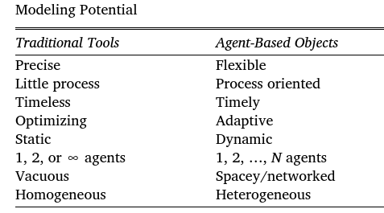
Versus Traditional Tools

Slide 28
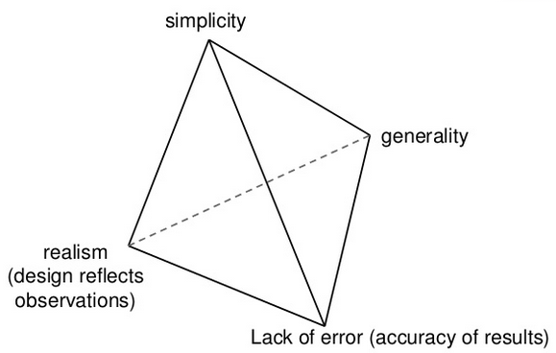
ABM Tradeoffs

Slide 29
Social vs Physical Systems
Assumptions about appropriate behavioral rules.
Physical system example: Quantum effects aside, all hydrogen atoms rely on a set of rigid external physical properties and forces.
Social agents, on the other hand, often alter their behavior in response to, and in anticipation of, the actions of others.
Social systems have an extra layer of complexity.

Slide 30
ABM vs Regression Model
Agent-based modeling vs. statistical regression models.
Regression model assumption: simplifying assumption: errors are iid.
Relax this assumption in ABM but gain model complexity – difficult to interpret.
Solution: Simplify on some dimensions!

Slide 31
Key Challenges
Results depend on the parameters’ values under which the simulation was performed and also on the “internal” structure of the model.
Transparency
Variability
Reproducibility

Slide 32
Dependency Issues (w.r.t. Input Values)
Use of non-parametric iterative procedures that change the parameters’ values until the greatest proximity between the observed and simulated macroscopic structures is achieved
Calibration if one has empirical data, sensitivity analysis otherwise

Slide 33
Dependency Issues (w.r.t. Internal Structure)
Robustness analysis if the previous methods aren’t feasible.
We can adjust the following:
a) the form of probability distributions used for the stochastic parts of the model
b) the functional forms adopted to link the elementary entities’ attributes
c) the rules of behaviour of these entities
d) the structure of their interactions (which is often done by simulating the model under several network topologies)
e) the sequence followed to “call” each entity
f) the way in which the behaviours of elementary entities are adapted and updated from a temporal point of view

Slide 34
Variability of Results
Random elements contained in model is source of variability
Quantify variability by replicating simulation for each parameter set and describe central tendencies
If comparing simulated and real data, evaluate overlap between variability in simulation between repetitions and empirical variability between samples.
If interested in trajectories of each agent, this is very difficult to understand. Multi-level regression models suggested to deal with this variability.

Slide 35
When Sensitivity Analysis Fails
Error creep
Do nonlinearities in the models destroy their usefulness? NO.
Is there a stabilizing (homeostatic) process in the real system?
Processes like agent-to-agent negotiation, averaging, and aggregation will often dampen down error propagation.

Slide 36
Transparency
Sensitivity analysis may help develop intuitions (Railsback and Grimm, 2011)
Mathematical description of state sequences is helpful
Isolate effects of mechanisms on internal dynamic and aggregated results, ideally
Otherwise, ad-hoc measures needed – call the model’s “currencies” (Railsback and Grimm, 2011) to study evolution of an aspect over time and its impact on results

Slide 37
Reproducibility
Two trends to deal with this:
  Standardized presentation of ABMs (Richiardi et al., 2006; Grimm, Berger and DeAngelis, 2010).
  Platforms for classification and sharing of models (Janssen et al., 2008)

Slide 38
Verificiation and validation
Verification – ensure model works correctly
Validation – check that the right model is chosen
Example: VOMAS (virtual overlay multi-agent system).
  Recent work (2017) by Niazi, Hussain, Kolberg
  https://arxiv.org/abs/1708.02361

Slide 39
VOMAS
Formal way of validation and verification
Design VOMAS agents alongside agents in simulation
Simulations are validated in simulation.

Slide 40
Conclusion
ABMs have their flaws but their advantages, particularly emergence, make them useful
Great complements to analytic methods
Next time: further discussion of agent based models in economics

