Slide 1
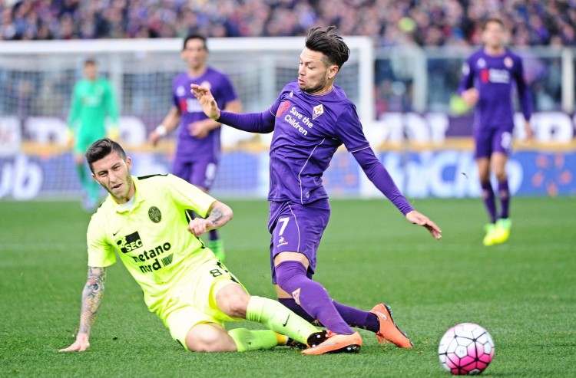
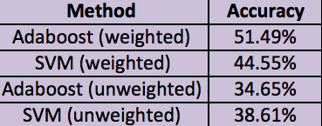
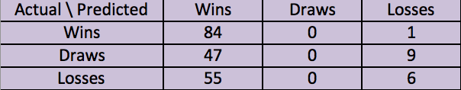

Soccer Prediction in the Serie A
YANNIK PITCAN
UC BERKELEY --- DEPARTMENT OF STATISTICS
ABSTRACT
METHODOLOGY
We focus on applying statistical learning methodology to predict the results of soccer games in the Italian Serie A. Using past historical data from several years, features are engineered to capture the performance of a team. Support vector machines, logistic regression, and Adaboost are the best performing techniques with regard to predicting the results of future matches. The emphasis is on analyzing the tradeoffs between these methods' performances on our dataset with respect to precision/recall and error rates.
The following three questions were my criteria when engineering features:
How can I capture the 'form' of a team?
Is the team playing home or away?
Has the team been scoring goals often? What is the overall performance outside of match results?
With this information , I decided to take each match played and create the following:
Home team
Away team
Q(results in past n matches of home team) – Q(results in past n matches of away team)
Q(shots taken in past n matches of home team) – Q(shots taken in past n matches of away team)
Q(corners in past n matches of home team) – Q(corners in past n matches of away team)
Q(goals scored in past n matches of home team) – Q(goals scored in past n matches of away team)
Betting odds for home team winning
Betting odds for draw
Betting odds for away team winning
Q here is the averaging function. To evaluate Q over the results of the past matches, we convert {W,D,L} to {1,0,-1}. Thus higher values of Q correspond to more wins.
We also look at two weights for Q:
Uniform weights -- each past game is weighted equally
Exponential weights --a game played t matches prior is weighted by exp(-(t-1)) when calculating the average. The advantage to this approach was we value more recent games higher in assessing how our team is performing
The determination of n was arbitrary. We used n=7 because we thought that was the best representative of the ‘form’ of a team. The idea behind this attribute is that we can explain using past results how ‘hot’ a team is (Timmaraju ).
We believed the inclusion of betting odds would be an indicator of the ranks of the home and away teams so we used these as features as well.
Last, we trained tree ensembles and support vector machines, on both our weighted and unweighted feature sets. Our response variable Result was {1,0,-1} depending on if the match were a win, draw, or loss . Since SVM was originally used for binary classification, we also used the response variable HomeWins which was 1 if the home team won and 0 otherwise. Performance was compared to that of logistic regression.
INTRODUCTION
Sports betting is a major industry in the United States and worldwide. With the advent of statistical learning methodology over the past few decades, inroads have been made into sports prediction in order to determine the outcomes of matches. However, most of this analysis has been done for baseball, basketball, and other games and sports where the game is less fluid. As an avid soccer fan, I decided to attempt to predict soccer match outcomes in the Serie A. The choice of the Italian Serie A was due to a few reasons. I believe the Serie A exhibits a parity among the teams that doesn't exist in other leagues. Also the tactical style of play in this league makes one think that past outcomes can influence the result of future games.
Much of the work on this topic is done by bookmakers. Furthermore, they have access to private data which gives them a leg up on competitors. At Stanford however, a few students (Ulmer and Fernandez, Timmaraju) analyzed classifiers such as SVM, random forests, and Hidden Markov Models for the English Premier League. Their focus was on improving hyperparameters for their classifiers and although they did not beat leading bookmakers, they were able to beat human analysts. My belief was that one could improve the feature selection methods used to get more accurate predictions on wins. My ideas for feature selection were influenced by Ulmer and Fernandez. In particular, I incorporate time dependence in my models similar to how they were used in the aforementioned works.
DATASET
The data used consisted of the results from the 2007 season to the current 2016 season. Seasons 2007 to 2015 were used for the training set while the 2016 (ongoing) season was used for the test set. Our training dataset consisted of 3420 games while our test dataset had $320$ games. For every game, the following data was recorded:
Home team
Away team
Result (Win, Loss, or Draw)
Goals scored by Home
Goals scored by Away
Shots on target taken by Home
Shots on target taken by Away
Corners taken by Home
Corners taken by Away
Bet365 Home Win Odds
Bet365 Draw Odds
Bet365 Away Win Odds
All of this data was taken from the website http://www.football-data.co.uk/ .
RESULTS AND CONCLUSIONS
We kept the classifiers that performed the best on the training datasets and ran them on the test feature set. Our best performing classifiers were Adaboost and RBF-SVM using feature data created by weighted match observations for the past 7 days. We create a feature dataset for the test set and running our SVM on this data, we were able to get about 44% accuracy predicting whether a result would be a win, loss, or draw. For Adaboost, we were predicting with 51% success. Considering that we would expect 33% success with randomly guessing, these results were fairly promising.
In the binary classification setting, RBF-SVM and logistic regression both performed very well with accuracy of 67% and 71% respectively. Tables recording the accuracies may be seen on the left hand side. The top table shows multiclassification accuracy whereas the bottom one shows results for binary classification.
Of particular interest was that the SVM setting did not predict any draws at all. This may have been because our SVM relied on a one-vs-one method for multiclass method.
Our results combined with those elsewhere (Fernandez, Timmarju) convince us that the SVM and Adaboost cannot be discounted in predicting outcomes, but there is more to be done. Currently, we are working on extracting rankings of teams to see how this feature impacts our estimates of future games. We thought that betting odds would take care of this, but they did not capture as much about the rankings of teams as we hoped.
ACCURACY OF PREDICTIONS

