Slide 1

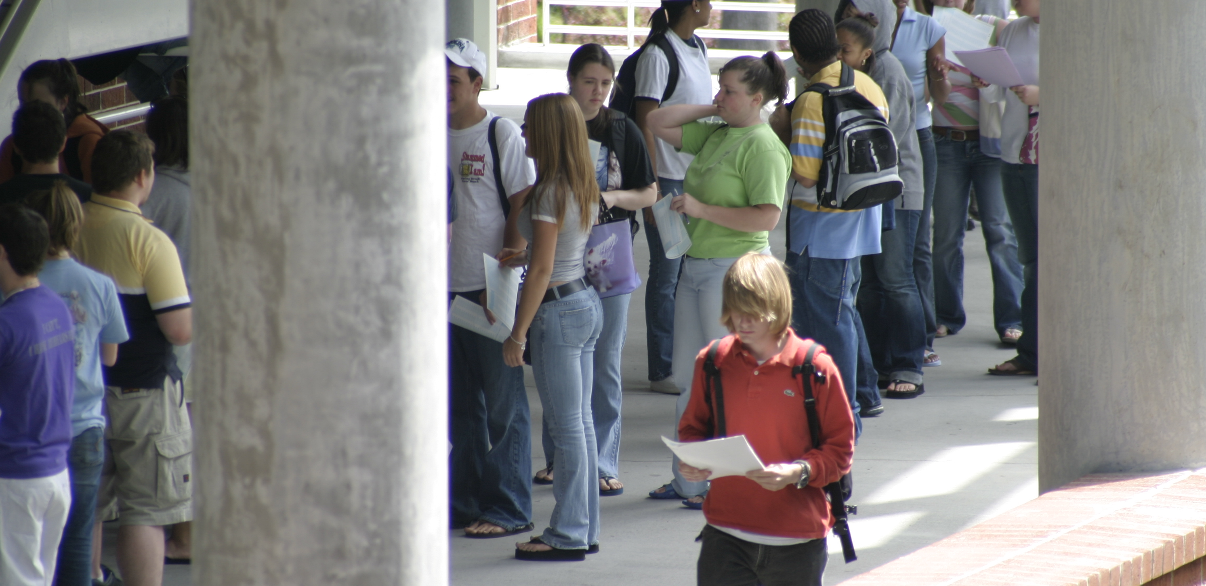
Yannik Pitcan
Department of Statistics
University of California, Berkeley
pitcany@berkeley.edu
The Soccer Oracle: Predicting Serie A Matches Using Statistical Learning
Abstract
I focus on applying statistical learning methodology to predict the results of soccer games in the Italian Serie A. Using past historical data from several years, features are engineered to capture the performance of a team. Support vector machines, logistic regression, and Adaboost are the best performing techniques with regard to predicting the results of future matches. The emphasis is on analyzing the tradeoffs between these methods' performances on our dataset with respect to precision/recall and error rates.
Results
To bring data in from Excel select the chart and choose Edit > Copy, and then choose Edit > Paste in PowerPoint. The chart can then be stretched to fit as required. If you need to edit parts of the chart, it can be ungrouped. Watch out for scientific symbols used in imported charts, which PowerPoint will not recognize as a used font and may print improperly if the font is not installed on our system.
To bring text in from Word select the text to be brought into PowerPoint, choose Edit > Copy, then Edit > Paste the text into a new or existing text block. This text is editable. You can change the size, color, etc. using Format > Text. Avoid using shadows on smaller text.
Images should be 100 dpi in their final size, or use a rule of thumb of 2 to 4 megabytes of uncompressed .tif file per square foot of image. For instance, a 3x5” photo that will be 6x10” in size on the final poster should be scanned at 200 ppi. Remember that this template is set up at half size, so anything that is 3x5” on the template will be 6x10” on the final piece. Table 1 to the right gives suggested scanning resolutions to obtain an image that will be 100 in its final size. Table 2 gives suggested scanning resolutions for slides. When possible use a slide scanner rather than a flat bed scanner adapted to slides to get the best results when scanning slides.
If you use a digital camera to acquire images there a couple of things to be aware of. The standard 480x640 pixel digital picture should not be any larger than about 8x10" on your poster. Megapixel digital pictures can go quite a bit larger, the rule of thumb is for them to be 100 ppi in the actual size. To have an image that's 10x20” and 100 ppi, it should be 1000x2000 pixels.
It is best to import tiff images into PowerPoint. JPEG files are OK, but they will be better quality if you can convert them to tiff. Remember – JPEG is a lousy compression file format which means you loose pixel information and quality.
Materials and Methods
The dotted lines through the center of this text box are guides and will not print, they are there for alignment. To move them, click, hold and drag them to a new location. As you drag, the cursor will change from an arrow to the numeric values for the x and y position. Use guides to get your pictures and/or text boxes aligned together.
Conclusions
If the proportions of the print you want are different than your image, you should crop it. For example, if you scan a 4x6" photo, and you want to print 16x20", you have to take a little off the width. Otherwise it would print as 16x24" (which has the same proportions or aspect ratio as 4x6’). Simply calculate the width divided by the height, and make sure this ratio corresponds
to your print size.
Do all image editing including cropping and resizing in a graphics software before bringing the image into PowerPoint.
To see your in poster in actual size, go to View > Zoom > 200%. This is a good way to be sure your pictures are going to look OK..
Introduction
Sports betting is a major industry in the United States and worldwide. With the advent of statistical learning methodology over the past few decades, inroads have been made into sports prediction in order to determine the outcomes of matches. However, most of this analysis has been done for baseball, basketball, and other games and sports where the game is less fluid. As an avid soccer fan, I decided to attempt to predict soccer match outcomes in the Serie A. The choice of the Italian Serie A was due to a few reasons. I believe the Serie A exhibits a parity among the teams that doesn't exist in other leagues. Also the tactical style of play in this league makes one think that past outcomes can influence the result of future games.
Much of the work on this topic is done by bookmakers. Furthermore, they have access to private data which gives them a leg up on competitors. At Stanford however, a few students (Ulmer and Fernandez, Timmaraju) analyzed classifiers such as SVM, random forests, and Hidden Markov Models for the English Premier League. Their focus was on improving hyperparameters for their classifiers and although they did not beat leading bookmakers, they were able to beat human analysts. My belief was that one could improve the feature selection methods used to get more accurate predictions on wins. My ideas for feature selection were influenced by Ulmer and Fernandez. In particular, I incorporate time dependence in my models similar to how they were used in the aforementioned works.
References
The dotted lines through the center of this text box are guides and will not print, they are there for alignment. To move them, click, hold and drag them to a new location. As you drag, the cursor will change from an arrow to the numeric values for the x and y position. Use guides to get your pictures and/or text boxes aligned together.
Poster Submission
To print your poster …
No idea yet.
If you have any questions or comments about this template contact:
Good luck!
Table Heading | Table Heading | Table Heading
Table row 1
Table row 2
Table row 3
Table 1. Title for table 1.
Figure 1. This is a caption place holder for Figure 1 which will be 6x9” when printed at 200%. This is an example of a caption that is 4 or more lines. This caption is left aligned. The text is set to 10 which is 20 when printed
at 200%. It is also bold.

