Slide 1
Module 3
Introduction to Odoo
OpenSPP and Odoo Foundations Training, Day 2, 8:30 to 10:00
Edwin Gonzales, OpenSPP

Slide 2
Before we start
./odoo-project start
Log in with admin / admin. Settings, scroll to the bottom, Activate the developer mode.
Then wait. Nothing before 8:50 needs your laptop.
Guide 0.3
2

Slide 3
By ten you can
Say what Odoo is and name the three parts of MVC in Odoo terms.
Say what a module is, the role of each file in one, and why a file not in the manifest does not exist.
Write a model with Char, Selection, Date, Many2one and Boolean fields: "model = table, field = column".
Write a list view, a form view, an action and a menu: menu, action, view, model.
Write the access row a new model needs, and recognise its absence in the log and on screen.
Use the ORM from a method and from the shell: search, browse, create, write, unlink.
Add a PDF report and find it in the Print menu.
Run ./odoo-project test dswd_asset and read the summary line.
After the break you learn why you will almost never build a module this way for 4Ps.
Guide 3.1
3

Slide 4
What Odoo is
Python on PostgreSQL, web client in JavaScript. 2005 TinyERP, then OpenERP, since 2014 Odoo.
One major release a year. This training: Odoo 19 (2025).
Community edition, LGPL v3: what OpenSPP builds on and what you run. Enterprise: proprietary modules on top.
Everything is a module, including the core. A module adds tables, columns, screens, menus, reports and rules to other modules without changing their code.
OpenSPP: about a hundred spp_* modules on Odoo. Your dswd_* modules: on top of those.
Guide 3.2
4

Slide 5
MVC, in Odoo terms
MVC | In Odoo | You write it in
Model | models.Model classes and fields; the ORM maps them to tables | models/*.py
View | XML on ir.ui.view (list, form, search, kanban), QWeb templates for reports | views/*.xml, report/*.xml
Controller | actions and menus route clicks; model methods run the logic; HTTP controllers serve URLs | views/*.xml, models/*.py, controllers/*.py
Data and rules in the model. Drawing in the view. The controller stays thin: a button calls a method, the method uses the ORM, the view only says where the button sits.
Guide 3.3
5

Slide 6
Odoo in five words
Word | Means | See it at
Module | a folder with __manifest__.py on the addons path | Apps
Model | a table: _name = "dswd.asset" becomes dswd_asset | Settings > Technical > Models
Field | a column with a type | Settings > Technical > Fields
View | how the table is drawn: list, form, search | Settings > Technical > Views
Menu | menu, then action, then view, then model | the top bar and the app tiles
Look at res.partner under Models: fields from base, from spp_registry, from spp_vocabulary. Many modules add columns to one table. Hold that thought until 10:40.
Guide 3.4
6

Slide 7
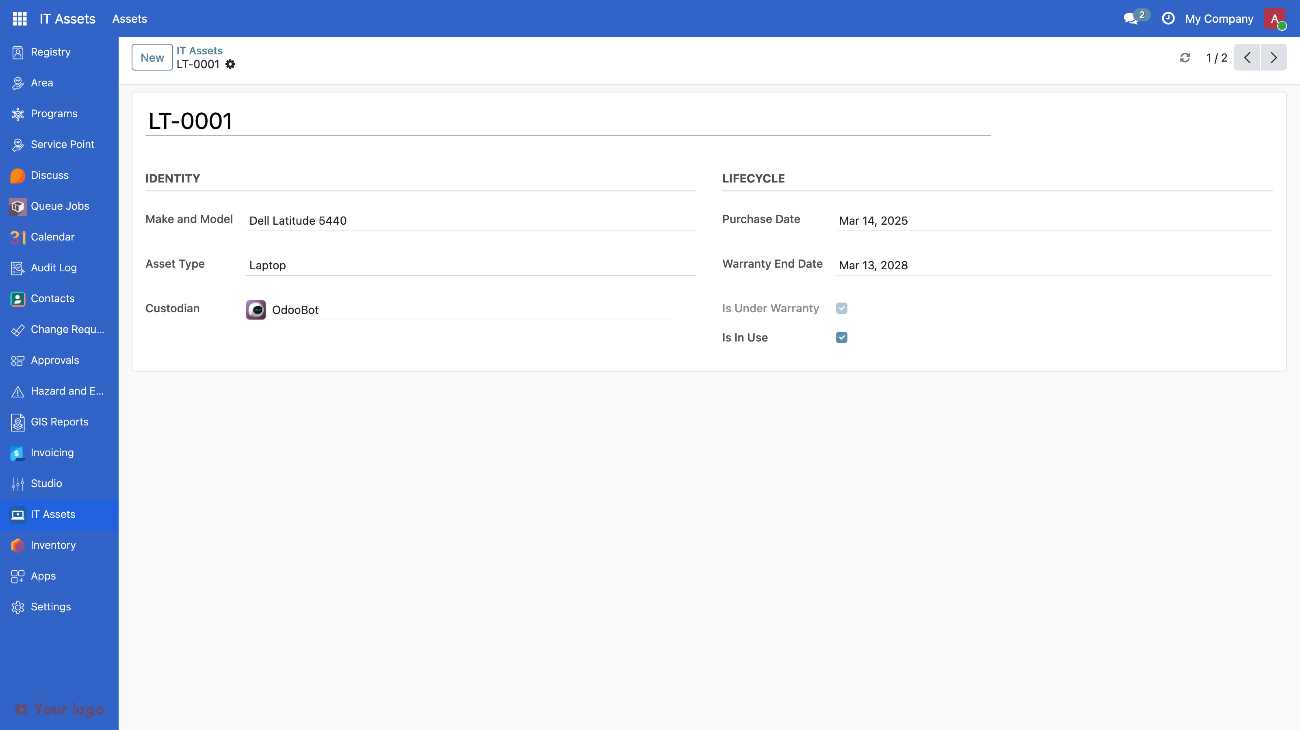
What we build: an IT asset register
Fill in the file map on your handout, section 3, as we go. Every file and its role: Guide 3.5.
Guide 3.5
7

Slide 8
Step 0: a module is a folder and a manifest
{
"name": "DSWD Training: IT Asset Register",
"category": "DSWD 4Ps/Training",
"version": "19.0.1.0.0",
"license": "LGPL-3",
"depends": ["base", "spp_security"],
"data": ["security/ir.model.access.csv"],
"application": False,
"installable": True,
"auto_install": False,
}
Abridged: the full manifest is in Guide 3.6. Odoo needs a folder and a manifest, nothing more. The dswd_ prefix is our project's rule, the way spp_ is OpenSPP's: it says who owns the code, not what it is about.
A file not listed in data does not exist to Odoo: no error, it is simply ignored.
Install now: ./odoo-project install dswd_asset
Guide 3.6
8

Slide 9
Step 1: the model is the table
class DswdAsset(models.Model):
_name = "dswd.asset"
_description = "IT Asset"
_order = "name"
name = fields.Char(string="Asset Tag", required=True)
model_name = fields.Char(string="Make and Model")
asset_type = fields.Selection(
[("laptop", "Laptop"), ("desktop", "Desktop"), ("printer", "Printer"),
("other", "Other")], required=True, default="laptop")
custodian_id = fields.Many2one(
"res.users", string="Custodian", default=lambda self: self.env.user)
purchase_date = fields.Date()
warranty_end_date = fields.Date()
is_in_use = fields.Boolean(default=True)
Plus from . import dswd_asset in models/__init__.py and from . import models in __init__.py; forget either and the model is silently absent.
Predict: Region IV buys tablets. What do we change?
Guide 3.7
9

Slide 10
Computed and constrained
is_under_warranty = fields.Boolean(compute="_compute_is_under_warranty")
@api.depends("warranty_end_date")
def _compute_is_under_warranty(self):
today = fields.Date.context_today(self)
for asset in self:
asset.is_under_warranty = bool(
asset.warranty_end_date and asset.warranty_end_date >= today)
@api.constrains("purchase_date", "warranty_end_date")
def _check_warranty_after_purchase(self):
for asset in self:
if (asset.purchase_date and asset.warranty_end_date
and asset.warranty_end_date < asset.purchase_date):
raise ValidationError(
_("The warranty end date must be on or after the purchase date."))
A computed field is never typed in; it is not stored, so it cannot be searched or filtered without a search= method (Guide 3.8). A constraint refuses bad data with a sentence the user reads.
Guide 3.7 · more in 3.8
10

Slide 11
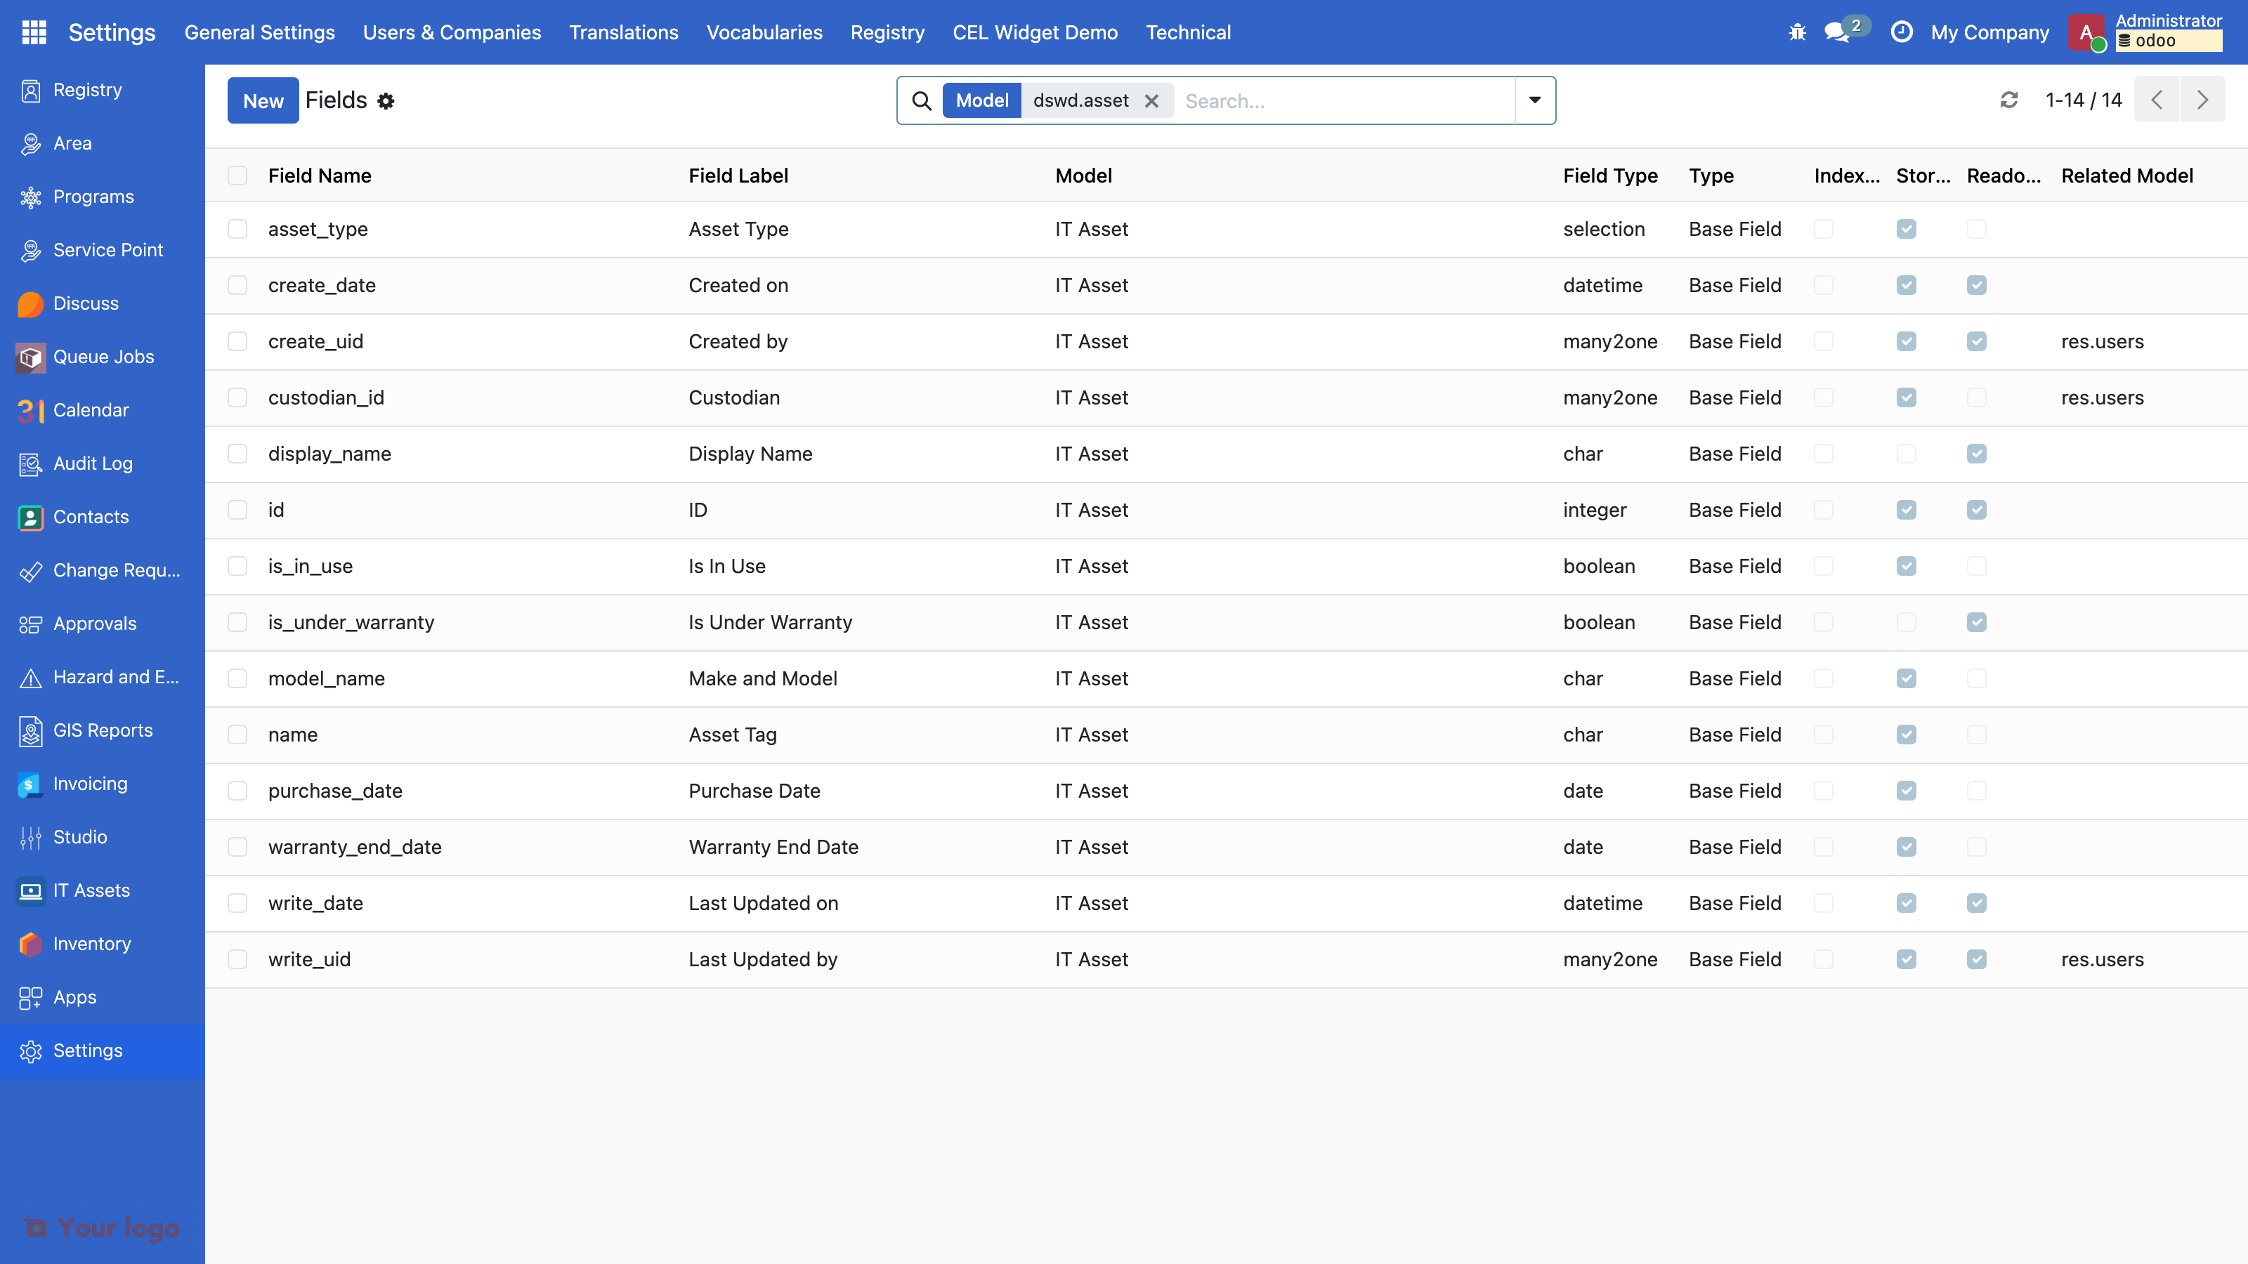
After step 1: a table, no door
Guide 3.7
11

Slide 12
The warning you will meet again
WARNING ... odoo.modules.loading: The models ['dswd.asset']
have no access rules in module dswd_asset, consider adding some, like:
id,name,model_id:id,group_id:id,perm_read,perm_write,perm_create,perm_unlink
dswd_asset.access_dswd_asset,access_dswd_asset,dswd_asset.model_dswd_asset,
base.group_user,1,0,0,0
Odoo even suggests a row; ours will have four, with the system row first.
Nothing is broken yet. Nobody can open the table either. Remember this warning: in fifteen minutes it becomes an error on screen.
Guide 3.7
12

Slide 13
Step 2: a list view draws the table
<record id="view_dswd_asset_list" model="ir.ui.view">
<field name="name">dswd.asset.list</field>
<field name="model">dswd.asset</field>
<field name="arch" type="xml">
<list>
<field name="name" />
<field name="model_name" />
<field name="asset_type" />
<field name="custodian_id" widget="many2one_avatar_user" />
<field name="purchase_date" optional="show" />
<field name="is_under_warranty" />
</list>
</field>
</record>
Abridged: the form and search views are in Guide 3.9. Odoo 19: <list>, not <tree>.
Guide 3.9
13

Slide 14
Step 2: an action and a menu open it
<record id="action_dswd_asset" model="ir.actions.act_window">
<field name="name">IT Assets</field>
<field name="res_model">dswd.asset</field>
<field name="view_mode">list,form</field>
<field name="context">{'search_default_filter_in_use': 1}</field>
</record>
<menuitem id="menu_dswd_asset_root" name="IT Assets"
web_icon="dswd_asset,static/description/icon.png" sequence="95" />
<menuitem id="menu_dswd_asset" name="Assets" parent="menu_dswd_asset_root"
action="action_dswd_asset" sequence="10" />
Abridged: the action's help text is in the file (Guide 3.9). Predict: where will it appear?
Guide 3.9
14

Slide 15
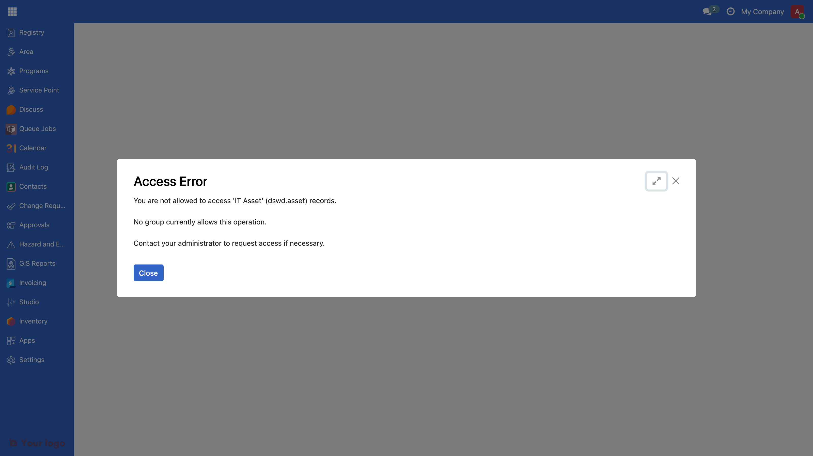
After step 2: no tile, and an error even for admin
Odoo hides a menu whose model you cannot read, and admin is not the superuser: no IT Assets tile. Open the action by its URL instead: http://localhost:8069/odoo/action-dswd_asset.action_dswd_asset (dev profile: the port start printed).
Guide 3.9 · then read 3.10
15

Slide 16
Step 3: groups and access rows
<record id="group_asset_officer" model="res.groups">
<field name="name">IT Assets: Officer</field>
<field name="privilege_id" ref="privilege_asset_officer" />
<field name="implied_ids" eval="[Command.link(ref('group_asset_viewer'))]" />
</record>
<record id="spp_security.group_spp_admin" model="res.groups">
<field name="implied_ids" eval="[Command.link(ref('group_asset_manager'))]" />
</record>
id,name,model_id:id,group_id:id,perm_read,perm_write,perm_create,perm_unlink
access_dswd_asset_system,dswd.asset system,model_dswd_asset,base.group_system,1,1,1,1
access_dswd_asset_viewer,dswd.asset viewer,model_dswd_asset,group_asset_viewer,1,0,0,0
access_dswd_asset_officer,dswd.asset officer,model_dswd_asset,group_asset_officer,1,1,1,0
access_dswd_asset_manager,dswd.asset manager,model_dswd_asset,group_asset_manager,1,1,1,1
Abridged: the category, privilege, viewer and manager records are in Guide 3.11. Viewer reads. Officer reads, writes, creates. Manager also deletes. The last record makes every OpenSPP admin an asset manager.
Guide 3.11
16

Slide 17
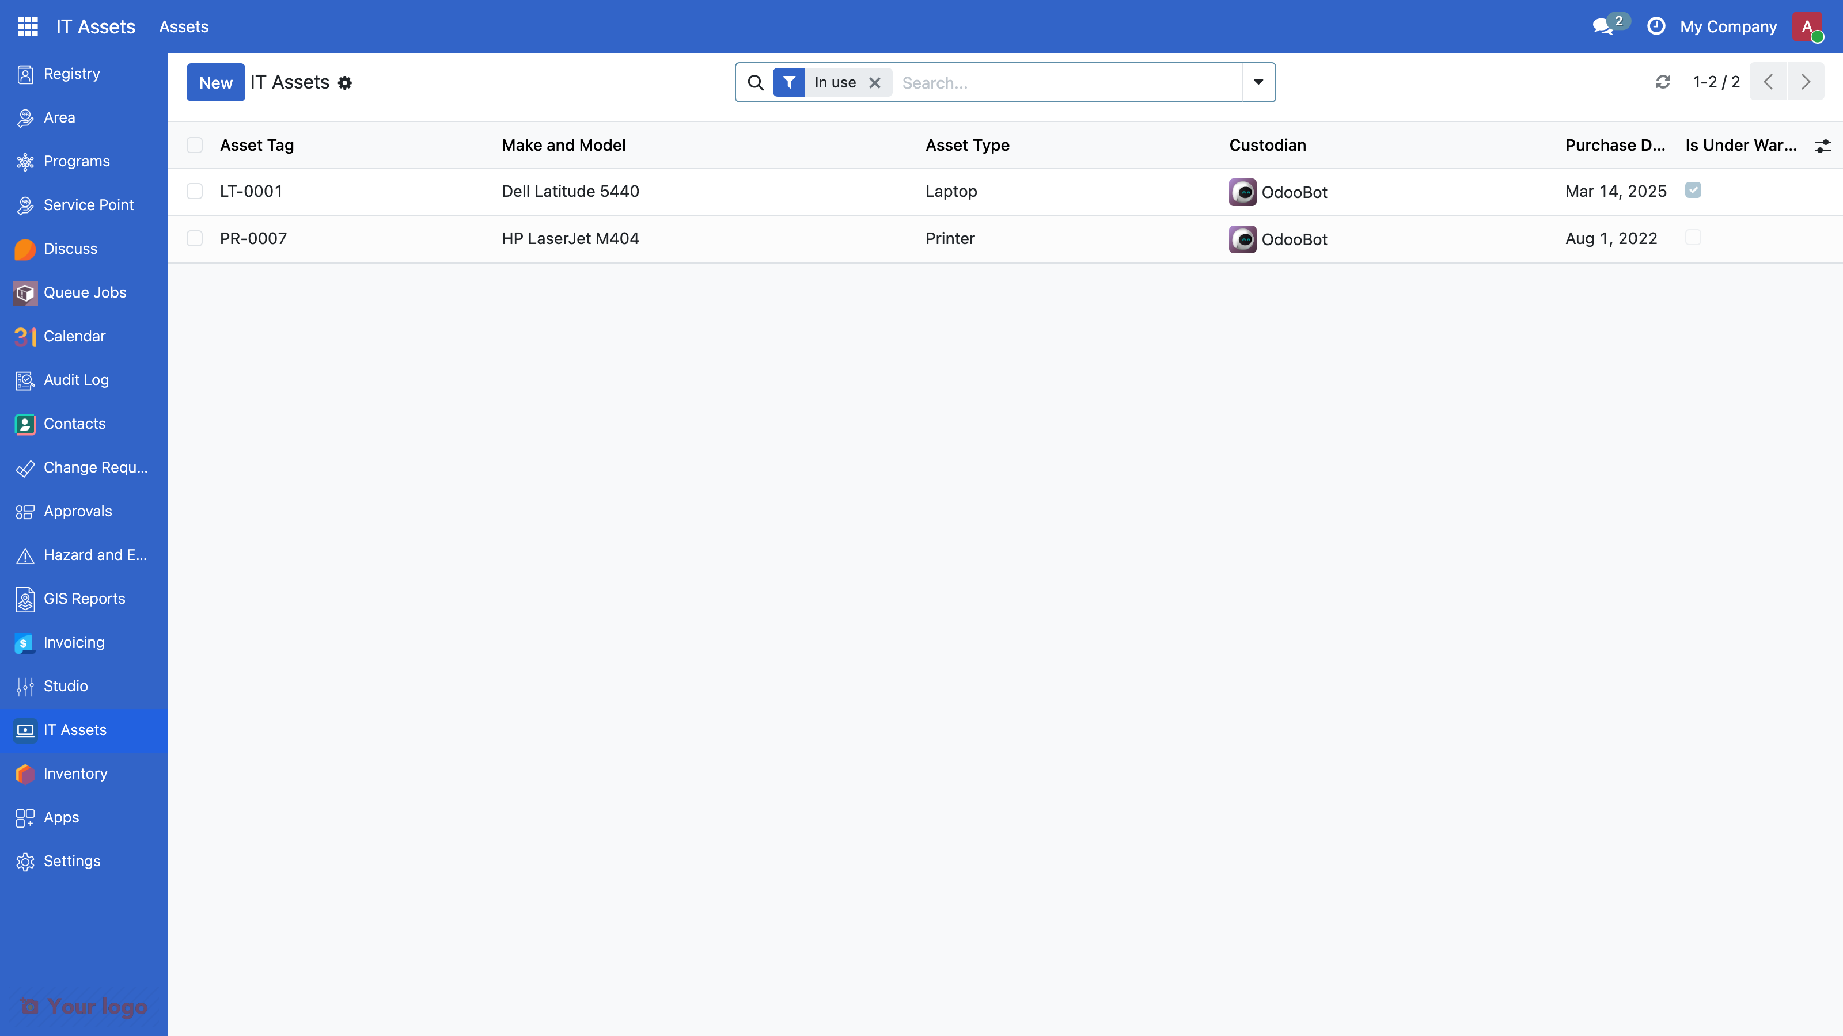
After step 3: the tile opens. Your turn
update: the IT Assets tile appears and the list opens.
Your turn: register the laptop in front of you. Then group by Type. Then set a warranty end date before the purchase date, and read the dialog.
Guide 3.11 · then read 3.12
17

Slide 18
Step 4: a test says what "working" means
@tagged("post_install", "-at_install")
class TestDswdAsset(TransactionCase):
def setUp(self):
super().setUp()
self.Asset = self.env["dswd.asset"]
self.asset = self.Asset.create(
{"name": "LT-0001", "model_name": "Dell Latitude 5440"})
def test_warranty_before_purchase_is_refused(self):
with self.assertRaises(ValidationError):
self.asset.write({"purchase_date": date(2026, 1, 10),
"warranty_end_date": date(2025, 12, 31)})
$ ./odoo-project test dswd_asset
0 failed, 0 error(s) of 12 tests
Abridged: the full files hold more tests (Guide 3.13). Written with each step: the demo tag runs 8, your copy 12. Start yours now; read the summary line at 9:56.
Guide 3.13
18

Slide 19
Step 5: the ORM, in a method
def action_assign_to_me(self):
self.write({"custodian_id": self.env.user.id})
@api.model
def find_warranty_expiring(self, days=30):
today = fields.Date.context_today(self)
return self.search(
[("is_in_use", "=", True), ("warranty_end_date", ">=", today),
("warranty_end_date", "<=", fields.Date.add(today, days=days))],
order="warranty_end_date",
)
<button name="action_assign_to_me" type="object" string="Assign to me"
class="btn-primary" groups="dswd_asset.group_asset_officer" />
The button sits in the form's <header>; type="object" calls the method of that name on the record. No decorator: self is the record. @api.model: works on the whole table. Five operations: search, browse, create, write, unlink (Guide 3.14).
Guide 3.14
19

Slide 20
Step 5: the ORM, in the shell
$ ./odoo-project shell
>>> Asset = env["dswd.asset"]
>>> Asset.search_count([])
2
>>> laptops = Asset.search([("asset_type", "=", "laptop")])
>>> laptops.mapped("name")
['LT-0001']
>>> a = Asset.create({"name": "LT-0099", "asset_type": "laptop"})
>>> a.write({"model_name": "Lenovo ThinkPad T14"})
True
>>> a.custodian_id.name
'OdooBot'
>>> Asset.find_warranty_expiring(365).mapped("name")
['LT-0001']
Then a.unlink() (True) and env.cr.commit(). A Many2one is itself a record: a.custodian_id.name walks the link. Nothing is saved until env.cr.commit(), and that line belongs in the shell only, never in module code.
Guide 3.14 · then read 3.15 to 3.17
20

Slide 21
Step 6: a PDF report
<record id="action_report_dswd_asset" model="ir.actions.report">
<field name="name">Asset Sheet</field>
<field name="model">dswd.asset</field>
<field name="report_type">qweb-pdf</field>
<field name="report_name">dswd_asset.report_dswd_asset</field>
<field name="binding_model_id" ref="model_dswd_asset" />
</record>
<template id="report_dswd_asset">
<t t-call="web.html_container">
<t t-foreach="docs" t-as="asset">
<t t-call="web.external_layout">
<div class="page">
<h2>Asset Sheet: <span t-field="asset.name" /></h2>
<table class="table table-sm o_main_table">
<tbody>
Abridged: the six rows and the closing tags are in Guide 3.18. binding_model_id puts it in the Print menu. docs is what is being printed. HTML, then PDF.
Guide 3.18
21

Slide 22
The four mistakes of a new module
Mistake | Symptom | Where to look
No access row | have no access rules in the install or update output; the menu is hidden; AccessError on the action URL, even as admin | security/ir.model.access.csv
Action without a menu, or menu without action | clean update, nothing to click | Settings > Technical > User Interface > Menu Items
A view field that is not on the model | update fails: Field "x" does not exist in model "dswd.asset" | compare with Settings > Technical > Fields
_name versus model_id in the access file | No matching record found for external id 'model_dswd_...' | model_ plus _name with dots as underscores
Guide 3.19
22

Slide 23
The question
4Ps needs a well-being level on every household.
Which file do we start with?
Guide 3.20
23

Slide 24
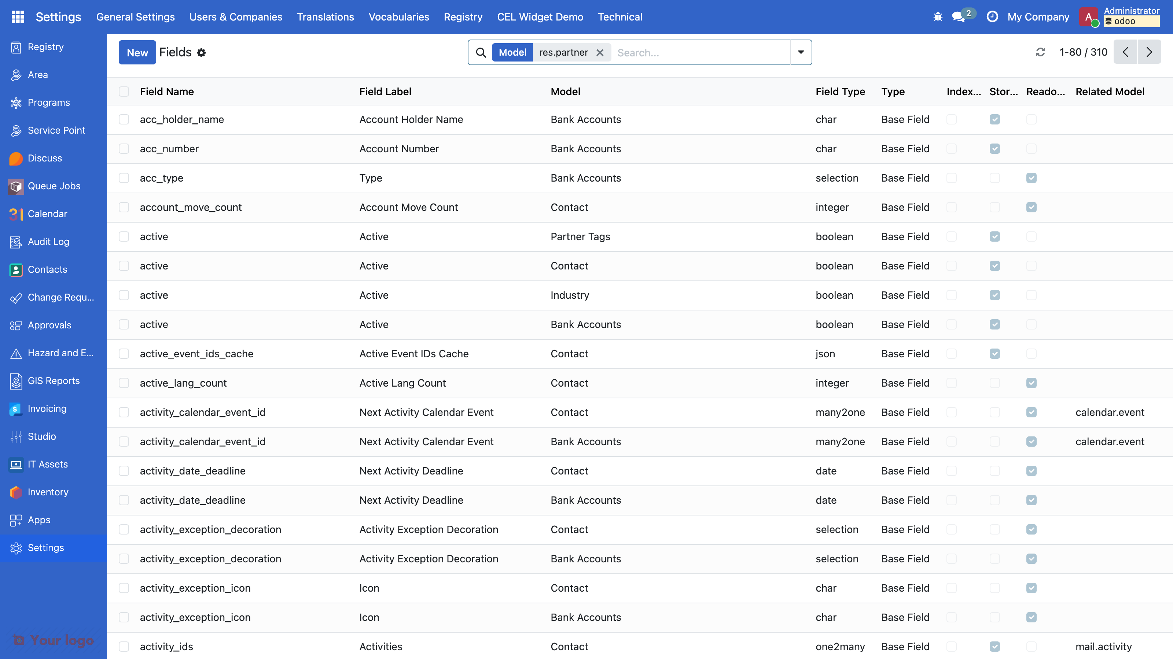
The household table already exists
Hundreds of columns, from several modules. A new dswd.household would mean two tables, two forms, two access files, and no link to programs. After the break you add one column to this table instead.
Guide 3.20
24

Slide 25
The tablet, resolved
asset_type = fields.Selection(
[("laptop", "Laptop"), ("desktop", "Desktop"), ("printer", "Printer"),
("tablet", "Tablet"),
("other", "Other")],
required=True, default="laptop",
)
One word cost: a code change, a release, an update on every server.
In OpenSPP a code list is data: Settings > Vocabularies. That is the first file you see after the break.
Guide 3.20
25

Slide 26
Today and after the break: the same files, three swaps
Module 3, dswd_asset | Module 4, dswd_wellbeing
_name = "dswd.asset", a new table | _inherit = "res.partner", columns on an existing table
asset_type = fields.Selection([...]) | dswd_well_being_level_id = fields.Many2one("spp.vocabulary.code")
<list> and <form> written from scratch | inherit_id plus one XPath on a named anchor
an action and a menu you created | no menu: the household form already has one
groups and four access rows | access file: header only, "no new model, no rows"
depends = ["base", "spp_security"] | depends = ["spp_registry", "spp_vocabulary"]
TransactionCase, create() your own record | RegistryCommon hands you a household
the field is yours: asset_type | a field on someone else's model: prefix dswd_
Same files, same loop, same test. Three swaps matter most: _inherit, a vocabulary instead of a Selection, an inherited view. See you at 10:10.
Guide 3.20
26

