Slide 1
Module 4
Developing Custom Modules and Extending Odoo Models
OpenSPP and Odoo Foundations Training, Day 2, 10:10 to 12:00
Edwin Gonzales, OpenSPP

Slide 2
By noon you can
Name the role of each file in a dswd_* module and state that a file not listed in the manifest does not exist.
Given a 4Ps requirement, pick the right pattern: _inherit on the upstream model, a dswd_ field, a Many2one to a vocabulary code; never a new model for an attribute, never a static Selection for a code list, never an edit under upstream/openspp/.
Explain view inheritance (inherit_id plus one XPath on a named anchor) and recognise the error when the anchor does not exist.
Given a log excerpt, say which step failed and which file to open.
Run the tests of a module and read the pass/fail summary.
Nothing today needs your laptop. Read, predict, diagnose. Keyboard time is Day 3.
Guide 4.1
2

Slide 3
The requirement
The SWDI assessment places every 4Ps household at one of three levels:
Level | Code | Meaning
1 | survival | cannot meet basic needs without assistance
2 | subsistence | meets basic needs, no buffer
3 | self_sufficient | can sustain itself, may exit the program
Since Executive Order 120 (July 2026) the level decides whether a household stays in the program past seven years.
Today: put that level on the household record in OpenSPP, as a dropdown on the household Profile page.
Guide 4.3
3

Slide 4
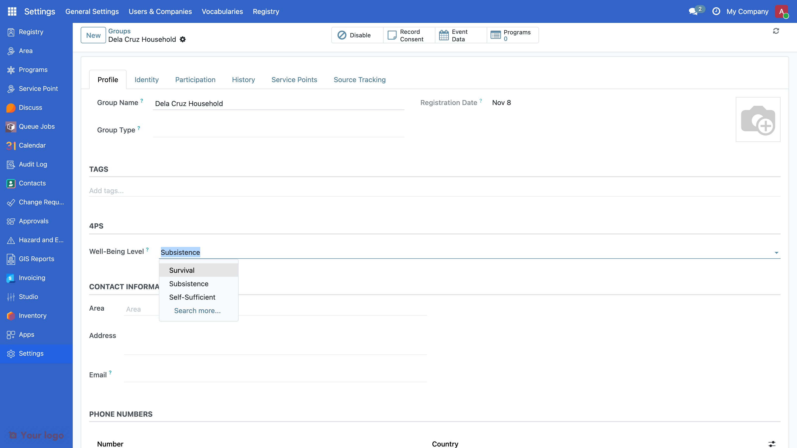
What you will see at noon
Guide 4.3
4

Slide 5
Where this lives in production
The production 4Ps registry module ships 27 vocabularies the same way:
urn:dswd:4ps:client-status (32 statuses in 9 categories)
urn:dswd:4ps:set-group (57 set codes, 1A to 14H)
urn:dswd:4ps:ip-group (394 codes)
urn:dswd:4ps:well-being-level (the one we build)
Client status and the other household fields are Many2one to spp.vocabulary.code, exactly like ours.
In production the household's level is copied from the latest SWDI assessment (dswd_4ps_swdi, Module 5 card 16, guide 5.8).
Guide 4.12
5

Slide 6
The three rules
Never edit upstream/openspp/. Read it. Extend it from your module. The next release overwrites it.
Inherit, do not redefine. _inherit = "res.partner" adds to the household. _name would create a new table. New fields on upstream models start with dswd_.
A file not listed in __manifest__.py does not exist. Data and view files load only if they are in data. No error. Just absence.
Guide 4.2
6

Slide 7
Anatomy of a module
dswd_wellbeing/
├── __manifest__.py depends on spp_registry and spp_vocabulary
├── __init__.py imports models
├── data/vocabulary_well_being_level.xml the vocabulary and its three codes
├── models/__init__.py imports res_partner
├── models/res_partner.py the field on the household, and a constraint
├── views/res_partner_views.xml where the field shows on the household form
├── security/ir.model.access.csv header only: no new model, no rows
├── tests/test_wellbeing.py what "working" means
└── readme/DESCRIPTION.md what the module is for
Fill in section 2 of your handout as the steps go by.
Guide 4.3
7

Slide 8
Step 0: the manifest
{
"name": "DSWD 4Ps: Household Well-Being Level",
"category": "DSWD 4Ps/Registry",
"version": "19.0.1.0.0",
"author": "DSWD",
"license": "LGPL-3",
"depends": ["spp_registry", "spp_vocabulary"],
"data": [
"security/ir.model.access.csv",
],
"application": False,
"installable": True,
}
Abridged: the file at m4-step-0 also has summary, website, development_status, maintainers and auto_install.
Installable, does nothing. Predict: where will it appear after we install it?
Guide 3.6, 4.3
8

Slide 9
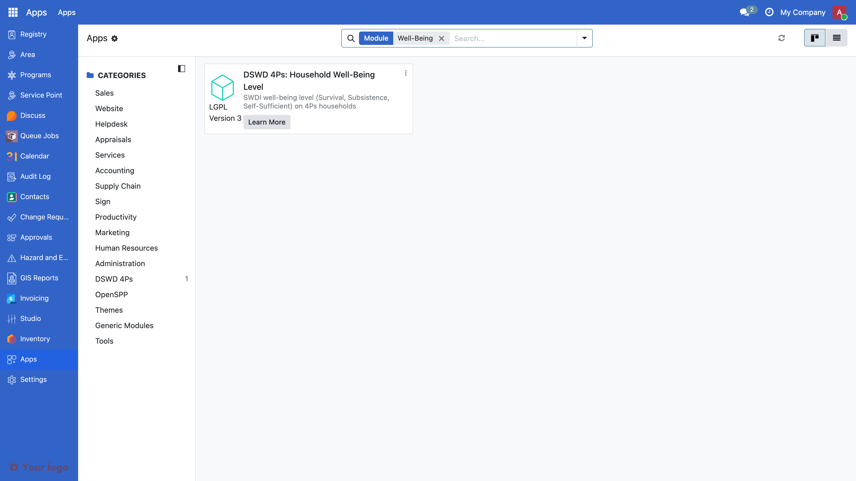
After step 0: Apps knows the module
Guide 4.3
9

Slide 10
The loop
You changed | Run
Nothing yet: a brand-new module | ./odoo-project install dswd_wellbeing
__manifest__.py, a data file, a security file, a new field, a new view record | ./odoo-project update
A Python method body | ./odoo-project restart (nothing with start --profile dev)
An existing view's XML | ./odoo-project update (nothing with start --profile dev)
A record in a noupdate="1" data file | a fresh database (stop -v -y, start, install); guide 4.4
A test | ./odoo-project test dswd_wellbeing, then read the summary line
update never installs a new module; install does. Both restart the server.
Guide 0.4
10

Slide 11
Step 1: the vocabulary
<odoo noupdate="1">
<record id="vocab_well_being_level" model="spp.vocabulary">
<field name="namespace_uri">urn:dswd:4ps:well-being-level</field>
<field name="is_system" eval="True" />
<field name="domain">social_assistance</field>
</record>
<record id="code_well_being_survival" model="spp.vocabulary.code">
<field name="vocabulary_id" ref="vocab_well_being_level" />
<field name="code">survival</field>
<field name="display">Survival</field>
<field name="target_type">group</field>
<field name="sequence">10</field>
</record>
Guide 4.4
11

Slide 12
Step 1: the vocabulary (continued)
Abridged (full file: guide 4.4): name, description and definition left out; subsistence (sequence 20) and self_sufficient (sequence 30) follow the same shape.
Predict: after update, where will the three codes show?
Guide 4.4
12

Slide 13
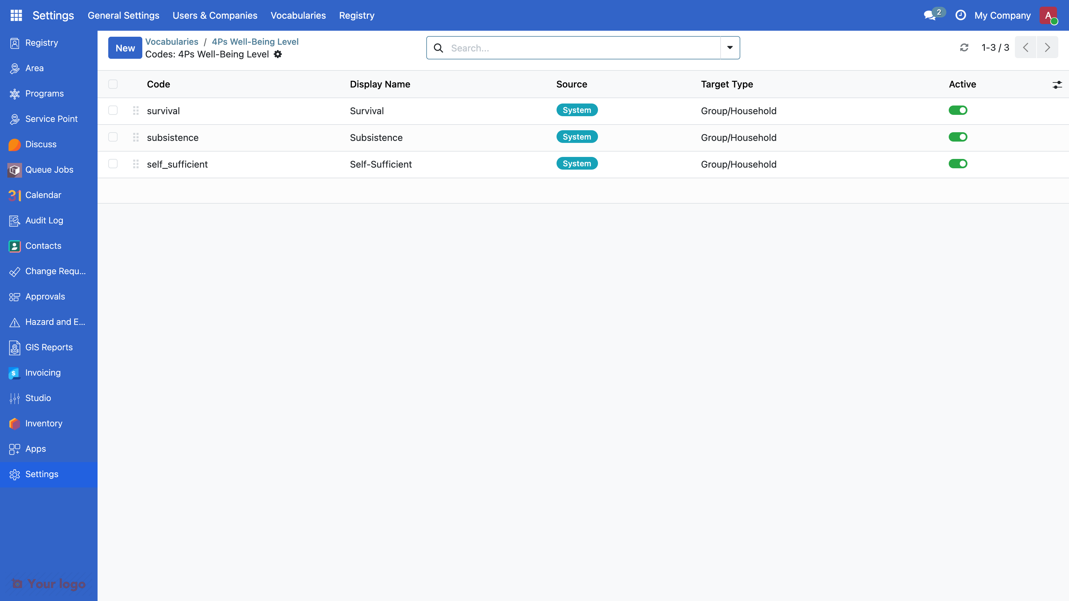
After step 1: Settings > Vocabularies
Guide 4.4
13

Slide 14
Why a vocabulary and not a Selection
# Not this
level = fields.Selection([
("1", "Survival"),
("2", "Subsistence"),
("3", "Self-Sufficient"),
])
A code list changes without a release: Settings > Vocabularies, no code change.
Deployments differ: a region can hide codes with a deployment profile.
Every code has a URI (urn:dswd:4ps:well-being-level#survival) other systems can match.
32 client statuses and 394 indigenous peoples groups do not belong in Python.
Static selections are for internal workflow states only.
Guide 4.4
14

Slide 15
Step 2: the field
from odoo import fields, models
WELL_BEING_NAMESPACE = "urn:dswd:4ps:well-being-level"
class ResPartner(models.Model):
_inherit = "res.partner"
dswd_well_being_level_id = fields.Many2one(
comodel_name="spp.vocabulary.code",
string="Well-Being Level",
domain=[("namespace_uri", "=", WELL_BEING_NAMESPACE)],
ondelete="restrict",
help="SWDI level from the latest assessment: ...",
)
Abridged: the full help text is in guide 4.5. Plus from . import res_partner in models/__init__.py. Predict: after update, what changes on screen?
Guide 4.5
15

Slide 16
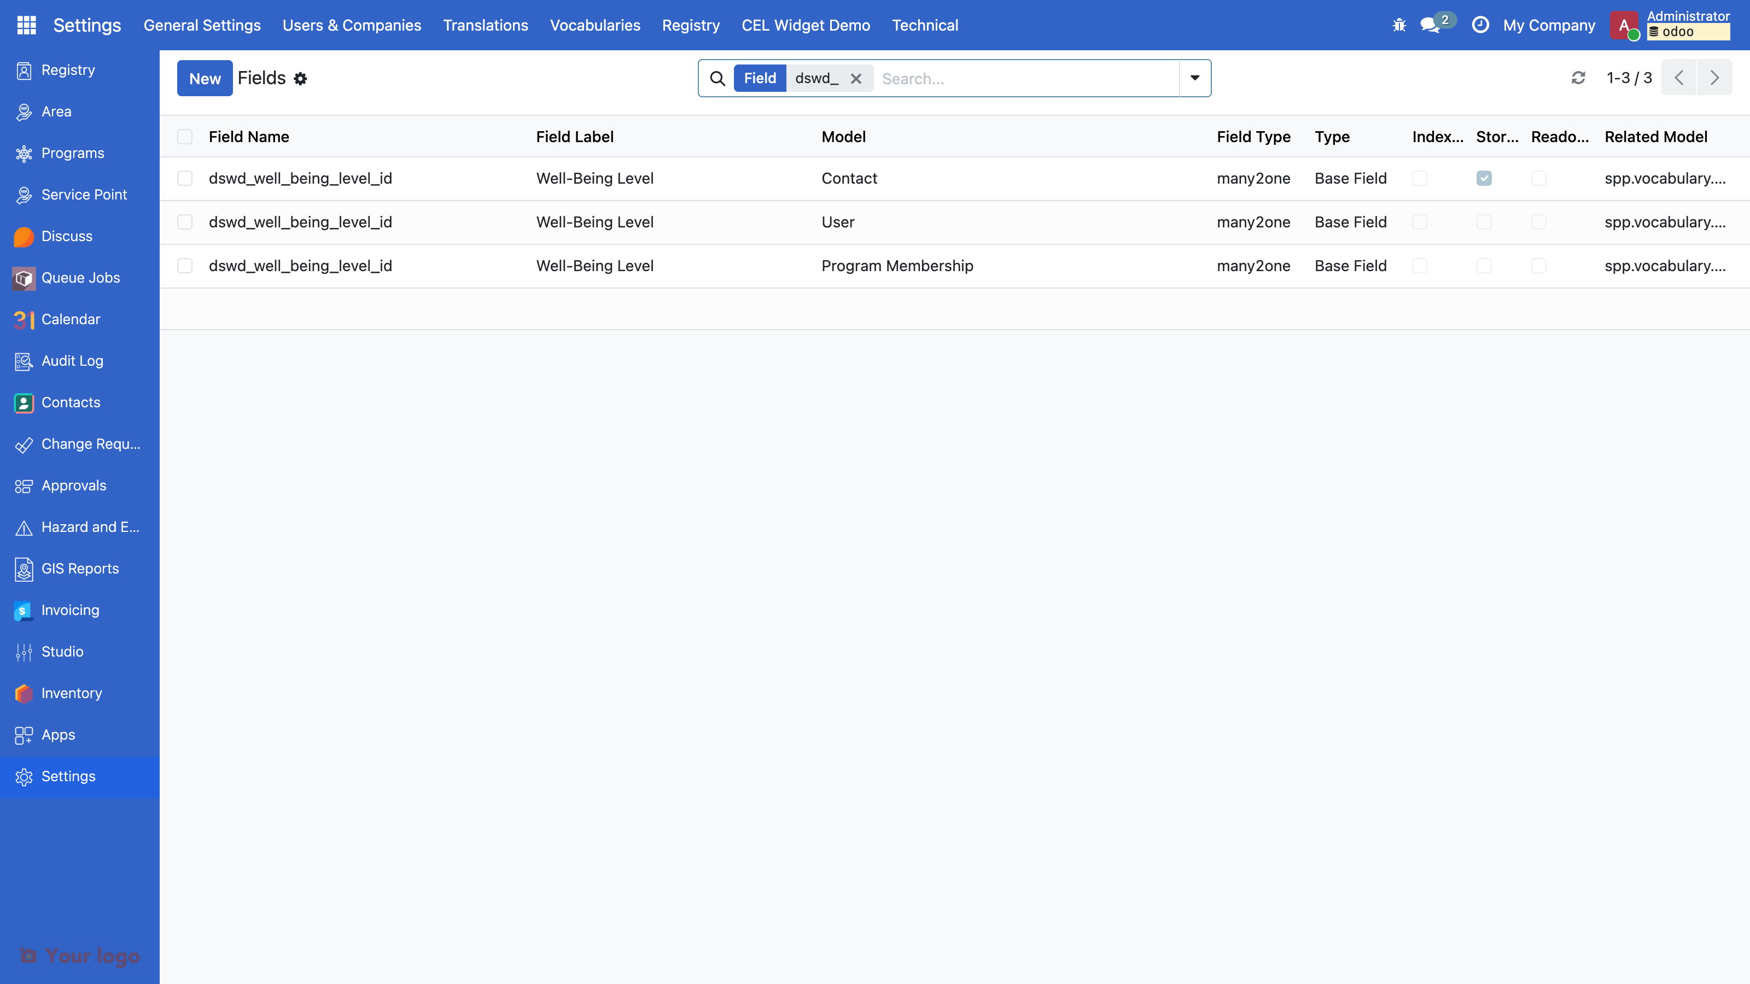
The silent failure
models/res_partner.py is perfect. update says nothing. The field is nowhere.
# models/__init__.py
from . import res_partner # <- the line that was missing
Python never imported the file, so Odoo never saw the class. Where to look: Settings > Technical > Fields, search dswd_. A field without a view is invisible, not broken.
Guide 4.5, 4.11
16

Slide 17
Step 3: the view
<field name="inherit_id" ref="spp_registry.view_individuals_form" />
<field name="arch" type="xml">
<xpath expr="//group[@name='group_tags_section']" position="after">
<group name="dswd_4ps_section" string="4Ps">
<field
name="dswd_well_being_level_id"
readonly="disabled"
options="{'no_create': True, 'no_open': True}"
/>
</group>
</xpath>
</field>
Abridged from the finished file (guide 4.7 has the whole record). Find the anchor first: search name="group_ in upstream/openspp/spp_registry/views/individual_views.xml.
Guide 4.7
17

Slide 18
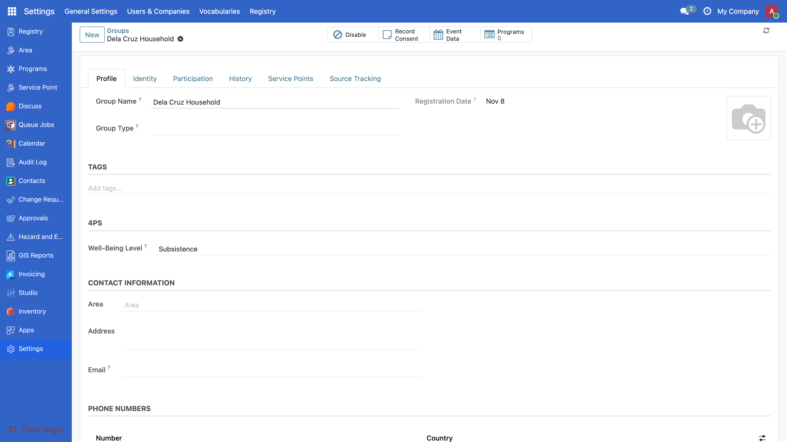
After step 3: the household Profile page
Guide 4.7
18

Slide 19
Reading an error, bottom up
ValueError: Wrong value for spp.vocabulary.domain: 'administrative'
odoo.tools.convert.ParseError: while parsing .../vocabulary_well_being_level.xml:10
odoo.tools.convert.ParseError: while parsing .../views/res_partner_views.xml:8
Element '<xpath ...>' cannot be located in parent view
Paths and the XPath shortened with ...; the full lines are in guide 4.11.
Find the first line that names a file in your module, open it there, compare it with upstream (the selection, the view). Lint passed on both: it checks shape, not meaning.
Guide 4.11
19

Slide 20
Step 4: the test
@tagged("post_install", "-at_install")
class TestHouseholdWellBeing(RegistryCommon):
def test_household_stores_a_level(self):
subsistence = self.VocabCode.get_code(NAMESPACE, "subsistence")
self.group.dswd_well_being_level_id = subsistence
self.assertEqual(self.group.dswd_well_being_level_id.display, "Subsistence")
security/ir.model.access.csv: header only. No new model, no rows; access to the field follows res.partner.
Guide 4.10, 4.9
20

Slide 21
Step 5: run the tests
$ ./odoo-project test dswd_wellbeing
========== TEST RESULTS ==========
0 failed, 0 error(s) of 5 tests
Passed: 5 | Failed: 0 | Errors: 0
Full log: .../odoo-test-logs/dswd_wellbeing_unittest_<date>_<time>.log
A Many2one domain only filters the dropdown: step 5 adds an @api.constrains so code and the API are guarded too.
Guide 4.10, 4.5
21

Slide 22
From a change to a merge
On your laptop | On GitHub
1. git switch main, git pull | 11. Open a pull request (base main)
2. git switch -c feat/... | 12. CI: pre-commit, image build, module tests
3. Test first, then code | 13. Review: a second person reads the diff
4. install or update on your stack | 14. Merge, delete the branch
5. Check the screen
6. .\odoo-project test <module>: 0 failed, 0 error(s) | Back on your laptop:
7. lint, audit-security | 15. git switch main, git pull, git branch -d feat/...
8. git add <files>, git status
9. git commit -m "feat(scope): ...": hooks run
10. git push -u origin feat/...
Guide 7.4
22

Slide 23
CI, review, merge
Every pull request to main runs pre-commit and CI: the image is built, each changed module is installed in a fresh database, its tests run, coverage must reach 85%. The first run builds the image: 10 to 25 minutes; later runs reuse the cache.
Red? Details, read the log bottom up, reproduce on your laptop with the same command, fix, push again. Never merge red.
The reviewer reads Files changed: tests that could fail, every file in the manifest, nothing under upstream/, names that follow the rules, no secrets. Comments on lines; the author pushes fixes; the reviewer approves; Merge pull request, then Delete branch.
Back on your laptop: step 15, and update if the merge changed a module on your stack.
Guide 7.4
23

Slide 24
The five mistakes
Mistake | Symptom | Look at
Data file written but not in manifest data | update clean, UI unchanged | the manifest's data list
Invalid value in a data file (domain) | ParseError in the update output, the registry fails to load | the upstream field definition
Import missing in models/__init__.py | no error, field absent; Field ... does not exist once a view uses it | Settings > Technical > Fields
Wrong XPath anchor (group_tag_section, @class=) | cannot be located in parent view | search name="group_ in the upstream view
restart instead of update, or edited noupdate data | change never shows | update; noupdate: a fresh database or a migration (4.4)
Drill time: three real excerpts, in pairs, 12 minutes.
Guide 4.11
24

Slide 25
Recap, and what comes next
Today: manifest, data, model, view, security, tests. Inherit, prefix, point at a vocabulary. Read errors bottom up. Run the tests.
Module 5 (this afternoon): the production 4Ps modules, then Claude Code.
Module 6 (Day 3): your hands on the keyboard. Before Day 3:
./odoo-project start
./odoo-project test dswd_wellbeing # 0 failed, 0 error(s) of 5 tests
No Docker? Lunch triage table today; tomorrow, pair with a working laptop.
Guide 4.1, 4.14
25

