Slide 1

Classification of Oil Wells in the DSEATS Field Using Machine Learning
Team Name: Pioneers
Team Members
Name: Udoh Chigozie M.
SPE Number: 5272808
SPE Section: Portharcourt Section
Technical Area: Data Engineering
Name: Udoh Chioma
SPE Number: 5581761
Category: Young Professional
Technical Area: Data Analysis
Name: Abdulateef Adedoyin Adeyemi
SPE Number: 4977464
SPE Section: Lagos Section
Technical Area: Reservoir Engineering
Name: Maduabuchi David
SPE Number:
Category: Young Professional
Technical Area: Data Scientist

Slide 2
Outline
Problem Overview
Research and Empirical approach to Questions asked
Brief Introduction to Machine Learning
Types of Machine Learning
Time Series Forecasting
Machine Learning Flow and Contributions
Data Cleaning
Exploratory Data Analysis (EDA)
Feature Engineering
Data Splitting
Modeling
Supervised and Unsupervised
Results

Slide 3
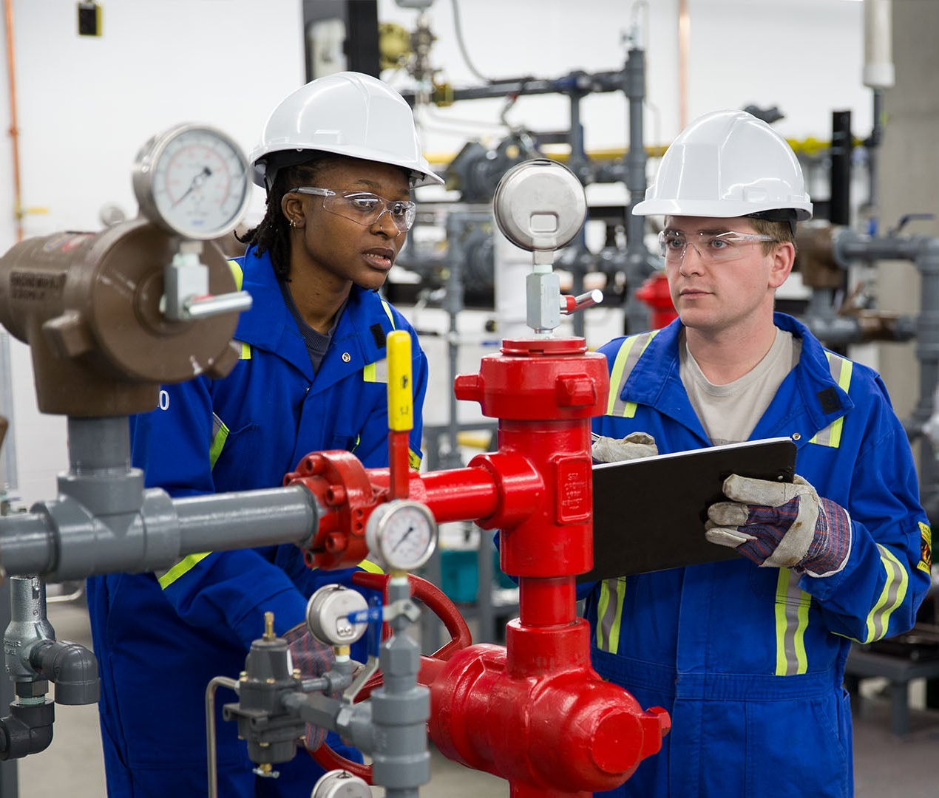
Problem Overview
Accurately classifying oil wells that produce oil, gas, and water plays a vital role in optimizing production strategies and enhancing resource management in the oil and gas industry. The objective was to implement a standard machine learning (ML) workflow to classify multiple wellbores into Reservoirs based on seven key criteria: producing reservoir, reservoir type, lift type, flow type, gas-oil ratio (GOR) trend, water cut trend, and production index trend. This approach involves leveraging reservoir characteristics, historical production data, and well-specific parameters.

Slide 4




Research and Empirical approach to Questions asked
Step 2
Study of Well and Reservoir Data
Empirical Solution
The provided reservoir and well data was examined to determine what data would be most important to the solution we needed to find.
Having arranged the data in a highly practical manner. Empirical solution for the classification were developed by applying core reservoir engineering principles. These solutions were guided by the predefined constraints and instructions that were outlined in the project expectations.
Understanding Features in the Dataset
Gained an understanding of parameters and how they influence well and reservoir classifications. E.g.
Features | Description
Total and Formation Gas production | Comparison of total gas produced and formation gas produced can give insights to type of lift.
Initial and Bubble point pressure | Comparison of initial pressure and bubble point pressure can give insights.
Step 1
Step 3

Slide 5

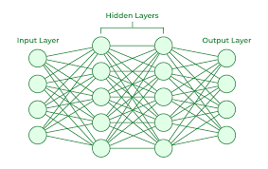
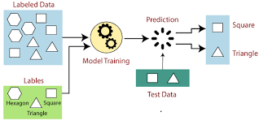

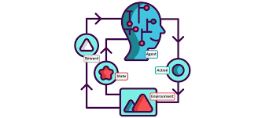
Brief Intro to Machine Learing
Machine learning is a powerful tool that enables computers to learn from data and make predictions or decisions without being explicitly programmed.
a
Subfield (Deep Learning)
1
2
3
Deep Learning is a subset of machine learning that utilizes neural networks with many layers to model and understand complex patterns in data.
Supervised Learning
Unsupervised Learning
Reinforcement Learning
Supervised learning is a machine learning approach where the model is trained on labeled data. It learns to map inputs to outputs based on example input-output pairs.
Unsupervised learning is a type of machine learning that involves training a model on data without labeled responses. This approach allows the model to discover patterns and relationships within the data on its own. It is popularly know as “Clustering”
Reinforcement Learning (RL) is a type of machine learning where an agent learns to make decisions by performing actions and receiving feedback in the form of rewards or penalties.

Slide 6
Machine Learning Flow and Contribution
OVERVIEW
Contributions
Data Cleaning
Adedoyin Adeyemi – Empirical Formulation and Calculations/Slides Prep
Udoh Chigozie – Machine Learning Modelling/Slides Prep
Udoh Chioma – Data Analysis/Slides Review
Maduabuchi David – Machine Learning Modelling
EDA
Feature Engineering
Data Splitting
Supervised Modeling
Unsupervised Modelling
Predictions

Slide 7

Machine Learning Flow
Data Cleaning and EDA
Consistency Check: All concerned columns for this check like well name had no inconsistencies.
DataType Confirmation: Comma was removed from some Numeric columns were and then they were changed to float datatype.
Handling Missing Values: There was no missing data
Duplicates Check: Involved scanning for duplicate rows. No duplicate rows were found.
Insights from EDA
Category | Insight
Date | The entire dataset spanned 2011 – 2016
Well | Gas and oil production in Mako and Jani is Similar across wells. But the water production profile is very different.

Slide 8
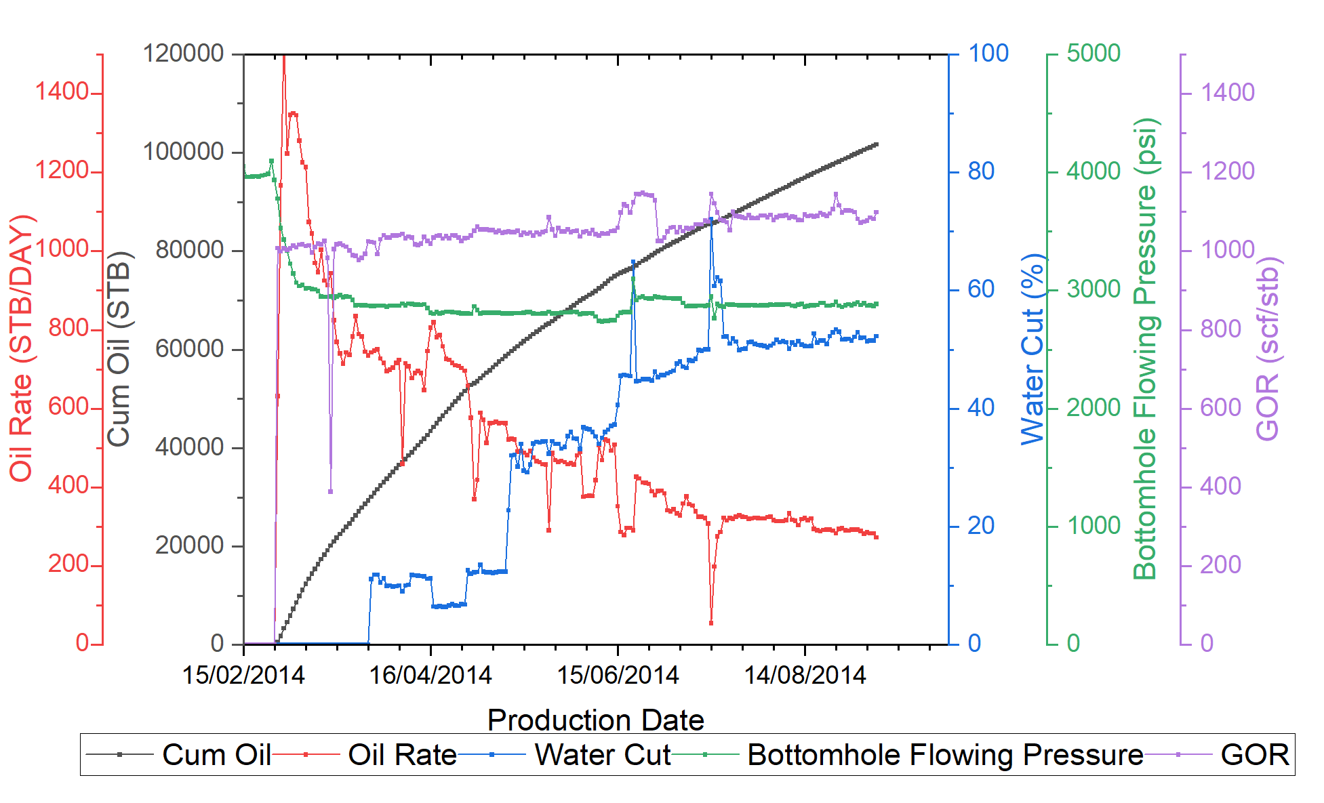
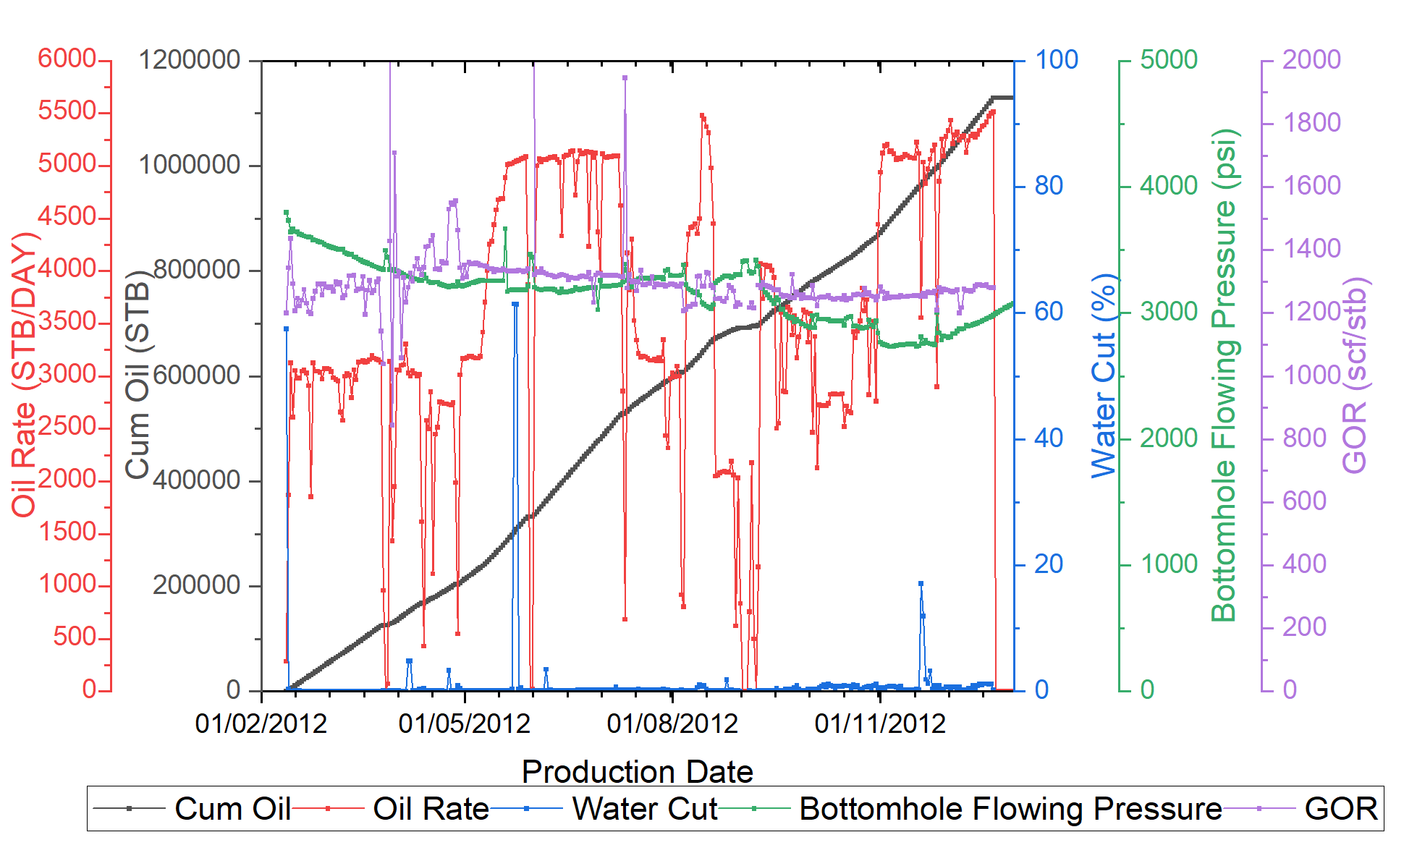
Exploratory Data Analysis
Statistical Plots for Well 1 and Well 6
Well 1 production profile Plot
Well 6 production profile Plot

Slide 9

Machine Learning Flow
Feature Engineering
In line with handling timeseries as supervised learning, the below features were engineered towards better modelling;
1. Empirical based: Features like formation GOR, and water cut were generated.
2. Time based: Year, dayofyear, day, week.
2. Lag based: 1 to 7 days lag of bottom hole psi, Anulus pressure, choke size, downhole temperature and other features were generated.
3. Rolling based: Features based on rolling average was computed.
Data Splitting
Being a timeseries problem the data was split into training and testing in a sorted way as opposed to splitting randomly in non-timeseries problems.
The last 25% for all wells were used as test data and the rest as training data.

Slide 10


Results
Prediction Results
Estimated Reservoir Oil Production in Reservoir Barrels
Modeling Approach
1. We solved empirically
2. We used the obtained label as a target and trained a supervised model to predict all 7 features
3. We attempted using an unsupervised model to cluster the data with techniques like Principal Component Analysis but it didn’t perform well (More details in notebook file)
Models Tested
KMeans
Multi Chain RandomForest Classifier (Used )
Note on Model Tuning
- There was no need for model tuning as the Feature Engineering produced good features
Reservoir Name | Oil Production
ACHI | 1,500,047
DEPU | 1,513,569
JANI | 595,545.6
KEMA | 2,701,546
MAKO | 1,111,676
Total= | 7,422,384
Model Prediction Metrics
Parameters | F1 Score | Accuracy
Reservoir Name | 0.996 | 0.997
Reservoir Type | 0.999 | 0.999
Well Type | 1 | 1
Production Type | 0.98 | 0.993
Formation GOR | 0.997 | 0.997
Water Cut | 0.953 | 0.954
Oil Productivity | 0.997 | 0.997

