Slide 1
Foundational Concepts

Slide 2
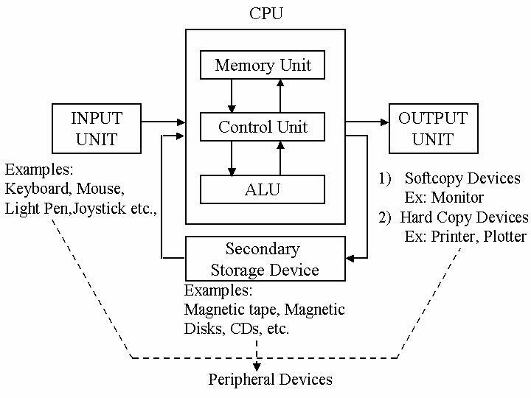
Foundational Concepts
Introduction to Computational Systems
Source: https://peda.net/kenya/ass/subjects2/computer-studies/form-1/the-computer-system/nameless-89db/bdotc#top

Slide 3
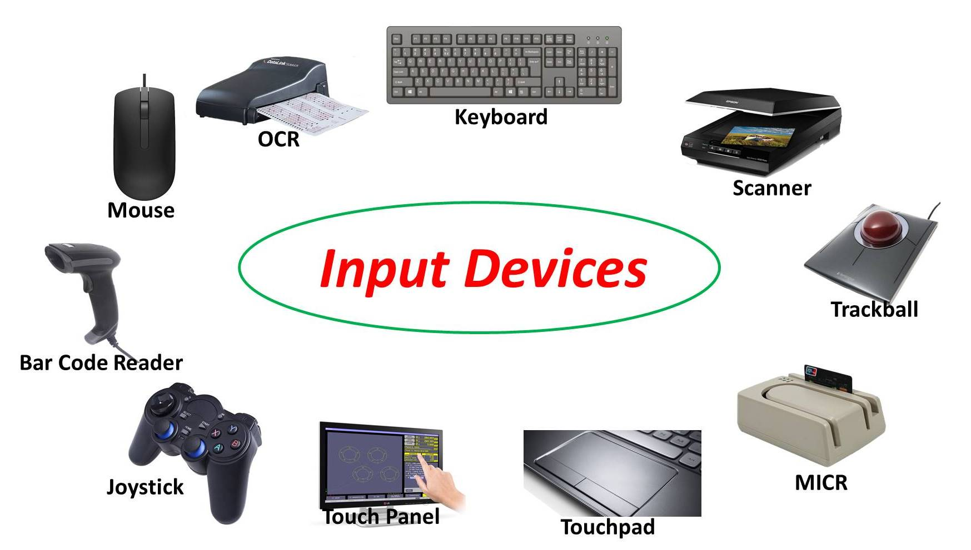
Foundational Concepts
Input Devices
Source: https://mycomputernotes.com/what-is-input-device/

Slide 4
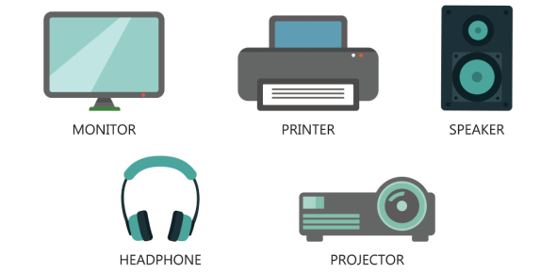
Foundational Concepts
Output Devices
Source: https://www.proprofs.com/quiz-school/story.php?title=output-device-quiz

Slide 5
Foundational Concepts
Arithmetic and Logic Unit (ALU) and Control Unit (CU)

Slide 6
Foundational Concepts
Arithmetic and Logic Unit (ALU) and Control Unit (CU)
The ALU performs all arithmetic and logic operations required by a program's instructions.

Slide 7
Foundational Concepts
Arithmetic and Logic Unit (ALU) and Control Unit (CU)
The ALU performs all arithmetic and logic operations required by a program's instructions.
The central processing unit (CU) manages sequential instruction execution, interprets instructions, and directs data flow through the computer's memory, ALU, and input/output devices.

Slide 8
Foundational Concepts
Types of Memory

Slide 9
Foundational Concepts
Types of Memory
Primary Memory

Slide 10
Foundational Concepts
Types of Memory
Primary Memory
Secondary Memory

Slide 11
Foundational Concepts
Primary Memory
A computer system cannot function without primary memory. Before processing, the program and data are loaded into primary memory.

Slide 12
Foundational Concepts
Primary Memory
A computer system cannot function without primary memory. Before processing, the program and data are loaded into primary memory.
To perform read or write operations, the CPU communicates directly with the primary memory.

Slide 13
Foundational Concepts
Primary Memory
A computer system cannot function without primary memory. Before processing, the program and data are loaded into primary memory.
To perform read or write operations, the CPU communicates directly with the primary memory.
It is classified into two types: random access memory (RAM) and read-only memory (ROM) .

Slide 14
Foundational Concepts
Primary Memory
A computer system cannot function without primary memory. Before processing, the program and data are loaded into primary memory.
To perform read or write operations, the CPU communicates directly with the primary memory.
It is classified into two types: random access memory (RAM) and read-only memory (ROM) .
RAM is volatile, which means that it retains the data it contains as long as the computer is powered on.

Slide 15
Foundational Concepts
Primary Memory
A computer system cannot function without primary memory. Before processing, the program and data are loaded into primary memory.
To perform read or write operations, the CPU communicates directly with the primary memory.
It is classified into two types: random access memory (RAM) and read-only memory (ROM) .
RAM is volatile, which means that it retains the data it contains as long as the computer is powered on.
However, as soon as the power supply is turned off, the contents of RAM are erased.

Slide 16
Foundational Concepts
Primary Memory
It is used to temporarily store data while the computer is operating.

Slide 17
Foundational Concepts
Primary Memory
It is used to temporarily store data while the computer is operating.
The required program and data are loaded into RAM for processing whenever the computer is started or a software application is launched.

Slide 18
Foundational Concepts
Primary Memory
It is used to temporarily store data while the computer is operating.
The required program and data are loaded into RAM for processing whenever the computer is started or a software application is launched.
RAM is also known as main memory, and it is faster than secondary memory or storage devices.

Slide 19
Foundational Concepts
Primary Memory
It is used to temporarily store data while the computer is operating.
The required program and data are loaded into RAM for processing whenever the computer is started or a software application is launched.
RAM is also known as main memory, and it is faster than secondary memory or storage devices.
ROM, on the other hand, is non-volatile, which means that its contents are preserved even when the power is turned off.

Slide 20
Foundational Concepts
Primary Memory
It is used to temporarily store data while the computer is operating.
The required program and data are loaded into RAM for processing whenever the computer is started or a software application is launched.
RAM is also known as main memory, and it is faster than secondary memory or storage devices.
ROM, on the other hand, is non-volatile, which means that its contents are preserved even when the power is turned off.
It is used as a small but faster permanent storage for rarely changed contents.

Slide 21
Foundational Concepts
Primary Memory
It is used to temporarily store data while the computer is operating.
The required program and data are loaded into RAM for processing whenever the computer is started or a software application is launched.
RAM is also known as main memory, and it is faster than secondary memory or storage devices.
ROM, on the other hand, is non-volatile, which means that its contents are preserved even when the power is turned off.
It is used as a small but faster permanent storage for rarely changed contents.
The startup program (boot loader), for example, that loads the operating system into primary memory is stored in ROM.

Slide 22
Foundational Concepts
Secondary Memory
Primary memory has a limited storage capacity and can be volatile (RAM) or read-only (ROM) (ROM).

Slide 23
Foundational Concepts
Secondary Memory
Primary memory has a limited storage capacity and can be volatile (RAM) or read-only (ROM) (ROM).
As a result, a computer system requires auxiliary or secondary memory to store data or instructions for future use.

Slide 24
Foundational Concepts
Secondary Memory
Primary memory has a limited storage capacity and can be volatile (RAM) or read-only (ROM) (ROM).
As a result, a computer system requires auxiliary or secondary memory to store data or instructions for future use.
Secondary memory is non-volatile and has a larger capacity than primary memory.

Slide 25
Foundational Concepts
Secondary Memory
Primary memory has a limited storage capacity and can be volatile (RAM) or read-only (ROM) (ROM).
As a result, a computer system requires auxiliary or secondary memory to store data or instructions for future use.
Secondary memory is non-volatile and has a larger capacity than primary memory.
It is slower and less expensive than main memory. However, the CPU cannot directly access it.

Slide 26
Foundational Concepts
Secondary Memory
Primary memory has a limited storage capacity and can be volatile (RAM) or read-only (ROM) (ROM).
As a result, a computer system requires auxiliary or secondary memory to store data or instructions for future use.
Secondary memory is non-volatile and has a larger capacity than primary memory.
It is slower and less expensive than main memory. However, the CPU cannot directly access it.
Secondary storage contents must first be brought into main memory for the CPU to access. Secondary memory devices include Hard Disk Drives (HDD), CD/DVDs, Memory Cards, and so on.

Slide 27
Foundational Concepts
Secondary Memory
However, secondary storage devices such as SSD now support very fast data transfer speeds when compared to earlier HDDs.

Slide 28
Foundational Concepts
Secondary Memory
However, secondary storage devices such as SSD now support very fast data transfer speeds when compared to earlier HDDs.
Furthermore, the availability of small and portable flash or pen drives has made data transfer between computers easier and simpler.

Slide 29
Foundational Concepts
Problem Formulation
The process of defining the scope of a problem, formulating one or more specific questions about it, and establishing the assessment methods required to address the questions is known as problem formulation.
https://www.ncbi.nlm.nih.gov/books/NBK552813/

Slide 30
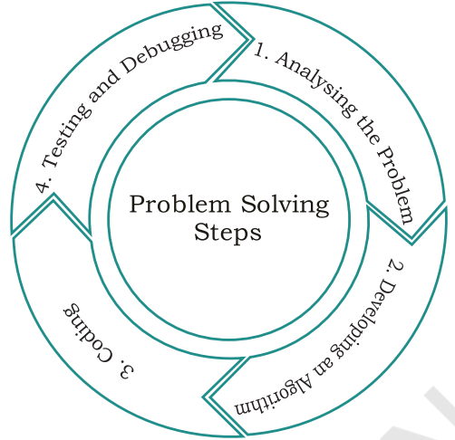
Foundational Concepts
Problem Solving

Slide 31
Foundational Concepts
Problem Solving
Analyzing the problem
It is critical to fully comprehend a problem before attempting to solve it.

Slide 32
Foundational Concepts
Problem Solving
Analyzing the problem
It is critical to fully comprehend a problem before attempting to solve it.
If we are unclear about the problem to be solved, we may end up developing a program that does not achieve our goal.

Slide 33
Foundational Concepts
Problem Solving
Analyzing the problem
It is critical to fully comprehend a problem before attempting to solve it.
If we are unclear about the problem to be solved, we may end up developing a program that does not achieve our goal.
As a result, we must carefully read and analyze the problem statement in order to identify the main components of the problem and determine the core functionalities that our solution should have.

Slide 34
Foundational Concepts
Problem Solving
Analyzing the problem
It is critical to fully comprehend a problem before attempting to solve it.
If we are unclear about the problem to be solved, we may end up developing a program that does not achieve our goal.
As a result, we must carefully read and analyze the problem statement in order to identify the main components of the problem and determine the core functionalities that our solution should have.
We would be able to figure out what inputs our program should accept and what outputs it should produce by analyzing a problem.

Slide 35
Foundational Concepts
Problem Solving
Developing an algorithm
Before writing program code to solve a problem, it is necessary to devise a solution.

Slide 36
Foundational Concepts
Problem Solving
Developing an algorithm
Before writing program code to solve a problem, it is necessary to devise a solution.
The solution is expressed in natural language and is referred to as an algorithm.

Slide 37
Foundational Concepts
Problem Solving
Developing an algorithm
Before writing program code to solve a problem, it is necessary to devise a solution.
The solution is expressed in natural language and is referred to as an algorithm.
We can think of an algorithm as a very well-written recipe for a dish, with clearly defined steps that, if followed, will result in the dish being prepared.

Slide 38
Foundational Concepts
Problem Solving
Developing an algorithm
Before writing program code to solve a problem, it is necessary to devise a solution.
The solution is expressed in natural language and is referred to as an algorithm.
We can think of an algorithm as a very well-written recipe for a dish, with clearly defined steps that, if followed, will result in the dish being prepared.
We begin with a rough solution plan and keep refining the algorithm until it can capture all aspects of the desired solution.

Slide 39
Foundational Concepts
Problem Solving
Developing an algorithm
Before writing program code to solve a problem, it is necessary to devise a solution.
The solution is expressed in natural language and is referred to as an algorithm.
We can think of an algorithm as a very well-written recipe for a dish, with clearly defined steps that, if followed, will result in the dish being prepared.
We begin with a rough solution plan and keep refining the algorithm until it can capture all aspects of the desired solution.
There may be more than one algorithm for a given problem, and we must choose the best one.

Slide 40
Foundational Concepts
Problem Solving
Coding
After we have finalized the algorithm, we must convert it into a format that the computer can understand in order to generate the desired solution.

Slide 41
Foundational Concepts
Problem Solving
Coding
After we have finalized the algorithm, we must convert it into a format that the computer can understand in order to generate the desired solution.
A program can be written in a variety of high-level programming languages.

Slide 42
Foundational Concepts
Problem Solving
Coding
After we have finalized the algorithm, we must convert it into a format that the computer can understand in order to generate the desired solution.
A program can be written in a variety of high-level programming languages.
It is equally important to record the details of the coding procedures followed and document the solution.

Slide 43
Foundational Concepts
Problem Solving
Coding
After we have finalized the algorithm, we must convert it into a format that the computer can understand in order to generate the desired solution.
A program can be written in a variety of high-level programming languages.
It is equally important to record the details of the coding procedures followed and document the solution.
This is useful when returning to the programs later.

Slide 44
Foundational Concepts
Problem Solving
Testing and Debugging
The created program should be tested on various parameters.

Slide 45
Foundational Concepts
Problem Solving
Testing and Debugging
The created program should be tested on various parameters.
The program must meet the needs of the user. It must respond within the time frame specified. It should produce correct results for all possible input. There will be no output if there are syntactical errors.

Slide 46
Foundational Concepts
Problem Solving
Testing and Debugging
The created program should be tested on various parameters.
The program must meet the needs of the user. It must respond within the time frame specified. It should produce correct results for all possible input. There will be no output if there are syntactical errors.
If the output is incorrect, the program should be checked for logical errors, if any exist.

Slide 47
Foundational Concepts
Problem Solving
Testing and Debugging
The created program should be tested on various parameters.
The program must meet the needs of the user. It must respond within the time frame specified. It should produce correct results for all possible input. There will be no output if there are syntactical errors.
If the output is incorrect, the program should be checked for logical errors, if any exist.
When developing complex applications, the software industry uses standardized testing methods such as unit or component testing, integration testing, system testing, and acceptance testing.

Slide 48
Foundational Concepts
Problem Solving
Testing and Debugging
The created program should be tested on various parameters.
The program must meet the needs of the user. It must respond within the time frame specified. It should produce correct results for all possible input. There will be no output if there are syntactical errors.
If the output is incorrect, the program should be checked for logical errors, if any exist.
When developing complex applications, the software industry uses standardized testing methods such as unit or component testing, integration testing, system testing, and acceptance testing.
This is done to ensure that the software meets all of the business and technical requirements and functions properly.

Slide 49
Foundational Concepts
Problem Solving
Testing and Debugging
The created program should be tested on various parameters.
The program must meet the needs of the user. It must respond within the time frame specified. It should produce correct results for all possible input. There will be no output if there are syntactical errors.
If the output is incorrect, the program should be checked for logical errors, if any exist.
When developing complex applications, the software industry uses standardized testing methods such as unit or component testing, integration testing, system testing, and acceptance testing.
This is done to ensure that the software meets all of the business and technical requirements and functions properly.
The errors or defects discovered during the testing phases are debugged or corrected, and the program is tested again.

Slide 50
Foundational Concepts
Problem Solving
Testing and Debugging
This process is repeated until all errors have been removed from the program.

Slide 51
Foundational Concepts
Problem Solving
Testing and Debugging
This process is repeated until all errors have been removed from the program.
After the software application has been developed, tested, and delivered to the user, problems with functionality may arise and must be resolved from time to time.

Slide 52
Foundational Concepts
Problem Solving
Testing and Debugging
This process is repeated until all errors have been removed from the program.
After the software application has been developed, tested, and delivered to the user, problems with functionality may arise and must be resolved from time to time.
Thus, solution maintenance entails resolving problems encountered by users, responding to user inquiries, and even serving requests for feature addition or modification.

Slide 53
Foundational Concepts
Intelligence vs Artificial Intelligence
Artificial Intelligence tries to create computers that can replicate human behavior and do human-like tasks, whereas Human Intelligence aims to adapt to new surroundings by combining various cognitive processes.
Machines are digital, whereas the human brain is analogue.
The brain's computational capacity, memory, and ability to reason are used by humans, but AI-powered computers rely on data and particular instructions provided into the system.

Slide 54
Foundational Concepts
Intelligence vs Artificial Intelligence
Artificial Intelligence tries to create computers that can replicate human behavior and do human-like tasks, whereas Human Intelligence aims to adapt to new surroundings by combining various cognitive processes.
Source: https://www.upgrad.com/blog/ai-vs-human-intelligence

Slide 55
Foundational Concepts
Intelligence vs Artificial Intelligence
Artificial Intelligence tries to create computers that can replicate human behavior and do human-like tasks, whereas Human Intelligence aims to adapt to new surroundings by combining various cognitive processes.
Machines are digital, whereas the human brain is analogue.
Source: https://www.upgrad.com/blog/ai-vs-human-intelligence

Slide 56
Foundational Concepts
Intelligence vs Artificial Intelligence
Artificial Intelligence tries to create computers that can replicate human behavior and do human-like tasks, whereas Human Intelligence aims to adapt to new surroundings by combining various cognitive processes.
Machines are digital, whereas the human brain is analogue.
The brain's computational capacity, memory, and ability to reason are used by humans, but AI-powered computers rely on data and particular instructions provided into the system.
Source: https://www.upgrad.com/blog/ai-vs-human-intelligence

Slide 57
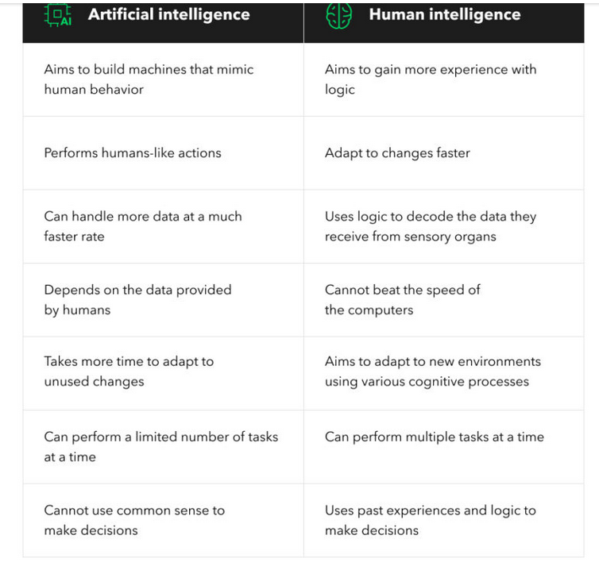

Slide 58
History of AI
1941- The initial computer. Even to run a single program, they need to do many connections and it is used to be a complex task to do.
1943- First work recognized by Warren Mcculloch and Walter Pits. Proposed a model of AI neuron.
1949-Donald Hebb- update and modify connection strength between neurons called Hebbian learning.
1950- Alan Turing proposed a test “computing machinery and intelligence” test to check machine ability by human intelligence.

Slide 59
History of AI
1956- Birth of AI Darth Mouth Conference adopt the word Artificial Intelligence by American scientist (John Mccarthy)
1966- Joseph Weizen Baum- first chatbot Eliza( researchers were developing algorithm which can solve mathematical problems.
1972- First intelligent humanoid robot WABOT-1 made in Japan.
1980- AI come back with Expert system. They are program with decision making abilities. Ex: Mycin and Dendral.

Slide 60
History of AI
1997- IBM deep blue beat world chess champion (Gary Kasparow)
2002- AI entered in home in the form of Roomba, a vacuum cleaner.
2006-AI in business world, company like facebook, twitter etc.
2011-IBM Watson won jeopardy (a quiz show), it can solve complex question and riddles.
2012- Google launched android app “Google now” which can provide information to the user as a prediction
2014-chatbot Eugene Gostman won a competition in the turing test.
After that with the fifth generation of computers AI came in full swing and many AI based applications were developed like Alexa, Siri and Cortana etc.

Slide 61
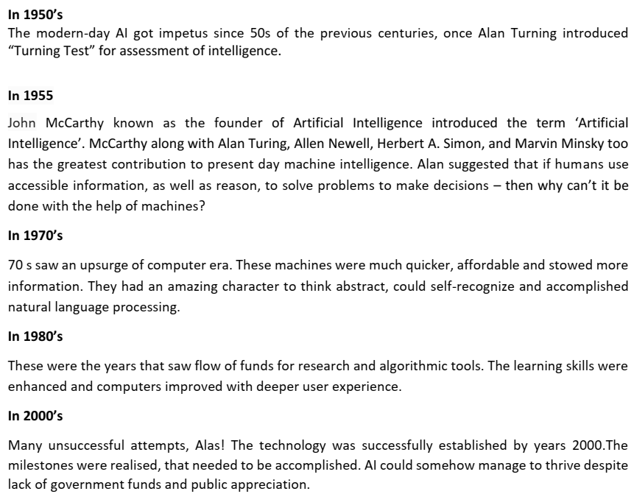
Foundational Concepts
History of Artificial Intelligence
Source: AI Curriculum Handbook

Slide 62
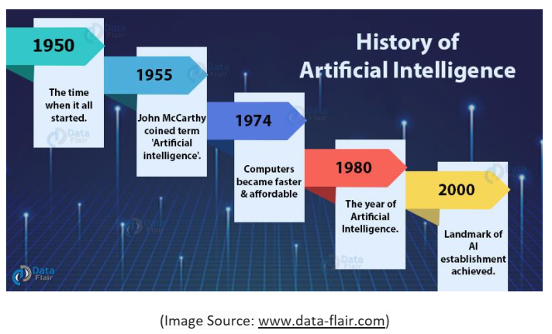
Foundational Concepts
History of Artificial Intelligence
Source: AI Curriculum Handbook

Slide 63
Recent AI Based Tools
Solves anything- ChatGPT
Writes anything Copy.AI
Create art Midjourney
Create ppt- Tome.app
Create music- soundraw.io
Create videos Kaiber
Create 3D GIFs-Leiapix converter
Create reels- fliki
Notetaking- Fireflies
Edit videos-Runway
Create avatars-Anime AI

Slide 64
Foundational Concepts
Data vs Information vs Knowledge
Data

Slide 65
Foundational Concepts
Data vs Information vs Knowledge
Data
Raw facts
Structured or unstructured
Example: It is raining

Slide 66
Foundational Concepts
Data vs Information vs Knowledge
Information

Slide 67
Foundational Concepts
Data vs Information vs Knowledge
Information
When we establish relationship between data, they become information
Example: When humidity went high, it started raining.

Slide 68
Foundational Concepts
Data vs Information vs Knowledge
Knowledge

Slide 69
Foundational Concepts
Data vs Information vs Knowledge
Knowledge
Knowledge is patterns in data
Example: When humidity is high and it is gloomy, it rains

Slide 70
Disclaimer
Content of this presentation is not original and it has been prepared from various sources for teaching purpose.

