Slide 1
Data Exploration

Slide 2
Data Exploration
Types of Data

Slide 3
Data Exploration
Types of Data
Structured Data
Unstructured Data
Semi Structured Data

Slide 4
Types of Data
Structured Data
Source: https://k21academy.com/microsoft-azure/dp-900/structured-data-vs-unstructured-data-vs-semi-structured-data/

Slide 5
Types of Data
Structured Data
Structured data is typically tabular data represented in a database by columns and rows.
Source: https://k21academy.com/microsoft-azure/dp-900/structured-data-vs-unstructured-data-vs-semi-structured-data/

Slide 6
Types of Data
Structured Data
Structured data is typically tabular data represented in a database by columns and rows.
Databases that hold tables in this form are called relational databases.
Source: https://k21academy.com/microsoft-azure/dp-900/structured-data-vs-unstructured-data-vs-semi-structured-data/

Slide 7
Types of Data
Structured Data
Structured data is typically tabular data represented in a database by columns and rows.
Databases that hold tables in this form are called relational databases.
The mathematical term "relation" refers to a structured set of data stored as a table.
Source: https://k21academy.com/microsoft-azure/dp-900/structured-data-vs-unstructured-data-vs-semi-structured-data/

Slide 8
Types of Data
Structured Data
Structured data is typically tabular data represented in a database by columns and rows.
Databases that hold tables in this form are called relational databases.
The mathematical term "relation" refers to a structured set of data stored as a table.
Each row in a table in structured data has the same set of columns.
Source: https://k21academy.com/microsoft-azure/dp-900/structured-data-vs-unstructured-data-vs-semi-structured-data/

Slide 9
Types of Data
Structured Data
Structured data is typically tabular data represented in a database by columns and rows.
Databases that hold tables in this form are called relational databases.
The mathematical term "relation" refers to a structured set of data stored as a table.
Each row in a table in structured data has the same set of columns.
SQL (Structured Query Language) programming language used for structured data.
Source: https://k21academy.com/microsoft-azure/dp-900/structured-data-vs-unstructured-data-vs-semi-structured-data/

Slide 10
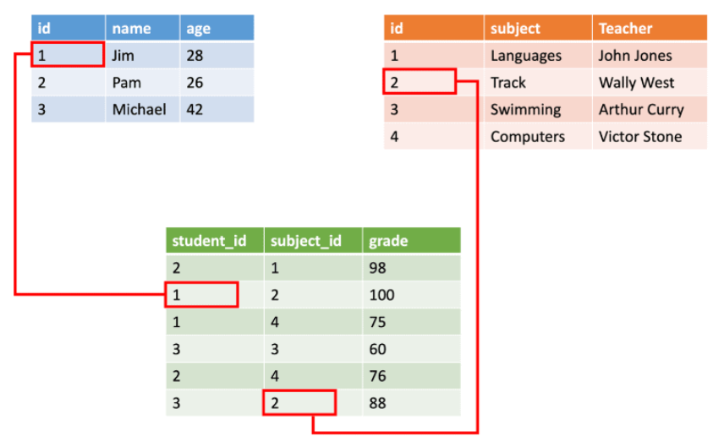
Types of Data
Structured Data
Source: https://k21academy.com/microsoft-azure/dp-900/structured-data-vs-unstructured-data-vs-semi-structured-data/

Slide 11
Types of Data
Semi Structured Data
Source: https://k21academy.com/microsoft-azure/dp-900/structured-data-vs-unstructured-data-vs-semi-structured-data/

Slide 12
Types of Data
Semi Structured Data
Semi-structured data is information that lacks the structure of structured data (relational databases), but still has some structure.
Source: https://k21academy.com/microsoft-azure/dp-900/structured-data-vs-unstructured-data-vs-semi-structured-data/

Slide 13
Types of Data
Semi Structured Data
Semi-structured data is information that lacks the structure of structured data (relational databases), but still has some structure.
One of the examples of semi-structured data is JavaScript Object Notation (JSON) objects.
Source: https://k21academy.com/microsoft-azure/dp-900/structured-data-vs-unstructured-data-vs-semi-structured-data/

Slide 14
Types of Data
Semi Structured Data
Semi-structured data is information that lacks the structure of structured data (relational databases), but still has some structure.
One of the examples of semi-structured data is JavaScript Object Notation (JSON) objects.
Semi structured data also includes key-value stores and graph databases.
Source: https://k21academy.com/microsoft-azure/dp-900/structured-data-vs-unstructured-data-vs-semi-structured-data/

Slide 15
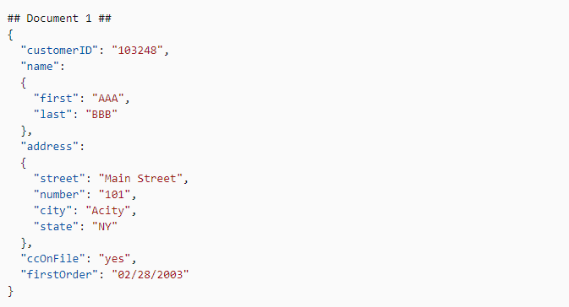
Types of Data
Semi Structured Data
Source: https://k21academy.com/microsoft-azure/dp-900/structured-data-vs-unstructured-data-vs-semi-structured-data/

Slide 16
Types of Data
Unstructured Data
Source: https://k21academy.com/microsoft-azure/dp-900/structured-data-vs-unstructured-data-vs-semi-structured-data/

Slide 17
Types of Data
Unstructured Data
Unstructured data is information that either is not organized in a pre-defined manner or do not have a pre-defined data model.
Source: https://k21academy.com/microsoft-azure/dp-900/structured-data-vs-unstructured-data-vs-semi-structured-data/

Slide 18
Types of Data
Unstructured Data
Unstructured data is information that either is not organized in a pre-defined manner or do not have a pre-defined data model.
Unstructured information is a collection of text-heavy data that may also include numbers, dates, and facts.
Source: https://k21academy.com/microsoft-azure/dp-900/structured-data-vs-unstructured-data-vs-semi-structured-data/

Slide 19
Types of Data
Unstructured Data
Unstructured data is information that either is not organized in a pre-defined manner or do not have a pre-defined data model.
Unstructured information is a collection of text-heavy data that may also include numbers, dates, and facts.
Videos, audio, and binary data files may or may not be structured. They are classified as unstructured data.
Source: https://k21academy.com/microsoft-azure/dp-900/structured-data-vs-unstructured-data-vs-semi-structured-data/

Slide 20
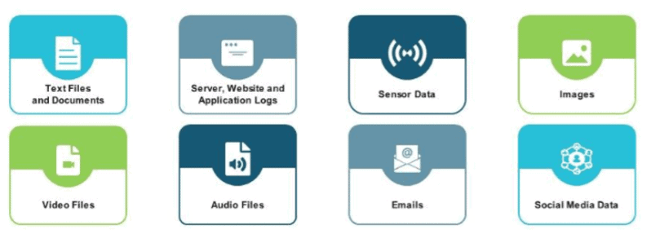
Types of Data
Unstructured Data
Source: https://k21academy.com/microsoft-azure/dp-900/structured-data-vs-unstructured-data-vs-semi-structured-data/

Slide 21
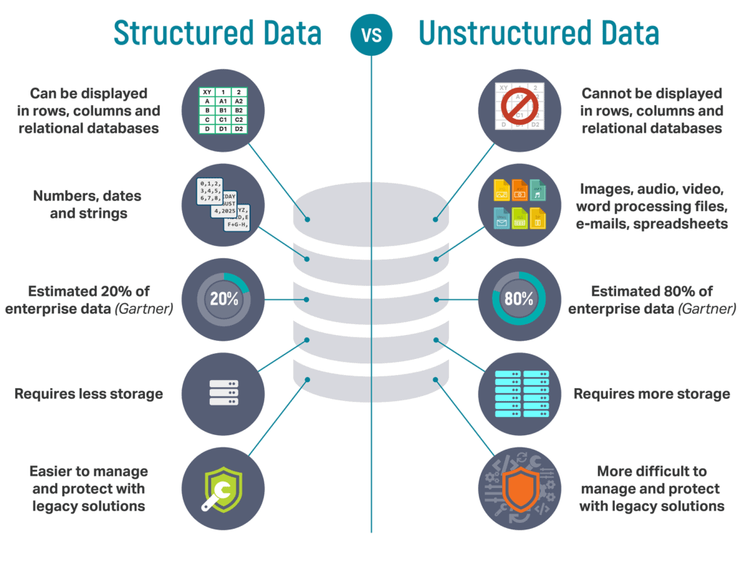
Types of Data
Structured Data vs Unstructured Data
Source: https://k21academy.com/microsoft-azure/dp-900/structured-data-vs-unstructured-data-vs-semi-structured-data/

Slide 22
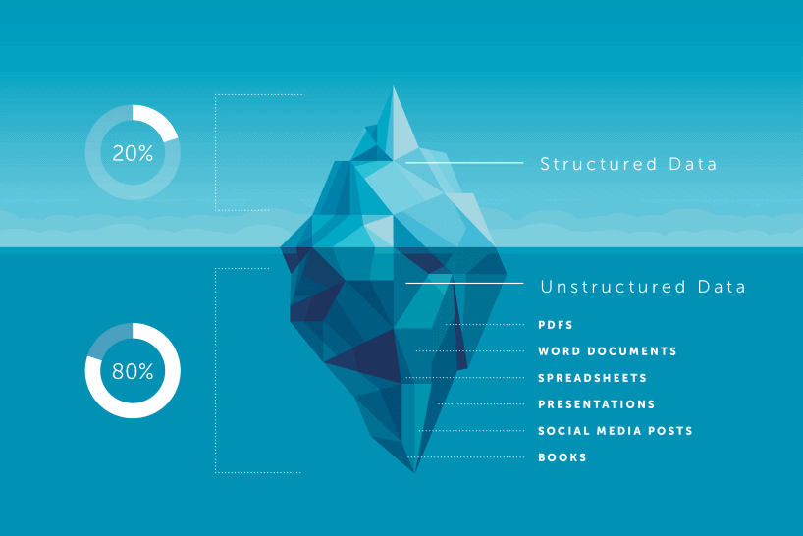
Types of Data
Structured Data vs Unstructured Data
Source: https://k21academy.com/microsoft-azure/dp-900/structured-data-vs-unstructured-data-vs-semi-structured-data/

Slide 23
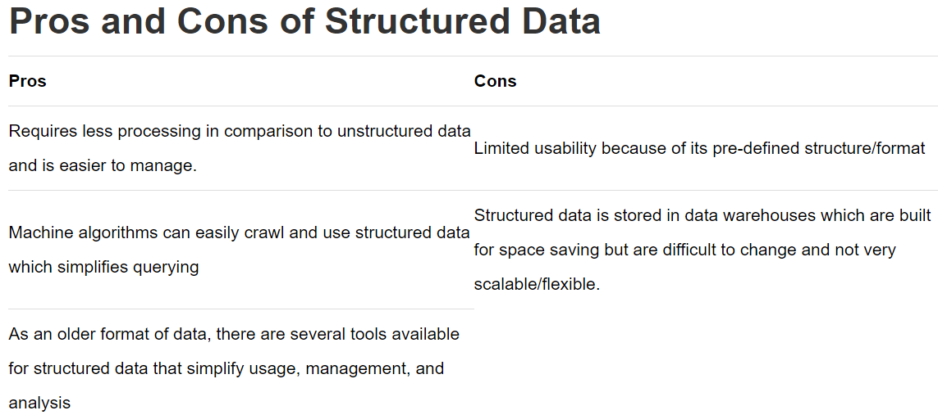
Types of Data
Structured Data vs Unstructured Data
Source: https://k21academy.com/microsoft-azure/dp-900/structured-data-vs-unstructured-data-vs-semi-structured-data/

Slide 24
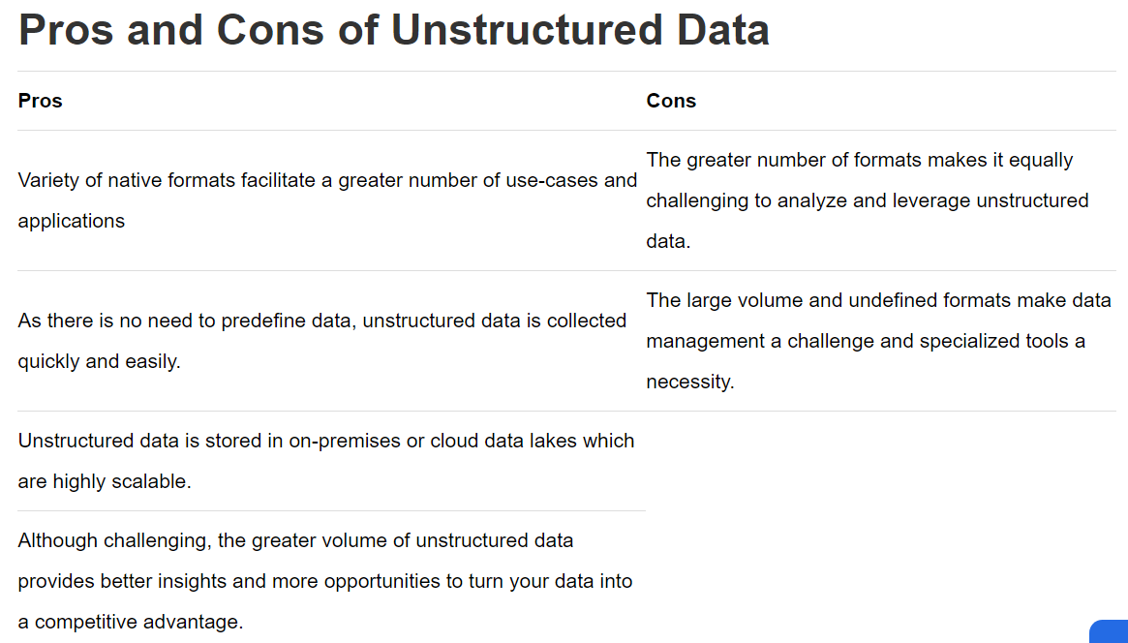
Types of Data
Structured Data vs Unstructured Data
Source: https://k21academy.com/microsoft-azure/dp-900/structured-data-vs-unstructured-data-vs-semi-structured-data/

Slide 25
Data Collection Methods
Source: https://www.jotform.com/data-collection-methods/

Slide 26
Data Collection Methods
Interviews
Questionnaires and surveys
Observations
Documents and records
Focus groups
Oral histories
Sensors
Open Public Government Portals
Reliable Websites (e.g. Kaggle)
World Organizations’ public statistical websites
Source: https://www.jotform.com/data-collection-methods/

Slide 27
Handling Missing Values
Source: Data Mining-Concepts and Techniques, Jiawei Han, Micheline Kamber, and Jian Pei, Morgan Kaufmann

Slide 28
Handling Missing Values
Ignore the tuple
Source: Data Mining-Concepts and Techniques, Jiawei Han, Micheline Kamber, and Jian Pei, Morgan Kaufmann

Slide 29
Handling Missing Values
Ignore the tuple
This method is not very effective, unless the tuple contains several attributes with missing values.
Source: Data Mining-Concepts and Techniques, Jiawei Han, Micheline Kamber, and Jian Pei, Morgan Kaufmann

Slide 30
Handling Missing Values
Ignore the tuple
This method is not very effective, unless the tuple contains several attributes with missing values.
It is especially poor when the percentage of missing values per attribute varies considerably.
Source: Data Mining-Concepts and Techniques, Jiawei Han, Micheline Kamber, and Jian Pei, Morgan Kaufmann

Slide 31
Handling Missing Values
Fill in the missing value manually
Source: Data Mining-Concepts and Techniques, Jiawei Han, Micheline Kamber, and Jian Pei, Morgan Kaufmann

Slide 32
Handling Missing Values
Fill in the missing value manually
In general, this approach is time-consuming and may not be feasible given a large data set with many missing values.
Source: Data Mining-Concepts and Techniques, Jiawei Han, Micheline Kamber, and Jian Pei, Morgan Kaufmann

Slide 33
Handling Missing Values
Use a global constant to fill in the missing value
Source: Data Mining-Concepts and Techniques, Jiawei Han, Micheline Kamber, and Jian Pei, Morgan Kaufmann

Slide 34
Handling Missing Values
Use a global constant to fill in the missing value
Replace all missing attribute values by the same constant, such as a label like “Unknown” or −∞.
Source: Data Mining-Concepts and Techniques, Jiawei Han, Micheline Kamber, and Jian Pei, Morgan Kaufmann

Slide 35
Handling Missing Values
Use a global constant to fill in the missing value
Replace all missing attribute values by the same constant, such as a label like “Unknown” or −∞.
If missing values are replaced by, say, “Unknown,” then the algorithm may mistakenly think that they form an interesting concept, since they all have a value in common—that of “Unknown.”
Source: Data Mining-Concepts and Techniques, Jiawei Han, Micheline Kamber, and Jian Pei, Morgan Kaufmann

Slide 36
Handling Missing Values
Use a global constant to fill in the missing value
Replace all missing attribute values by the same constant, such as a label like “Unknown” or −∞.
If missing values are replaced by, say, “Unknown,” then the algorithm may mistakenly think that they form an interesting concept, since they all have a value in common—that of “Unknown.”
Hence, although this method is simple, it is not foolproof.
Source: Data Mining-Concepts and Techniques, Jiawei Han, Micheline Kamber, and Jian Pei, Morgan Kaufmann

Slide 37
Handling Missing Values
Use the attribute mean/most frequent value to fill in the missing value
Source: Data Mining-Concepts and Techniques, Jiawei Han, Micheline Kamber, and Jian Pei, Morgan Kaufmann

Slide 38
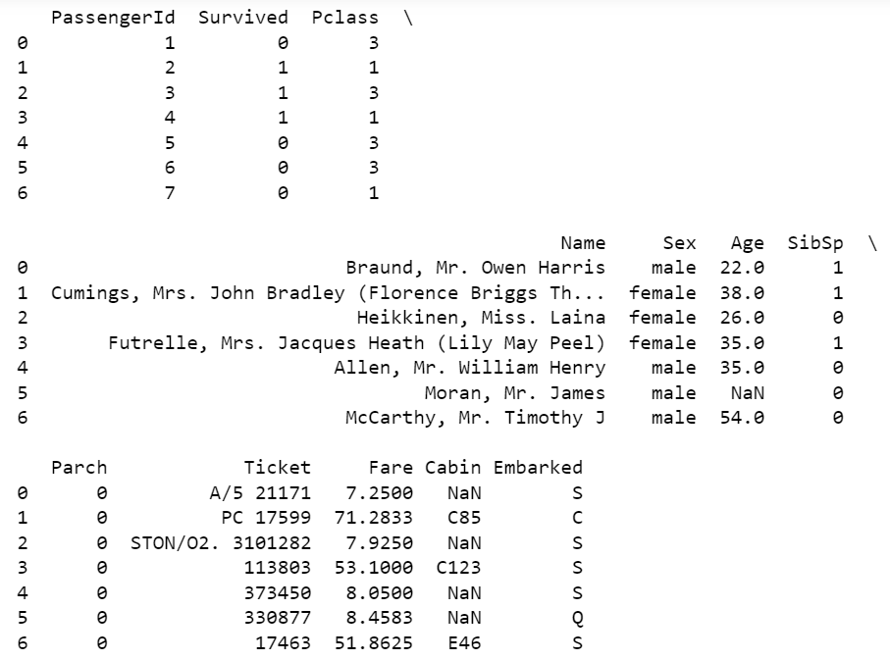
Handling Missing Values
Use the attribute mean/most frequent value to fill in the missing value
First 7 rows of Titanic Data
First 7 rows of Titanic Data
Source: Data Mining-Concepts and Techniques, Jiawei Han, Micheline Kamber, and Jian Pei, Morgan Kaufmann

Slide 39
Handling Missing Values
Use the attribute mean/most frequent value to fill in the missing value
For example, suppose that the average age of All passengers on Titanic is 29.7. Use this value to replace the missing value for “Age”. (Note: Age is a numeric attribute)
Source: Data Mining-Concepts and Techniques, Jiawei Han, Micheline Kamber, and Jian Pei, Morgan Kaufmann

Slide 40
Handling Missing Values
Use the attribute mean/most frequent value to fill in the missing value
For example, suppose that the average age of All passengers on Titanic is 29.7. Use this value to replace the missing value for “Age”. (Note: Age is a numeric attribute)
Similarly for “Cabin” if the most frequent value for the “Cabin” is “B96 B98” then use it to replace all the missing values for “Cabin”.
Source: Data Mining-Concepts and Techniques, Jiawei Han, Micheline Kamber, and Jian Pei, Morgan Kaufmann

Slide 41
Handling Missing Values
Use the attribute mean/most frequent value for all samples belonging to the same class as the given tuple
First 7 rows of Titanic Data
Source: Data Mining-Concepts and Techniques, Jiawei Han, Micheline Kamber, and Jian Pei, Morgan Kaufmann

Slide 42
Handling Missing Values
Use the attribute mean/most frequent value for all samples belonging to the same class as the given tuple
For example, if classifying passengers according to “Survived”, replace the missing value in “Age” with the average age for passengers in the same “Survived” category as that of the given tuple.
Source: Data Mining-Concepts and Techniques, Jiawei Han, Micheline Kamber, and Jian Pei, Morgan Kaufmann

Slide 43
Handling Missing Values
Use the attribute mean/most frequent value for all samples belonging to the same class as the given tuple
For example, if classifying passengers according to “Survived”, replace the missing value in “Age” with the average age for passengers in the same “Survived” category as that of the given tuple.
For example, if classifying passengers according to “Survived”, replace the missing value in “Cabin” with the most frequent “Cabin” value for passengers in the same “Survived” category as that of the given tuple.
Source: Data Mining-Concepts and Techniques, Jiawei Han, Micheline Kamber, and Jian Pei, Morgan Kaufmann

Slide 44
Data Visualization
Source: AI Facilitator HandBook

Slide 45
Data Visualization
It is possible that some errors will occur while collecting data. Let us first look at the different types of issues that can arise:
Source: AI Facilitator HandBook

Slide 46
Data Visualization
It is possible that some errors will occur while collecting data. Let us first look at the different types of issues that can arise:
1. Erroneous Data: There are two ways in which the data can be erroneous:
Source: AI Facilitator HandBook

Slide 47
Data Visualization
It is possible that some errors will occur while collecting data. Let us first look at the different types of issues that can arise:
1. Erroneous Data: There are two ways in which the data can be erroneous:
Incorrect values:
Source: AI Facilitator HandBook

Slide 48
Data Visualization
It is possible that some errors will occur while collecting data. Let us first look at the different types of issues that can arise:
1. Erroneous Data: There are two ways in which the data can be erroneous:
Incorrect values:
The values in the dataset are incorrect (at random locations).
Source: AI Facilitator HandBook

Slide 49
Data Visualization
It is possible that some errors will occur while collecting data. Let us first look at the different types of issues that can arise:
1. Erroneous Data: There are two ways in which the data can be erroneous:
Incorrect values:
The values in the dataset are incorrect (at random locations).
For example, in the phone number column, there is a decimal value, and in the marks column, there is a name mentioned, and so on.
Source: AI Facilitator HandBook

Slide 50
Data Visualization
It is possible that some errors will occur while collecting data. Let us first look at the different types of issues that can arise:
1. Erroneous Data: There are two ways in which the data can be erroneous:
Incorrect values:
The values in the dataset are incorrect (at random locations).
For example, in the phone number column, there is a decimal value, and in the marks column, there is a name mentioned, and so on.
These are incorrect values that do not correspond to the type of information expected in that position.
Source: AI Facilitator HandBook

Slide 51
Data Visualization
It is possible that some errors will occur while collecting data. Let us first look at the different types of issues that can arise:
1. Erroneous Data: There are two ways in which the data can be erroneous:
Invalid or Null values:
Source: AI Facilitator HandBook

Slide 52
Data Visualization
It is possible that some errors will occur while collecting data. Let us first look at the different types of issues that can arise:
1. Erroneous Data: There are two ways in which the data can be erroneous:
Invalid or Null values:
In some places, the values become corrupted and thus invalid.
Source: AI Facilitator HandBook

Slide 53
Data Visualization
It is possible that some errors will occur while collecting data. Let us first look at the different types of issues that can arise:
1. Erroneous Data: There are two ways in which the data can be erroneous:
Invalid or Null values:
At some places, the values get corrupted and hence they become invalid.
NaN values will appear frequently in the dataset.
Source: AI Facilitator HandBook

Slide 54
Data Visualization
It is possible that some errors will occur while collecting data. Let us first look at the different types of issues that can arise:
1. Erroneous Data: There are two ways in which the data can be erroneous:
Invalid or Null values:
At some places, the values get corrupted and hence they become invalid.
Many times you will find NaN values in the dataset.
These are null values that have no meaning and cannot be processed.
Source: AI Facilitator HandBook

Slide 55
Data Visualization
It is possible that some errors will occur while collecting data. Let us first look at the different types of issues that can arise:
1. Erroneous Data: There are two ways in which the data can be erroneous:
Invalid or Null values:
At some places, the values get corrupted and hence they become invalid.
Many times you will find NaN values in the dataset.
These are null values which do not hold any meaning and are not processible.
As a result, when these values are encountered, they are removed from the database.
Source: AI Facilitator HandBook

Slide 56
Data Visualization
It is possible that some errors will occur while collecting data. Let us first look at the different types of issues that can arise:
2. Missing Data:
Source: AI Facilitator HandBook

Slide 57
Data Visualization
It is possible that some errors will occur while collecting data. Let us first look at the different types of issues that can arise:
2. Missing Data:
Some cells in some datasets remain empty. Because the values for these cells are missing, the cells remain empty.
Source: AI Facilitator HandBook

Slide 58
Data Visualization
It is possible that some errors will occur while collecting data. Let us first look at the different types of issues that can arise:
2. Missing Data:
Some cells in some datasets remain empty. Because the values for these cells are missing, the cells remain empty.
Missing data cannot be interpreted as an error because the values are not incorrect and may not be missing due to an error.
Source: AI Facilitator HandBook

Slide 59
Data Visualization
It is possible that some errors will occur while collecting data. Let us first look at the different types of issues that can arise:
3. Outliers:
Source: AI Facilitator HandBook

Slide 60
Data Visualization
It is possible that some errors will occur while collecting data. Let us first look at the different types of issues that can arise:
3. Outliers:
Outliers are data points that do not fall within the range of a specific element.
Source: AI Facilitator HandBook

Slide 61
Data Visualization
It is possible that some errors will occur while collecting data. Let us first look at the different types of issues that can arise:
3. Outliers:
Outliers are data points that do not fall within the range of a specific element.
To better understand this, consider the grades of students in a class. Assume a student missed an exam and thus received no credit for it.
Source: AI Facilitator HandBook

Slide 62
Data Visualization
It is possible that some errors will occur while collecting data. Let us first look at the different types of issues that can arise:
3. Outliers:
Outliers are data points that do not fall within the range of a specific element.
To better understand this, consider the grades of students in a class. Assume a student missed an exam and thus received no credit for it.
If his grades are included, the average for the entire class falls. To avoid this, the average is calculated for the range of marks from highest to lowest, while keeping this specific result separate.
Source: AI Facilitator HandBook

Slide 63
Data Visualization
It is possible that some errors will occur while collecting data. Let us first look at the different types of issues that can arise:
3. Outliers:
Outliers are data points that do not fall within the range of a specific element.
To better understand this, consider the grades of students in a class. Assume a student missed an exam and thus received no credit for it.
If his grades are included, the average for the entire class falls. To avoid this, the average is calculated for the range of marks from highest to lowest, while keeping this specific result separate.
This ensures that the class average marks are correct based on the data.
Source: AI Facilitator HandBook

Slide 64
Data Visualization
Analyzing the collected data can be challenging because it is all about tables and numbers.
Source: AI Facilitator HandBook

Slide 65
Data Visualization
Analyzing the collected data can be challenging because it is all about tables and numbers.
While machines can process numbers efficiently, humans require visual aid to understand and comprehend the information passed.
Source: AI Facilitator HandBook

Slide 66
Data Visualization
Analyzing the collected data can be challenging because it is all about tables and numbers.
While machines can process numbers efficiently, humans require visual aid to understand and comprehend the information passed.
As a result, data visualization is used to interpret the collected data and identify patterns and trends.
Source: AI Facilitator HandBook

Slide 67
Data Visualization
Scatter Plot
Source: AI Facilitator HandBook

Slide 68
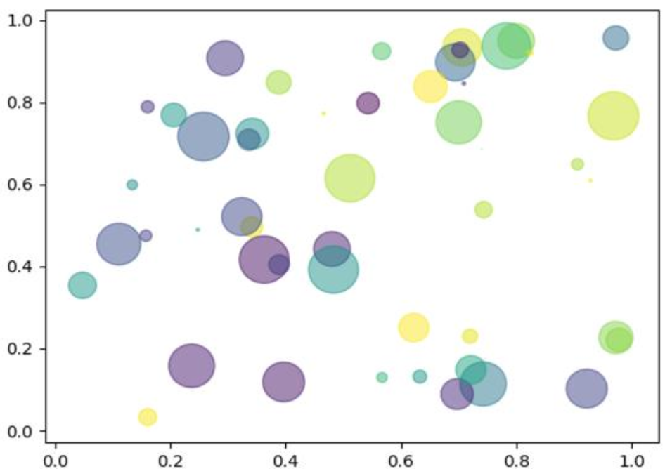
Data Visualization
Scatter Plot
The two axes (X and Y) in this scatter plot represent two different parameters. The colour and size of circles represent two distinct parameters. Thus, by using just one coordinate on the graph, one can see four different parameters at the same time.
Source: AI Facilitator HandBook

Slide 69
Data Visualization
Scatter Plot
Scatter plots are used to plot discontinuous data, which is defined as data that does not have any continuity in flow. There are gaps in data that cause discontinuity.
Source: AI Facilitator HandBook

Slide 70
Data Visualization
Scatter Plot
Scatter plots are used to plot discontinuous data, which is defined as data that does not have any continuity in flow. There are gaps in data that cause discontinuity.
A 2D scatter plot can show information from up to four parameters.
Source: AI Facilitator HandBook

Slide 71
Data Visualization
Bar Chart
Source: AI Facilitator HandBook, https://statisticsbyjim.com/graphs/bar-charts/

Slide 72
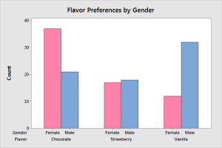
Data Visualization
Bar Chart
Source: AI Facilitator HandBook, https://statisticsbyjim.com/graphs/bar-charts/

Slide 73
Data Visualization
Bar Chart
There are several types of bar charts, such as single bar charts, double bar charts, and so on.
Source: AI Facilitator HandBook, https://statisticsbyjim.com/graphs/bar-charts/

Slide 74
Data Visualization
Bar Chart
There are several types of bar charts, such as single bar charts, double bar charts, and so on.
The bar chart also works with discontinuous data and is made at uniform intervals.
Source: AI Facilitator HandBook, https://statisticsbyjim.com/graphs/bar-charts/

Slide 75
Data Visualization
Bar Chart
There are several types of bar charts, such as single bar charts, double bar charts, and so on.
The bar chart also works with discontinuous data and is made at uniform intervals.
Use bar charts to compare categories when you have at least one categorical or discrete variable.
Source: AI Facilitator HandBook, https://statisticsbyjim.com/graphs/bar-charts/

Slide 76
Data Visualization
Bar Chart
There are several types of bar charts, such as single bar charts, double bar charts, and so on.
The bar chart also works with discontinuous data and is made at uniform intervals.
Use bar charts to compare categories when you have at least one categorical or discrete variable.
Each bar represents a summary value for one discrete level, where longer bars indicate higher values.
Source: AI Facilitator HandBook, https://statisticsbyjim.com/graphs/bar-charts/

Slide 77
Data Visualization
Bar Chart
There are several types of bar charts, such as single bar charts, double bar charts, and so on.
The bar chart also works with discontinuous data and is made at uniform intervals.
Use bar charts to compare categories when you have at least one categorical or discrete variable.
Each bar represents a summary value for one discrete level, where longer bars indicate higher values.
Types of summary values include counts, sums, means, and standard deviations.
Source: AI Facilitator HandBook, https://statisticsbyjim.com/graphs/bar-charts/

Slide 78
Data Visualization
Bar Chart
There are several types of bar charts, such as single bar charts, double bar charts, and so on.
The bar chart also works with discontinuous data and is made at uniform intervals.
Use bar charts to compare categories when you have at least one categorical or discrete variable.
Each bar represents a summary value for one discrete level, where longer bars indicate higher values.
Types of summary values include counts, sums, means, and standard deviations.
Bar charts, unlike histograms, have spaces between the bars to emphasize that each bar represents a discrete value, whereas histograms are for continuous data.
Source: AI Facilitator HandBook, https://statisticsbyjim.com/graphs/bar-charts/

Slide 79
Data Visualization
Histograms
Source: AI Facilitator HandBook, https://www.mathsisfun.com/data/histograms.html

Slide 80
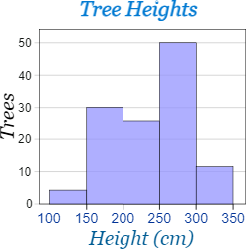
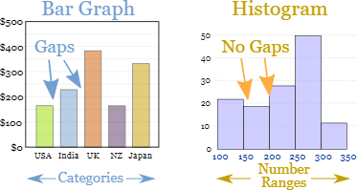
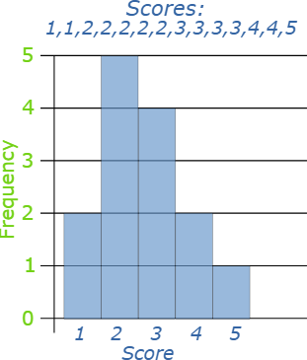
Data Visualization
Histograms
A Frequency Histogram is a special graph that uses vertical columns to show frequencies (how many times each score occurs):
Source: AI Facilitator HandBook, https://www.mathsisfun.com/data/histograms.html

Slide 81
Data Visualization
Histograms
Histograms are the accurate representation of a continuous data.
Source: AI Facilitator HandBook, https://www.mathsisfun.com/data/histograms.html

Slide 82
Data Visualization
Histograms
Histograms are the accurate representation of a continuous data.
It is similar to a Bar Chart, but a histogram groups numbers into ranges.
Source: AI Facilitator HandBook, https://www.mathsisfun.com/data/histograms.html

Slide 83
Data Visualization
Histograms
Histograms are the accurate representation of a continuous data.
It is similar to a Bar Chart, but a histogram groups numbers into ranges.
The height of each bar shows how many fall into each range. And you decide what ranges to use!
Source: AI Facilitator HandBook, https://www.mathsisfun.com/data/histograms.html

Slide 84
Data Visualization
Histograms
Histograms are the accurate representation of a continuous data.
It is similar to a Bar Chart, but a histogram groups numbers into ranges.
The height of each bar shows how many fall into each range. And you decide what ranges to use!
It uses bins to represent the frequency of the variable in different intervals of its value.
Source: AI Facilitator HandBook, https://www.mathsisfun.com/data/histograms.html

Slide 85
Data Visualization
Box Plots
Source: AI Facilitator HandBook, Data Mining-Concepts and Techniques, Jiawei Han, Micheline Kamber, and Jian Pei, Morgan Kaufmann

Slide 86
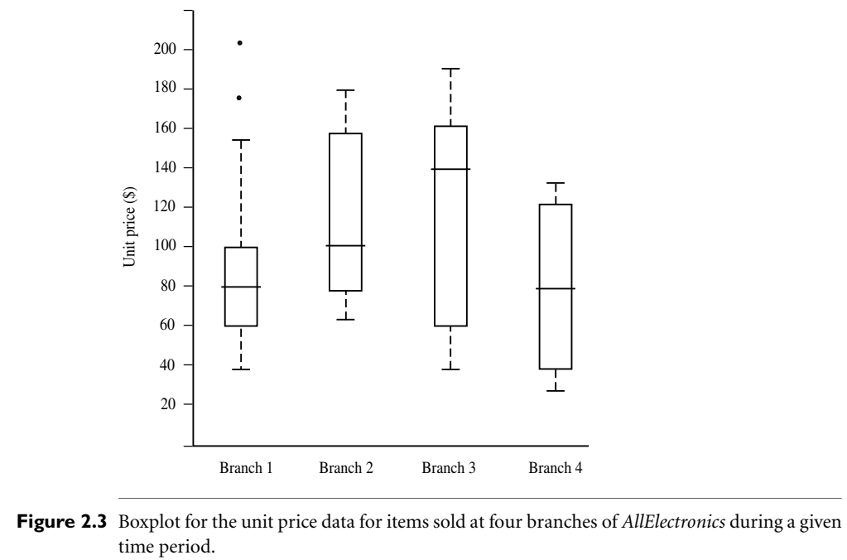
Data Visualization
Box Plots
Source: AI Facilitator HandBook, Data Mining-Concepts and Techniques, Jiawei Han, Micheline Kamber, and Jian Pei, Morgan Kaufmann

Slide 87
Data Visualization
Box Plots
Box plots come in handy when the data is divided into percentiles across the range.
Source: AI Facilitator HandBook, Data Mining-Concepts and Techniques, Jiawei Han, Micheline Kamber, and Jian Pei, Morgan Kaufmann

Slide 88
Data Visualization
Box Plots
Box plots come in handy when the data is divided into percentiles across the range.
Box plots, also known as box and whiskers plots, show the distribution of data across a range using four quartiles.
Source: AI Facilitator HandBook, Data Mining-Concepts and Techniques, Jiawei Han, Micheline Kamber, and Jian Pei, Morgan Kaufmann

Slide 89
Data Visualization
Box Plots
Box plots come in handy when the data is divided into percentiles across the range.
Box plots, also known as box and whiskers plots, show the distribution of data across a range using four quartiles.
Boxplots are a popular way of visualizing a distribution. A boxplot incorporates the five-number summary as follows:
Source: AI Facilitator HandBook, Data Mining-Concepts and Techniques, Jiawei Han, Micheline Kamber, and Jian Pei, Morgan Kaufmann

Slide 90
Data Visualization
Box Plots
Box plots come in handy when the data is divided into percentiles across the range.
Box plots, also known as box and whiskers plots, show the distribution of data across a range using four quartiles.
Boxplots are a popular way of visualizing a distribution. A boxplot incorporates the five-number summary as follows:
Typically, the ends of the box are at the quartiles, so that the box length is the interquartile range, IQR.
Source: AI Facilitator HandBook, Data Mining-Concepts and Techniques, Jiawei Han, Micheline Kamber, and Jian Pei, Morgan Kaufmann

Slide 91
Data Visualization
Box Plots
Box plots come in handy when the data is divided into percentiles across the range.
Box plots, also known as box and whiskers plots, show the distribution of data across a range using four quartiles.
Boxplots are a popular way of visualizing a distribution. A boxplot incorporates the five-number summary as follows:
Typically, the ends of the box are at the quartiles, so that the box length is the interquartile range, IQR.
The median is marked by a line within the box.
Source: AI Facilitator HandBook, Data Mining-Concepts and Techniques, Jiawei Han, Micheline Kamber, and Jian Pei, Morgan Kaufmann

Slide 92
Data Visualization
Box Plots
Box plots come in handy when the data is divided into percentiles across the range.
Box plots, also known as box and whiskers plots, show the distribution of data across a range using four quartiles.
Boxplots are a popular way of visualizing a distribution. A boxplot incorporates the five-number summary as follows:
Typically, the ends of the box are at the quartiles, so that the box length is the interquartile range, IQR.
The median is marked by a line within the box.
Two lines (called whiskers) outside the box extend to the smallest (Minimum) and largest (Maximum) observations.
Source: AI Facilitator HandBook, Data Mining-Concepts and Techniques, Jiawei Han, Micheline Kamber, and Jian Pei, Morgan Kaufmann

Slide 93
Data Visualization
Box Plots
When dealing with a moderate number of observations, it is worthwhile to plot potential outliers individually.
Source: AI Facilitator HandBook, Data Mining-Concepts and Techniques, Jiawei Han, Micheline Kamber, and Jian Pei, Morgan Kaufmann

Slide 94
Data Visualization
Box Plots
When dealing with a moderate number of observations, it is worthwhile to plot potential outliers individually.
To do this in a boxplot, the whiskers are extended to the extreme low and high observations only if these values are less than 1:5 × IQR beyond the quartiles.
Source: AI Facilitator HandBook, Data Mining-Concepts and Techniques, Jiawei Han, Micheline Kamber, and Jian Pei, Morgan Kaufmann

Slide 95
Data Visualization
Box Plots
When dealing with a moderate number of observations, it is worthwhile to plot potential outliers individually.
To do this in a boxplot, the whiskers are extended to the extreme low and high observations only if these values are less than 1:5 × IQR beyond the quartiles.
Otherwise, the whiskers terminate at the most extreme observations occurring within 1:5×IQR of the quartiles.
Source: AI Facilitator HandBook, Data Mining-Concepts and Techniques, Jiawei Han, Micheline Kamber, and Jian Pei, Morgan Kaufmann

Slide 96
Data Visualization
Box Plots
When dealing with a moderate number of observations, it is worthwhile to plot potential outliers individually.
To do this in a boxplot, the whiskers are extended to the extreme low and high observations only if these values are less than 1:5 × IQR beyond the quartiles.
Otherwise, the whiskers terminate at the most extreme observations occurring within 1:5×IQR of the quartiles.
The remaining cases are plotted individually.
Boxplots can be used in the comparisons of several sets of compatible data.
Source: AI Facilitator HandBook, Data Mining-Concepts and Techniques, Jiawei Han, Micheline Kamber, and Jian Pei, Morgan Kaufmann

Slide 97
Data Visualization
Box Plots
When dealing with a moderate number of observations, it is worthwhile to plot potential outliers individually.
To do this in a boxplot, the whiskers are extended to the extreme low and high observations only if these values are less than 1:5 × IQR beyond the quartiles.
Otherwise, the whiskers terminate at the most extreme observations occurring within 1:5×IQR of the quartiles.
The remaining cases are plotted individually.
Boxplots can be used in the comparisons of several sets of compatible data.
Figure 2.3 shows boxplots for unit price data for items sold at four branches of AllElectronics during a given time period.
Source: AI Facilitator HandBook, Data Mining-Concepts and Techniques, Jiawei Han, Micheline Kamber, and Jian Pei, Morgan Kaufmann

Slide 98
Data Visualization
Box Plots
When dealing with a moderate number of observations, it is worthwhile to plot potential outliers individually.
To do this in a boxplot, the whiskers are extended to the extreme low and high observations only if these values are less than 1:5 × IQR beyond the quartiles.
Otherwise, the whiskers terminate at the most extreme observations occurring within 1:5×IQR of the quartiles.
The remaining cases are plotted individually.
Boxplots can be used in the comparisons of several sets of compatible data.
Figure 2.3 shows boxplots for unit price data for items sold at four branches of AllElectronics during a given time period.
For branch 1, we see that the median price of items sold is $80, Q1 is $60, Q3 is $100.
Source: AI Facilitator HandBook, Data Mining-Concepts and Techniques, Jiawei Han, Micheline Kamber, and Jian Pei, Morgan Kaufmann

Slide 99
Data Visualization
Box Plots
When dealing with a moderate number of observations, it is worthwhile to plot potential outliers individually.
To do this in a boxplot, the whiskers are extended to the extreme low and high observations only if these values are less than 1:5 × IQR beyond the quartiles.
Otherwise, the whiskers terminate at the most extreme observations occurring within 1:5×IQR of the quartiles.
The remaining cases are plotted individually.
Boxplots can be used in the comparisons of several sets of compatible data.
Figure 2.3 shows boxplots for unit price data for items sold at four branches of AllElectronics during a given time period.
For branch 1, we see that the median price of items sold is $80, Q1 is $60, Q3 is $100.
Notice that two outlying observations for this branch were plotted individually, as their values of 175 and 202 are more than 1.5 times the IQR here of 40.
Source: AI Facilitator HandBook, Data Mining-Concepts and Techniques, Jiawei Han, Micheline Kamber, and Jian Pei, Morgan Kaufmann

Slide 100
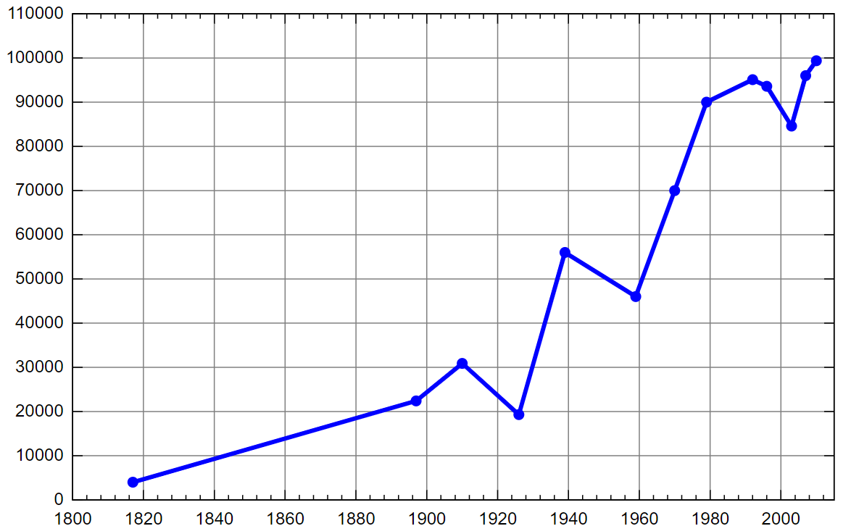
Data Visualization
Line Chart
Line chart showing the population of the town of Pushkin, Saint Petersburg from 1800 to 2010, measured at various intervals
Source:https://en.wikipedia.org/wiki/Line_chart, https://chartio.com/learn/charts/line-chart-complete-guide/

Slide 101
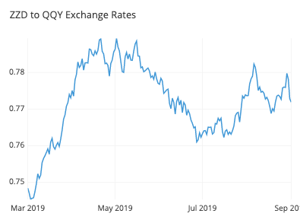
Data Visualization
Line Chart
Source:https://en.wikipedia.org/wiki/Line_chart, https://chartio.com/learn/charts/line-chart-complete-guide/

Slide 102
Data Visualization
Line Chart
A line chart, also known as a curve chart, is a type of chart that displays information as a series of data points called "markers" that are connected by straight line segments.
Source:https://en.wikipedia.org/wiki/Line_chart, https://chartio.com/learn/charts/line-chart-complete-guide/

Slide 103
Data Visualization
Line Chart
A line chart, also known as a curve chart, is a type of chart that displays information as a series of data points called "markers" that are connected by straight line segments.
It is a basic type of chart that is used in many fields. It's similar to a scatter plot, except the measurement points are ordered (typically by x-axis value) and connected with straight line segments.
Source:https://en.wikipedia.org/wiki/Line_chart, https://chartio.com/learn/charts/line-chart-complete-guide/

Slide 104
Data Visualization
Line Chart
A line chart, also known as a curve chart, is a type of chart that displays information as a series of data points called "markers" that are connected by straight line segments.
It is a basic type of chart that is used in many fields. It's similar to a scatter plot, except the measurement points are ordered (typically by x-axis value) and connected with straight line segments.
A line chart is frequently used to depict a trend in data over time intervals.
Source:https://en.wikipedia.org/wiki/Line_chart, https://chartio.com/learn/charts/line-chart-complete-guide/

Slide 105
Data Exploration
Typically, at the start of any project, we must define the project's goal and identify data collection methods.
Source: AI Facilitator HandBook,

Slide 106
Data Exploration
Typically, at the start of any project, we must define the project's goal and identify data collection methods.
Most of the time, when gathering data, it is discovered that the data is a complex entity - it is full of numbers, and if anyone wants to make sense of it, they must work out some patterns.
Source: AI Facilitator HandBook,

Slide 107
Data Exploration
Typically, at the start of any project, we must define the project's goal and identify data collection methods.
Most of the time, when gathering data, it is discovered that the data is a complex entity - it is full of numbers, and if anyone wants to make sense of it, they must work out some patterns.
For example, if we go to the library and pick up a random book, we try to quickly go through its content by turning pages and reading the description before borrowing it, because this helps us understand if the book is appropriate to our needs and interests or not.
Source: AI Facilitator HandBook,

Slide 108
Data Exploration
Typically, at the start of any project, we must define the project's goal and identify data collection methods.
Most of the time, when gathering data, it is discovered that the data is a complex entity - it is full of numbers, and if anyone wants to make sense of it, they must work out some patterns.
For example, if we go to the library and pick up a random book, we try to quickly go through its content by turning pages and reading the description before borrowing it, because this helps us understand if the book is appropriate to our needs and interests or not.
Thus, in order to analyze the data, it must be visualized in a user-friendly format so that you can:
Source: AI Facilitator HandBook,

Slide 109
Data Exploration
Typically, at the start of any project, we must define the project's goal and identify data collection methods.
Most of the time, when gathering data, it is discovered that the data is a complex entity - it is full of numbers, and if anyone wants to make sense of it, they must work out some patterns.
For example, if we go to the library and pick up a random book, we try to quickly go through its content by turning pages and reading the description before borrowing it, because this helps us understand if the book is appropriate to our needs and interests or not.
Thus, in order to analyze the data, it must be visualized in a user-friendly format so that you can:
Quickly get a sense of the trends, relationships, and patterns contained within the data.
Source: AI Facilitator HandBook,

Slide 110
Data Exploration
Typically, at the start of any project, we must define the project's goal and identify data collection methods.
Most of the time, when gathering data, it is discovered that the data is a complex entity - it is full of numbers, and if anyone wants to make sense of it, they must work out some patterns.
For example, if we go to the library and pick up a random book, we try to quickly go through its content by turning pages and reading the description before borrowing it, because this helps us understand if the book is appropriate to our needs and interests or not.
Thus, in order to analyze the data, it must be visualized in a user-friendly format so that you can:
Quickly get a sense of the trends, relationships, and patterns contained within the data.
Define a strategy for deciding which model to use later.
Source: AI Facilitator HandBook,

Slide 111
Data Exploration
Typically, at the start of any project, we must define the project's goal and identify data collection methods.
Most of the time, when gathering data, it is discovered that the data is a complex entity - it is full of numbers, and if anyone wants to make sense of it, they must work out some patterns.
For example, if we go to the library and pick up a random book, we try to quickly go through its content by turning pages and reading the description before borrowing it, because this helps us understand if the book is appropriate to our needs and interests or not.
Thus, in order to analyze the data, it must be visualized in a user-friendly format so that you can:
Quickly get a sense of the trends, relationships, and patterns contained within the data.
Define a strategy for deciding which model to use later.
Effectively communicate the same to others. We can use a variety of visual representations to visualize data.
Source: AI Facilitator HandBook,

Slide 112
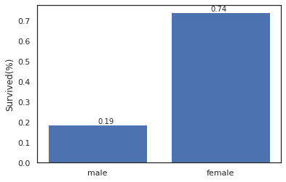
Data Exploration
Example: Titanic Dataset

Slide 113
Data Exploration
Example: Titanic Dataset
The dataset has quite a few features and the problem is to predict for each passenger whether he/she was survived or not.

Slide 114
Data Exploration
Example: Titanic Dataset
The dataset has quite a few features and the problem is to predict for each passenger whether he/she was survived or not.
Perhaps all of us have seen the movie and we suspect that more females should have been survived.

Slide 115
Data Exploration
Example: Titanic Dataset
The dataset has quite a few features and the problem is to predict for each passenger whether he/she was survived or not.
Perhaps all of us have seen the movie and we suspect that more females should have been survived.
If you analyze the data then indeed it is observed that only 19% males while 74% females were survived.

Slide 116
Data Exploration
Example: Titanic Dataset
The dataset has quite a few features and the problem is to predict for each passenger whether he/she was survived or not.
Perhaps all of us have seen the movie and we suspect that more females should have been survived.
If you analyze the data then indeed it is observed that only 19% males while 74% females were survived.
This gives us an insight about how important this attribute/feature is in predicting whether the person was survived or not.

Slide 117
Data Exploration
Example: Titanic Dataset
The dataset has quite a few features and the problem is to predict for each passenger whether he/she was survived or not.
Perhaps all of us have seen the movie and we suspect that more females should have been survived.
If you analyze the data then indeed it is observed that only 19% males while 74% females were survived.
This gives us an insight about how important this attribute/feature is in predicting whether the person was survived or not.
This kind of analysis is known as Exploratory Data Analysis

Slide 118
Data Exploration
Example: Titanic Dataset
The dataset has quite a few features and the problem is to predict for each passenger whether he/she was survived or not.
Perhaps all of us have seen the movie and we suspect that more females should have been survived.
If you analyze the data then indeed it is observed that only 19% males while 74% females were survived.
This gives us an insight about how important this attribute/feature is in predicting whether the person was survived or not.
This kind of analysis is known as Exploratory Data Analysis
For more detailed EDA of titanic dataset, you can refer: https://www.kaggle.com/code/priyankdl/titanic-eda-demo-for-students

Slide 119
Disclaimer
Content of this presentation is not original and it has been prepared from various sources for teaching purpose.

