Slide 1
Unit-V- Recurrence Relations

Slide 2
DISCLAIMER
The slides are adapted from Kenneth H. Rosen, C. L. Liu, and Presentation Slides of discrete mathematics at IIT, Kanpur.

Slide 3
Recurrence Relations
A recurrence relation for the sequence {a_{n}} is an equation that expresses a_{n} is terms of one or more of the previous terms of the sequence, namely, a₀, a₁, …, a_{n-1}, for all integers n with n ≥ n₀, where n₀ is a nonnegative integer.
A sequence is called a solution of a recurrence relation if it terms satisfy the recurrence relation.

Slide 4
Recurrence Relations
In other words, a recurrence relation is like a recursively defined sequence, but without specifying any initial values (initial conditions).
Therefore, the same recurrence relation can have (and usually has) multiple solutions.
If both the initial conditions and the recurrence relation are specified, then the sequence is uniquely determined.

Slide 5
Recurrence Relations
Example: Consider the recurrence relation a_{n} = 2a_{n-1} – a_{n-2} for n = 2, 3, 4, …
Is the sequence {a_{n}} with a_{n}=3n a solution of this recurrence relation?
For n ≥ 2 we see that 2a_{n-1} – a_{n-2} = 2(3(n – 1)) – 3(n – 2) = 3n = a_{n}.
Therefore, {a_{n}} with a_{n}=3n is a solution of the recurrence relation.

Slide 6
Recurrence Relations
Is the sequence {a_{n}} with a_{n}=5 a solution of the same recurrence relation?
For n ≥ 2 we see that 2a_{n-1} – a_{n-2} = 2⋅5 - 5 = 5 = a_{n}.
Therefore, {a_{n}} with a_{n}=5 is also a solution of the recurrence relation.

Slide 7
Modeling with Recurrence Relations
Example:
Someone deposits $10,000 in a savings account at a bank yielding 5% per year with interest compounded annually. How much money will be in the account after 30 years?
Solution:
Let P_{n} denote the amount in the account after n years.
How can we determine P_{n} on the basis of P_{n-1}?

Slide 8
Modeling with Recurrence Relations
We can derive the following recurrence relation:
P_{n} = P_{n-1} + 0.05P_{n-1} = 1.05P_{n-1}.
The initial condition is P₀ = 10,000.
Then we have:
P₁ = 1.05P₀
P₂ = 1.05P₁ = (1.05)²P₀
P₃ = 1.05P₂ = (1.05)³P₀
…
P_{n} = 1.05P_{n-1} = (1.05)^{n}P₀
We now have a formula to calculate P_{n} for any natural number n and can avoid the iteration.

Slide 9
Modeling with Recurrence Relations
Let us use this formula to find P₃₀ under the
initial condition P₀ = 10,000:
P₃₀ = (1.05)³⁰⋅10,000 = 43,219.42
After 30 years, the account contains $43,219.42.

Slide 10
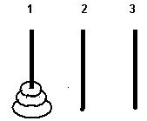
Towers of Hanoi
Start with three pegs numbered 1, 2 and 3 mounted on a board, n disks of different sizes with holes in their centers, placed in order of increasing size from top to bottom.
Object of the game: find the minimum number of moves needed to have all n disks stacked in the same order in peg number 3.

Slide 11
Rules of the game: Hanoi towers
Start with all disks stacked in peg 1 with the smallest at the top and the largest at the bottom
Use peg number 2 for intermediate steps
Only a disk of smaller diameter can be placed on top of another disk

Slide 12
Analysis Of Recursive Towers of Hanoi Algorithm
The recurrence relation for the running time of the method hanoi is:
T(n) = a if n = 1
T(n) = 2T(n - 1) + b if n > 1
public static void hanoi(int n, char from, char to, char temp){
if (n == 1)
System.out.println(from + " --------> " + to);
else{
hanoi(n - 1, from, temp, to);
System.out.println(from + " --------> " + to);
hanoi(n - 1, temp, to, from);
}
}

Slide 13
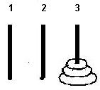
End of game: Hanoi towers
What is the recurrence??
What are the boundary conditions??
Game ends when all disks are stacked in peg number 3 in the same order they were stored at the start in peg number 1.
Verify that the minimum number of moves needed is the Catalan number C₃ = 5.
Start End
T(1) = 1
T(n)= 2T(n-1)+1, n>=2
Solution- T(n)=2^{n}-1. How to prove it?? Use Mathematical Induction

Slide 14
Modeling with Recurrence Relations
Another example:
Let a_{n} denote the number of bit strings of length n that do not have two consecutive 0s (“valid strings”). Find a recurrence relation and give initial conditions for the sequence {a_{n}}.
Solution:
Idea: The number of valid strings equals the number of valid strings ending with a 0 plus the number of valid strings ending with a 1.

Slide 15
Modeling with Recurrence Relations
Let us assume that n ≥ 3, so that the string contains at least 3 bits.
Let us further assume that we know the number a_{n-1} of valid strings of length (n – 1).
Then how many valid strings of length n are there, if the string ends with a 1?
There are a_{n-1} such strings, namely the set of valid strings of length (n – 1) with a 1 appended to them.
Note: Whenever we append a 1 to a valid string, that string remains valid.

Slide 16
Modeling with Recurrence Relations
Now we need to know: How many valid strings of length n are there, if the string ends with a 0?
Valid strings of length n ending with a 0 must have a 1 as their (n – 1)st bit (otherwise they would end with 00 and would not be valid).
And what is the number of valid strings of length (n – 1) that end with a 1?
We already know that there are a_{n-1} strings of length n that end with a 1.
Therefore, there are a_{n-2} strings of length (n – 1) that end with a 1.

Slide 17
Modeling with Recurrence Relations
So there are a_{n-2} valid strings of length n that end with a 0 (all valid strings of length (n – 2) with 10 appended to them).
As we said before, the number of valid strings is the number of valid strings ending with a 0 plus the number of valid strings ending with a 1.
That gives us the following recurrence relation:
a_{n} = a_{n-1} + a_{n-2}

Slide 18
Modeling with Recurrence Relations
What are the initial conditions?
a₁ = 2 (0 and 1)
a₂ = 3 (01, 10, and 11)
a₃ = a₂ + a₁ = 3 + 2 = 5
a₄ = a₃ + a₂ = 5 + 3 = 8
a₅ = a₄ + a₃ = 8 + 5 = 13
…
This sequence satisfies the same recurrence relation as the Fibonacci sequence.
Since a₁ = f₃ and a₂ = f₄, we have a_{n} = f_{n+2}.

Slide 19
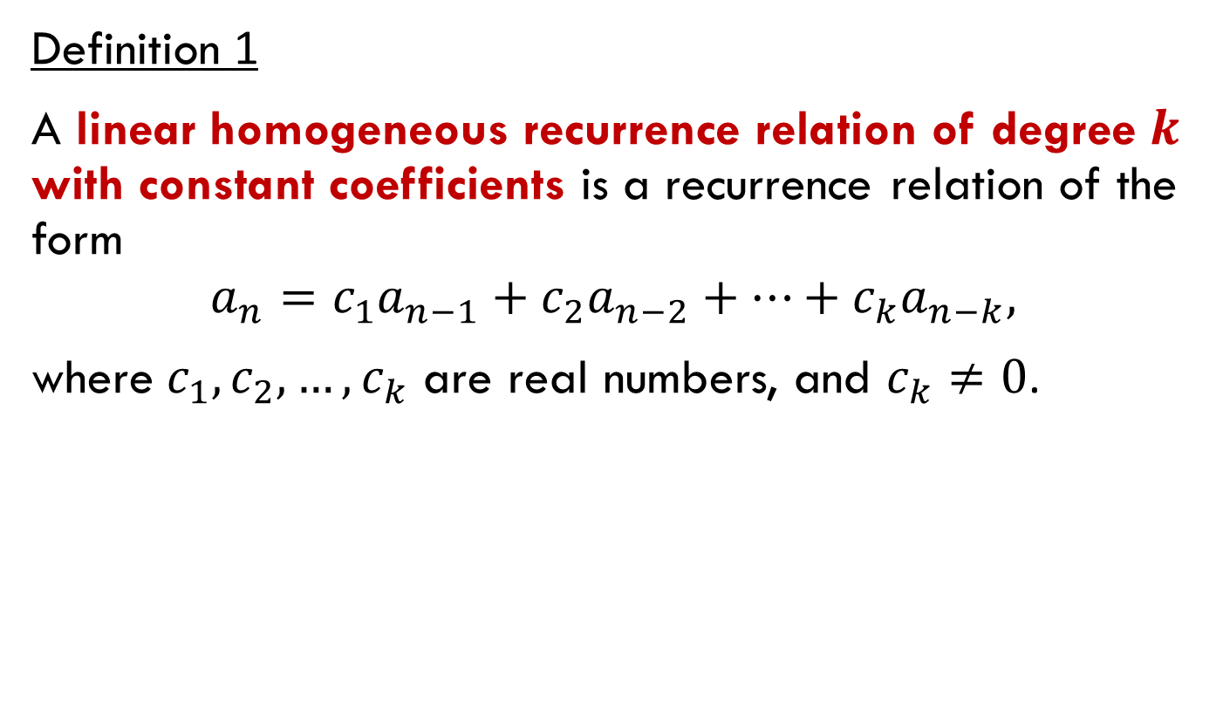
Linear homogeneous recurrence relations with constant coefficients
Definition 1
A linear homogeneous recurrence relation of degree $k$ with constant coefficients is a recurrence relation of the form
$$a_{n}=c_{1}a_{n−1}+c_{2}a_{n−2}+…+c_{k}a_{n−k},$$
where $c_{1}, c_{2},…, c_{k}$ are real numbers, and $c_{k}≠0$.

Slide 20
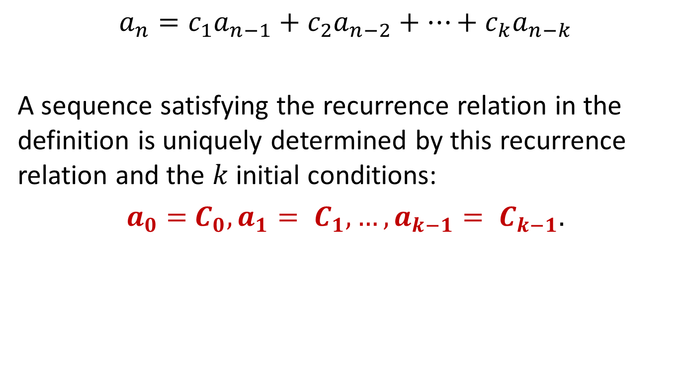
Linear homogeneous recurrence relations with constant coefficients
$$a_{n}=c_{1}a_{n−1}+c_{2}a_{n−2}+…+c_{k}a_{n−k}$$
A sequence satisfying the recurrence relation in the definition is uniquely determined by this recurrence relation and the $k$ initial conditions:
$a_{0}=$ $C_{0},a_{1}= C_{1}, …,a_{k−1}= C_{k−1}.$

Slide 21
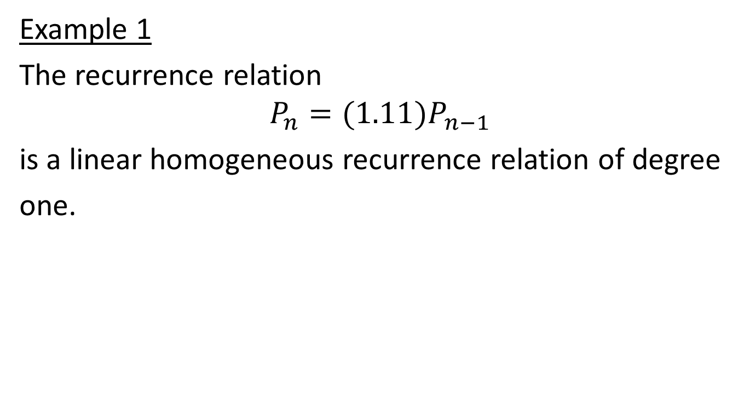
Linear homogeneous recurrence relations with constant coefficients
Example 1
The recurrence relation
$$P_{n}=(1.11)P_{n−1}$$
is a linear homogeneous recurrence relation of degree
one.

Slide 22
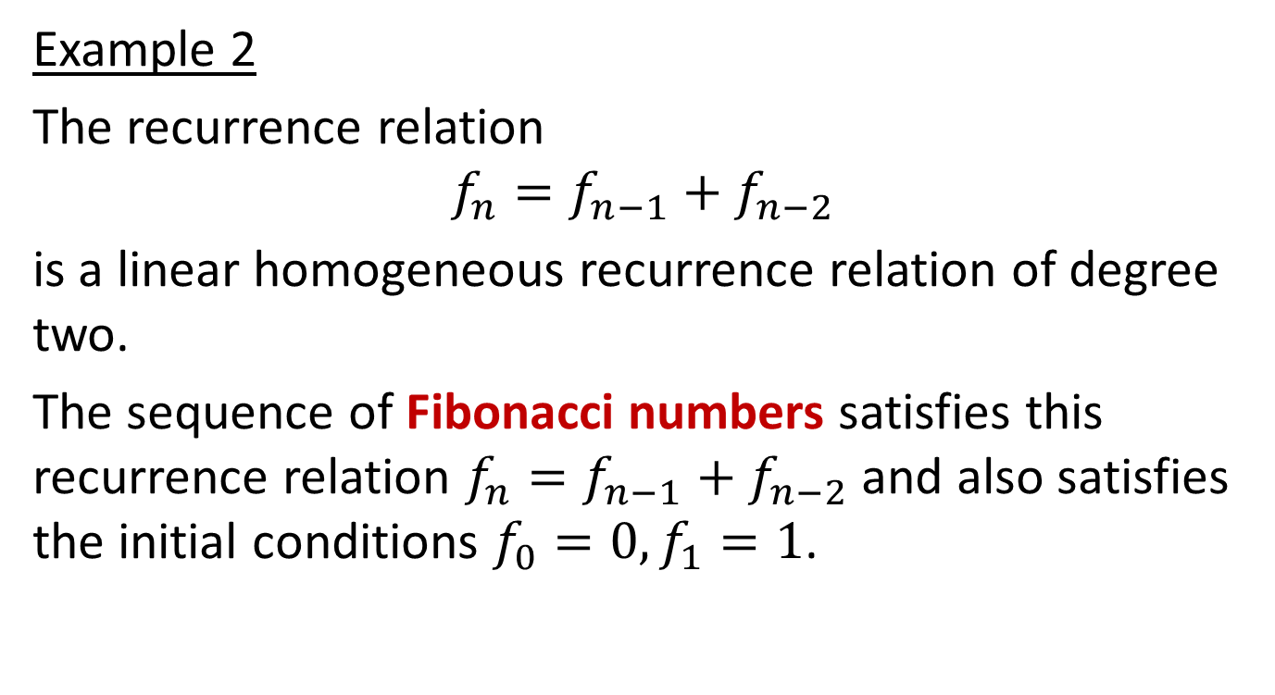
Linear homogeneous recurrence relations with constant coefficients
Example 2
The recurrence relation
$$f_{n}=f_{n−1}+f_{n−2}$$
is a linear homogeneous recurrence relation of degree two.
The sequence of Fibonacci numbers satisfies this recurrence relation $f_{n}=f_{n−1}+f_{n−2}$and also satisfies the initial conditions $f_{0}=0, f_{1}=1$.

Slide 23

Linear homogeneous recurrence relations with constant coefficients
Example 3
The recurrence relation
$$a_{n}=a_{n−5}$$
is a linear homogeneous recurrence relation of degree five.

Slide 24

Linear homogeneous recurrence relations with constant coefficients
Example 4
The recurrence relation
$$a_{n}=a_{n−1}+a_{n−2}^{2}$$
is not linear.

Slide 25

Linear homogeneous recurrence relations with constant coefficients
Example 5
The recurrence relation
$$H_{n}={2H}_{n−1}+1$$
is not homogeneous.

Slide 26

Linear homogeneous recurrence relations with constant coefficients
Example 6
The recurrence relation
$$B_{n}={nB}_{n−1}$$
does not have constant coefficients.

Slide 27
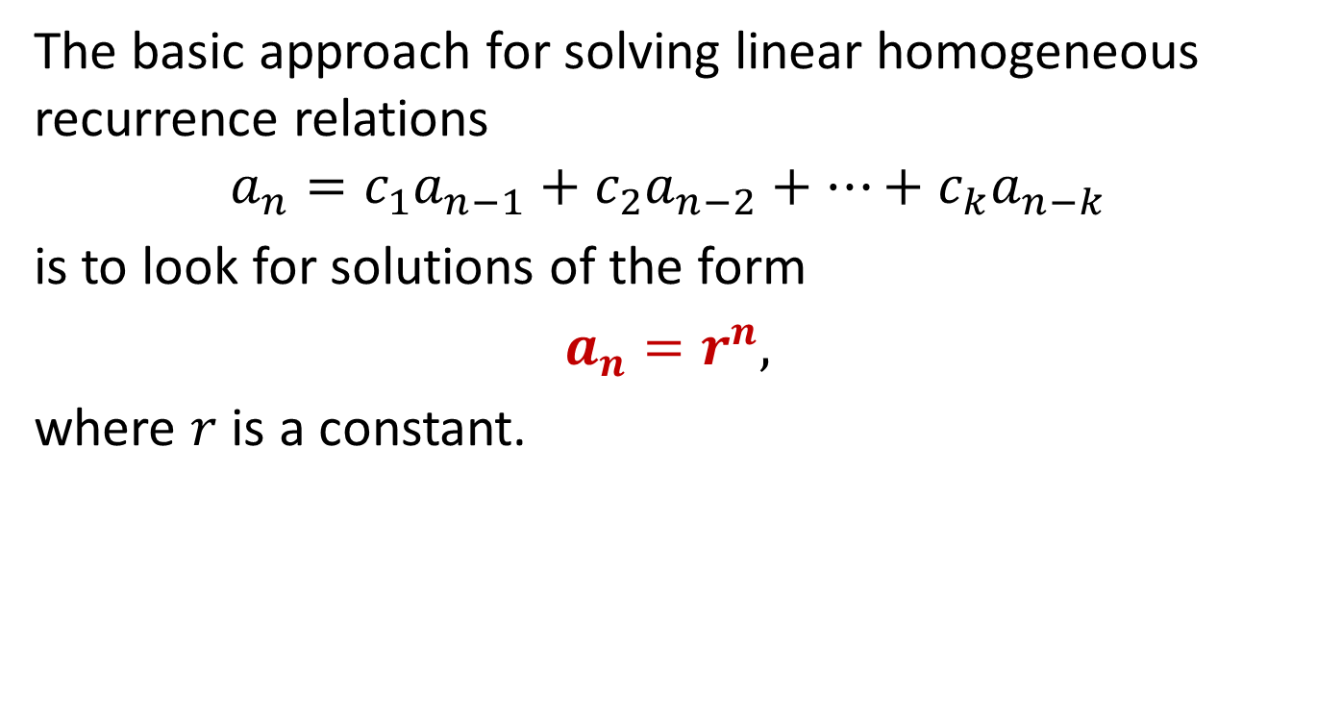
Solving linear homogeneous recurrence relations with constant coefficients
The basic approach for solving linear homogeneous recurrence relations
$$a_{n}=c_{1}a_{n−1}+c_{2}a_{n−2}+…+c_{k}a_{n−k}$$
is to look for solutions of the form
$a_{n}=r^{n},$
where $r$ is a constant.

Slide 28
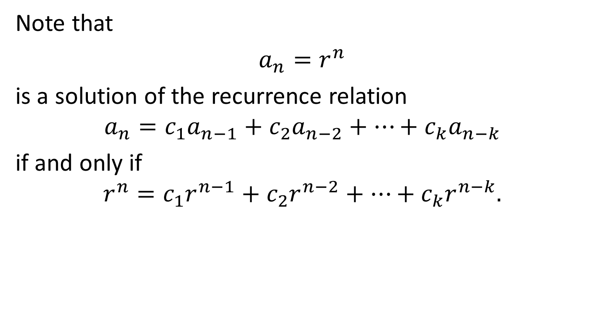
Solving linear homogeneous recurrence relations with constant coefficients
Note that
$a_{n}=r^{n}$
is a solution of the recurrence relation
$$a_{n}=c_{1}a_{n−1}+c_{2}a_{n−2}+…+c_{k}a_{n−k}$$
if and only if
$$r^{n}=c_{1}r^{n−1}+c_{2}r^{n−2}+…+c_{k}r^{n−k}.$$

Slide 29
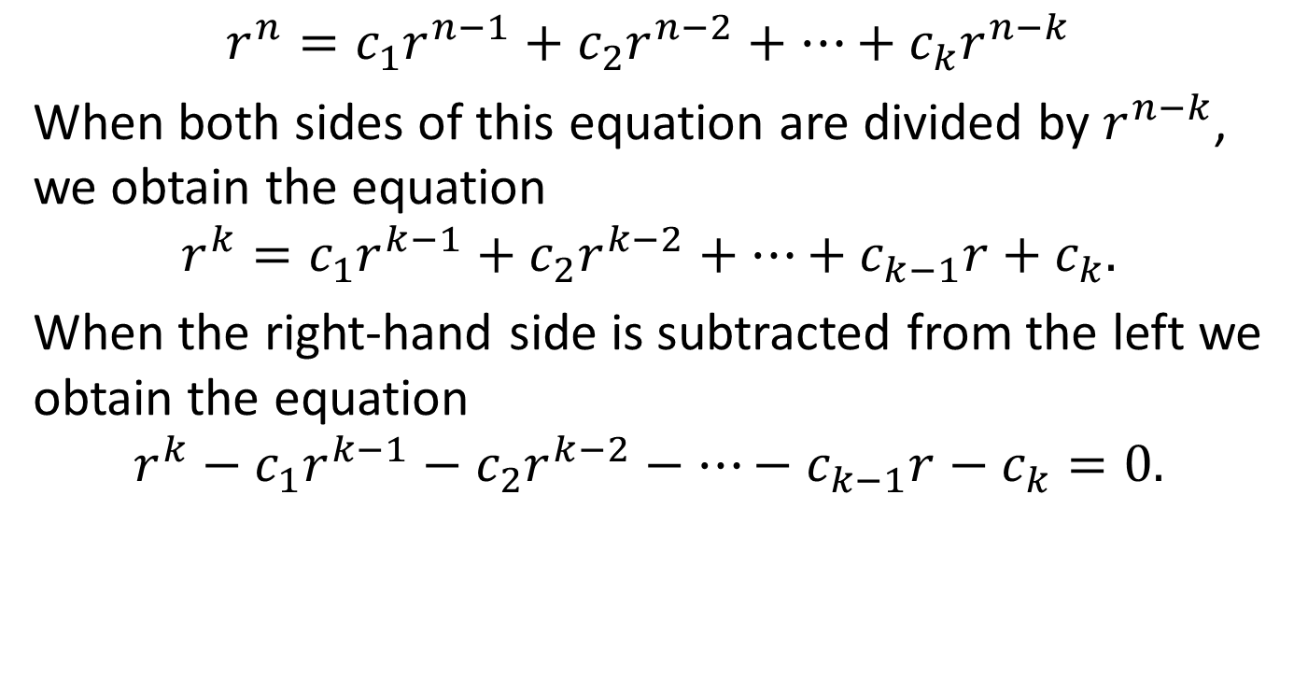
Solving linear homogeneous recurrence relations with constant coefficients
$$r^{n}=c_{1}r^{n−1}+c_{2}r^{n−2}+…+c_{k}r^{n−k}$$
When both sides of this equation are divided by $r^{n−k}$, we obtain the equation
$$r^{k}=c_{1}r^{k−1}+c_{2}r^{k−2}+…+c_{k−1}r+c_{k}.$$
When the right-hand side is subtracted from the left we obtain the equation
$$r^{k}−c_{1}r^{k−1}−c_{2}r^{k−2}−…−c_{k−1}r−c_{k}=0.$$

Slide 30
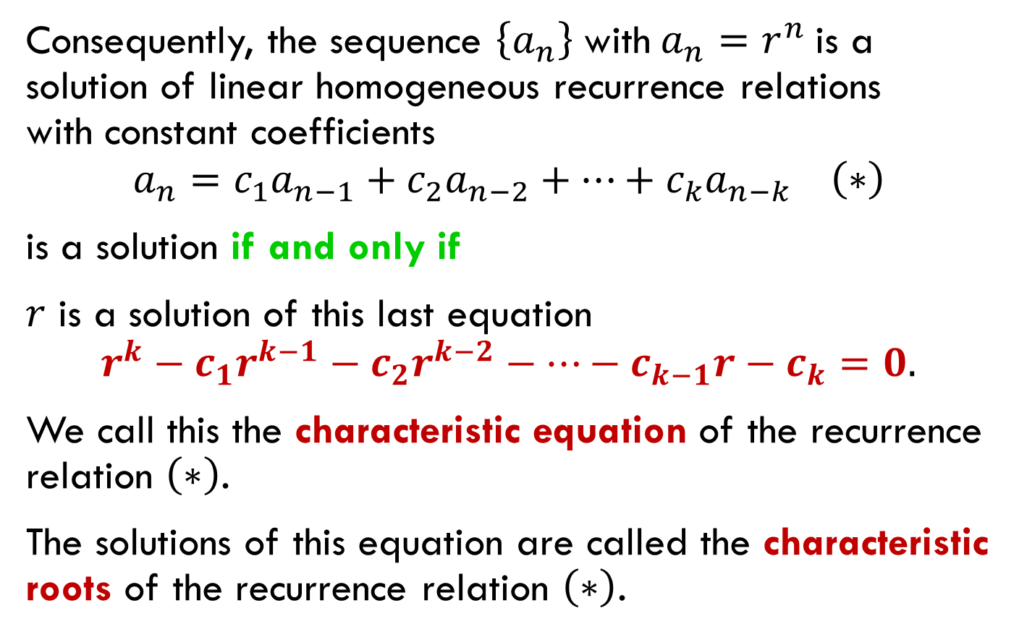
Solving linear homogeneous recurrence relations with constant coefficients
Consequently, the sequence $\left\{a_{n}\right\}$ with $a_{n}=r^{n}$ is a solution of linear homogeneous recurrence relations with constant coefficients
$$a_{n}=c_{1}a_{n−1}+c_{2}a_{n−2}+…+c_{k}a_{n−k} \left(∗\right)$$
is a solution if and only if
$r$ is a solution of this last equation
$$r^{k}−c_{1}r^{k−1}−c_{2}r^{k−2}−…−c_{k−1}r−c_{k}=0.$$
We call this the characteristic equation of the recurrence relation $\left(∗\right)$.
The solutions of this equation are called the characteristic roots of the recurrence relation $\left(∗\right)$.

Slide 31
Solving linear homogeneous recurrence relations with constant coefficients
As we will see, these characteristic roots can be used to give an explicit formula for all the solutions of the recurrence relation.

Slide 32
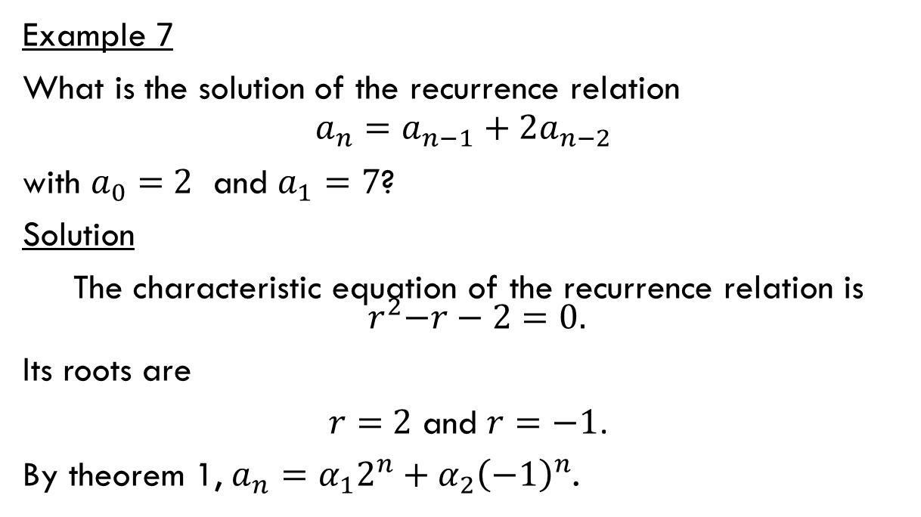
Solving linear homogeneous recurrence relations with constant coefficients of degree two
Example 7
What is the solution of the recurrence relation
$$a_{n}=a_{n−1}+2a_{n−2}$$
with $a_{0}=$ $2$ and $a_{1}=7$?
Solution
The characteristic equation of the recurrence relation is ${ r}^{2}−r−2=0.$
Its roots are
$r=$ $2$ and $r=−1$.
By theorem 1, $a_{n}=α_{1}2^{n}+α_{2}{\left(−1\right)}^{n}$.

Slide 33
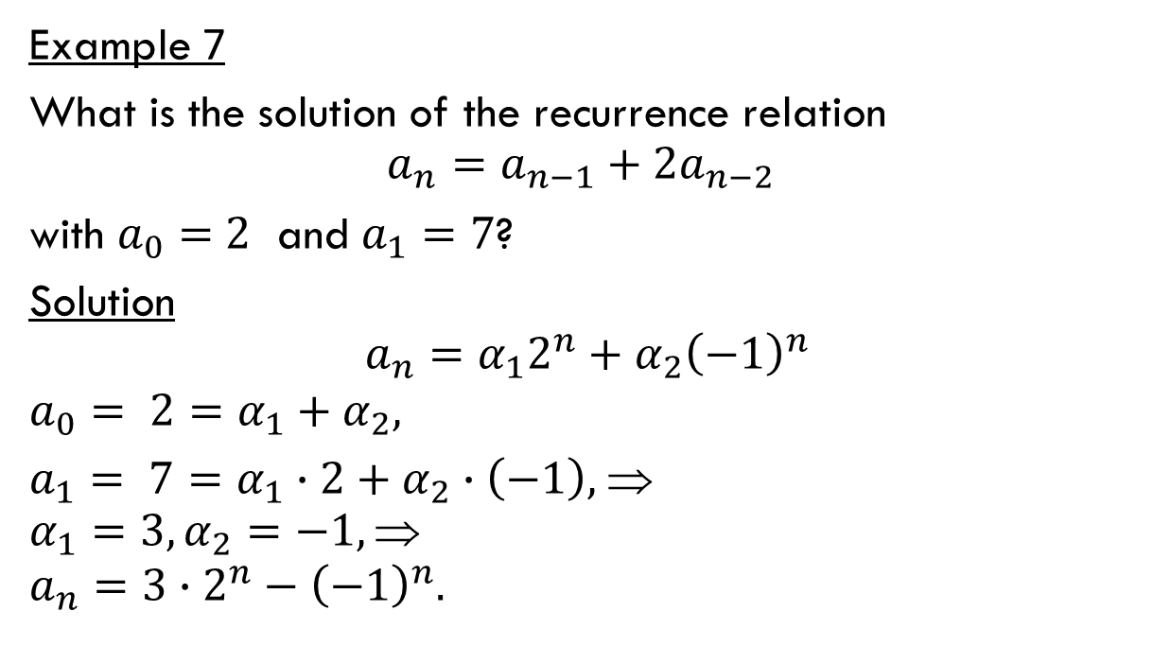
Solving linear homogeneous recurrence relations with constant coefficients of degree two
Example 7
What is the solution of the recurrence relation
$$a_{n}=a_{n−1}+2a_{n−2}$$
with $a_{0}=$ $2$ and $a_{1}=7$?
Solution
$$a_{n}=α_{1}2^{n}+α_{2}{\left(−1\right)}^{n}$$
$$a_{0}= 2=α_{1}+α_{2},$$
$a_{1}= 7=α_{1}∙2+α_{2}∙\left(−1\right),$ ⇒
$$α_{1}=3, α_{2}=−1, $$
$$a_{n}=3∙2^{n}−{\left(−1\right)}^{n}.$$

Slide 34
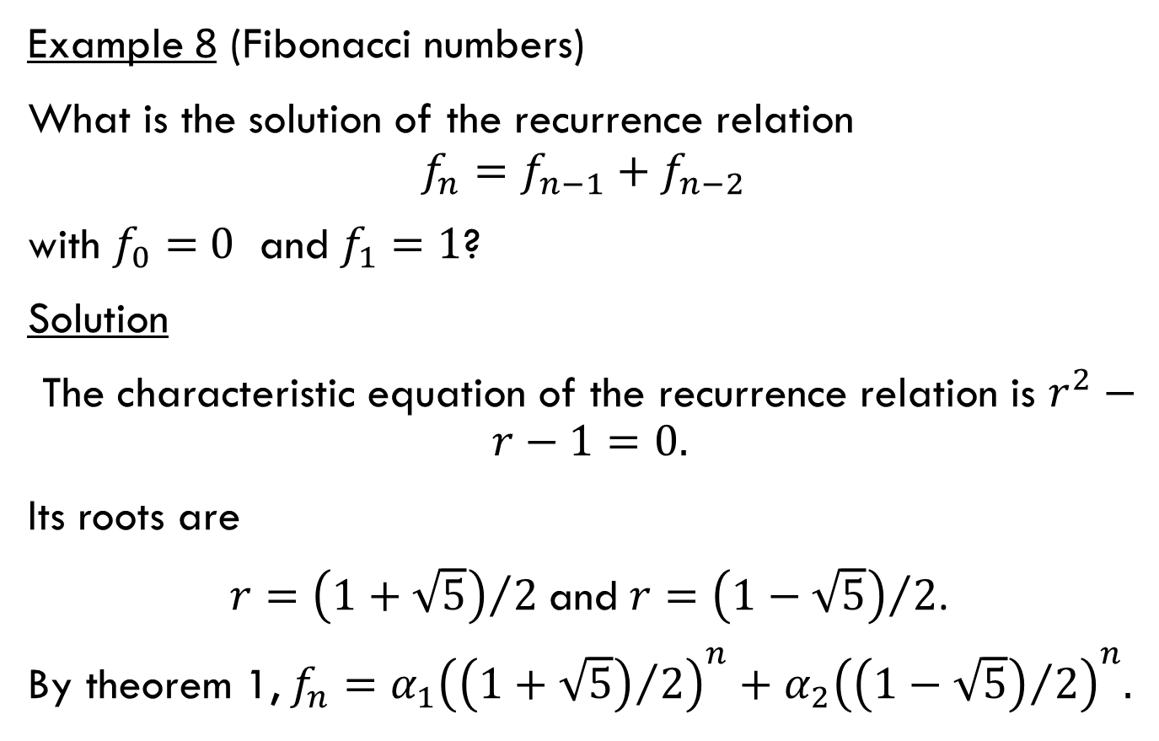
Solving linear homogeneous recurrence relations with constant coefficients of degree two
Example 8 (Fibonacci numbers)
What is the solution of the recurrence relation
$$f_{n}=f_{n−1}+f_{n−2}$$
with $f_{0}=$ $0$ and $f_{1}=1$?
Solution
The characteristic equation of the recurrence relation is $r^{2}−r−1=0.$
Its roots are
$r={\left(1+\sqrt{5}\right)}/2$ and $r={\left(1−\sqrt{5}\right)}/2$.
By theorem 1, $f_{n}=α_{1}{\left({\left(1+\sqrt{5}\right)}/2\right)}^{n}+α_{2}{\left({\left(1−\sqrt{5}\right)}/2\right)}^{n}.$

Slide 35
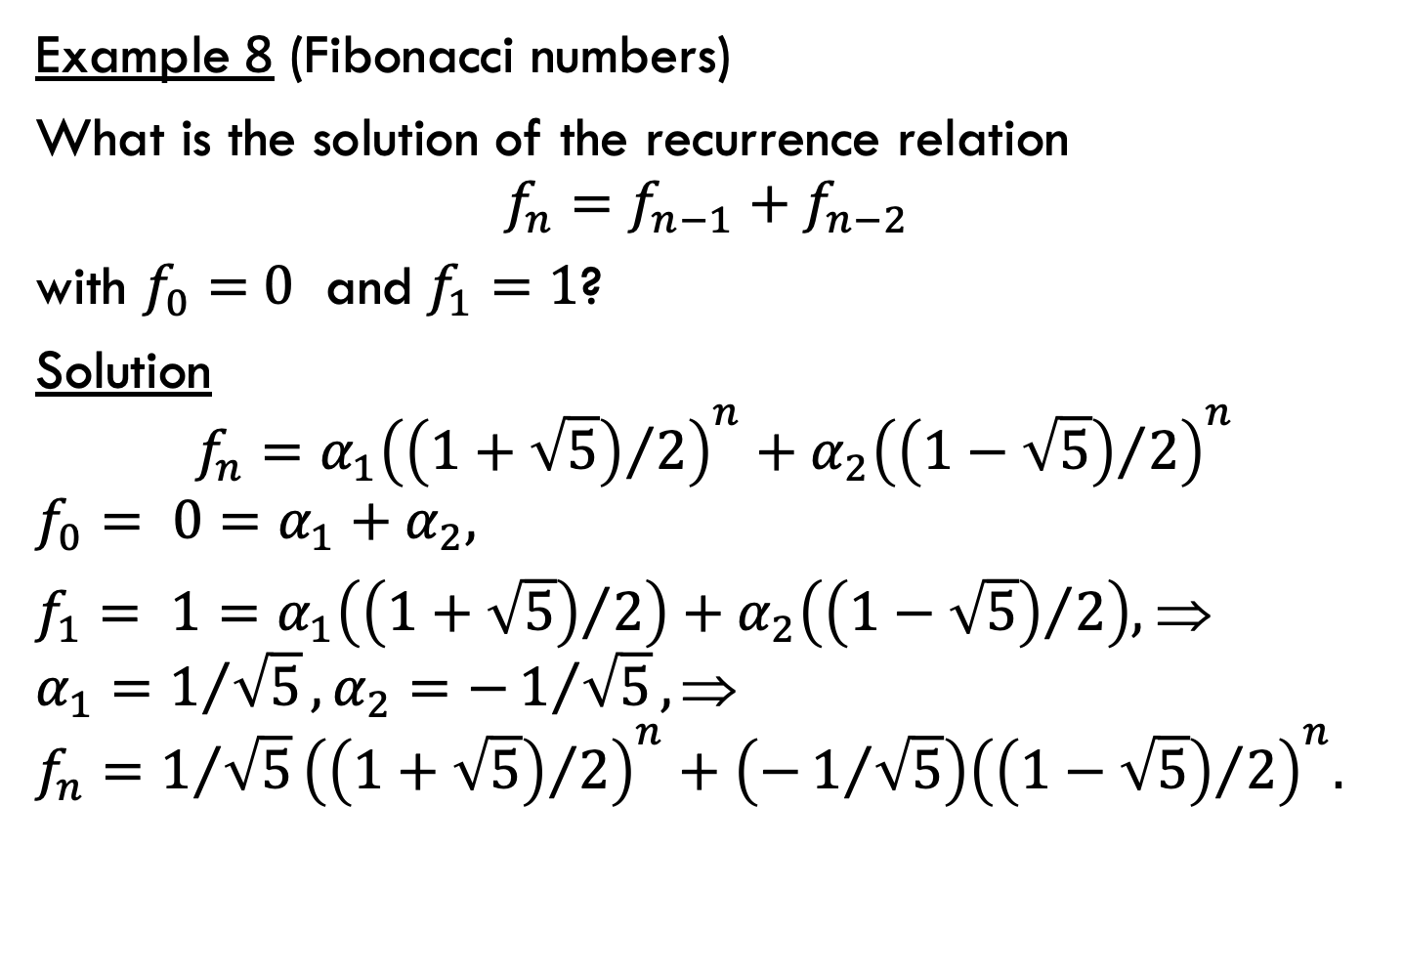
Solving linear homogeneous recurrence relations with constant coefficients of degree two
Example 8 (Fibonacci numbers)
What is the solution of the recurrence relation
$$f_{n}=f_{n−1}+f_{n−2}$$
with $f_{0}=$ $0$ and $f_{1}=1$?
Solution
$$f_{n}=α_{1}{\left({\left(1+\sqrt{5}\right)}/2\right)}^{n}+α_{2}{\left({\left(1−\sqrt{5}\right)}/2\right)}^{n}$$
$$f_{0}= 0=α_{1}+α_{2},$$
$f_{1}= 1=α_{1}\left({\left(1+\sqrt{5}\right)}/2\right)+α_{2}\left({\left(1−\sqrt{5}\right)}/2\right),$ ⇒
$$α_{1}=1/{\sqrt{5}}, α_{2}=−1/{\sqrt{5}}, $$
$$f_{n}=1/{\sqrt{5}}{\left({\left(1+\sqrt{5}\right)}/2\right)}^{n}+\left(−1/{\sqrt{5}}\right){\left({\left(1−\sqrt{5}\right)}/2\right)}^{n}.$$

Slide 36
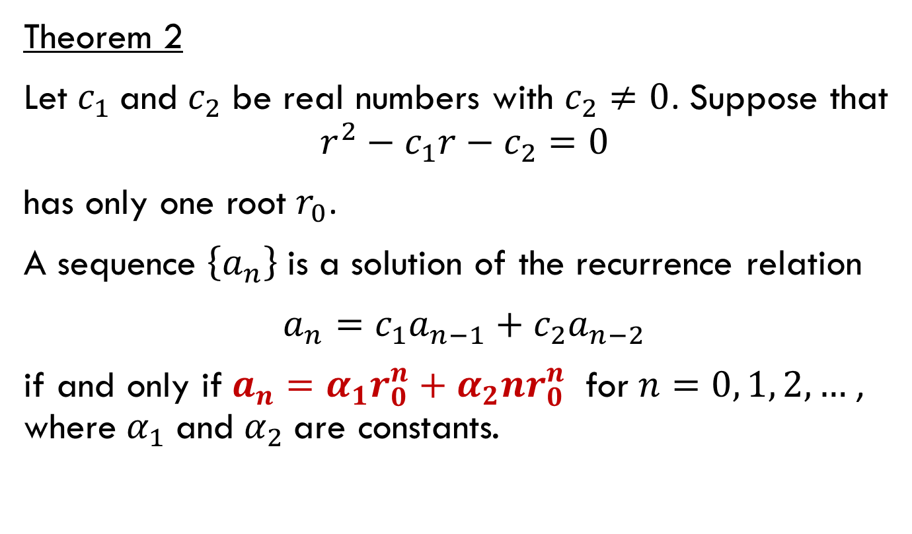
Solving linear homogeneous recurrence relations with constant coefficients of degree two
Theorem 2
Let $c_{1}$ and $c_{2}$ be real numbers with $c_{2}≠0$. Suppose that
$$r^{2}−c_{1}r−c_{2}=0$$
has only one root $r_{0}$.
A sequence $\left\{a_{n}\right\}$ is a solution of the recurrence relation
$a_{n}=c_{1}a_{n−1}+c_{2}a_{n−2}$
if and only if $a_{n}=α_{1}r_{0}^{n}+α_{2}{nr}_{0}^{n}$ for $n=0, 1, 2,…$, where $α_{1}$ and $α_{2}$ are constants.

Slide 37
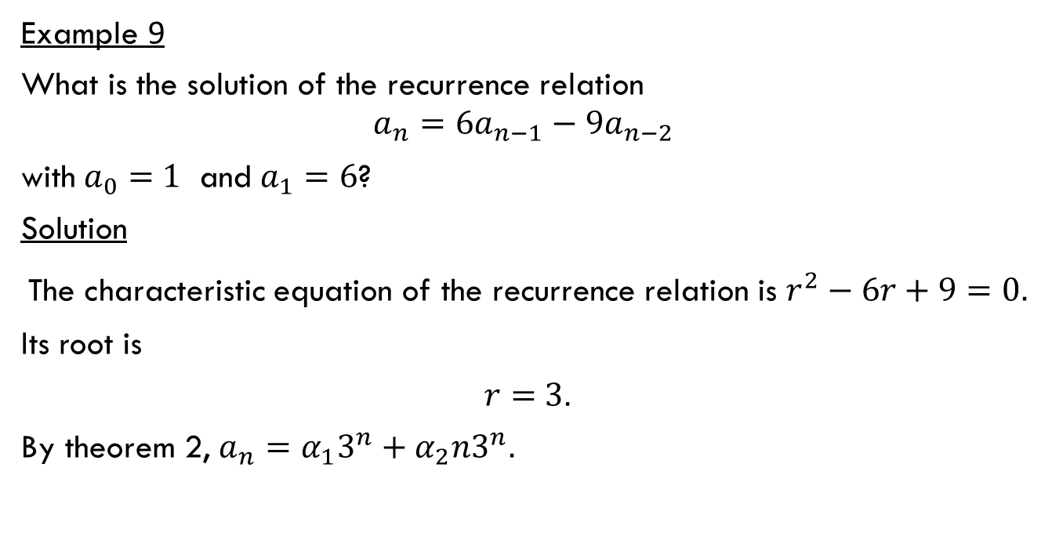
Solving linear homogeneous recurrence relations with constant coefficients of degree two
Example 9
What is the solution of the recurrence relation
$$a_{n}={6a}_{n−1}−9a_{n−2}$$
with $a_{0}=$ $1$ and $a_{1}=6$?
Solution
The characteristic equation of the recurrence relation is $r^{2}−6r+9=0.$
Its root is
$r=$ $3$.
By theorem 2, $a_{n}=α_{1}3^{n}+α_{2}n3^{n}.$

Slide 38
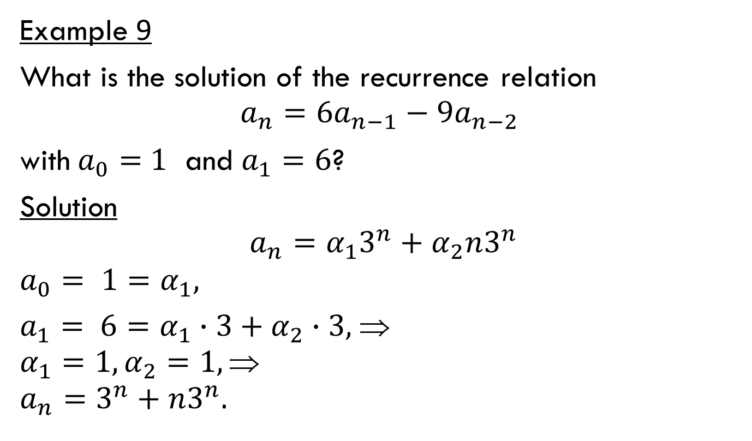
Solving linear homogeneous recurrence relations with constant coefficients of degree two
Example 9
What is the solution of the recurrence relation
$$a_{n}={6a}_{n−1}−9a_{n−2}$$
with $a_{0}=$ $1$ and $a_{1}=6$?
Solution
$$a_{n}=α_{1}3^{n}+α_{2}n3^{n}$$
$$a_{0}= 1=α_{1},$$
$a_{1}= 6=α_{1}∙3+α_{2}∙3,$ ⇒
$$α_{1}=1, α_{2}=1, $$
$$a_{n}=3^{n}+n3^{n}.$$

Slide 39
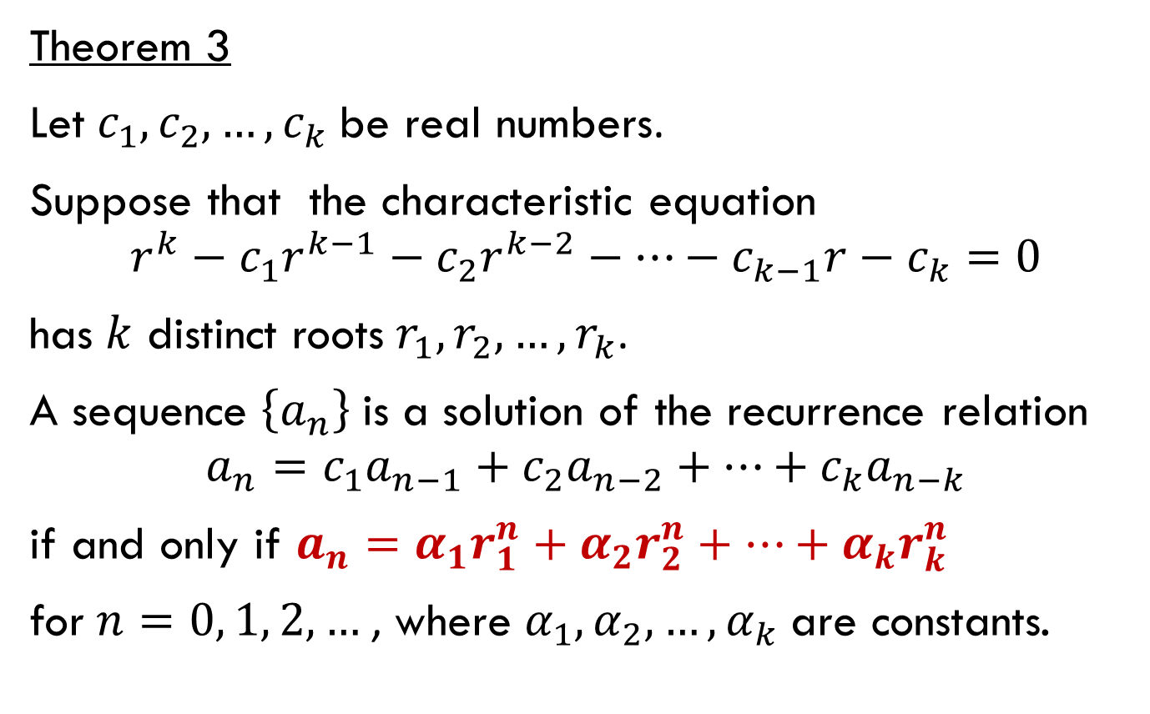
Solving linear homogeneous recurrence relations with constant coefficients of degree three
Theorem 3
Let $c_{1}, c_{2}, …, c_{k}$ be real numbers.
Suppose that the characteristic equation
$$r^{k}−c_{1}r^{k−1}−c_{2}r^{k−2}−…−c_{k−1}r−c_{k}=0$$
has $k$ distinct roots $r_{1}, r_{2}, …, r_{k}$.
A sequence $\left\{a_{n}\right\}$ is a solution of the recurrence relation
$$a_{n}=c_{1}a_{n−1}+c_{2}a_{n−2}+…+c_{k}a_{n−k}$$
if and only if $a_{n}=α_{1}r_{1}^{n}+α_{2}r_{2}^{n}+…+α_{k}r_{k}^{n}$
for $n=0, 1, 2,…$, where $α_{1}, α_{2}, …, α_{k}$ are constants.

Slide 40
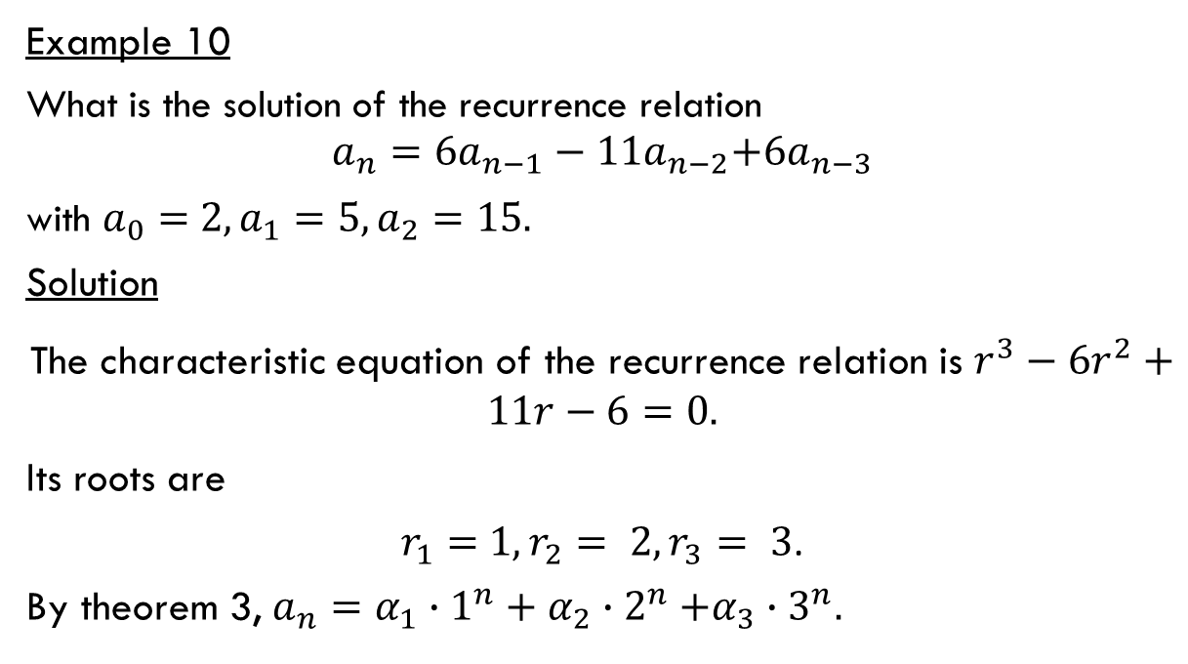
Solving linear homogeneous recurrence relations with constant coefficients of degree three
Example 10
What is the solution of the recurrence relation
$$a_{n}={6a}_{n−1}−11a_{n−2}\text{+6}a_{n−3}$$
with $a_{0}=$ $2,a_{1}=5, a_{2}=15.$
Solution
The characteristic equation of the recurrence relation is ${r^{3}−6r}^{2}+11r−6=0.$
Its roots are
$r_{1}=$ $1,r_{2}= 2,r_{3}= 3$.
By theorem 3, $a_{n}=α_{1}∙1^{n}+α_{2}{∙2}^{n}+α_{3}{∙3}^{n}.$

Slide 41
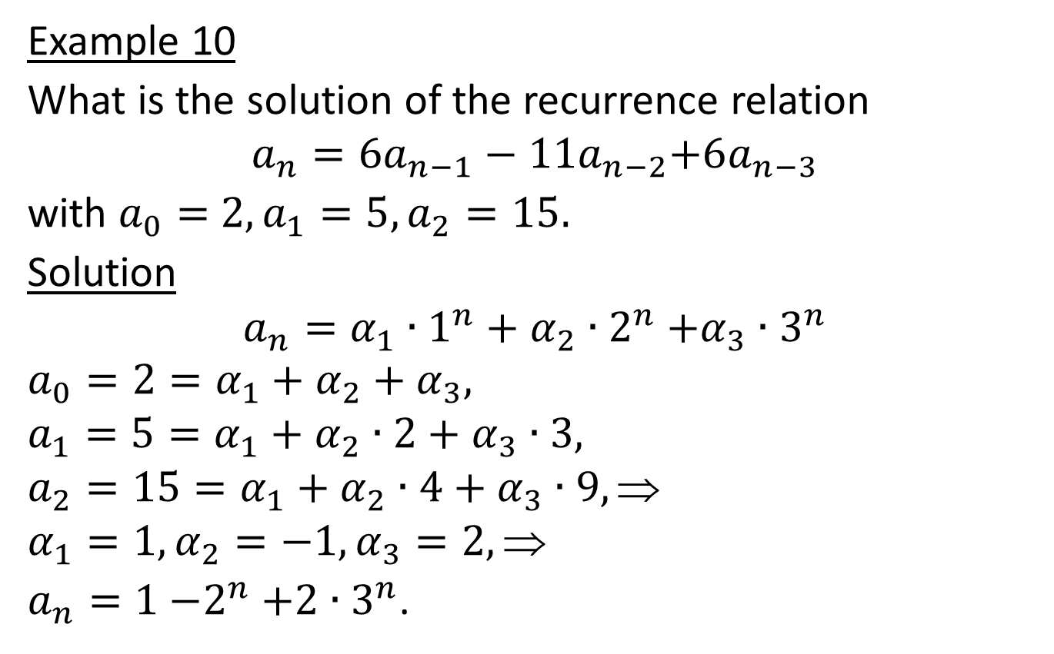
Solving linear homogeneous recurrence relations with constant coefficients of degree three
Example 10
What is the solution of the recurrence relation
$$a_{n}={6a}_{n−1}−11a_{n−2}\text{+6}a_{n−3}$$
with $a_{0}=$ $2,a_{1}=5, a_{2}=15.$
Solution
$$a_{n}=α_{1}∙1^{n}+α_{2}{∙2}^{n}+α_{3}{∙3}^{n}$$
$$a_{0}=2=α_{1}+α_{2}+α_{3},$$
$$a_{1}=5=α_{1}+α_{2}∙2+α_{3}∙3,$$
$$a_{2}=15=α_{1}+α_{2}∙4+α_{3}∙9, $$
$$α_{1}=1, α_{2}=−1, α_{3}=2, $$
$a_{n}=1{−2}^{n}+2{∙3}^{n}$.

Slide 42
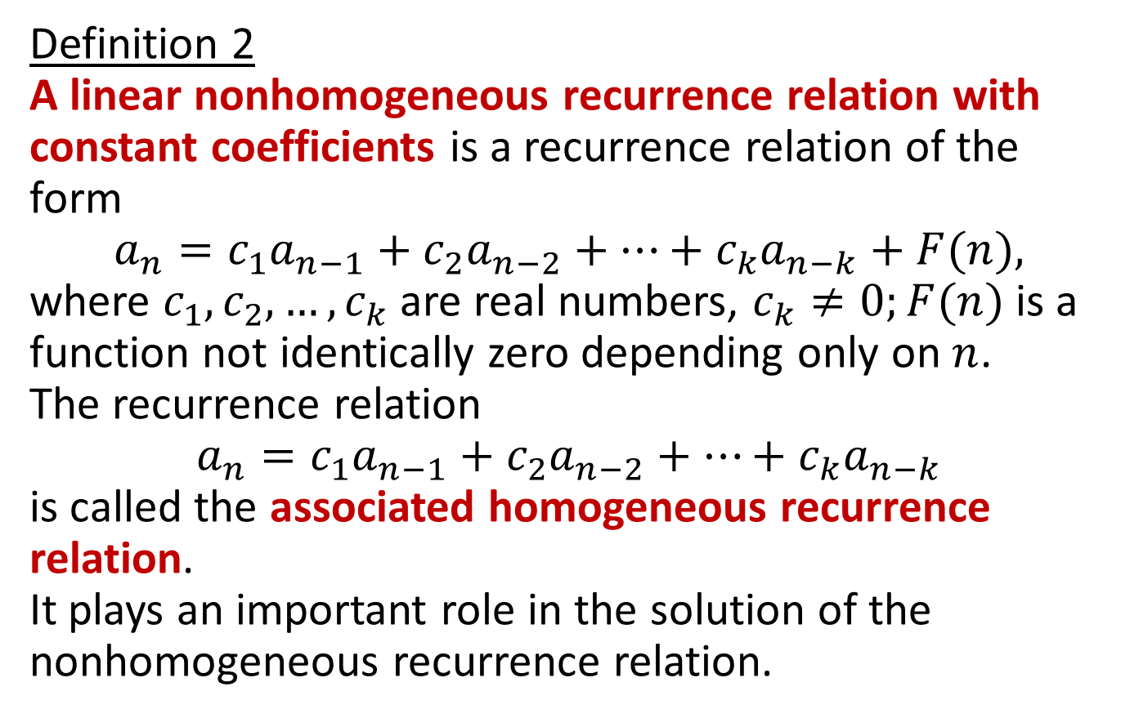
Linear nonhomogeneous recurrence relations with constant coefficients
Definition 2
A linear nonhomogeneous recurrence relation with constant coefficients is a recurrence relation of the form
$$a_{n}=c_{1}a_{n−1}+c_{2}a_{n−2}+…+c_{k}a_{n−k}+F(n),$$
where $c_{1}, c_{2},…, c_{k}$ are real numbers, $c_{k}≠0;F(n)$ is a function not identically zero depending only on $n$.
The recurrence relation
$$a_{n}=c_{1}a_{n−1}+c_{2}a_{n−2}+…+c_{k}a_{n−k}$$
is called the associated homogeneous recurrence relation.
It plays an important role in the solution of the nonhomogeneous recurrence relation.

Slide 43
PARTICULAR Solution Forms
F(n) | a_{n}^{(P)}
c | A, a constant
n | A₁n+A₀
n² | ^{A}₂ n^{2+A}₁n+A₀
n^{t} , t ε Z | ^{A}_{t} n^{t} + A_{t-1} n^{t-1} + ….+ ^{A}₁n+A₀
r^{n} , r ε R | A.r^{n}
sinθn | A sinθn + B cos θn
cos θn | A sinθn + B cos θn
n^{t} r^{n} | r^{n} (^{A}_{t} n^{t} + A_{t-1} n^{t-1} + ….+ ^{A}₁n+A₀)
r^{n} sinθn | A r^{n} sinθn + B r^{n} cos θn
r^{n} cosθn | A r^{n} sinθn + B r^{n} cos θn

Slide 44
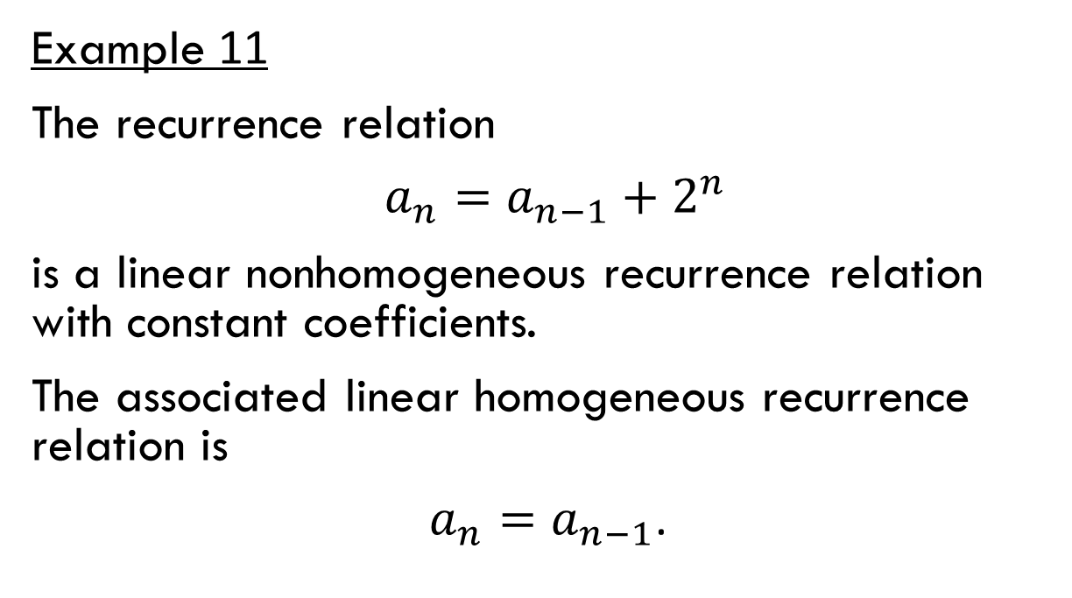
Linear nonhomogeneous recurrence relations with constant coefficients
Example 11
The recurrence relation
$a_{n}=a_{n−1}+2^{n}$
is a linear nonhomogeneous recurrence relation with constant coefficients.
The associated linear homogeneous recurrence relation is
$a_{n}=a_{n−1}$.

Slide 45
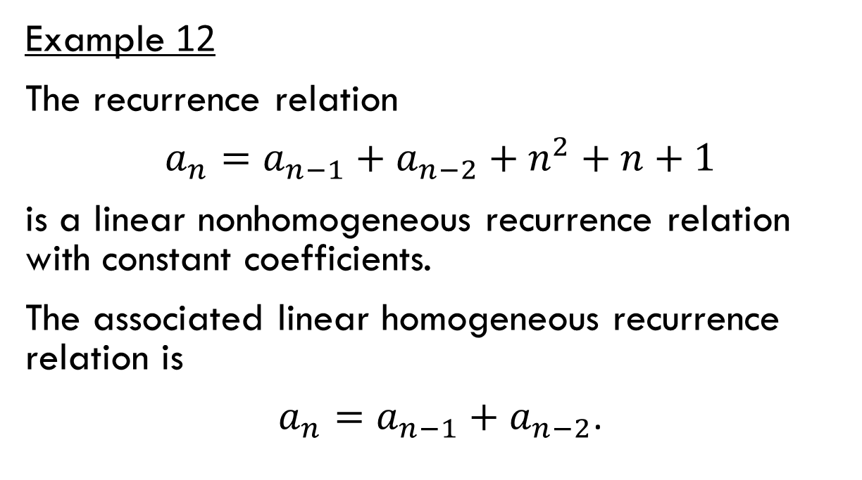
Linear nonhomogeneous recurrence relations with constant coefficients
Example 12
The recurrence relation
$a_{n}=a_{n−1}+a_{n−2}+n^{2}+n+1$
is a linear nonhomogeneous recurrence relation with constant coefficients.
The associated linear homogeneous recurrence relation is
$a_{n}=a_{n−1}+a_{n−2}$.

Slide 46
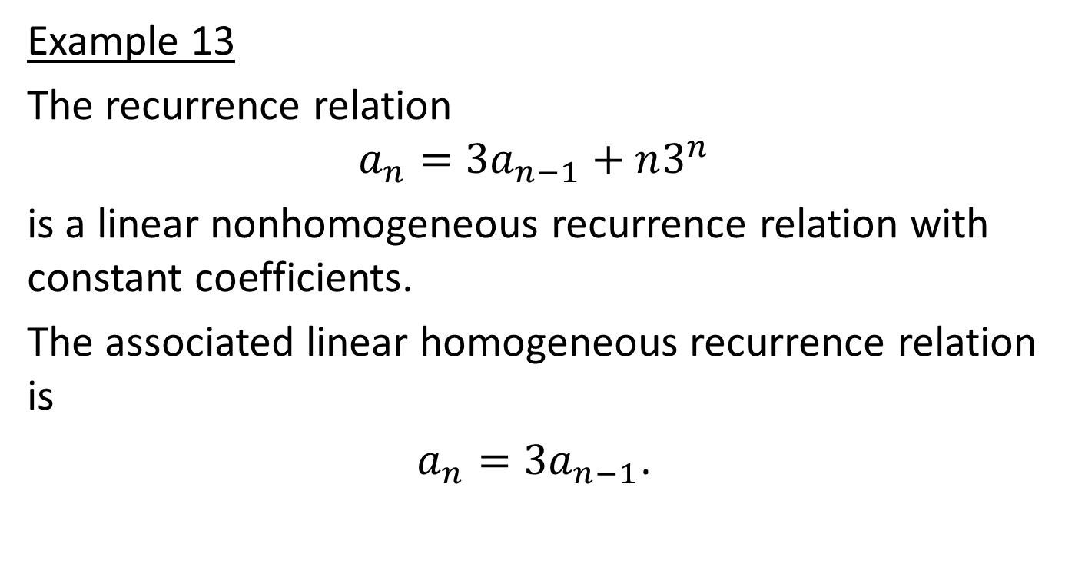
Linear nonhomogeneous recurrence relations with constant coefficients
Example 13
The recurrence relation
$$a_{n}={3a}_{n−1}+n3^{n}$$
is a linear nonhomogeneous recurrence relation with constant coefficients.
The associated linear homogeneous recurrence relation is
$a_{n}={3a}_{n−1}$.

Slide 47
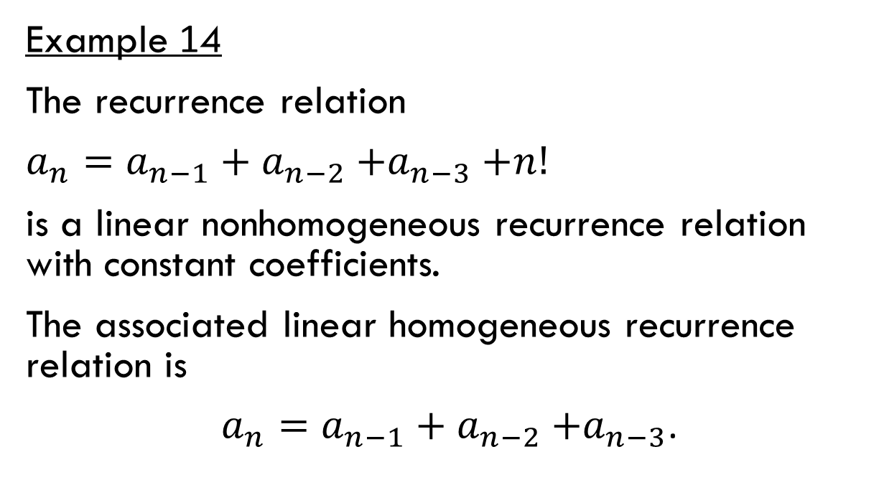
Linear nonhomogeneous recurrence relations with constant coefficients
Example 14
The recurrence relation
$a_{n}=a_{n−1}+a_{n−2}{+a}_{n−3}+n!$
is a linear nonhomogeneous recurrence relation with constant coefficients.
The associated linear homogeneous recurrence relation is
$a_{n}=a_{n−1}+a_{n−2}{+a}_{n−3}$.

Slide 48
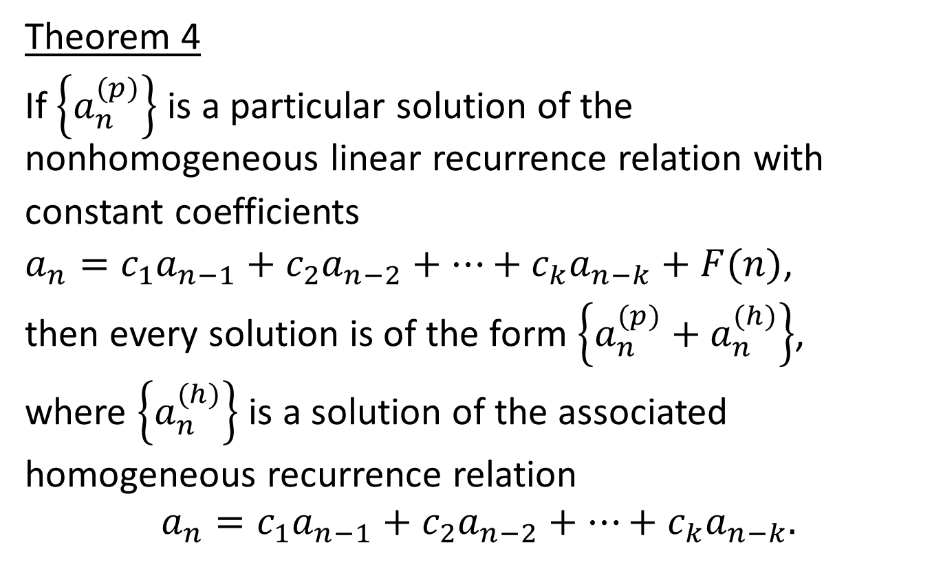
Linear nonhomogeneous recurrence relations with constant coefficients
Theorem 4
If $\left\{a_{n}^{(p)}\right\}$ is a particular solution of the nonhomogeneous linear recurrence relation with
constant coefficients
$a_{n}=c_{1}a_{n−1}+c_{2}a_{n−2}+…+c_{k}a_{n−k}+F(n)$,
then every solution is of the form $\left\{a_{n}^{(p)}+a_{n}^{(h)}\right\}$,
where $\left\{a_{n}^{(h)}\right\}$ is a solution of the associated
homogeneous recurrence relation
$$a_{n}=c_{1}a_{n−1}+c_{2}a_{n−2}+…+c_{k}a_{n−k}.$$

Slide 49
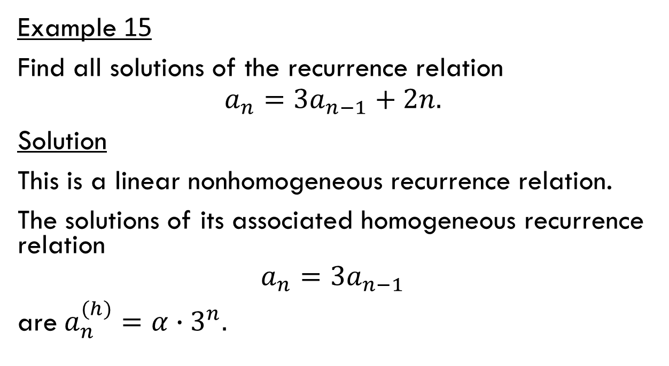
Linear nonhomogeneous recurrence relations with constant coefficients
Example 15
Find all solutions of the recurrence relation
$$a_{n}={3a}_{n−1}+2n.$$
Solution
This is a linear nonhomogeneous recurrence relation.
The solutions of its associated homogeneous recurrence relation
$$a_{n}={3a}_{n−1}$$
are $a_{n}^{(h)}=α∙3^{n}.$

Slide 50
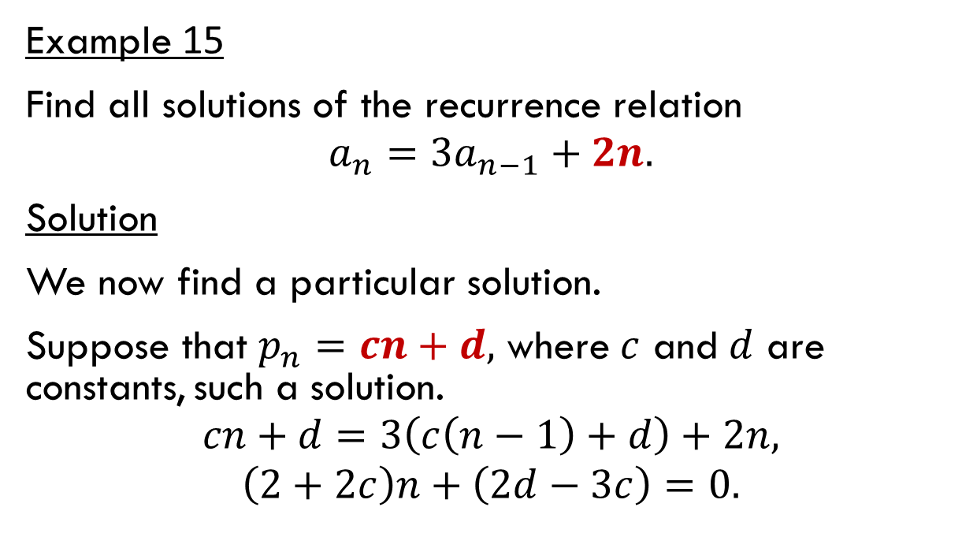
Linear nonhomogeneous recurrence relations with constant coefficients
Example 15
Find all solutions of the recurrence relation
$$a_{n}={3a}_{n−1}+2n.$$
Solution
We now find a particular solution.
Suppose that $p_{n}=cn+d,$ where $c$ and $d$ are constants, such a solution.
$$cn+d=3\left(c\left(n−1\right)+d\right)+2n,$$
$$\left(2+2c\right)n+\left(2d−3c\right)=0.$$

Slide 51
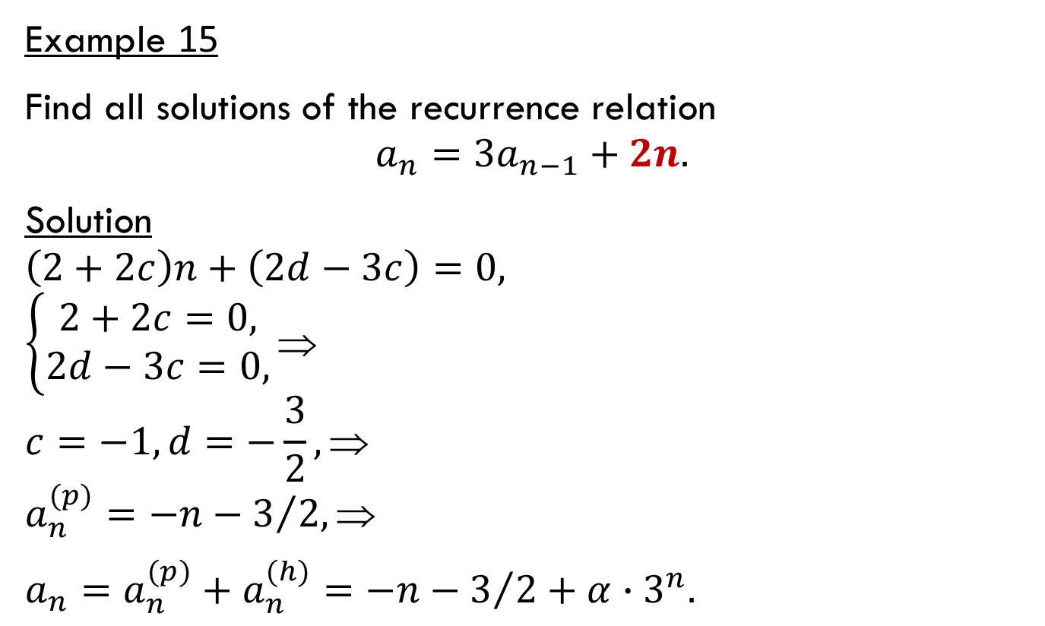
Linear nonhomogeneous recurrence relations with constant coefficients
Example 15
Find all solutions of the recurrence relation
$$a_{n}={3a}_{n−1}+2n.$$
Solution
$$\left(2+2c\right)n+\left(2d−3c\right)=0,$$
$$\left\{\begin{aligned}2+2c=0, \\ 2d−3c=0,\end{aligned}\right.⇒$$
$$c=−1, d=−\frac{3}{2}, $$
$$a_{n}^{(p)}=−n−3/{2, }$$
$a_{n}=a_{n}^{(p)}+a_{n}^{(h)}=$ $−n−3/2+α∙3^{n}.$

Slide 52
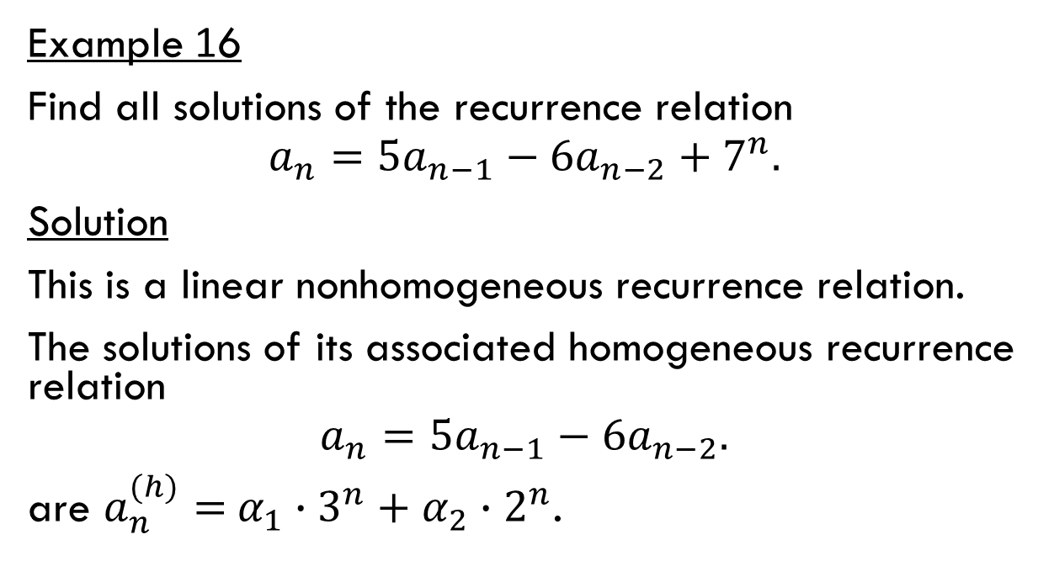
Linear nonhomogeneous recurrence relations with constant coefficients
Example 16
Find all solutions of the recurrence relation
$$a_{n}={5a}_{n−1}−6a_{n−2}+7^{n}.$$
Solution
This is a linear nonhomogeneous recurrence relation.
The solutions of its associated homogeneous recurrence relation
$$a_{n}={5a}_{n−1}−6a_{n−2}.$$
are $a_{n}^{(h)}=$ $α_{1}∙3^{n}+α_{2}∙2^{n}$.

Slide 53
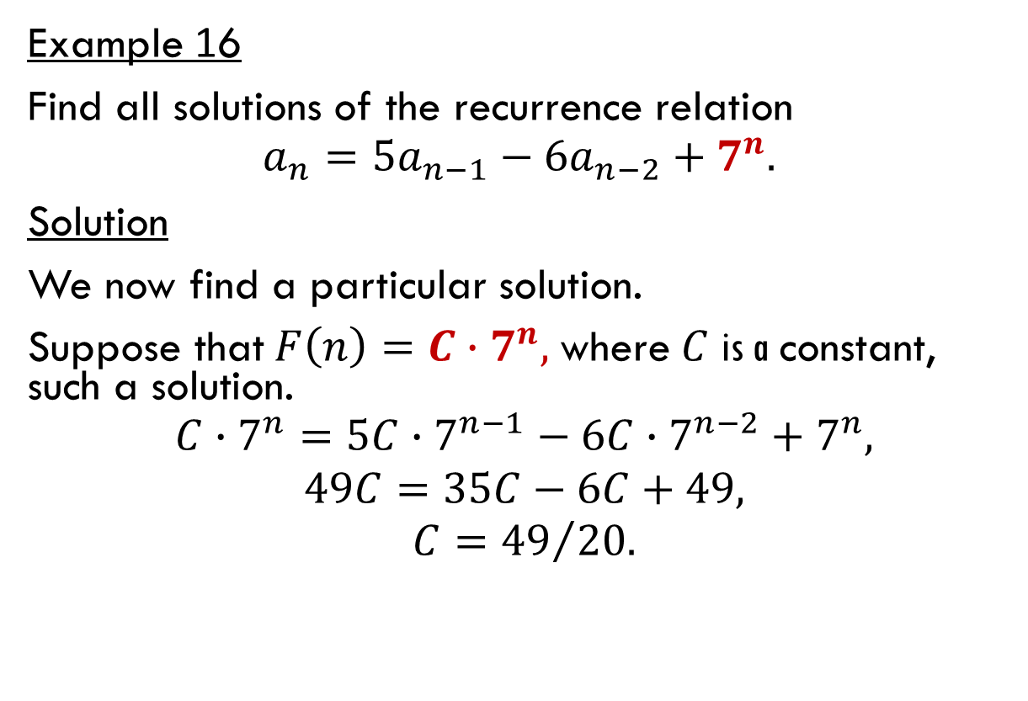
Linear nonhomogeneous recurrence relations with constant coefficients
Example 16
Find all solutions of the recurrence relation
$$a_{n}={5a}_{n−1}−6a_{n−2}+7^{n}.$$
Solution
We now find a particular solution.
Suppose that $F\left(n\right)=C∙7^{n}\text{, }\text{where} C$is a$\text{constant}\text{,} \text{such} \text{a} \text{solution}\text{.}$
$$C∙7^{n}=5C∙7^{n−1}−6C∙7^{n−2}+7^{n},$$
$$49C=35C−6C+49,$$
$$C={49}/{20.}$$

Slide 54
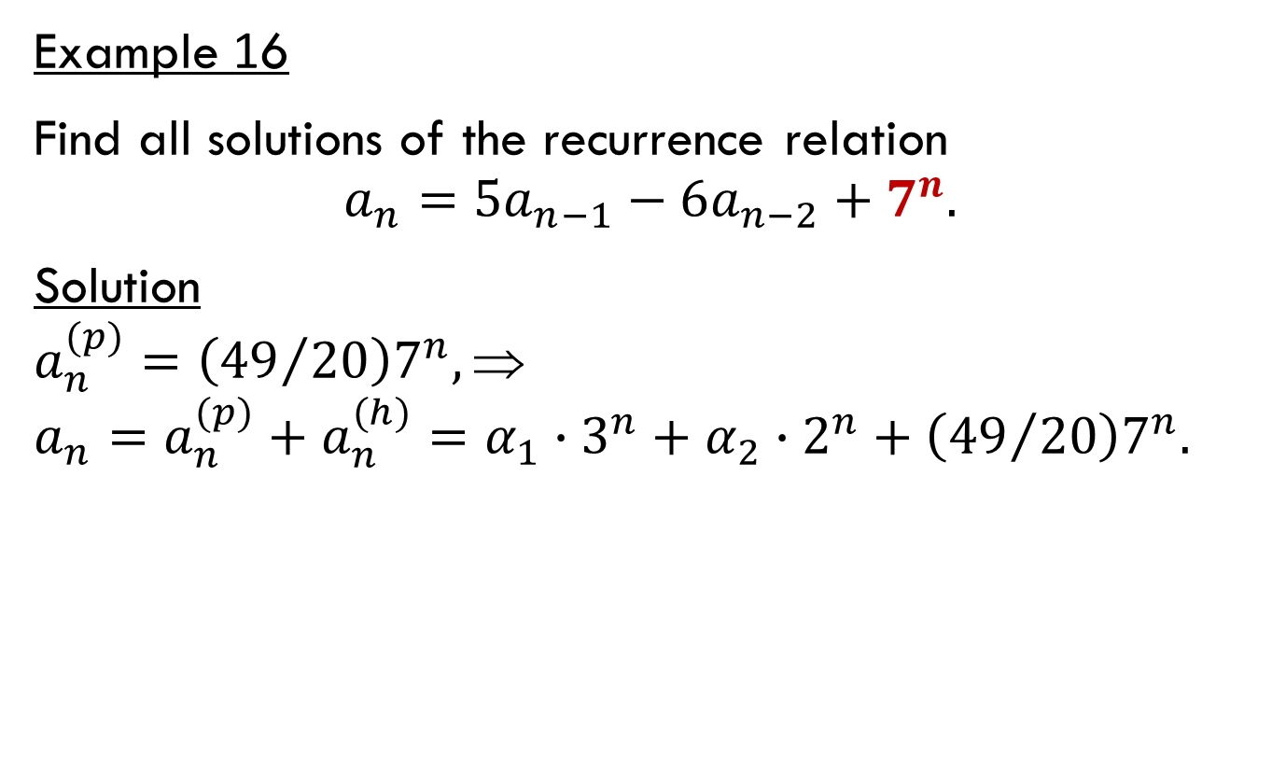
Linear nonhomogeneous recurrence relations with constant coefficients
Example 16
Find all solutions of the recurrence relation
$$a_{n}={5a}_{n−1}−6a_{n−2}+7^{n}.$$
Solution
$$a_{n}^{(p)}=\left({49}/{20}\right)7^{n},⇒$$
$$a_{n}=a_{n}^{(p)}+a_{n}^{(h)}=α_{1}∙3^{n}+α_{2}∙2^{n}+\left({49}/{20}\right)7^{n}.$$

