Slide 1
Unit-VI- Graphs and Trees
Copyright © McGraw-Hill Education. All rights reserved. No reproduction or distribution without the prior written consent of McGraw-Hill Education.

Slide 2
PART I- GRAPHS AND THEIR TERMINOLOGIES

Slide 3
Disclaimer
The slides are adapted from Kenneth H. Rosen, 5th Edition, and C. L. Liu, 4e.

Slide 4
Outline
Introduction
Basic Graph Terminology
Digraphs and Relations
Representation of Graphs
Operation on Graphs
Paths and Circuits
Graph traversals
Shortest Path in Weighted Graphs
Eulerian paths and Circuits
Hamiltonian Paths and Circuits
Planar Graphs

Slide 5
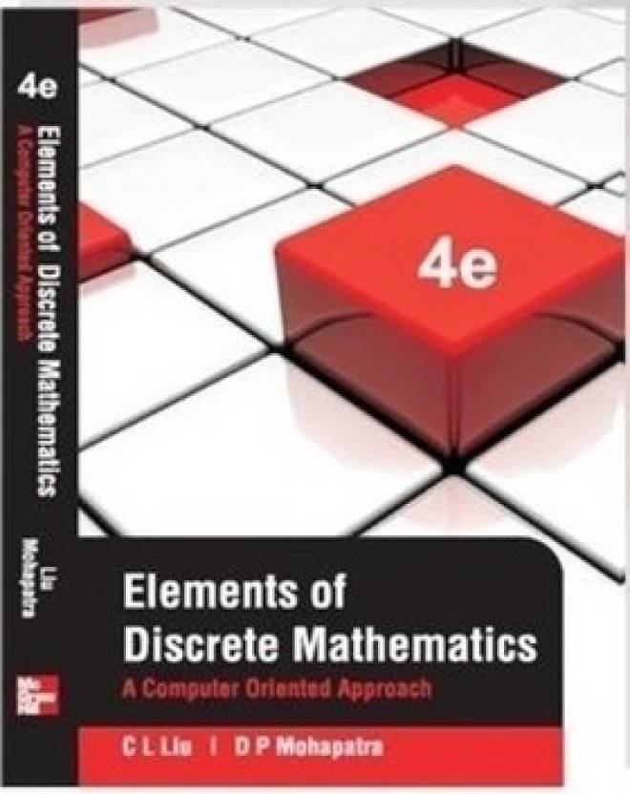
Topics for Self Study
Multigraphs and Weighted Graphs(Elements of Discrete Mathematics, C.L Liu and D.P Mohapatra, 4e)
Factors of a Graph(Elements of Discrete Mathematics, C.L Liu and D.P Mohapatra, 4e)
Graph Coloring(Elements of Discrete Mathematics, C.L Liu and D.P Mohapatra, 4e)

Slide 6
Introduction and Motivation
To model a computer network where we care about the number of links between data centers, we use a multigraph.
To model a computer network with diagnostic links at data centers, we use a pseudograph, as loops are needed.
To model a network with multiple one-way links, we use a directed multigraph. Note that we could use a directed graph without multiple edges if we only care whether there is at least one link from a data center to another data center.

Slide 7
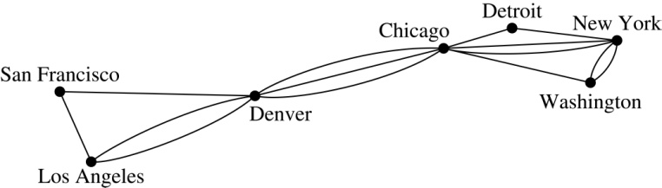
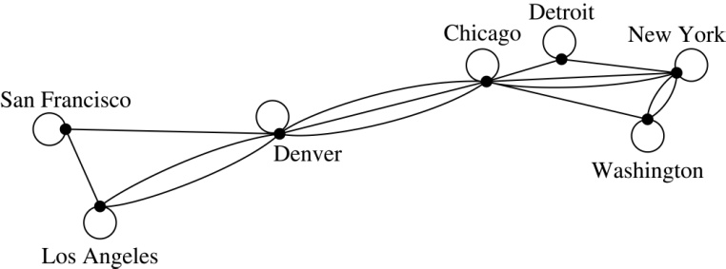
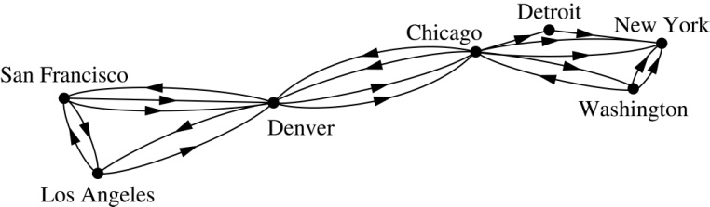
Graph Models: Computer Networks (continued)
.

Slide 8
Introduction and Motivation
We will illustrate how graph theory can be used in models of:
Social networks
Communications networks
Information networks
Software design
Transportation networks
Biological networks
It’s a challenge to find a subject to which graph theory has not yet been applied. Can you find an area without applications of graph theory?

Slide 9
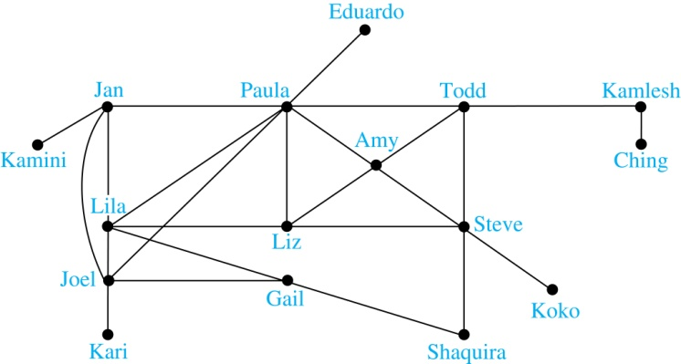
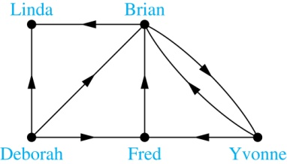
Introduction and Motivation
Example: A friendship graph where two people are connected if they are Facebook friends.
Example: An influence graph

Slide 10
Graph Terminology
Definition: A graph G = (V, E) consists of a nonempty set V of vertices (or nodes) and a set E of edges. Each edge has either one or two vertices associated with it, called its endpoints. An edge is said to connect its endpoints.
A graph with an infinite vertex set is called an infinite graph. A graph with a finite vertex set is called a finite graph. A graph with no vertex and no edge is a null graph.
Example:
a
b
This is a graph with four vertices and five edges.
d
c

Slide 11
Graph Terminology
In a simple graph each edge connects two different vertices and no two edges connect the same pair of vertices.
Multigraphs may have multiple edges connecting the same two vertices. When m different edges connect the vertices u and v, we say that {u,v} is an edge of multiplicity m.
An edge that connects a vertex to itself is called a loop.
A pseudograph may include loops, as well as multiple edges connecting the same pair of vertices.
Example:
This pseudograph has both multiple edges and a loop.
a
b
Remark: There is no standard terminology for graph theory. So, it is crucial that you understand the terminology being used whenever you read material about graphs.
c

Slide 12
Directed Graphs
Definition: A directed graph (or digraph) G = (V, E) consists of a nonempty set V of vertices (or nodes) and a set E of directed edges (or arcs). Each edge is associated with an ordered pair of vertices. The directed edge associated with the ordered pair (u,v) is said to start at u and end at v.
Remark:
Graphs where the end points of an edge are not ordered are said to be undirected graphs.

Slide 13
Some Terminology (continued)
A simple directed graph has no loops and no multiple edges.
A directed multigraph may have multiple directed edges. When there are m directed edges from the vertex u to the vertex v, we say that (u,v) is an edge of multiplicity m.
Example:
a
b
This is a directed graph with three vertices and four edges.
c
Example:
In this directed multigraph the multiplicity of (a,b) is 1 and the multiplicity of (b,c) is 2.
a
b
c

Slide 14

Basic Terminology
Definition 1. Two vertices u, v in an undirected graph G are called adjacent (or neighbors) in G if there is an edge e between u and v. Such an edge e is called incident with the vertices u and v and e is said to connect u and v.
Definition 2. The set of all neighbors of a vertex v of G = (V, E), denoted by N(v), is called the neighborhood of v. If A is a subset of V, we denote by N(A) the set of all vertices in G that are adjacent to at least one vertex in A. So,
Definition 3. The degree of a vertex in a undirected graph is the number of edges incident with it, except that a loop at a vertex contributes two to the degree of that vertex. The degree of the vertex v is denoted by deg(v).

Slide 15
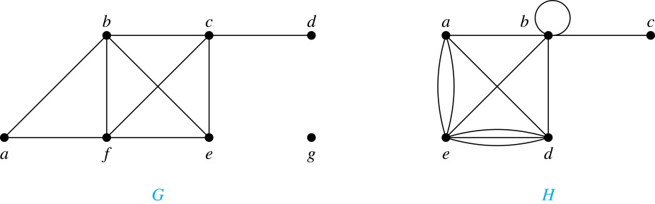
Degrees and Neighborhoods of Vertices
Example: What are the degrees and neighborhoods of the vertices in the graphs G and H?
Solution:
G: deg(a) = 2, deg(b) = deg(c) = deg(f ) = 4, deg(d ) = 1,
deg(e) = 3, deg(g) = 0.
N(a) = {b, f }, N(b) = {a, c, e, f }, N(c) = {b, d, e, f }, N(d) = {c},
N(e) = {b, c , f }, N(f) = {a, b, c, e}, N(g) = ∅ .
H: deg(a) = 4, deg(b) = deg(e) = 6, deg(c) = 1, deg(d) = 5.
N(a) = {b, d, e}, N(b) = {a, b, c, d, e}, N(c) = {b},
N(d) = {a, b, e}, N(e) = {a, b ,d}.

Slide 16
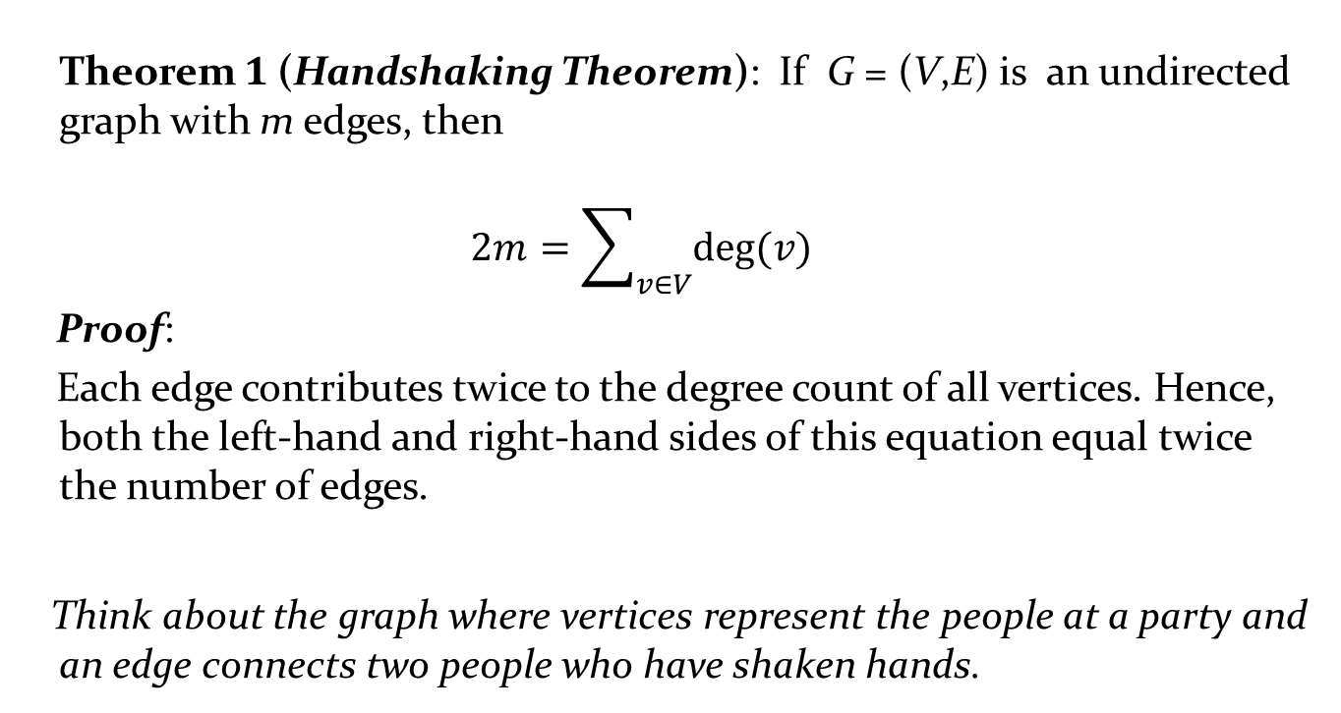
Degrees of Vertices
Theorem 1 (Handshaking Theorem): If G = (V,E) is an undirected graph with m edges, then
$$2m=\sum_{v∈V}{deg⁡(v)}$$
Proof:
Each edge contributes twice to the degree count of all vertices. Hence, both the left-hand and right-hand sides of this equation equal twice the number of edges.
Think about the graph where vertices represent the people at a party and an edge connects two people who have shaken hands.

Slide 17
Handshaking Theorem
We now give two examples illustrating the usefulness of the handshaking theorem.
Example: How many edges are there in a graph with 10 vertices of degree six?
Solution: Because the sum of the degrees of the vertices is 6 ⋅ 10 = 60, the handshaking theorem tells us that 2m = 60. So the number of edges m = 30.
Example: If a graph has 5 vertices, can each vertex have degree 3?
Solution: This is not possible by the handshaking thorem, because the sum of the degrees of the vertices 3 ⋅ 5 = 15 is odd.

Slide 18
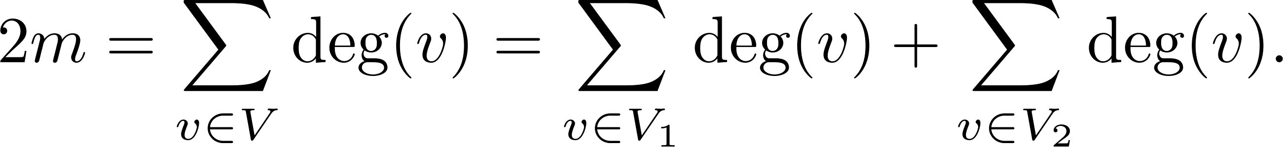
Degree of Vertices (continued)
Theorem 2: An undirected graph has an even number of vertices of odd degree.
Proof: Let V₁ be the vertices of even degree and V₂ be the vertices of odd degree in an undirected graph G = (V, E) with m edges. Then
even
This sum must be even because 2m is even and the sum of the degrees of the vertices of even degrees is also even. Because this is the sum of the degrees of all vertices of odd degree in the graph, there must be an even number of such vertices.
must be even since deg(v) is even for each v ∈ V₁

Slide 19
Directed Graphs and relations
Recall the definition of a directed graph.
Definition: An directed graph G = (V, E) consists of V, a nonempty set of vertices (or nodes), and E, a set of directed edges or arcs. Each edge is an ordered pair of vertices. The directed edge (u,v) is said to start at u and end at v.
Definition: Let (u,v) be an edge in G. Then u is the initial vertex of this edge and is adjacent to v and v is the terminal (or end) vertex of this edge and is adjacent from u. The initial and terminal vertices of a loop are the same.

Slide 20
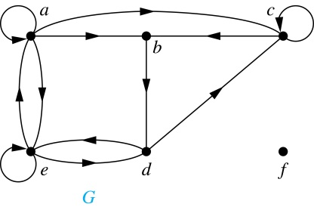
Directed Graphs (continued)
Definition: The in-degree of a vertex v, denoted deg⁻(v), is the number of edges which terminate at v. The out-degree of v, denoted deg⁺(v), is the number of edges with v as their initial vertex. Note that a loop at a vertex contributes 1 to both the in-degree and the out-degree of the vertex.
Example: In the graph G we have
deg⁻(a) = 2, deg⁻(b) = 2, deg⁻(c) = 3, deg⁻(d) = 2,
deg⁻(e) = 3, deg⁻(f) = 0.
deg⁺(a) = 4, deg⁺(b) = 1, deg⁺(c) = 2, deg⁺(d) = 2,
deg⁺ (e) = 3, deg⁺(f) = 0.

Slide 21
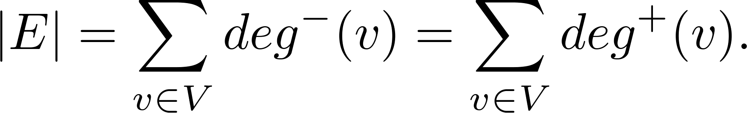
Directed Graphs (continued)
Theorem 3: Let G = (V, E) be a graph with directed edges. Then:
Proof: The first sum counts the number of outgoing edges over all vertices and the second sum counts the number of incoming edges over all vertices. It follows that both sums equal the number of edges in the graph.

Slide 22
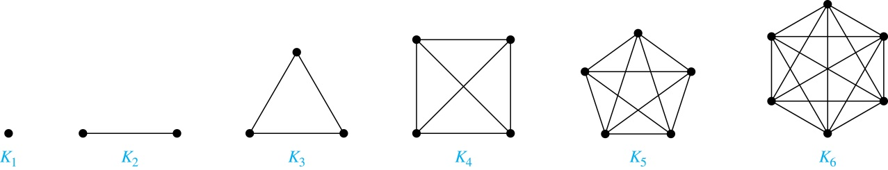
Special Types of Simple Graphs: Complete Graphs
A complete graph on n vertices, denoted by K_{n}, is the simple graph that contains exactly one edge between each pair of distinct vertices.
What are the number of edges in a complete graph of n vertices??
^{Number of edge = n} C ₂

Slide 23
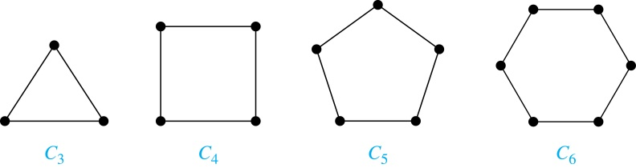
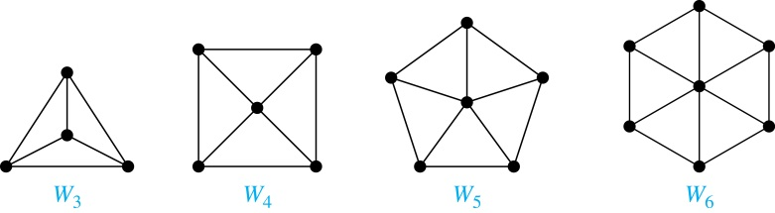
Special Types of Simple Graphs: Cycles and Wheels
A cycle C_{n} for n ≥ 3 consists of n vertices v₁, v₂ ,⋯ , v_{n}, and edges {v₁, v₂}, {v₂, v₃} ,⋯ , {v_{n-1}, v_{n}}, {v_{n}, v₁}.
A wheel W_{n} is obtained by adding an additional vertex to a cycle C_{n} for n ≥ 3 and connecting this new vertex to each of the n vertices in C_{n} by new edges.
|E| = 2n
Exactly n vertices
Exactly n edges
Every vertex has degree 2

Slide 24
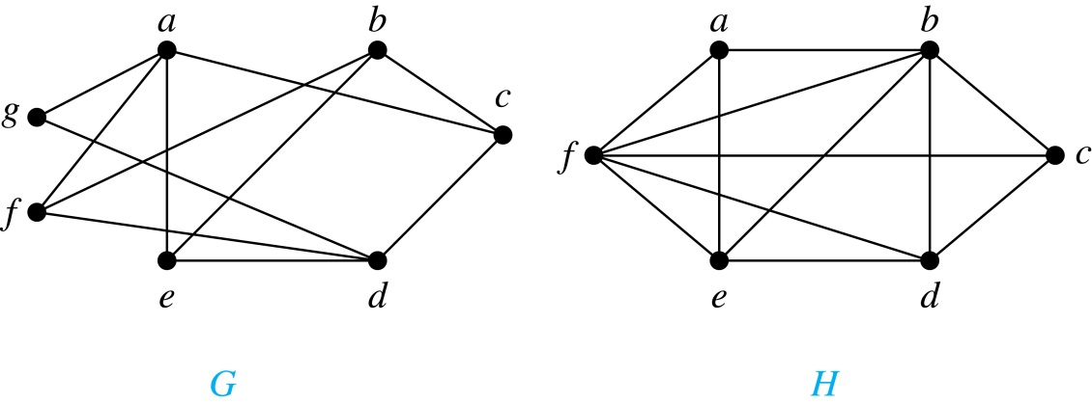
Bipartite Graphs
Definition: A simple graph G is bipartite if V can be partitioned into two disjoint subsets V₁ and V₂ such that every edge connects a vertex in V₁ and a vertex in V₂. In other words, there are no edges which connect two vertices in V₁ or in V₂.
It is not hard to show that an equivalent definition of a bipartite graph is a graph where it is possible to color the vertices red or blue so that no two adjacent vertices are the same color.
H is not bipartite
since if we color a red, then the adjacent vertices f and b must both be blue.
G is bipartite

Slide 25
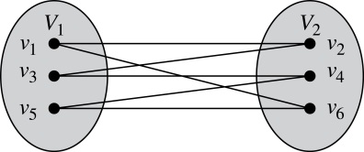
Bipartite Graphs (continued)
Example: Show that C₆ is bipartite.
Solution: We can partition the vertex set into V₁ = {v₁, v₃, v₅} and V₂ = {v₂, v₄, v₆} so that every edge of C₆ connects a vertex in V₁ and V₂ .
Example: Show that C₃ is not bipartite.
Solution: If we divide the vertex set of C₃ into two nonempty sets, one of the two must contain two vertices. But in C₃ every vertex is connected to every other vertex. Therefore, the two vertices in the same partition are connected. Hence, C₃ is not bipartite.

Slide 26
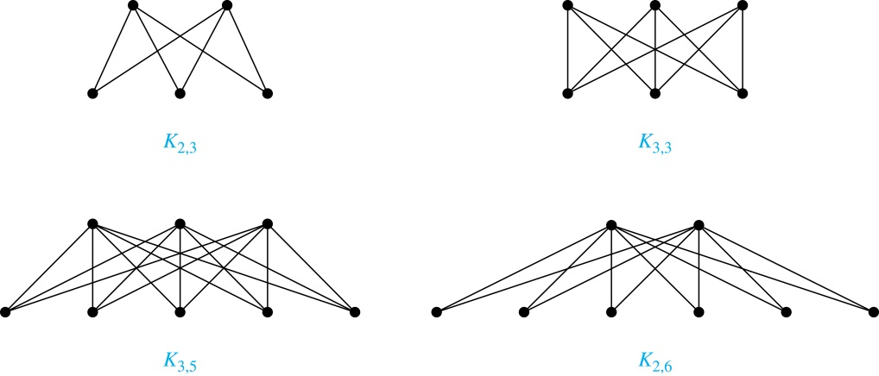
Complete Bipartite Graphs
Definition: A complete bipartite graph K_{m,n} is a graph that has its vertex set partitioned into two subsets V₁ of size m and V₂ of size n such that there is an edge from every vertex in V₁ to every vertex in V₂.
Example: We display four complete bipartite graphs here.

Slide 27
Bipartite Graphs and Matchings
Bipartite graphs are used to model applications that involve matching the elements of one set to elements in another, for example:
Job assignments - vertices represent the jobs and the employees, edges link employees with those jobs they have been trained to do. A common goal is to match jobs to employees so that the most jobs are done.
Marriage - vertices represent the men and the women and edges link a a man and a woman if they are an acceptable spouse. We may wish to find the largest number of possible marriages.

Slide 28
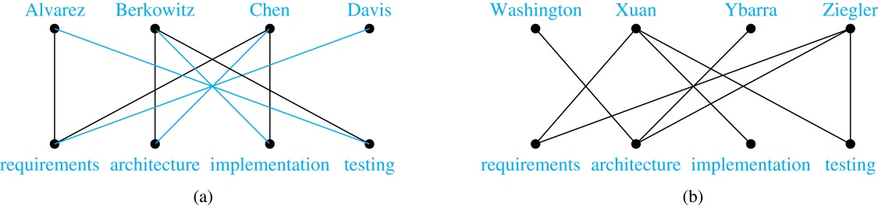

Slide 29
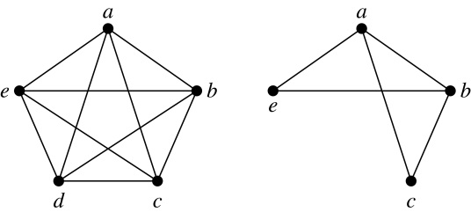
New Graphs from Old
Definition: A subgraph of a graph G = (V,E) is a graph (W,F), where W ⊂ V and F ⊂ E. A subgraph H of G is a proper subgraph of G if H ≠ G.
Example: Here we show K₅ and one of its subgraphs.
Definition: Let G = (V, E) be a simple graph. The subgraph induced by a subset W of the vertex set V is the graph (W,F), where the edge set F contains an edge in E if and only if both endpoints are in W.
Example: Here we show K₅ and the subgraph induced by W = {a,b,c,e}.

Slide 30
Isomorphism of Graphs
Definition: The simple graphs G₁ = (V₁, E₁) and G₂ = (V₂, E₂) are isomorphic if there is a one-to-one and onto function f from V₁ to V₂ with the property that a and b are adjacent in G₁ if and only if f(a) and f(b) are adjacent in G₂ , for all a and b in V₁ . Such a function f is called an isomorphism. Two simple graphs that are not isomorphic are called nonisomorphic.

Slide 31
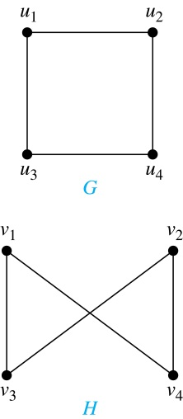
Isomorphism of Graphs (cont.)
Example: Show that the graphs G =(V, E) and H = (W, F) are isomorphic.
Solution: The function f with f(u₁) = v₁,
f(u₂) = v₄, f(u₃) = v₃, and f(u₄) = v₂ is a
one-to-one correspondence between V and W. Note that adjacent vertices in G are u₁ and u₂, u₁ and u₃, u₂ and u₄, and u₃ and u₄. Each of the pairs f(u₁) = v₁ and f(u₂) = v₄, f(u₁) = v₁ and f(u₃) = v₃ , f(u₂) = v₄ and f(u₄) = v₂ , and f(u₃) = v₃ and f(u₄) = v₂ consists of two adjacent vertices in H.

Slide 32
Isomorphism of Graphs (cont.)
It is difficult to determine whether two simple graphs are isomorphic using brute force because there are n! possible one-to-one correspondences between the vertex sets of two simple graphs with n vertices.
The best algorithms for determining weather two graphs are isomorphic have exponential worst case complexity in terms of the number of vertices of the graphs.
Sometimes it is not hard to show that two graphs are not isomorphic. We can do so by finding a property, preserved by isomorphism, that only one of the two graphs has. Such a property is called graph invariant.
There are many different useful graph invariants that can be used to distinguish nonisomorphic graphs, such as the number of vertices, number of edges, and degree sequence (list of the degrees of the vertices in nonincreasing order). We will encounter others in later sections of this chapter.

Slide 33
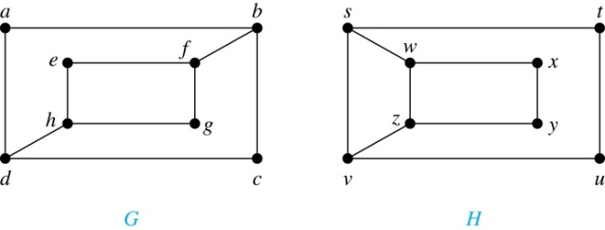
Isomorphism of Graphs (cont.)
Example: Determine whether these two graphs are isomorphic.
Solution: Both graphs have eight vertices and ten edges.
They also both have four vertices of degree two and four of degree three.
However, G and H are not isomorphic. Note that since deg(a) = 2 in G, a must correspond to t, u, x, or y in H, because these are the vertices of degree 2. But each of these vertices is adjacent to another vertex of degree two in H, which is not true for a in G.
.

Slide 34
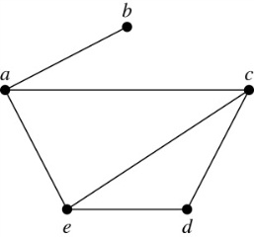
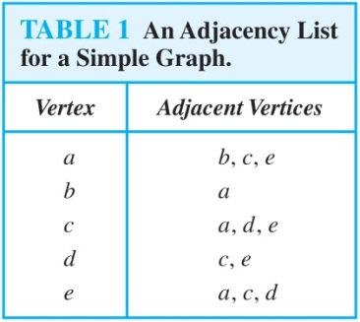
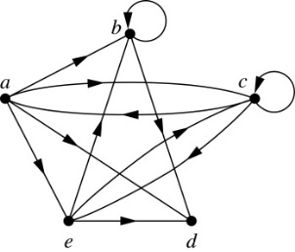
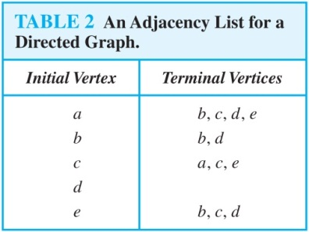
Representing Graphs: Adjacency Lists
Definition: An adjacency list can be used to represent a graph with no multiple edges by specifying the vertices that are adjacent to each vertex of the graph.
Example:
Example:

Slide 35
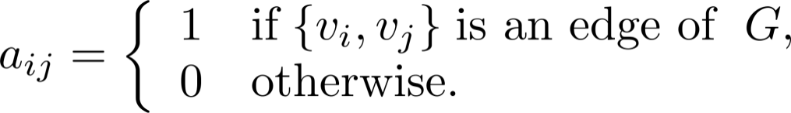
Representation of Graphs: Adjacency Matrices
Definition: Suppose that G = (V, E) is a simple graph where |V| = n. Arbitrarily list the vertices of G as v₁, v₂, … , v_{n}. The adjacency matrix A_{G} of G, with respect to the listing of vertices, is the n × n zero-one matrix with 1 as its (i, j)th entry when v_{i} and v_{j} are adjacent, and 0 as its (i, j)th entry when they are not adjacent.
In other words, if the graphs adjacency matrix is A_{G} = [a_{ij}], then

Slide 36
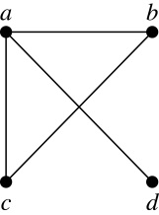
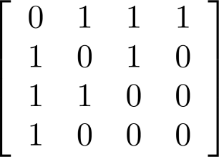
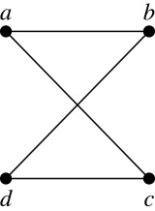
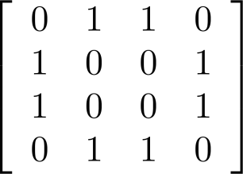
Adjacency Matrices (continued)
Example:
When a graph is sparse, that is, it has few edges relatively to the total number of possible edges, it is much more efficient to represent the graph using an adjacency list than an adjacency matrix. But for a dense graph, which includes a high percentage of possible edges, an adjacency matrix is preferable.
The ordering of
vertices is a, b, c, d.
The ordering of
vertices is a, b, c, d.
Note: The adjacency matrix of a simple graph is symmetric, i.e., a_{ij} = a_{ji}
Also, since there are no loops, each diagonal entry a_{ij} for i = 1, 2, 3, …, n, is 0.

Slide 37
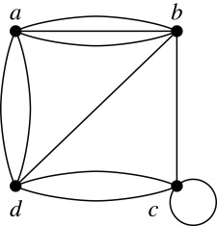
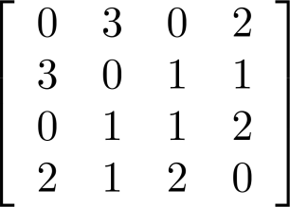
Adjacency Matrices (continued)
Adjacency matrices can also be used to represent graphs with loops and multiple edges.
A loop at the vertex v_{i} is represented by a 1 at the (i, j)th position of the matrix.
When multiple edges connect the same pair of vertices v_{i} and v_{j}, (or if multiple loops are present at the same vertex), the (i, j)th entry equals the number of edges connecting the pair of vertices.
Example: We give the adjacency matrix of the pseudograph shown here using the ordering of vertices a, b, c, d.

Slide 38
Adjacency Matrices (continued)
Adjacency matrices can also be used to represent directed graphs. The matrix for a directed graph G = (V, E) has a 1 in its (i, j)th position if there is an edge from v_{i} to v_{j}, where v₁, v₂, … v_{n} is a list of the vertices.
In other words, if the graphs adjacency matrix is A_{G} = [a_{ij}], then
The adjacency matrix for a directed graph does not have to be symmetric, because there may not be an edge from v_{i} to v_{j}, when there is an edge from v_{j} to v_{i}.
To represent directed multigraphs, the value of a_{ij} is the number of edges connecting v_{i} to v_{j}.

Slide 39
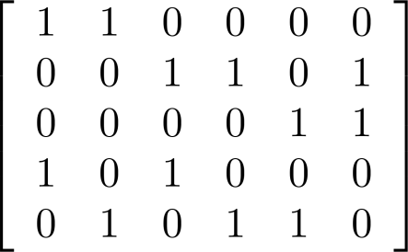
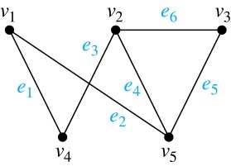
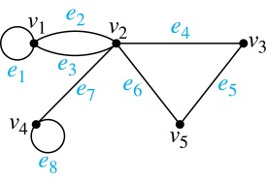
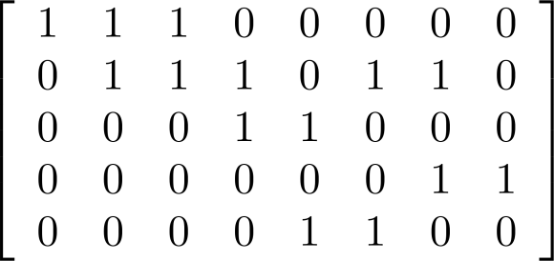
Incidence Matrices (continued)
Example: Simple Graph and Incidence Matrix
The rows going from top to bottom represent v₁ through v₅ and the columns going from left to right represent e₁ through e₆.
Example: Pseudograph and Incidence Matrix
The rows going from top to bottom represent v₁ through v₅ and the columns going from left to right represent e₁ through e₈.

Slide 40
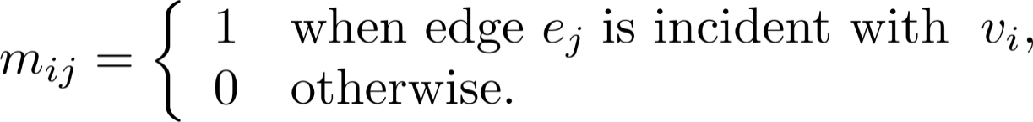
Representation of Graphs: Incidence Matrices
Definition: Let G = (V, E) be an undirected graph with vertices where v₁, v₂, … v_{n} and edges e₁, e₂, … e_{m}. The incidence matrix with respect to the ordering of V and E is the n × m matrix M = [m_{ij}], where

Slide 41
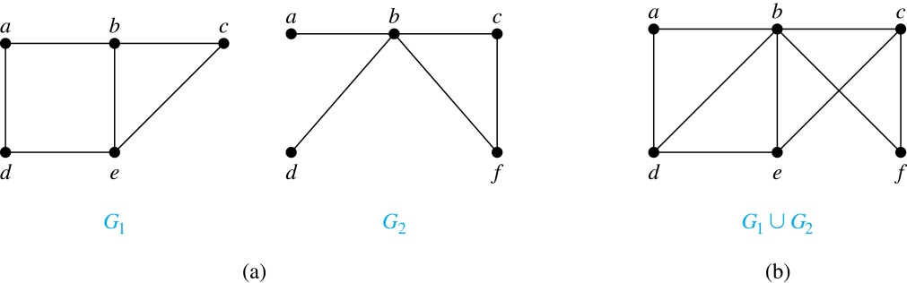
New Graphs from Old (continued)
Definition: The union of two simple graphs G₁ = (V₁, E₁) and G₂ = (V₂, E₂) is the simple graph with vertex set V₁ ⋃ V₂ and edge set E₁ ⋃ E₂. The union of G₁ and G₂ is denoted by G₁ ⋃ G₂.
Example:

Slide 42
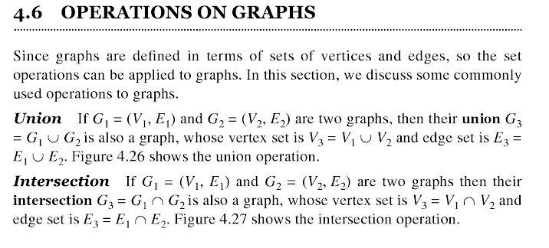
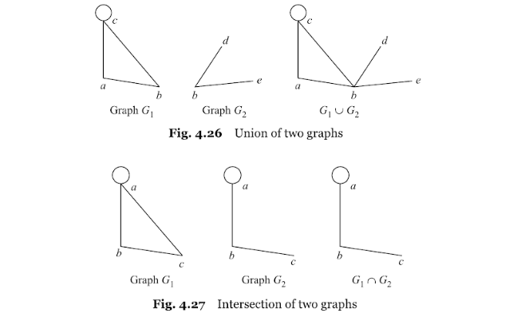

Slide 43

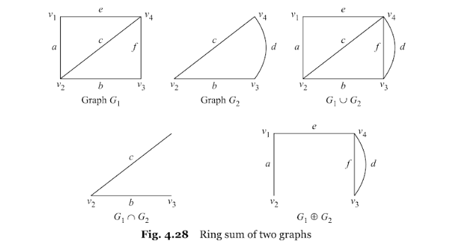

Slide 44

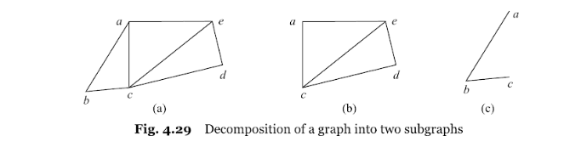
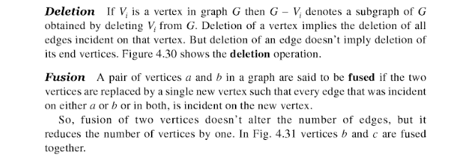

Slide 45
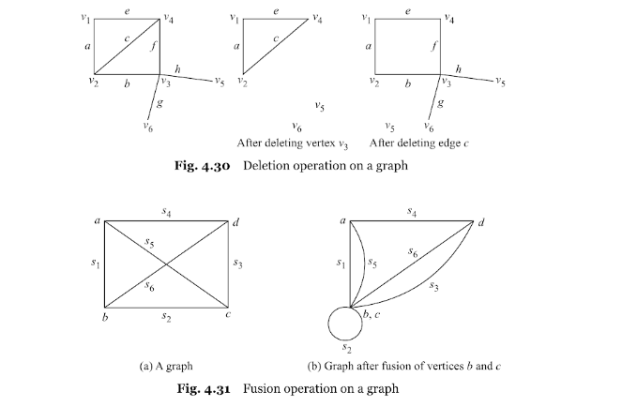

Slide 46
Paths and Circuits
Informal Definition: A path is a sequence of edges that begins at a vertex of a graph and travels from vertex to vertex along edges of the graph. As the path travels along its edges, it visits the vertices along this path, that is, the endpoints of these.
Applications: Numerous problems can be modeled with paths formed by traveling along edges of graphs such as:
determining whether a message can be sent between two computers.
efficiently planning routes for mail delivery.

Slide 47
Paths
Definition: Let n be a nonnegative integer and G an undirected graph. A path of length n from u to v in G is a sequence of n edges e₁, … , e_{n} of G for which there exists a sequence x₀ = u, x₁, …, x_{n-1}, x_{n} = v of vertices such that e_{i} has, for i = 1, …, n, the endpoints x_{i-1} and x_{i}.
When the graph is simple, we denote this path by its vertex sequence x₀, x₁, … , x_{n}(since listing the vertices uniquely determines the path).
The path is a circuit if it begins and ends at the same vertex (u = v) and has length greater than zero.
The path or circuit is said to pass through the vertices x₁, x₂, … , x_{n-1} and traverse the edges e₁, … , e_{n}.
A path or circuit is simple if it does not contain the same edge more than once.
This terminology is readily extended to directed graphs. (see text)

Slide 48
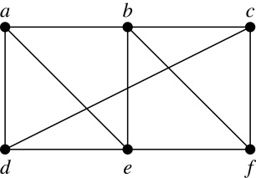
Paths (continued)
Example: In the simple graph here:
a, d, c, f, e is a simple path of length 4.
d, e, c, a is not a path because e is not connected to c.
b, c, f, e, b is a circuit of length 4.
a, b, e, d, a, b is a path of length 5, but it is not a simple path.

Slide 49
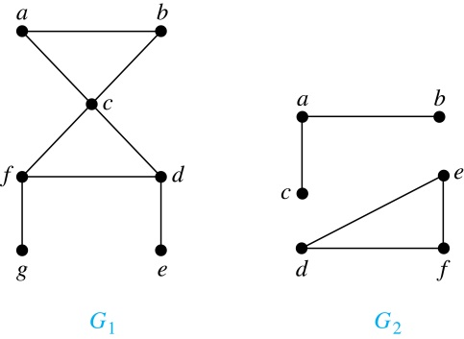
Connectedness in Undirected Graphs
Definition: An undirected graph is called connected if there is a path between every pair of vertices. An undirected graph that is not connected is called disconnected. We say that we disconnect a graph when we remove vertices or edges, or both, to produce a disconnected subgraph.
Example: G₁ is connected because there is a path between any pair of its vertices, as can be easily seen. However G₂ is not connected because there is no path between vertices a and f, for example.

Slide 50
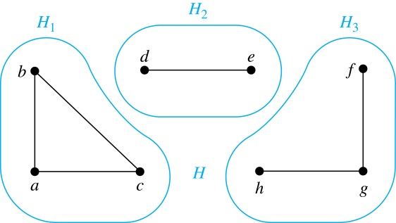
Connected Components
Definition: A connected component of a graph G is a connected subgraph of G that is not a proper subgraph of another connected subgraph of G. A graph G that is not connected has two or more connected components that are disjoint and have G as their union.
Example: The graph H is the union of three disjoint subgraphs H₁, H₂, and H₃, none of which are proper subgraphs of a larger connected subgraph of G.These three subgraphs are the connected components of H.

Slide 51
Connectedness in Directed Graphs
Definition: A directed graph is strongly connected if there is a path from a to b and a path from b to a whenever a and b are vertices in the graph.
Definition: A directed graph is weakly connected if there is a path between every two vertices in the underlying undirected graph, which is the undirected graph obtained by ignoring the directions of the edges of the directed graph.

Slide 52
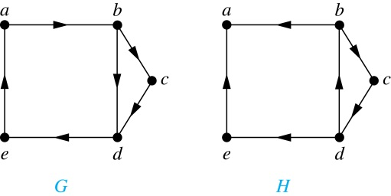
Connectedness in Directed Graphs (continued)
Example: G is strongly connected because there is a path between any two vertices in the directed graph. Hence, G is also weakly connected. The graph H is not strongly connected, since there is no directed path from a to b, but it is weakly connected.
Definition: The subgraphs of a directed graph G that are strongly connected but not contained in larger strongly connected subgraphs, that is, the maximal strongly connected subgraphs, are called the strongly connected components or strong components of G.
Example (continued): The graph H has three strongly connected components, consisting of the vertex a; the vertex e; and the subgraph consisting of the vertices b, c, d and edges (b,c), (c,d), and (d,b).

Slide 53
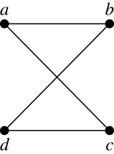
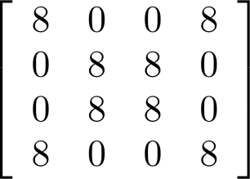
Counting Paths between Vertices (continued)
Example: How many paths of length four are there from a to d in the graph G.
Solution: The adjacency matrix of G (ordering the vertices as a, b, c, d) is given above. Hence the number of paths of length four from a to d is the (1, 4)th entry of A⁴ . The eight paths are as:
adjacency matrix of G
G
A =
A⁴ =
a, b, a, b, d a, b, a, c, d
a, b, d, b, d a, b, d, c, d
a, c, a, b, d a, c, a, c, d
a, c, d, b, d a, c, d, c, d

Slide 54


Euler Paths and Circuits
The town of Kӧnigsberg, Prussia (now Kalingrad, Russia) was divided into four sections by the branches of the Pregel river. In the 18th century seven bridges connected these regions.
People wondered whether it was possible to follow a path that crosses each bridge exactly once and returns to the starting point.
The Swiss mathematician Leonard Euler proved that no such path exists. This result is often considered to be the first theorem ever proved in graph theory.
Multigraph Model of the Bridges of Kӧnigsberg
The 7 Bridges of Kӧnigsberg

Slide 55

Euler Paths and Circuits (continued)
Definition: An Euler circuit in a graph G is a simple circuit containing every edge of G. An Euler path in G is a simple path containing every edge of G.
Example: Which of the undirected graphs G₁, G₂, and G₃ has a Euler circuit? Of those that do not, which has an Euler path?
We have to use every edge of given graph
Solution: The graph G₁ has an Euler circuit (e.g., a, e, c, d, e, b, a). But, as can easily be verified by inspection, neither G₂ nor G_{3(not every edge is used)} has an Euler circuit. Note that G₃ has an Euler path (e.g., a, c, d, e, b, d, a, b), but there is no Euler path in G₂, which can be verified by inspection.

Slide 56
Necessary Conditions for Euler Circuits and Paths
An Euler circuit begins with a vertex a and continues with an edge incident with a, say {a, b}. The edge {a, b} contributes one to deg(a).
Each time the circuit passes through a vertex it contributes two to the vertex’s degree.
Finally, the circuit terminates where it started, contributing one to deg(a). Therefore deg(a) must be even.
We conclude that the degree of every other vertex must also be even.
By the same reasoning, we see that the initial vertex and the final vertex of an Euler path have odd degree, while every other vertex has even degree. So, a graph with an Euler path has exactly two vertices of odd degree.
In the next slide we will show that these necessary conditions are also sufficient conditions.

Slide 57

Sufficient Conditions for Euler Circuits and Paths
Suppose that G is a connected multigraph with ≥ 2 vertices, all of even degree. Let x₀ = a be a vertex of even degree. Choose an edge {x₀, x₁} incident with a and proceed to build a simple path {x₀, x₁}, {x₁, x₂}, …, {x_{n-1}, x_{n}} by adding edges one by one until another edge can not be added.
The path begins at a with an edge of the form {a, x}; we show that it must terminate at a with an edge of the form {y, a}. Since each vertex has an even degree, there must be an even number of edges incident with this vertex. Hence, every time we enter a vertex other than a, we can leave it. Therefore, the path can only end at a.
If all of the edges have been used, an Euler circuit has been constructed. Otherwise, consider the subgraph H obtained from G by deleting the edges already used.
We illustrate this idea in the graph G here. We begin at a and choose the edges {a, f}, {f, c}, {c, b}, and {b, a} in succession.
In the example H consists of the vertices c, d, e.

Slide 58
Sufficient Conditions for Euler Circuits and Paths (continued)
Because G is connected, H must have at least one vertex in common with the circuit that has been deleted.
Every vertex in H must have even degree because all the vertices in G have even degree and for each vertex, pairs of edges incident with this vertex have been deleted. Beginning with the shared vertex construct a path ending in the same vertex (as was done before). Then splice this new circuit into the original circuit.
Continue this process until all edges have been used. This produces an Euler circuit. Since every edge is included and no edge is included more than once.
Similar reasoning can be used to show that a graph with exactly two vertices of odd degree must have an Euler path connecting these two vertices of odd degree
In the example, the vertex is c.
In the example, we end up with the circuit a, f, c, d, e, c, b, a.

Slide 59
Necessary and Sufficient Conditions for Euler Circuits and Paths (continued)
Theorem: A connected multigraph with at least two vertices has an Euler circuit if and only if each of its vertices has an even degree and it has an Euler path if and only if it has exactly two vertices of odd degree.
Example: Two of the vertices in the multigraph model of the Kӧnigsberg bridge problem have odd degree. Hence, there is no Euler circuit in this multigraph and it is impossible to start at a given point, cross each bridge exactly once, and return to the starting point.

Slide 60

Euler Circuits and Paths
Example:
G₁ contains exactly two vertices of odd degree (b and d). Hence it has an Euler path, e.g., d, a, b, c, d, b.
G₂ has exactly two vertices of odd degree (b and d). Hence it has an Euler path, e.g., b, a, g, f, e, d, c, g, b, c, f, d.
G₃ has six vertices of odd degree. Hence, it does not have an Euler path.

Slide 61
Applications of Euler Paths and Circuits
Euler paths and circuits can be used to solve many practical problems such as finding a path or circuit that traverses each
street in a neighborhood,
road in a transportation network,
connection in a utility grid,
link in a communications network.
Other applications are found in the
layout of circuits,
network multicasting,
molecular biology, where Euler paths are used in the sequencing of DNA.

Slide 62



Hamilton Paths and Circuits
William Rowan Hamilton (1805- 1865)
Euler paths and circuits contained every edge only once. Now we look at paths and circuits that contain every vertex exactly once.
William Hamilton invented the Icosian puzzle in 1857. It consisted of a wooden dodecahedron (with 12 regular pentagons as faces), illustrated in (a), with a peg at each vertex, labeled with the names of different cities. String was used to plot a circuit visiting 20 cities exactly once.
The graph form of the puzzle is given in (b).
The solution (a Hamilton circuit) is given here.

Slide 63
Hamilton Paths and Circuits
Definition: A simple path in a graph G that passes through every vertex exactly once is called a Hamilton path, and a simple circuit in a graph G that passes through every vertex exactly once is called a Hamilton circuit.
That is, a simple path x₀, x₁, …, x_{n-1}, x_{n} in the graph G = (V, E) is called a Hamilton path if V = {x₀, x₁, … , x_{n-1,} x_{n} } and x_{i} ≠ x_{j} for 0≤ i < j ≤ n, and the simple circuit x₀, x₁, …, x_{n-1}, x_{n}, x₀ (with n > 0) is a Hamilton circuit if x₀, x₁, … , x_{n-1}, x_{n} is a Hamilton path.

Slide 64
Hamilton Paths and Circuits (continued)
Example: Which of these simple graphs has a Hamilton circuit or, if not, a Hamilton path?
Solution: G₁ has a Hamilton circuit: a, b, c, d, e, a.
G₂ does not have a Hamilton circuit (Why?), but does have a Hamilton path : a, b, c, d.
G₃ does not have a Hamilton circuit, or a Hamilton path. Why?

Slide 65


Necessary Conditions for Hamilton Circuits
Gabriel Andrew Dirac
(1925-1984)
Unlike for an Euler circuit, no simple necessary and sufficient conditions are known for the existence of a Hamiton circuit.
However, there are some useful necessary conditions. We describe two of these now.
Dirac’s Theorem: If G is a simple graph with n ≥ 3 vertices such that the degree of every vertex in G is ≥ n/2, then G has a Hamilton circuit.
Ore’s Theorem: If G is a simple graph with n ≥ 3 vertices such that deg(u) + deg(v) ≥ n for every pair of nonadjacent vertices, then G has a Hamilton circuit.
Øysten Ore
(1899-1968)

Slide 66
Applications of Hamilton Paths and Circuits
Applications that ask for a path or a circuit that visits each intersection of a city, each place pipelines intersect in a utility grid, or each node in a communications network exactly once, can be solved by finding a Hamilton path in the appropriate graph.
The famous traveling salesperson problem (TSP) asks for the shortest route a traveling salesperson should take to visit a set of cities. This problem reduces to finding a Hamilton circuit such that the total sum of the weights of its edges is as small as possible.
A family of binary codes, known as Gray codes, which minimize the effect of transmission errors, correspond to Hamilton circuits in the n-cube Q_{n}. (See the text for details.)

Slide 67

Planar Graphs
Which are planar and which are not planar??

Slide 68

Planar Graphs

Slide 69

Planar Graphs

Slide 70

Corollary 1
Prove K5 is non planar

Slide 71


Corollary 2

Slide 72

Examples

Slide 73

Kuratwoski’s Theorm

Slide 74
PART-II TREES

Slide 75
Definition:
A tree is a connected undirected graph with no simple circuits.
Recall: A circuit is a path of length >=1 that begins and ends a the same vertex.

Slide 76
d
d

Slide 77
Tournament Trees
A common form of tree used in everyday life is the tournament tree, used to describe the outcome of a series of games, such as a tennis tournament.
Alice
Antonia
Anita
Abigail
Amy
Agnes
Angela
Audrey
Alice
Abigail
Agnes
Angela
Alice
Angela
Alice

Slide 78
A Family Tree
Much of the tree terminology derives from family trees.
Gaea
Ocean
Phoebe
Cronus
Zeus
Poseidon
Demeter
Pluto
Leto
Iapetus
Apollo
Atlas
Prometheus
Persephone

Slide 79
Ancestor Tree
An inverted family tree. Important point - it is a binary tree.
Iphigenia
Clytemnestra
Agamemnon
Leda
Tyndareus
Aerope
Atreus
Catreus

Slide 80
Forest
Graphs containing no simple circuits that are not connected, but each connected component is a tree.

Slide 81
Theorem
An undirected graph is a tree if and only if there is a unique simple path between any two of its vertices.

Slide 82
Rooted Trees
Once a vertex of a tree has been designated as the root of the tree, it is possible to assign direction to each of the edges.

Slide 83
Rooted Trees
g
a
e
f
e
c
b
b
d
d
a
c
g
f

Slide 84
root node
a
internal vertex
parent of g
b
c
d
e
f
g
leaf
siblings
h
i

Slide 85
a
b
c
d
e
f
g
ancestors of h and i
h
i

Slide 86
a
b
c
d
e
f
g
subtree with b as its root
h
i
subtree with c as its root

Slide 87
m-ary trees
A rooted tree is called an m-ary tree if every internal vertex has no more than m children. The tree is called a full m-ary tree if every internal vertex has exactly m children. An m-ary tree with m=2 is called a binary tree.

Slide 89
Ordered Rooted Tree
An ordered rooted tree is a rooted tree where the children of each internal vertex are ordered. Ordered trees are drawn so that the children of each internal vertex are shown in order from left to right.

Slide 90
Properties of Trees
A tree with n vertices has n-1 edges.

Slide 91
Properties of Trees
A full m-ary tree with i internal vertices contains n = mi+1 vertices.

Slide 92
Properties of Trees
A full m-ary tree with
(i) n vertices has i = (n-1)/m internal vertices and l = [(m-1)n+1]/m leaves.
(ii) i internal vertices has n = mi + 1 vertices and l = (m-1)i + 1 leaves.
(iii) l leaves has n = (ml - 1)/(m-1) vertices and i = (l-1)/(m-1) internal vertices.

Slide 93
Properties of Trees
The level of a vertex v in a rooted tree is the length of the unique path from the root to this vertex.
level 2
level 3

Slide 94
Properties of Trees
The height of a rooted tree is the maximum of the levels of vertices.

Slide 95
Properties of Trees
A rooted m-ary tree of height h is called balanced if all leaves are at levels h or h-1.

Slide 96
Properties of Trees
There are at most m^{h} leaves in an m-ary tree of height h.

Slide 97
Properties of Trees
If an m-ary tree of height h has l leaves, then

Slide 98
Proof
From previous theorem:

Slide 99
APPLICATIONS OF TREES
CODING
MINING SPANNING TREES

Slide 100
Encoding messages
Encode a message composed of a string of characters
Codes used by computer systems
ASCII
uses 8 bits per character
can encode 256 characters
Unicode
16 bits per character
can encode 65536 characters
includes all characters encoded by ASCII
ASCII and Unicode are fixed-length codes
all characters represented by same number of bits

Slide 101
Problems
Suppose that we want to encode a message constructed from the symbols A, B, C, D, and E using a fixed-length code
How many bits are required to encode each symbol?
at least 3 bits are required
2 bits are not enough (can only encode four symbols)
How many bits are required to encode the message DEAACAAAAABA?
there are twelve symbols, each requires 3 bits
12*3 = 36 bits are required

Slide 102
Drawbacks of fixed-length codes
Wasted space
Unicode uses twice as much space as ASCII
inefficient for plain-text messages containing only ASCII characters
Same number of bits used to represent all characters
‘a’ and ‘e’ occur more frequently than ‘q’ and ‘z’
Potential solution: use variable-length codes
variable number of bits to represent characters when frequency of occurrence is known
short codes for characters that occur frequently

Slide 103
Advantages of variable-length codes
The advantage of variable-length codes over fixed-length is short codes can be given to characters that occur frequently
on average, the length of the encoded message is less than fixed-length encoding
Potential problem: how do we know where one character ends and another begins?
not a problem if number of bits is fixed!
A = 00
B = 01
C = 10
D = 11
0010110111001111111111
A C D B A D D D D D

Slide 104
Prefix property
A code has the prefix property if no character code is the prefix (start of the code) for another character
Example:
000 is not a prefix of 11, 01, 001, or 10
11 is not a prefix of 000, 01, 001, or 10 …
Symbol | Code
P | 000
Q | 11
R | 01
S | 001
T | 10
01001101100010
R S T Q P T

Slide 105
Code without prefix property
The following code does not have prefix property
The pattern 1110 can be decoded as QQQP, QTP, QQS, or TS
Symbol | Code
P | 0
Q | 1
R | 01
S | 10
T | 11

Slide 106
Problem
Design a variable-length prefix-free code such that the message DEAACAAAAABA can be encoded using 22 bits
Possible solution:
A occurs eight times while B, C, D, and E each occur once
represent A with a one bit code, say 0
remaining codes cannot start with 0
represent B with the two bit code 10
remaining codes cannot start with 0 or 10
represent C with 110
represent D with 1110
represent E with 11110

Slide 107
Encoded message
DEAACAAAAABA
Symbol | Code
A | 0
B | 10
C | 110
D | 1110
E | 11110
1110111100011000000100
22 bits

Slide 108
Another possible code
DEAACAAAAABA
Symbol | Code
A | 0
B | 100
C | 101
D | 1101
E | 1111
1101111100101000001000
22 bits

Slide 109
Better code
DEAACAAAAABA
Symbol | Code
A | 0
B | 100
C | 101
D | 110
E | 111
11011100101000001000
20 bits

Slide 110
What code to use?
Question: Is there a variable-length code that makes the most efficient use of space?
Answer: Yes!

Slide 111
Huffman coding tree
Binary tree
each leaf contains symbol (character)
label edge from node to left child with 0
label edge from node to right child with 1
Code for any symbol obtained by following path from root to the leaf containing symbol
Code has prefix property
leaf node cannot appear on path to another leaf
note: fixed-length codes are represented by a complete Huffman tree and clearly have the prefix property

Slide 112
Building a Huffman tree
Find frequencies of each symbol occurring in message
Begin with a forest of single node trees
each contain symbol and its frequency
Do recursively
select two trees with smallest frequency at the root
produce a new binary tree with the selected trees as children and store the sum of their frequencies in the root
Recursion ends when there is one tree
this is the Huffman coding tree

Slide 113
Example
Build the Huffman coding tree for the message
This is his message
Character frequencies
A | G | M | T | E | H | _ | I | S
1 | 1 | 1 | 1 | 2 | 2 | 3 | 3 | 5
1
1
1
1
2
2
3
3
5
A
G
M
T
E
H
_
I
S

Slide 114
Step 1
2
1
1
1
1
2
2
3
3
5
A
G
M
T
E
H
_
I
S

Slide 115
Step 2
2
2
1
1
1
1
2
2
3
3
5
A
G
M
T
E
H
_
I
S

Slide 116
Step 3
2
2
4
1
1
1
1
2
2
3
3
5
A
G
M
T
E
H
_
I
S

Slide 117
Step 4
4
2
2
4
1
1
1
1
2
2
3
3
5
A
G
M
T
E
H
_
I
S

Slide 118
Step 5
4
2
2
4
6
1
1
1
1
2
2
3
3
5
A
G
M
T
E
H
_
I
S

Slide 119
Step 6
8
4
4
2
2
2
2
6
E
H
1
1
1
1
3
3
5
A
G
M
T
_
I
S

Slide 120
Step 7
8
11
4
4
6
5
S
2
2
2
2
3
3
E
H
_
I
1
1
1
1
A
G
M
T

Slide 121
Step 8
19
8
11
4
4
6
5
S
2
2
2
2
3
3
E
H
_
I
1
1
1
1
A
G
M
T

Slide 122
Label edges
19
0
1
8
11
0
1
0
1
4
4
6
5
0
1
0
1
0
1
S
2
2
2
2
3
3
0
1
0
1
E
H
_
I
1
1
1
1
A
G
M
T

Slide 123
Huffman code & encoded message
This is his message
S 11
E 010
H 011
_ 100
I 101
A 0000
G 0001
M 0010
T 0011
00110111011110010111100011101111000010010111100000001010

Slide 124
Spanning trees
Suppose you have a connected undirected graph
Connected: every node is reachable from every other node
Undirected: edges do not have an associated direction
...then a spanning tree of the graph is a connected subgraph in which there are no cycles
A connected, undirected graph
Four of the spanning trees of the graph
If a graph is a complete graph with n vertices, then total number of spanning trees is n^{(n-2)} where n is the number of nodes in the graph.

Slide 125
Finding a spanning tree
To find a spanning tree of a graph,
pick an initial node and call it part of the spanning tree
do a search from the initial node:
each time you find a node that is not in the spanning tree, add to the spanning tree both the new node and the edge you followed to get to it
An undirected graph
One possible result of a BFS starting from top
One possible result of a DFS starting from top

Slide 126
Minimizing costs
Suppose you want to supply a set of houses (say, in a new subdivision) with:
electric power
water
sewage lines
telephone lines
To keep costs down, you could connect these houses with a spanning tree (of, for example, power lines)
However, the houses are not all equal distances apart
To reduce costs even further, you could connect the houses with a minimum-cost spanning tree

Slide 127
Minimum-cost spanning trees
Suppose you have a connected undirected graph with a weight (or cost) associated with each edge
The cost of a spanning tree would be the sum of the costs of its edges
A minimum-cost spanning tree is a spanning tree that has the lowest cost
16
16
A
B
A
B
21
11
6
11
6
19
5
5
F
C
F
C
33
14
10
E
18
D
E
18
D
A connected, undirected graph
A minimum-cost spanning tree

Slide 128
Finding spanning trees
There are two basic algorithms for finding minimum-cost spanning trees, and both are greedy algorithms
Kruskal’s algorithm: Start with no nodes or edges in the spanning tree, and repeatedly add the cheapest edge that does not create a cycle
Here, we consider the spanning tree to consist of edges only
Prim’s algorithm: Start with any one node in the spanning tree, and repeatedly add the cheapest edge, and the node it leads to, for which the node is not already in the spanning tree.
Here, we consider the spanning tree to consist of both nodes and edges

Slide 129
Kruskal’s algorithm
T = empty spanning tree; E = set of edges; N = number of nodes in graph;
while T has fewer than N - 1 edges {
remove an edge (v, w) of lowest cost from E
if adding (v, w) to T would create a cycle
then discard (v, w)
else add (v, w) to T
}
Finding an edge of lowest cost can be done just by sorting the edges
Efficient testing for a cycle requires a fairly complex algorithm (UNION-FIND) which we don’t cover in this course…. There is no cycle has to build why selctiing edges

Slide 130
Prim’s algorithm
T = a spanning tree containing a single node s; E = set of edges adjacent to s; while T does not contain all the nodes {
remove an edge (v, w) of lowest cost from E
if w is already in T then discard edge (v, w)
else {
add edge (v, w) and node w to T
add to E the edges adjacent to w
}
}
An edge of lowest cost can be found with a priority queue
Testing for a cycle is automatic
Hence, Prim’s algorithm is far simpler to implement than Kruskal’s algorithm

Slide 131
Example
Apply PRIMs and KRUSKAL to find MST.
16
16
A
B
A
B
21
11
6
11
6
5
5
19
F
C
F
C
33
14
10
E
18
D
E
18
D
A connected, undirected graph
A minimum-cost spanning tree

