Slide 1
Chapter - 2
Principles of Object Oriented Programming

Slide 2
2.1 What is C++?
C++ is a object-oriented programming language. It was developed by Bjarne Stroustrup at AT&T Bell Laboratories in Murray Hill, New Jersey, USA, in the early 1580’s.

Slide 3
2.2 Applications of C++
Since C++ allows us to create hierarchy-related objects, we can build special object-oriented libraries which can be used later by many programmers.
While C++ is able to map the real-world problems.
C++ programs are easily maintainable and expandable.
It is expected that C++ will replace C as a general-purpose language in the near future.

Slide 4
A Simple C++ Program
#include <iostream> //include header file
using namespace std;
int main()
{
cout << "Hello World"; // C++ statement
return 0;
}
iostream is just like we include stdio.h in c program.
It contains declarations for the identifier cout and the insertion operator <<.
iostream should be included at the beginning of all programs that use input/output statements.

Slide 5
A Simple C++ Program (Cont…)
A namespace is a declarative region.
A namespace is a part of the program in which certain names are recognized; outside of the namespace they're unknown.
namespace defines a scope for the identifies that are used in a program.
using and namespace are the keywords of C++.

Slide 6
A Simple C++ Program (Cont…)
std is the namespace where ANSI C++ standard class libraries are defined.
Various program components such as cout, cin, endl are defined within std namespace.
If we don't use the using directive at top, we have to add the std followed by in the program before identifier.
std::cout << "Hello World";

Slide 7
A Simple C++ Program (Cont…)
In C++, main () returns an integer type value to operating system.
Therefore, every main() in C++ should end with a return 0; statement; otherwise, error will occur.
The return value from the main() function is used by the runtime library as the exit code for the process.

Slide 8
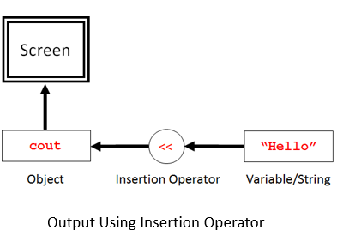
Insertion Operator <<
cout << "Hello World";
The operator << is called the insertion operator.
It inserts the contents of the variable on its right to the object on its left.
The identifier cout is a predefined object object that represents standard output stream in C++.
Here, Screen represents the output. We can also redirect the output to other output devices.
The operator << is used as bitwise left shift operator also.

Slide 9
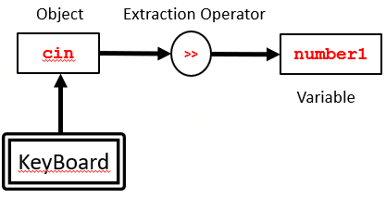
Extraction Operator >>
cin >> number1
The operator >> is called the extraction operator.
It extracts (or takes) the value from keyboard and assigns it to the variable on its right.
The identifier cin is a predefined object that represents standard input stream in C++.
Here, standard input stream represents the Keyboard.
The operator >> is used as bitwise right shift operator also.

Slide 10
More C++ Statement
Average of Two Numbers
#include <iostream>
using namespace std;
int main()
{
Float number1, number2, sum, average;
cout << “Enter the two numbers:";
cin >> number1 //Read from the keyboard
cin >> number2
sum = number1 + number2;
average = sum/2;
cout << “Sum = ” << sum << “\n”;
cout << “Average = ” << average << “\n”;
return 0;
}
Output
Enter the two numbers: 6.5 7.5
Sum = 14
Average = 7

Slide 11
Cascading of 1/0 Operators
If we use insertion operator << repeatedly in the statements for printing results.
For example, The statement like this
cout << "Sum” << sum <<"\n";
First sends the string "Sum" to cout and then sends the value of sum. Finally, it sends the newline character so that the next output will be in the new line.
The multiple use of << in one statement is called cascading.

Slide 12
Two statements can be combined as follows:
cout<<"Sum = ” <<sum "\n"
<< "Average average << "\n";
This is one statement but provides two lines of output. If you want only one line of output,
the statement will be:
cout << "Sum = “ << sum “, ”
<< "Average << average << "\n";
We can also cascade input operator as follows
cin >> number1 >> number2 ;

Slide 13
Table provides lists of C++ standard library header files that may be needed in C++ programs. The header files with .h extension are "old style" flies which should be used with old compilers. Table also gives the version of these files that should be used with the ANSI standard compilers.
Old C Header File (C-style) | New C++ Header File (C++-style)
#include <stdio.h> | #include <cstdio>
#include <stdlib.h> | #include <cstdlib>
#include <string.h> | #include <cstring>
#include <math.h> | #include <cmath>
#include <time.h> | #include <ctime>
#include <ctype.h> | #include <cctype>
#include <errno.h> | #include <cerrno>
#include <float.h> | #include <cfloat>
#include <limits.h> | #include <climits>
#include <assert.h> | #include <cassert>
#include <signal.h> | #include <csignal>
#include <stdarg.h> | #include <cstdarg>
#include <stddef.h> | #include <cstddef>
#include <stdint.h> | #include <cstdint>
#include <locale.h> | #include <clocale>
#include <setjmp.h> | #include <csetjmp>

Slide 14
C++ Program with class
#include siostream
using namespace std;
class person
{
char name(30):
int age;
public:
void getdata (void);
void display (void);
};
void person :: getdata(void) // Scope resolution operator
{
cout << "Enter Name:”
cin >> name;
cout << "Enter Age:"
cin >> age;
}
void person :: display(void)
{
cout<<“Name : “ << name
cout<<“ Age : << age }

Slide 15
C++ Program with class (Cont…)
int main ()
{
person p;
p.getdata();
p.display();
return 0;
}
Output:
Enter name: NN
Enter age: 15
Name: NN
Age: 15

Slide 16
Structure of C++ Program

Slide 17
Creating the Source File
Like C programs, C++ program can be created any text editor. For example, on LINIX, we can use vi or ed text erlitor for creating and editing the source code. On the DOS system, we can use edlin or any other editor or word processor system.
Some systems such as Turbo C++ provide an integrated environment for developing and editing programs.
The file name should have a proper file exstension to indicate that it is a C++ program.. C++ implementations use extensions such as .c .C, .cc, .cpp and .cxx. Turbo C++ and Borland C++ use .c for C programs and .cpp for C++ programs. Zortech C++ system uses .cxx while UNIX AT&T version uses .cc and .C . The operating system manuala should be consulted to determine the proper file name extensions to be used.

