Slide 1
Chapter - 8
Inheritance

Slide 2
What is Inheritance?
The mechanism of deriving a new class from an old one is called Inheritance.
The old class is called 'BASE' class, and the new one is called ‘DERIVED’ class.
Advantages of Inheritance
Code Reusability
Improved Code Maintenance
Method Overriding / Polymorphism
Extensibility / Scalability

Slide 3
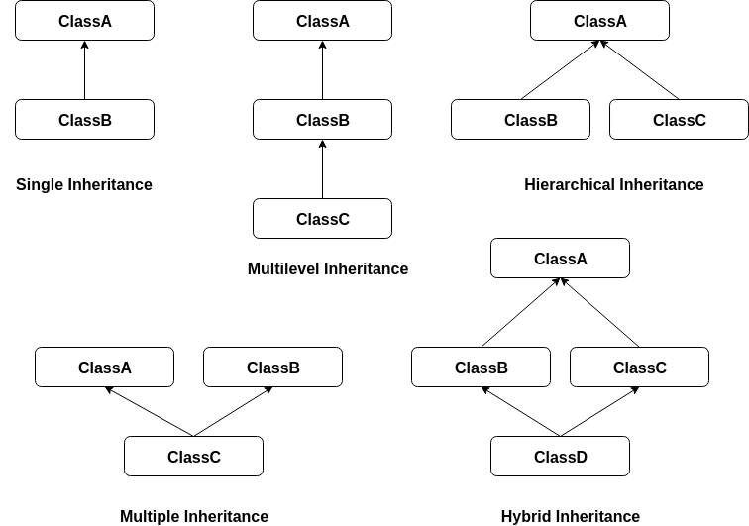
Types

Slide 4
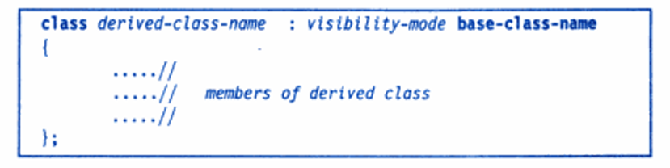
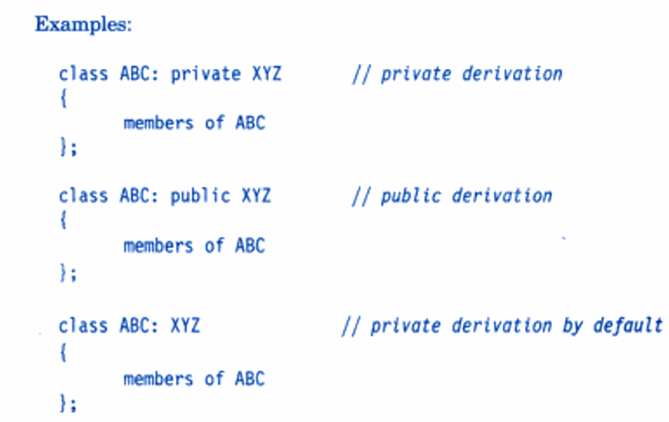
Inheritance – Terminology and Notation

Slide 5
Inheritance vs. Access
How inherited base class members
appear in derived class
Base class members
private: x
protected: y
public: z
private
base class
x is inaccessible
private: y
private: z
private: x
protected: y
public: z
protected
base class
x is inaccessible
protected: y
protected: z
private: x
protected: y
public: z
public
base class
x is inaccessible
protected: y
public: z

Slide 6
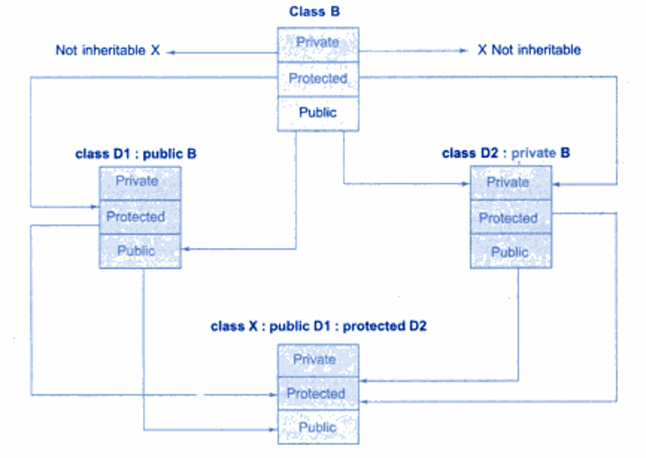
Inheritance vs. Access

Slide 7
Single Inheritance
#include <iostream>
using namespace std;
// Base class
class Animal {
public:
void eat() {
cout << "I can eat!" << endl;
}
};
// Derived class (single inheritance)
class Dog : public Animal {
public:
void bark() {
cout << "I can bark! Woof woof!" << endl;
}
};
int main() {
Dog myDog;
myDog.eat(); // Inherited from Animal
myDog.bark(); // Own method
return 0;
}

Slide 8
Making a private member inheritable Use protected instead of private
class Base {
private:
int privateValue; // Not inheritable
protected:
int protectedValue; // Inheritable (accessible in Derived)
public:
// Setter for private value
void setPrivateValue(int p) {
privateValue = p;
}
// Setter for protected value
void setProtectedValue(int q) {
protectedValue = q;
}
void showPrivate() {
cout << "Private Value (only accessible in Base): " << privateValue << endl;
}
};
class Derived : public Base {
public:
void showValues() {
// cout << privateValue; // ERROR: private not accessible
cout << "Protected Value (accessible in Derived): " << protectedValue << endl;
} };
int main() {
Derived d;
// Set values through setter methods
d.setPrivateValue(10);
d.setProtectedValue(20);
d.showPrivate(); // Access private through Base's public method
d.showValues(); // Direct access to protected member
return 0; }

Slide 9
Multilevel inheritance
class Student {
private:
int rollNo;
public:
void getRollNo(int r) {
rollNo = r;
}
void putRollNo() {
cout << "Roll Number: " << rollNo << endl;
}
};
// First derived class
class Marks : public Student {
protected:
int mark1, mark2;
public:
void getMarks(int m1, int m2) {
mark1 = m1;
mark2 = m2;
}
void putMarks() {
cout << "Marks in Subject 1: " << mark1 << endl;
cout << "Marks in Subject 2: " << mark2 << endl;
} };
class Result : public Marks {
public:
void displayResult() {
int total = mark1 + mark2;
float percentage = total / 2.0;
cout << "Total Marks: " << total << endl;
cout << "Percentage: " << percentage << "%";
}
};
// Driver code
int main() {
Result r;
r.getRollNo(101); // from Student
r.getMarks(85, 90); // from Marks
cout << "--- Student Details ---" << endl;
r.putRollNo();
r.putMarks();
r.displayResult(); // from Result
return 0;
}

Slide 10
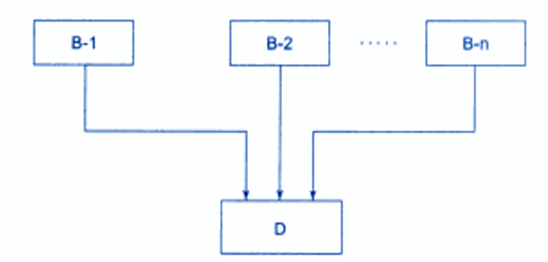
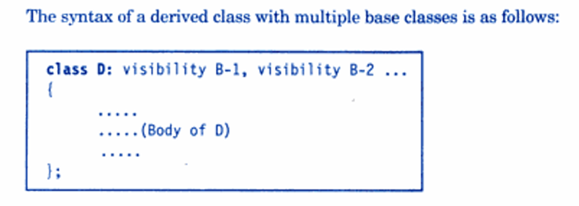
Multiple Inheritance

Slide 11
Multiple Inheritance
// First base class
class MathSkills {
public:
void add(int a, int b) {
cout << "Sum: " << a + b << endl;
}
};
// Second base class
class ScienceSkills {
public:
void experiment() {
cout << "Performing experiment..." << endl;
}
};
class SmartStudent : public MathSkills, public ScienceSkills {
public:
void study() {
cout << "Studying..." << endl;
}
};
int main() {
SmartStudent student;
// Using methods from both parent classes
student.add(5, 3); // From MathSkills
student.experiment(); // From ScienceSkills
student.study(); // Own method
return 0;
}

Slide 12
Ambiguity Resolution:
// Two base classes with same method name
class Father {
public:
void show() {
cout << "Father's method" << endl;
} };
class Mother {
public:
void show() {
cout << "Mother's method" << endl;
} };
// Derived class from both
class Child : public Father, public Mother {
public:
void display() {
cout << "Child's method" << endl; }};
int main() {
Child c;
// These would cause ambiguity error:
// c.show(); // Error: ambiguous call
// Resolving ambiguity:
c.Father::show(); // Call Father's method
c.Mother::show(); // Call Mother's method
c.display(); // Call Child's own method
c.showBoth(); // Call method that resolves ambiguity
return 0; }

Slide 13
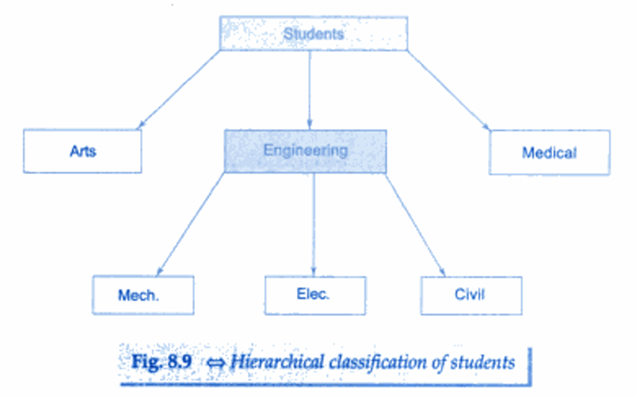
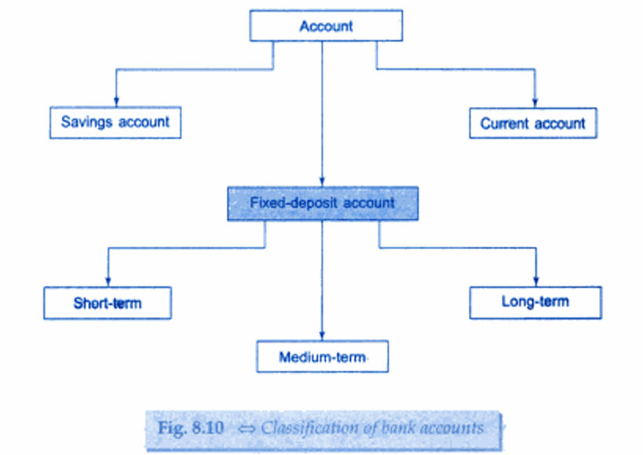
Hierarchical Inheritance

Slide 14
Hierarchical Inheritance
class Arts : public Student {
public:
void getMarks(int s1, int s2) {
sub1 = s1;
sub2 = s2; }
void showResult() {
cout << "Arts Marks: " << sub1 << ", " << sub2 << endl;
cout << "Total: " << sub1 + sub2 << endl; }
private: int sub1, sub2; };
int main() {
Science sci;
Arts art;
cout << "Science Student:" << endl;
sci.getRoll(101);
sci.getMarks(85, 90);
sci.showRoll();
sci.showResult();
cout << "\nArts Student:" << endl;
art.getRoll(102);
art.getMarks(78, 82);
art.showRoll();
art.showResult();
return 0; }
class Student {
public:
void getRoll(int r) {
roll = r; }
void showRoll() {
cout << "Roll: " << roll << endl; }
private:
int roll; };
class Science : public Student {
public:
void getMarks(int s1, int s2) {
sub1 = s1;
sub2 = s2; }
void showResult() {
cout << "Science Marks: " << sub1 << ", " << sub2 << endl;
cout << "Total: " << sub1 + sub2 << endl; }
private: int sub1, sub2; };

Slide 15
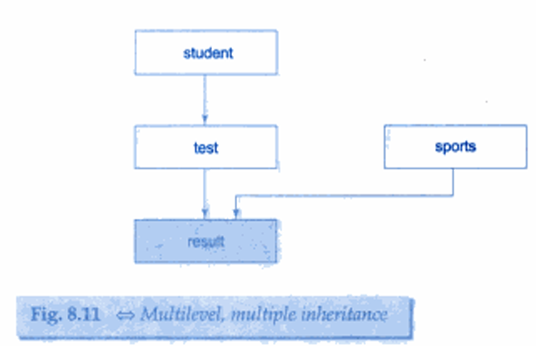
Hybrid inheritance
class Person {
protected:
string name;
int age;
public:
void setPerson(string n, int a) {
name = n;
age = a; }
void showPerson() {
cout << "Name: " << name << ", Age: " << age << endl;
} };
// Derived from Person
class Student : public Person {
protected:
int rollNo;
public:
void setStudent(int r) {
rollNo = r; }
void showStudent() {
cout << "Roll No: " << rollNo << endl; } };
class Marks {
protected:
int m1, m2;
public:
void setMarks(int x, int y) {
m1 = x; m2 = y;
}
void showMarks() {
cout << "Marks: " << m1 << ", " << m2 << endl;
}
};
// Hybrid Inheritance: Derived from Student and Marks
class Result : public Student, public Marks {
int total;
public:
void calculate() {
total = m1 + m2;
}
void showResult() {
showPerson();
showStudent();
showMarks();
cout << "Total = " << total << endl;
} };
int main() {
Result r;
r.setPerson("Alice", 20);
r.setStudent(101);
r.setMarks(80, 90);
r.calculate();
r.showResult();
return 0;}

Slide 16
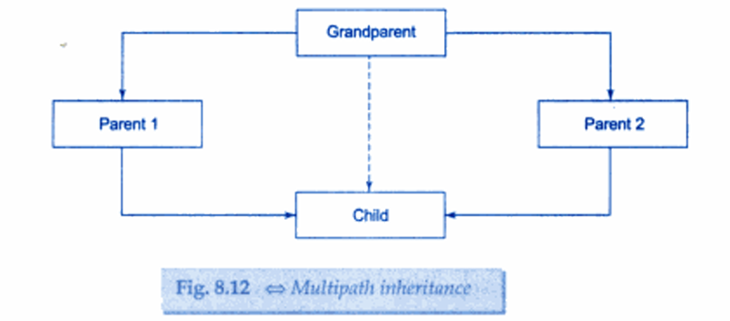
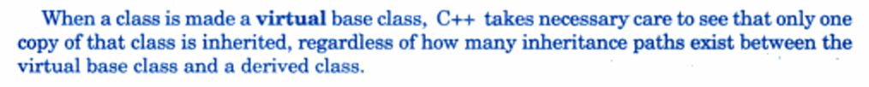
Virtual Base Classes
Problems with Multiple Inheritance
Ambiguity Problem
If two base classes have a function with the same name, the derived class cannot decide which one to call.
Diamond Problem (Duplicate Inheritance of Same Base)
When two classes inherit from the same base class, and then a third class inherits from both of them, the base class members are inherited twice.
Solution → Virtual Base Classes
To solve the diamond problem, we declare the base class as virtual:

Slide 17
Abstract Classes
An abstract class is a class that cannot be instantiated (you cannot create objects of it).
It is designed only to act as a base class (to be inherited by other classes).
An abstract class is a class that has at least one pure virtual function.

Slide 18
Constructors in Derived Classes
Order of Execution:
When an object of a derived class is created, the base class’s constructor is executed first, followed by the derived class’s constructor.
When an object of a derived class is destroyed, its destructor is called first, then that of the base class.
Default Constructor Invocation:
If a base class has a default (no-argument) constructor, and the derived class does not explicitly call a specific base class constructor, the base class's default constructor is automatically invoked.
Explicit Base Class Constructor Call:
If a base class has a parameterized constructor, the derived class must explicitly call it using an initializer list.
Notes:
Base class constructors are not inherited in derived classes – Why?

Slide 19
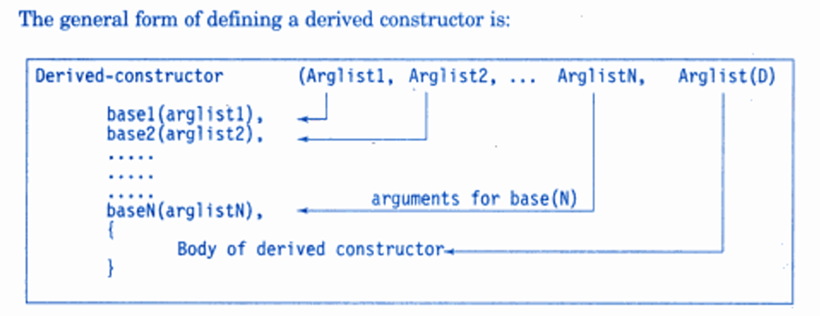
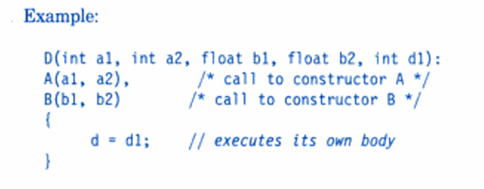
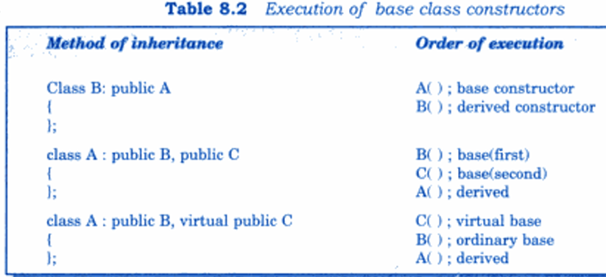

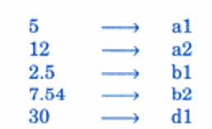
Cont..

Slide 20
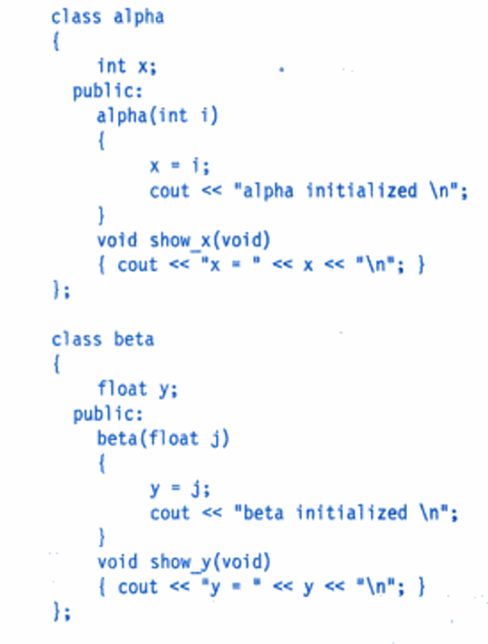
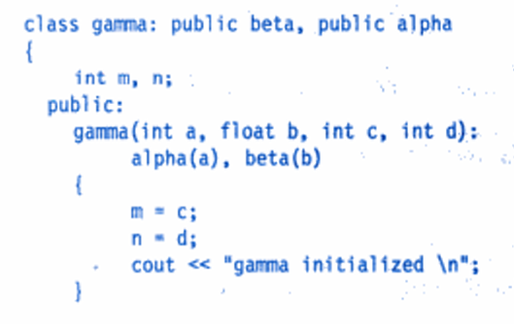
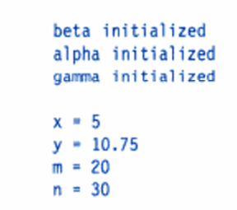
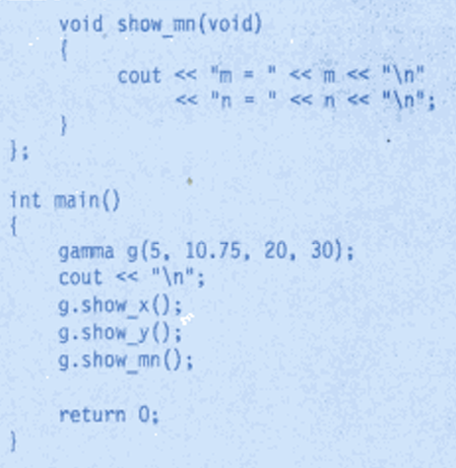
Constructors in Derived Class Example

Slide 21
Cont..
A constructor initializer list is a way to initialize data members of a class before the constructor body executes.
ClassName(parameters) : member1(value1), member2(value2), ... {
// constructor body
}
#include <iostream>
using namespace std;
class Student {
int roll;
string name;
public:
Student(int r, string n) : roll(r), name(n) {
cout << "Student created with roll = " << roll << ", name = " << name << endl;
} };
int main() {
Student s1(101, "Alice");
return 0; }

Slide 22
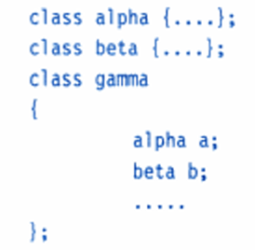
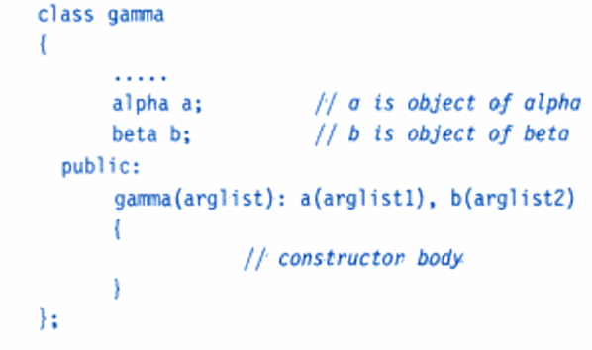
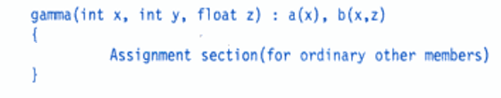
Member classes: nesting of classes
All objects of the gamma class will contain the objects a and b. This kind of relationship is called containership or nesting.
A nested object is created in two stages. First, the member objects are created using their respective constructors and then the other 'ordinary' members are created.
This means, constructors of all the member objects should be called before its own constructor body is executed.
This is accomplished using an initialization list in the constructor of the nested class.

