Slide 1
Notes:
INTRODUCE – WHAT WHAT WE DO…AND WHO WE ARE.
TODAY WE’RE GOING TO TALK ABOUT HOW OUR VIDEO CONTENT IS MADE FAST, YES, PLUS AT VERY LOW COST, AND WITH POWERFUL, MEASURABLE RESULTS.
THEN WE’RE GOING TO SHOW YOU HOW THE ACTUAL WAY WE CREATE VIDEO CONTENT SERVES YOUR CROSS-MARKETING CAMPAIGN GOALS – NAMELY, TO GET A CAMPAIGN TO MARKET QUICKLY; TO MAKE IT NIMBLE ENOUGH TO BE CUSTOMIZED AND RECONFIGURED FOR MULTIPLE CSP’S AT A MOMENT’S NOTICE, AND TO MAKE IT INEXPENSIVELY ENOUGH TO BE MADE IN HIGH VOLUME, FOR MAXIMUM REACH.
FOCUS: PAUL’S HISTORY – NBC TODAY SHOW, CONTRIBUTING WRITER FOR NYTIMES, WALL STREET JOURNAL, FORTUNE
FOCUS: BILL’S HISTORY – 30 YEARS ENTERPRISE SOFTWARE ENTREPRENEUR; 3 SUCCESSFUL COMPANIES, SVP ENGINEERING AT ATG (GOES PUBLIC) TWO SUCCESSFUL WEB VIDEO COMPANIES.
TRANSITION: BOTH OF OUR CAREERS HAVE BEEN FOUNDED ON VIDEO AS A POWERFUL MARKETING TOOL.
WELL, LUCKY US – WE BACKED THE RIGHT HORSE. VIDEO IS THE FUTURE.

Slide 2
Video Works
6,000,000,000 Hours
(of video watched a month on YouTube)
60%
(of Americans watch 395 videos a month)
300%
(boost in engagement when video is on a web page)
60,000 x Faster
(our brains process video faster than text)
Notes:
OFFER WHITE PAPER, STATS, ANALYTICS FOR POST-MTG – email addresses to paul@humogongousmedia.com

Slide 3
Video Works
139%
video increases brand association
300%
increase in click-through rates on email campaigns
98%
sales lift with Humongous Media videos on Amazon product page
Better Analytics:
Video consumption is more easily measured than text
Notes:
NOTE: Actual consumption is measurable with Video – Examples: View-to-Completion, View Duration, Viewing Habits
EASIER TO GET INFORMATION ABOUT THE EFFECTIVENESS OF YOUR CO-MARKETING, WHEN YOU USE VIDEO
NOTE: YOUR CO-MARKETING CHALLENGE IS TO COMBINE BRAND ASSOCIATION of INTEL CLOUD TECHNOLOGY WITH YOUR CSP’s DESIRE TO BOOST SALES
NOTE 2: WHEN WEBSITES CONTAIN VIDEO, THEY RISE TO THE TOP OF THE RESULTS IN SEARCH ENGINES
TRANSITION: VIDEO IS GREAT AT BOTH -- WE CREATE VIDEO CONTENT…HOW ARE WE DIFFERENT?

Slide 4


Amazon - The Challenge
Video can be expensive and slow to produce
The Goal: Develop video content for 10,000 vendors quickly and cost effectively
…With little investment in time or money by Amazon
Notes:
IN THE BEGINNING, there was Amazon. Our first customer.
PARADOX: Most marketers need time to control the message, but they don’t have time.
THEY DON’T WANT TO BE HANDHOLDING DURING THE VIDEO PROCESS.
TRANSITION: THIS IS HOW WE DID IT FOR AMAZON

Slide 5
Amazon - The Solution
Repeatable process
Standardized core elements:
Style, format, talent, duration
Customized elements:
scripts, graphics, branding, local languages
Eliminates “starting from scratch” for each vendor and video
Notes:
STANDARDIZED ELEMENTS MAKE IT INEXPENSIVE
CUSTOMIZED ELEMENTS MAKE IT GOOD.
BOTH TOGETHER MAKE IT FAST AND INEXPENSIVE
TRANSITION – RESULTS WERE POWERFUL

Slide 6

Amazon - The Results (Volume)
1500 videos created
HM videos now a standard part of Amazon VPS
Notes:
TRANSITION: ALONG THE WAY, THESE ARE SOME OF THE CUSTOMERS WE CREATED VIDEOS FOR.

Slide 7
Amazon - The Results (Social Media)
When an Amazon vendor added our social video to their Amazon @deals tweets, unit sales went up 300%.
Notes:
TRANSITION: ALONG THE WAY, THESE ARE SOME OF THE CUSTOMERS WE CREATED VIDEOS FOR.

Slide 8
Amazon - The Results (Support)
When the Amazon CERC added our product videos to their new learning center, product returns dropped 1000%
Notes:
TRANSITION: ALONG THE WAY, THESE ARE SOME OF THE CUSTOMERS WE CREATED VIDEOS FOR.

Slide 9
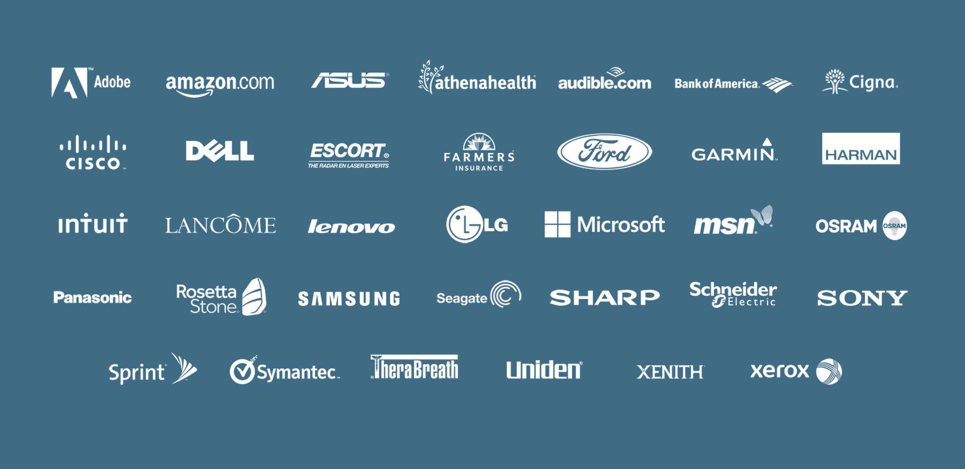

Customers
Notes:
I’M PROUD TO SAY THAT THEY’RE ALL REFERENCEABLE, AND CONTINUE TO DO WORK WITH US TO THIS DAY, ON AND OFF AMAZON.
I’M EVEN PROUDER TO SAY THAT ONE OF THEM IS YOU. (NEXT SLIDE)

Slide 10
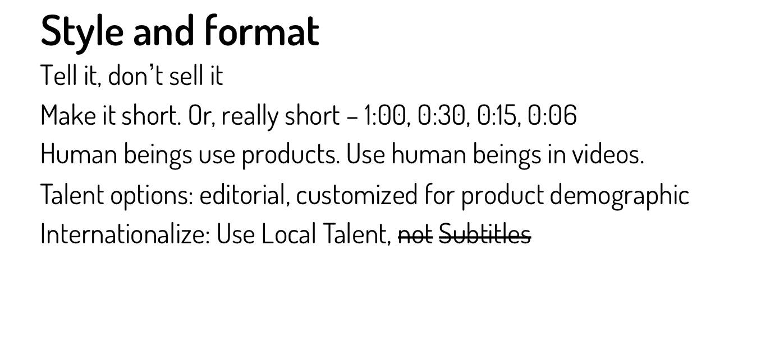
Best Practices - What we’ve learned.
Notes:
Last-Minute Conversion with the facts – don’t sell me. I’m already sold
WE’LL FOLLOW UP WITH SPECIFIC Price List

Slide 11
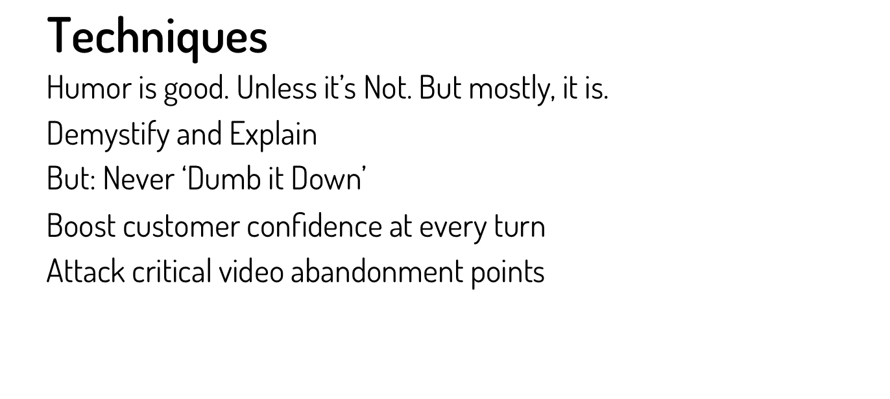
Best Practices - What we’ve learned 2.
Notes:
Last-Minute Conversion with the facts – don’t sell me. I’m already sold
WE’LL FOLLOW UP WITH SPECIFIC Price List

Slide 12
Best Practices - What we’ve learned 3.
Reassurance is a real product benefit.
Solution: Testimonial videos
Focus on customer success
Keep it real – ‘Man/Woman on the Street’
Make it Plain – Jargon-free
Stick with Use Cases, not Technologies
Notes:
Last-Minute Conversion with the facts – don’t sell me. I’m already sold
WE’LL FOLLOW UP WITH SPECIFIC Price List

Slide 13
Best Practices - What we’ve learned 4.
Reducing support costs - a key priority
Solution: ‘Training Bites’
Ultra-Short video content focused on specific tasks
Organized by subject area – FAQ’s, Pain Points
Designed for Mobile Consumption – Field Reference
Low Cost
Easy distribution, Multiple Use (press, promo, tease)
Notes:
Last-Minute Conversion with the facts – don’t sell me. I’m already sold
WE’LL FOLLOW UP WITH SPECIFIC Price List

Slide 14
Thank you.
Notes:
PRICING: $10K outside, $6K Intel Partner Pricing
EDITING: $2K TO $6K per video, depending on level of CUSTOMIZATION
LOCALIZATION: FROM $6K per video to $5K per video.
WE’LL FOLLOW UP WITH SPECIFIC Price List

