Slide 1
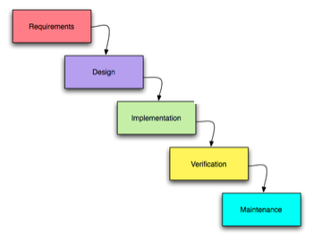
Traditional Product Development Unit of progress: Advance to Next Stage
Waterfall
Problem: known
Solution: known
Notes:
1

Slide 2
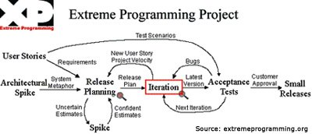
Agile Unit of progress: a line of working code
Agile (XP)‏
“Product Owner” or
in-house customer
Problem: known
Solution: unknown
Notes:
2

Slide 3

Product Development at Lean Startup Business, marketing, engineering are tightly coupled in a company-wide feedback loop. Unit of progress: customer validation
Data, feedback, insights
Hypotheses, experiments, insights
Problem: unknown
Solution: unknown
Notes:
Speed wins

Slide 4

Customer Development
Continuous cycle of customer interaction
Rapid hypothesis testing about market, pricing, customers, …
Extreme low cost, low burn, tight focus
Measurable gates for investors
http://bit.ly/3oartD

