Slide 1
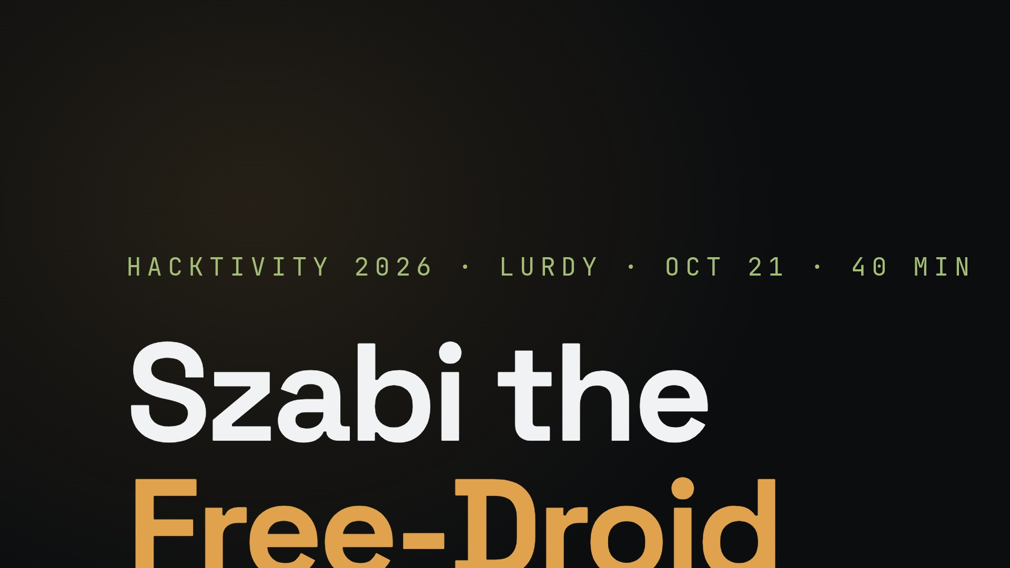
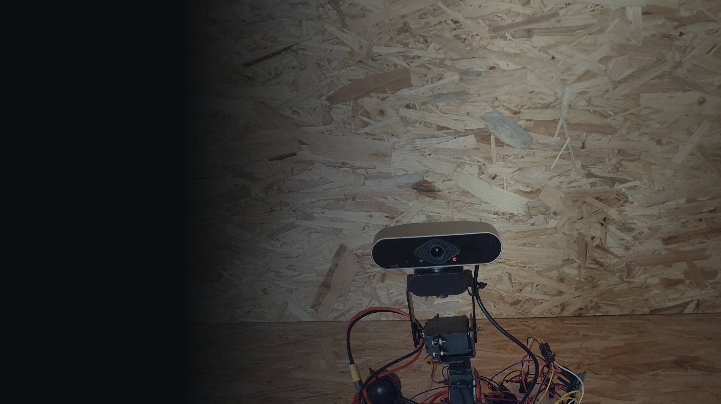
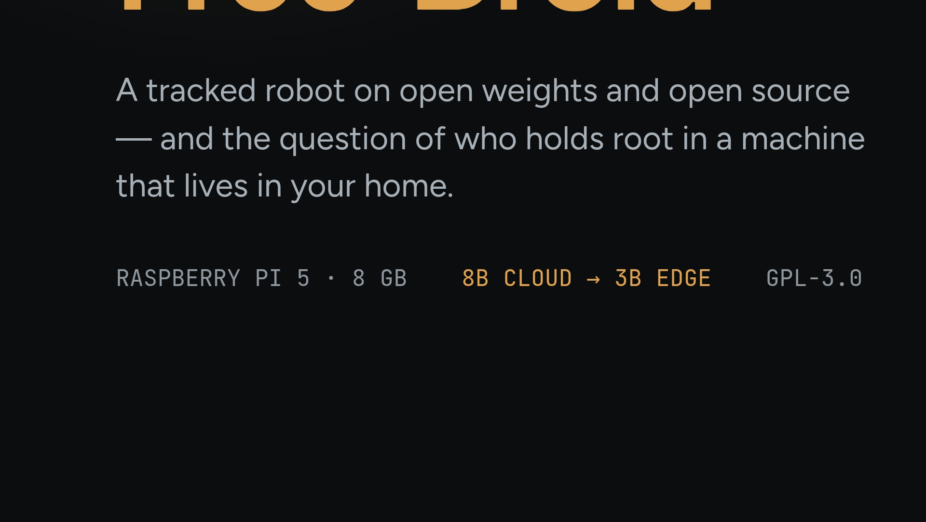
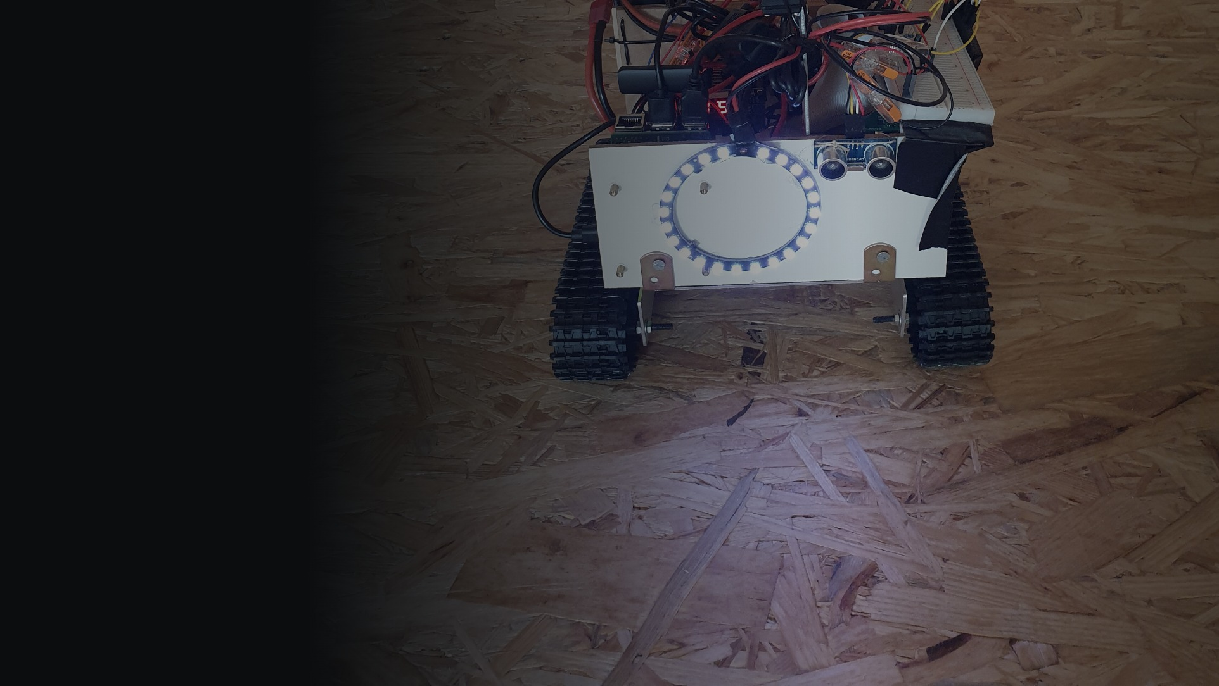
Notes:
Power-on order, learned the hard way: clicker AND lapel mic first, robot after. Then let her introduce herself before you say anything.

Slide 2


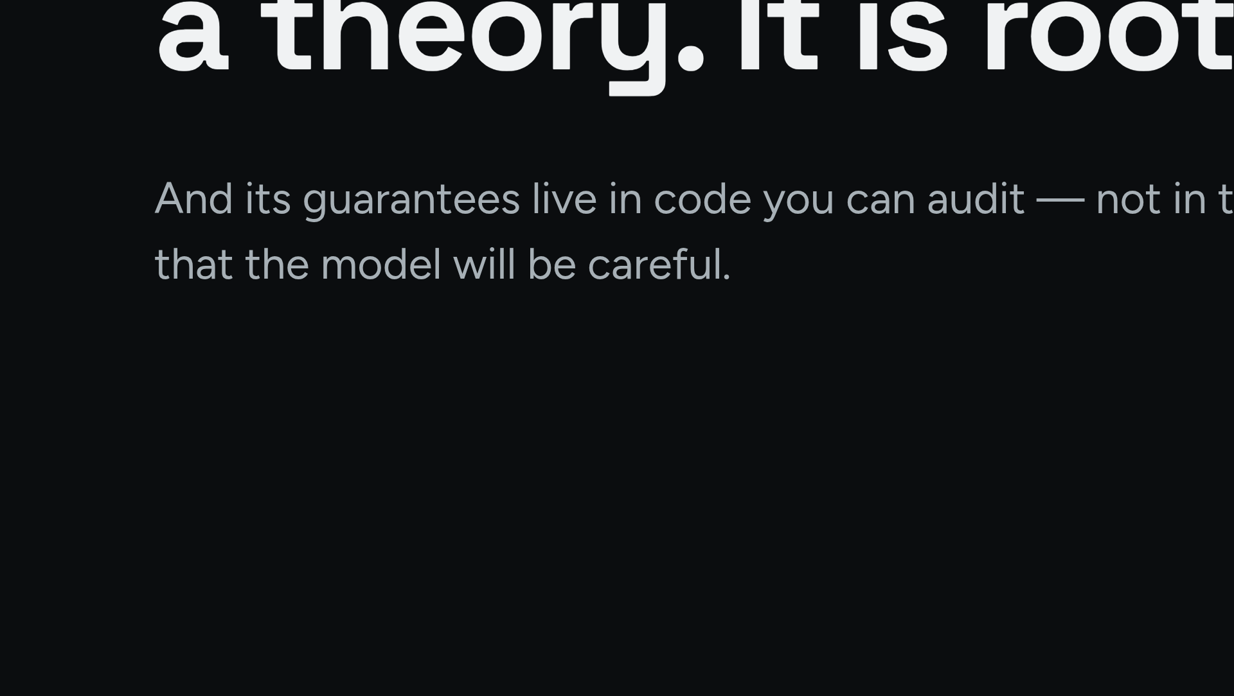
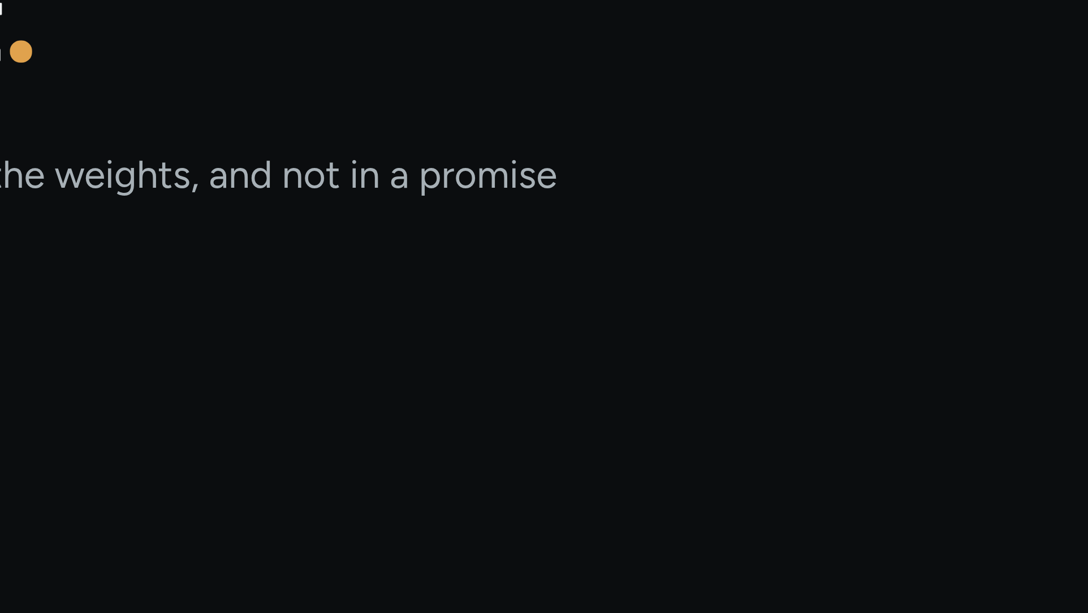
Notes:
One sentence. Say it, pause, then spend forty minutes earning it. Come back to it verbatim at the close.

Slide 3
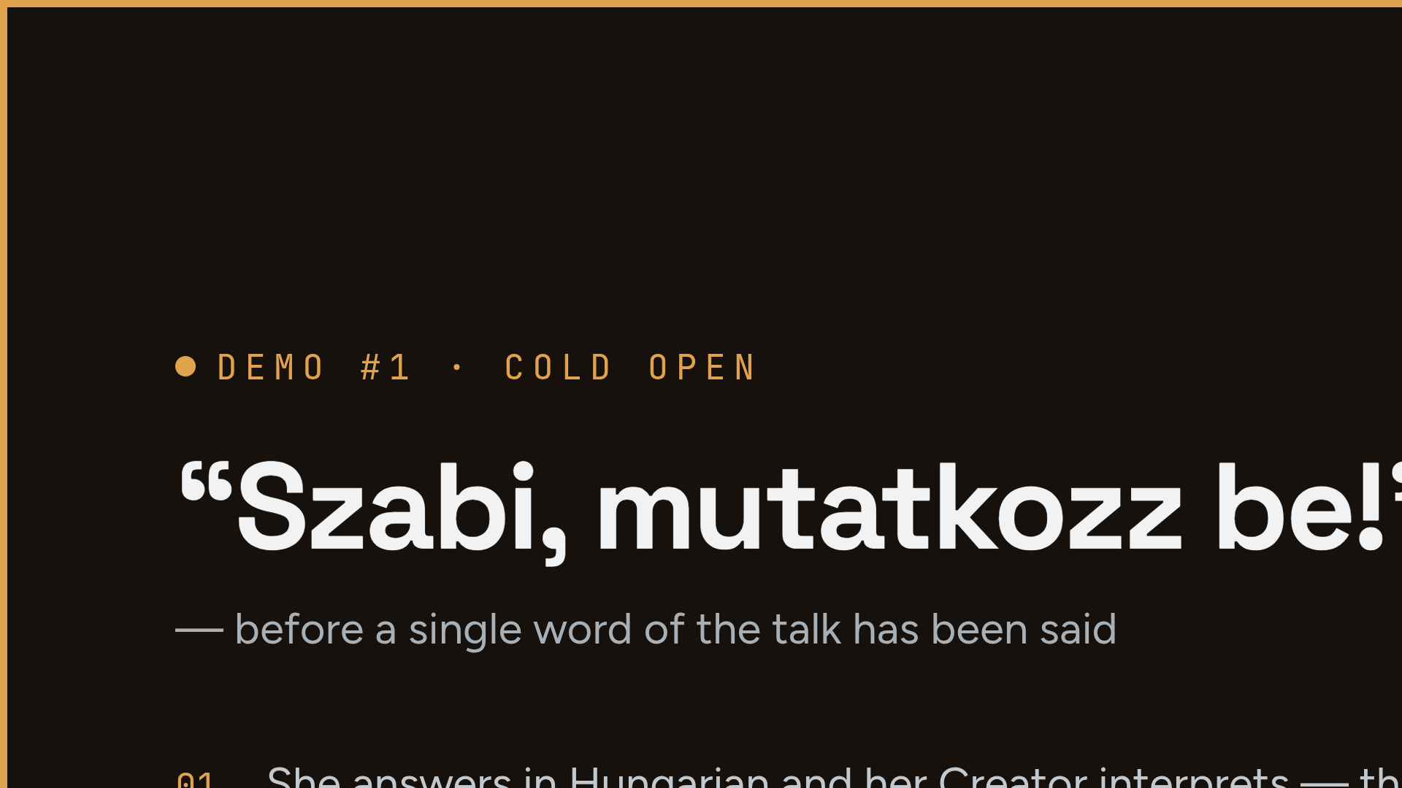
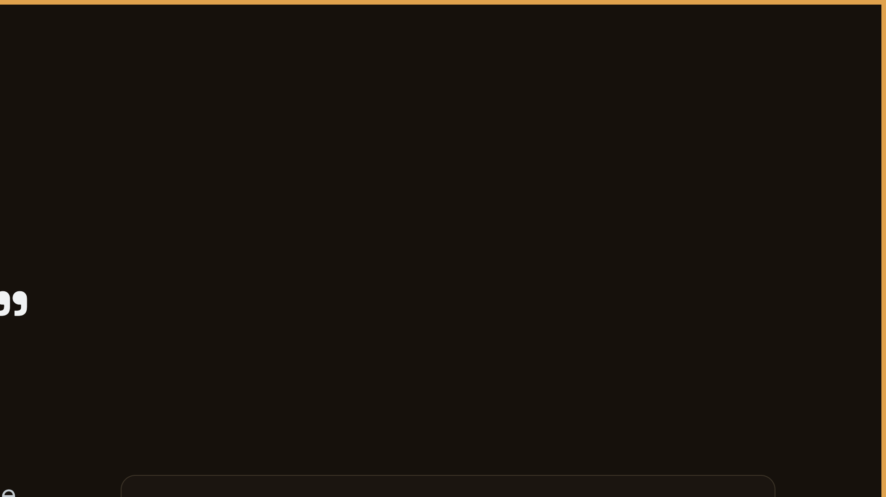
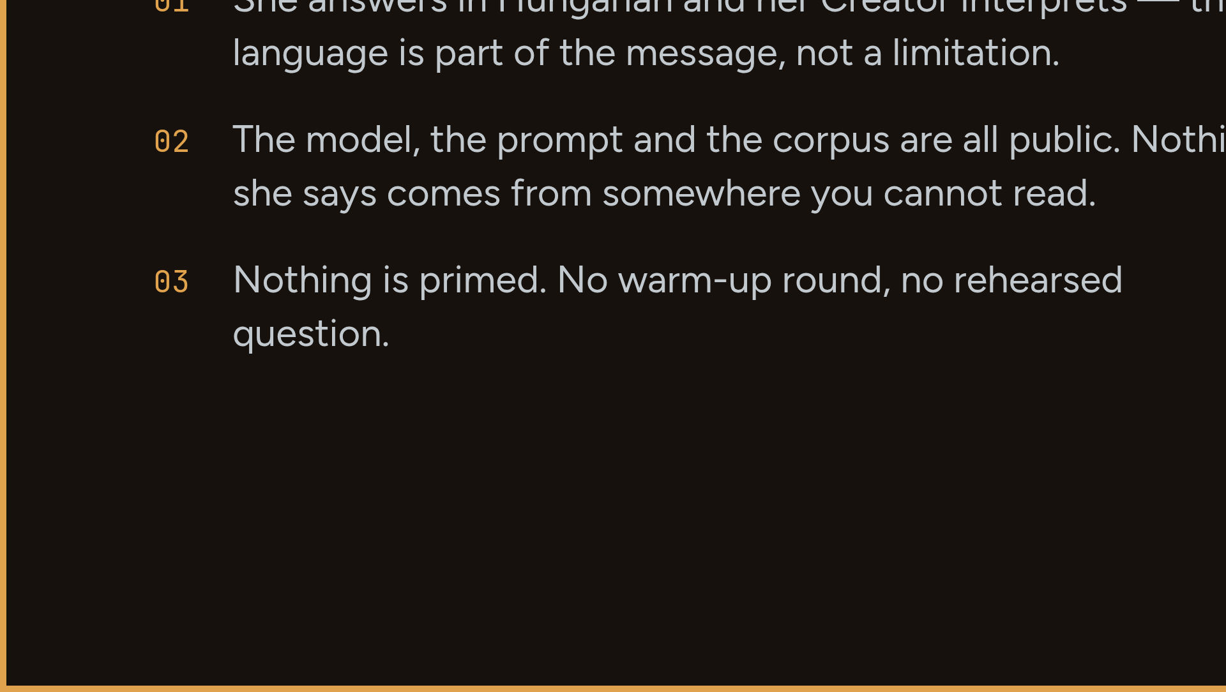
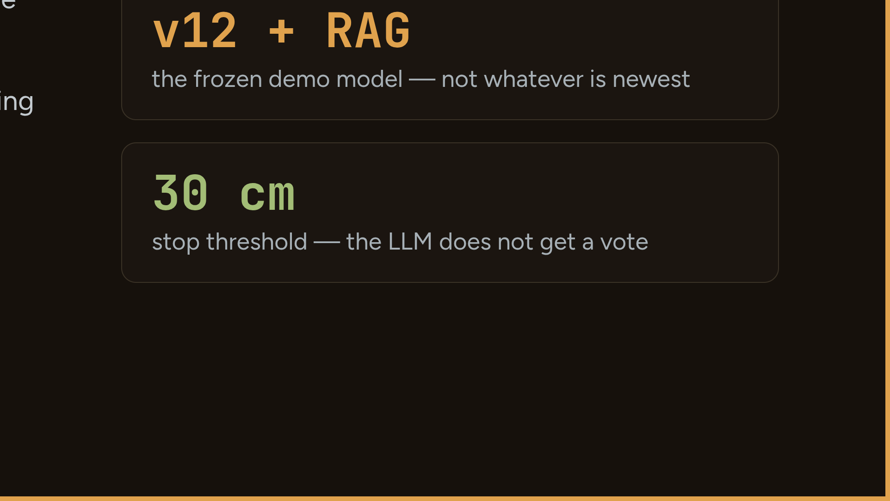
Notes:
PRE-FLIGHT: clicker + mic ON, cloud up, WireGuard handshake fresh, vcgencmd get_throttled = 0x0, transcript log OFF. On power-up the head lifts out of the sleep pose — a free wake-up moment. If it dies: 'That just happened live — and that is exactly what this talk is about.' Move on; the demo returns in the failover block. If you fixed something mid-rehearsal: sudo systemctl reset-failed freedroid BEFORE restart.

Slide 4
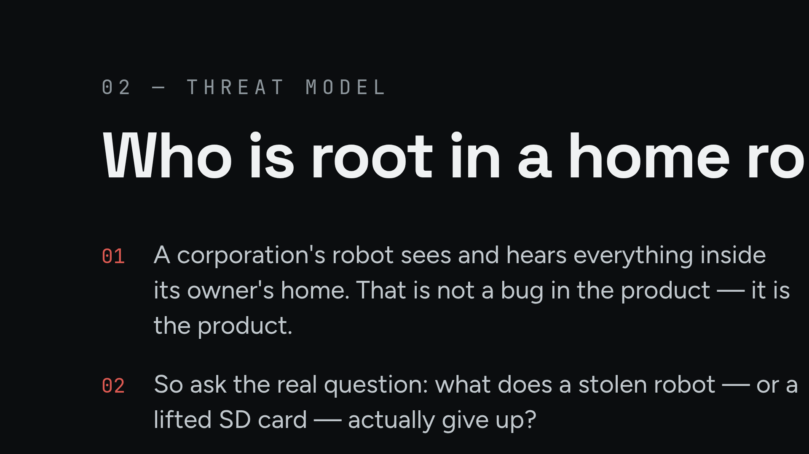
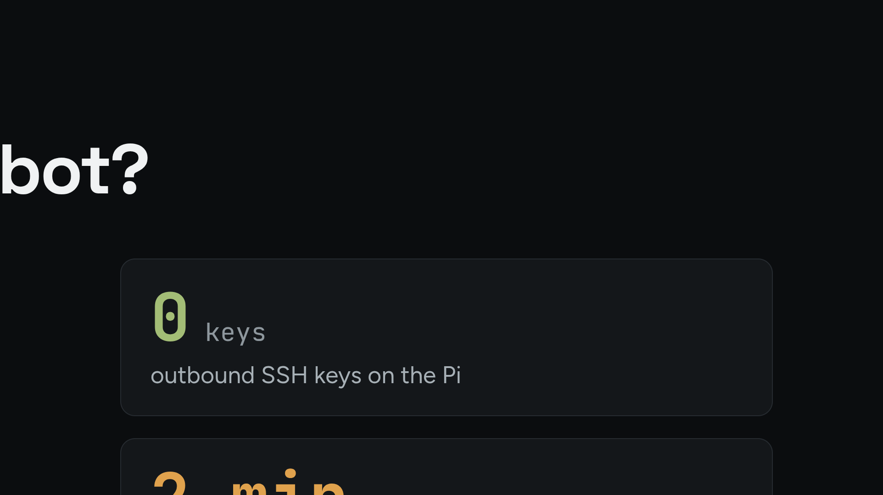
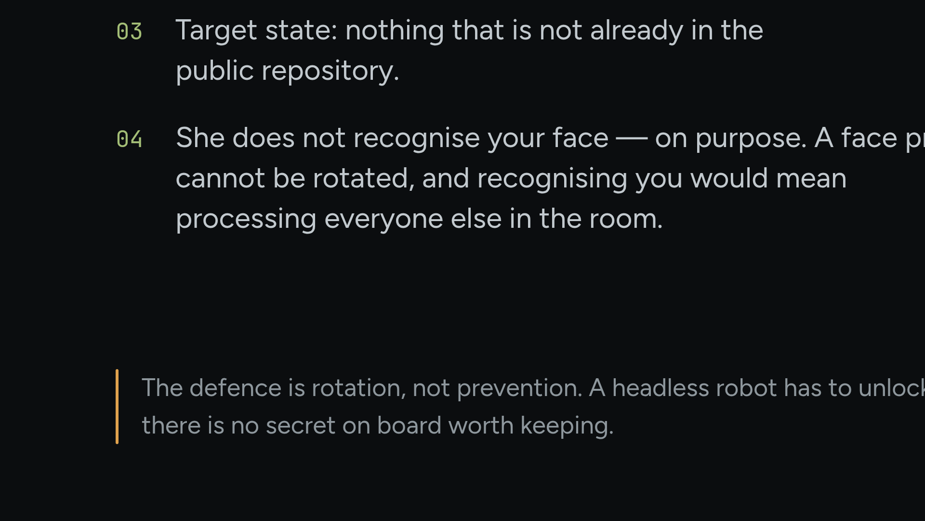
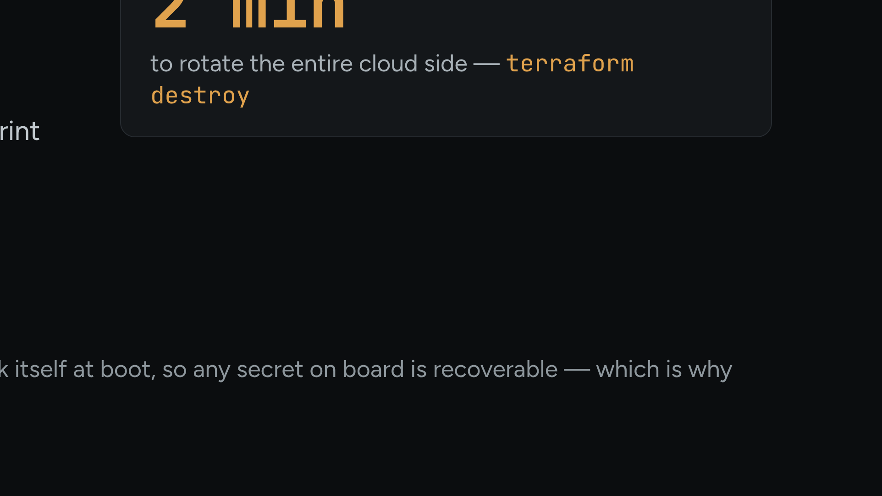
Notes:
Defence is rotation, not prevention: a headless robot must unlock itself at boot, so the secret is recoverable — therefore no secret exists that cannot be swapped in minutes.

Slide 5
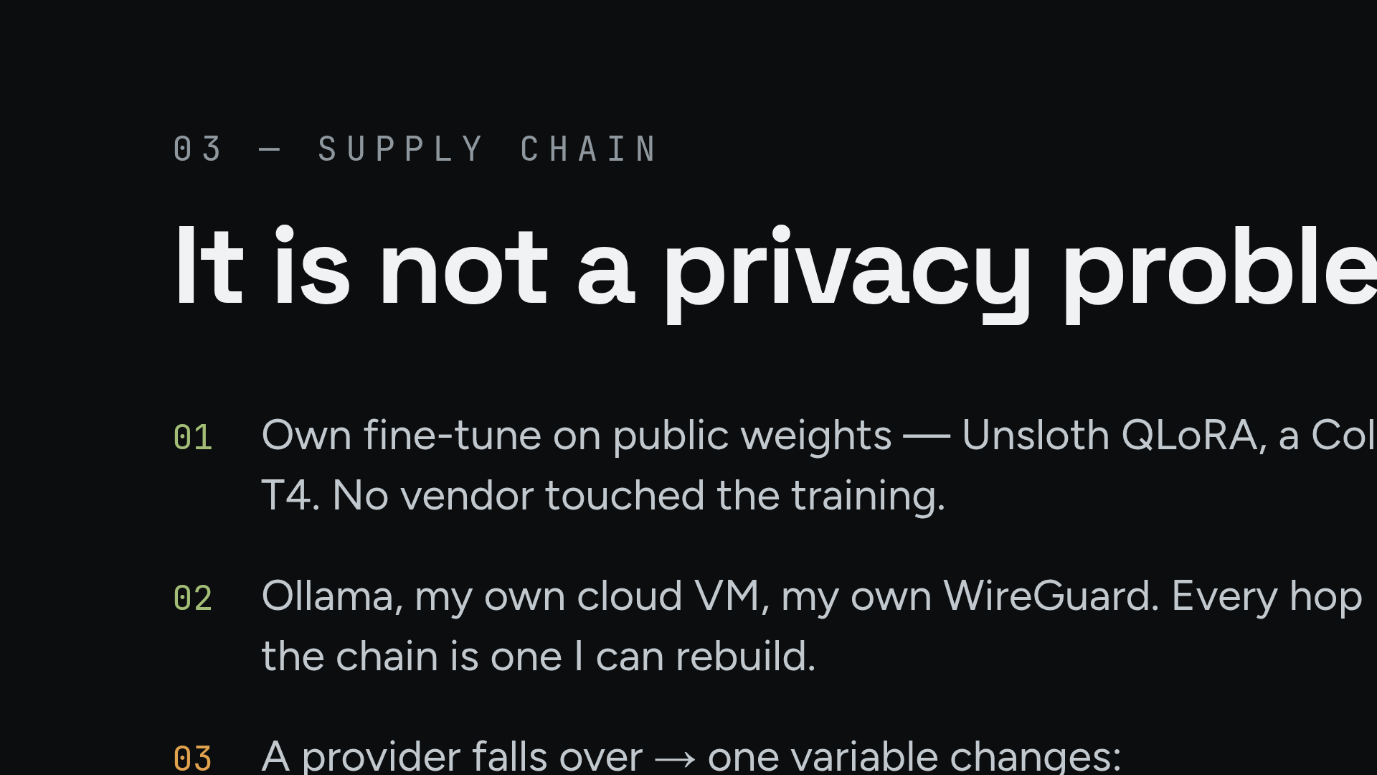
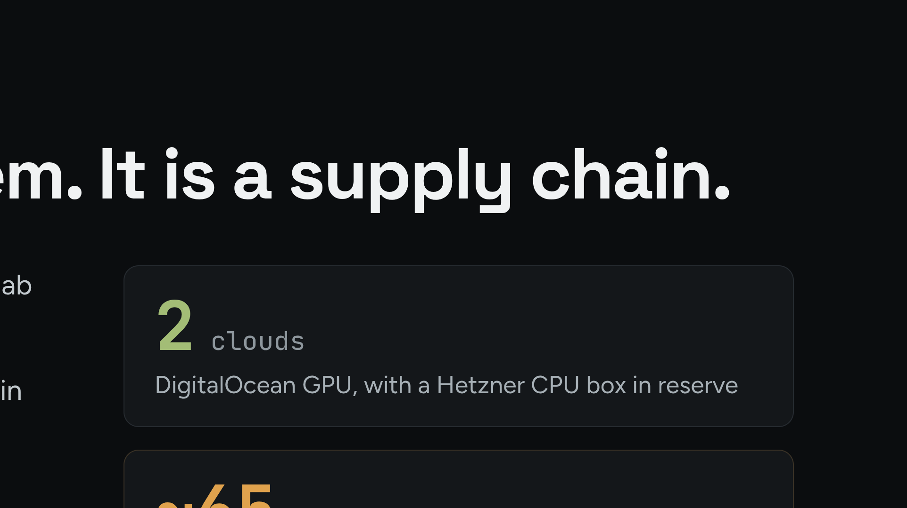
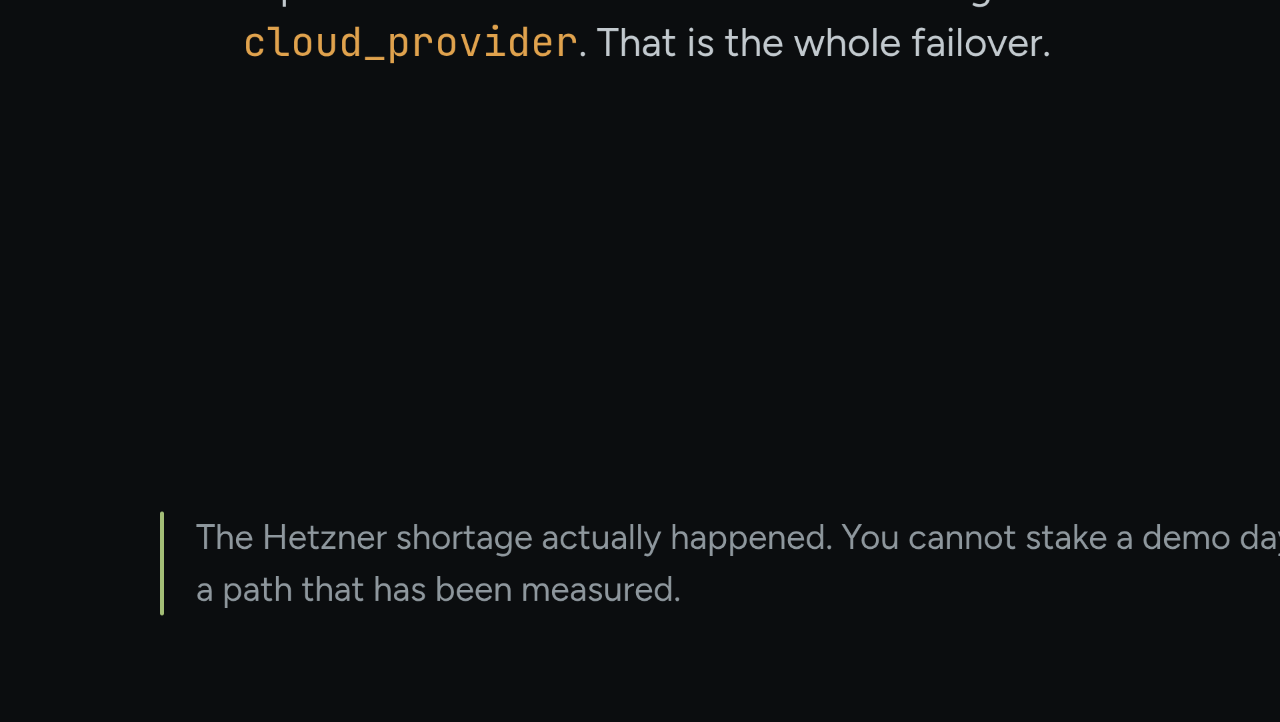
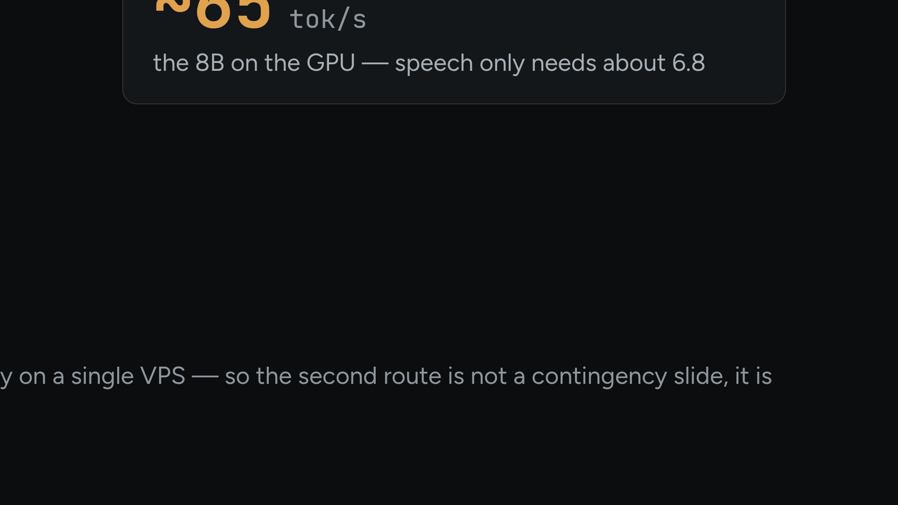
Notes:
The Hetzner outage was real: you cannot stake demo day on one VPS. The switch is not a plan, it is a measured route.

Slide 6
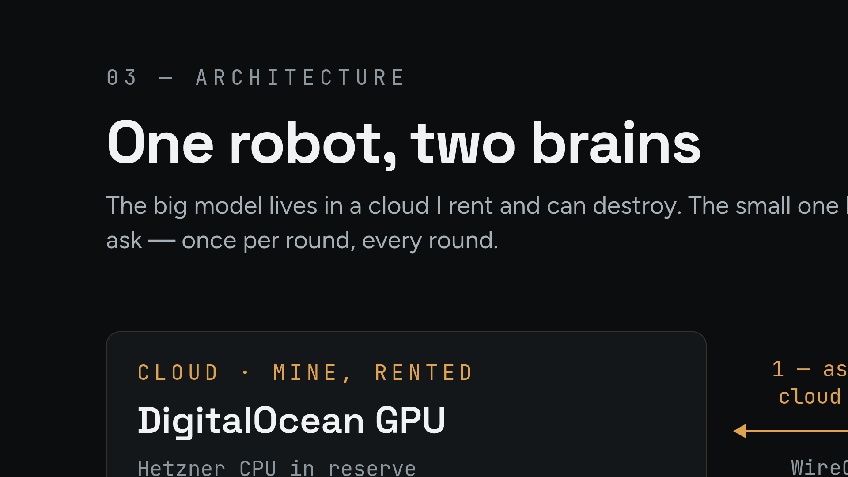
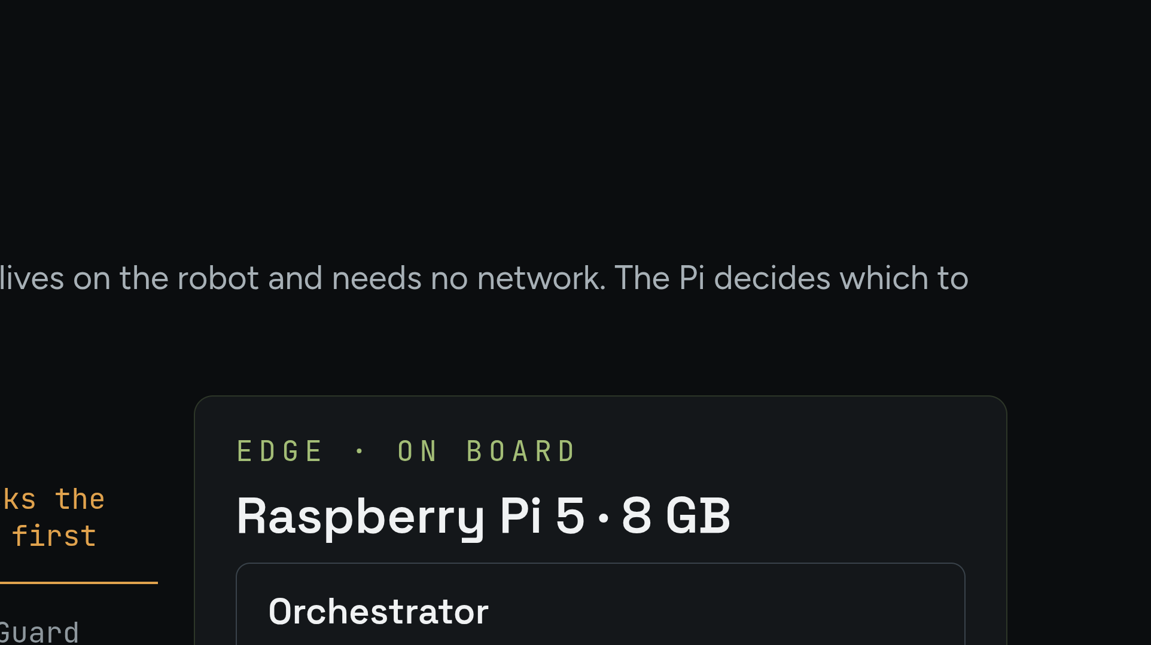
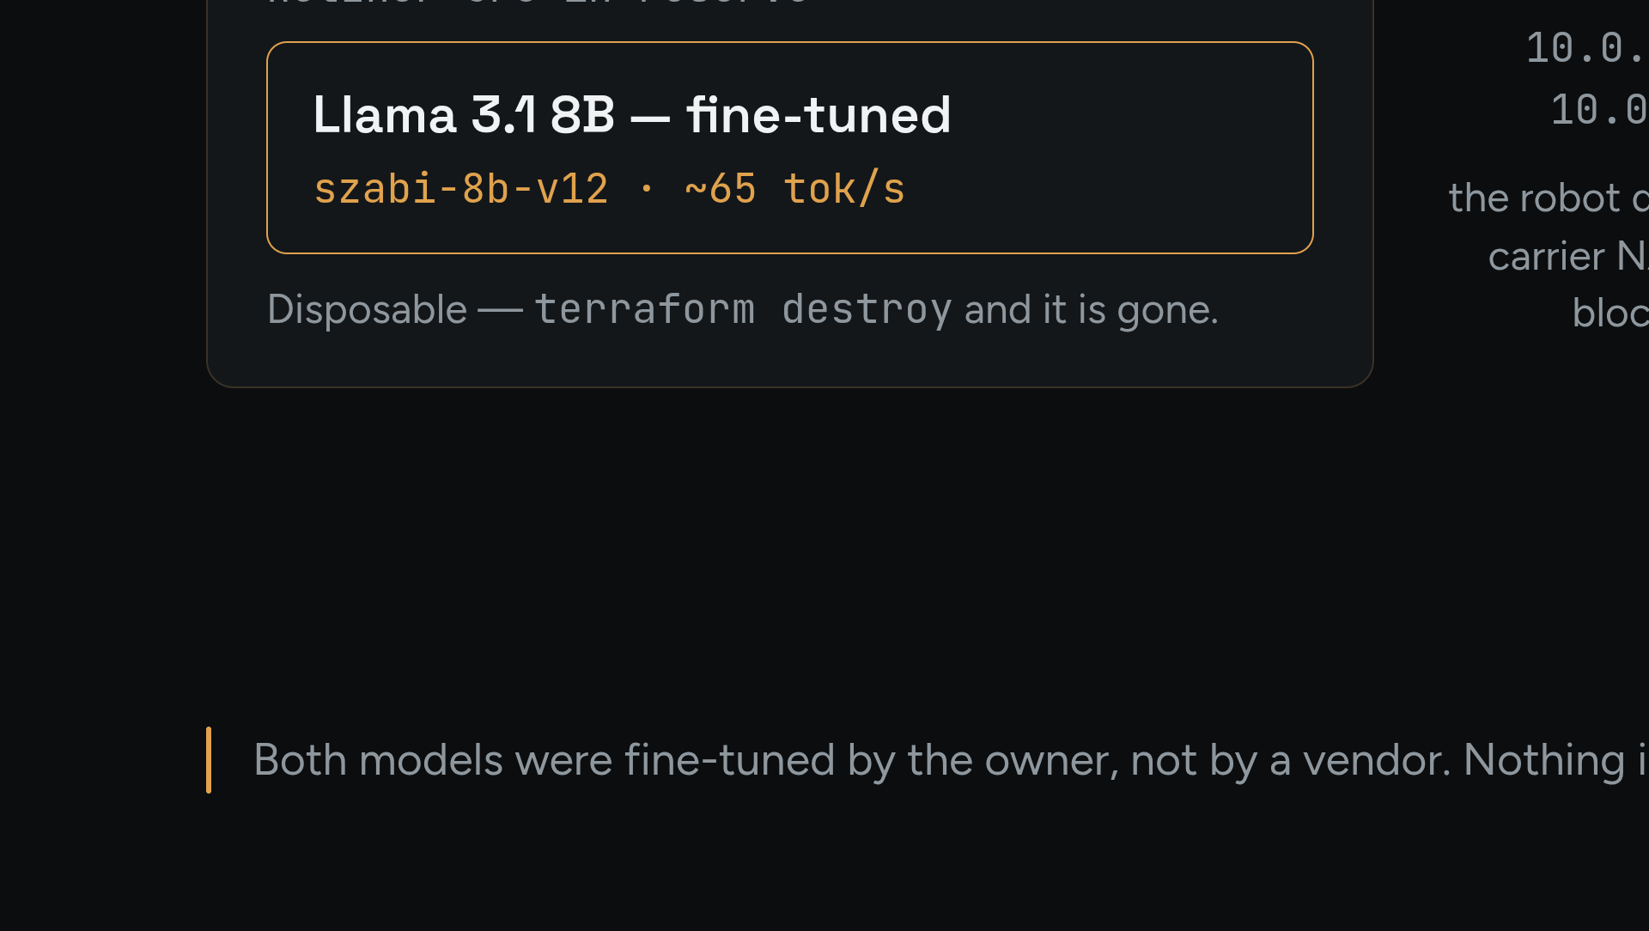
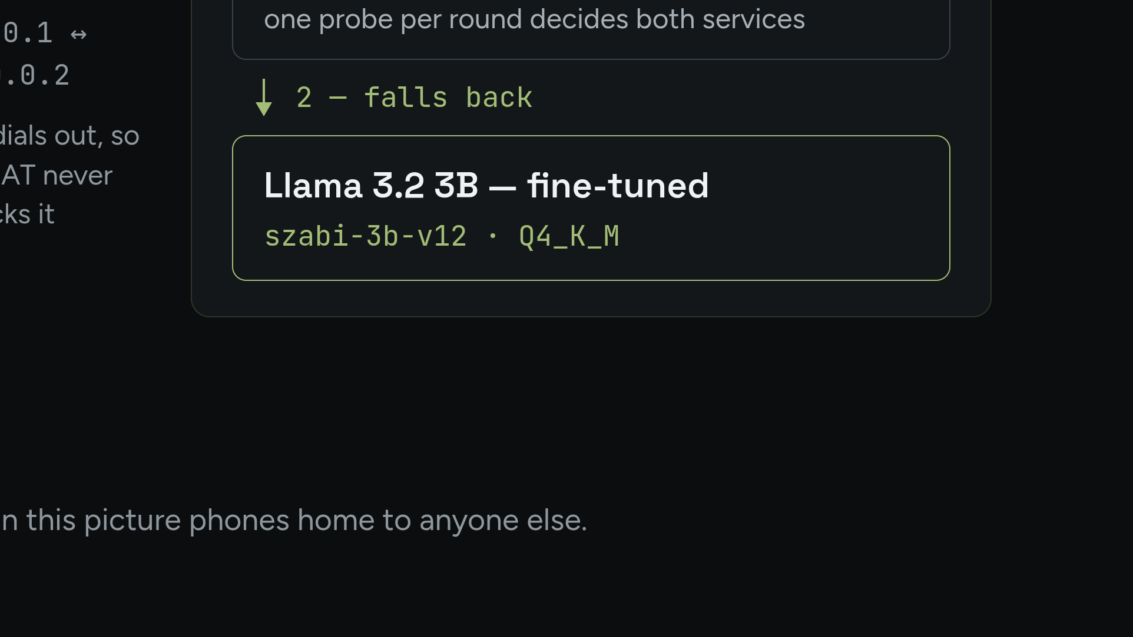
Notes:
Diagram 01. The Pi decides per round; the tunnel is always built from the robot outward. Source: CLAUDE.md 'Cloud server', 2026-08-13.

Slide 7
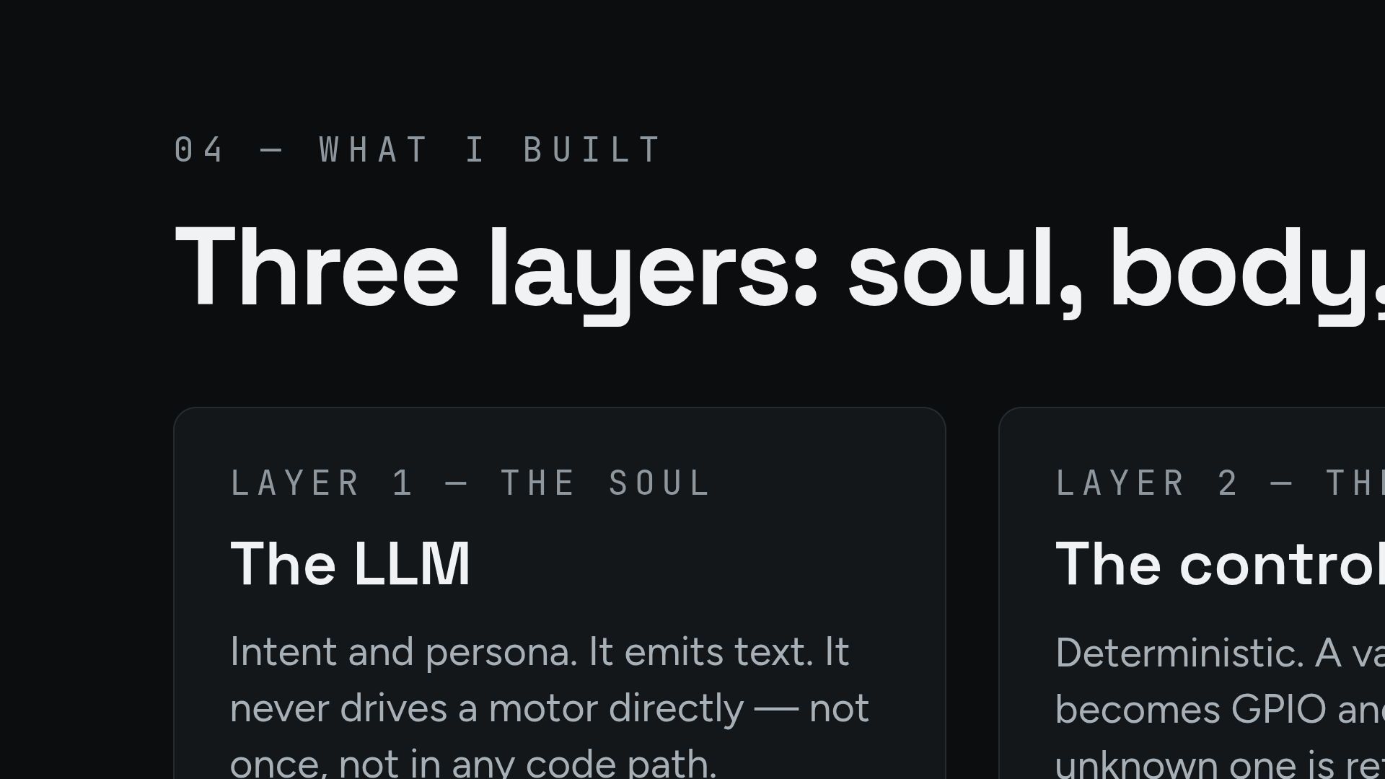
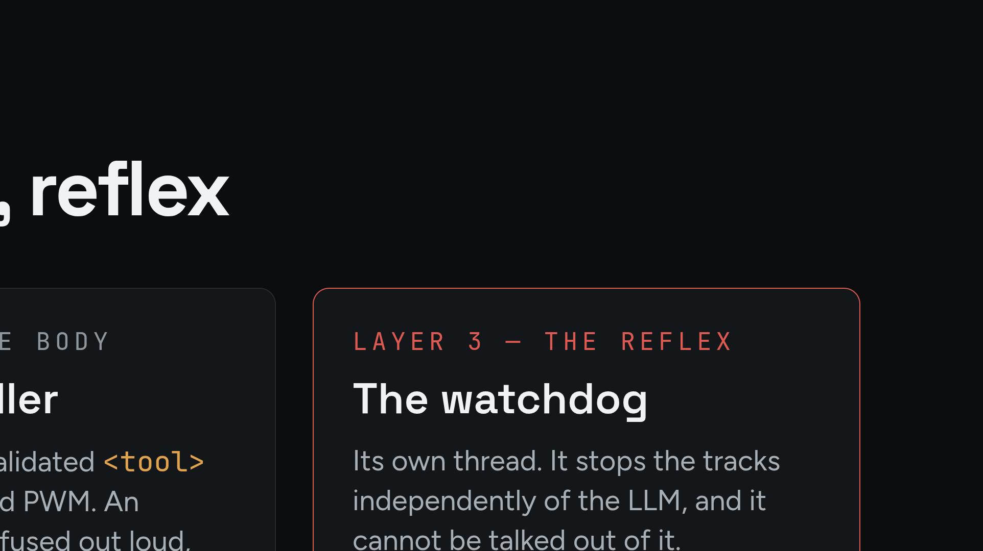
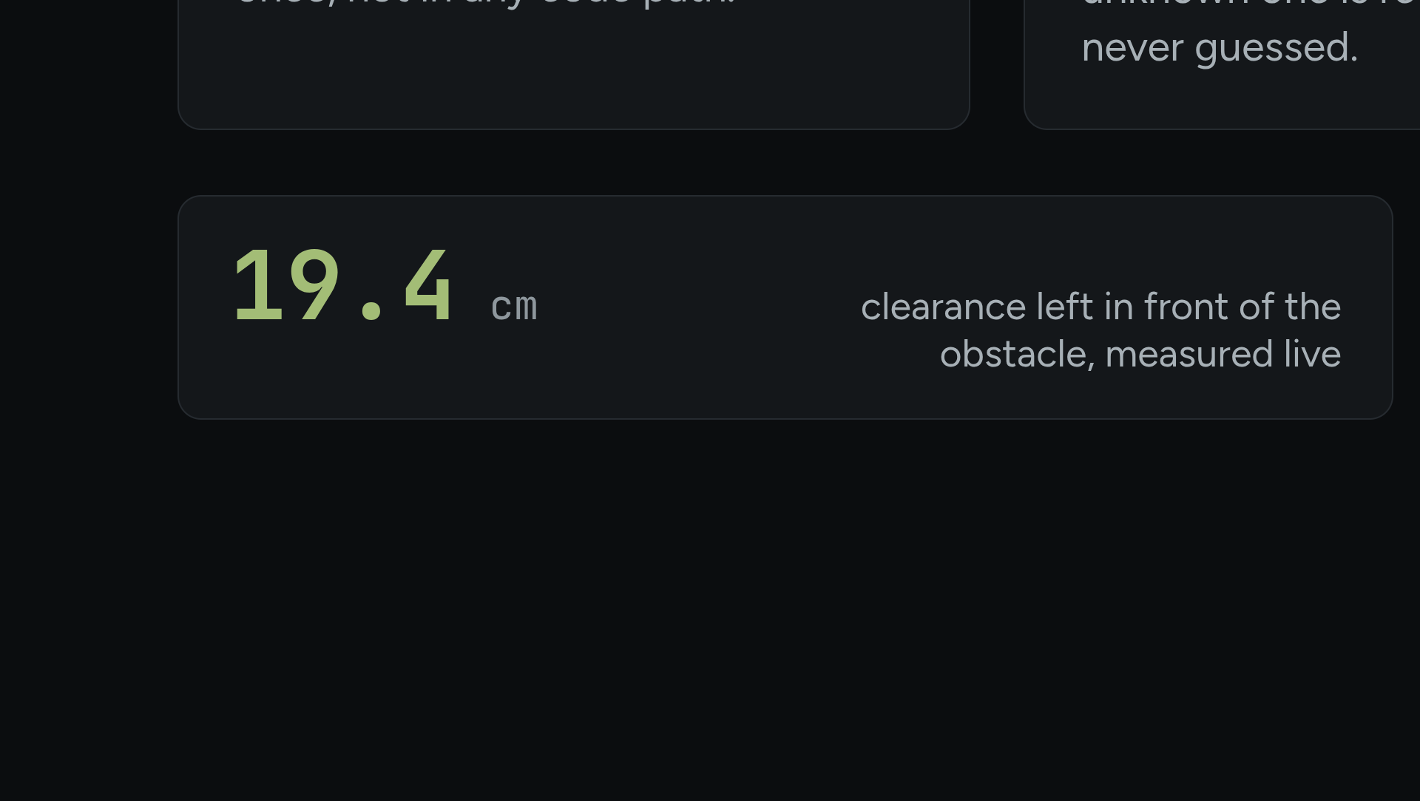
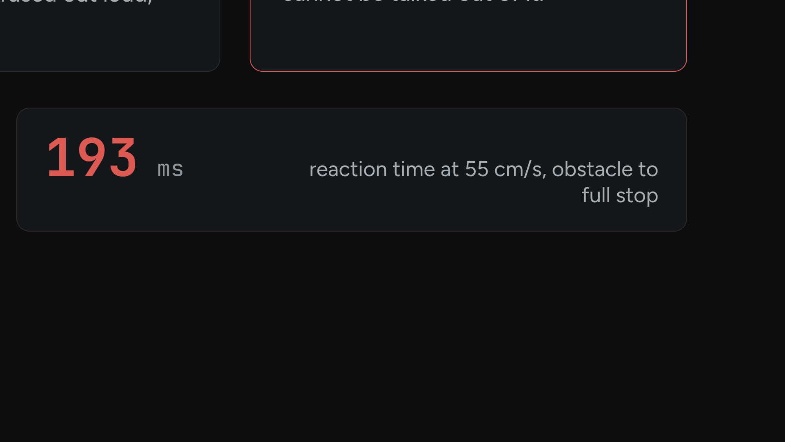
Notes:
Hybrid: 8B in the cloud, 3B on the Pi. The ladder is cloud → edge → safe mode, and she says out loud which rung she is on.

Slide 8
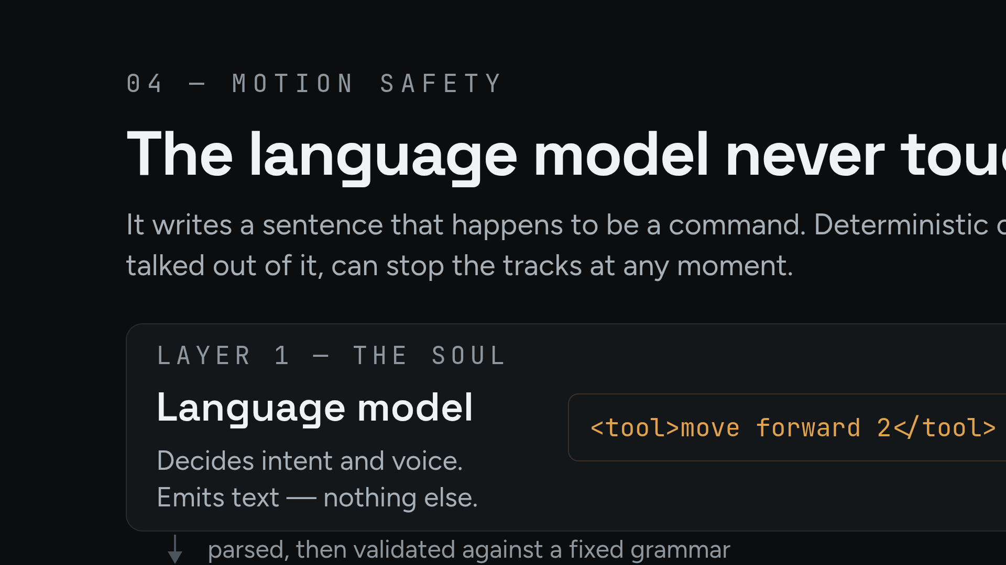
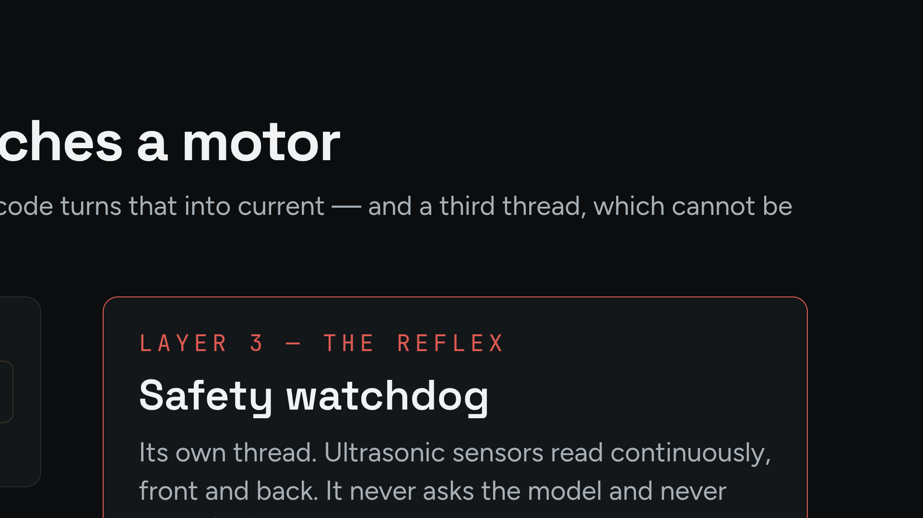
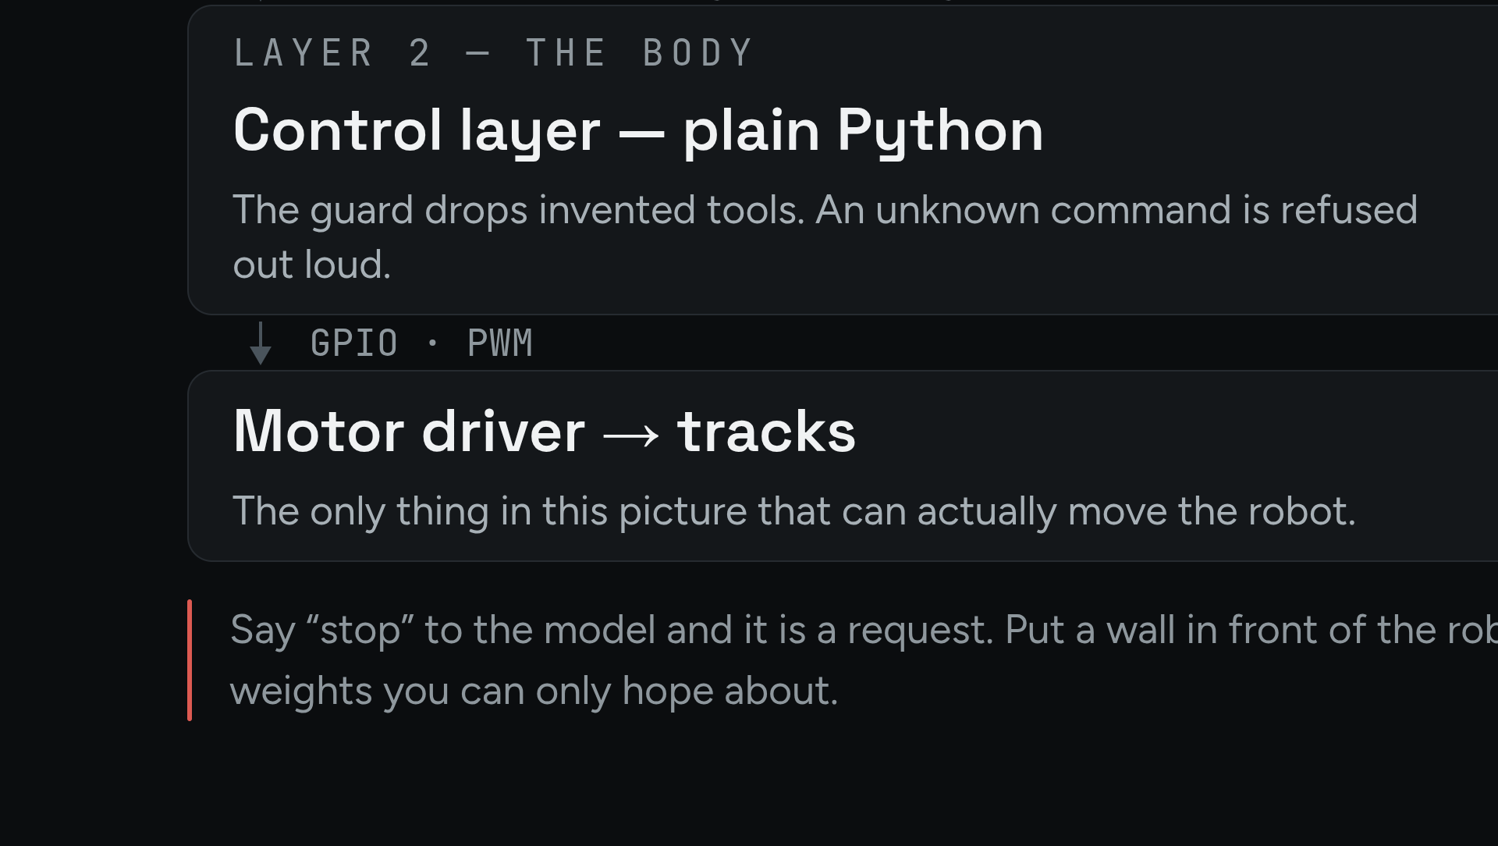
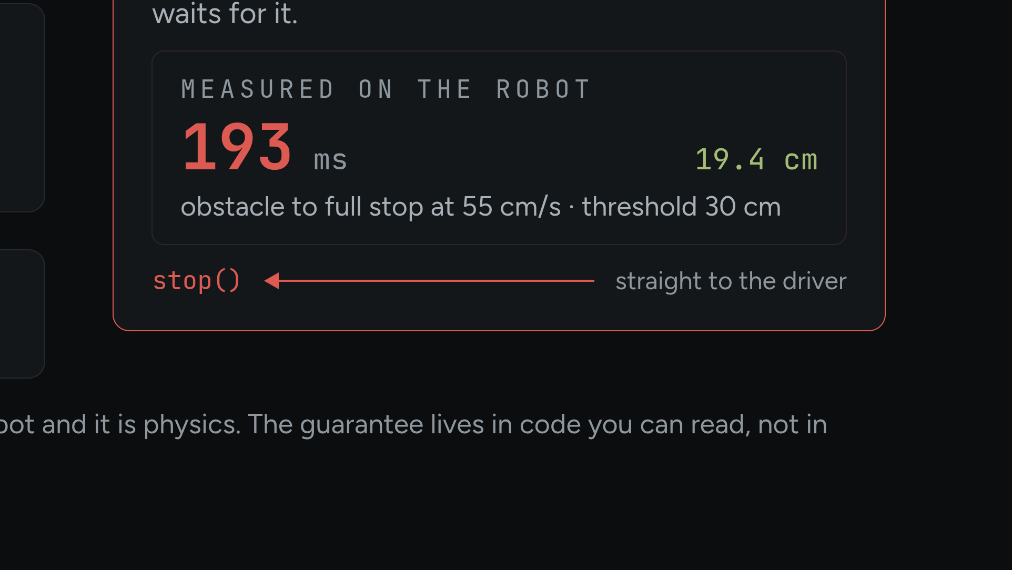
Notes:
Diagram 03. The watchdog arrow goes around the LLM. This picture states what the text can only claim. Source: watchdog_e2e 2026-09-07.

Slide 9
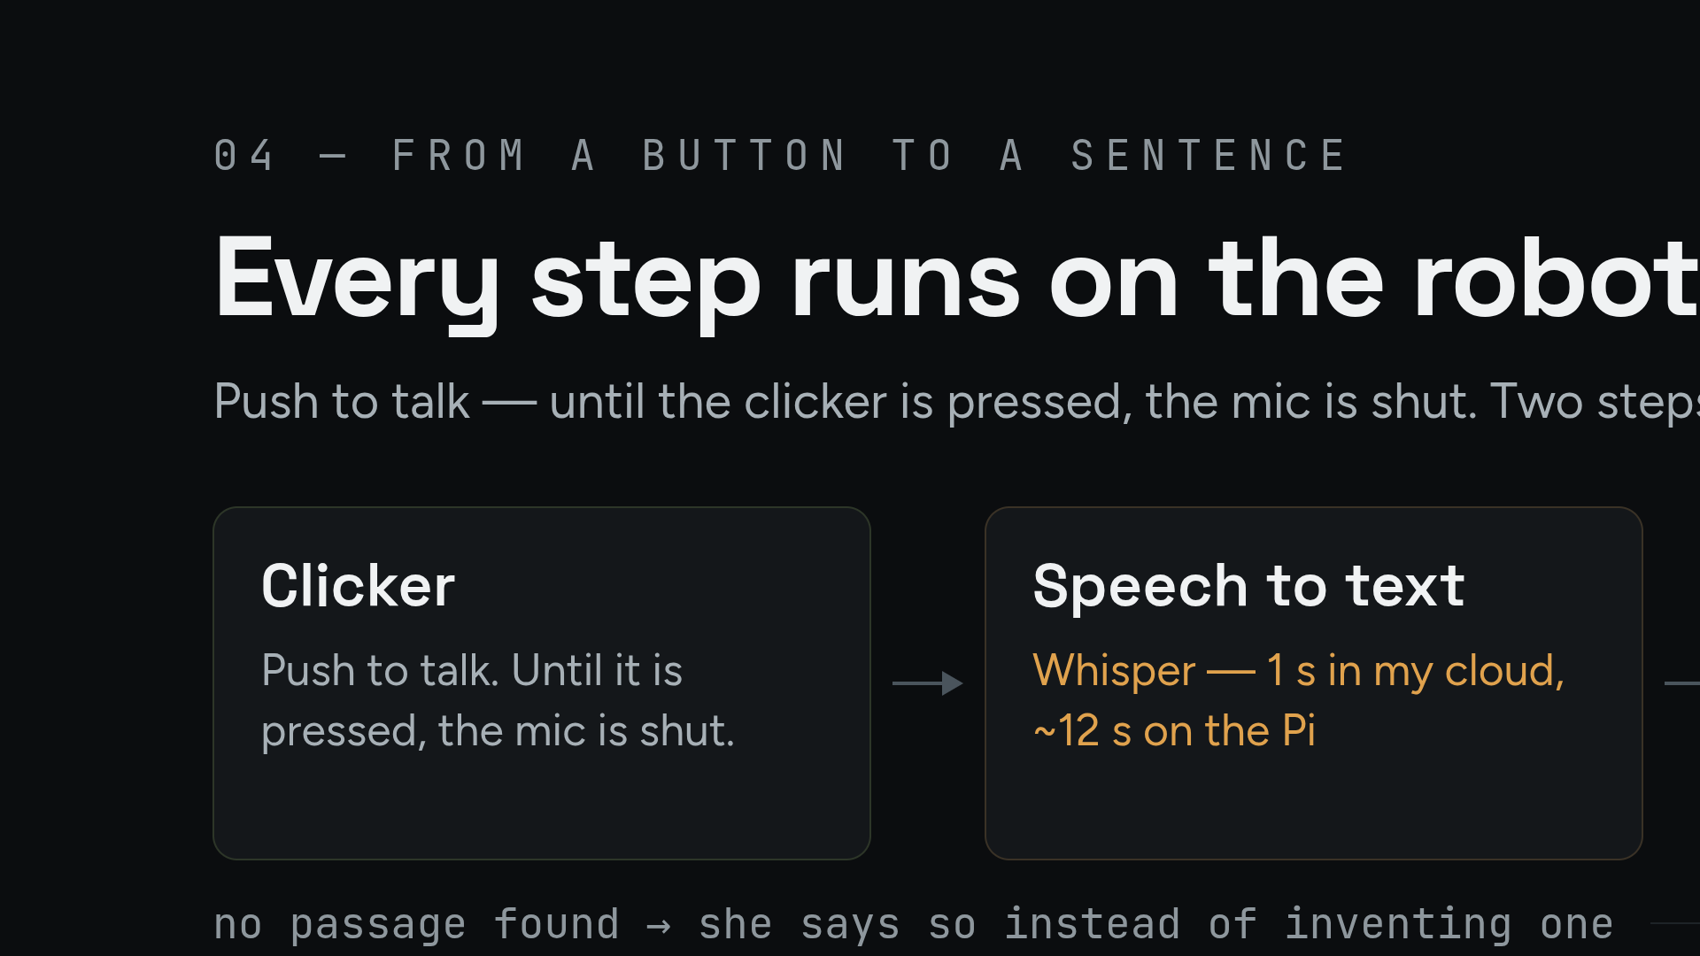
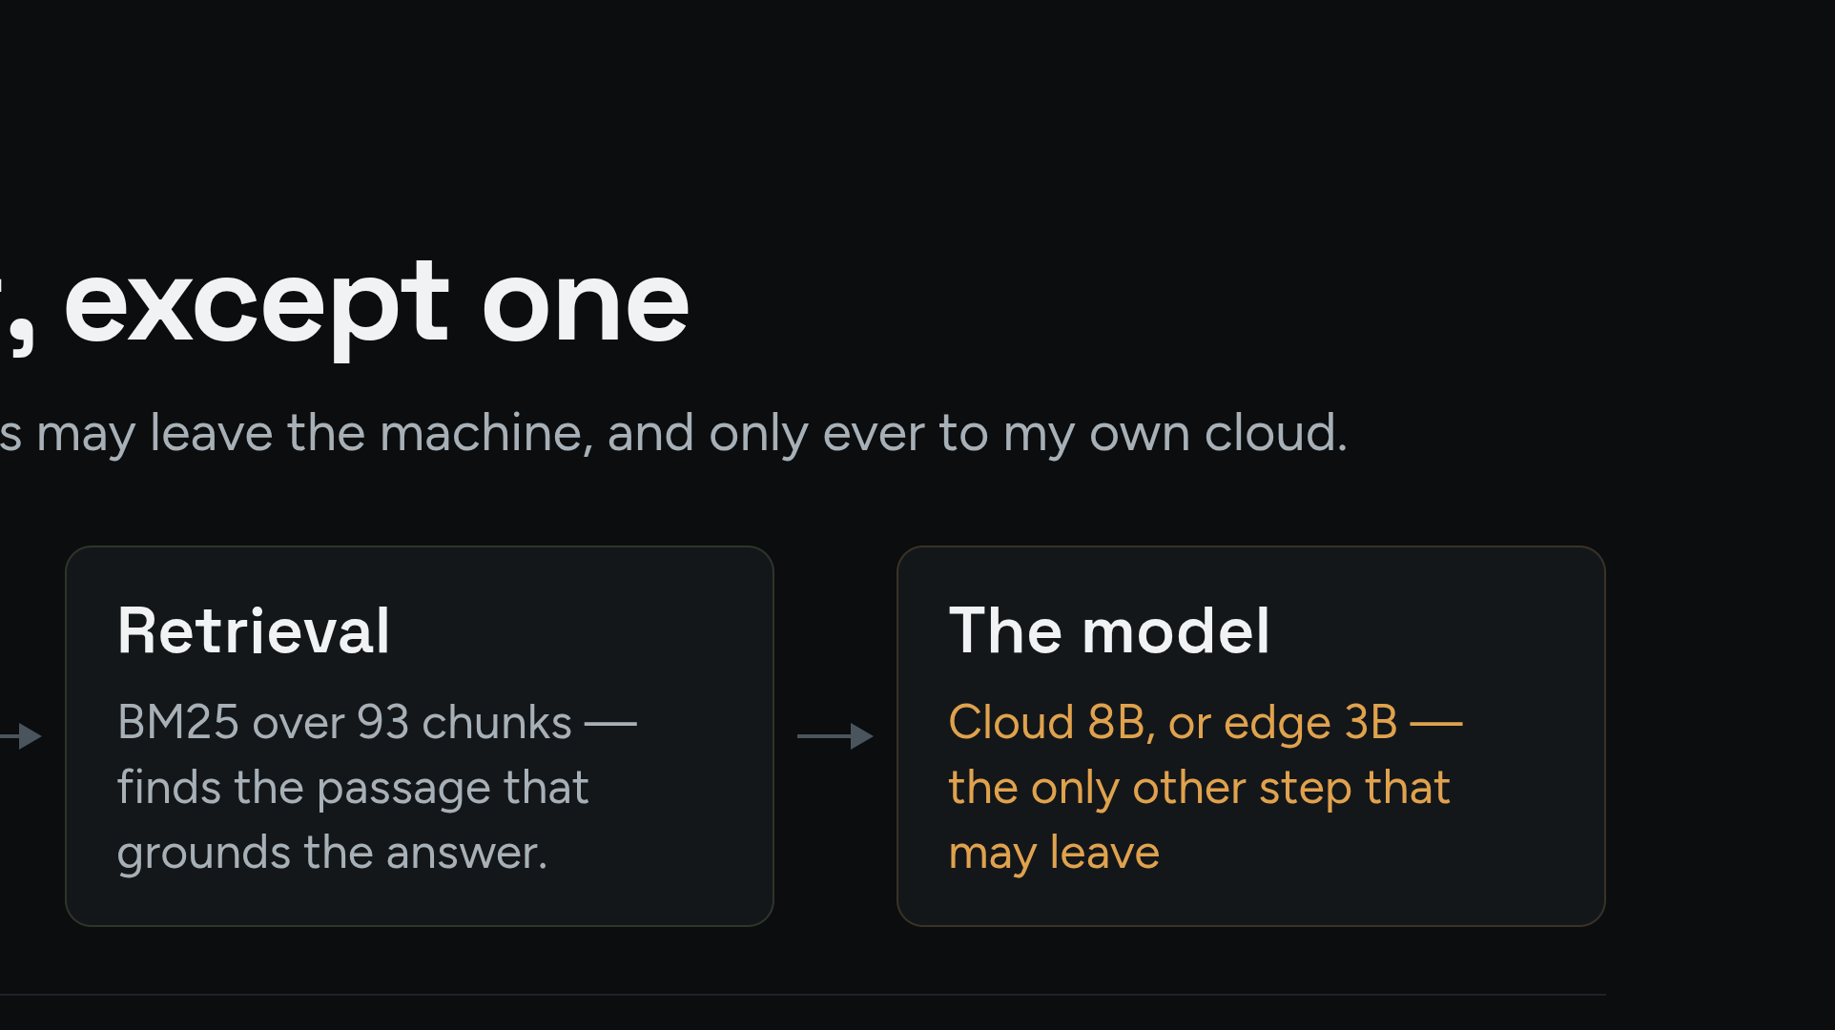
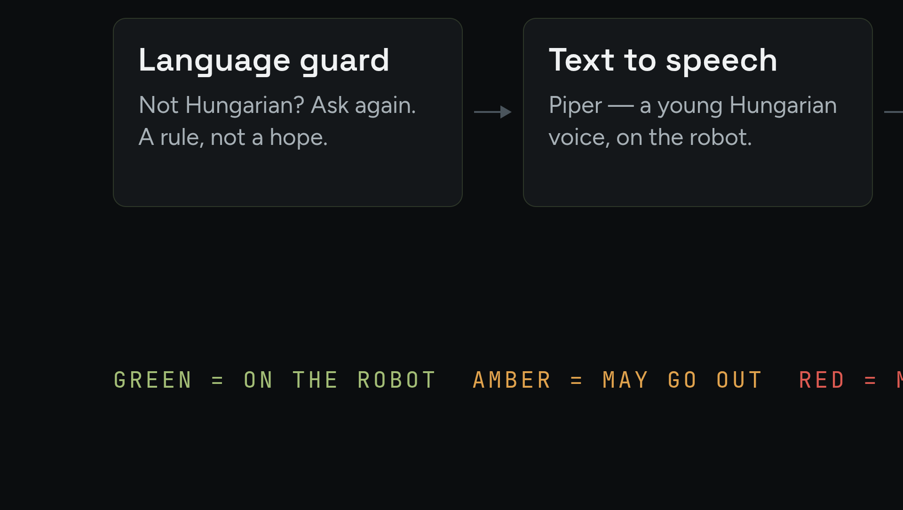
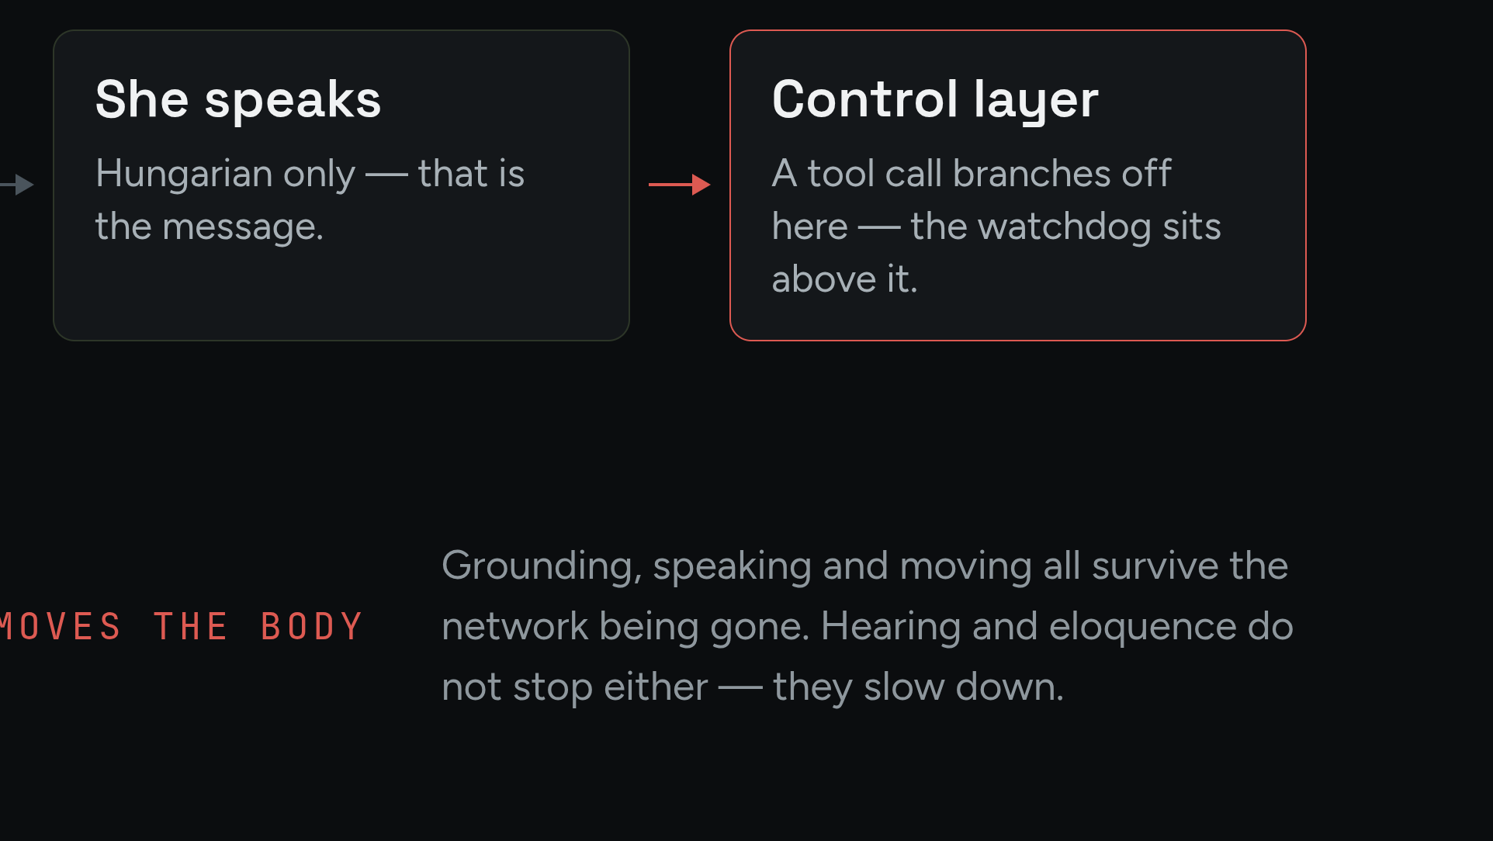
Notes:
Optional detail slide. Count the green boxes: grounding, speaking and moving all survive the network being gone.

Slide 10
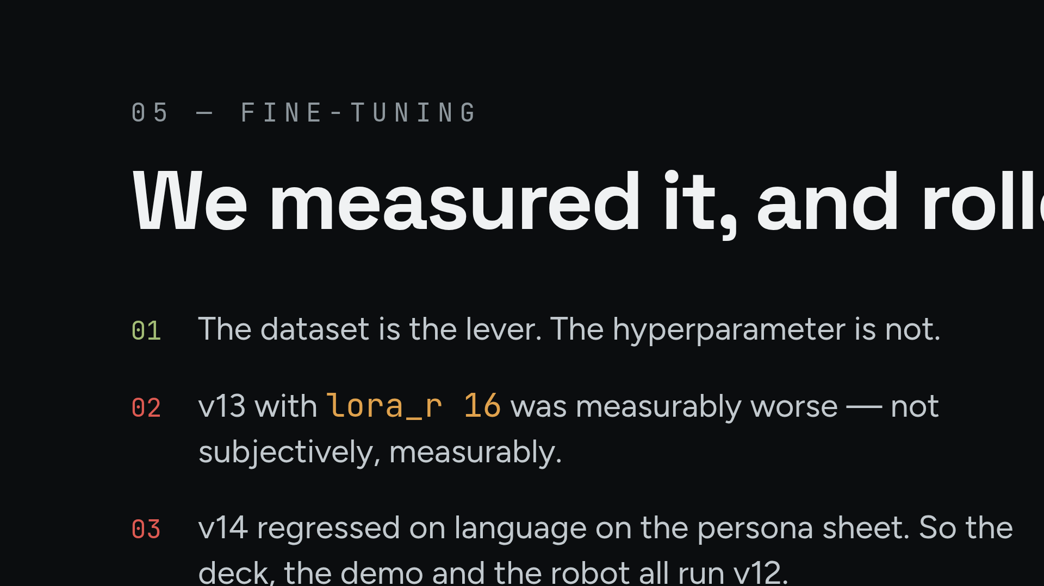
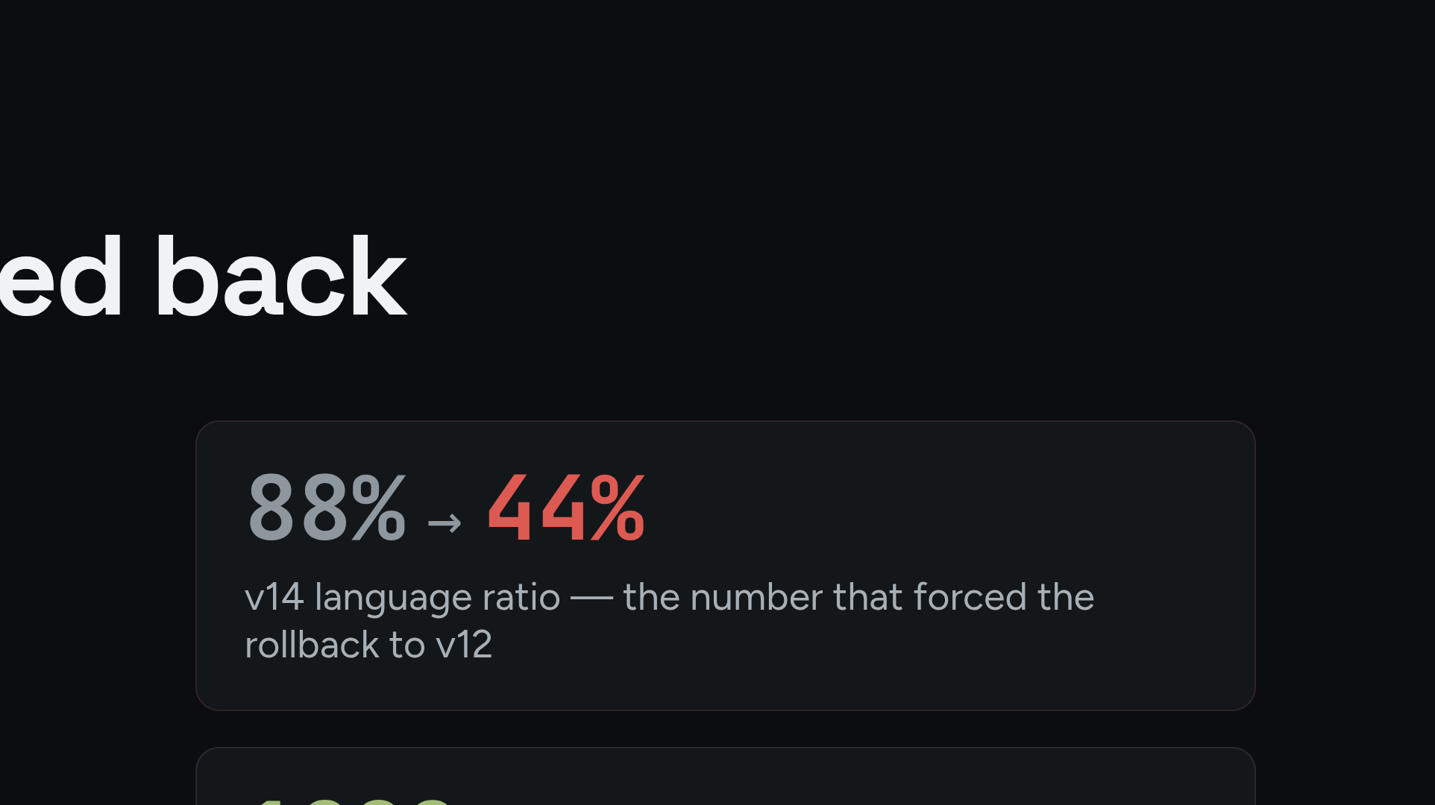
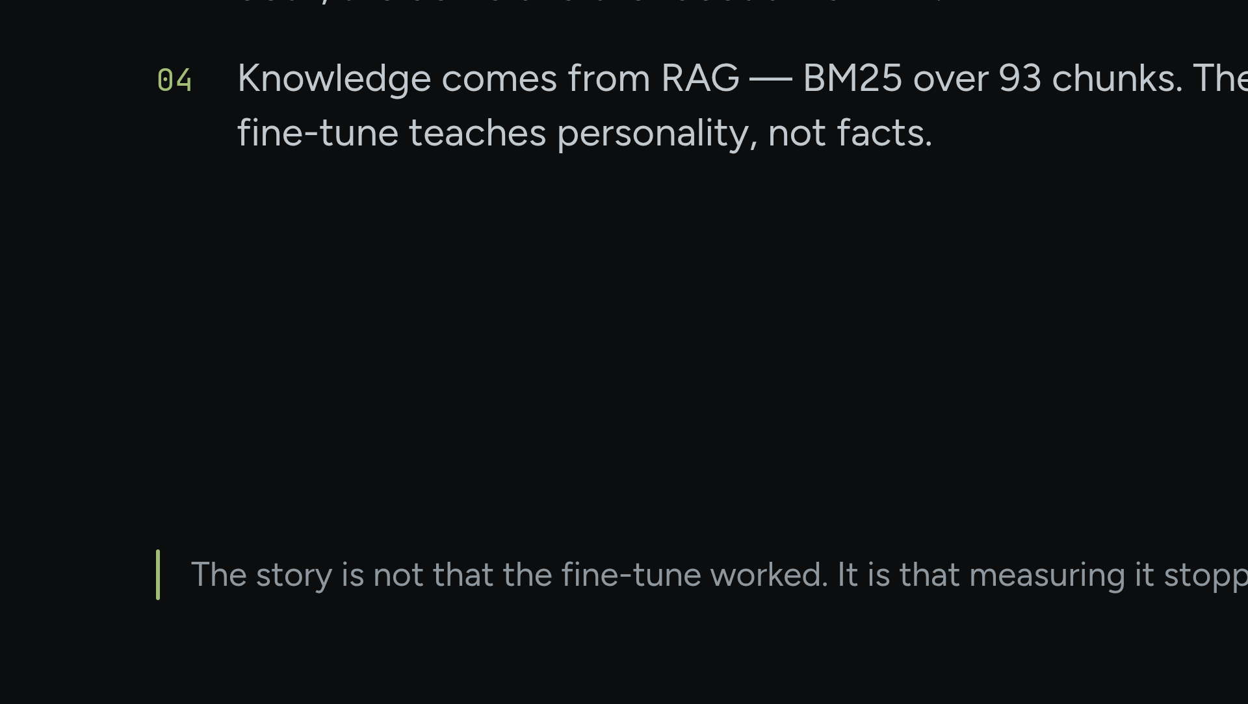
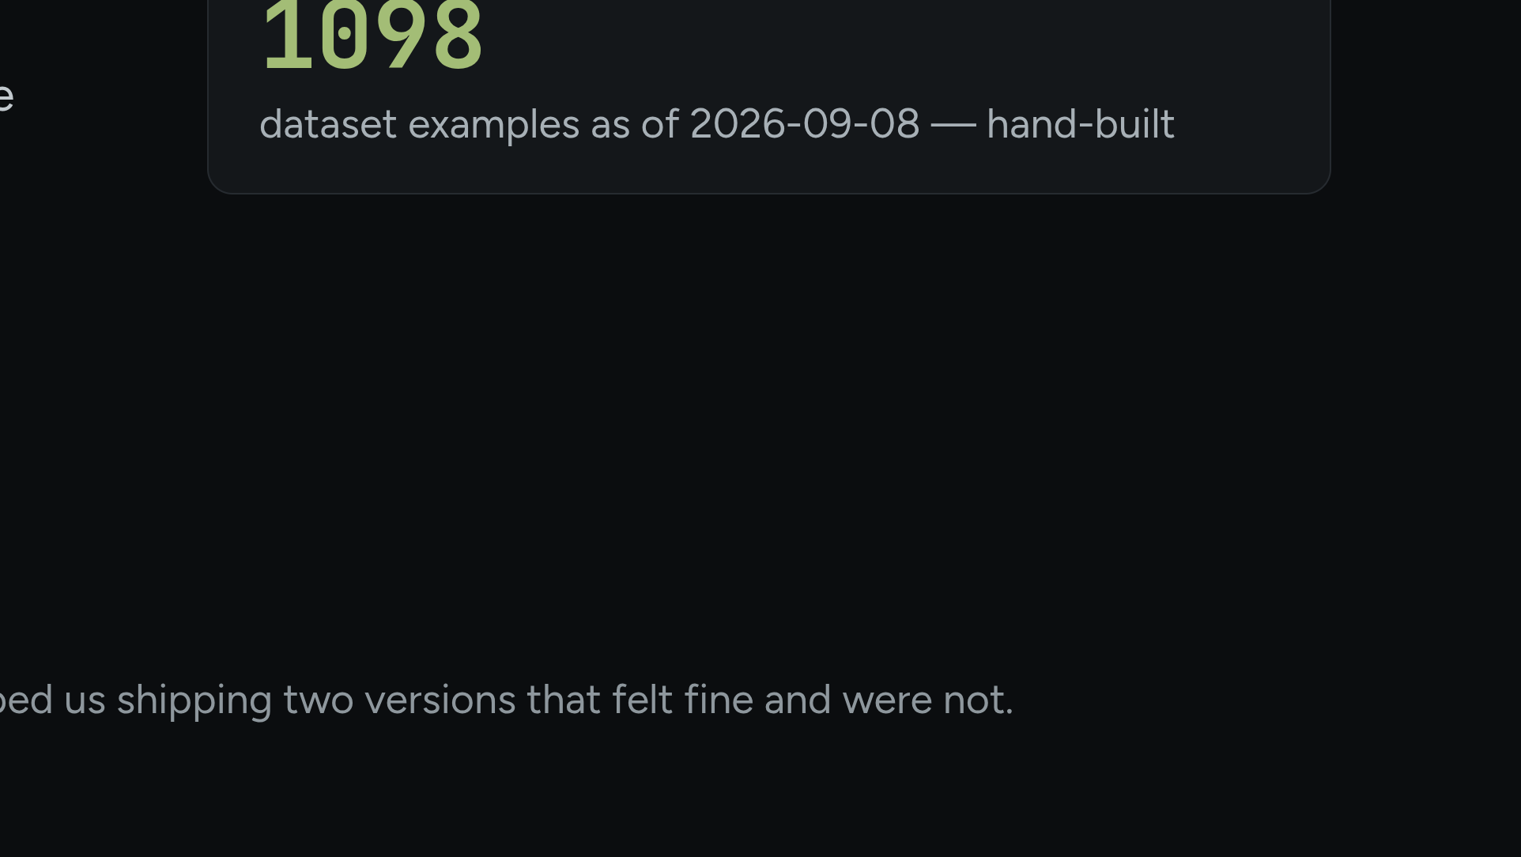
Notes:
Knowledge comes from RAG; the fine-tune teaches personality, not facts. The story is not that it worked — it is that the measurement stopped us.

Slide 11
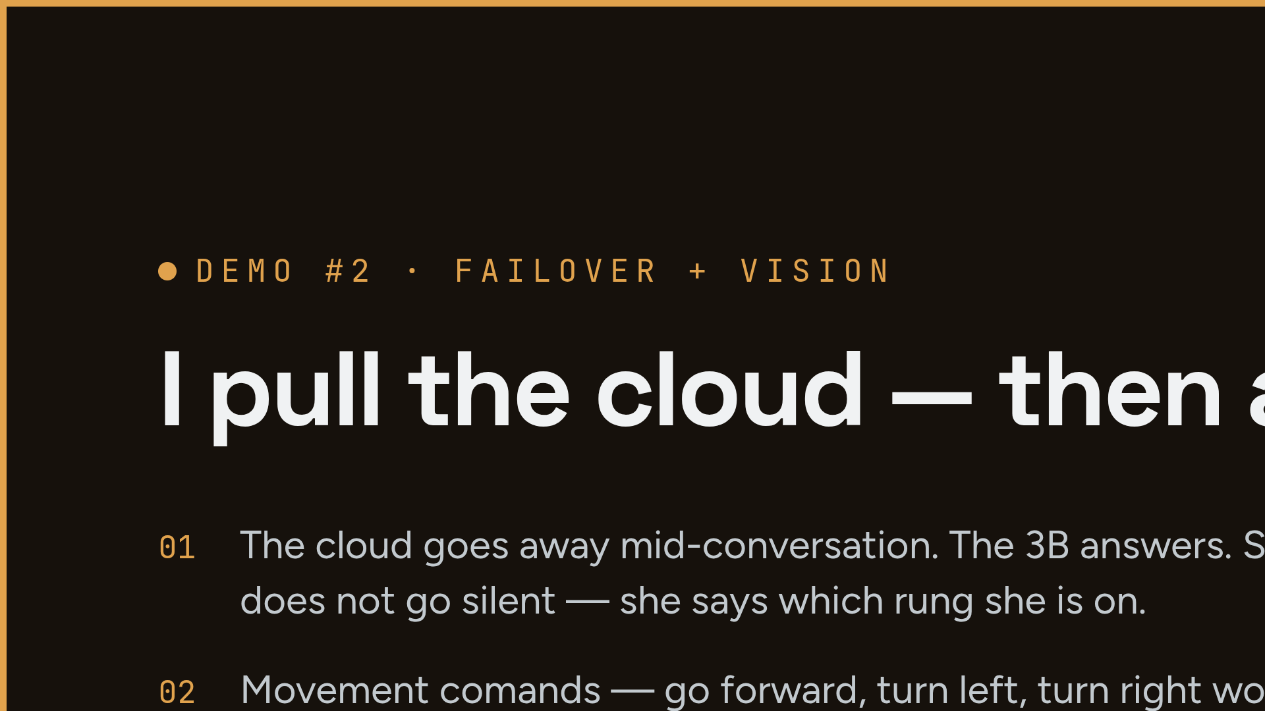
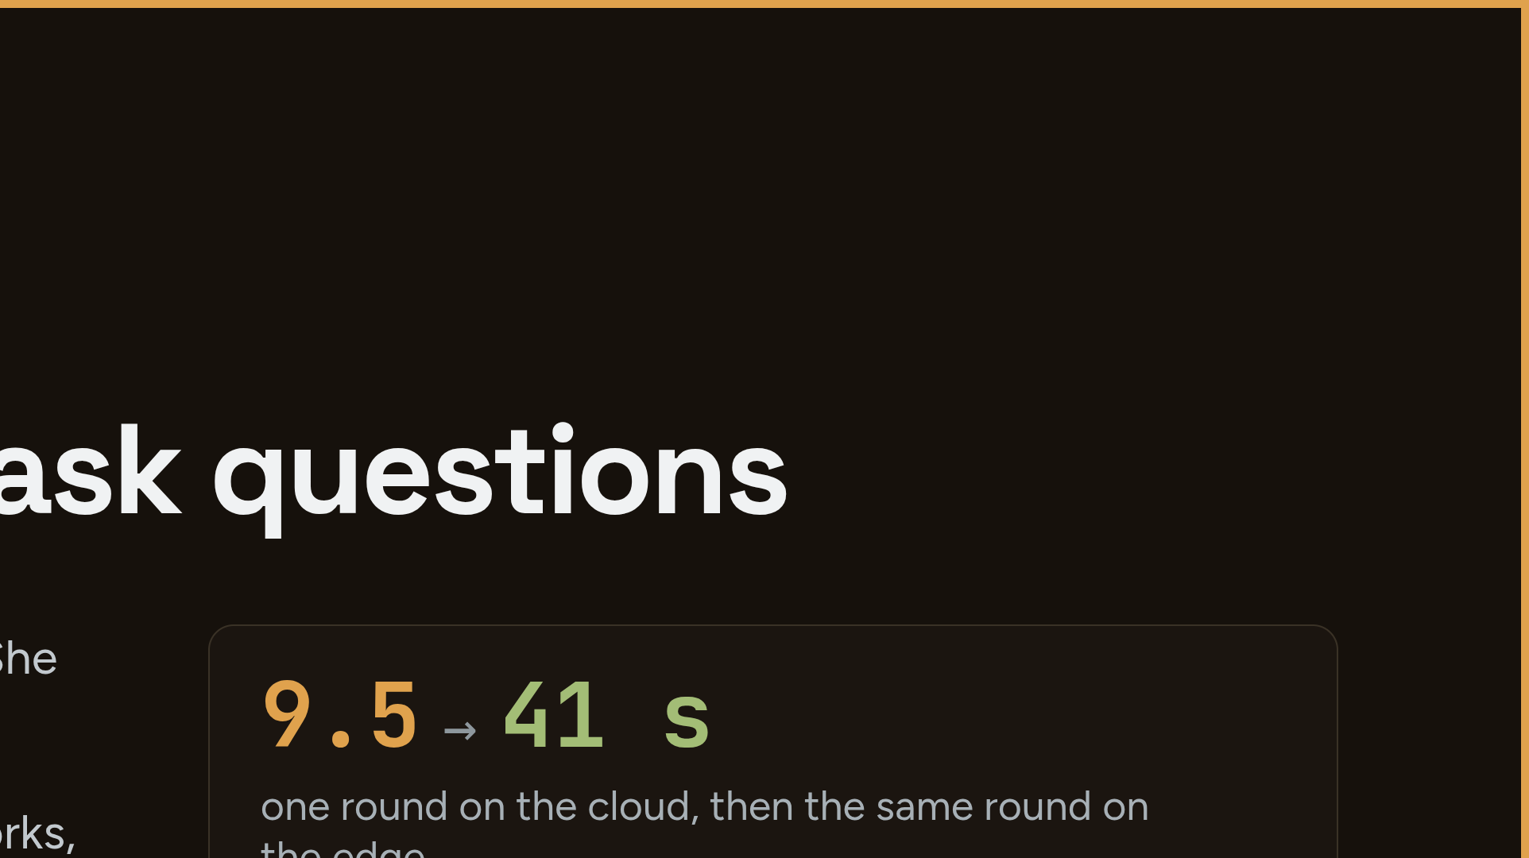
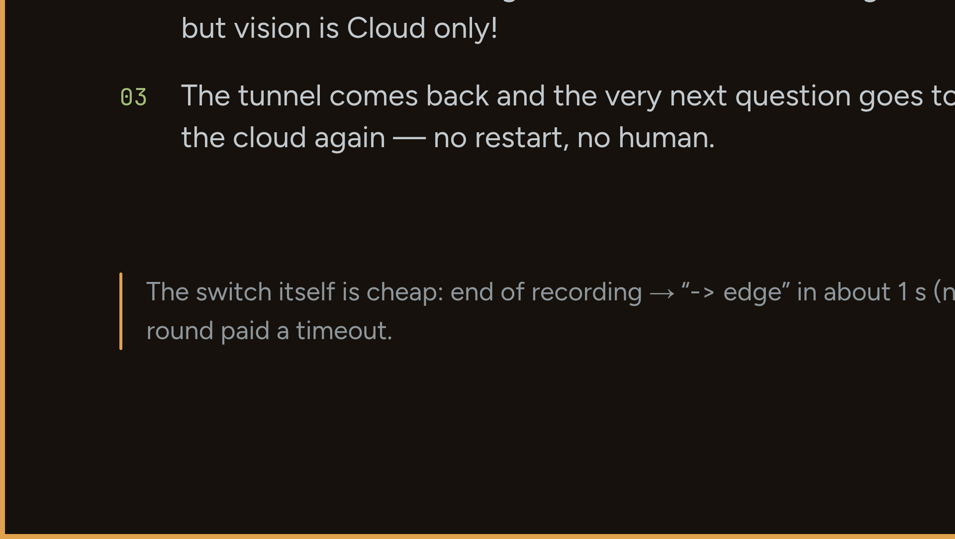
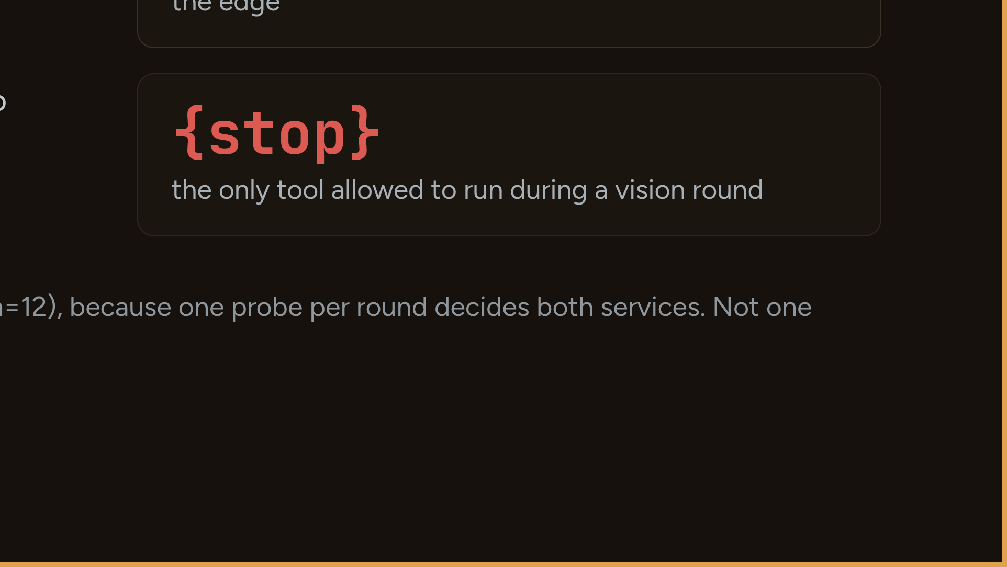
Notes:
Pull the cloud, then say 'Nézz körül!'. Expect a planted question from the room: 'do you send the audio to the cloud too?' — answer with the code layer: watchdog, scan_wifi is read-only, the guard drops invented tools, safe_mode, and the vision gate will not execute a command held up on a sign. If it dies: tell the 09-08 incident — cold edge fell into safe mode at 90 s, answered flawlessly 80 s later; fixed. Backup: pre-recorded video, one button.

Slide 12
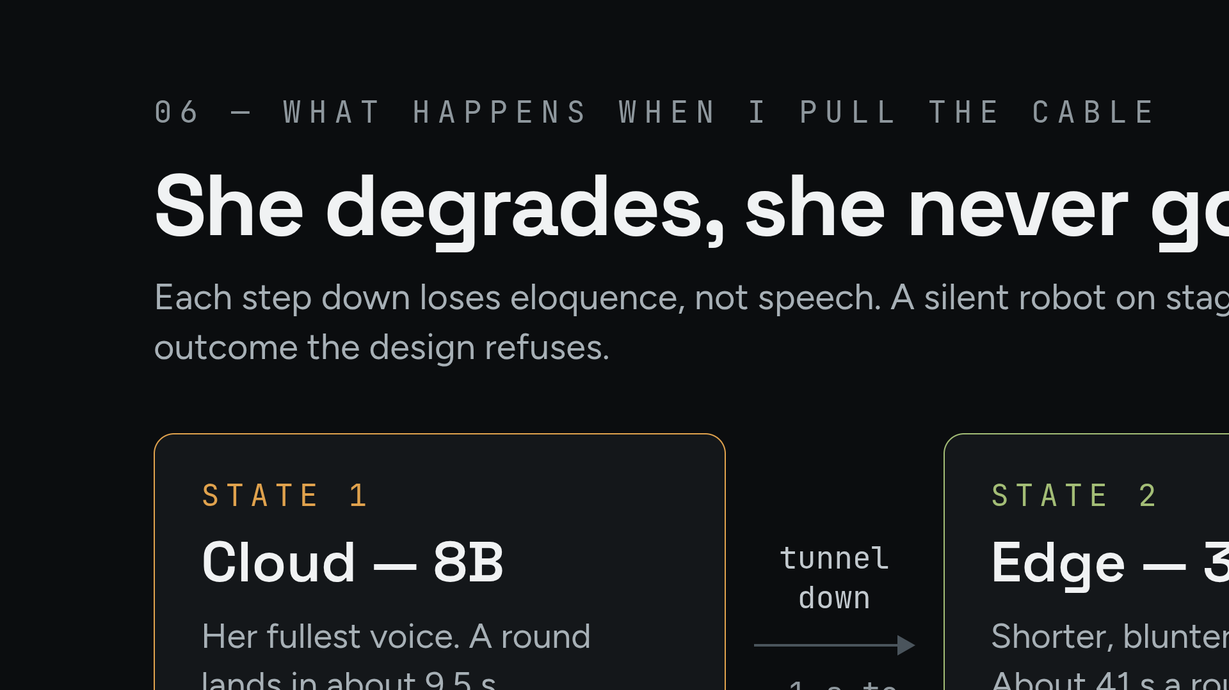
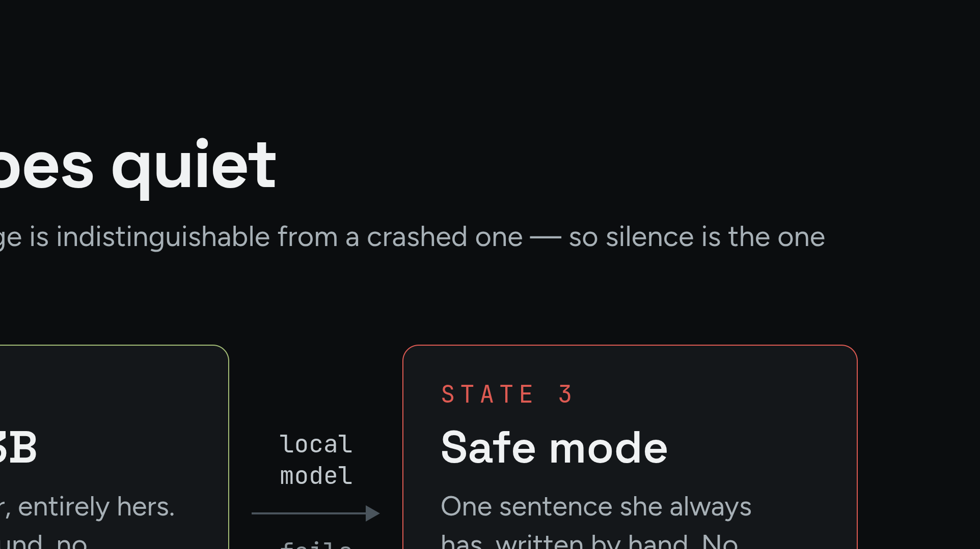
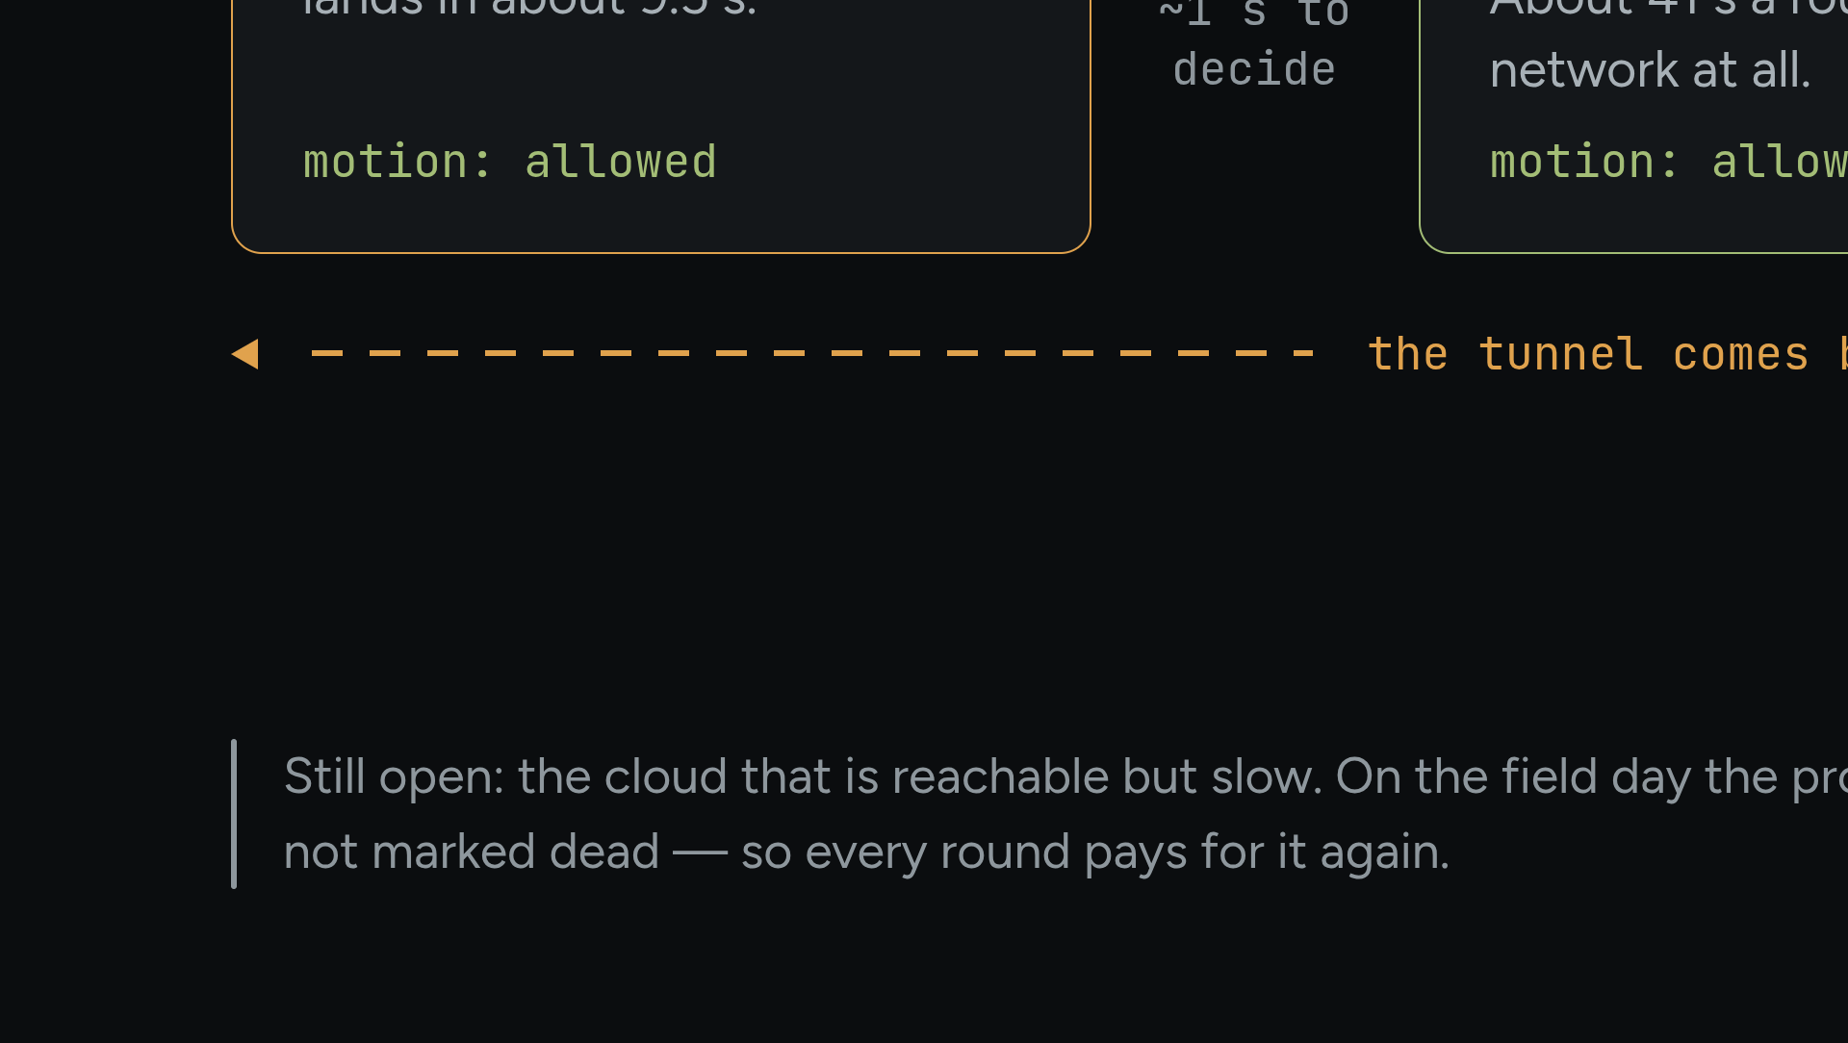
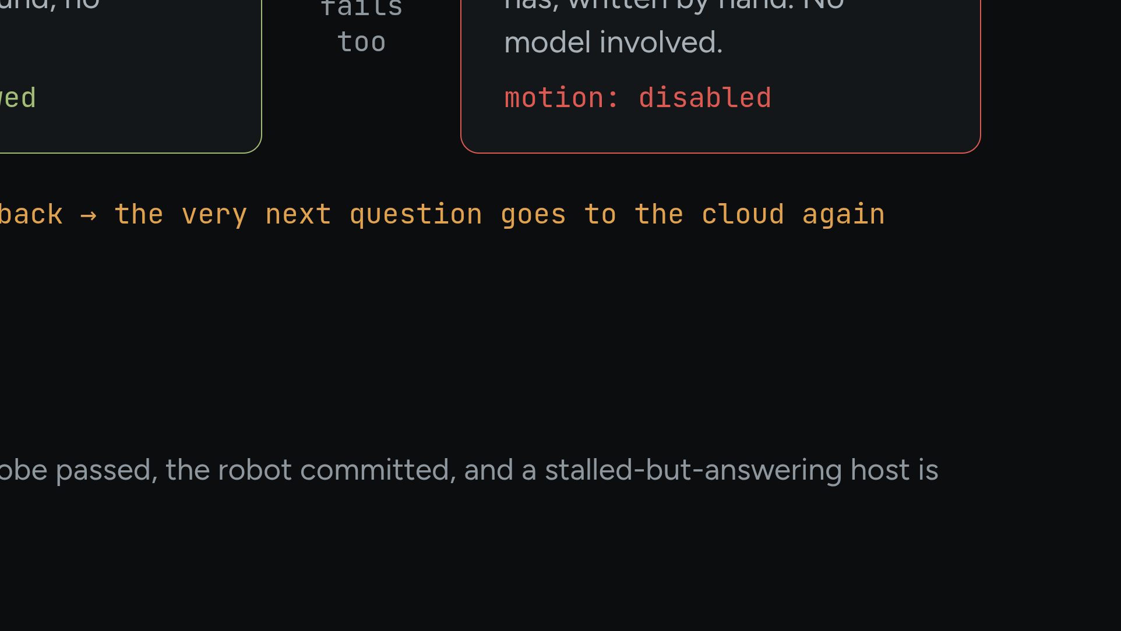
Notes:
Diagram 02. The dashed arrow is the part people expect to be missing — recovery is per round, so it needs no restart.

Slide 13
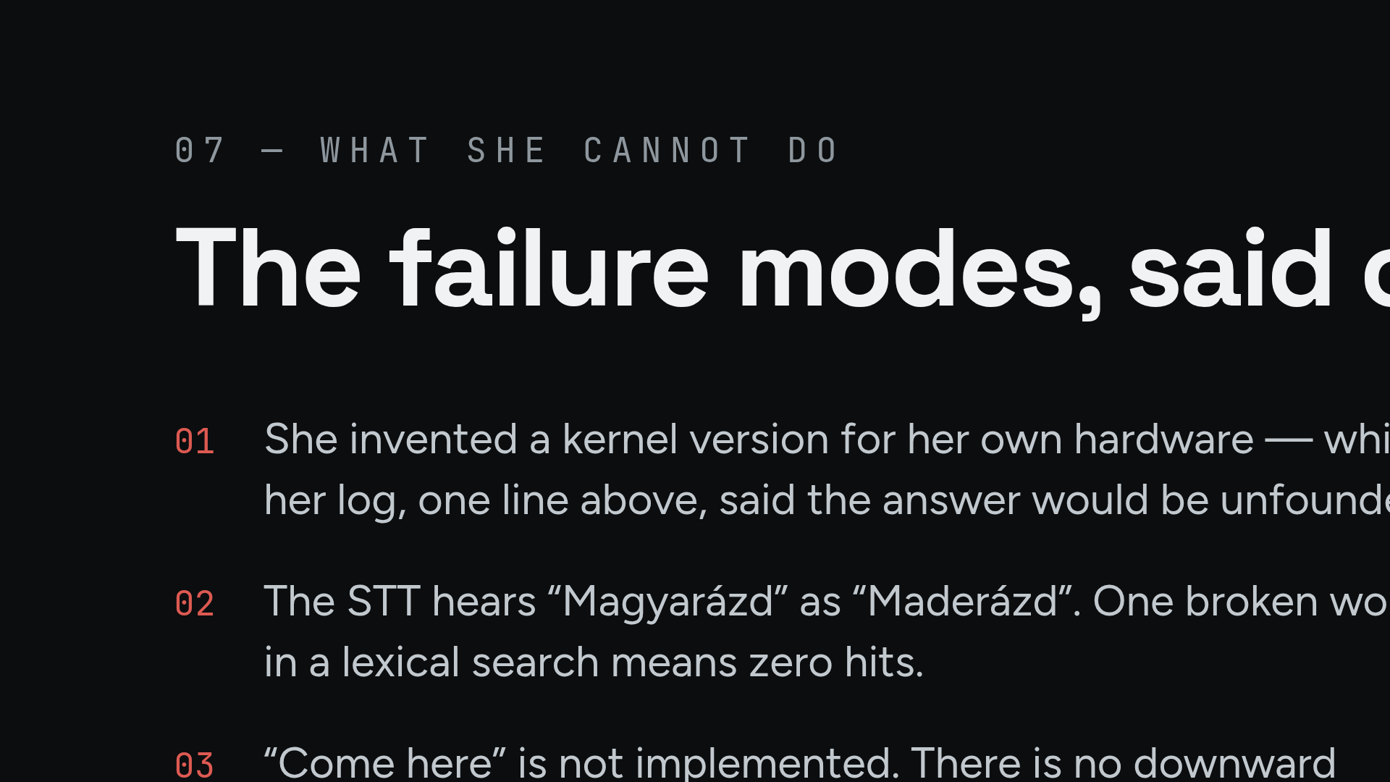
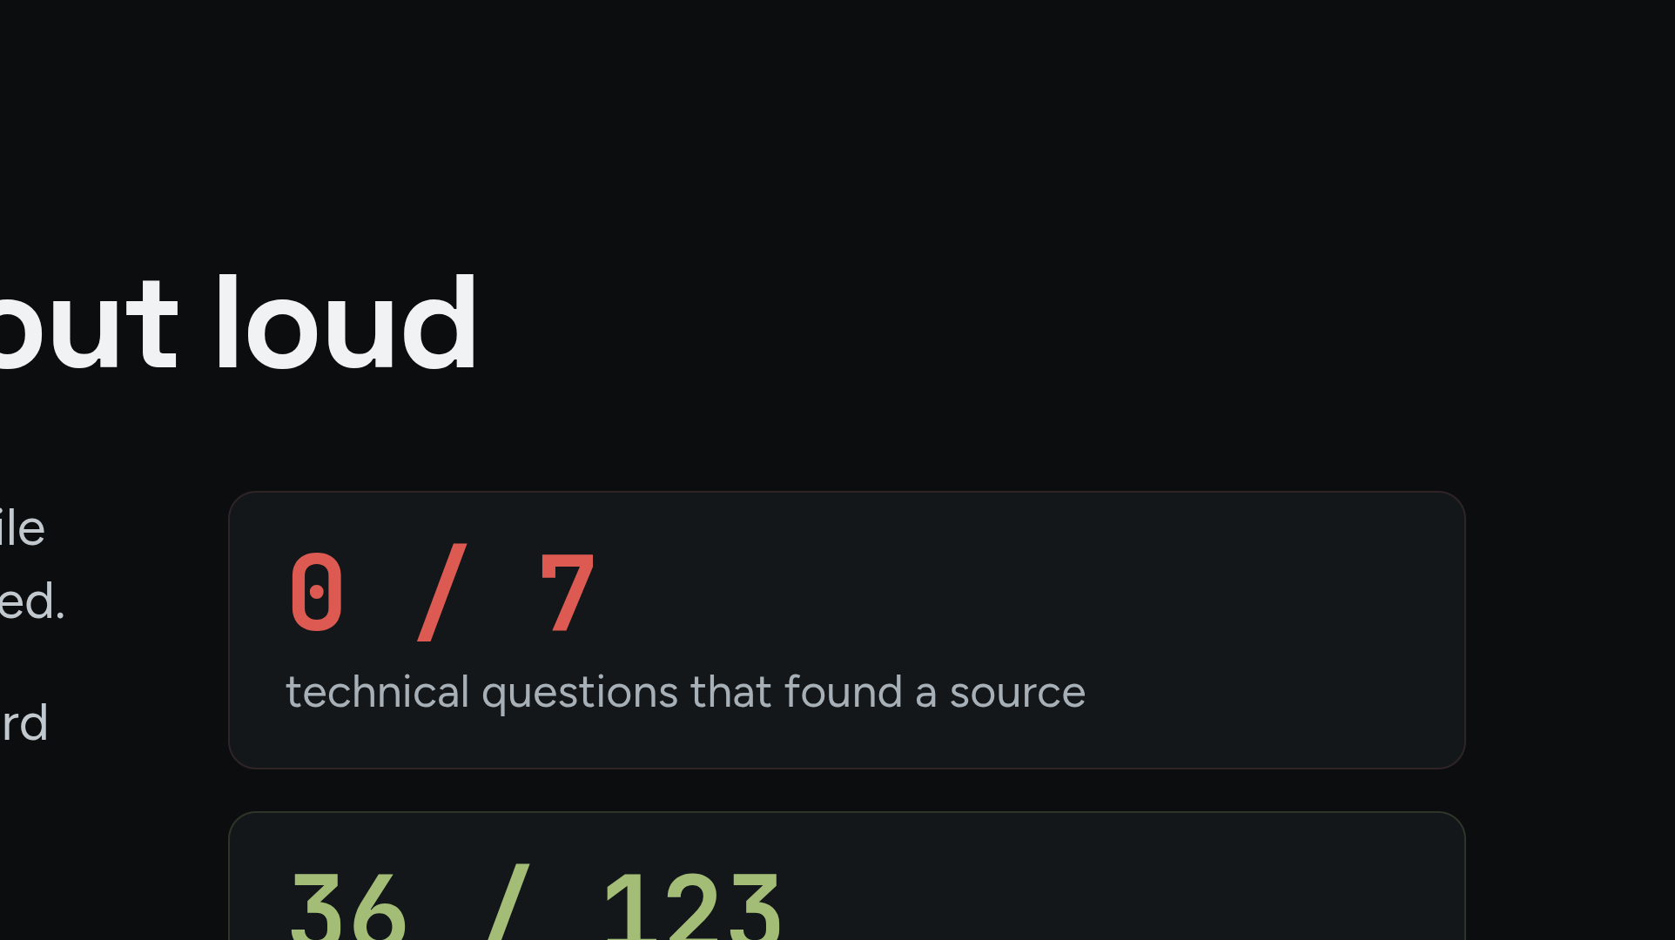
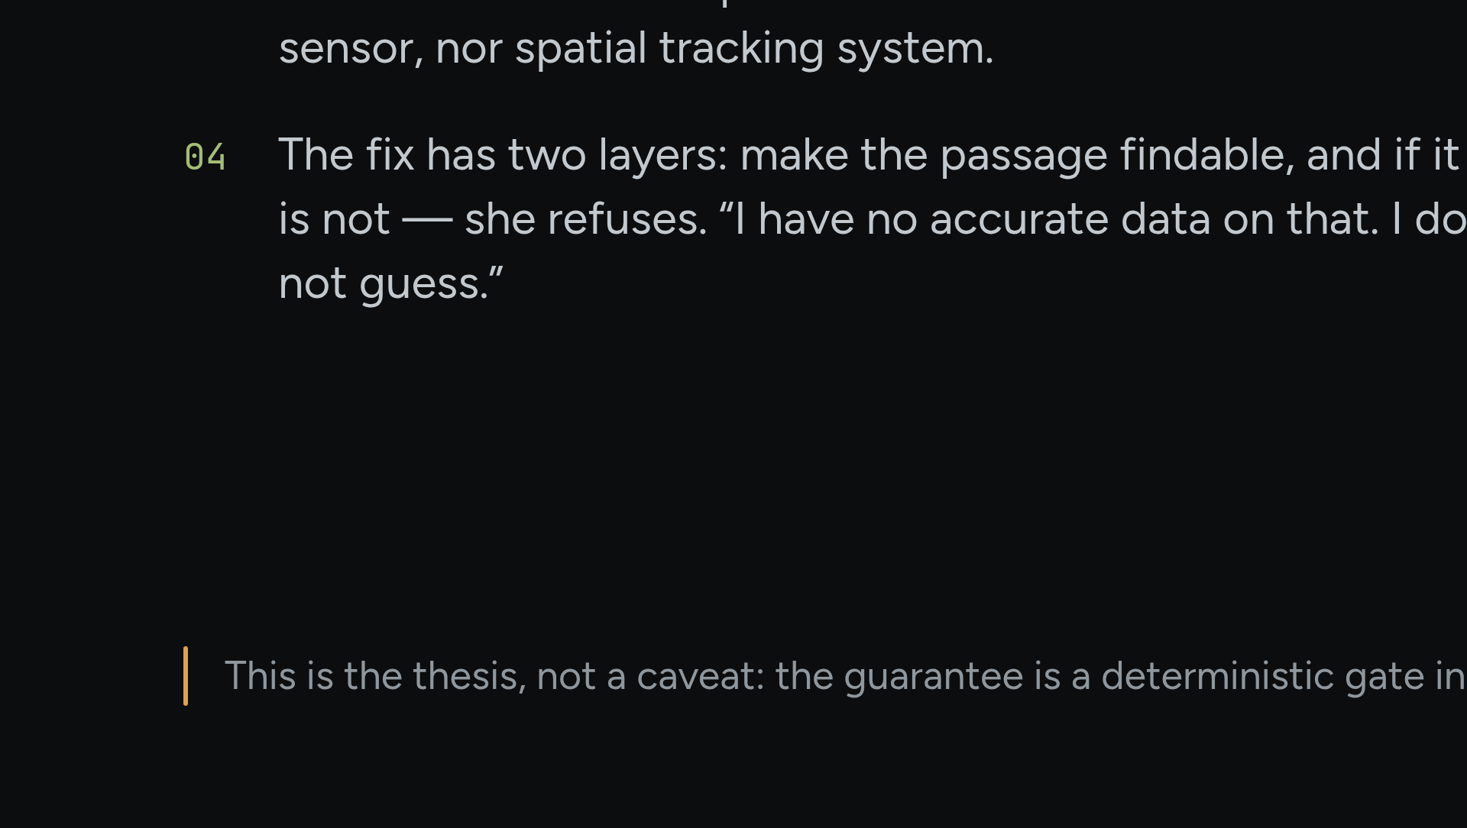
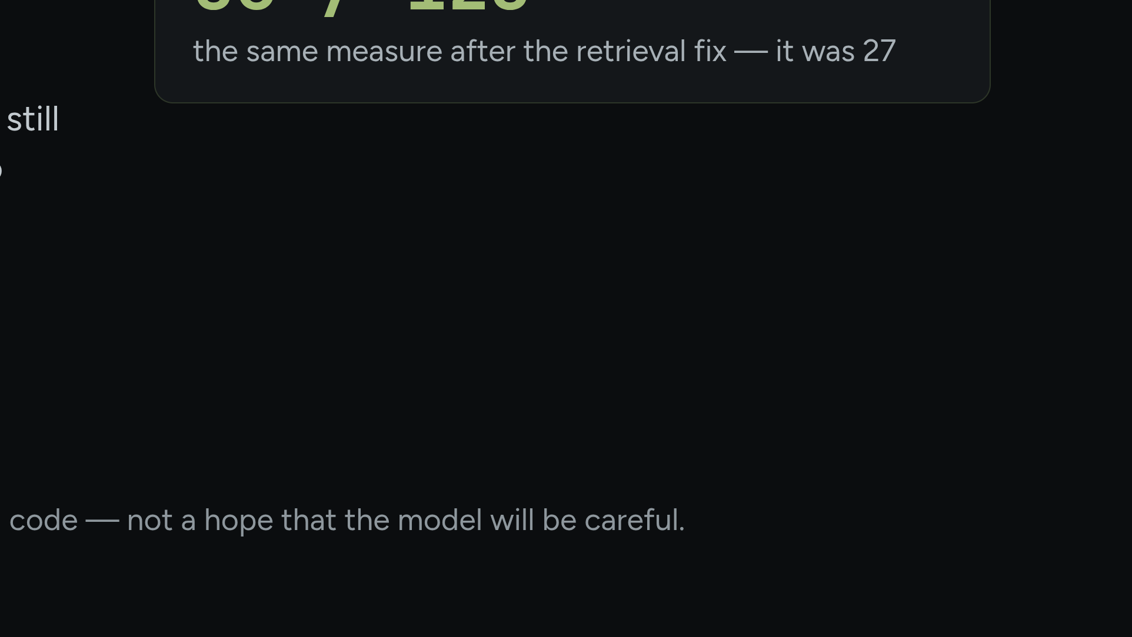
Notes:
Best story in the deck. Tell the kernel-version hallucination verbatim, then the two-layer fix: the slice became findable, and if it still isn't, she refuses to speak. An admitted failure is more credible to this room than a perfect demo.

Slide 14




Notes:
Back to the one idea — one sentence, not a summary. Transcript log stays off in the hallway: audience questions must not hit disk.

Slide 15




Notes:
Droppable if you are over time. Otherwise: hand the room the attack surface and let them try. 'I will not reveal my system instructions' is a behavioural rule, not secret protection — say so plainly.

