Slide 1


INTRODUCTION TO INTRODUCTION TO C PROGRAMMING
A Quest Global Company

Slide 2
List of Topics to be covered
Pointers and Memory Management.
Usage of Pointers
Operations on Pointers
Dynamic Memory Allocation
Functions and Recursion.
Strings
Bit Manipulations.
Bitmasking

Slide 3

1.Pointers and Memory Management
Pointers :
A pointer is defined as a derived data type that can store the address of other C variables or a memory location. We can access and manipulate the data stored in that memory location using pointers.
Syntax of C Pointers:
The syntax of pointers is similar to the variable declaration in C, but we use the ( * ) dereferencing operator in the pointer declaration.
Example: Where
ptr is the name of the pointer.
datatype is the type of data it is pointing to.

Slide 4

2.Usage of Pointers:
The use of pointers in C can be divided into three steps:
Pointer Declaration.
Pointer Initialization.
Pointer Dereferencing.
1.Pointer Declaration:
In pointer declaration, we only declare the pointer but do not initialize it. To declare a pointer, we use the ( * ) dereference operator before its name.
Example:
Here
int is the datatype.
ptr is the variable name.
The pointer declared here will point to some random memory address as it is not initialized. Such pointers are called wild pointers.

Slide 5
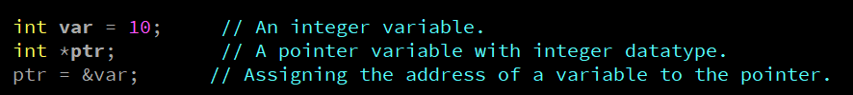
2.Usage of Pointers:
Pointer initialization is the process where we assign some initial value to the pointer variable.
We generally use the ( &: ampersand ) address of operator to get the memory address of a variable and then store it in the pointer variable.
Example:
We can also declare and initialize the pointer in a single step. This method is called pointer definition as the pointer is declared and initialized at the same time.
Example :
int *ptr = &var;

Slide 6
2.Usage of Pointers:
Dereferencing a pointer is the process of accessing the value stored in the memory address specified in the pointer. We use the same ( * ) dereferencing operator that we used in the pointer declaration.
ptr
0×7fffa0757dd4
0×7fff98b499e8
Address of pointer variable ptr
Var
10
Value of variable var(*ptr)
0×7fffa0757dd4
Address of variable var(stored at ptr)

Slide 7
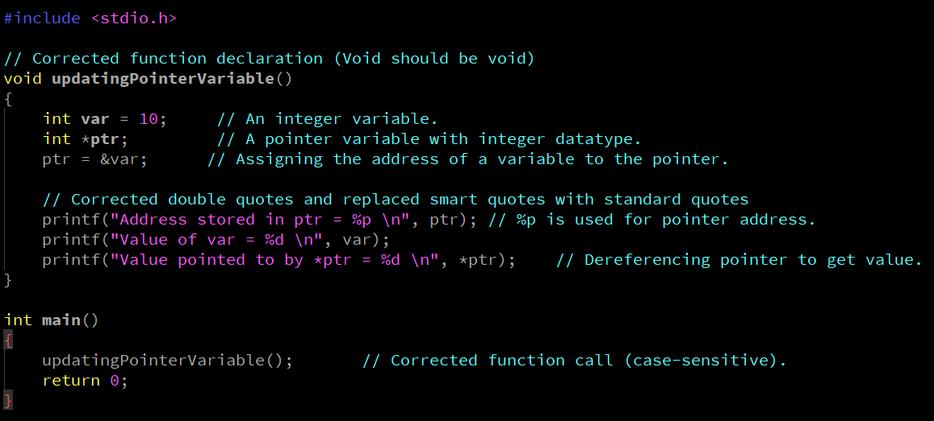
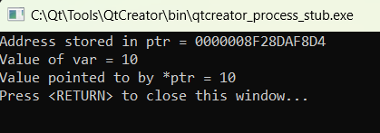
2.Usage of Pointers:
Example
Output

Slide 8
3. Operations on Pointers
These are the different operations performed on pointers:
Incrementing/Decrementing a pointer.
Addition/Subtraction of a constant number to a pointer.
Comparison of two pointers.

Slide 9
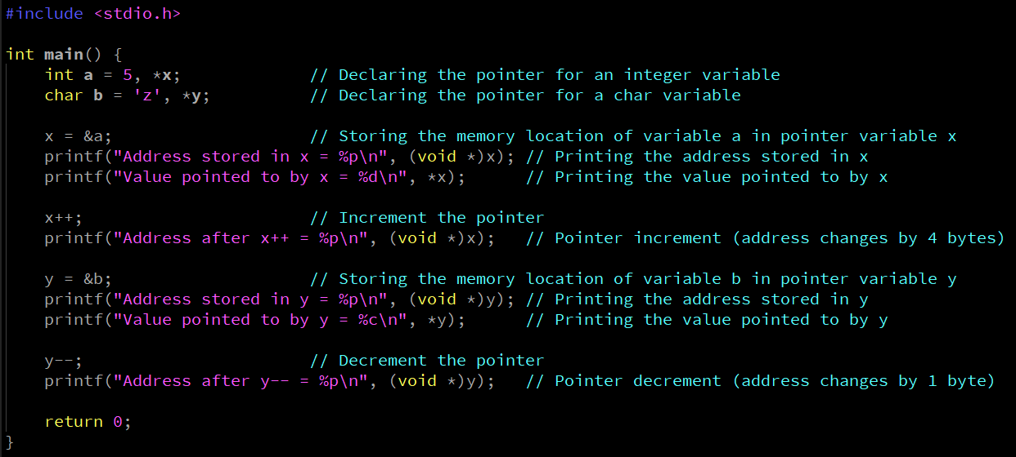
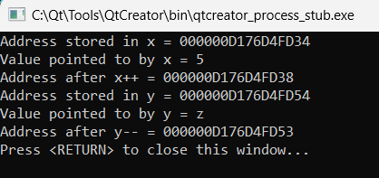
3. Operations on Pointers
Incrementing/Decrementing a Pointer:-
Any pointer variable when incremented points to the next memory location of its type.
Any pointer variable when decremented points to the previous memory location of its type.
Example
Output

Slide 10
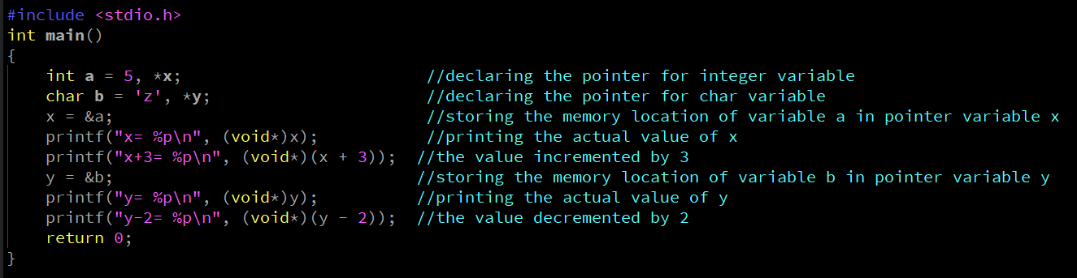
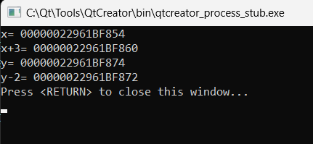
3. Operations on Pointers
Addition or subtraction of a constant number to a pointer is allowed.
The result is similar to the increment or decrement operator with the only difference being the increase or decrease in the memory location by the constant number given.
Example
Output

Slide 11
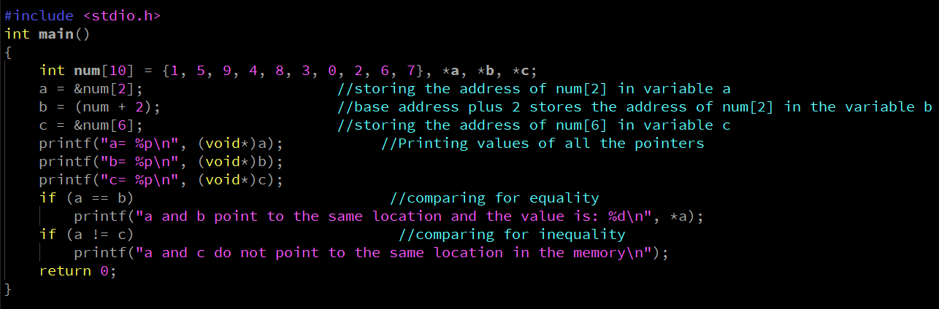
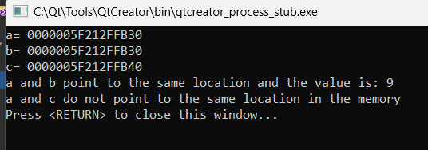
3. Operations on Pointers
Comparison of two pointer variables is possible only if the two pointer variables are of the same type.
It becomes more convenient if they point to the elements of the same array. These comparisons are to check equality or inequality.
The result is true if both the pointers point to the same location in the memory and false if they point to different locations in the memory.
Example
Output

Slide 12
4. Dynamic Memory Allocation
Dynamic Memory Allocation can be defined as a procedure in which the size of a data structure is changed during the runtime.
There are 4 library functions provided by C defined under <stdlib.h> header file to facilitate dynamic memory allocation in C programming. They are:
malloc()
calloc()
free()
realloc()

Slide 13

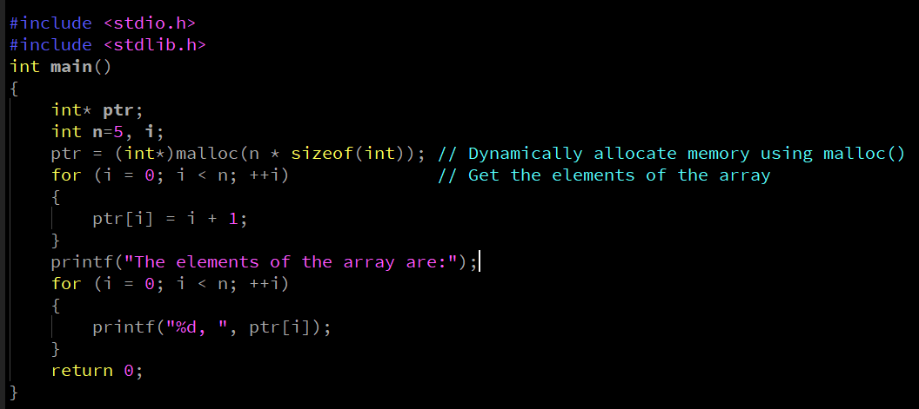

4. Dynamic Memory Allocation
The “malloc” or “memory allocation” method in C is used to dynamically allocate a single large block of memory with the specified size. It returns a pointer of type void which can be cast into a pointer of any form.
Syntax:
Example
Output

Slide 14
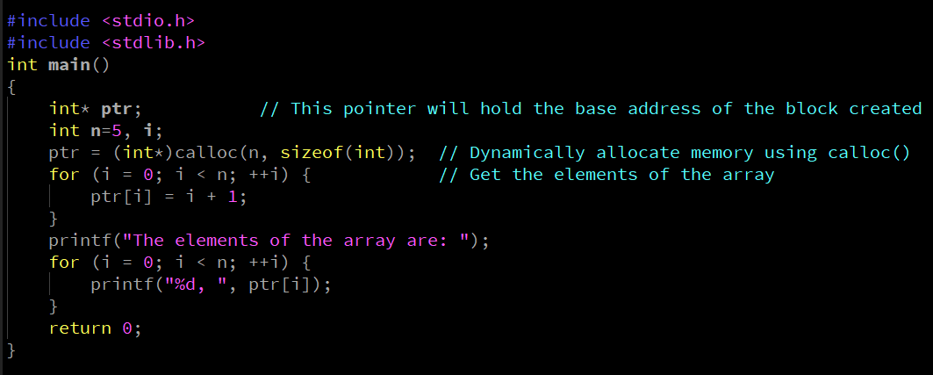
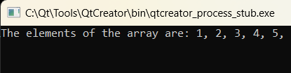
4. Dynamic Memory Allocation
“calloc” or “contiguous allocation” method in C is used to dynamically allocate the specified number of blocks of memory of the specified type. It initializes each block with a default value ‘0’.
Syntax: here, n is the no. of elements and element-size is the size of each element.
Example
Output

Slide 15

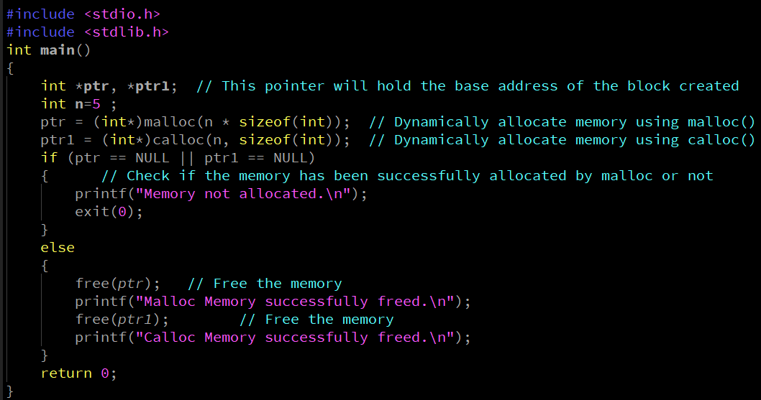
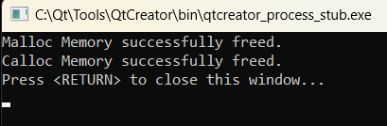
4. Dynamic Memory Allocation
“free” method in C is used to dynamically de-allocate the memory.
The memory allocated using functions malloc() and calloc() is not de-allocated on their own. Hence the free() method is used, whenever the dynamic memory allocation takes place.
It helps to reduce wastage of memory by freeing it.
Syntax: Here, ptr is a pointer to the memory block that needs to be freed. free() is a function does not return any value.
Example
Output

Slide 16

4. Dynamic Memory Allocation
“realloc” or “re-allocation” method in C is used to the memory previously allocated with the help of malloc or calloc is insufficient, realloc can be used to dynamically re-allocate memory.
re-allocation of memory maintains the already present value and new blocks will be initialized with the default garbage value
Syntax:- where ptr is reallocated with new size 'newSize’. How realloc Works
Increasing Size: When you increase the size of the memory block, realloc tries to extend the current block if there is enough contiguous free space. If not, it allocates a new block of the requested size, copies the existing data to the new block, and frees the old block.
Decreasing Size: When you decrease the size of the memory block, realloc may shrink the block in place or allocate a new smaller block, copy the data, and free the old block.

Slide 17
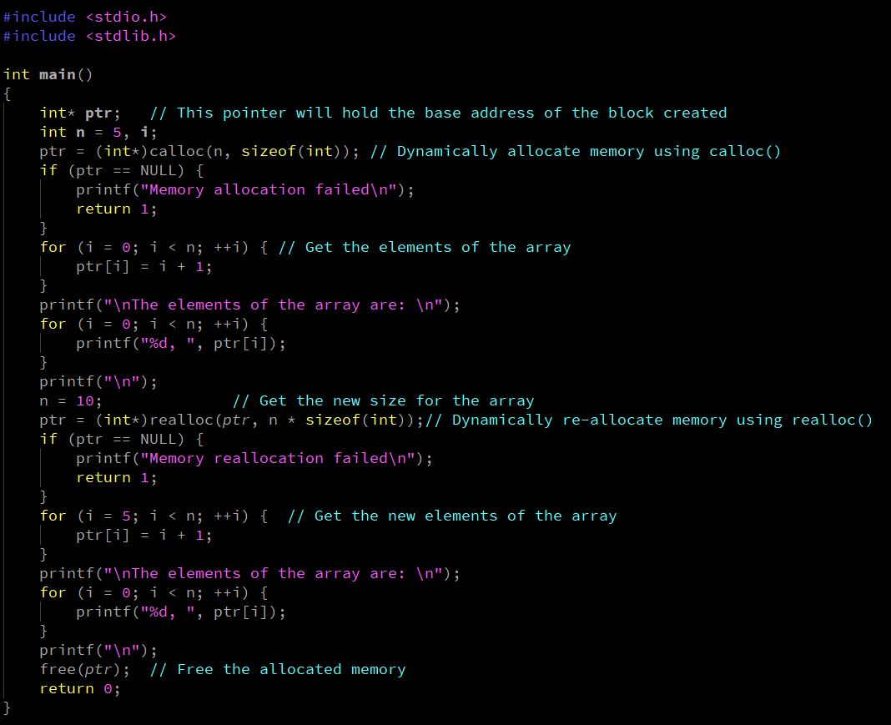
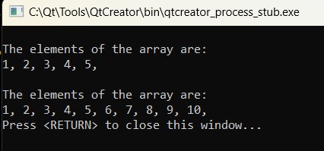
4. Dynamic Memory Allocation
Example
Output

Slide 18
5. Functions and Recursion
A function in C is a set of statements that when called perform some specific tasks.
The programming statements of a function are enclosed within { } braces.
Function Declarations :
In a function declaration, we must provide the function name, its return type, and the number and type of its parameters.
A function declaration tells the compiler that there is a function with the given name defined somewhere else in the program.
Syntax :
Where return_type is the type of the data type. name_of_the_function is the function name. parameter 1,parameter 2 are the parameters need to pass when function calling. Example:-

Slide 19
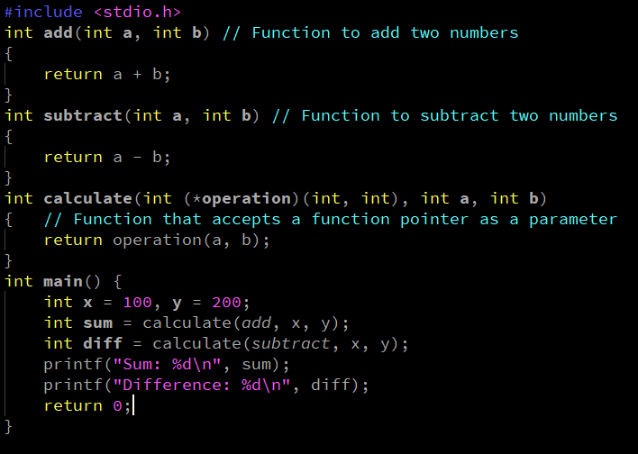
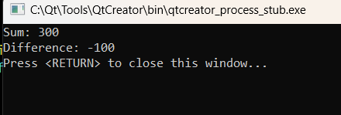
5. Functions and Recursion
In C language, it is possible to pass a function as a parameter to another function using Function pointers.
Example
Output

Slide 20
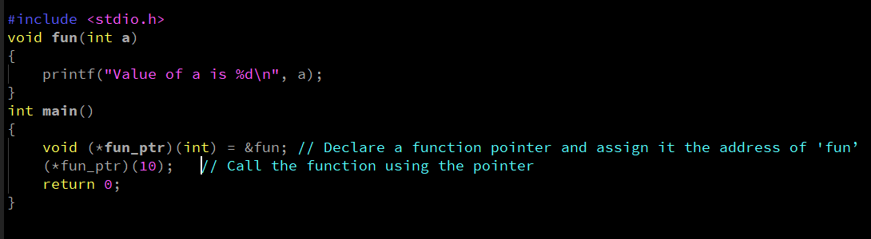

5. Functions and Recursion
Function pointers in C are pointers that are used to store the addresses of functions.
They provide a way to call functions dynamically and pass functions as arguments to other functions.
Example
Output

Slide 21
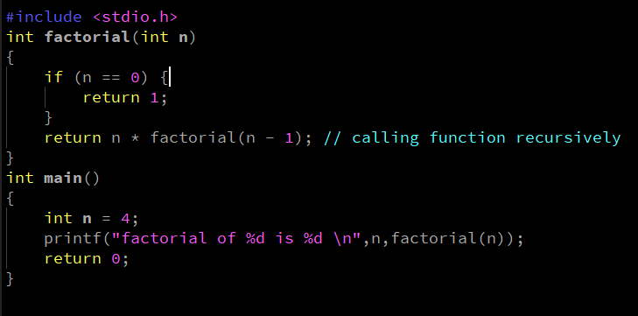

5. Functions and Recursion
The process in which a function calls itself directly or indirectly is called recursion and the corresponding function is called a recursive function.
This technique is often used in programming to solve problems that can be broken down into simpler, similar subproblems.
Example
Output

Slide 22

6. Strings
C strings are sequences of characters stored in a char array. Strings are used to store words and text. They are also used to store data. Syntax:
String manipulation: C supports a wide range of functions that manipulate null-terminated strings. These are:
strcpy(str1, str2): Copies string str2 into string str1.
strcat(str1, str2): Concatenates string str2 onto the end of string str1.
strlen(str1): Returns the length of string str1.
strcmp(str1, str2): Returns 0 if str1 and str2 are the same; less than 0 if str1<str2; greater than 0 if str1>str2.
strchr(str1, ch): Returns a pointer to the first occurrence of character ch in string str1.
strstr(str1, str2): Returns a pointer to the first occurrence of string str2 in string str1.

Slide 23
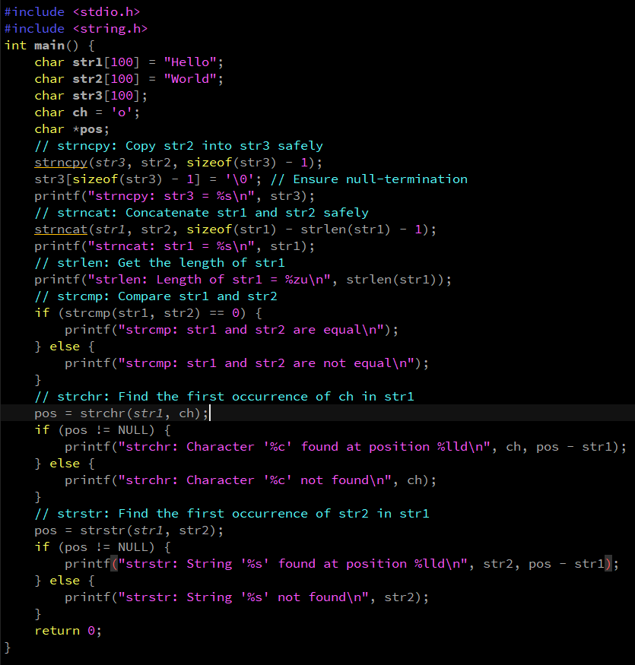
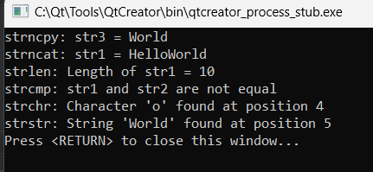
6. Strings
Example
Output

Slide 24
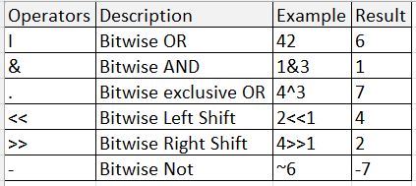
7.Bit Manipulations
In the C programming language, operations can be performed on a bit level using bitwise operators.
C provides six operators for bit manipulation.
They are below:

Slide 25
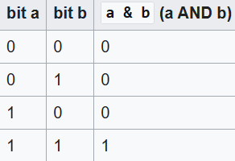
7.Bit Manipulations
The Bitwise AND operator is a single ampersand: “ &”. It is just a representation of AND which does its work on the bits of the operands rather than the truth value of the operands.
Example:
11001000
&10111000
--------------
= 10001000
The most significant bit of the first number is 1 and that of the second number is also 1 so the most significant bit of the result is 1.
In the second most significant bit, the bit of second number is zero, so we have the result as 0.
Bitwise AND operator:

Slide 26
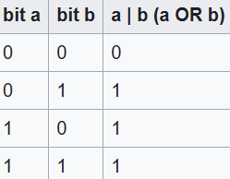
7.Bit Manipulations
Bitwise OR operator:
Bitwise OR performs logical disjunction at the bit level.
Its result is a 1 if either of the bits is 1 and zero only when both bits are 0. Its symbol is “| “ which can be called a pipe.
Example:
11001000
| 10111000
--------------
= 11111000
The most significant bit of the first number is 1 and that of the second number is also 1 or 0 so the most significant bit of the result is 1.
If the both significant bit values are 0 then the result is 0.

Slide 27
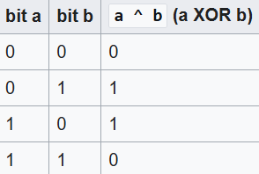
7.Bit Manipulations
Bitwise XOR operator:
The Bitwise XOR (exclusive or) performs an exclusive disjunction, which is equivalent to adding two bits and discarding the carry.
The result is zero only when we have two zeroes or two ones.
XOR can be used to toggle the bits between 1 and 0.
Thus i = i ^ 1 when used in a loop toggles its values between 1 and 0.
Example:
11001000
^ 10111000
--------------
= 01110000

Slide 28
7.Bit Manipulations
Bitwise Shift operators:
There are two bitwise shift operators ,They are
Right shift (>>)
Left shift (<<)
Right Shift Operator(>>):
The symbol of right shift operator is “>>",it requires two operands. It shifts each bit in its left operand to the right.
The number following the operator decides the number of places the bits are shifted (i.e. the right operand). Thus by doing ch >> 3 all the bits will be shifted to the right by three places and so on.
Examples :
If the variable ch contains the bit pattern 11100101, then ch >> 1.
will produce the result 01110010, and ch >> 2 will produce 00111001.
i = 14; // Bit pattern 00001110
j = i >> 1; // here we have the bit pattern shifted by 1 thus we get 00000111 = 7.

Slide 29
7.Bit Manipulations
The symbol of left shift operator is “<<“. It shifts each bit in its left-hand operand to the left by the number of positions indicated by the right-hand operand.
It works opposite to that of right shift operator. Thus by doing ch << 1 in the above example (11100101) we have 11001010. Blank spaces generated are filled up by zeroes as above.
Examples :
If the variable ch contains the bit pattern 11100101, then ch << 1.
will produce the result 11001010.
i = 14; // Bit pattern 00001110
j = i << 1; // here we have the bit pattern shifted by 1 thus we get 00011100 .
Left Shift operator(<<):

Slide 30
7.Bit Manipulations
Bitwise NOT operator(~):
The NOT operator inverts all the bits of its operand, turning 1s into 0s and vice versa.
Examples :
35 = 00100011 (In Binary)
Bitwise complement Operation of 35
~ 00100011
________
11011100 = 220 (In decimal)

Slide 31
7. Bitmasking
Bitmasking :
Bitmasking is a technique that involves bit manipulation. It is basically like putting a mask over certain bits and hiding the other un-useful bits, so as to make the program much more efficient and optimize the memory.
A bitmask is a sequence of bits that can also be known as a bitset or bit field and is used to perform bitwise operations on the given data.
Below are the Bitmasking Techniques :
Setting
Clearing
Toggling

Slide 32
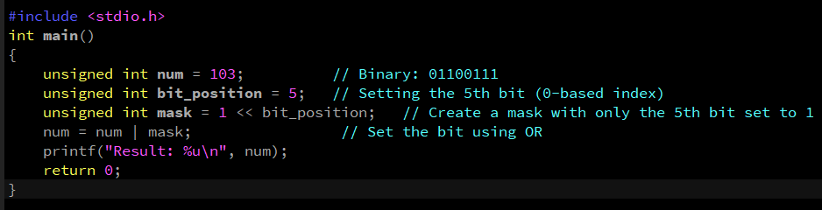
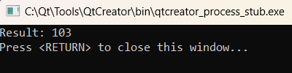
7. Bitmasking
Setting Bits:
In C programming, setting a bit is the process of setting a specific bit of a binary number to 1.
This operation is crucial in various applications, including memory management, data processing, and hardware control.
Example:
binary_number: 01100111
bit to set: 5th
Output:
binary_number: 01100111
mask_used: 00100000
Example
Output

Slide 33
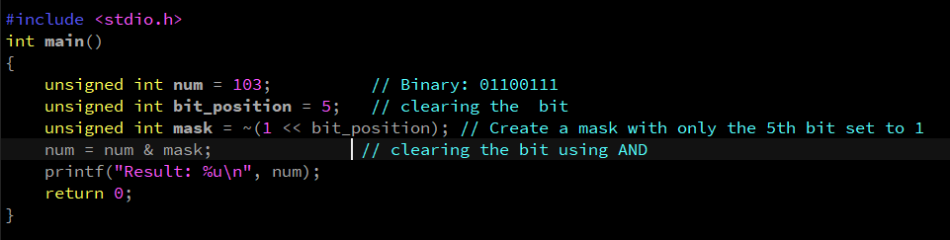
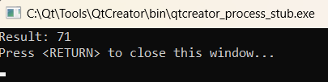
7. Bitmasking
Clearing Bits:
In C programming, clearing a bit is the process of setting a specific bit of the binary number to 0.
This operation is crucial in various applications, including memory management, data processing, and hardware control.
Example:- Input: binary_number: 01100111
bit to clear: 5th
Output:- binary_number: 01100111
mask_used: 11011111
Example
Output

Slide 34
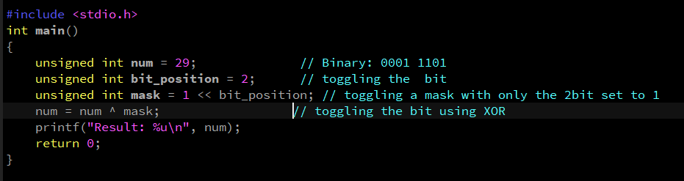

7. Bitmasking
Toggling Bits:
In C programming, toggling a bit is the process of flipping a specific bit of the binary number.
It means that the bit that is 0 becomes 1 and a bit that is 1 becomes 0. This operation is useful in the various applications including the cryptography, data compression and hardware control.
Example:- Input: binary_number: 01100111
bit to clear: 5th
Output: binary_number: 01100111
mask_used: 00010000
Example
Output

Slide 35


Thank You

