Slide 1


INTRODUCTION TO Multithreading IN C++
A Quest Global Company

Slide 2
List of Topics to be covered
Introduction to Multithreading
Key Concepts in Multithreading
Thread Management
Thread Safety
Advanced Thread Management
Condition Variables
Deadlock
Thread Priority

Slide 3
1.Introduction to Multithreading
Multithreading is a programming technique that allows multiple threads of execution to run concurrently within a single process. It enables efficient utilization of CPU resources, improves application performance, and facilitates parallel processing of tasks.
What is a Thread?
A thread is the smallest unit of execution in a program.
A process can contain multiple threads that share the same memory space but execute independently.
Each thread has its own:
Stack
Program Counter
Registers
Why Multithreading?
Concurrency: Allows multiple tasks to run simultaneously, even on single-core processors by time-slicing.
Parallelism: On multi-core processors, threads can run in parallel, speeding up computationally intensive tasks.
Responsive Applications: UI applications (like HMI systems) can remain responsive while performing background tasks.
Efficient Resource Utilization: Threads share the same memory and resources of the parent process, reducing overhead compared to multi-process systems.
Task Separation: Different tasks or parts of a program can be handled by separate threads, simplifying the code structure.

Slide 4
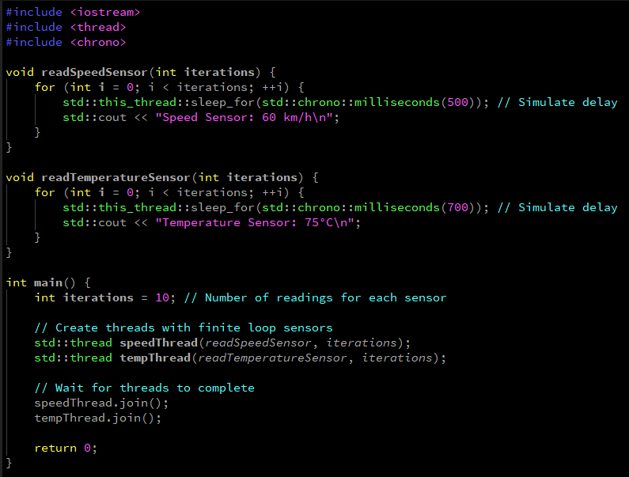
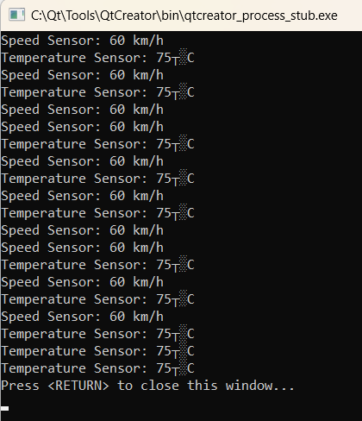
1.Introduction to Multithreading
Example
Output

Slide 5
2. Key Concepts in Multithreading
Process vs. Thread
2. Shared Resources
Threads within a process share:
Global variables
Heap memory
File descriptors
Each thread has:
Its own stack for function calls and local variables.
A separate program counter and execution state.
Feature | Process | Thread
Memory | Separate memory space | Shared memory space
Overhead | High (context switching) | Low
Communication | Inter-process communication | Shared memory
Failure Impact | Failure isolates process | Failure may affect entire process

Slide 6
2. Key Concepts in Multithreading
3. Race Conditions
Occurs when two or more threads access shared data simultaneously, and at least one thread modifies the data.
Without proper synchronization, this can lead to unpredictable outcomes.
4. Thread Safety
Ensuring that shared data is accessed and modified correctly when used by multiple threads.
Requires synchronization techniques like:
Mutexes
Semaphores
Locks

Slide 7
3. Thread Management
Thread management is the practice of controlling the lifecycle, execution, and synchronization of threads in a multi-threaded application. It includes creating, starting, pausing, resuming, and terminating threads, as well as managing shared resources and communication between threads.
Creating and Managing Threads:-
std::thread: A thread object that starts a thread on creation.
join(): Blocks the current thread until the thread represented by std::thread finishes execution.
detach(): Detaches the thread, allowing it to run independently.
Thread Lifecycle:-
Start: When a thread is created, it starts execution immediately.
Join: The calling thread waits for the created thread to finish.
Detach: The calling thread doesn't wait for the created thread to finish (independent execution)

Slide 8
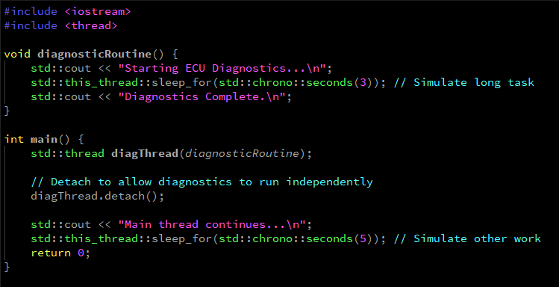
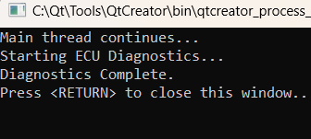
3. Thread Management
Example
Output

Slide 9
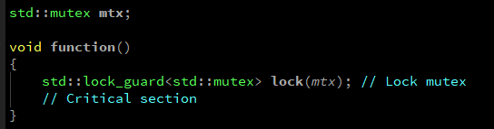

4. Thread Safety
Thread safety refers to ensuring that shared data is accessed by multiple threads without causing corruption or unexpected behavior.
Critical Sections: Parts of code where shared data is accessed should be protected to avoid race conditions.
Mutex (Mutual Exclusion):-
A mutex is used to lock shared resources, ensuring only one thread accesses the resource at a time.
Syntax:-
Lock Guard:-
std::lock_guard is a wrapper that automatically locks a mutex when it is created and releases the mutex when it goes out of scope.
Syntax:-

Slide 10
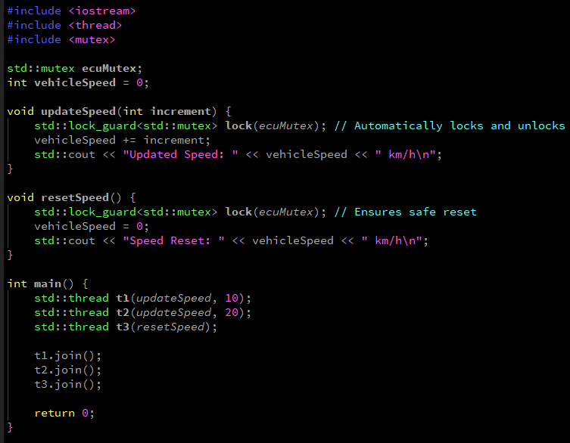
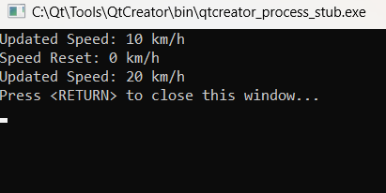
4. Thread Safety
Example
Output

Slide 11
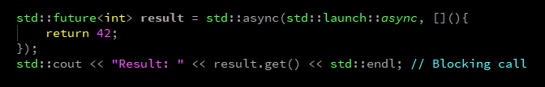
5. Advanced Thread Management
Advanced thread management involves techniques like task-based programming, thread pooling, and using high-level abstractions for better performance and maintainability.
Thread Pooling:-
A thread pool is a collection of pre-created threads that can be used to perform tasks concurrently. This reduces the overhead of creating and destroying threads repeatedly.
std::async and std::future
std::async: Launches a task asynchronously (in a separate thread).
std::future: Used to retrieve the result from an asynchronous operation.
Syntax:-

Slide 12
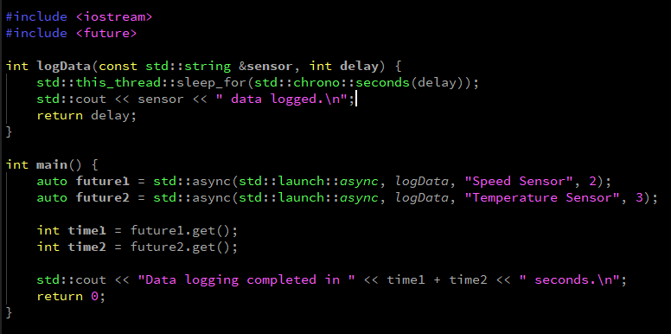
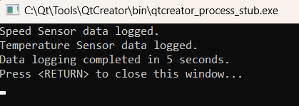
5. Advanced Thread Management
Example
Output

Slide 13
6. Condition Variables
A condition variable is used for signaling between threads to manage situations where a thread needs to wait until a particular condition is true before proceeding.
Common Use Cases
Producer-consumer problem: A thread waits for another thread to produce data before it consumes it.
Using Condition Variables
Condition variables typically work with a mutex to protect shared data.
Key Functions:
wait(): Makes a thread wait until notified.
notify_one(): Wakes up one waiting thread.
notify_all(): Wakes up all waiting threads.

Slide 14
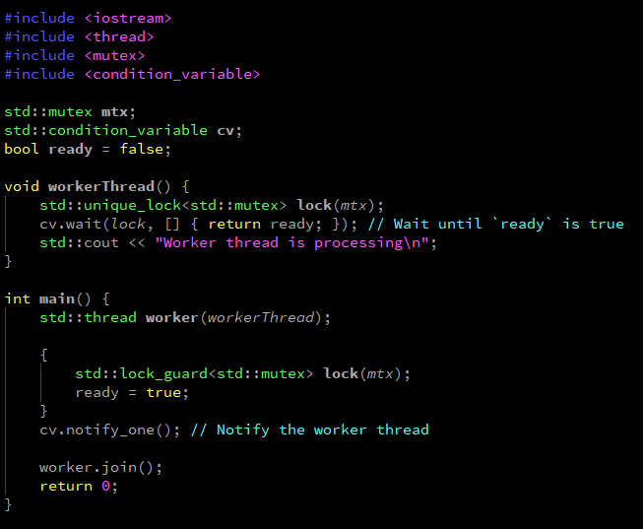
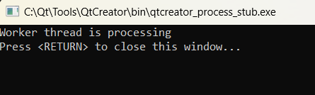
6. Condition Variables
Example
Output

Slide 15
7. Deadlock
Deadlock occurs when two or more threads are blocked forever, each waiting for the other to release a resource.
Conditions for Deadlock
Mutual Exclusion: At least one resource is held in a non-shareable mode.
Hold and Wait: A thread is holding at least one resource and is waiting to acquire additional resources.
No Preemption: Resources cannot be forcibly taken from threads holding them.
Circular Wait: A set of threads are waiting for each other in a circular chain.
Common Causes of Deadlocks:
Nested locks where threads acquire resources in different orders.
Incorrect use of synchronization primitives.
Techniques to Avoid Deadlocks:
Always acquire locks in a consistent order.
Use std::lock() for deadlock-free locking of multiple mutexes.
Avoid holding locks for extended periods.
Prefer lock-free programming when possible.

Slide 16
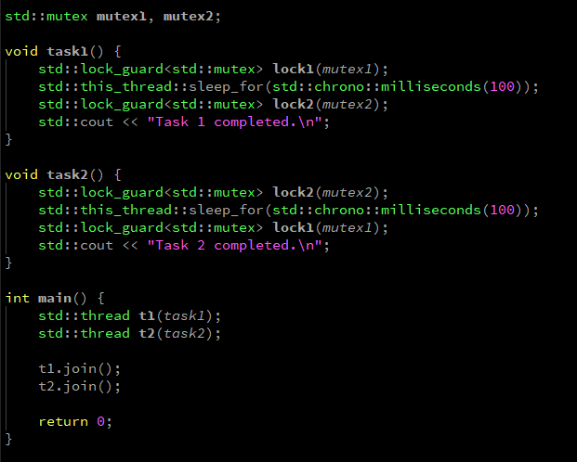

7. Deadlock
Example
Avoiding Deadlock

Slide 17
8. Thread Priority
What is Thread Priority?
Thread priority is an integer or value that indicates the relative importance of a thread. A higher priority thread is likely to be scheduled before a lower priority thread by the operating system's scheduler. For example:
A high-priority thread might preempt a low-priority thread, meaning it will execute first.
A low-priority thread might be put on hold while higher-priority threads are running.
Thread priority is crucial in systems that require precise timing and resource allocation, such as real-time systems (e.g., embedded systems, multimedia processing, or applications with strict latency requirements).
How Thread Priority Works:
When multiple threads are running, the operating system's scheduler decides which thread to run based on factors like:
Thread priority
Thread state (e.g., running, waiting, blocked)
Available CPU time
Operating system scheduling policies (e.g., Round-Robin, FIFO)
Threads with higher priority are generally given more CPU time, whereas threads with lower priority may have to wait longer to get scheduled.

Slide 18
8. Thread Priority
Why use Thread Priority?
Improving Responsiveness of Time-Critical Tasks
Ensuring Fairer Resource Allocation
Minimizing Latency in Real-Time Systems
Preventing Thread Starvation
Better Control Over Task Scheduling
Improving Throughput in Multi-Threaded Applications
Enabling Real-Time and High-Performance Computing
While thread priority can be very useful in certain cases, it's not always necessary, and using it improperly can lead to unintended side effects. Some situations where thread priority should be used cautiously include:
Overuse of High Priority: Assigning all threads high priority can lead to performance degradation. If many threads are high-priority, the system could spend too much time switching between threads and not enough time executing them.

Slide 19
8. Thread Priority
Complexity in Debugging: Managing thread priorities adds another layer of complexity. Thread starvation, priority inversion (where lower-priority threads block higher-priority ones), and deadlock can occur if not handled properly.
Unnecessary for Simple Applications: If your application does not have time-sensitive tasks, it may not benefit from manually adjusting thread priorities. The operating system's default thread scheduling might be sufficient for most tasks.
Advantages:-
Ensuring Fair Allocation of System Resources
Real-Time Task Management
Better Control Over Scheduling and Execution
Optimizing Throughput in Multi-Threaded Applications
Enhanced User Experience in Interactive Applications
Support for High-Performance Computing (HPC) Applications
Reducing Latency in Networked Applications
Enabling Real-Time Systems and Guarantees

Slide 20
8. Thread Priority
Thread Priority Types:-
Windows:
THREAD_PRIORITY_IDLE
THREAD_PRIORITY_LOWEST
THREAD_PRIORITY_BELOW_NORMAL
THREAD_PRIORITY_NORMAL (default)
THREAD_PRIORITY_ABOVE_NORMAL
THREAD_PRIORITY_HIGHEST
THREAD_PRIORITY_TIME_CRITICAL
Linux:
Scheduling Policies:
SCHED_OTHER (default, time-sharing)
SCHED_FIFO (real-time, first-in, first-out)
SCHED_RR (real-time, round-robin)

Slide 21
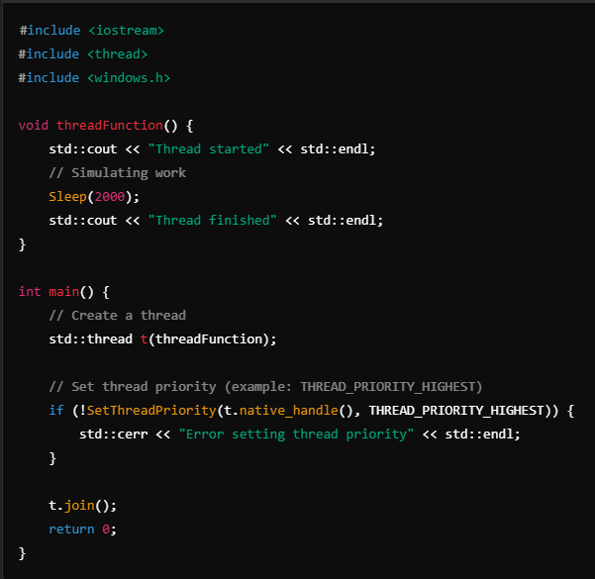

8. Thread Priority
Example: Thread Priority in Windows
Example
Output

Slide 22
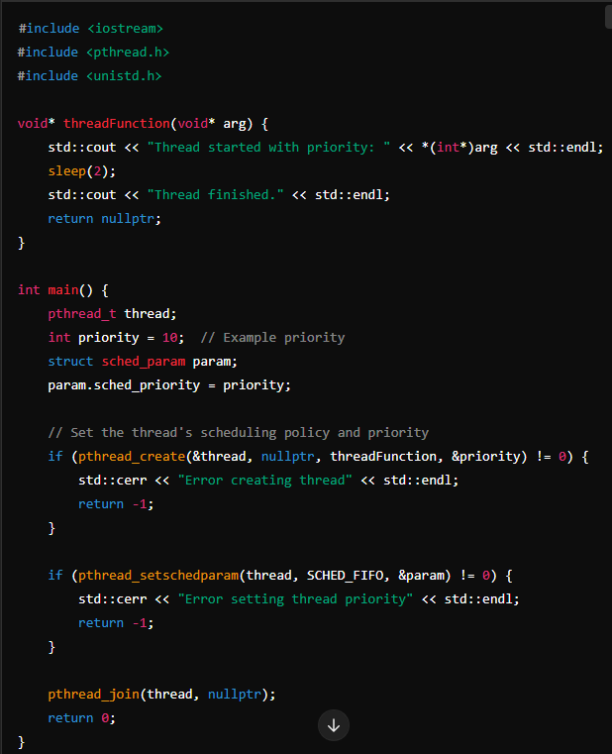

8. Thread Priority
Example: Thread Priority in Linux Using pthread
Example
Output

Slide 23


Thank You

