Slide 1


INTRODUCTION TO INTRODUCTION TO OOPS
A Quest Global Company

Slide 2
List of Topics to be covered
1. Introduction to OOPS
2. Classes & Objects
3. Encapsulation.
4. Abstraction.
5. Inheritance.
6. Polymorphism.
7. Pure Virtual Function
8. Constructors
9. Types of Constructors
10. Destructors

Slide 3
1. Introduction to OOPS
Object-oriented programming – As the name suggests uses objects in programming.
Object-oriented programming aims to implement real-world entities like inheritance, hiding, polymorphism, etc. in programming.
The major purpose of C++ programming is to introduce the concept of object orientation to the C programming language.
Object Oriented Programming is a paradigm that provides many concepts such as inheritance, abstraction, encapsulation, polymorphism etc.
Object-Oriented Programming is a methodology or paradigm to design a program using classes and objects.

Slide 4
1. Introduction to OOPS
There are some basic concepts that act as the building blocks of OOPs:-
Class
Objects
Encapsulation
Abstraction
Polymorphism
Inheritance
Polymorphism
Inheritance
OOPs
Concepts
Encapsulation
Abstraction
Class
Object

Slide 5
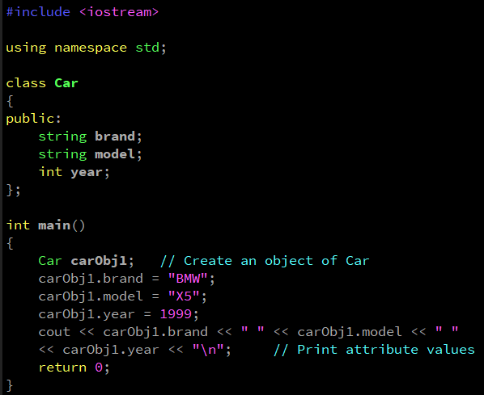
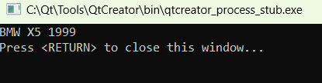
2. Classes & Objects
The building block of C++ that leads to Object-Oriented programming is a Class.
It is a user-defined data type, which holds its own data members and member functions, which can be accessed and used by creating an instance of that class.
A class is like a blueprint for an object.
For Example: Consider the Class of Cars. There may be many cars with different names and brands but all of them will share some common properties like all of them will have 4 wheels, Speed Limit, Mileage range, etc. So here, the Car is the class, and wheels, speed limits, and mileage are their properties.
Example
Output

Slide 6
2. Classes & Objects
An Object is an identifiable entity with some characteristics and behavior.
An Object is an instance of a Class.
When a class is defined, no memory is allocated but when it is instantiated (i.e. an object is created) memory is allocated.
Object means a real word entity such as pen, chair, table etc.
Any entity that has state and behavior is known as an object.

Slide 7
3. Encapsulation
Binding (or wrapping) code and data together into a single unit is known as encapsulation.
For example: capsule, it is wrapped with different medicines.
Encapsulation is typically understood as the grouping of related pieces of information and data into a single entity.
Encapsulation is the process of tying together data and the functions that work with it in object-oriented programming.
In a real car, users cannot directly interact with internal components like fuel injectors, engine temperature sensors, or oil systems. Instead, the user interacts through an interface like starting/stopping the car, driving, and refueling.

Slide 8
4. Abstraction
Hiding internal details and showing functionality is known as abstraction.
Data abstraction is the process of exposing to the outside world only the information that is absolutely necessary while concealing implementation or background information.
For example: phone call, we don't know the internal processing.
In C++, we use abstract class and interface to achieve abstraction.

Slide 9
5. Inheritance
Inheritance is a mechanism of reusing and extending existing classes without modifying them, thus producing hierarchical relationships between them.
The object being inherited from is called the parent or base, and the object doing the inheriting is called the child or derived object.
Reusability - As a result, when we wish to create a new class, but an existing class already contains some of the code we need, we can generate our new class from the old class thanks to inheritance. This allows us to utilize the fields and methods of the pre-existing class.
Types of Inheritance in C++
Single Inheritance
Multiple Inheritance
Multilevel Inheritance
Hierarchical Inheritance
Hybrid Inheritance

Slide 10
5. Inheritance
1.Single inheritance is defined as the inheritance in which a derived class is inherited from the only one base class.
A
Where 'A' is the base class, and 'B' is the derived class.
B
2.Multilevel inheritance is a process of deriving a class from another derived class.
A
When one class inherits another class which is further inherited by another class, it is known as multi level inheritance in C++. Inheritance is transitive so the last derived class acquires all the members of all its base classes.
B
C

Slide 11
5. Inheritance
3. Multiple inheritance is the process of deriving a new class that inherits the attributes from two or more classes.
B-1
B-2
B-n
Derived Class
4. Hierarchical Inheritance is defined as the process of deriving more than one class from a base class.
A
In C++, Hierarchical Inheritance is a type of inheritance where multiple derived classes inherit from a single base class. This allows different classes to share common functionality from the base class while also extending or modifying it with their own unique features.
B
C
D

Slide 12
5. Inheritance
5. Hybrid inheritance is a combination of more than one type of inheritance.
A
In C++, Hybrid Inheritance is a type of inheritance that combines two or more types of inheritance (like single, multiple, hierarchical, and multilevel inheritance). It allows a class to inherit properties and methods from more than one base class in different inheritance forms.
B
C
D

Slide 13
6. Polymorphism
Polymorphism means one name many forms. Polymorphism means one object behaving as multiple forms. One function behaves in different forms. In other words, "Many forms of a single object is called Polymorphism.“
Example:- A person at the same time can have different characteristics. Like a man at the same time is a father, a husband, an employee. posse's the same person posse's different behavior in different situations. This is called polymorphism.
Polymorphism
Compile time Polymorphism
Run time Polymorphism
Function overloading
Operator overloading
Virtual function

Slide 14
Compile time Polymorphism:-
6. Polymorphism
Function overloading:- Function Overloading is defined as the process of having two or more function with the same name, but different in parameters is known as function overloading in C++.
#include <iostream>
using namespace std;
int add(int a, int b) {
return a + b; // Function to add two integers
}
int add(int a, int b, int c) {
return a + b + c; // Function to add three integers
}
float add(float a, float b) {
return a + b; // Function to add two floats
}
int main()
{
// Calling overloaded functions
cout << "Addition of two integers: " << add(5, 10) << endl; // Calls add(int, int)
cout << "Addition of three integers: " << add(5, 10, 15) << endl; // Calls add(int, int, int)
cout << "Addition of two floats: " << add(5.5f, 10.5f) << endl; // Calls add(float, float)
return 0;
}

Slide 15
6. Polymorphism
Compile time Polymorphism:- Operator Overloading:- The process of making an operator to exhibit different behaviors in different instances is known as operator overloading. Only predefined operator can be overloaded.
#include <iostream>
using namespace std;
class Complex {
private:
float real, imag;
public:
// Constructor
Complex(float r = 0, float i = 0) : real(r), imag(i) {}
// Overloading the + operator
Complex operator + (const Complex& other) {
Complex temp;
temp.real = real + other.real;
temp.imag = imag + other.imag;
return temp;
}
// Function to display the complex number
void display() {
cout << real << " + " << imag << "i" << endl;
}
};
int main() {
Complex c1(3.0, 4.0), c2(1.0, 2.0);
Complex c3 = c1 + c2; // using overloaded + operator
c3.display();
return 0;
}

Slide 16
6. Polymorphism
Dynamic Polymorphism:-
Dynamic polymorphism is a programming concept in object-oriented languages like C++ where a derived class can override or redefine methods of its base class. This means that a single method call can have different implementations based on the type of object it is called on.
Dynamic polymorphism is achieved through virtual functions, which are member functions of a base class marked with the virtual keyword.
This allows the function to be overridden in derived classes, enabling them to provide their own specific implementations.
Advantages of Dynamic Polymorphism
Flexibility and Reusability of Code
Enhancing Maintainability and Scalability
Overall, the strategic use of dynamic polymorphism can lead to better-structured and more maintainable software that is well-prepared to meet evolving requirements and technological advances.

Slide 17
6. Polymorphism
#include <iostream>
class CarHMI // Base class representing generic Car HMI
{
public:
// Virtual function to be overridden in derived classes
virtual void display() const {
std::cout << "Generic Car HMI Display." << std::endl;
}
// Virtual destructor to ensure proper cleanup of derived classes
virtual ~CarHMI() {}
};
// Derived class representing Normal mode HMI
class NormalModeHMI : public CarHMI {
public:
void display() const override {
std::cout << "Normal Mode HMI: Fuel Efficiency, Speed, Basic Alerts." << std::endl;
}
};
// Derived class representing Sport mode HMI
class SportModeHMI : public CarHMI {
public:
void display() const override {
std::cout << "Sport Mode HMI: Performance Metrics, Engine RPM, Boost Indicator." << std::endl;
}
};
// Derived class representing Eco mode HMI
class EcoModeHMI : public CarHMI {
public:
void display() const override {
std::cout << "Eco Mode HMI: Eco Score, Energy Consumption, Regenerative Braking Info." << std::endl;
}
};
// Function that takes a pointer to the base class and calls the virtual function
void showHmiFeatures(const CarHMI& carHmi) {
carHmi.display();
}

Slide 18
6. Polymorphism
int main()
{
// Creating objects for each mode
NormalModeHMI normalMode;
SportModeHMI sportMode;
EcoModeHMI ecoMode;
// Displaying different HMI features using dynamic polymorphism
std::cout << "Normal Mode:" << std::endl;
showHmiFeatures(normalMode);
std::cout << "\nSport Mode:" << std::endl;
showHmiFeatures(sportMode);
std::cout << "\nEco Mode:" << std::endl;
showHmiFeatures(ecoMode);
return 0;
}
Output :-
Normal Mode:
Normal Mode HMI: Fuel Efficiency, Speed, Basic Alerts.
Sport Mode:
Sport Mode HMI: Performance Metrics, Engine RPM, Boost Indicator.
Eco Mode:
Eco Mode HMI: Eco Score, Energy Consumption, Regenerative Braking Info.

Slide 19
7. Pure Virtual Function
A pure virtual function in C++ is a function declared in a base class that has no implementation. It’s meant to be overridden in any derived class that inherits from this base class.
A class that contains at least one pure virtual function becomes an abstract class, meaning it cannot be instantiated on its own.
Instead, derived classes must provide concrete implementations of the pure virtual function.
Advantage: Pure virtual functions ensure that all derived classes implement specific methods. This enforces a common interface that all derived classes must follow.
Example: In the HMI control example, every control (like Button, Slider, ToggleSwitch) must implement render() and handleInteraction(). This guarantees that all controls have the essential behavior required for rendering and interaction, no matter the type of control.

Slide 20
8. Constructors
In C++, constructors are special member functions used to initialize objects of a class. They are called automatically when an object is created. There are different types of constructors in C++, and each serves a specific purpose depending on the type of object initialization required.
Types of Constructors in C++:
Default Constructor
Parameterized Constructor
Copy Constructor
Move Constructor
Constructor with Initializer List

Slide 21
9. Types of Constructors
Default Constructor:- A default constructor is one that takes no arguments. It is called when an object is created without any parameters.
Syntax:- ClassName();
#include <iostream>
class HmiFeature
{
public:
// Default Constructor
HmiFeature()
{
std:: cout << "Default HMI Feature initialized." << endl;
}
};
int main()
{
HmiFeature feature1; // Default constructor is called
return 0;
}

Slide 22
9. Types of Constructors
Parameterized Constructor:- A parameterized constructor allows the initialization of an object with specific values by passing arguments.
Syntax:- ClassName(data_type arg1, data_type arg2, ...);
#include <iostream>
using namespace std;
class HmiFeature
{
string featureName;
public:
HmiFeature(string name) // Parameterized Constructor
{
featureName = name;
cout << "HMI Feature: " << featureName << " initialized." << endl;
}
};
int main() {
HmiFeature feature1("Climate Control"); // Calls parameterized constructor
HmiFeature feature2("Media Player"); // Calls parameterized constructor
return 0;
}

Slide 23
9. Types of Constructors
Copy Constructor:- A copy constructor creates a new object as a copy of an existing object. If not defined explicitly, the compiler provides a default copy constructor.
Syntax:- ClassName(const ClassName &obj);
#include <iostream>
using namespace std;
class HmiFeature
{
string featureName;
public:
// Parameterized Constructor
HmiFeature(string name) : featureName(name) {}
HmiFeature(const HmiFeature &obj) { // Copy Constructor
featureName = obj.featureName;
cout << "Copy Constructor: HMI Feature copied." << endl;
}
void display() {
cout << "HMI Feature: " << featureName << endl;
}
};
int main()
{
HmiFeature feature1("Navigation System"); // Parameterized constructor
HmiFeature feature2 = feature1; // Copy constructor is called
feature1.display();
feature2.display();
return 0;
}

Slide 24
9. Types of Constructors
Move Constructor:- A move constructor transfers ownership of resources (e.g., dynamic memory) from one object to another, leaving the original object in a valid but empty state. This is useful for optimizing performance, especially with temporary objects.
Syntax:- ClassName(ClassName &&obj) noexcept;
#include <iostream>
#include <utility> // for std::move
using namespace std;
class HmiFeature {
string featureName;
public:
HmiFeature(string name) : featureName(name) {} // Parameterized Constructor
HmiFeature(HmiFeature &&obj) noexcept // Move Constructor
{
featureName = std::move(obj.featureName); // Transfer ownership
obj.featureName = ""; // Leave the moved-from object in a valid but empty state
cout << "Move Constructor: Ownership transferred." << endl;
}
void display() {
cout << "HMI Feature: " << featureName << endl;
}
};
int main( )
{
HmiFeature feature1("Gesture Control");
HmiFeature feature2 = std::move(feature1);
// Move constructor is called
feature1.display(); // Will display empty
feature2.display(); // Displays "Gesture Control"
return 0;
}

Slide 25
9. Types of Constructors
Constructor with Initializer List:- The initializer list is used to initialize member variables before the body of the constructor executes. It's particularly useful for initializing constants, references, or base class members in inheritance.
Syntax :- ClassName(parameters) : member1(value1), member2(value2), ... {
// Constructor body (optional)
}
#include <iostream>
using namespace std;
class HmiFeature
{
string featureName;
const int version;
public:
HmiFeature(string name, int ver) : featureName(name), version(ver) // Constructor with Initializer List
{
cout << "HMI Feature: " << featureName << " initialized with version " << version << "." << endl;
}
void display() {
cout << "HMI Feature: " << featureName << ", Version: " << version << endl;
}
};
int main()
{
HmiFeature feature1("Adaptive Cruise Control", 2); // Initializer list constructor
feature1.display();
return 0;
}

Slide 26
9. Destructor
Destructor :- A destructor is a special member function in a class that is called when an object of that class goes out of scope or is explicitly deleted. Its primary purpose is to release resources that the object may have acquired during its lifetime, such as dynamically allocated memory, file handles, network connections, etc.
Key Characteristics of Destructors
The destructor has the same name as the class but is preceded by a tilde (~).
It does not take any parameters and does not return a value.
class ClassName {
public:
~ClassName() {
// Destructor body
}
};

Slide 27
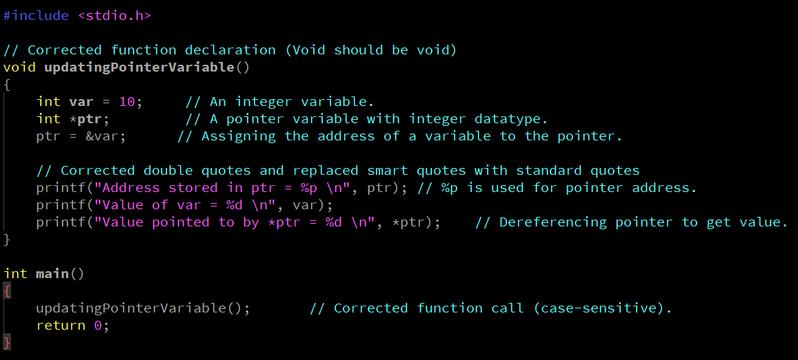
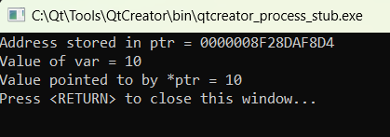
2.Usage of Pointers:
Example
Output

Slide 28


Thank You

