Slide 1


T1934
Learning Document
A Quest Global Company

Slide 2
Agenda
Topics Covered Today
Key Learnings / Concepts Understood:
Key Concepts with Definitions/ Code Snippet – Hands-on Practice
Challenges / Debugging Experience
Tasks/Assignments Completed
Additional Learning Resources / Notes
Q&A
Plan for Tomorrow

Slide 3
List of Topics to be covered
Stack
Queue

Slide 4
Key Learnings/Concepts Understood
Stack Definition, Purpose and Example
Queue Definition, Purpose and Example

Slide 5
Stack
1. Stack
Definition:
A stack is a linear data structure that follows the Last In, First Out (LIFO) principle. Elements are added (pushed) and removed (popped) from the same end, called the top. Think of it like a stack of car parts (e.g., tires) in an automotive assembly line: the last tire placed on the stack is the first one removed.
Why We Use It:
Purpose: Stacks are used when we need to reverse the order of operations or track history:
Use in Automotive Context:
In a car manufacturing plant, a stack can track the sequence of tasks (e.g., painting, assembling, testing). If a car fails testing, you "pop" back to the previous task (e.g., assembling) to fix issues.
Common uses: Function call stack, undo functionality in software, or parsing expressions.

Slide 6

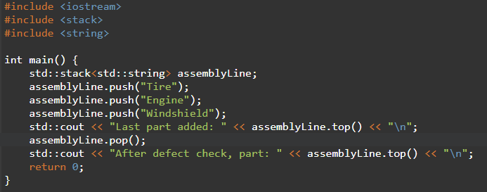


Sort

Slide 7
Challenges/Debugging Experience and Additional Learning Resources
Challenges / Debugging Experience
Challenge: Stack overflow in array-based implementation if size exceeds MAX.
Debugging: Check top >= MAX - 1 before pushing.
Challenge: Stack underflow when popping from an empty stack.
Debugging: Use isEmpty() or check top < 0 before popping.
Automotive Issue: If a car part is incorrectly logged (e.g., wrong ID), the stack may need validation before pushing.
Notes:
Stacks are memory-efficient for backtracking tasks.
In automotive systems, stacks can manage diagnostic logs or navigation history.

Slide 8
Queue
2. Queue
Definition:
A queue is a linear data structure that follows the First In, First Out (FIFO) principle. Elements are added (enqueued) at the rear and removed (dequeued) from the front. Think of it like a line of cars waiting at a car wash: the first car in is the first washed.
Why We Use It:
Purpose: Queues are used when order matters:
Use in Automotive Context:
In a car manufacturing plant, a queue can manage cars waiting for quality checks. The first car produced is checked first.
Common uses: Task scheduling, breadth-first search, or buffering data.

Slide 9
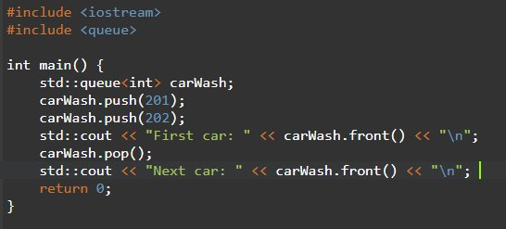

Sort

Slide 10
Challenges/Debugging Experience and Additional Learning Resources
Challenges / Debugging Experience
Challenge: Queue overflow in array-based implementation.
Debugging: Use circular queues or check rear >= MAX - 1.
Challenge: Queue underflow when dequeuing an empty queue.
Debugging: Check isEmpty() before dequeuing.
Automotive Issue: If a car is prioritized (e.g., emergency vehicle), a regular queue fails—use a priority queue instead.
Notes:
Queues are ideal for ordered processing in automotive systems.
Priority queues are useful for scheduling urgent tasks (e.g., defective car repairs).

Slide 11
Q & A
Q: Why use a stack for car assembly?
A: Stacks allow reversing steps (LIFO), useful for undoing tasks or backtracking in navigation.
Q: Can stacks handle large datasets in automotive applications?
A: Yes, linked list-based or STL stacks are dynamic, but array-based stacks need predefined sizes.
Q: How to avoid stack overflow?
A: Use dynamic structures (linked lists or STL) or monitor array size.
Q: Why use a queue for a car wash?
A: Queues ensure cars are processed in the order they arrive (FIFO).

Slide 12


Thank You

