Slide 1


T1934
Learning Document
A Quest Global Company

Slide 2
Agenda
Topics Covered Today
Key Learnings / Concepts Understood:
Key Concepts with Definitions/ Code Snippet – Hands-on Practice
Challenges / Debugging Experience
Tasks/Assignments Completed
Additional Learning Resources / Notes
Q&A
Plan for Tomorrow

Slide 3
List of Topics to be covered
Single lInked list
Double linked list
Circular linked list

Slide 4
Key Learnings/Concepts Understood
Single linked list Definition, Purpose and Example
Double linked list Definition, Purpose and Example
Circular linked list Definition, Purpose and Example

Slide 5
Single Linked List
1. Single Linked List
Definition:
A single linked list is a linear data structure where each node contains data and a pointer to the next node. The last node points to NULL, indicating the end of the list.
Why We Use It:
Purpose:
Simple to implement for sequential access.
Memory-efficient as it only stores one pointer per node.
Suitable for applications with forward-only navigation, like a basic menu display in a car HMI.
Use in Automotive Context:
Used to manage a sequential menu system (e.g., "Navigation" -> "Audio" -> "Climate") where users traverse options in one direction.

Slide 6

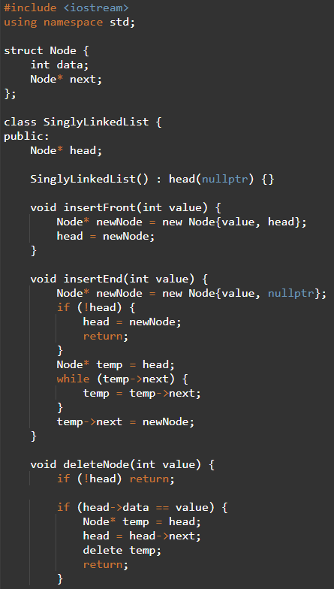
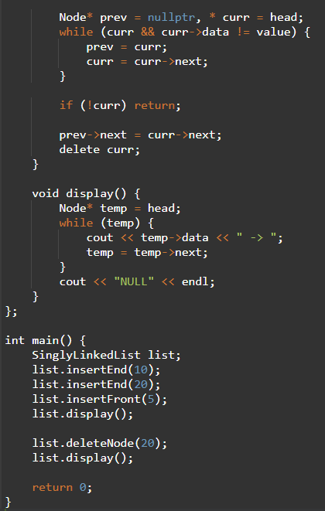
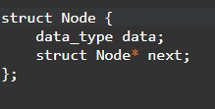


Single Linked List
Part-1
Part-2
Syntax

Slide 7
Challenges/Debugging Experience
Challenges / Debugging Experience
No backward traversal, limiting navigation in HMI menus.
Debugging memory leaks when freeing the list.
Handling edge cases (e.g., empty list or single node).

Slide 8
Double Linked List
2. Double Linked List
Definition:
A double linked list is a linear data structure where each node contains data, a pointer to the next node, and a pointer to the previous node, allowing bidirectional traversal.
Why We Use It:
Purpose:
Enables bidirectional navigation, enhancing user experience in HMI.
Useful for applications requiring frequent insertions/deletions at both ends.
Provides flexibility for dynamic menu systems.
Use in Automotive Context:
Ideal for interactive menus where users can navigate forward and backward (e.g., scrolling through settings like "Navigation" <-> "Audio" <-> "Climate").

Slide 9
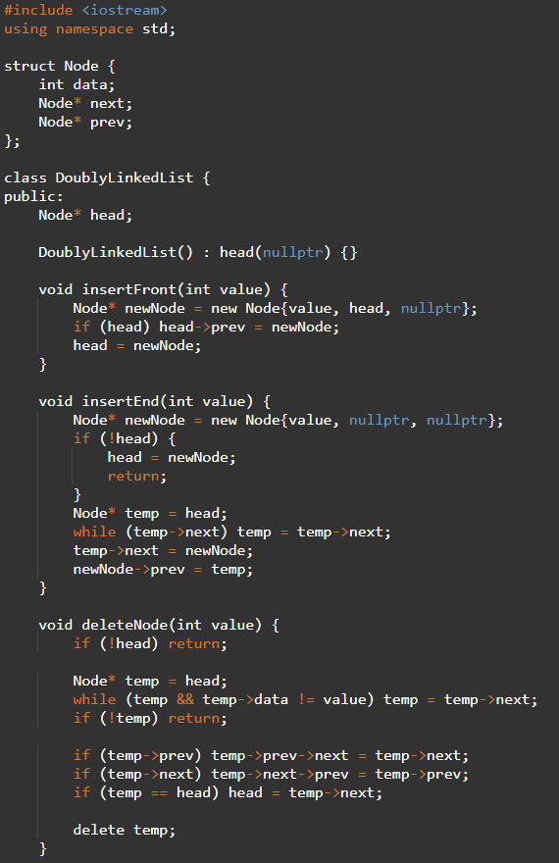
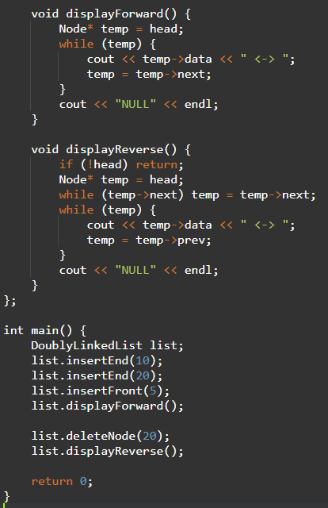

Double Linked List
Part-1
Part-2
Syntax

Slide 10
Challenges/Debugging Experience and Additional Learning Resources
Challenges / Debugging Experience
Complex pointer updates during insertions/deletions.
Debugging issues like dangling pointers or incorrect prev/next links.
Handling edge cases (e.g., navigating an empty list).

Slide 11
Circular Linked List
3. Circular Linked List
Definition:
A circular linked list is a variation where the last node points back to the first node, forming a loop. It can be single or double linked.
Why We Use It:
Purpose:
Enables bidirectional navigation, enhancing user experience in HMI.
Useful for applications requiring frequent insertions/deletions at both ends.
Provides flexibility for dynamic menu systems.
Use in Automotive Context:
Ideal for interactive menus where users can navigate forward and backward (e.g., scrolling through settings like "Navigation" <-> "Audio" <-> "Climate").

Slide 12
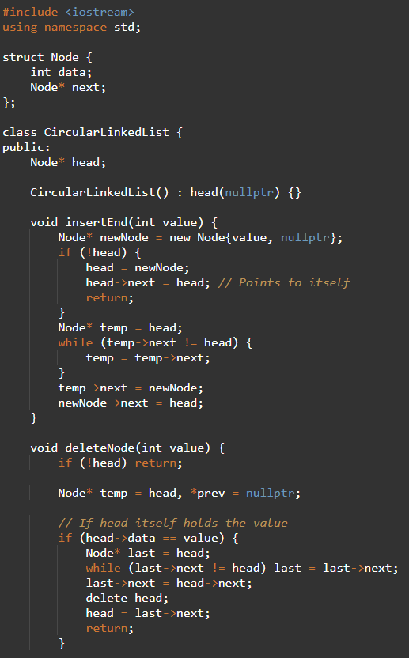
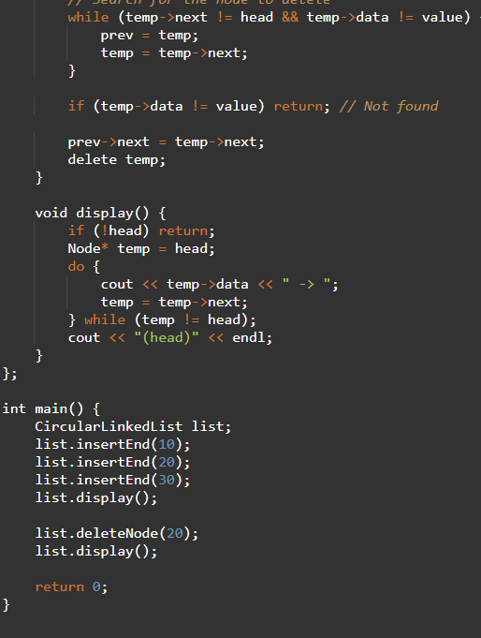

Circular Linked List
Part-1
Part-2

Slide 13
Challenges/Debugging Experience and Additional Learning Resources
Challenges / Debugging Experience
Issue: Infinite loop during traversal without a stopping condition.
Solution: Used a counter or specific node reference to control cycles.
Edge Case: Freeing the list required breaking the circular link.

Slide 14
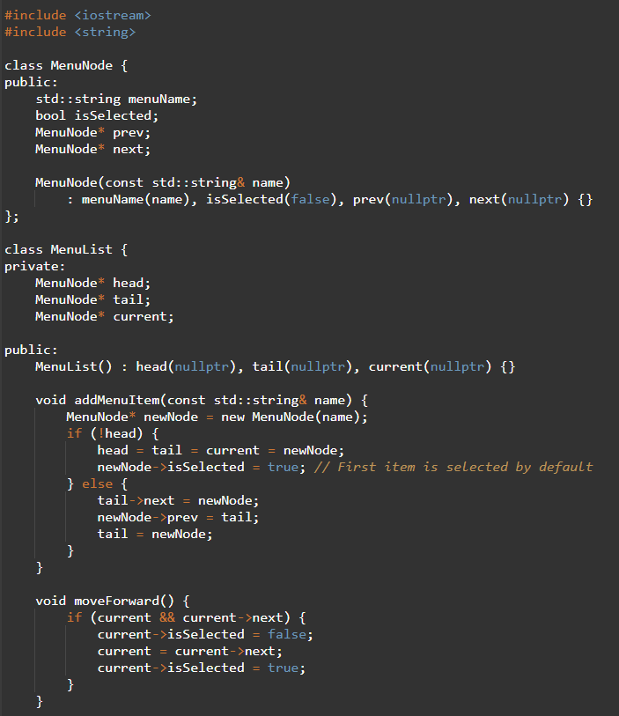
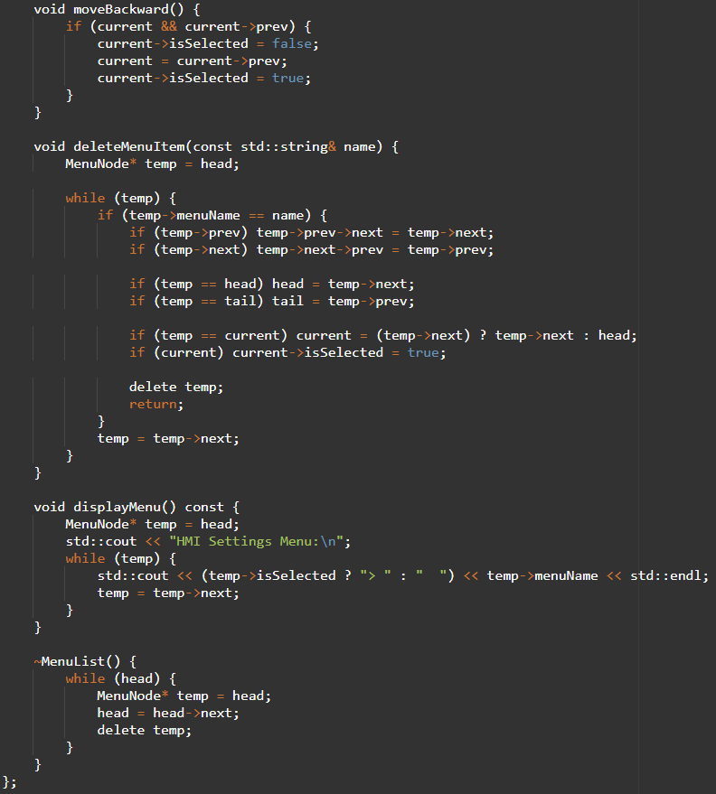
Task
In an HMI settings screen (like Sound, Display, Vehicle, Connectivity), the user can navigate forward and backward using the rotary knob or touch.
Part-1
Part-2

Slide 15
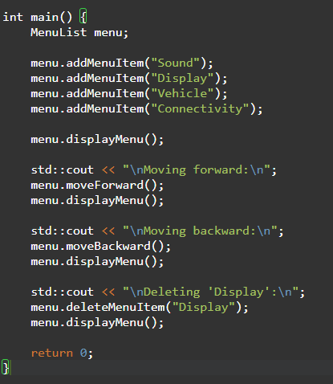
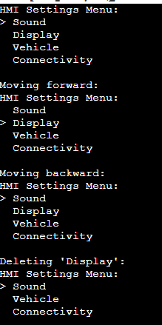
Task
In an HMI settings screen (like Sound, Display, Vehicle, Connectivity), the user can navigate forward and backward using the rotary knob or touch.
Part-3

Slide 16
Q & A
Q: Why use a double linked list over a single linked list in a car HMI?
A: A double linked list allows bidirectional navigation, which is user-friendly for scrolling through menus (e.g., forward to "Audio," backward to "Navigation"). Single linked lists are limited to forward-only traversal, which may frustrate users.
Q: How does a circular linked list benefit a car HMI?
A: It enables seamless cycling through options (e.g., looping from "Climate" back to "Navigation"), ideal for rotary knob or button-based interfaces where users expect continuous navigation.
Q: What are common errors in linked list implementations?
A: Common errors include:
Forgetting to update pointers (prev/next) correctly.
Not handling edge cases (empty lists, single node).
Memory leaks due to improper deallocation.

Slide 17
Plan for Tommorrow
Concepts and usage of std::vector, std::deque, std::list, std::queue, std::priority_queue, std::stack.
Methods and iterators for accessing and modifying data.
Hands-on practice with simple and complex data types.

Slide 18


Thank You

