Slide 1


T1934
Learning Document
A Quest Global Company
16/05/2025

Slide 2

Agenda
Topics Covered Today
Key Learnings / Concepts Understood:
Key Concepts with Definitions/ Code Snippet – Hands-on Practice
Challenges / Debugging Experience
Tasks/Assignments Completed
Additional Learning Resources / Notes
Q&A
Plan for Tomorrow

Slide 3
Topics Covered Today
Constructors​
Parameterized Constructors​
Copy Constructors​
Destructors​
Virtual Destructors​
Automatic Storage Class (Auto)​
Register Storage Class (Register)
Static Storage Class(static)​
Extern Storage Class (Extern)​
Mutable Storage Class (Mutable)​
Thread Storage Class (Thread_local)​

Slide 4
Key Learnings
Constructor:
A constructor is a member function in a class that initializes an object right when it is created.
Purpose: To prepare and assign initial values to an object’s properties automatically.
Key Points:
It shares the name of the class.
Doesn't return any value—not even void.
Automatically triggered during object creation.
Real-Life Analogy: Imagine getting a new laptop. The first time you boot it up, the initial setup process (language, region, time zone) begins without your command—just like a constructor auto-runs when an object is born.

Slide 5
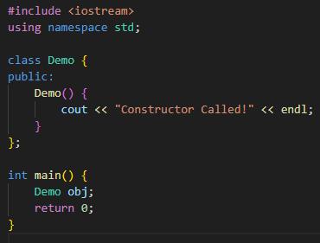

Code Snippet – Hands-on Practice

Slide 6
Challenges, Tasks
Challenges / Debugging Experience:
Constructor was not getting called due to missing parentheses in object declaration.
Learned the importance of correct syntax.
Tasks/Assignments Completed:
Wrote examples for default constructors.
Explored constructor overloading.
Additional Learning Resources:
https://www.geeksforgeeks.org/
Constructor can’t return any value, not even void.

Slide 7
Key Learnings
Parameterized Constructor:
This is a constructor that takes arguments to assign custom values during object creation.
Purpose: To allow different objects of the same class to start with different data.
Key Points:
Accepts parameters.
Enables object customization at the time of instantiation.
Can be overloaded for flexibility.
Real-Life Analogy: Booking a hotel room with preferences like sea view, king-size bed, or breakfast included. Your preferences are like parameters, and the room is initialized accordingly.

Slide 8
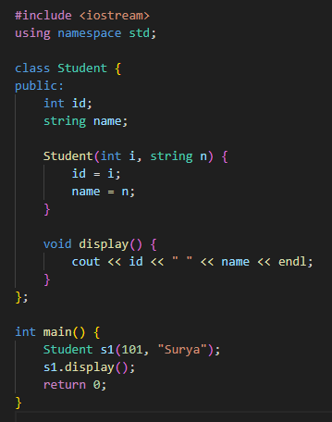

Code Snippet – Hands-on Practice

Slide 9
Challenges, Tasks
Challenges / Debugging Experience:
Forgot to use constructor initializer list; caused confusion in object initialization.
Tasks/Assignments Completed:
Implemented class with parameterized constructor.
Tested with multiple parameter values.
Additional Learning Resources / Notes:
https://cplusplus.com/doc/tutorial/classes/
Use const & references when needed to optimize performance.

Slide 10
Key Learnings
Copy Constructor
A constructor that creates a new object by copying an existing object.
Purpose: To duplicate the contents of one object into another safely.
Key Points:
Takes a reference to the same class object.
Essential for passing or returning objects by value.
Can be user-defined or compiler-generated.
Real-Life Analogy: It's like duplicating a saved game on your console. You make a copy of the existing file to continue the same progress under a new name.

Slide 11
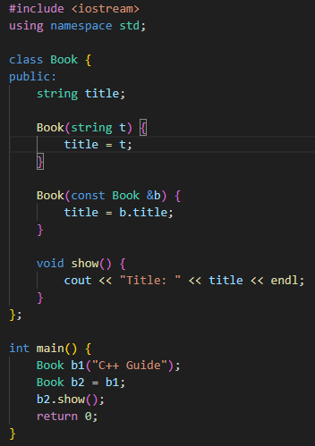

Code Snippet – Hands-on Practice

Slide 12
Challenges, Tasks
Challenges / Debugging Experience:
Didn't use const reference in copy constructor; led to recursion.
Tasks/Assignments Completed:
Implemented copy constructor manually.
Compared shallow vs deep copy.
Additional Learning Resources / Notes:
https://www.geeksforgeeks.org/

Slide 13
Key Learnings
Destructor:
A destructor is a special function that gets automatically called when an object is no longer in use.
Purpose: To release resources and perform cleanup before the object is destroyed.
Key Points:
Same name as the class,but preceded with a tilde (~).
No return type or parameters.
Executes when the object goes out of scope or is deleted.
Real-Life Analogy: Think of closing a restaurant kitchen at night—turning off stoves, cleaning up, and locking everything before leaving. That’s what a destructor does for an object.

Slide 14
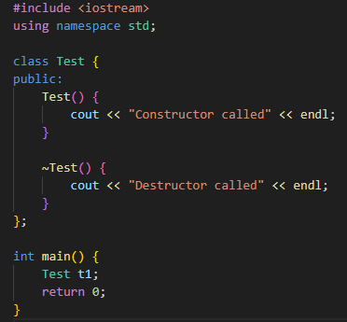

Code Snippet – Hands-on Practice

Slide 15
Challenges, Tasks
Challenges / Debugging Experience:
Destructor wasn't called in dynamically allocated objects without delete.
Tasks/Assignments Completed:
Demonstrated constructor and destructor lifecycle.
Additional Learning Resources / Notes:
https://en.cppreference.com/w/cpp/language/destructor

Slide 16
Key Learnings
Virtual Destructor:
A destructor that can be overridden in a derived class, ensuring proper cleanup in inheritance.
Purpose: To guarantee that destructors of derived classes are called when deleting through a base class pointer.
Key Points:
Declared with virtual keyword.
Crucial for polymorphism and dynamic memory management.
Prevents memory leaks.
Real-Life Analogy: Imagine firing an employee (base class) who has multiple roles (derived class). A virtual destructor ensures all roles are properly closed, not just the general job.

Slide 17
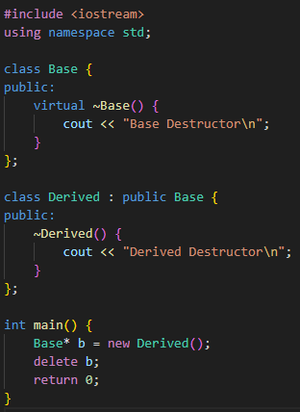

Code Snippet – Hands-on Practice

Slide 18
Challenges, Tasks
Challenges / Debugging Experience:
Destructor of derived class was not called without virtual.
Tasks/Assignments Completed:
Implemented base and derived classes with virtual destructors.
Additional Learning Resources / Notes:
https://www.geeksforgeeks.org/

Slide 19
Key Learnings
Auto Storage Class:
Automatically handles the variable's lifetime and visibility, usually inside functions.
Purpose: Defines local variables that exist during function execution and are destroyed afterward.
Key Points:
Default storage for local variables.
Keyword auto is optional in modern C++.
Limited to the block in which it’s declared.
Real-Life Analogy: It’s like a pop-up tent that appears for a camping night and folds away when done temporary and local to its use.

Slide 20
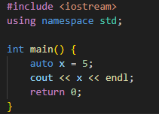

Code Snippet – Hands-on Practice

Slide 21
Challenges, Tasks
Challenges / Debugging Experience:
Misunderstood auto as old C-style storage class.
Tasks/Assignments Completed:
Practiced type inference with auto.
Additional Learning Resources / Notes:
In modern C++, auto is used for type inference, not storage class.

Slide 22
Key Learnings
Register Storage Class:
Used to hint the compiler to store a variable in a CPU register instead of RAM for quick access.
Purpose: Improve performance for frequently accessed variables.
Key Points:
Cannot take its address with &.
Only applicable to local variables.
Compiler may ignore the suggestion.
Real-Life Analogy: It’s like placing your phone in your pocket instead of a bag—you access it faster. But not all items fit in your pocket (registers have limited space).

Slide 23
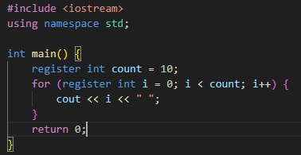

Code Snippet – Hands-on Practice

Slide 24
Challenges, Tasks
Challenges / Debugging Experience:
Tried to use &count, which gave a compilation error (address can't be taken).
Tasks/Assignments Completed:
Implemented register variables in loops.
Compared performance with regular variables.
Additional Learning Resources / Notes:
Register is a request to the compiler; it may ignore it.
Deprecated in modern C++, use auto and optimization instead.

Slide 25
Key Learnings
Static Storage Class:
Preserves the value of a variable between function calls.
Purpose: Retains data even after a function ends, useful for maintaining state.
Key Points:
Initialized only once.
Exists for the entire program duration.
Scope can be local or global.
Real-Life Analogy: It’s like saving your game progress—when you come back later, you pick up right where you left off.

Slide 26
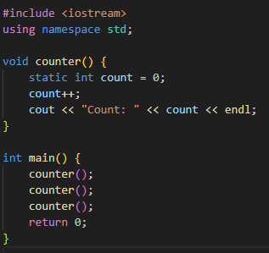
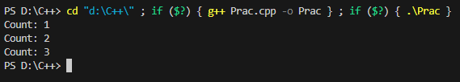
Code Snippet – Hands-on Practice

Slide 27
Challenges, Tasks
Challenges / Debugging Experience:
Initially confused static with global variables.
Understood lifetime vs scope clearly.
Tasks/Assignments Completed:
Created a static variable in a function and tested persistent state.
Additional Learning Resources / Notes:
https://www.geeksforgeeks.org/static-variables-in-c/
Static members in classes are shared across all objects.

Slide 28
Key Learnings
Extern Storage Class:
Declares a variable that’s defined in another file or scope.
Purpose: Allows shared access to a global variable across multiple source files.
Key Points:
Declares but doesn’t define.
Used in multi-file programs.
Needs correct linking.
Real-Life Analogy: It’s like referencing a shared document in a team drive. You don’t upload it again—you just point to where it already exists.

Slide 29
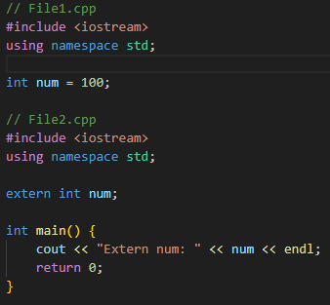
Code Snippet – Hands-on Practice

Slide 30
Challenges, Tasks
Challenges / Debugging Experience:
Missed linking object files; program didn’t compile.
Learned importance of compiling both .cpp files together.
Tasks/Assignments Completed:
Declared and accessed extern variables across files.
Additional Learning Resources / Notes:
Use extern for better modular code in large projects.
Avoid overuse; increases coupling.

Slide 31
Key Learnings
Mutable Storage Class:
Allows a specific class member to be changed even if the object is constant.
Purpose: To enable selective mutability for data members inside const objects.
Key Points:
Only applies to non-static class members.
Useful for caching, logging, or lazy updates.
Real-Life Analogy: Think of a sealed envelope (const object) that has a tiny tracking chip (mutable member) you can still update, like current location, without opening it.

Slide 32
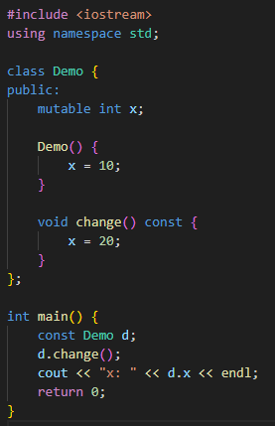

Code Snippet – Hands-on Practice

Slide 33
Challenges, Tasks
Challenges / Debugging Experience:
Tried modifying non-mutable members in const object and got errors.
Tasks/Assignments Completed:
Demonstrated mutable with const object.
Additional Learning Resources / Notes:
https://en.cppreference.com/w/cpp/
Only allowed with non-static class members.

Slide 34
Key Learnings
Thread_local Storage Class:
Specifies that each thread has its own separate instance of the variable.
Purpose: Ensures thread safety by isolating variables per thread.
Key Points:
Lifetime is the same as the thread.
Introduced in C++11.
Reduces data races in multi-threaded apps.
Real-Life Analogy: Imagine every employee (thread) gets their own desk calendar (variable). Changes to one don’t affect the others, keeping personal data separate.

Slide 35
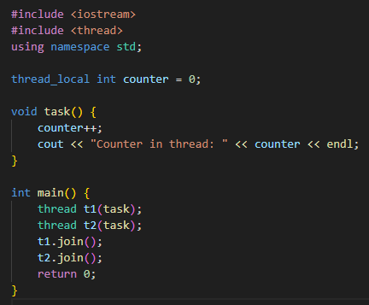

Code Snippet – Hands-on Practice

Slide 36
Challenges, Tasks
Challenges / Debugging Experience:
Forgot to use join() for threads, causing unexpected behavior.
Initially declared outside any thread context—variable behaved globally.
Tasks/Assignments Completed:
Implemented thread_local variable with multiple threads.
Additional Learning Resources / Notes:
https://en.cppreference.com/w/cpp/language/storage_duration
Introduced in C++11; ensures thread safety.

Slide 37
Overview
Storage Class | Scope | Lifetime | Linkage | Stored In
auto (default) | Local | Function duration | None | Stack
register | Local | Function duration | None | CPU Register (suggested)
static | Local/File | Entire program | Internal | Data Segment
extern | Global | Entire program | External | Data Segment
mutable | Class Member | Object lifetime | None | Heap or stack
thread_local | Thread Local | Thread lifetime | Internal | Thread stack/segment

Slide 38
Plan for Tomorrow
Templates
Smart Pointers

