Slide 1


T1934
Learning Document
A Quest Global Company
19/05/2025

Slide 2

Agenda
Topics Covered Today
Key Learnings / Concepts Understood:
Key Concepts with Definitions/ Code Snippet – Hands-on Practice
Challenges / Debugging Experience
Tasks/Assignments Completed
Additional Learning Resources / Notes
Q&A
Plan for Tomorrow

Slide 3
Topics Covered Today
Copy Constructor
Shallow Copy
Deep Copy
Move Constructor
R-Value & L-Value
Assignment Operator Overloading
Operator Overloading

Slide 4

Key Learnings
1. Copy Constructor
Purpose
Creates a new object as a copy of an existing object.
Used when passing objects by value or returning them from a function.
Ensures proper copying in cases where objects contain dynamically allocated memory.
Key Points
Default copy constructor performs a shallow copy.
A user-defined copy constructor is needed for deep copy.
Syntax: ClassName(const ClassName& other)
Real-life Analogy
Making an exact photocopy of a document—same content, different sheet of paper.

Slide 5
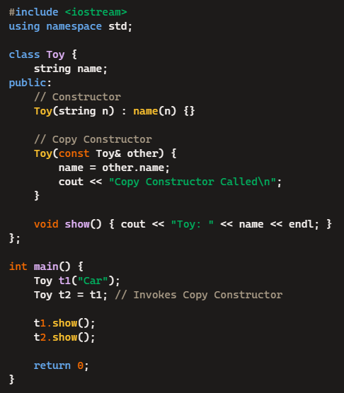

Code Snippet – Hands-on Practice
Copy Constructor

Slide 6
Challenges / Debugging Experience
Challenges / Debugging
Accidental shallow copy issues when copying objects with dynamic memory.
Unintended object mutations if copies share heap-allocated data.
Tasks Completed
Implemented copy constructors in deep vs shallow copies.
Fixed memory leaks caused by incorrect copying of dynamic memory.
Learning Resources
Effective Modern C++ – Covers copy constructor optimizations cppreference.com – Copy constructor documentation

Slide 7
Key Learnings
2. Shallow Copy:
Purpose
Copies memory addresses, rather than duplicating content.
Default behavior for objects containing pointers.
Key Points
Causes memory corruption when multiple objects delete the same pointer.
Used when no dynamic allocation exists or performance is critical.
Real-life Analogy
Imagine giving a friend your house key—now you both have access to the same house.

Slide 8
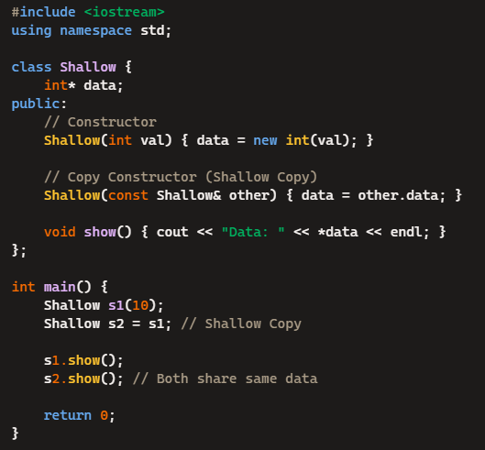
Code Snippet – Hands-on Practice
Shallow Copy

Slide 9
Challenges / Debugging Experience
Challenges / Debugging
Memory leaks if both objects delete the same memory.
Dangling pointer issues when one object modifies shared memory.
Tasks Completed
Debugged cases of accidental shared ownership in shallow copies.
Learning Resources
C++ Primer – Covers deep vs shallow copies in depth

Slide 10
Key Learnings
3. Deep Copy
Purpose
Creates a new copy of dynamically allocated memory.
Prevents data corruption and ownership conflicts.
Key Points
Requires manual allocation of new memory.
Used for objects with dynamically allocated data.
Real-life Analogy
Instead of sharing a house key, you build an identical house.

Slide 11
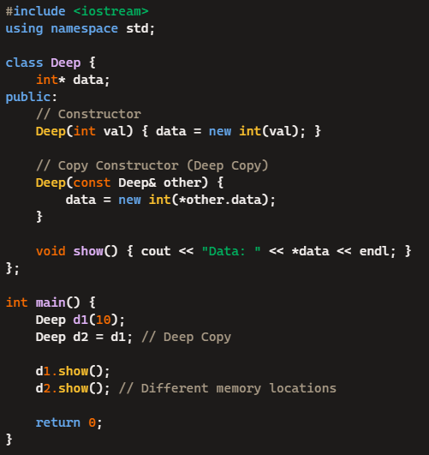
Code Snippet – Hands-on Practice
Deep Copy

Slide 12
Challenges / Debugging Experience
Challenges / Debugging
Performance overhead from duplicating memory.
Memory leaks from improper cleanup.
Tasks Completed
Optimized deep copy implementation with smart pointers.

Slide 13
Key Learnings
4. Move Constructor
Purpose
Transfers ownership without deep copying.
Used when an object is temporary or being passed by value.
Key Points
Uses r-value references (ClassName(ClassName&& other)).
Improves performance by avoiding unnecessary allocations.
Real-life Analogy
Instead of copying furniture, you move everything into a new house.

Slide 14
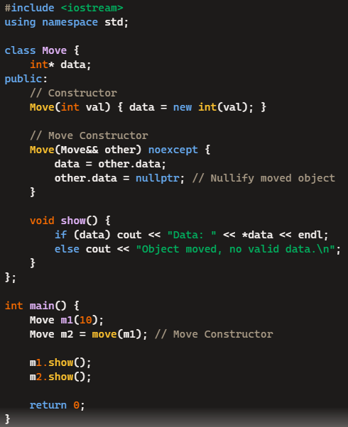
Code Snippet – Hands-on Practice
Move Constructor​

Slide 15
Challenges / Debugging Experience
Challenges / Debugging
Dangling pointer issues if nullptr isn't assigned properly.
Unexpected deep copies if move semantics are missing.
Tasks Completed
Debugged move semantics issues in high-performance applications.

Slide 16
Key Learnings
5. R-Value & L-Value
Purpose
L-Value: Identifiable memory locations, persist beyond a single expression.
R-Value: Temporary values, used for optimization.
Key Points
L-values exist in memory (int x = 10; where x is an L-value).
R-values are transient (int y = x + 5; where x + 5 is an R-value).
Real-life Analogy
Think of permanent storage (L-value) vs temporary notes (R-value).

Slide 17
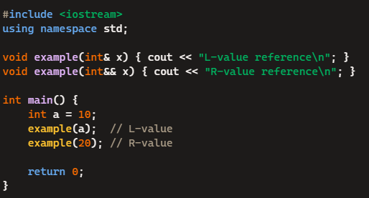
Code Snippet – Hands-on Practice
R-Value & L-Value​
​

Slide 18
Challenges / Debugging Experience
Challenges / Debugging
Errors with reference binding when mistakenly assigning an R-value to a non-const L-value reference.
Tasks Completed
Identified performance bottlenecks in incorrect L-value/R-value handling.

Slide 19
Key Learnings
6. Assignment Operator Overloading
Purpose
Controls how objects are assigned.
Prevents memory leaks in deep copies.
Key Points
Implements operator= to define custom assignment behavior.
Requires handling self-assignment properly.
Real-life Analogy
Imagine replacing old furniture with identical new furniture.

Slide 20
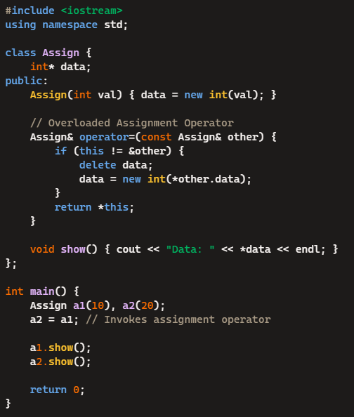
Code Snippet – Hands-on Practice
Assignment Operator Overloading​

Slide 21
Challenges / Debugging Experience
Challenges / Debugging
Self-assignment errors (if (this != &other) prevents deleting itself).
Tasks Completed
Fixed dangling pointer issues in assignment operator overloads.

Slide 22
Key Learnings
7. Operator Overloading
Purpose
Enables user-defined objects to support standard operations.
Makes custom types intuitive.
Key Points
Used for math, comparison, input/output operations.
Defined using operator+, operator==, etc.
Real-life Analogy
Think of custom rules for calculations—adding objects like numbers.

Slide 23
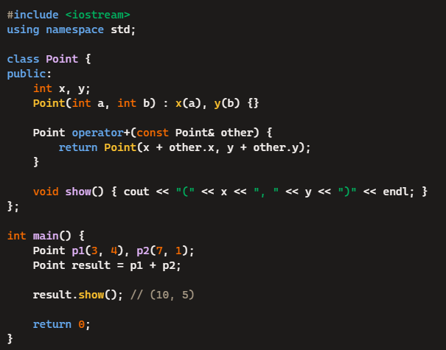
Code Snippet – Hands-on Practice
Operator Overloading

Slide 24
Challenges / Debugging Experience
Challenges / Debugging
Ambiguities with multiple overloaded operators.
Ensuring correct return types.
Tasks Completed
Implemented custom mathematical operations using overloaded operators.

Slide 25
Q&A
Q: What is a copy constructor in C++?
A: A copy constructor is a special constructor that creates a new object by copying an existing object.
Q: What is a shallow copy?
A: A shallow copy copies the object's members as-is, including pointers, so both objects point to the same memory.
Q: What is the drawback of shallow copy?
A: Changing or deleting data in one object affects the other because they share memory.
Q: What is a deep copy?
A: A deep copy creates a new object and duplicates the memory pointed to by pointers, so both objects are independent.

Slide 26
Q&A
Q: What is a move constructor?
A: A move constructor transfers ownership of resources from one object to another, avoiding unnecessary copying.
Q: When is a move constructor used?
A: When a temporary object is passed (e.g., return from a function).
Q: What is an L-value?
A: An L-value refers to a location in memory (e.g., variables).
Q: What is an R-value?
A: An R-value is a temporary value that doesn’t have a memory address (e.g., x + y).
Q: What is assignment operator overloading? A: It allows custom behavior when using = between objects of a class.

Slide 27
Plan for Tomorrow
Template functions and classes
Specializations
Template instantiations
Smart pointers

