Slide 1


T1934
Learning Document
A Quest Global Company
20/05/2025

Slide 2

Agenda
Topics Covered Today
Key Learnings / Concepts Understood:
Key Concepts with Definitions/ Code Snippet – Hands-on Practice
Challenges / Debugging Experience
Tasks/Assignments Completed
Additional Learning Resources / Notes
Q&A
Plan for Tomorrow

Slide 3
Topics Covered Today
Templates in C++​
Learn to define template functions and classes​
Specialization​
usage inside other templates(Nested Template)​
Smart Pointers​
Unique_ptr – Sole Owner​
Shared_ptr – Shared Ownership​
Weak_ptr – No Ownership (Observer)​
auto_ptr (Deprecated in C++11, Removed in C++17) ​
Memory management through smart pointers.​

Slide 4
Key Learnings
Template Functions and Classes
Purpose: To enable writing generic and reusable code that works with any data type without duplicating the logic.
Key Points:
Use template<typename T> or template<class T> to define functions/classes that work with different types.
Supports both function and class templates.
Promotes type independence and code reusability.
Specialization allows you to tailor behavior for specific data types when needed.
Real-Life Analogy: Think of a multi-size suitcase. You pack different kinds of items (clothes, electronics, shoes), but the suitcase adjusts itself based on what you’re storing. You don’t need a different suitcase for each category just one flexible one.
Types of Templates:
Function Template
Class Template

Slide 5
Key Learnings
1. Template Functions
Purpose:
Eliminate redundancy by allowing functions to work with any data type.
Improve flexibility in algorithms that operate on multiple types (like sorting or searching).
Maintain strong type safety while avoiding unnecessary code duplication.
Key Points:
Defined using the template<typename T> syntax.
The type T is a placeholder that gets replaced at compile time.
Useful for mathematical operations, sorting, and comparisons.
Real-life Analogy:
Think of a universal screwdriver instead of carrying different screwdrivers for each type of screw, you have one handle and interchangeable heads. The screwdriver adapts to the type of screw it’s being used on, much like how a template function adapts to different data types.

Slide 6
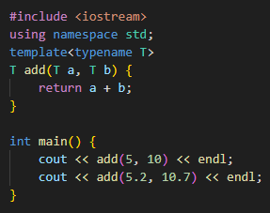
Code Snippet – Hands-on Practice
1. Function Template

Slide 7
Key Learnings
2. Template Classes
Purpose:
Allows writing data structures that work with multiple types.
Used to build generic containers like linked lists, stacks, and queues.
Avoids code repetition in classes that only differ by data type.
Key Points:
Defined using template<typename T> before class definition.
Helps design flexible, type-independent objects.
Commonly used in STL (Standard Template Library) (vector, map, queue, etc.).
Real-life Analogy:
Imagine a shipping container instead of having different containers for electronics, furniture, or books, you have one container that can hold any item. The container's structure remains the same, but its contents can change based on need, just like how template classes store different types of data.

Slide 8
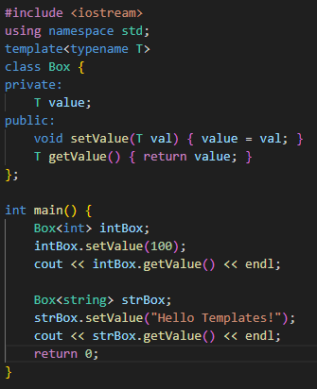
Code Snippet – Hands-on Practice
2. Class Template

Slide 9
Key Learnings
3.Template Specialization
Purpose: To customize the implementation of a template for a specific data type when the default template logic isn’t suitable.
Key Points:
Overrides generic template behavior for particular data types.
Comes in two forms: full and partial specialization.
Useful when specific types need optimized or alternate logic.
Real-Life Analogy: Imagine a restaurant that offers a standard menu (template) but creates a special dish for regular VIP customers (specialization). Everyone gets food, but VIPs get custom service.

Slide 10
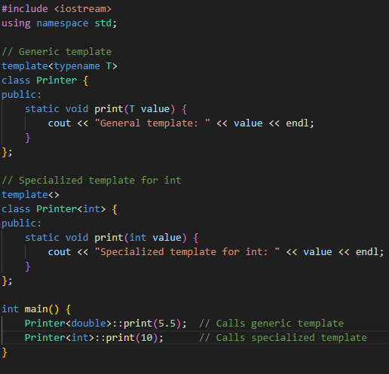
Code Snippet – Hands-on Practice
3.Template Specialization

Slide 11
Key Learnings
4.Template Inside a Template (Nested Templates)
Purpose:
Used when a template depends on another template.
Helps create modular and reusable designs.
Essential for complex data structures like linked lists, trees, or graphs.
Key Points:
One template contains another template.
Used in STL containers (e.g., std::vector<std::pair<T1, T2>>).
Enables multi-level customization.
Real-life Analogy:
Imagine a box inside another box the outer box provides structure, while the inner box holds items in a specific format. Nested templates allow a higher level of organization, just like packaging systems.

Slide 12
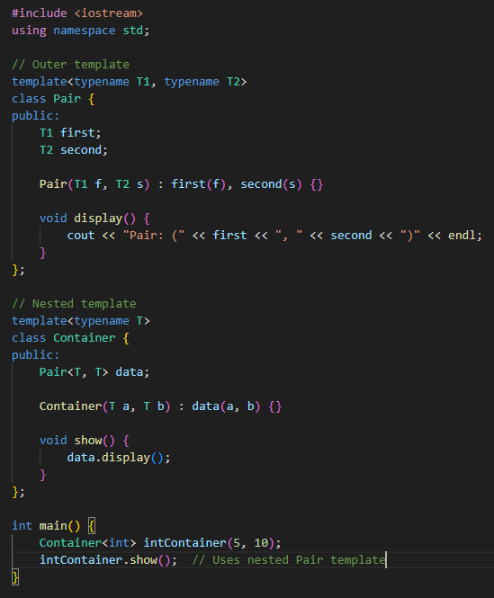
Code Snippet – Hands-on Practice
4.Template Inside a Template

Slide 13
Key Learnings
5.Template Instantiations
Purpose
Allows a template to be converted into a concrete type during compilation.
Helps reduce code duplication by enabling reuse across multiple types.
Can be either explicit or implicit instantiations.
Key Points
Implicit Instantiation: Compiler deduces the type automatically when calling the template function/class.
Explicit Instantiation: Developer manually specifies the type when defining the template.
Precompiled Templates: Useful for optimizing performance in large applications.
Real-life Analogy
Imagine a mold for making chocolates—the same mold is used to create chocolates of different flavors. During instantiation, the mold is filled with a specific ingredient (data type), and it produces the final product accordingly.

Slide 14
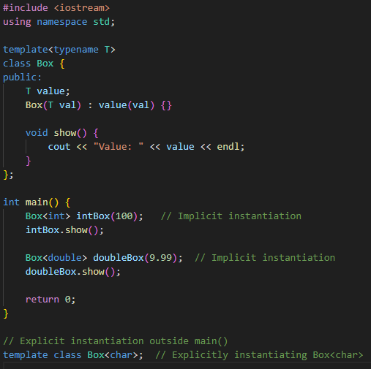
Code Snippet – Hands-on Practice
5.Template Instantiations

Slide 15
Key Learnings
6.Template Operators (Overloading Operators in Templates)
Purpose
Allows generic classes to support custom operator behavior.
Enables operators like +, -, ==, or << to work with templated types.
Makes user-defined data structures behave more naturally.
Key Points
Uses operator keyword inside the template class.
Operator functions must match the template type.
Common in mathematical structures, custom containers, and complex numbers.
Real-life Analogy
Think of mixing two paint colors—each paint container holds a different color (like Point<int> holding coordinates), and when mixed (operator+), they combine into a new shade.

Slide 16
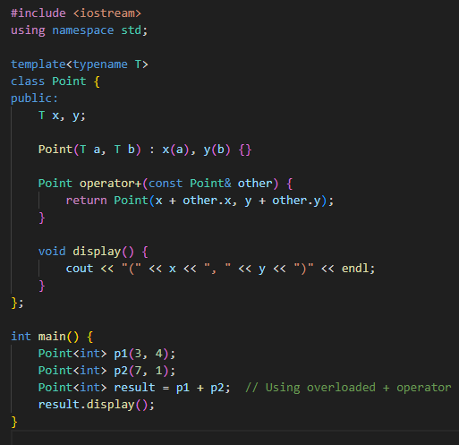
Code Snippet – Hands-on Practice
6.Template Operators (Overloading Operators in Templates)

Slide 17
Challenges / Debugging Experience
Challenges / Debugging Experience:
Errors caused by incorrect template syntax or missing template parameters.
Difficulty understanding compiler error messages related to templates.
Managing specialization and partial specialization properly to avoid ambiguous calls.
Tasks / Assignments Completed:
Created function templates to perform operations (e.g., max of two values) for any type.
Defined class templates representing containers for generic data types.
Implemented template specialization for a particular type to change behavior.
Used templates inside templates to build a simple generic matrix class.
Mistakes in operator overloading syntax leading to unexpected behavior.
Template instantiation errors due to missing or incompatible operators for certain types.
Confusing compiler error messages when operators are incorrectly used in templates.
Additional Learning Resources / Notes:
CppReference - Templates
LearnCpp - Template Introduction
Explore specialization and nested templates tutorials.
CppReference - Operator Overloading
LearnCpp - Templates and Operator Overloading
Practice exercises on template instantiation and operators.

Slide 18
Key Learnings
Smart pointers:
Smart pointers in C++ are a powerful feature of modern memory management that help automatically handle dynamic memory allocation and deallocation. They are part of the Standard Library (<memory> header) and serve as wrappers around raw pointers, ensuring proper cleanup when objects go out of scope.
Why do we need Smart Pointers?
Without smart pointers, developers need to manually allocate and free memory using new and delete. If not handled correctly, this can lead to:
Memory leaks (forgetting to free memory)
Dangling pointers (using memory that has already been freed)
Double deletions (freeing memory twice, causing undefined behavior)
Exception safety issues (memory leaks if exceptions occur before delete is called)
Smart pointers solve these problems by automatically managing memory and ensuring proper cleanup when they go out of scope.
Types of Smart Pointers:
unique_ptr
shared_ptr
weak_ptr

Slide 19
Key Learnings
1.Unique_ptr:
std::unique_ptr (Exclusive Ownership)
Purpose
Provides exclusive ownership over an object.
Ensures the allocated memory is automatically released when the pointer goes out of scope.
Prevents multiple ownership, making it efficient and lightweight.
Key Points
Cannot be copied, only moved (std::move).
The object is destroyed when unique_ptr goes out of scope.
Best for resource management where ownership isn’t shared.
Real-life Analogy
Think of owning a single house—only one owner can possess it at a time. If ownership changes (std::move), the previous owner no longer has access.

Slide 20
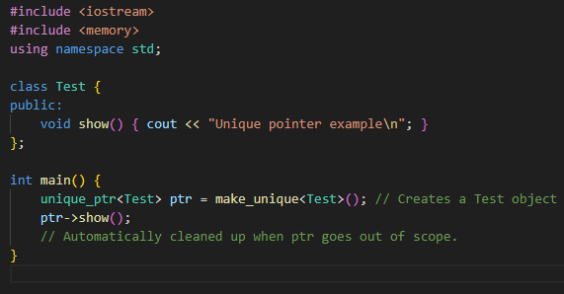
Code Snippet – Hands-on Practice
1.unique_ptr

Slide 21
Key Learnings
2.Shared_ptr:
std::shared_ptr (Shared Ownership)
Purpose:
Allows multiple smart pointers to share ownership of an object.
The object is destroyed only when the last reference is removed.
Provides reference counting, ensuring memory is freed safely.
Key Points
Uses reference counting to track ownership.
Ideal for shared resources (e.g., data structures used in multiple places).
Can be copied freely, unlike unique_ptr.
Real-life Analogy
Imagine sharing a car in a carpool everyone gets to use it. The car isn’t scrapped until the last person stops using it, much like how the object exists until all references are gone.

Slide 22
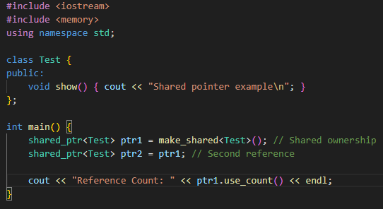
Code Snippet – Hands-on Practice
2.shared_ptr

Slide 23
Key Learnings
3.weak_ptr:
std::weak_ptr (Non-Owning Reference)
Purpose
Avoids cyclic dependencies when using shared_ptr.
Does not increase reference count, preventing memory leaks.
Helps check if an object is still valid before accessing it.
Key Points
Used alongside shared_ptr but does not keep the object alive.
Useful in observer patterns and caching systems.
Can be converted to shared_ptr when needed.
Real-life Analogy
Think of a guest pass to a club—you can visit, but you don’t own membership. If the club shuts down (object is deleted), your pass is useless.

Slide 24
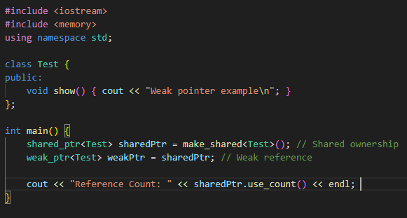
Code Snippet – Hands-on Practice
3.weak_ptr

Slide 25
Key Learnings
unique_ptr vs shared_ptr vs weak_ptr:
Feature | unique_ptr | shared_ptr | weak_ptr
Ownership | Exclusive (single owner) | Shared (multiple owners) | Non-owning reference to shared_ptr
Reference Count | No | Yes (increases/decreases automatically) | Yes, but doesn't affect the count
Copyable | ❌ No (only movable) | ✅ Yes | ✅ Yes
Memory Deallocation | When the sole owner is destroyed | When the last shared owner is destroyed | Does not delete object
Use Case | Simple, fast ownership | Multiple shared access | Observing shared resources without ownership
Needs std::make_* | std::make_unique<T>() | std::make_shared<T>() | Used with shared_ptr

Slide 26
Key Learnings
4.Converting unique_ptr to shared_ptr
Purpose
Transfers ownership from a single owner (unique_ptr) to multiple owners (shared_ptr).
Ensures the object remains alive until the last reference is destroyed.
Useful when an initially exclusive resource later needs shared ownership.
Key Points
std::move() is required to transfer ownership from unique_ptr to shared_ptr.
After moving, the unique_ptr becomes null.
The object is destroyed only when the last shared_ptr is out of scope.
Real-life Analogy
Think of a personal vehicle (unique_ptr). Initially, one person owns it, but later, it’s converted into a shared ride service (shared_ptr). Multiple people share ownership, and the car remains operational until the last user returns it.

Slide 27
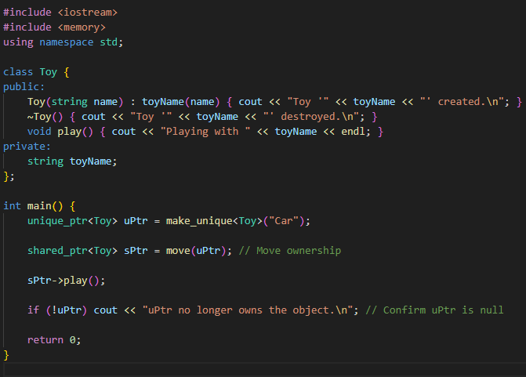
Code Snippet – Hands-on Practice
4.Converting unique_ptr to shared_ptr

Slide 28
Key Learnings
5.Converting shared_ptr to weak_ptr:
Purpose
Allows temporary references without increasing the reference count.
Prevents cyclic dependencies in scenarios like parent-child relationships.
Provides a safe way to check if an object still exists before accessing it.
Key Points
weak_ptr.lock() converts it into a valid shared_ptr, allowing access to the object.
If the original shared_ptr is reset or destroyed, weak_ptr.lock() returns nullptr.
Used in observer patterns, caching, and dependency management.
Real-life Analogy
Imagine borrowing a book from a library. The library owns the book (shared_ptr), but you have a library card that lets you check if the book is available (weak_ptr). If the book is removed from circulation (shared_ptr.reset()), your card is useless.

Slide 29
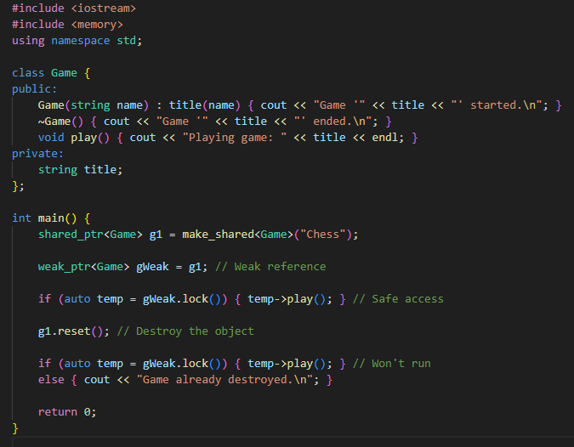
Code Snippet – Hands-on Practice
5.Converting shared_ptr to weak_ptr

Slide 30
Key Learnings
Difference:
Feature | unique_ptr → shared_ptr | shared_ptr → weak_ptr
Ownership | Transferred | Referenced but not owned
Reference Count | Starts tracking references | Does not increase count
Memory Cleanup | Last shared_ptr deletes object | Does not control cleanup
Use Case | When exclusive ownership needs sharing | Avoid cyclic dependencies

Slide 31
Challenges / Debugging Experience
Challenges / Debugging Experience
Dangling weak_ptr references: Accessing an expired weak_ptr may lead to unexpected behavior.
Unintended shared_ptr cycles: Two shared_ptr objects referencing each other can cause memory leaks (resolved using weak_ptr).
Incorrect unique_ptr ownership transfer: Forgetting to use std::move() can cause compilation errors.
Performance concerns in shared_ptr: Reference counting introduces slight overhead that may not be suitable for high-performance scenarios.
Multithreading issues: Sharing shared_ptr across threads requires synchronization to avoid race conditions.

Slide 32
Tasks / Assignments Completed
Unique to Shared Ownership
Converted unique_ptr to shared_ptr using std::move() to shift ownership.
Used reference counting (shared_ptr.use_count()) to track object lifetime.
Implemented smart pointers in resource management systems (e.g., managing dynamically allocated objects).
Shared to Weak for Dependency Handling
Prevented cyclic dependencies using weak_ptr in graphs, linked lists, and caching systems.
Used weak_ptr.lock() to safely access objects while ensuring they still exist.
Explored observer patterns, where weak_ptr allowed multiple objects to reference a shared resource without affecting memory cleanup.
Helpful Articles & Books
Effective Modern C++ by Scott Meyers – Great insights into smart pointer best practices.
cppreference.com – Technical details and examples.
Best Practices
Use unique_ptr when possible; prefer shared_ptr only when sharing is required.
Always use std::move() when transferring ownership of unique_ptr.
Use weak_ptr to avoid cyclic dependencies in shared_ptr-based designs.
Avoid raw new and delete, letting smart pointers handle memory cleanup.

Slide 33
Plan for Tomorrow
Important Language Features​
Using auto, range-based for loops, lambdas, constexpr, tuples, and strongly-typed enums.​

