Slide 1


T1934
Learning Document
A Quest Global Company
21/05/2025

Slide 2

Agenda
Topics Covered Today
Key Learnings / Concepts Understood:
Key Concepts with Definitions/ Code Snippet – Hands-on Practice
Challenges / Debugging Experience
Tasks/Assignments Completed
Additional Learning Resources / Notes
Q&A
Plan for Tomorrow

Slide 3
Topics Covered Today
auto keyword​
Range-based for loops​
Lambdas (Lambda Expressions)​
constexpr (Compile-time constants)​
Tuples​
Strongly-typed Enums (enum class)​

Slide 4
Key Learnings
auto keyword​
Range-based for loops​
Lambdas (Lambda Expressions)​
constexpr (Compile-time constants)​
Tuples​
Strongly-typed Enums (enum class)​

Slide 5
Key Learnings
1. auto Keyword
Purpose: The auto keyword enables type inference, allowing the compiler to deduce the type of a variable at compile time, improving code readability and reducing errors in complex type declarations.
Key Points:
Introduced in C++11 to simplify variable declarations.
The compiler infers the type based on the initializer expression.
Useful for complex types like iterators or template types.
Does not affect performance; type is resolved at compile time.
Real-Life Analogy:
Think of auto as a librarian who automatically picks the right book (type) for you based on the title (initializer) you provide, saving you from specifying the exact book details.

Slide 6

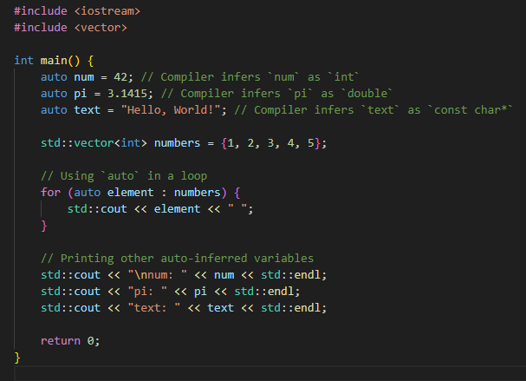
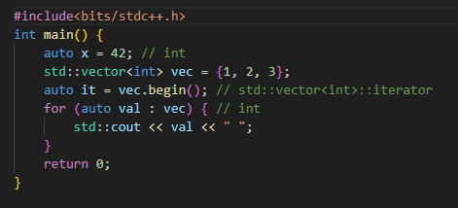
Code Snippet – Hands-on Practice
auto:

Slide 7
Challenges / Debugging Experience
Challenges/Debugging Experience:
Challenge: Overuse of auto can make code less readable if the type isn’t obvious from context (e.g., auto result = someFunction();).
Debugging: When auto deduces an unexpected type (e.g., const or reference), it can cause errors in assignments or modifications. Use decltype or IDE type hints to inspect deduced types.
Example Issue: Declaring auto x = vec[0] in an empty vector causes undefined behavior; always ensure valid initialization.
Tasks/Assignments Completed:
Wrote a program to iterate over a std::map using auto for key-value pairs.
Converted explicit type declarations in a loop to auto and verified identical behavior.
Debugged a type mismatch where auto deduced a const type, resolved by using auto&.
Additional Learning Resources/Notes:
cppreference.com: Detailed explanation of auto type deduction rules.
C++ Core Guidelines: Recommends using auto when the type is clear from the initializer.
Note: Avoid auto for fundamental types in simple cases (e.g., auto i = 0;) unless it improves clarity in a larger context.

Slide 8
Key Learnings
2. Range-based For Loops:
Purpose: Range-based for loops (C++11) simplify iteration over containers (e.g., arrays, vectors) by abstracting iterator management, making code more concise and readable.
Key Points:
Syntax: for (type var : container) { ... }.
Works with any type supporting begin() and end() (e.g., arrays, STL containers).
Use auto for type deduction, & for references to avoid copies. Real-Life Analogy: Imagine a conveyor belt (container) where you process each item (element) as it passes, without worrying about how the belt moves or where it starts/ends.
Challenges/Debugging Experience:
Real-Life Analogy:
Imagine a conveyor belt (container) where you process each item (element) as it passes, without worrying about how the belt moves or where it starts/ends.

Slide 9
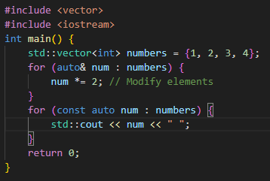
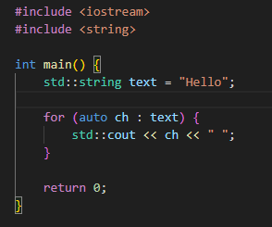
Code Snippet – Hands-on Practice
Range-based For Loop:

Slide 10
Challenges / Debugging Experience
Challenges/Debugging Experience:
Challenge: Forgetting to use & for non-const iteration leads to modifying copies instead of original elements.
Debugging: Encountered issues with iterating over temporary containers (e.g., for (auto x : getVector())), causing lifetime issues; resolved by storing the container in a variable.
Example Issue: Iterating over a std::map without auto& for pairs caused unexpected behavior due to copying.
Tasks/Assignments Completed:
Iterated over a std::vector to compute the sum of elements.
Modified a std::string vector in-place using range-based for with references.
Debugged a loop iterating over an empty container, adding checks for emptiness.
Additional Learning Resources/Notes:
LearnCpp.com: Clear tutorial on range-based for loops with examples.
Note: Use const auto& for read-only iteration to avoid unnecessary copies, especially for large objects.

Slide 11
Key Learnings
3. Lambdas (Lambda Expressions)
Purpose: Lambdas (C++11) allow defining anonymous functions inline, useful for short, localized function definitions, especially in STL algorithms or event handling.
Key Points:
Syntax: [capture](parameters) -> return_type { body }.
Capture modes: [] (no capture), [=] (by value), [&] (by reference), or specific variables.
Used heavily with STL algorithms like std::sort, std::for_each.
Real-Life Analogy:
A lambda is like a quick, disposable tool you craft on the spot for a specific task (e.g., a custom key for sorting), instead of building a full-fledged machine (named function).

Slide 12
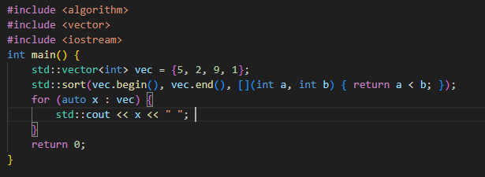
Code Snippet – Hands-on Practice
Lambdas:

Slide 13
Challenges / Debugging Experience
Challenges/Debugging Experience:
Challenge: Incorrect capture modes (e.g., capturing by value instead of reference) can lead to stale data or unintended modifications.
Debugging: Faced issues with lambda lifetime in async callbacks; resolved by ensuring captured variables outlive the lambda.
Example Issue: Capturing a local variable by reference in a lambda stored for later use caused dangling reference errors.
Tasks/Assignments Completed:
Used a lambda with std::for_each to print vector elements.
Sorted a vector of custom objects using a lambda comparator.
Debugged a lambda capturing a loop variable incorrectly, fixed by using value capture.
Additional Learning Resources/Notes:
C++ Reference (cppreference.com): Comprehensive lambda syntax and capture rules.
Note: Use mutable in lambdas to modify captured variables by value; avoid capturing unnecessary variables to reduce overhead.

Slide 14
Key Learnings
4. constexpr (Compile-time Constants)
Purpose: constexpr (C++11) ensures expressions or functions are evaluated at compile time, improving performance and enabling use in contexts requiring constant expressions (e.g., array sizes).
Key Points:
Variables declared constexpr must be initialized with a constant expression.
constexpr functions can be evaluated at compile time if inputs are constant.
Extended in C++14/C++17 for more complex computations.
Real-Life Analogy:
constexpr is like pre-cooking a meal (computing at compile time) so it’s ready instantly when you need it, instead of cooking it fresh every time (runtime computation).

Slide 15
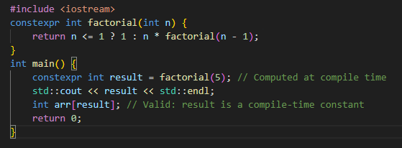
Code Snippet – Hands-on Practice
constexpr

Slide 16
Challenges / Debugging Experience
Challenges/Debugging Experience:
Challenge: constexpr functions must be simple in C++11 (single return statement); C++14 relaxed this, but errors still occur with non-constant inputs.
Debugging: Encountered errors when a constexpr function was called with runtime values; resolved by ensuring inputs are constant expressions.
Example Issue: Using a non-constexpr function inside a constexpr context caused compilation errors.
Tasks/Assignments Completed:
Wrote a constexpr function to compute the square of a number.
Used constexpr to define a compile-time array size based on a computed constant.
Debugged a constexpr function failing due to a non-constant parameter.
Additional Learning Resources/Notes:
Modern C++ Programming Cookbook: Explains constexpr use cases.
Note: Use consteval (C++20) for functions that must always be evaluated at compile time.

Slide 17
Key Learnings
5. Tuples:
Purpose: Tuples (C++11) provide a fixed-size collection of heterogeneous types, useful for returning multiple values from a function or storing mixed-type data compactly.
Key Points:
Defined in <tuple>; accessed via std::get<index>, std::tie, or structured bindings (C++17).
Operations: std::make_tuple, std::tuple_cat, std::get.
Fixed size, unlike std::vector.
Real-Life Analogy:
A tuple is like a lunchbox with fixed compartments, each holding a different type of food (data), neatly packed together.

Slide 18
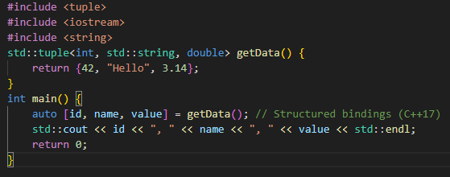
Code Snippet – Hands-on Practice
Tuples:

Slide 19
Challenges / Debugging Experience
Challenges/Debugging Experience:
Challenge: Accessing tuple elements by index (std::get) is error-prone if indices are incorrect.
Debugging: Faced issues with std::tie ignoring variables; resolved by using structured bindings for clarity.
Example Issue: Compile-time error from wrong index in std::get<3> on a 3-element tuple (valid indices: 0–2).
Tasks/Assignments Completed:
Created a function returning a tuple of different types (int, string, double).
Used structured bindings to unpack a tuple in a loop.
Debugged incorrect tuple access using std::get with out-of-bounds index.
Additional Learning Resources/Notes:
C++ Primer: Covers tuples and structured bindings.
Note: Structured bindings (C++17) make tuple unpacking more readable than std::tie or std::get.

Slide 20
Key Learnings
6. Strongly-typed Enums (enum class)
Purpose: Strongly-typed enums (enum class, C++11) provide type safety and scoped enumerators, preventing implicit conversions and name clashes.
Key Points:
Syntax: enum class Name { Value1, Value2 };.
No implicit conversion to int, unlike traditional enum.
Scoped: Access values as Name::Value1.
Can specify underlying type (e.g., enum class Color : uint8_t).
Real-Life Analogy:
An enum class is like a set of labeled lockers (scoped values) where only specific keys (enum values) can open them, preventing mix-ups with other lockers (traditional enum clashes).

Slide 21
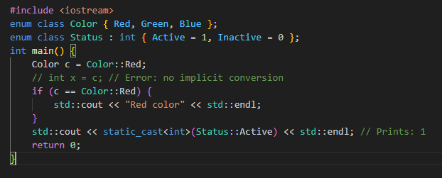
Code Snippet – Hands-on Practice
Enums

Slide 22
Challenges / Debugging Experience
Challenges/Debugging Experience:
Challenge: Forgetting to use scope (Color::Red vs. Red) causes compile errors.
Debugging: Faced issues with legacy code expecting int conversions; resolved by explicit casts (static_cast<int>).
Example Issue: Name conflicts in large projects with traditional enums; enum class resolved this by scoping.
Tasks/Assignments Completed:
Defined an enum class for states in a finite state machine.
Converted a traditional enum to enum class in a project to improve type safety.
Debugged a comparison error between two enum class types, fixed by ensuring same type.
Additional Learning Resources/Notes:
Effective Modern C++ (Scott Meyers): Discusses benefits of enum class.
Note: Use underlying types (e.g., : uint8_t) for memory efficiency in large systems.

Slide 23
Q&A
Q: When should I avoid using auto?
A: Avoid auto when the type needs to be explicit for readability (e.g., function return types in public APIs) or when type conversion might lead to errors (e.g., narrowing conversions).
Q: Does auto work with references?
A: Yes, use auto& or auto&& to deduce references explicitly; otherwise, auto strips reference qualifiers.
Q: Can range-based for loops modify elements? A: Yes, use auto& or auto&& to modify elements; otherwise, auto creates a copy. Q: What containers support range-based for loops? A: Any container with begin() and end() methods, including arrays, std::vector, std::map, etc.

Slide 24
Q&A
Q: When should I use a lambda instead of a regular function?
A: Use lambdas for short, localized functions, especially in STL algorithms or callbacks, to avoid cluttering code with named functions.
Q: Can lambdas capture variables from outer scopes?
A: Yes, via capture clauses ([], [=], [&], or specific variables like [x, &y]).
Q: What’s the difference between const and constexpr? A: const prevents modification but may be computed at runtime; constexpr ensures compile-time evaluation. Q: Can constexpr functions be used at runtime? A: Yes, if inputs aren’t constant, the function evaluates at runtime like a regular function.
Q: How do tuples differ from structs? A: Tuples are generic, fixed-size containers for heterogeneous types; structs are user-defined with named fields and more flexibility.

Slide 25
Q&A
Q: Can tuples be modified? A: Tuple elements are immutable in terms of structure, but their values can be modified if the types allow (e.g., std::get<0>(tup) = 5).
Q: Why use enum class over traditional enum?
A: enum class prevents implicit conversions and name clashes, improving type safety and code clarity.
Q: Can enum class values be used in switch statements?
A: Yes, but use fully qualified names (e.g., Color::Red) and ensure all cases are handled or use a default case.

Slide 26
Plan for Tomorrow
NameSpace Inline Macros Type casting
Hands-on coding to reinforce the usage of these features.

