Slide 1


T1934
Learning Document
A Quest Global Company
22/05/2025

Slide 2

Agenda
Topics Covered Today
Key Learnings / Concepts Understood:
Key Concepts with Definitions/ Code Snippet – Hands-on Practice
Challenges / Debugging Experience
Tasks/Assignments Completed
Additional Learning Resources / Notes
Q&A
Plan for Tomorrow

Slide 3
Topics Covered Today
NameSpace ​
Inline​
Macros​
Type casting ​

Slide 4
Key Learnings/Concepts Understood
Namespace Definition, Purpose and Example
Inline Functions Definition, Purpose and Example
Macros Definition, Purpose and Example
Type Casting Definition and types of type casting, Purpose and Example

Slide 5
Namespaces
1. Namespace
Definition:
A namespace is a feature in C++ that allows grouping of identifiers (variables, functions, classes, etc.) under a named scope to avoid naming conflicts and organize code logically.
Why We Use It:
Avoid Naming Conflicts: Prevents issues when multiple libraries or modules use the same identifier names.
Code Organization: Groups related code, improving readability and modularity.
Scalability: Facilitates large-scale projects by keeping code modular.
Application in Automotive:
In automotive software (e.g., AUTOSAR-based ECUs), namespaces are used to:
Organize code for different modules (e.g., engine control, braking system, infotainment).
Prevent naming conflicts when integrating third-party libraries or multiple teams’ code.
Ensure modularity in complex systems like Advanced Driver Assistance Systems (ADAS).

Slide 6

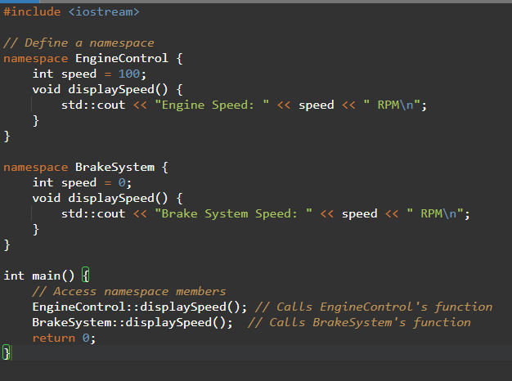


Namespaces

Slide 7
Challenges/Debugging Experience and Additional Learning Resources
Challenges / Debugging Experience
Challenge: Accidentally using a variable/function from the wrong namespace.
Debugging: Use explicit namespace qualifiers (e.g., EngineControl::speed) to avoid ambiguity.
Challenge: Overusing using namespace std; in large projects.
Debugging: Avoid using namespace std; in header files; prefer std:: for clarity.
Automotive Issue: Mismatched namespaces in multi-team projects can cause linker errors.
Solution: Standardize namespace conventions across teams.
Resources:
C++ Reference: cppreference.com
AUTOSAR C++ Coding Guidelines for namespace usage in automotive software.
Notes: In automotive, prefer descriptive namespaces (e.g., ADAS::LaneDetection) for clarity in safety-critical systems.

Slide 8
Inline Functions
2.Inline Functions
Definition
An inline function in C/C++ is a function whose body is expanded at the point of call during compilation, reducing function call overhead.
Why We Use It:
Performance Optimization: Eliminates function call overhead (stack push/pop).
Small Functions: Ideal for small, frequently called functions.
Code Readability: Inline code can be easier to follow in some cases.
Application in Automotive:
In automotive embedded systems:
Inline functions optimize performance-critical code (e.g., sensor data processing in real-time ECUs).
Used in time-sensitive operations like fuel injection timing or brake response.
Reduces latency in AUTOSAR-compliant systems where timing is critical.

Slide 9
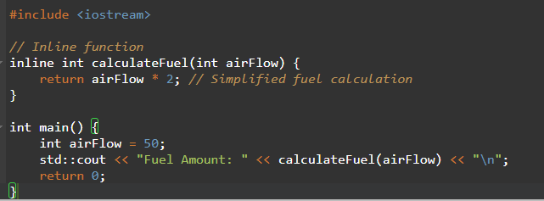

Inline Functions

Slide 10
Challenges/Debugging Experience and Additional Learning Resources
Challenges / Debugging Experience
Challenge: Code bloat from inlining large functions.
Debugging: Use inline only for small, performance-critical functions.
Challenge: Linker errors if inline function definition is missing in a header file.
Debugging: Ensure inline functions are defined in headers or single translation units.
Automotive Issue: Overuse of inline in resource-constrained ECUs can increase memory usage.
Solution: Profile code to balance performance and memory.
Resources:
cppreference.com
Embedded C++ tutorials on performance optimization.
Notes: In automotive, use inline sparingly in memory-constrained ECUs to avoid code size issues.

Slide 11
Macros
3.Macros
Definition
Macros in C/C++ are preprocessor directives defined using #define that perform text substitution before compilation.
Why We Use It:
Code Reusability: Simplifies repetitive code.
Conditional Compilation: Enables platform-specific code (e.g., different ECU configurations).
Constant Definitions: Defines compile-time constants.
Application in Automotive:
In automotive systems:
Macros define hardware-specific constants (e.g., CAN bus baud rates).
Used for conditional compilation in multi-platform ECUs (e.g., different vehicle models).
Optimize performance by avoiding function calls in time-critical code.

Slide 12
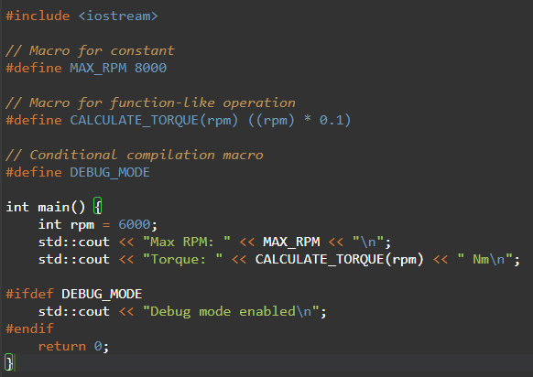

Macros

Slide 13
Challenges/Debugging Experience and Additional Learning Resources
Challenges / Debugging Experience
Challenge: Macros lack type safety, leading to errors (e.g., CALCULATE_TORQUE("invalid")).
Debugging: Use const variables or inline functions for type safety.
Challenge: Macro redefinition errors.
Debugging: Use #ifndef to prevent redefinition.
Automotive Issue: Macros in safety-critical systems can obscure bugs.
Solution: Follow MISRA C guidelines to restrict macro usage.
Resources:
MISRA C guidelines for macro usage in automotive.
cppreference.com
Notes: Avoid complex macros in automotive software to comply with safety standards like ISO 26262.

Slide 14
Type Casting
4.Type Casting
Definition
Type casting converts a variable from one data type to another, either implicitly (automatic) or explicitly (programmer-defined).
Why We Use It:
Data Compatibility: Ensures variables match expected types for operations or functions.
Interfacing Hardware: Converts data for hardware registers or sensor inputs.
Precision Control: Manages data precision in calculations.
Application in Automotive:
In automotive systems:
Type casting is used when reading sensor data (e.g., converting raw ADC values to floats for temperature).
Interfaces with hardware registers (e.g., casting integers to pointers for memory-mapped I/O).
Ensures compatibility in communication protocols like CAN or LIN.

Slide 15
Type Casting
Types of Casting:
Implicit: Automatic, safe conversions (e.g., int to double).
Explicit (C-style): (type)variable, less safe.
Explicit (C++ style): static_cast, dynamic_cast, const_cast, reinterpret_cast.
static_cast is preferred in C++ for type safety.
reinterpret_cast is common in embedded systems for hardware access.

Slide 16
Type Casting
Implicit type casting:
Definition
Implicit type casting, also known as automatic type conversion, occurs when the compiler automatically converts one data type to another without explicit programmer intervention, typically in safe conversions.
Why We Use It:
Convenience: Simplifies code by eliminating the need for explicit casts in safe scenarios.
Compatibility: Allows operations between compatible types (e.g., int to double).
Readability: Reduces clutter in code for straightforward conversions.
Application in Automotive:
In automotive software:
Used when processing sensor data, e.g., converting an integer ADC value to a floating-point temperature.
Common in arithmetic operations for ECU calculations (e.g., fuel injection timing).
Simplifies interfacing with libraries expecting wider types (e.g., float to double).

Slide 17
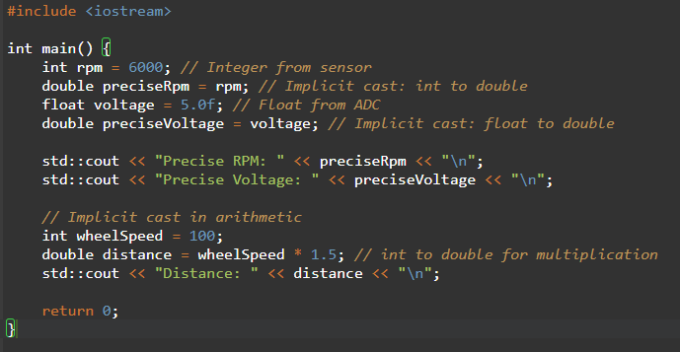

Type Casting

Slide 18
Challenges/Debugging Experience and Additional Learning Resources
Challenges / Debugging Experience
Challenge: Unintended implicit casts in mixed-type expressions can lead to precision issues.
Debugging: Explicitly cast types or use consistent types to avoid surprises.
Challenge: Implicit casts may hide bugs in safety-critical automotive code.
Debugging: Follow MISRA C++ rules to limit implicit conversions in critical systems.
Automotive Issue: Implicit casting of sensor data (e.g., int to float) can cause rounding errors.
Solution: Validate results with unit tests and use explicit casts when precision matters.
Resources:
cppreference.com: Implicit Conversions
MISRA C++ guidelines for safe type conversions in automotive.
Notes: In automotive, implicit casting is acceptable for safe widening conversions but should be avoided in safety-critical calculations without validation.

Slide 19
Type Casting
Explicit Type Casting
static_cast:
Definition
static_cast is a C++-style cast for safe, well-defined conversions between related types (e.g., numeric types or base-to-derived classes).
Why We Use It:
Type Safety: Ensures only valid conversions are performed.
Clarity: Makes code intent explicit.
Compliance: Preferred in MISRA C++ and AUTOSAR for safety-critical systems.
Application in Automotive:
Used to convert sensor data (e.g., int to float for calculations).
Common in ECU software for type-safe arithmetic or interfacing with APIs.
Ensures compliance with automotive safety standards like ISO 26262.

Slide 20
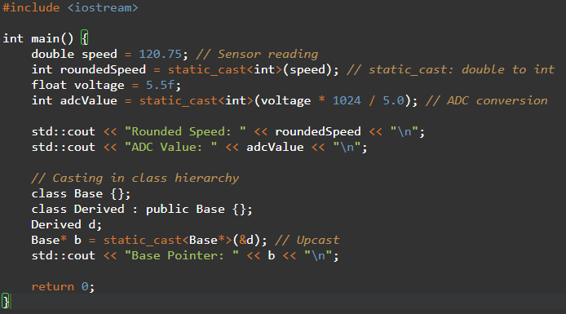

Type Casting

Slide 21
Challenges/Debugging Experience and Additional Learning Resources
Challenges / Debugging Experience
Challenge: Invalid static_cast (e.g., unrelated types) causes compile-time errors.
Debugging: Verify type compatibility before casting.
Challenge: Data loss in narrowing conversions.
Debugging: Check for truncation with assertions or tests.
Automotive Issue: Incorrect use in polymorphic hierarchies can cause undefined behavior.
Solution: Use dynamic_cast for polymorphic types if needed.
Resources:
cppreference.com: static_cast
MISRA C++ Rule 5-2-7 for safe casting.
Notes: Preferred cast in automotive for numeric and safe pointer conversions.

Slide 22
Type Casting
Explicit Type Casting
dynamic_cast:
Definition
dynamic_cast is a C++-style cast used for safe downcasting and cross-casting in polymorphic class hierarchies, relying on runtime type information (RTTI).
Why We Use It:
Safety: Ensures safe casting in inheritance hierarchies with runtime checks.
Polymorphism: Supports object-oriented designs with virtual functions.
Error Handling: Returns nullptr (for pointers) or throws an exception (for references) on invalid casts.
Application in Automotive:
Rarely used in automotive embedded systems due to RTTI overhead.
Applicable in infotainment systems or complex ADAS software with object-oriented designs (e.g., managing different sensor types).
Avoided in resource-constrained ECUs to minimize memory and performance overhead.

Slide 23
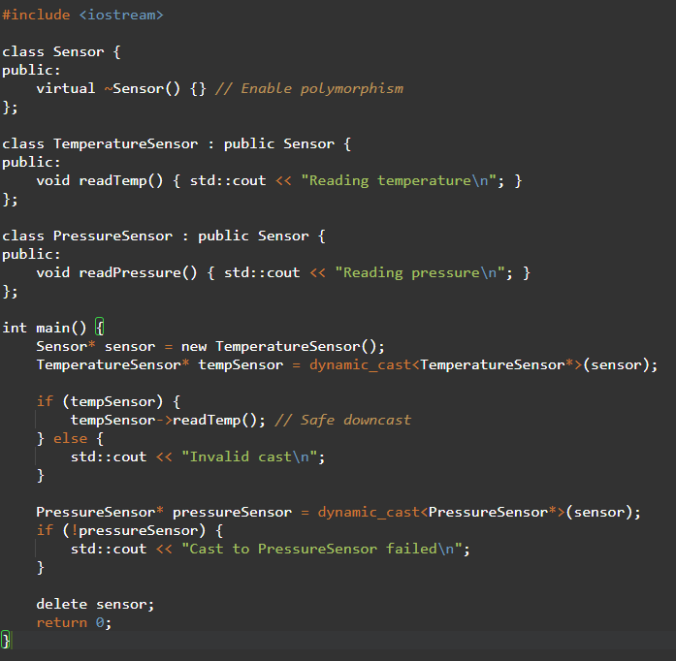

Type Casting

Slide 24
Challenges/Debugging Experience and Additional Learning Resources
Challenges / Debugging Experience
Challenge: dynamic_cast fails if RTTI is disabled (common in embedded systems).
Debugging: Ensure RTTI is enabled or use static_cast for non-polymorphic casts.
Challenge: Null pointer dereference if cast fails and not checked.
Debugging: Always check the result of dynamic_cast.
Automotive Issue: RTTI overhead is prohibitive in ECUs.
Solution: Avoid dynamic_cast in resource-constrained systems.
Resources:
cppreference.com: dynamic_cast
AUTOSAR guidelines discouraging RTTI in embedded systems.
Notes: Avoid in automotive ECUs; use only in non-critical systems like infotainment.

Slide 25
Type Casting
Explicit Type Casting
const_cast:
Definition
const_cast is a C++-style cast used to add or remove const or volatile qualifiers from a variable.
Why We Use It:
Modify Const Variables: Allows modification of const objects in specific cases (e.g., legacy APIs).
Interfacing Legacy Code: Useful when working with older C APIs that don’t respect const.
Flexibility: Enables temporary removal of const for specific operations.
Application in Automotive:
Used when interfacing with legacy automotive libraries or hardware drivers that don’t use const correctly.
Rare in modern automotive code due to safety standards discouraging const violations.
May be used in debugging or testing ECU firmware.

Slide 26
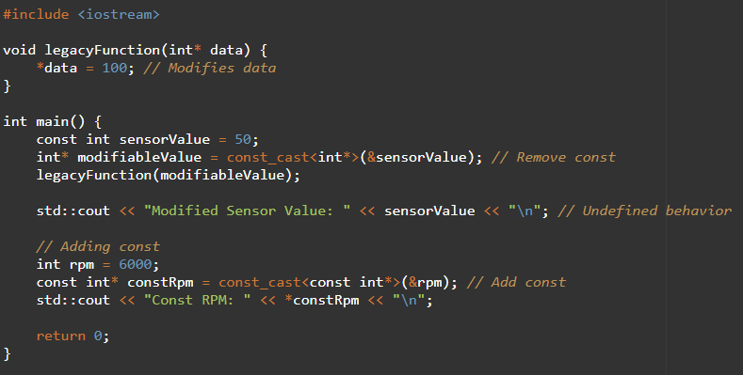

Type Casting

Slide 27
Challenges/Debugging Experience and Additional Learning Resources
Challenges / Debugging Experience
Challenge: Undefined behavior when modifying originally const objects.
Debugging: Avoid modifying const objects; ensure the object is mutable.
Challenge: Misuse in safety-critical systems can violate ISO 26262.
Debugging: Limit const_cast to non-critical code or legacy interfaces.
Automotive Issue: Overuse can break const-correctness in ECU software.
Solution: Refactor legacy code to respect const.
Resources:
cppreference.com: const_cast
MISRA C++ Rule 5-2-5 discouraging const_cast.
Notes: Use sparingly in automotive to maintain safety and reliability.

Slide 28
Type Casting
Explicit Type Casting
reinterpret_cast:
Definition
reinterpret_cast is a C++-style cast for low-level, potentially unsafe conversions, such as pointer-to-pointer or pointer-to-integer conversions.
Why We Use It:
Hardware Access: Converts pointers for memory-mapped I/O in embedded systems.
Low-Level Operations: Handles raw data reinterpretation (e.g., byte arrays to structs).
Flexibility: Allows type reinterpretation not possible with other casts.
Application in Automotive:
Critical for accessing hardware registers in ECUs (e.g., memory-mapped I/O).
Used in CAN bus message parsing to reinterpret raw bytes as ME=2E
Common in low-level drivers for automotive microcontrollers.

Slide 29
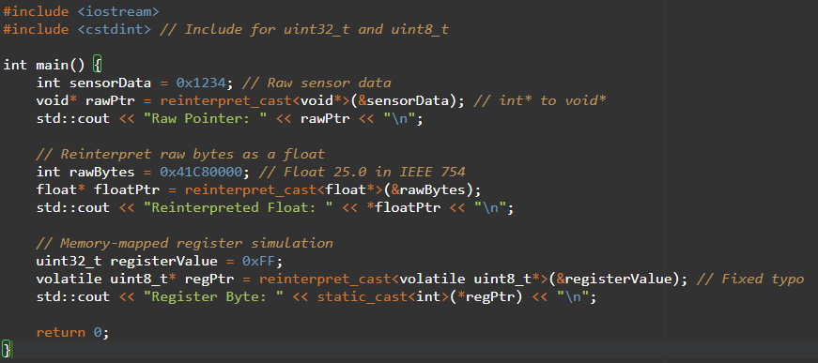

Type Casting

Slide 30
Challenges/Debugging Experience and Additional Learning Resources
Challenges / Debugging Experience
Challenge: Incorrect reinterpret_cast can cause undefined behavior (e.g., misaligned pointers).
Debugging: Ensure proper alignment and type compatibility.
Challenge: Hard-to-trace bugs due to raw memory access.
Debugging: Use debuggers and memory analysis tools.
Automotive Issue: Misuse in ECU firmware can corrupt hardware state.
Solution: Validate casts with extensive testing and MISRA compliance.
Resources:
cppreference.com: reinterpret_cast
AUTOSAR guidelines for safe pointer casting.
Notes: Essential for automotive hardware access but requires careful validation.

Slide 31
Q & A
Q: Can namespaces be nested?
A: Yes, e.g., namespace ADAS { namespace LaneDetection { ... } }.
Q: How do namespaces impact performance?
A: No runtime overhead; namespaces are a compile-time feature.
Q: Does inline guarantee inlining?
A: No, it’s a hint; the compiler decides based on optimization settings.
Q: Can inline functions be recursive?
A: Rarely; recursion often prevents inlining due to complexity.
Q: Are macros faster than functions?
A: Potentially, as they avoid function call overhead, but inline functions are safer.

Slide 32
Q & A
Q: Why avoid macros in modern C++?
A: They lack type safety and debugging support; use const, inline, or templates instead.
Q: When to use dynamic_cast?
A: For polymorphic types in object-oriented code; rarely used in embedded automotive systems.
Q: Is type casting safe?
A: Depends on the cast; static_cast is safer, while reinterpret_cast requires caution.

Slide 33
Plan for Tomorrow
Understanding how to use std::transform, and utility functions like plus(), minus(), and ptr_fun for manipulating data.
Practice hands-on with complex and simple data.
Manipulate I/O streams using cout/cin, format flags, and operators like boolalpha, setprecision, setw, etc.
Practice formatting complex output for data containers.

