Slide 1


T1934
Learning Document
A Quest Global Company
23/05/2025

Slide 2

Agenda
Topics Covered Today
Key Learnings / Concepts Understood:
Key Concepts with Definitions/ Code Snippet – Hands-on Practice
Challenges / Debugging Experience
Tasks/Assignments Completed
Additional Learning Resources / Notes
Q&A
Plan for Tomorrow

Slide 3
Topics Covered Today
Functional Objects
Utilities
Advanced I/O

Slide 4
Key Learnings/Concepts Understood
Functional Objects Definition, Purpose and Example
Utilities Definition, Purpose and Example
Advanced I/O Definition, Purpose and Example

Slide 5
Functional Objects
1. Functional Objects
Definition:
Functional objects (functors) are objects that can be used as functions by overloading the operator(). They are often used with algorithms like std::transform to apply operations to data containers. They are defined in the header.
Why We Use It:
Flexibility: Functors can maintain state, unlike regular functions, allowing customizable operations.
Reusability: Encapsulate complex logic in a reusable object.
STL Compatibility: Work seamlessly with Standard Template Library (STL) algorithms like std::transform.
Application in Automotive:
In automotive software:
Functors are used to process sensor data (e.g., scaling ADC values for temperature or speed).
Enable modular transformations in ECU data processing pipelines (e.g., filtering CAN bus messages).
Support AUTOSAR-compliant software by providing reusable, stateful operations for real-time systems.

Slide 6

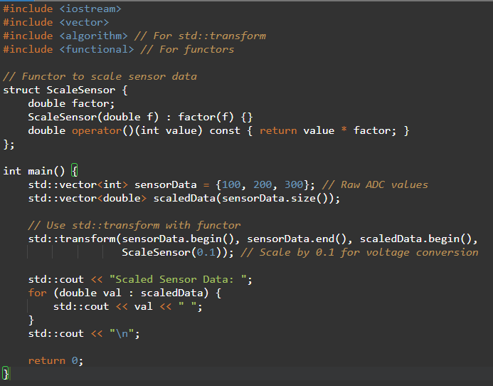


Functional Objects

Slide 7
Challenges/Debugging Experience and Additional Learning Resources
Challenges / Debugging Experience
Challenge: Incorrect iterator ranges in std::transform cause out-of-bounds errors.
Debugging: Ensure input and output ranges match in size and validity.
Challenge: Functor state not initialized correctly.
Debugging: Use constructor initialization lists and validate functor parameters.
Automotive Issue: Functors in real-time ECUs must be lightweight to avoid performance overhead.
Solution: Optimize functor logic and avoid dynamic memory allocation.
Resources:
cppreference.com: std::transform
cppreference.com: Functional
AUTOSAR C++ guidelines for STL usage in automotive.
Notes: In automotive, functors are preferred for stateful operations but must be optimized for resource-constrained systems.

Slide 8
Utilities
2. Utilities
Definition:
Utilities in the header, like std::plus, std::minus, and std::ptr_fun, provide predefined function objects for common operations. std::plus and std::minus perform addition and subtraction, while std::ptr_fun (deprecated in C++11) adapts regular functions for use with STL algorithms.
Why We Use It:
Convenience: Functors can maintain state, unlike regular functions, allowing customizable operations.
STL Integration: Encapsulate complex logic in a reusable object.
Legacy Support: Work seamlessly with Standard Template Library (STL) algorithms like std::transform.
Application in Automotive:
In automotive software:
Functors are used to process sensor data (e.g., scaling ADC values for temperature or speed).
Enable modular transformations in ECU data processing pipelines (e.g., filtering CAN bus messages).
Support AUTOSAR-compliant software by providing reusable, stateful operations for real-time systems.

Slide 9
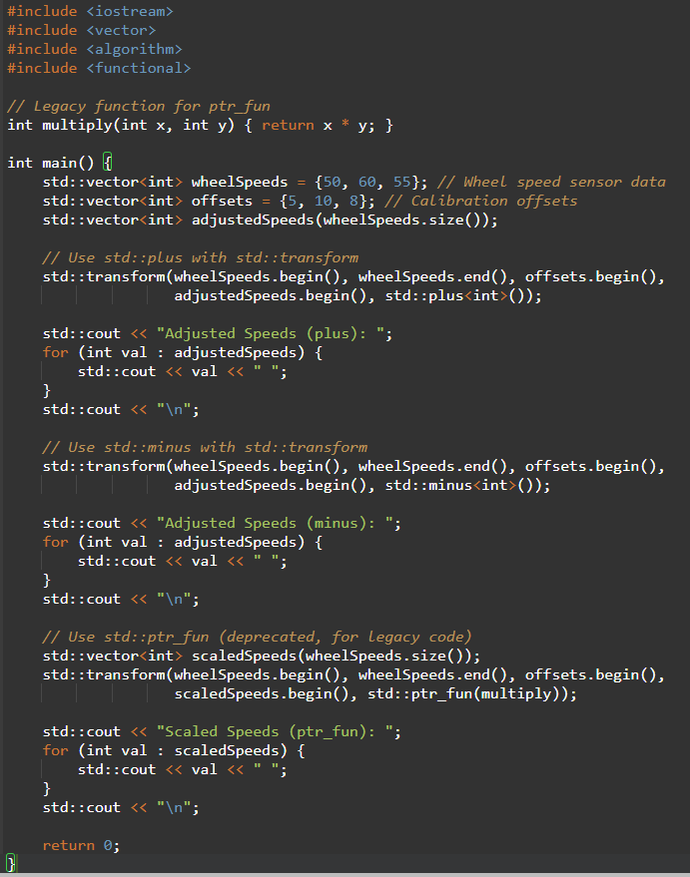

Utilities

Slide 10
Challenges/Debugging Experience and Additional Learning Resources
Challenges / Debugging Experience
Challenge: Type mismatches in std::plus or std::minus cause compile-time errors.
Debugging: Ensure template type T matches input data types.
Challenge: std::ptr_fun in modern C++ causes deprecation warnings.
Debugging: Replace with lambdas or std::function for modern code.
Automotive Issue: Overhead of utility functions in real-time systems.
Solution: Profile performance and use inline functions or functors for critical tasks.
Resources:
cppreference.com: std::plus
cppreference.com: std::ptr_fun
MISRA C++ guidelines for STL utilities.
Notes: Prefer lambdas over std::ptr_fun in modern automotive code for maintainability.

Slide 11
Advanced I/O
Advanced I/O
Definition:
Advanced I/O in C++ involves manipulating input/output streams (std::cout, std::cin) using format flags (std::ios::fmtflags), manipulators like std::boolalpha, std::setprecision, std::setw, and other formatting tools to control output appearance.
Why We Use It:
Formatted Output: Displays data in a human-readable or machine-readable format.
Precision Control: Manages numerical precision for sensor data or logs.
Readability: Aligns data for debugging or dashboard displays in automotive systems.
Application in Automotive:
In automotive software:
Formats sensor data for diagnostic logs (e.g., CAN bus messages, ECU status).
Displays data on vehicle dashboards or infotainment systems with aligned, precise output.
Used in testing tools to format complex data containers (e.g., vectors of sensor readings).

Slide 12
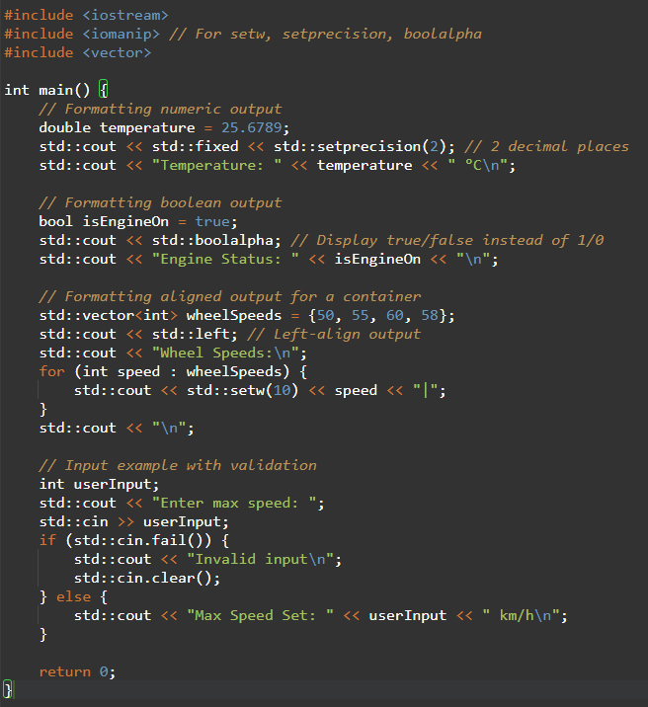
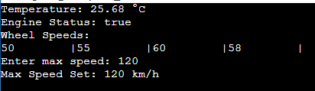
Advanced I/O

Slide 13
Challenges/Debugging Experience and Additional Learning Resources
Challenges / Debugging Experience
Challenge: Incorrect format flags persist across outputs, causing unexpected formatting.
Debugging: Use std::cout.unsetf or reset flags explicitly (e.g., std::cout << std::resetiosflags(std::ios::fixed)).
Challenge: Input errors (e.g., non-numeric input to std::cin) cause stream failure.
Debugging: Check std::cin.fail() and clear errors with std::cin.clear().
Automotive Issue: Formatting overhead in resource-constrained ECUs.
Solution: Minimize formatting in production code; use for debugging or logging.
Resources:
cppreference.com: std::iomanip
cppreference.com: std::ios
AUTOSAR guidelines for logging and diagnostics.
Notes: In automotive, use advanced I/O for debugging and dashboard displays, but avoid in performance-critical loops.

Slide 14
Plan for Tomorrow
I plan to practice this week's concepts, including Constructors, Storage Classes, Templates, Smart Pointers, Key C++ Features like Namespaces, Inline functions, Macros, Type Casting, Functors, Utilities, and Advanced I/O with different scenarios.

