Slide 1


T1934
Learning Document
A Quest Global Company
26/05/2025

Slide 2
Agenda
Topics Covered Today
Key Learnings / Concepts Understood:
Key Concepts with Definitions/ Code Snippet – Hands-on Practice
Challenges / Debugging Experience
Tasks/Assignments Completed
Additional Learning Resources / Notes
Q&A
Plan for Tomorrow

Slide 3
List of Topics to be covered
Error
Types of errors:
Syntax error
Runtime error
Logical error
Linker error
Exception
What is exception handling?
Exception handling techniques

Slide 4
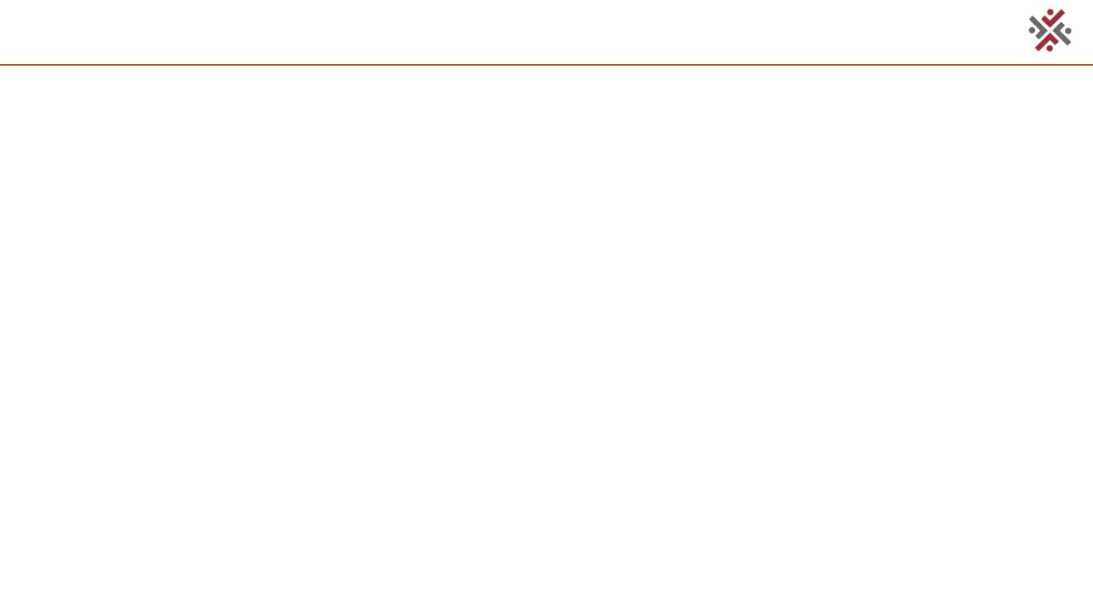
Key Learnings/Concepts Understood
Error Definition, Purpose and Example
Types of errors Definition, Purpose and Example
Exception Definition, Purpose and Example

Slide 5
Error
1. Error
Definition:
An error in programming is a mistake or fault in the code that prevents it from functioning as intended. Errors can occur at different stages: during compilation (syntax, linker), execution (runtime, exceptions), or due to incorrect logic (logical errors).
Why We Use It:
Reliability: Ensures software operates correctly, especially in safety-critical systems.
Safety: Prevents failures that could lead to unsafe vehicle behavior in automotive applications.
Debugging: Identifying and fixing errors improves code quality and maintainability.
Application in Automotive:
In automotive software:
Errors in ECU firmware, sensor processing, or ADAS can lead to critical failures (e.g., incorrect braking or engine control).
Handling errors ensures compliance with ISO 26262 for functional safety and MISRA C++ for code quality.
Robust error handling supports fault-tolerant systems, critical for real-time automotive applications.

Slide 6

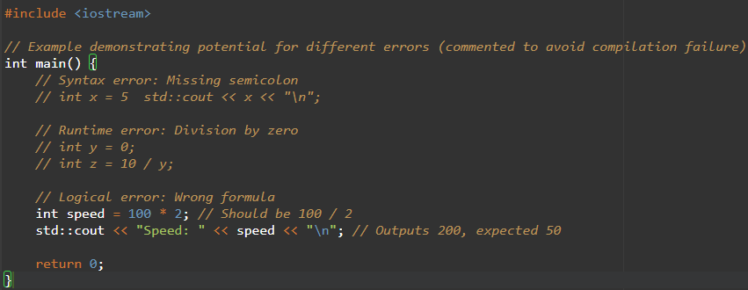

Error

Slide 7
Challenges/Debugging Experience and Additional Learning Resources
Challenges / Debugging Experience
Challenge: Identifying the root cause of errors in large codebases.
Debugging: Use compiler messages, debuggers (e.g., GDB), and logging.
Challenge: Errors may cascade, complicating diagnosis.
Debugging: Address errors sequentially, starting with the first reported issue.
Automotive Issue: Errors in safety-critical systems can lead to unsafe vehicle states.
Solution: Implement rigorous testing and static analysis to catch errors early.
Resources:
cppreference.com: C++ Errors
MISRA C++ Guidelines (e.g., Rule 0-1-1 for code correctness).
ISO 26262 for automotive functional safety.
Notes: Error handling in automotive requires strict adherence to safety standards to ensure reliable ECU and ADAS performance.

Slide 8
Types of Errors
2.1 Syntax Error
Definition:
Syntax errors occur when code violates C++ grammar rules (e.g., missing semicolons, unmatched braces), detected at compile time.
Why We Use It:
Prevents compilation, ensuring code correctness before execution.
Critical for automotive firmware to meet MISRA C++ and AUTOSAR standards.
Application in Automotive:
Syntax errors must be resolved to compile ECU firmware, ensuring no faulty code is deployed.
Caught by static analysis tools in automotive development pipelines.

Slide 9
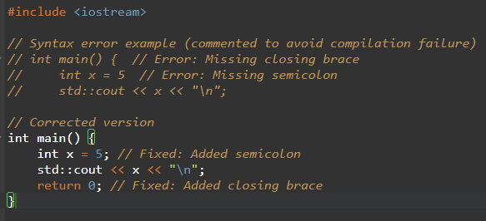
Types of Errors

Slide 10
Challenges/Debugging Experience and Additional Learning Resources
Challenges / Debugging Experience
Challenge: Cryptic compiler messages.
Debugging: Use IDEs with syntax highlighting and read error messages carefully.
Automotive Issue: Delays firmware development if not caught early.
Solution: Use linters (e.g., clang-tidy) and CI/CD pipelines.

Slide 11
Types of Errors
2.2 Runtime Error
Definition:
Runtime errors occur during program execution due to invalid operations (e.g., division by zero, out-of-bounds access).
Why We Use It:
Prevents crashes or undefined behavior in running programs.
Ensures fault tolerance in automotive systems, critical for safety.
Application in Automotive:
Handles errors like invalid sensor data or CAN bus timeouts in ECUs.
Ensures safe states (e.g., limp mode) in safety-critical systems.

Slide 12
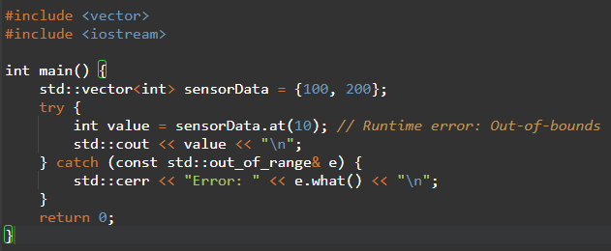
Types of Errors

Slide 13
Challenges/Debugging Experience and Additional Learning Resources
Challenges / Debugging Experience
Challenge: Unhandled runtime errors cause crashes.
Debugging: Use try-catch or error codes with logging.
Automotive Issue: Can lead to unsafe vehicle states.
Solution: Can lead to unsafe vehicle states.

Slide 14
Types of Errors
2.3 Logical Error
Definition:
Logical errors occur when a program runs correctly but produces incorrect results due to flawed logic or algorithms.
Why We Use It:
Ensures correct program behavior, especially in safety-critical systems.
Prevents subtle bugs that could go unnoticed without testing.
Application in Automotive:
Logical errors (e.g., wrong fuel injection timing) can cause unsafe vehicle behavior.
Detected through rigorous testing to meet ISO 26262 standards.

Slide 15
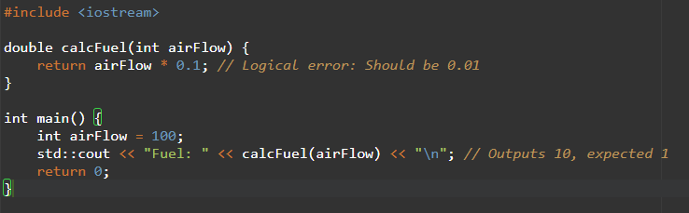
Types of Errors

Slide 16
Challenges/Debugging Experience and Additional Learning Resources
Challenges / Debugging Experience
Challenge: Hard to detect without thorough testing.
Debugging: Use unit tests, assertions, and code reviews.
Automotive Issue: Can cause critical failures (e.g., incorrect ADAS decisions).
Solution: Implement formal verification and comprehensive tests.

Slide 17
Types of Errors
2.4 Linker Error
Definition:
Linker errors occur during the linking phase when the linker cannot resolve references (e.g., missing function definitions, multiple definitions).
Why We Use It:
Ensures all code components are correctly linked to produce an executable.
Critical for integrating modules in automotive software.
Application in Automotive:
Common when linking ECU firmware with multiple modules or third-party libraries.
Must be resolved to produce deployable firmware.

Slide 18
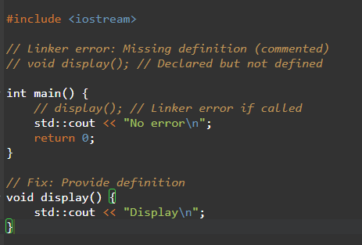

Types of Errors

Slide 19
Challenges/Debugging Experience and Additional Learning Resources
Challenges / Debugging Experience
Challenge: Vague linker error messages (e.g., “undefined reference”).
Debugging: Check for missing implementations or duplicate definitions.
Automotive Issue: Linker errors delay firmware integration.
Solution: Use modular design and verify linker inputs.

Slide 20
Types of Errors
2.5 Exception
Definition:
Exceptions are runtime errors or exceptional conditions signaled by throw and handled by try-catch blocks.
Why We Use It:
Prevents crashes by providing structured error recovery.
Improves diagnostics and fault tolerance.
Application in Automotive:
Used in non-critical systems (e.g., infotainment, diagnostics) for error recovery.
Avoided in real-time ECUs due to performance overhead.

Slide 21
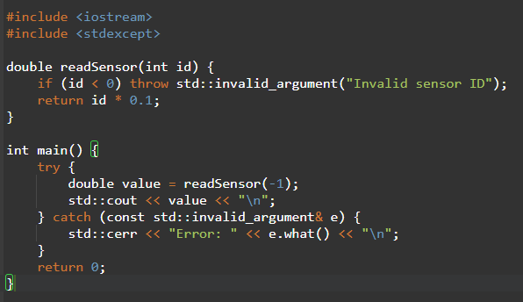

Types of Errors

Slide 22
Challenges/Debugging Experience and Additional Learning Resources
Challenges / Debugging Experience
Challenge: Uncaught exceptions cause program termination.
Debugging: Uncaught exceptions cause program termination.
Automotive Issue: Overhead in real-time systems.
Solution: Use error codes in ECUs, exceptions in diagnostics.

Slide 23
Exception Handling
2.5 Exception
Definition:
Exception handling is a C++ mechanism to manage runtime errors using try, catch, and throw constructs, allowing graceful recovery or error reporting.
Why We Use It:
Prevents program crashes by handling exceptional conditions.
Separates error-handling logic for cleaner code.
Supports diagnostics and fault tolerance.
Application in Automotive:
Used in diagnostics, logging, or infotainment for error recovery.
Limited in real-time ECUs due to performance constraints, per ISO 26262.

Slide 24
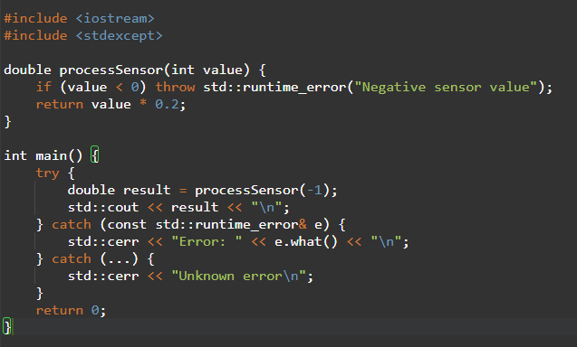

Types of Errors

Slide 25
Challenges/Debugging Experience and Additional Learning Resources
Challenges / Debugging Experience
Challenge: Overhead in real-time systems.
Debugging: Overhead in real-time systems.
Automotive Issue: Exceptions may violate timing constraints.
Solution: Limit to non-critical systems.

Slide 26
Exception Handling Techniques
Definition:
Exception handling techniques include using standard exceptions, custom exception classes, nested try-catch blocks, and noexcept specifications to manage errors effectively.
Why We Use It:
Provides structured error recovery and detailed reporting.
Enhances maintainability and fault tolerance.
Application in Automotive:
Custom exceptions for specific ECU failures (e.g., CAN bus errors).
Nested try-catch for layered error handling in ADAS or infotainment.

Slide 27
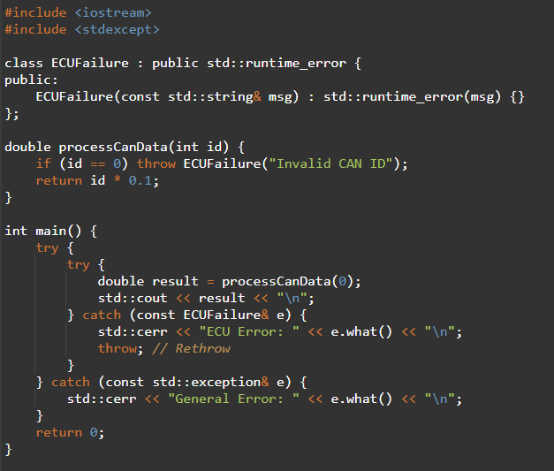

Types of Errors

Slide 28
Plan for Tomorrow
Going through above topics once and start learning next day topics.
Unit Testing.
Integration Testing.
Debugging

Slide 29


Thank You

