Slide 1


T1934
Learning Document
A Quest Global Company

Slide 2
Agenda
Topics Covered Today​
Key Learnings / Concepts Understood:​
Key Concepts with Definitions/ Code Snippet – Hands-on Practice​
Challenges / Debugging Experience​
Tasks/Assignments Completed​
Additional Learning Resources / Notes​
Q&A​
Plan for Tomorrow​
​
​ ​

Slide 3
Topics Covered Today
Unit tests,
Integration tests
Code debugging

Slide 4
Key Learnings/Concepts Understood
Unit tests Objects Definition, Purpose and Example
Integration tests Definition, Purpose and Example
Code de-bugging I/O Definition, Purpose and Example

Slide 5
Unit Tests
1. Unit Testing
Definition:
Unit testing involves testing individual components or functions of a program in isolation to ensure they work as intended. A "unit" is typically a single function or method.
Why We Use It:
Purpose: Verify that each unit of code performs its intended function correctly.
Benefits:
Early bug detection in isolated components.
Supports code refactoring by ensuring functionality remains intact.
Enhances code reliability and maintainability.
Application in Automotive:
Use Case: Validate critical functions in automotive systems, such as calculating brake pressure in an anti-lock braking system (ABS) or processing sensor data for adaptive cruise control.
Impact: Ensures safety-critical components meet standards like ISO 26262, reducing risks of failures and costly recalls.

Slide 6

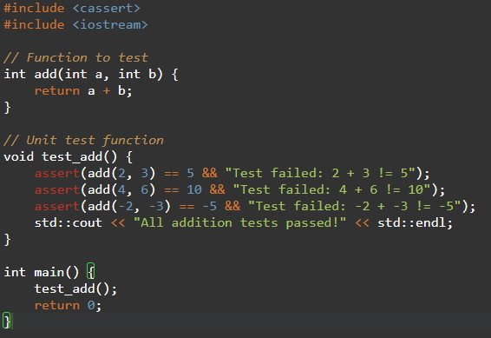


Unit Tests

Slide 7
Challenges/Debugging Experience and Additional Learning Resources
Challenges / Debugging Experience
Challenge: aborts on the first failure, making it harder to run multiple tests in one go compared to Google Test.
Debugging: When an assertion fails, use a debugger (e.g., GDB) to inspect variables at the failure point.
Solution: Wrap assertions in a custom test framework to log results without aborting, or use std::cerr for detailed output.
Resources:
C++ Reference for <cassert>: https://en.cppreference.com/w/cpp/error/assert
"Embedded Systems Programming" (online articles on unit testing in C++).
Notes:
<cassert> is simple but less feature-rich than Google Test (e.g., no test suites or detailed reporting).
Use NDEBUG to disable assertions in production code for performance

Slide 8
Integration Tests
2. Integration Testing
Definition:
Integration tests verify that multiple components or modules work together correctly, focusing on their interactions, such as interfaces or data flow.
Why We Use It:
Purpose: Ensure integrated components function as a cohesive system.
Benefits:
Detects issues in module interactions (e.g., incorrect data formats).
Validates system behavior under realistic scenarios.
Complements unit tests by testing system-level interactions.
Application in Automotive:
Use Case: Test communication between an engine control unit (ECU) and a transmission control unit (TCU) over a CAN bus to ensure proper gear-shifting logic.
Impact: Ensures reliable interactions between automotive subsystems, critical for vehicle performance and safety.

Slide 9
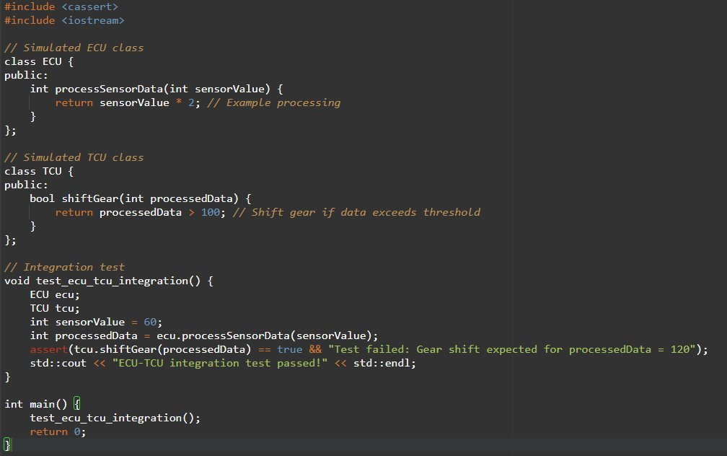

Integration Tests

Slide 10
Challenges/Debugging Experience and Additional Learning Resources
Challenges / Debugging Experience
Challenge: Simulating hardware interfaces (e.g., CAN bus) for integration tests.
Debugging: Used logging to trace data flow between components when assertions failed.
Solution: Leverage hardware-in-the-loop (HIL) testing or mock libraries to simulate automotive communication.
Resources:
"Automotive Software Engineering" by Jörg Schäuffele (covers integration testing).
Vector CANoe Documentation: https://www.vector.com
Notes:
Integration tests should focus on interfaces and data exchange.
Use logging to trace issues in complex automotive systems.

Slide 11
Code Debugging
3. Code Debugging
Definition:
Code debugging is the process of identifying, analyzing, and fixing bugs or errors in a program to ensure it behaves as intended.
Why We Use It:
Purpose: Locate and resolve defects causing incorrect behavior or crashes.
Benefits:
Improves code reliability and performance.
Reduces development time by pinpointing issues.
Ensures compliance with functional and safety requirements.
Application in Automotive:
Use Case: Debug issues in an automotive embedded system, such as incorrect sensor readings affecting airbag deployment.
Impact: Ensures safety-critical systems operate correctly, meeting standards like ISO 26262 and MISRA C++.

Slide 12
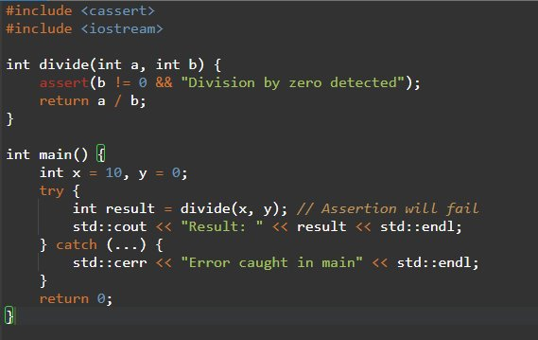
Integration Tests

Slide 13
Challenges/Debugging Experience and Additional Learning Resources
Challenges / Debugging Experience
Challenge: Debugging real-time embedded systems where timing issues are hard to reproduce.
Debugging: Used to catch invalid states and GDB to trace execution.
Solution: Employed real-time debugging tools like Lauterbach TRACE32 for automotive ECUs.
Resources:
GDB Documentation: https://www.gnu.org/software/gdb/
C++ Reference for <cassert>: https://en.cppreference.com/w/cpp/error/assert
Notes:
Combine <cassert> with logging for better debugging.
Follow MISRA C++ guidelines for debuggable automotive code.

Slide 14
Q & A
Q: How do unit tests ensure safety in automotive systems?
A: They validate individual components (e.g., throttle control logic) to ensure they meet safety requirements, reducing the risk of failures in critical systems.
Q: What’s the difference between EXPECT and ASSERT in Google Test?
A: EXPECT allows the test to continue running after a failure, while ASSERT stops the test immediately.
Q: How do integration tests differ from unit tests in automotive software?
A: Unit tests focus on individual functions (e.g., a single ECU function), while integration tests verify interactions between components (e.g., ECU and TCU over CAN).
Q: Why are integration tests critical for automotive systems?
A: They ensure that interconnected systems (e.g., braking and steering) work together, preventing failures that could compromise safety.

Slide 15
Q & A
Q: How do unit tests ensure safety in automotive systems?
A: They validate individual components (e.g., throttle control logic) to ensure they meet safety requirements, reducing the risk of failures in critical systems.
Q: What’s the difference between EXPECT and ASSERT in Google Test?
A: EXPECT allows the test to continue running after a failure, while ASSERT stops the test immediately.
Q: How do integration tests differ from unit tests in automotive software?
A: Unit tests focus on individual functions (e.g., a single ECU function), while integration tests verify interactions between components (e.g., ECU and TCU over CAN).
Q: Why are integration tests critical for automotive systems?
A: They ensure that interconnected systems (e.g., braking and steering) work together, preventing failures that could compromise safety.

Slide 16
Plan for Tomorrow
Introduction to Threads
Thread Management
Thread Safety(Mutex ,Lock Guard)
Advanced Thread Management
Condition Variables
Deadlock

Slide 17


Thank You

