Slide 1


T1934
Learning Document
A Quest Global Company
28/05/2025

Slide 2
Agenda
Topics Covered Today
Key Learnings / Concepts Understood:
Key Concepts with Definitions/ Code Snippet – Hands-on Practice
Challenges / Debugging Experience
Tasks/Assignments Completed
Additional Learning Resources / Notes
Q&A
Plan for Tomorrow

Slide 3
Topics Covered Today
Introduction to Threads
Thread Management
Thread Safety (Mutex, Lock Guard)
Advanced Thread Management
Condition Variables
Deadlock

Slide 4
Key Learnings/Concepts Understood
Thread Creation – Using std::thread to run functions concurrently in C++.
Thread Joining & Detaching – Managing thread execution using join() and detach().
Race Conditions – Issues caused by multiple threads accessing shared data simultaneously.
Mutex for Synchronization – Using std::mutex to protect shared resources.
Lock Guards – Simplifying mutex handling using std::lock_guard for exception safety.
Condition Variables – Coordinating threads using std::condition_variable for signaling.
Deadlock Prevention – Avoiding circular waits through lock ordering and scoped locks.
Futures & Promises – Handling asynchronous results using std::future and std::promise.

Slide 5
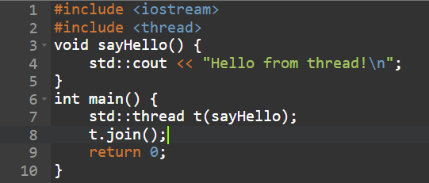


Key Concepts with Definitions/ Code Snippet – Hands –on Practice
1.Introduction to Threads
Definition:
A thread is a single sequence of execution in a program. Multithreading allows concurrent execution of two or more threads for better CPU utilization.

Slide 6
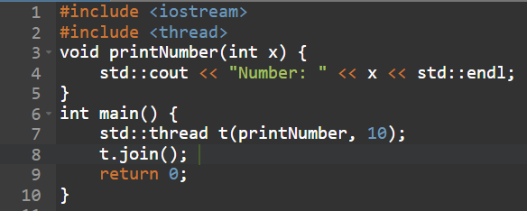
2.Thread Management
Definition:
Managing the lifecycle of a thread includes starting, joining, detaching, and passing parameters to threads.

Slide 7
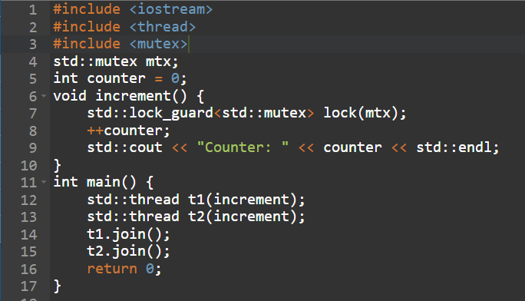

3.Thread Safety (Mutex, Lock Guard)
Definition:
Thread safety ensures that shared data is accessed by only one thread at a time using synchronization tools like mutex and lock guard.

Slide 8
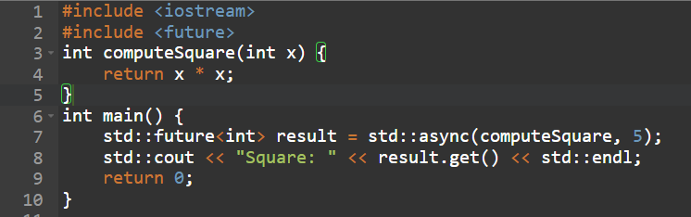

4. Advanced Thread Management
Definition:
Advanced features like std::async, std::future, and std::promise are used for task-based parallelism.

Slide 9
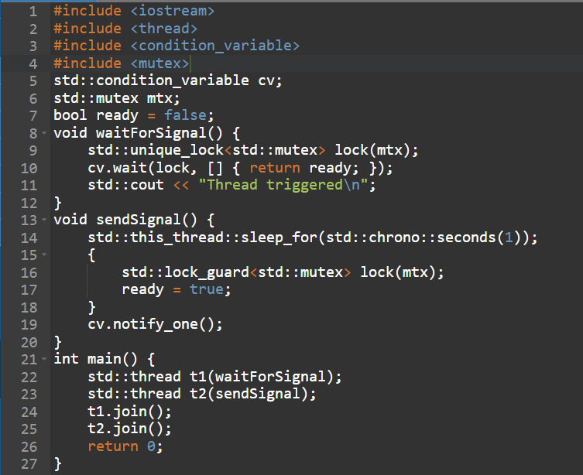

5. Condition Variables
Definition:
Condition variables are used to synchronize threads via notifications, allowing threads to wait for certain conditions to be met.

Slide 10
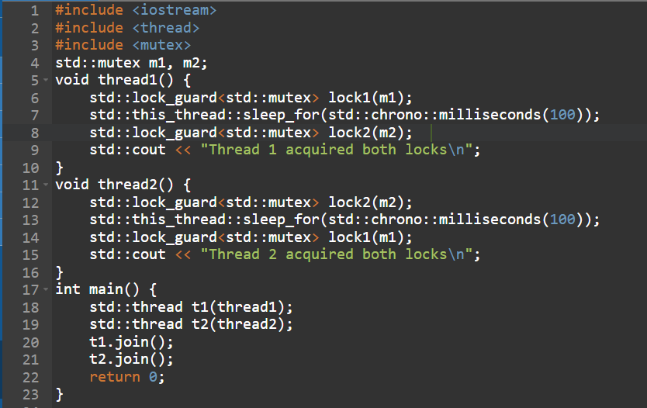

6. Deadlock
Definition:
Deadlock occurs when two or more threads wait for each other to release resources, preventing progress.

Slide 11
Challenges / Debugging Experience
Faced race conditions when multiple threads accessed shared variables without proper synchronization.
Encountered deadlocks due to inconsistent lock acquisition order across threads.
Forgot to call join() or detach() on threads, leading to runtime errors.
Crashes occurred due to shared variables being accessed before proper initialization.
Debugging issues were hard to reproduce due to non-deterministic behavior in multithreaded execution.
Overused mutexes, causing performance degradation and complex locking logic.
Used condition variables incorrectly without checking predicates, leading to missed or spurious wakeups.
Threads exited unexpectedly because of exceptions or deleted resources, causing undefined behavior.

Slide 12
Additional Learning Resources / Notes
C++ Concurrency in Action by Anthony Williams – Comprehensive guide to mastering threads in modern C++.
Udemy Course: Modern C++ Multithreading – Covers threads, mutexes, condition variables, and advanced topics.
cppreference.com – Official C++ reference for detailed and up-to-date threading documentation.
YouTube: The Cherno – C++ Threading Series – Visual learning with clear explanations on threading fundamentals.
Blog: Articles by Folkert van Heusden on practical applications of thread safety and concurrency.
GitHub – Explore open-source C++ projects showcasing real-world usage of threads and synchronization.
Tools: Valgrind and Helgrind – For detecting race conditions, memory leaks, and thread-related issues.
Practice Platforms: LeetCode and HackerRank – Solve real-world concurrency and threading challenges.

Slide 13
Q&A
Q1: What is a thread in C++? A thread is the smallest unit of execution within a process that can run concurrently with other threads.
Q2: How do you create and manage threads in C++? Using the std::thread class, you can create threads by passing a function to run. Threads can be joined or detached for management.
Q3: What is thread safety? Thread safety ensures that shared data is accessed correctly when multiple threads run concurrently, preventing data races and inconsistencies.
Q4: How do mutexes and lock guards help in thread safety? Mutexes provide mutual exclusion to protect shared data, and lock guards automatically manage mutex locking and unlocking to prevent deadlocks.
Q5: What are advanced thread management techniques? They include thread pools, futures/promises for asynchronous execution, and thread-local storage.

Slide 14
Plan for Tommorrow
Bubble sort
Selection sort
Binary search

Slide 15
Overall Overview
Threads enable concurrent execution within a program to improve performance and responsiveness.
Thread management includes creating, running, and synchronizing threads effectively.
Thread safety is essential to prevent data races and inconsistencies when accessing shared resources.
Mutexes and lock guards are common mechanisms to ensure exclusive access to shared data.
Advanced thread management techniques like futures and thread pools help handle asynchronous tasks.
Condition variables allow threads to wait and signal changes in program state for coordination.
Deadlocks occur when threads wait indefinitely for resources held by each other, causing a standstill.
Proper understanding and use of threading concepts help build efficient, safe, and reliable multithreaded programs.

Slide 16


Thank You

