Slide 1


T1934
Learning Document
A Quest Global Company
29/05/2025

Slide 2
Agenda
Topics Covered Today
Key Learnings / Concepts Understood:
Key Concepts with Definitions/ Code Snippet – Hands-on Practice
Challenges / Debugging Experience
Tasks/Assignments Completed
Additional Learning Resources / Notes
Q&A
Plan for Tomorrow

Slide 3
List of Topics to be covered
Searching algorithms
Binary search
Sorting algorithms
Bubble sorting
Selection sorting

Slide 4
Key Concepts with Definitions/ Code Snippet :
Searching Technique
Definition:
Searching technique is a systematic method used to find a particular item or piece of information among a collection of items or data.
Importance of Searching Technique:
They enable quick data retrieval, which is crucial for applications like databases, search engines, and real-time systems. Efficient searching minimizes response time and enhances overall system performance.
Types of Searching Technique:
When we search an item in an array, there are two most common algorithms used based on the type of input array.
Linear search:
Sequentially checks each element until the target is found or the end is reached.
Binary search:
Description: Divides the sorted dataset into halves to locate the target efficiently.

Slide 5
Linear search
Definition:
Linear Search, also known as sequential search, is a straightforward algorithm used to find a specific element within a list or array. It operates by checking each element one by one from the beginning until the desired element is found or the end of the list is reached.
Linear Search : It is used for an unsorted array. It mainly does one by one comparison of the item to be search with array elements
How Linear Search Works:
Start at the first element of the list.
Compare the current element with the target value.
If a match is found, return the index of the current element.
If not, move to the next element and repeat step 2.
Continue this process until the element is found or the list ends.
If the end is reached without finding the element, return -1 to indicate that the element is not present in the list.
Time Complexity:
Best Case: O(1) – when the target element is at the first position.
Average Case: O(n) – when the target element is somewhere in the middle.
Worst Case: O(n) –when the target element is at the end or not present at all.

Slide 6
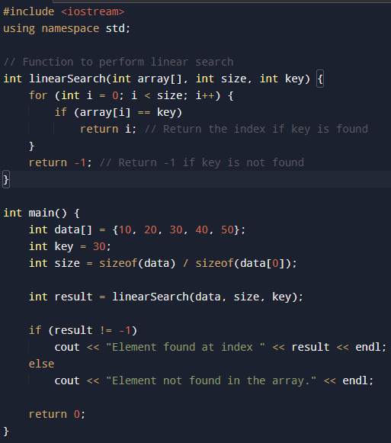
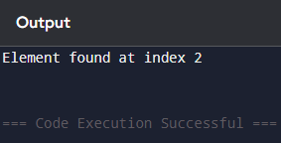
Example output:

Slide 7
Binary Search
Definition:
Binary Search is an efficient algorithm for finding a target value within a sorted array or list. It operates by repeatedly dividing the search interval in half, significantly reducing the number of comparisons needed compared to linear search.
How Binary Search Works:
Initialize Pointers: Set two pointers, low and high, to the start and end of the array, respectively.
Find Midpoint: Calculate the middle index: mid = (low + high) / 2.
Compare Values
If arr[mid] equals the target value, the search is successful.
If the target is less than arr[mid], adjust high = mid - 1 to search the left subarray.
If the target is greater than arr[mid], adjust low = mid + 1 to search the right subarray.
Repeat: Continue steps 2 and 3 until the target is found or the search interval is empty.
Time Complexity:
Best Case: O(1)
Average Case: O(log N)
Worst Case: O(log N)

Slide 8
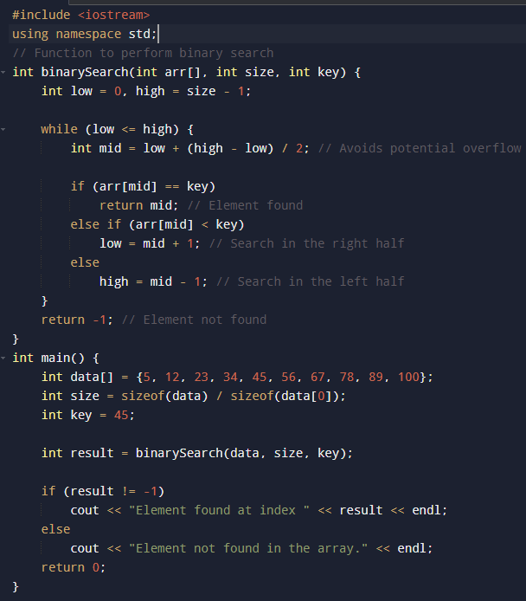
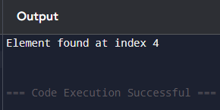
Example: Output:

Slide 9
Sorting techniques
Definition :
Sorting techniques are algorithms used to arrange elements in a specific order, typically in ascending or descending sequence.
Importance :
Sorting algorithms in are essential for efficiently organizing data, enabling faster searches and optimized performance in various applications.
Types of Sorting Techniques :
Sorting algorithms can be broadly categorized into two types:
Comparison-Based Sorting: These algorithms determine the order of elements by comparing them directly.
1.Bubble Sort 2.Selection Sort 3.Insertion Sort 4.Merge Sort 5.Quick Sort 6.Heap Sort:
Non-Comparison-Based Sorting: These algorithms determine the order of elements using operations other than comparisons, often utilizing the properties of the data.
1Counting Sort 2.Bucket Sort 3.Radix Sort:

Slide 10
Bubble Sort
Definition:
It is the simplest sorting algorithmRepeatedly steps through the list, compares adjacent elements, and swaps them if they are in the wrong order. This process is repeated until the list is sorted.
Step-by-Step Example
Let's sort the array [5, 1, 4, 2, 8] in ascending order using Bubble Sort:
Initial Array: [5, 1, 4, 2, 8]
Pass 1:
Compare 5 and 1 → swap → [1, 5, 4, 2, 8]
Compare 5 and 4 → swap → [1, 4, 5, 2, 8]
Compare 5 and 2 → swap → [1, 4, 2, 5, 8]
Compare 5 and 8 → no swap → [1, 4, 2, 5, 8]
Largest element 8 has "bubbled" to the end.
Pass 2:
Compare 1 and 4 → no swap → [1, 4, 2, 5, 8]
Compare 4 and 2 → swap → [1, 2, 4, 5, 8]
Compare 4 and 5 → no swap → [1, 2, 4, 5, 8]
Compare 5 and 8 → no swap → [1, 2, 4, 5, 8]
Second-largest element 5 is now in place.

Slide 11
Pass 3:
Compare 1 and 2 → no swap → [1, 2, 4, 5, 8]
Compare 2 and 4 → no swap → [1, 2, 4, 5, 8]
Compare 4 and 5 → no swap → [1, 2, 4, 5, 8]
Compare 5 and 8 → no swap → [1, 2, 4, 5, 8]
No swaps occurred; the array is sorted.
Key Points:
Time Complexity: O(n²)
Space Complexity: O(1).
Stability: Stable sort (does not change the relative order of equal elements).
Use Case: Best suited for small or nearly sorted datasets due to its simplicity.

Slide 12
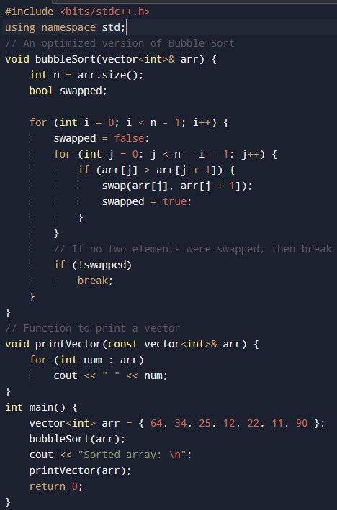
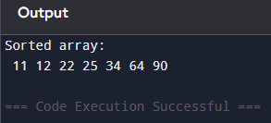
Example: Output:

Slide 13
Selection Sort
Definition:
Selection Sort is a comparison-based sorting algorithm. It sorts an array by repeatedly selecting the smallest (or largest) element from the unsorted portion and swapping it with the first unsorted element. This process continues until the entire array is sorted.
How Selection Sort works:
First we find the smallest element and swap it with the first element. This way we get the smallest element at its correct position.
Then we find the smallest among remaining elements (or second smallest) and swap it with the second element.
We keep doing this until we get all elements moved to correct position.
Time Complexity:
Best Case: O(0)
Average and Worst Case: O(n) swaps.
Space Complexity: O(1)

Slide 14
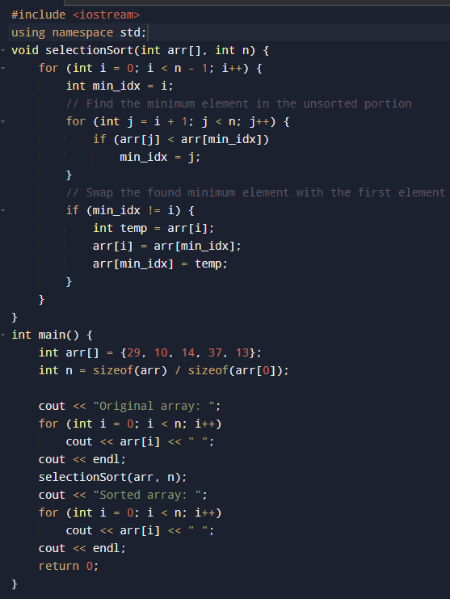
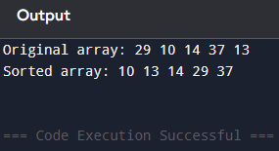
Example: Output:

Slide 15
Tasks/Assignments Completed :
I have completed task for assigned to me by the trainer.

Slide 16
Additional Learning Resources / Notes :
Greeks for Greeks
Youtube
chatgpt

Slide 17
Q&A :
Q.What is the best-case time complexity of linear search?
A: O(1), when the target element is at the first position.
Q: Is linear search suitable for unsorted arrays?
A: Yes, linear search can be applied to both sorted and unsorted arrays.
Q: What is the prerequisite for using binary search?
A: The array must be sorted in ascending or descending order.
Q: How many swaps does selection sort perform in the worst case?
A: At most (n - 1) swaps, which is less than other simple sorting algorithms.
Q: What is the time complexity of selection sort in all cases?
A: O(n²) in best, average, and worst cases.
Q: Is bubble sort a stable sorting algorithm?
A: Yes, bubble sort is stable; it maintains the relative order of equal elements.

Slide 18
Plan for Tomorrow :
Focus on std::sort, std::stable_sort, std::lower_bound, std::upper_bound, and std::binary_search.
Exercises on sorting and binary search on various container types.

Slide 19





Thank You
For More Quires, you can reach out to:

