Slide 1


T1934
Learning Document
A Quest Global Company

Slide 2
Agenda
Topics Covered Today
Key Learnings / Concepts Understood:
Key Concepts with Definitions/ Code Snippet – Hands-on Practice
Challenges / Debugging Experience
Tasks/Assignments Completed
Additional Learning Resources / Notes
Q&A
Plan for Tomorrow

Slide 3
List of Topics to be covered
td::sort
std::stable_sort
std::lower_bound
std::upper_bound
std::binary_search.

Slide 4
Key Learnings/Concepts Understood
std::sort Definition, Purpose and Example
std::stable_sort Definition, Purpose and Example
std::lower_bound Definition, Purpose and Example
std::upper_bound Definition, Purpose and Example
std::binary_search Definition, Purpose and Example

Slide 5
Sort
1. Sort
Definition:
std::sort is a C++ standard library function defined in that sorts elements in a range (e.g., a vector, array, or other container) in ascending order by default, or in a custom order if a comparator is provided. It uses an optimized implementation of introsort (a hybrid of quicksort, heapsort, and insertion sort) and is not stable (relative order of equal elements may change).
Why We Use It:
Purpose: To efficiently sort data for faster access, display, or processing.
Use in Automotive Context:
Sorting a list of cars by price, horsepower, or model name to display them in a catalog or optimize inventory management.

Slide 6


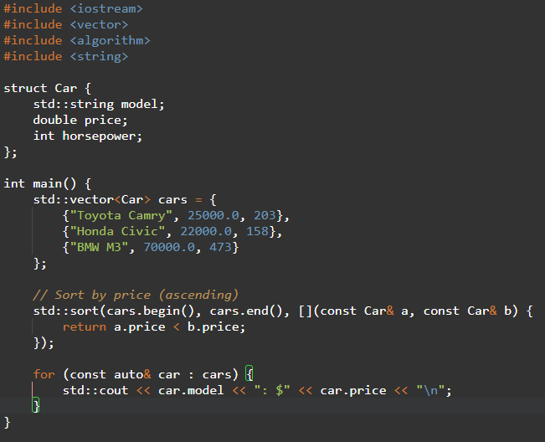


Sort
Syntax

Slide 7
Challenges/Debugging Experience and Additional Learning Resources
Challenges / Debugging Experience
Challenge: Incorrect comparator logic (e.g., return a.price <= b.price) can lead to undefined behavior or incorrect sorting.
Debugging: Ensure the comparator is strict weak ordering (irreflexive, antisymmetric, transitive).
Automotive Issue: Sorting cars with equal prices may shuffle their order, which may be undesirable if stability is needed (use std::stable_sort instead).
Notes:
Use std::sort when stability is not required, as it’s faster than std::stable_sort.

Slide 8
Stable_Sort
2. Stable_Sort
Definition:
std::stable_sort is a C++ standard library function in that sorts elements in a range while preserving the relative order of equal elements. It uses a merge sort-based algorithm.
Why We Use It:
Purpose: To sort data while maintaining the original order of equal elements.
Use in Automotive Context:
Sorting cars by price while keeping cars with the same price in their original order (e.g., by entry time in inventory).

Slide 9
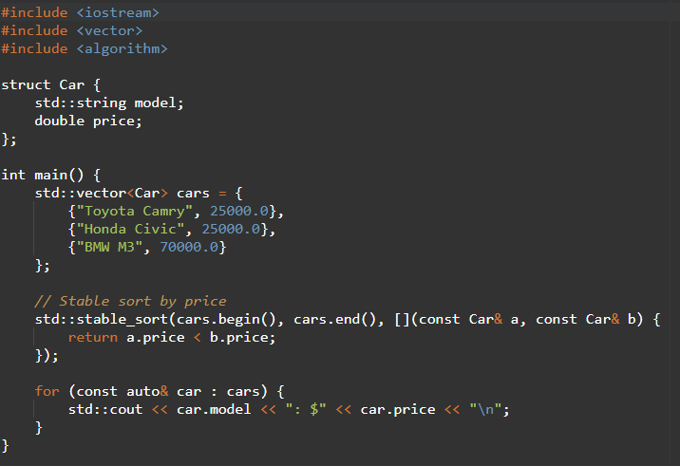

Stable_Sort
Syntax

Slide 10
Challenges/Debugging Experience and Additional Learning Resources
Challenges / Debugging Experience
Challenge: Higher memory usage for large datasets due to merge sort.
Debugging: Verify stability by checking order of equal elements post-sort.
Automotive Issue: If sorting by price and multiple cars have the same price, std::stable_sort ensures original order (e.g., by inventory ID) is preserved.
Notes:
Use std::stable_sort when order of equal elements matters, such as in multi-level sorting.

Slide 11
lower_bound
3.lower_bound
Definition:
std::lower_bound is a C++ standard library function in that finds the first element in a sorted range that is not less than (i.e., >=) a given value. It uses binary search.
Why We Use It:
Purpose: To locate the insertion, point for a value in a sorted container or check if a value exists.
Use in Automotive Context:
Finding the first car with a price >= a budget in a sorted list.

Slide 12
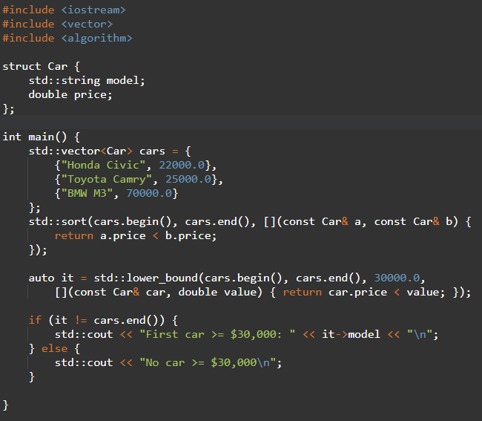

lower_bound
Syntax

Slide 13
Challenges/Debugging Experience and Additional Learning Resources
Challenges / Debugging Experience
Challenge: Using std::lower_bound on an unsorted range leads to incorrect results.
Debugging: Always verify the range is sorted before calling.
Automotive Issue: Ensure the comparator matches the sort order (e.g., ascending price).
Notes:
Use with sorted containers for efficient lookup.

Slide 14
upper_bound
4.upper_bound
Definition:
std::upper_bound is a C++ standard library function in that finds the first element in a sorted range that is greater than a given value. It uses binary search.
Why We Use It:
Purpose: To find the first element exceeding a value or the insertion point for a value in a sorted container.
Use in Automotive Context:
Finding the first car with a price strictly greater than a budget.

Slide 15
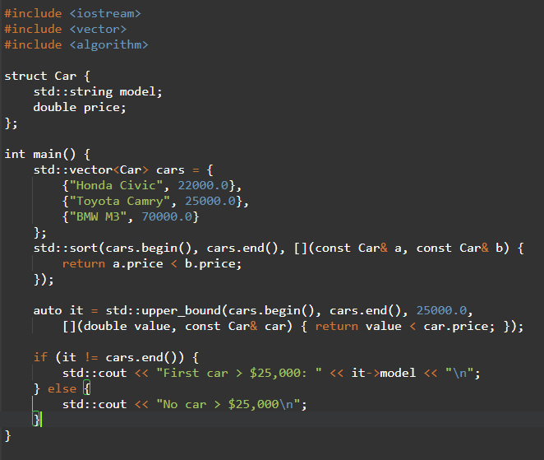

lower_bound
Syntax

Slide 16
Challenges/Debugging Experience and Additional Learning Resources
Challenges / Debugging Experience
Challenge: Comparator must match the sort order, or results are incorrect.
Debugging: Test with small datasets to verify iterator positions.
Automotive Issue: Useful for finding the next price tier in a sorted car catalog.
Notes:
Combine with std::lower_bound for range queries.

Slide 17
Binary_search
5.binary_search
Definition:
std::binary_search is a C++ standard library function in that checks if a value exists in a sorted range using binary search. It returns a boolean.
Why We Use It:
Purpose: To efficiently check if a specific value exists in a sorted container.
Use in Automotive Context:
Checking if a car with a specific price or horsepower exists in a sorted inventory.

Slide 18
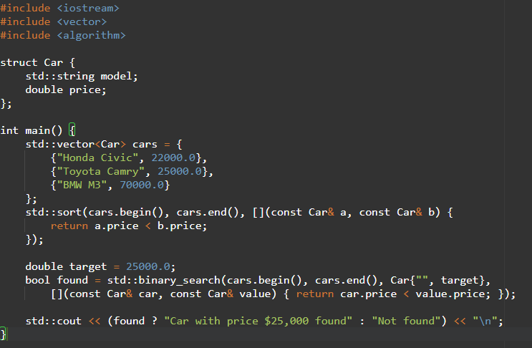

lower_bound
Syntax

Slide 19
Challenges/Debugging Experience and Additional Learning Resources
Challenges / Debugging Experience
Challenge: Unsorted range causes incorrect results.
Debugging: Verify sorting before calling std::binary_search.
Automotive Issue: Useful for quick checks in large inventories.
Notes:
Use std::lower_bound if you need the position of the element.

Slide 20
Q & A
Q: Can std::sort be used with std::list?
A: No, std::sort requires random-access iterators. Use std::list::sort instead.
Q: How to sort cars by multiple criteria (e.g., price then horsepower)?
A: Use a comparator that checks multiple fields:
Q: When to use std::stable_sort over std::sort?
A: Use std::stable_sort when maintaining the relative order of equal elements is important.
Q: Can std::stable_sort handle custom comparators?
A: Yes, it supports custom comparators like std::sort.

Slide 21
Q & A
Q: What happens if no element is >= the value?
A: Returns last iterator.
Q: Can std::lower_bound work with std::set?
A: Yes, but std::set::lower_bound is typically more efficient.
Q: How does std::upper_bound differ from std::lower_bound?
A: std::lower_bound finds the first element >= value, while std::upper_bound finds the first element > value.
Q: Does std::binary_search return the iterator?
A: No, it returns a boolean. Use std::lower_bound to get the iterator.

Slide 22
Plan for Tomorrow
I want to Revise the topics like multithreading, exception handling, unit testing, integration testing and also sorting and searching.

Slide 23


Thank You

