Slide 1


T1934
Learning Document
A Quest Global Company
05/06/2025

Slide 2
Agenda
Topics Covered Today
Key Learnings / Concepts Understood:
Key Concepts with Definitions/ Code Snippet – Hands-on Practice
Challenges / Debugging Experience
Tasks/Assignments Completed
Additional Learning Resources / Notes
Q&A
Plan for Tomorrow

Slide 3
List of Topics to be covered
Container Adapters
std::stack
std::queue
std::priority_queue

Slide 4
Container Adapters
Container adapters in C++ are classes in the Standard Template Library (STL) that provide a restricted interface to an underlying container (like std::vector, std::deque, or std::list) to enforce a specific access pattern. They simplify the usage of containers for specific data structures by limiting how elements can be added, accessed, or removed. The three main container adapters in C++ are:
std::stack: Implements a Last-In-First-Out (LIFO) structure.
std::queue: Implements a First-In-First-Out (FIFO) structure.
std::priority_queue: Implements a priority-based structure (typically a max-heap).

Slide 5
std::stack
std::stack is a container adapter in C++’s Standard Template Library (STL) that implements a Last-In-First-Out (LIFO) data structure. It restricts access to elements so that you can only add (push) or remove (pop) elements from the top of the stack. It adapts an underlying container (like std::deque, std::vector, or std::list) to enforce this LIFO behavior.
Header: Defined in <stack>.
Underlying Container: By default, std::deque. Can be customized to std::vector or std::list.
Key Methods:
push(value): Adds an element to the top.
pop(): Removes the top element (no return value).
top(): Returns a reference to the top element (const or non-const).
empty(): Checks if the stack is empty (true/false).
size(): Returns the number of elements.
Iterators: None. You can only access the top element, enforcing LIFO.
LIFO Behavior: The last element added is the first to be removed, like a stack of plates where you can only take the top plate.

Slide 6
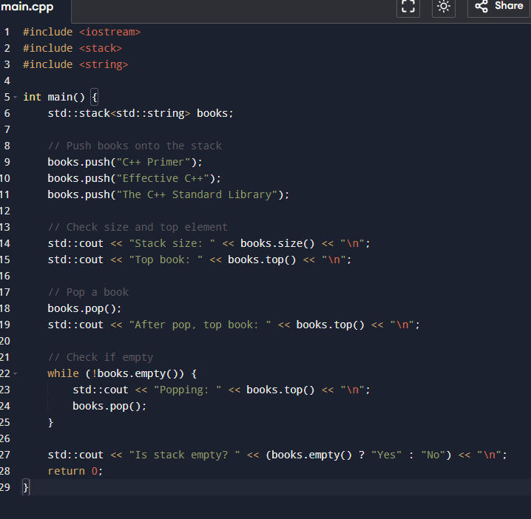
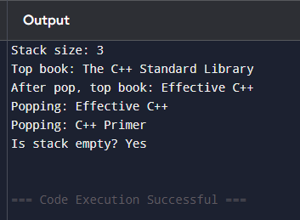
std::stack
Example
Output

Slide 7
std::stack
Time Complexity
The time complexity of std::stack operations depends on the underlying container, but with the default std::deque, they are:
push(value): O(1) amortized. Adds an element to the top (may involve occasional reallocation for std::vector).
pop(): O(1). Removes the top element.
top(): O(1). Accesses the top element.
empty(): O(1). Checks if the stack is empty.
size(): O(1). Returns the number of elements.
Note: If std::vector is used, push may occasionally be O(n) due to reallocation, but this is amortized to O(1). std::deque avoids this by using a block-based structure, ensuring consistent O(1) for push/pop.

Slide 8
std::queue
std::queue is a container adapter in C++’s Standard Template Library (STL) that implements a First-In-First-Out (FIFO) data structure. It restricts access to elements so that you can only add (push) elements to the back and remove (pop) elements from the front, mimicking a real-world queue (e.g., a line of people). It adapts an underlying container (like std::deque or std::list) to enforce this FIFO behavior.
Header: Defined in <queue>.
Underlying Container: By default, std::deque. Can be customized to std::list (but not std::vector, as it doesn’t support efficient front removal).
Key Methods:
push(value): Adds an element to the back of the queue.
pop(): Removes the front element (no return value).
front(): Returns a reference to the front element (const or non-const).
back(): Returns a reference to the back element (const or non-const).
empty(): Checks if the queue is empty (true/false).
size(): Returns the number of elements.

Slide 9
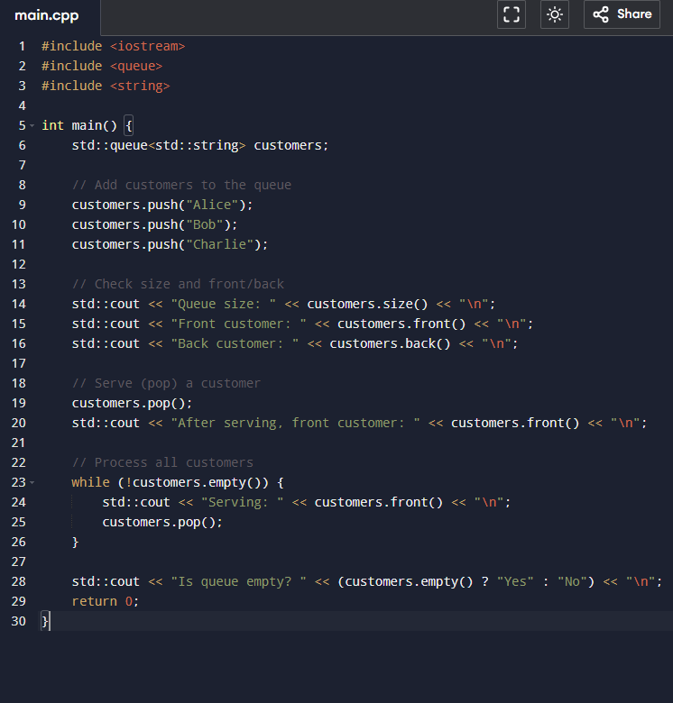
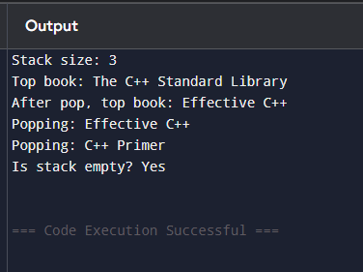
Std::deque
Example
Output

Slide 10
Std::deque
Time Complexity
The time complexity of std::queue operations depends on the underlying container, but with the default std::deque, they are:
push(value): O(1) amortized. Adds an element to the back (may involve occasional reallocation for std::deque).
pop(): O(1). Removes the front element.
front(): O(1). Accesses the front element.
back(): O(1). Accesses the back element.
empty(): O(1). Checks if the queue is empty.
size(): O(1). Returns the number of elements.
Note: std::deque ensures O(1) for front and back operations due to its block-based structure. If std::list is used, operations remain O(1) since lists support constant-time insertions/removals at both ends.

Slide 11
std::priority_queue
std::priority_queue is a container adapter in C++’s Standard Template Library (STL) that implements a priority-based data structure, typically a max-heap by default, where the element with the highest priority (largest value) is always at the front. It restricts access to only the top element and automatically maintains the priority order using heap algorithms. It adapts an underlying container (like std::vector or std::deque) to enforce this behavior.
Header: Defined in <queue>.
Underlying Container: By default, std::vector. Can be customized to std::deque.
Key Methods:
push(value): Adds an element and adjusts the heap to maintain priority order.
pop(): Removes the top (highest priority) element (no return value).
top(): Returns a reference to the top element (const or non-const).
empty(): Checks if the queue is empty (true/false).
size(): Returns the number of elements.
Priority Order: Elements are ordered based on a comparison function (default: std::less<T>, where a < b means b has higher priority).

Slide 12
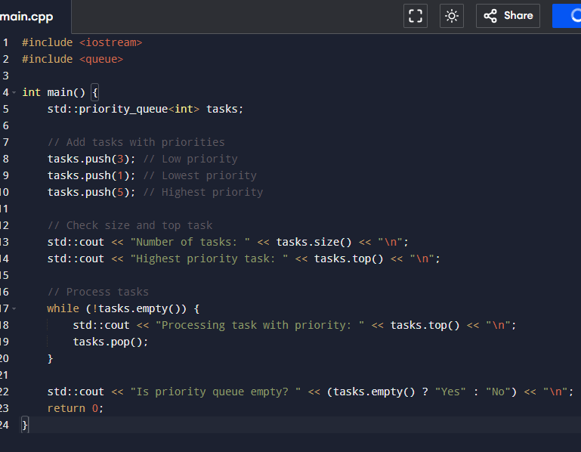
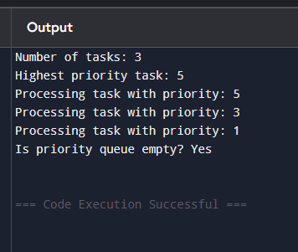
std::priority_queue
Example
Output

Slide 13
std::priority_queue
Time Complexity
The time complexity of std::priority_queue operations depends on the underlying container (default: std::vector) and heap algorithms:
push(value): O(log n). Adds an element and rebalances the heap.
pop(): O(log n). Removes the top element and rebalances the heap.
top(): O(1). Accesses the top element.
empty(): O(1). Checks if the queue is empty.
size(): O(1). Returns the number of elements.
Note: The heap structure (maintained by std::make_heap, std::push_heap, std::pop_heap) ensures logarithmic time for insertions and deletions, while std::vector provides efficient memory usage.

Slide 14
Challenges
Print Job Scheduler with std::queue: Design a FIFO-based print job queue where jobs are processed in arrival order, ensuring efficient front and back operations, but managing the limitation of no direct access to jobs in the middle of the queue.
Task Prioritization with std::priority_queue: Build a scheduling system for tasks with varying priority levels, ensuring the highest-priority task is always processed first, while addressing the challenge of logarithmic time complexity for insertions and removals in dynamic workloads.
LIFO (Last-In-First-Out) Limitation: std::stack enforces LIFO order, making it unsuitable for tasks requiring access to older elements without popping newer ones, complicating scenarios like task reordering or inspection.

Slide 15
Additional Resources
https://www.geeksforgeeks.org/stack-data-structure/
https://www.geeksforgeeks.org/queue-data-structure/
https://www.geeksforgeeks.org/priority-queue-set-1-introduction/

Slide 16
Questions and Answers
When is std::stack preferable over std::vector for a sequence container? Answer: Use std::stack when a Last-In-First-Out (LIFO) access pattern is needed, such as for undo operations or function call stacks, avoiding std::vector’s overhead for non-LIFO access.
How does std::queue differ from std::deque in terms of functionality and performance? Answer: std::queue provides a strict FIFO interface with O(1) front/back operations, typically using std::deque internally, but lacks direct access to middle elements, unlike std::deque’s random access capability.
What are the trade-offs of using std::priority_queue compared to std::vector for task scheduling? Answer: std::priority_queue ensures O(log n) access to the highest-priority element, ideal for scheduling, but lacks direct access to other elements and has higher insertion/removal complexity than std::vector’s O(1) end operations.
Describe a real-world scenario where std::queue is more suitable than other sequence containers? Answer: std::queue is ideal for managing tasks in a print spooler or network packet processing, where jobs must be processed in the order they arrive, leveraging efficient FIFO operations.

Slide 17
Plan for Tomorrow
Binary trees
Tree traversals

Slide 18


Thank You

