Slide 1
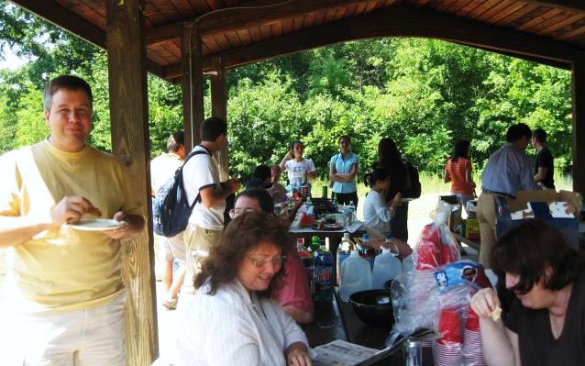
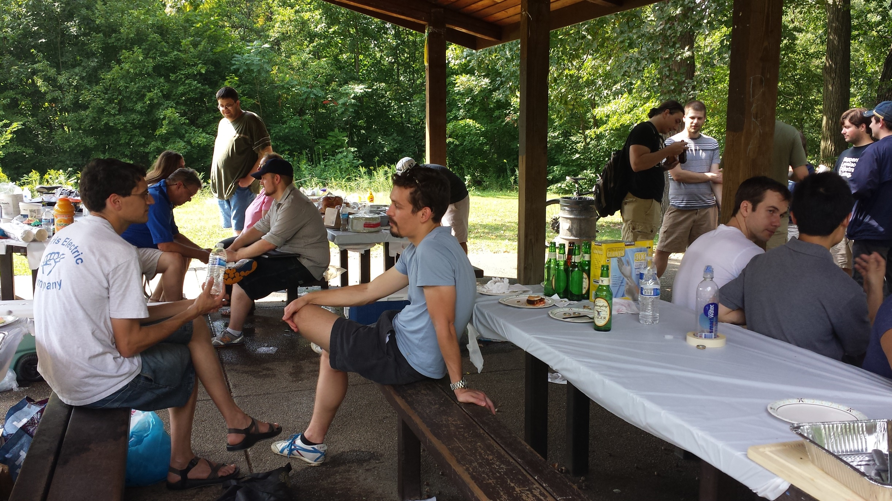


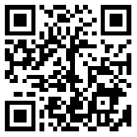
Computer Science Faculty, Staff, and Graduate Student Picnic
Friday 29 August 2014
1:00pm
Bartlett Shelter, Schenley Park
Bring a side dish
Make friends
Meet faculty
Games and recreation
Families welcome!
hosted by the
CS Graduate Student Organization
gso.cs.pitt.edu

