Slide 1
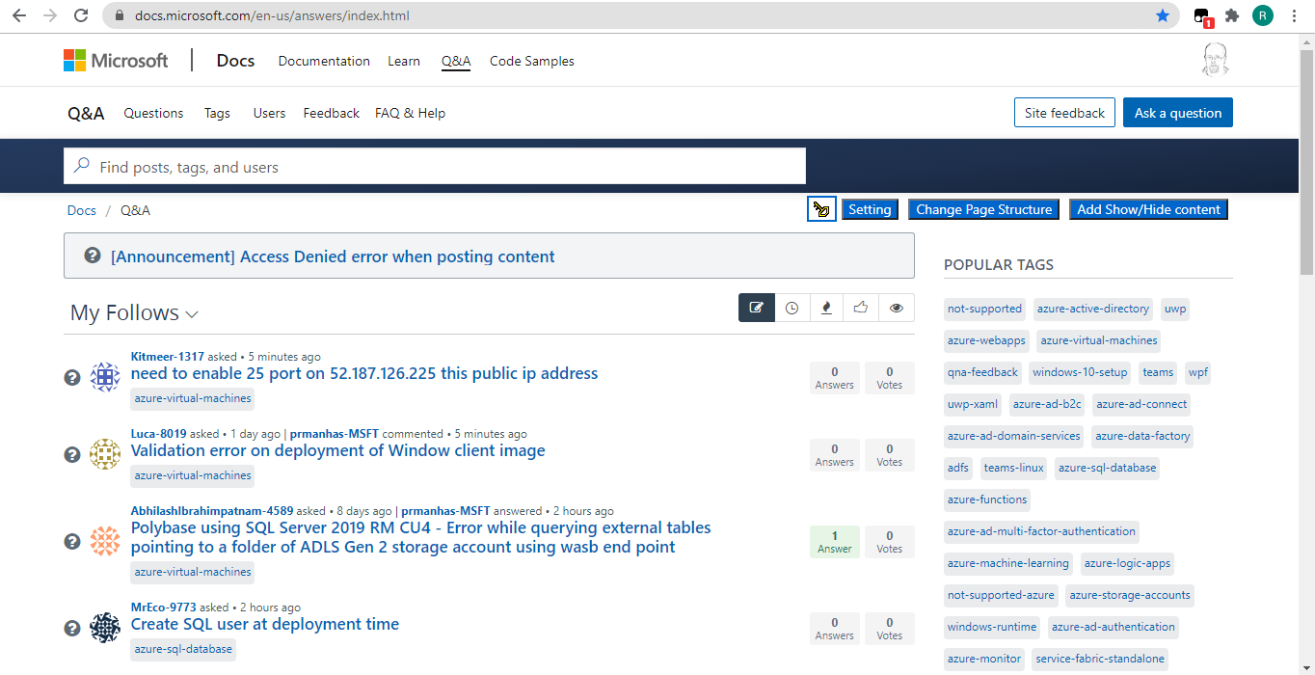
This is how the page looks
Notes:
This is how the page look after installing the extension

Slide 2
Notice that we only see the title of the messages. Totally useless!
Notes:
This is how the page look after installing the extension

Slide 3
Notice the space which is used to Present 15 categories. Totally waste of place, and useless if these are not your categories!
Notes:
This is how the page look after installing the extension

Slide 4
If you install my extension, then You can notice the new buttons on the right upper corner
Notes:
You can notice the new buttons on the right upper corner

Slide 5
First one is credit, simple link to my personal website
Notes:
You can notice the new buttons on the right upper corner

Slide 6
Second one is the setting, so you will not need to click on button 3 and 4 every time.
Click this to open the setting windows
Notes:
You can notice the new buttons on the right upper corner

Slide 7
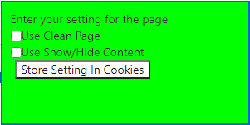
When you click the setting this window popup. The setting will work for all next uploads of the forums pages
Notes:
You can notice the new buttons on the right upper corner

Slide 8
Click button 3 to implement my new page design right now (setting will be changed according to this, and work on next page load)
Notes:
You can notice the new buttons on the right upper corner

Slide 9
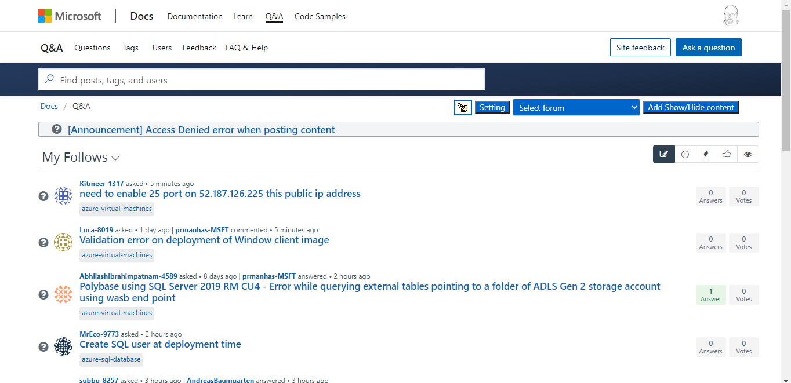
Notice the page after we clicked button 3
> There is no waste of space on the right! PAGE IS CLEAN
Notes:
You can notice the new buttons on the right upper corner

Slide 10
Moreover, Instead of only 15 categories, you can go directly to any existing category using simple drop-down select box
Notes:
You can notice the new buttons on the right upper corner

Slide 11
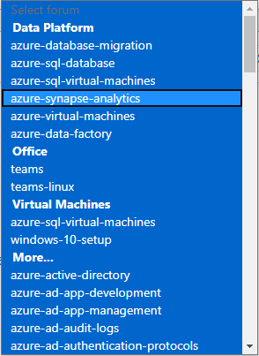
Note: Click on setting and you will see that it was changed. Option 1 which is button 3, is now marked as selected
Notes:
You can notice the new buttons on the right upper corner

Slide 12
Click button 4 which is the content issue
Notes:
You can notice the new buttons on the right upper corner

Slide 13
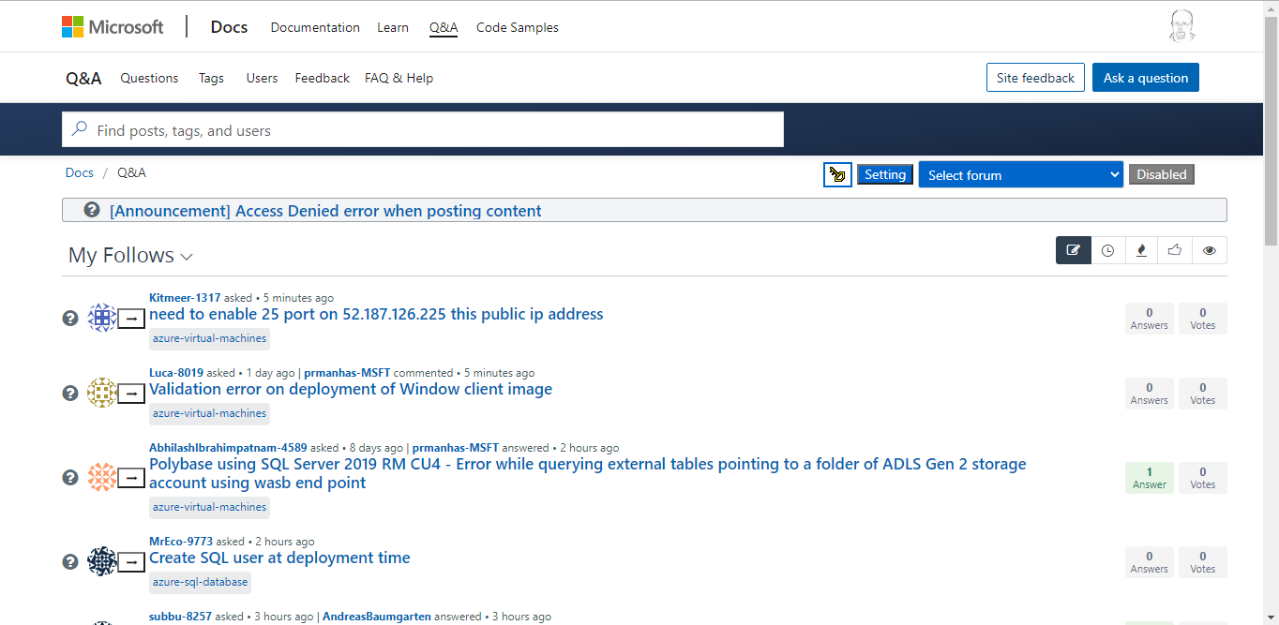
Notice the new button near each thread!
A new button was added to each thread. This is like the MSDN forums!
Click this button will show you the entire content of the tread (answers and comments)
Notes:
You can notice the new buttons on the right upper corner

Slide 14
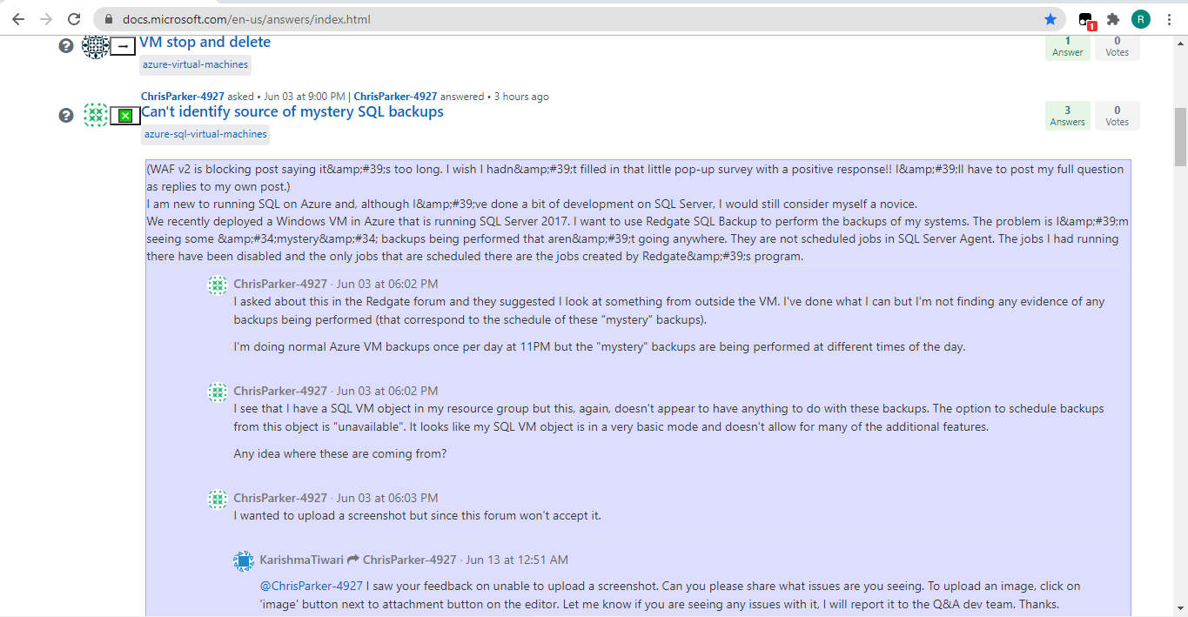
This is the content of the thread!
This way (like in the MSDN forums), we do not need to open each thread in separate page, only for the sake of checking if the content is relevant to us or if we wasted our time 😀
Notes:
You can notice the new buttons on the right upper corner

