Slide 1

How many solar panels do you need to charge a phone?
Team #
Pityas Teaghes
CSS 290 – Software for Renewable Energy

Slide 2
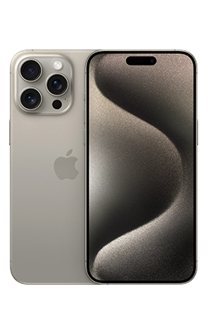
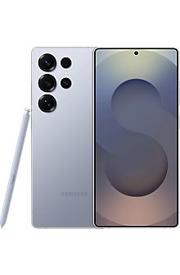
It depends on what you're charging
Model | Capacity
iPhone 15 Pro Max | 4422 mAh
Nothing Phone (2) | 4700 mAh
Huawei P60 Pro | 4815 mAh
Xiaomi 14 Pro | 4880 mAh
Samsung Galaxy S25 Ultra | 5000 mAh
Phones that can store more charge will need more energy, which means more panels in our scenario.
For example, the S25 Ultra can store over 500 mAh more than the iPhone 15 Pro Max, meaning it will take more solar energy to fully charge.

Slide 3


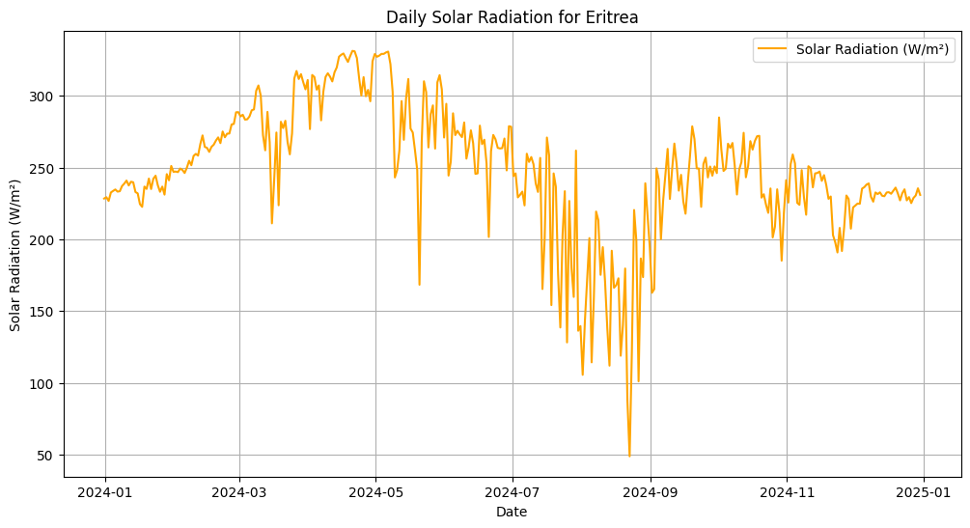
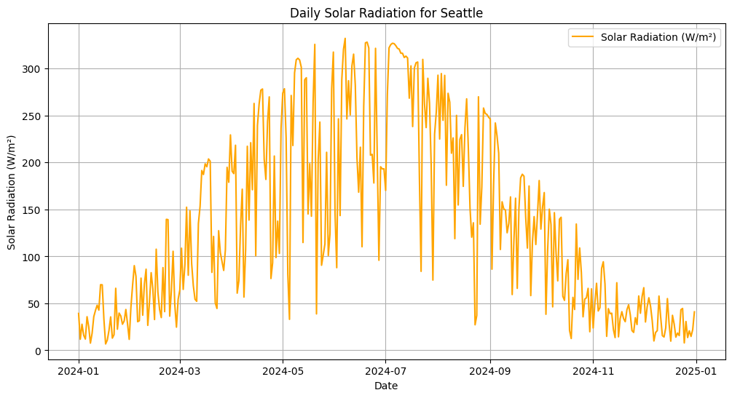
And it depends on where you live
Eritrea
Seattle

Slide 4
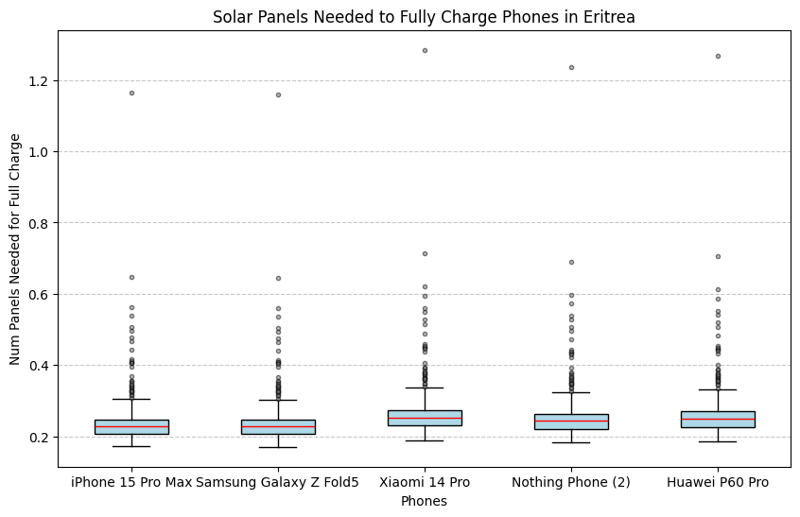
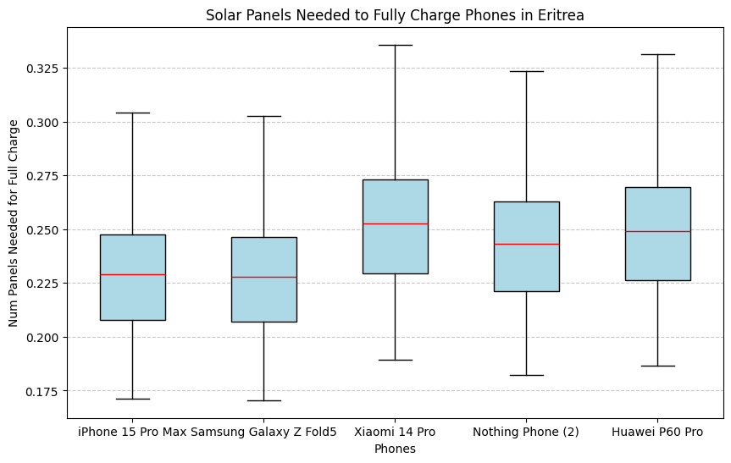
Visualization
Why choose a box and whisker graph?
Box and whisker graphs are a superior choice for data representation due to their ability to accurately convey key statistical measures.
Unlike bar graphs, which typically show only minimum and maximum values, box and whisker plots provide a comprehensive picture of data distribution by clearly displaying the median and range.
While initial data plotting may include individual points, these are often omitted in the final graph. This practice enhances clarity by preventing the dots from obscuring crucial statistical insights, thereby making the graph more effective and easier to interpret.

Slide 5
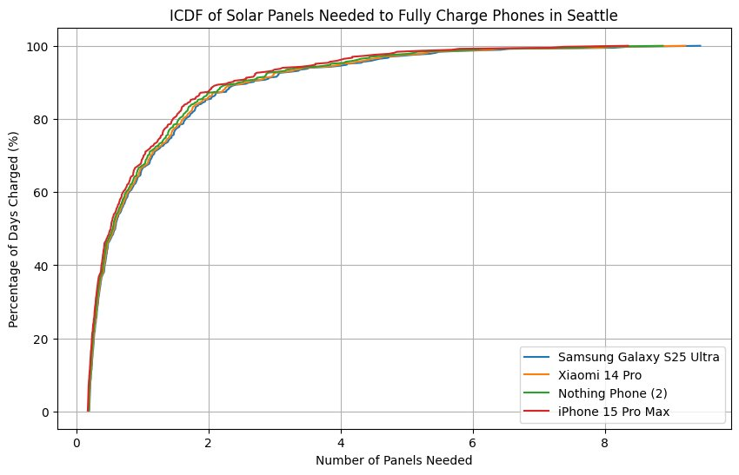
A different Visualization
If you look at this graph, you'll see that 90% of the year, you need only 2 panels to completely charge your phone.

Slide 6
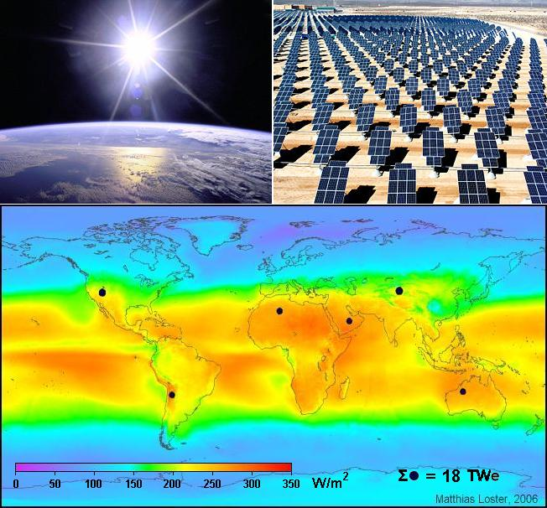
Data Sources
Visual Crossings helped us grasp a Weather API for solar panel performance estimation
It delivers critical data: solar energy, temperature, and cloud cover.
We've successfully used this API before.
Previously, it helped us predict solar farm output in Program 3.
The API offers key advantages for our project.
It's simple, accurate, and directly supports estimating solar charging needs by location year-round.

