Slide 1




Presented by sangita pari
Isolating & characterization of starch-utilizing bacteria from rice starch samples
B.sc microbiology, reg.no-200010376140,enroll no-2012211001037
Advisor- DR. ATREYI GHOSH
ASSISTANT PROFESSOR, HOD- MICROBIOLOGY

Slide 2

Topic for discussion
Content
1. INTRODUCTION
2. PROJECT GOALS
3. PROCESS-PREPARATION CULTURE MEDIA
ISOLATION OF BACTERIAL STRAINS
4. characterization of strains-
a) STARCH HYDROLYSIS TEST
b) INDOLE TEST
c) VOGES PROSKAUER TEST
d) METHYLREDTEST
e) CITRATEUTILIZATIONTEST
5. GRAM STAINING
6. RESULT
7.CONCLUSION
8. REFERENCES

Slide 3


Introduction
The starch hydrolytic amylases are the most widely used enzymes in present day industries. Glycoamylases are exo-acting amylases that produce glucose from the non- reducing end of starch and corresponding oligosaccharides. Amylases can be produced from various sources but amylases from microbes are most suitable for industrial production due to microbial short growth period, low cost effective production,eco-friendly behavior and easy manipulation of bacterial genes. Also, utilization of easily available and cheap sources of starch like rice water and potato can be used as the media and source for the isolation and growth of amylase-producing starch-utilising bacteria which highly benefits the industries as the method is cost effective and requires very limited resources.

Slide 4



Project Goals
1
2
3
Isolating starch utilising bacteria
Screening for amylase activity
Biochemical characterization
4
Contribution to microbial diversity knowledge

Slide 5
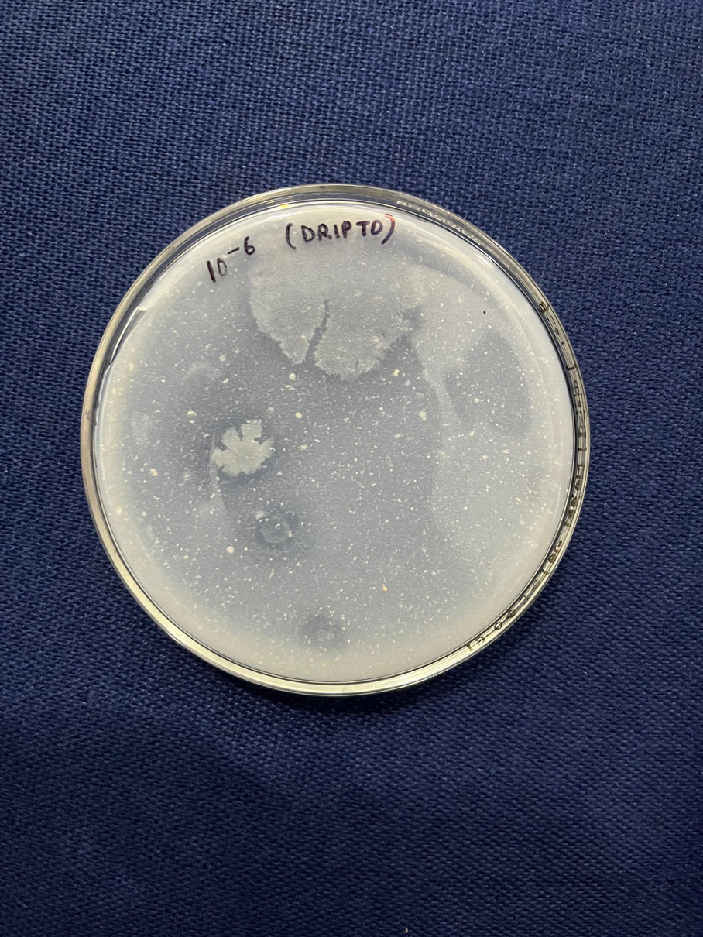
Process
1.
Preparation of culture media
rice starch agar-: ½ cup of uncooked rice is soaked in 2-3 cups of water. Rice is boiled and the starch water is strained into a conical flask and 2% agar (w/v) is added to it. After autoclaving at 120 for 15 min, the media is poured into sterilized petri plates and solidified.
2
Isolation Of Bacterial Strains
● 1ml of overnight and freshly prepared rice water samples are added to 9 ml of autoclaved water in sterilized test tube. Serial dilution was performed and spread on the plates containing starch enriched media (100 and incubated overnight at 37.
● Strains appeared on the plate containing rice starch agar media which was spread with the rice water kept overnight.
● These strains were subcultured in nutrient agar slants and stored at 4 for charecterisaton

Slide 6
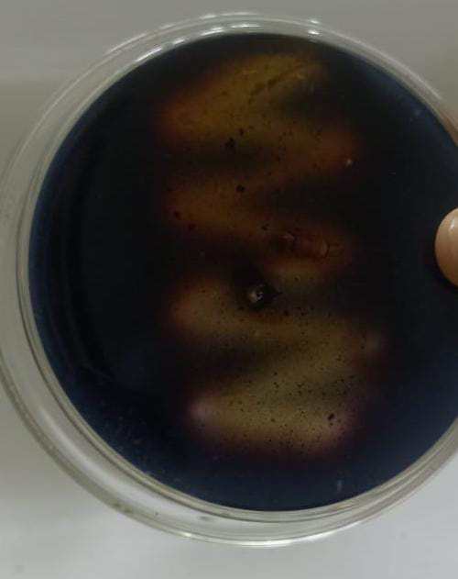
Process
3
Characterization of strains
■ Biochemical test
a) Starch Hydrolysis Test
●Inoculation- streak the bacterial isolates onto the prepared starch agar plates using an inoculating loop and Inoculated with the plates at 37°c 24 to 48 hours
● Detection of starch hydrolysis- after incubation flood the plates with iodine solution. Solution from complex with starch and gives blue black colour. If clear zones appeared around the colonies then it indicates that the bacteria produce amylase which hydrolyse the starch

Slide 7
Process
3
Characterization of strains
■ Biochemical test
b) INDOLE TEST-
This test demonstrates the ability of certain bacteria to hydrolyse amino acid tryptophan to indole by producing tryptophanase enzyme. When indole is combined with Kovac's reagent (which contains hydrochloric acid and p-dimethylaminobenzaldehyde) the solution turns yellow to cherry red.
Procedure-
● 0.8 g tryptone and 0.2 g Nacl is added to 40 ml distilled water and autoclaved at 120 and poured into sterilized test tubes.
● The test tubes were inoculated with the strains that were subcultured in liquid broth from slants . The inoculums were incubated for 24 hrs and then Kovac's reagent was added to them.
● A red coloured ring formation at the top indicates that the bacteria is positive for indole test.

Slide 8
Process
3
Characterization of strains
■ Biochemical test
c) METHYL RED TEST
- This test is done to detect the ability of the bacteria to produce and maintain stable acid end products from glucose fermentation. The fermentative enteric bacteria cause the conversion of glucose into pyruvic acid through their complex enzyme system. Pyruvic Acid enters the mixed acid pathway and forms stable acidic products and one molecule of ethanol, Carbon Dioxide and hydrogen by fermenting a single glucose molecule.
Procedure-
●0.7% peptone (w/v), 0.5% glucose (w/v) and 0.5% dipotassium phosphate (w/v) are added in 80 ml of distilled water. The glucose-phosphate broth is pored into test tubes and autoclaved.
After autoclaving, the strains are inoculated into the broth from the liquid culture and incubated for around 48 hrs. Within this time sufficient acid can be produced if mixed-acid producing bacteria are present.
● 5 drops of methyl red reagent is added to check the pH.If colour changes to red, it indicates that the bacteria resulted positive for methyl red.

Slide 9
Process
3
Characterization of strains
■ Biochemical test
d) VOGES PROSKAUER TEST-
This test is done to detect the ability of bacteria to metabolise pyruvate into a neutral intermediate called acetylmethylcarbinol or acetoin.
The acetoin will be oxidized to diacetyl after addition of KOH. The diacetyl after addition of alpha napthol reacts with the guanidine component of peptone forming a pink to red cooured polymer.
Procedure-
● 0.6 ml of alpha-napthol is added to it and shaken
● 0.2 ml of 40% KOH is added to it and shaken. Kept for 15 min.
● Appearance of red colour indicates positive result.

Slide 10
Process
3
Characterization of strains
■ Biochemical test
e) CITRATE UTILIZATION TEST-
This test is done to detect the ability of an organism to utilise citrate as the sole source of carbon.
The growth of the organism indicates the utilization of citrate. Enzyme citrase breaks down citrate into oxaloacetate and acetate which is further brokn down to pyruvate and carbon dioxide
Procedure-
●0.02% (w/v) Magnesium Sulphate, 0.1% (w/v) ammonium dihydrogen phosphate, 0.1% (w/v) dipotassium hydrogen phosphate, 0.2% (w/v) sodium citrate, 0.5% (w/v) NaCl,0.008% (w/v) bromothymol blue are added in 40 ml of distilled water.
●After autoclaving, the citrate broth is poured into test tubes and inoculated with the bacterial strains and incubated at 37. If the colour changes from green to blue, then the bacteria can utilise citrate and hence, is citrate positive.

Slide 11
Process
4
classification & identification of strain
■ GRAM STAINING
The Gram stain is a crucial, fundamental technique in microbiology, aiding in the classification, identification, and characterization of bacteria.
Prepared bacterial culture smear on the microscope slide.
Then heat fix the bacteria to the slide .
Then add primary stain(crystal violet)on it,wait 1 minutes.
Rinse the slide with distilled water
Add mordant(iodine), wait 1 minute rinse the slide with distilled water
Apply decolorization(acetone and alcohol)wait 10-20 seconds rinse slide with distilled water
Add counterstain(Safranin), wait 1 minute ,rinse slide with distilled water.
Then allow the slide dry completely
Examine the slide under microscope
Procedure-

Slide 12

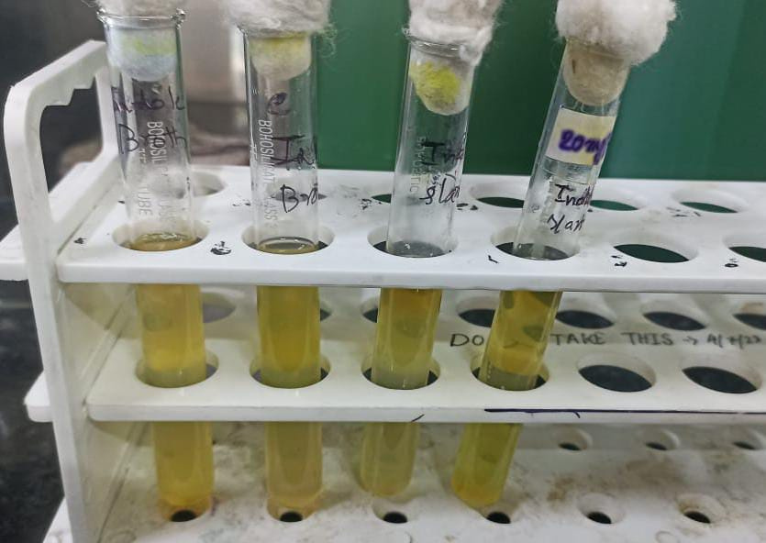
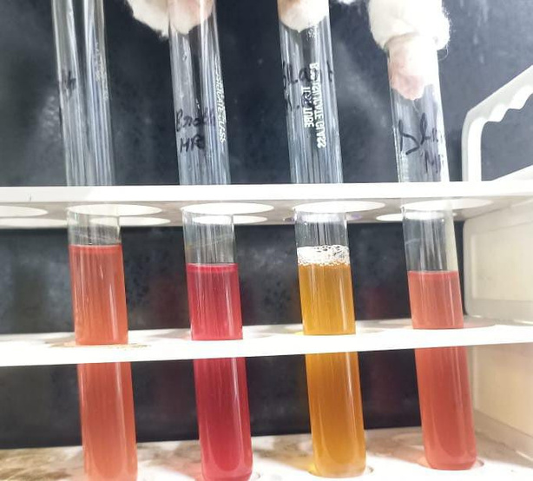
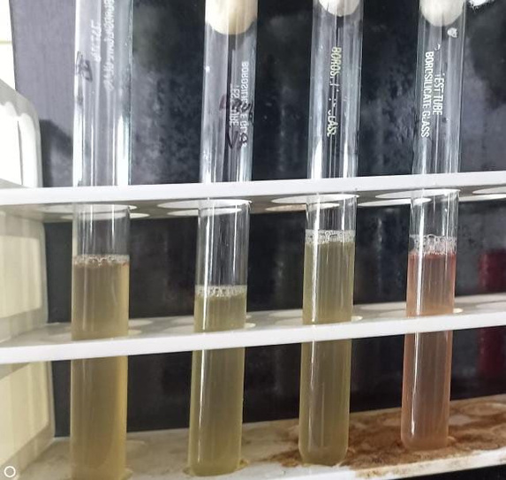
Result
Indole test-all are negative
Methyl red test-strain 1,2,4 is positive, strain 3 are negative
VP test- stain 4 are positive while stain 1 2,3 are negative

Slide 13
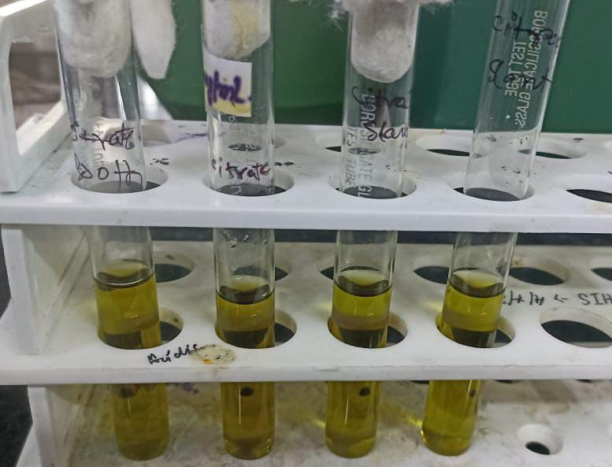
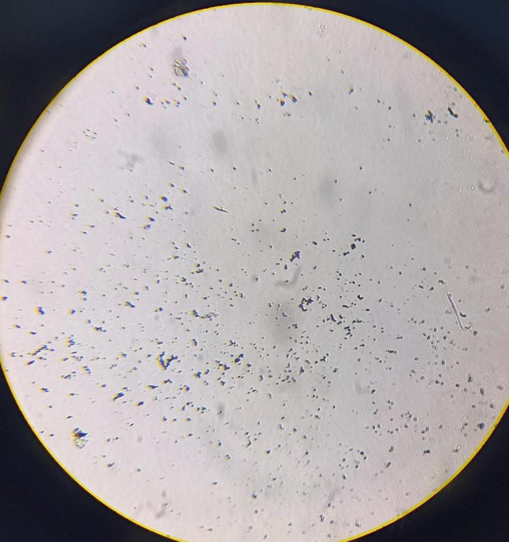
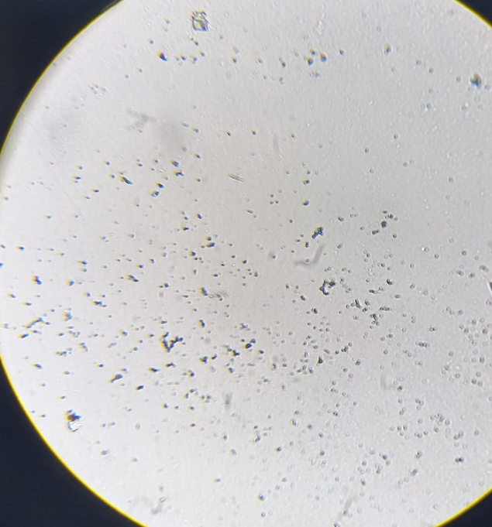
Result
Citrate utilization test-all are negative
Observations showing in 2 sample that,it is Gram Positive coccus.Appear purple or blue under the microscope. This is due to the retention of the crystal violet-iodine complex in their thick peptidoglycan layer.

Slide 14

Conclusion
In this project, the isolation and characterization of starch-utilizing from rice starch samples were successfully conducted, revealing bacterial isolates with significant amylolytic activity. Through the series of biochemical tests, including starch hydrolysis, indole production, and Voges-Proskauer reactions the metabolic capabilities and enzymatic profiles of these isolates were thoroughly evaluated. So we conclude that the bacterial strains that we isolates are able to utilize starch by producing amylase.
Screening on starch agar plates identified those with the highest amylase activity, indicated by clear zones around bacterial colonies.The identified bacterial strains with significant amylase activity and favorable biochemical traits hold promise for various biotechnological applications. Future research should focus on the optimization of enzyme production, scaling up fermentation processes, and exploring the genetic basis of starch degradation to fully harness the industrial potential of these isolates.

Slide 15
Reference
Luang-in V, Yotchaisarn M, Saengha W, Udomwong P, Deeseenthum S, Maneewan K. Isolation and Identification of Amylase producing Bacteria from Soil in Nasinuan Community Forest, Maha Sarakham, Thailand. Biomed Pharmacol J 2019;12(3)
Mittal, A., Joshi, M., Rath,S.K. et al. Isolation of Alpha Amylase -Producing Bacteria from Local Region of Ambala and Production of Amylase Under Optimized Factors Using Solid-State Fermentation. Curr Microbiol 79,375 (2022).
1.Pandey A., Nigam P., Soccol C.R., Soccol V.T., Singh D., Mohan R. Advances in microbial amylases. Biotechnology and Applied Biochemistry. 2000;31(2): 135-152.
Balakrishnan M, Jeevarathinam G, Kumar SKS, Muniraj I, Uthandi S (2021) Optimization and scale-up of a-amylase production by Aspergillus oryzae using solid-state fermentation of edible oil cakes. BMC Biotechnol 21:1-11
Kiran S, Kumari 5, Singh A, Prabha C, Kumari S (2018) Extracellular amylase production under submerged fermentation by Bacillus subtilis RK6. Int J Pharm Biol Sci 8:376-383
Akula S, Golla N (2020) 11 Significance of process parameters on fungal cellulase production. In: Srivastava N, Srivastava M, Mishra PK, Gupta VK (eds) Biofuel production technologies critical analysis for sustainability. Springer, Singapore
Okolo BN, Ezeogu LI, Mba CN (1995) Production of raw starch digesting amylase by Aspergillus niger grown on native starch sources. J Sci Food Agric 69:109-

Slide 16


Thank
you

