Slide 1
Audio Voice Over Circuit
The audio voice-over circuit is designed to effortlessly alternate between two audio sources, typically a microphone input and an external audio input, based on user desire. It guarantees higher sound quality with minimum noise, distortion, and latency.

Slide 2
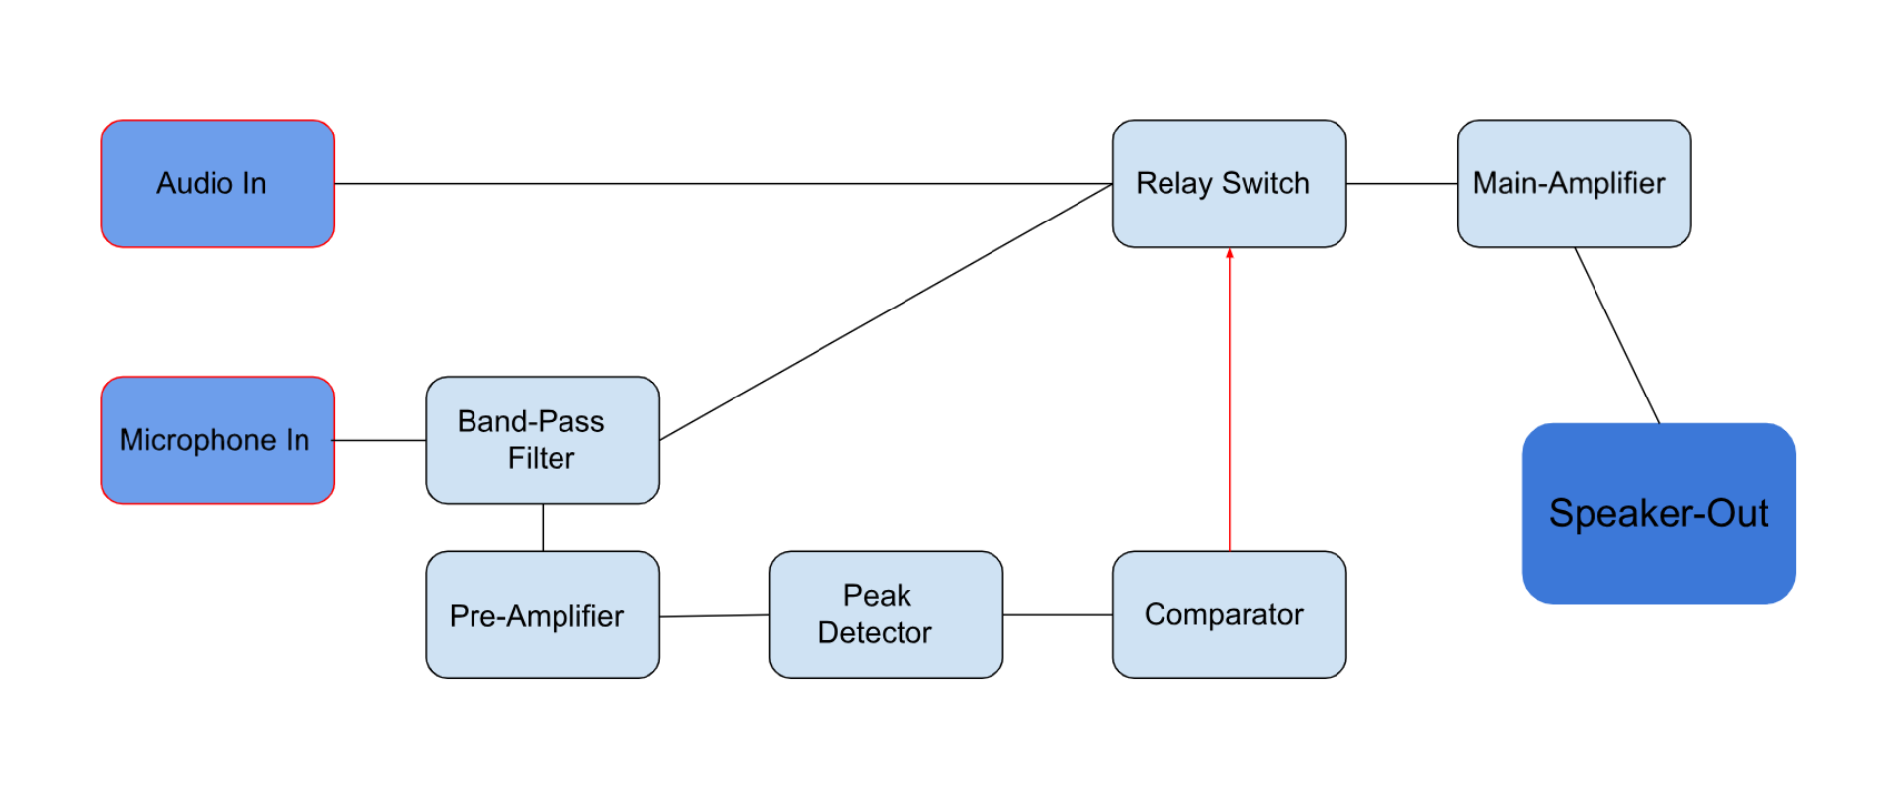

Audio Voice Over Circuit

Slide 3

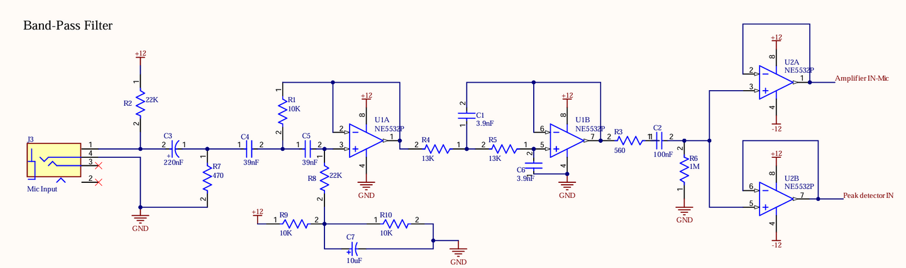


Bandpass-Filter
Used NE5532P IC containing two op-amps to build a bandpass filter.
Designed to reduce echo feedback from the microphone input.
Filter isolates the frequency range of 500-5000 Hz.
Ensures clear audio output by minimizing unwanted feedback and preserving signal quality.

Slide 4
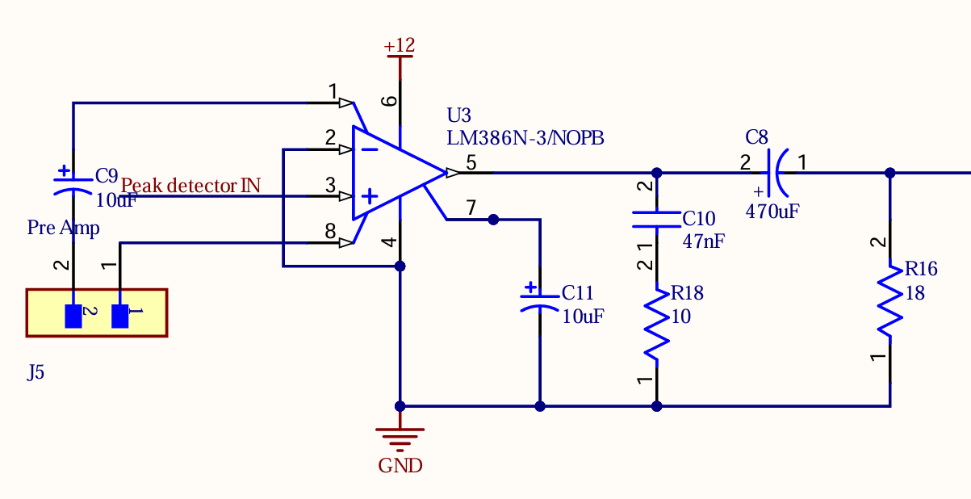
Pre-Amplifier
Band-Pass filter output drives through a pre-amplifier.

Slide 5
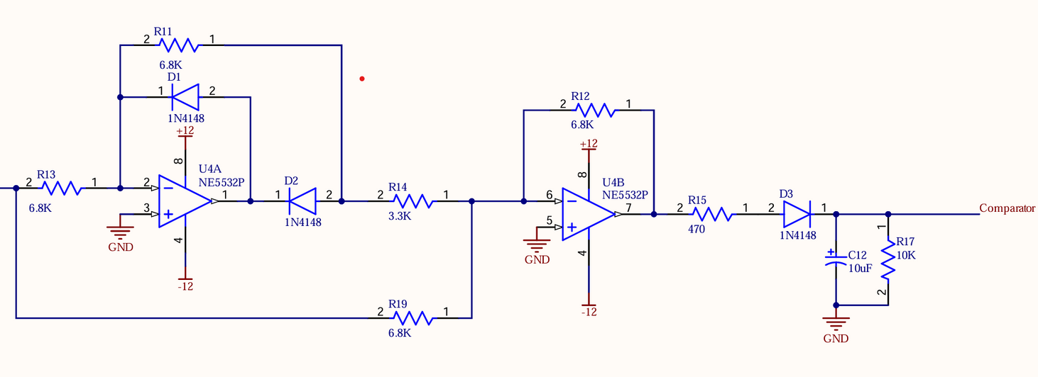
Peak-Detector
Utilized a NE5532P IC.
Circuit captures the peak amplitude of the input audio signal.
Provides a steady DC output proportional to the peak amplitude.
Output serves as the input to the comparator for threshold detection.

Slide 6
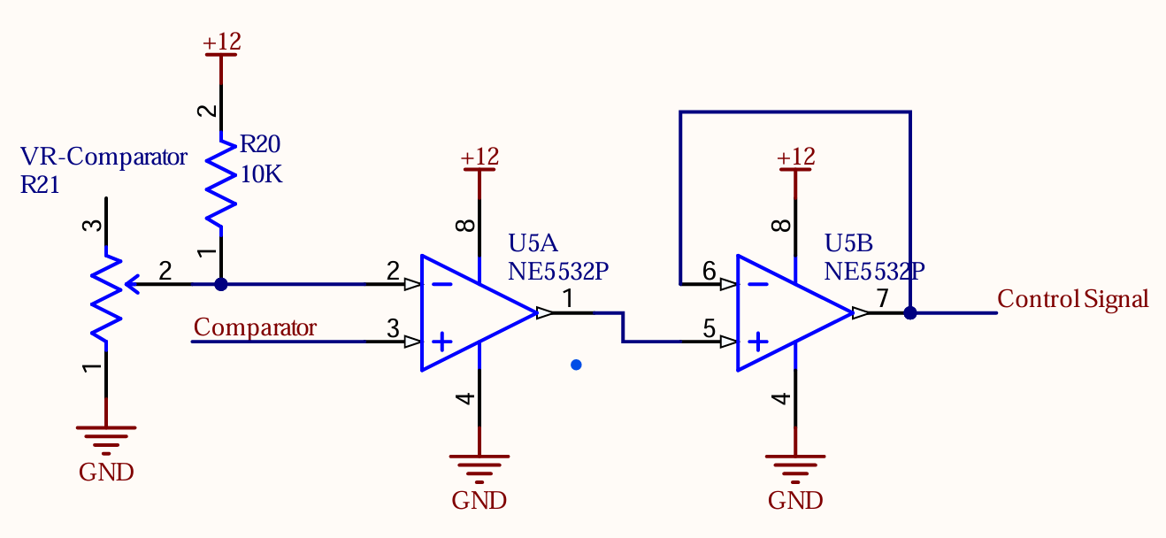
Comparator
Used another NE5532P IC.
Comparator compares the peak detector’s output with a predefined threshold voltage.
Generates a high output when the peak signal exceeds the threshold.

Slide 7
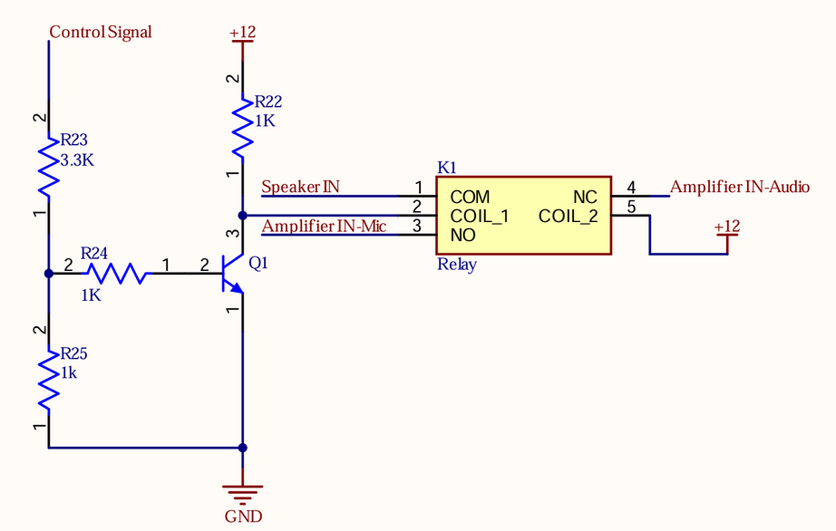
Switching-Circuit
Employed a 2N3904 NPN transistor and a relay.
Comparator's output acts as the control signal for the circuit.
Transistor output drives the relay.
Ensures efficient signal routing between,
microphone input
audio input.

Slide 8
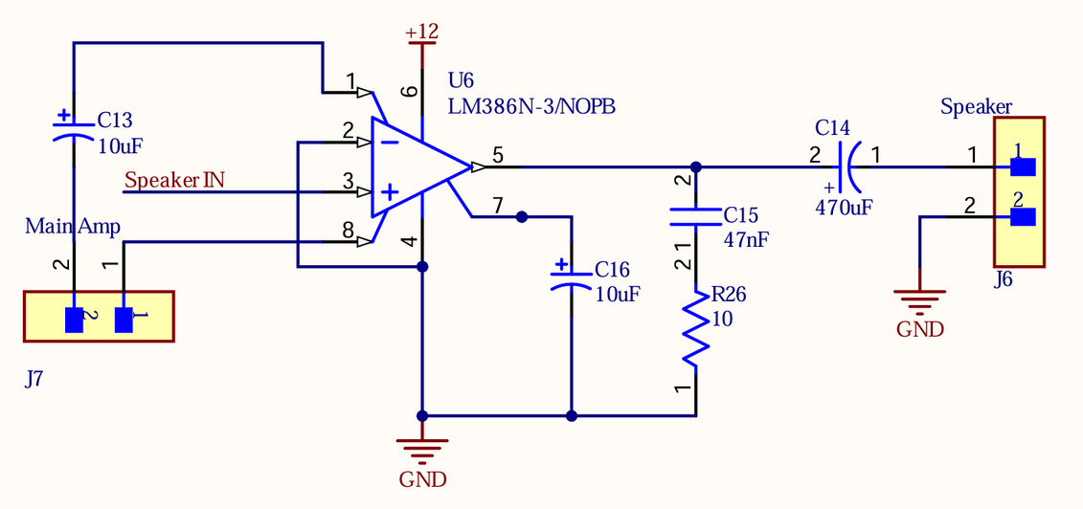
Main-Amplifier
Used the LM386N IC to build an audio amplifier.
Designed to boost the signal strength for audio applications.
Provides sufficient gain and output power for clear sound.
Amplifies the input audio signal effectively.
Ensures compactness and energy efficiency in the overall design.

Slide 9
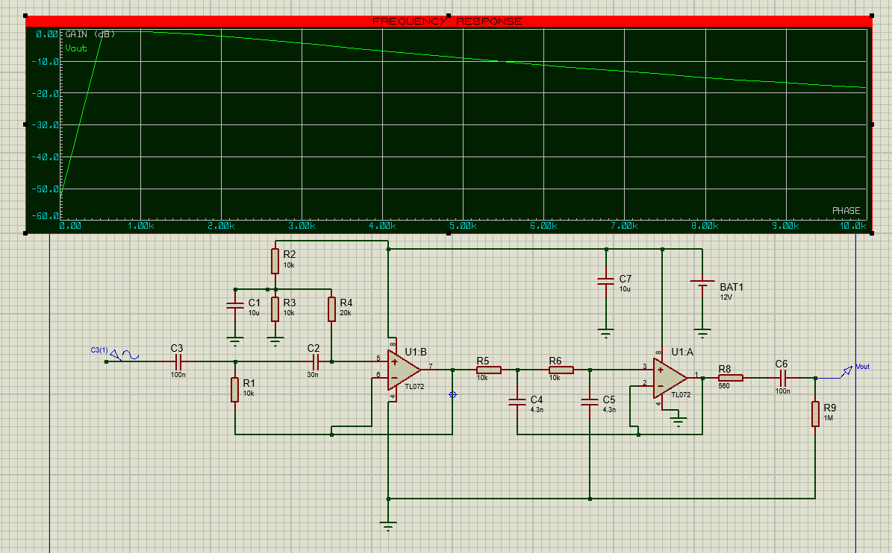

Slide 10
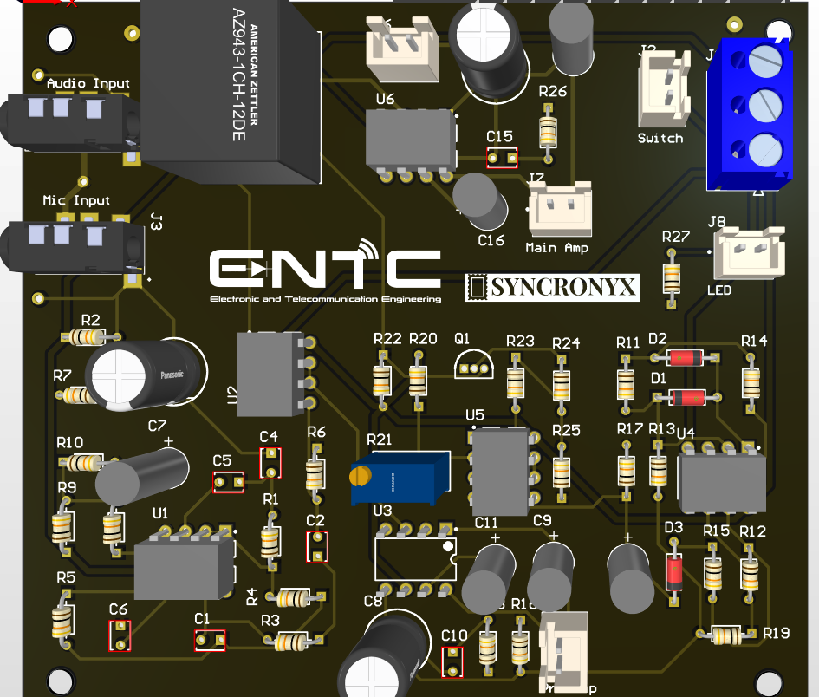
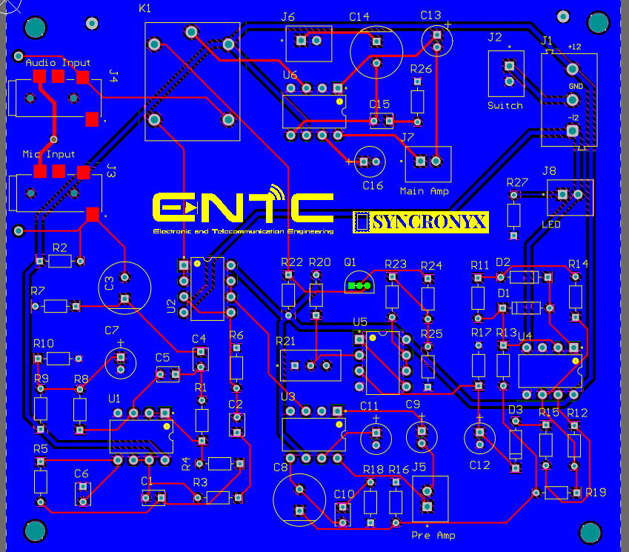
PCB Design

Slide 11
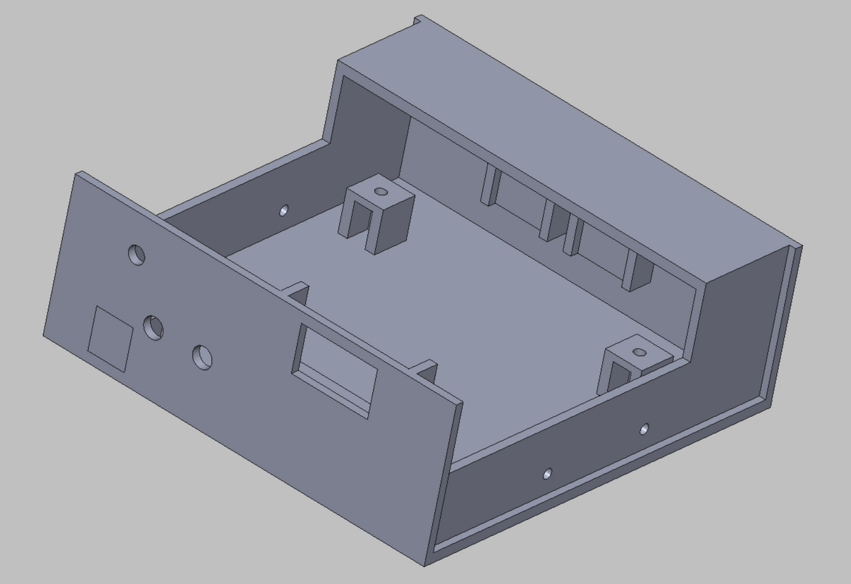
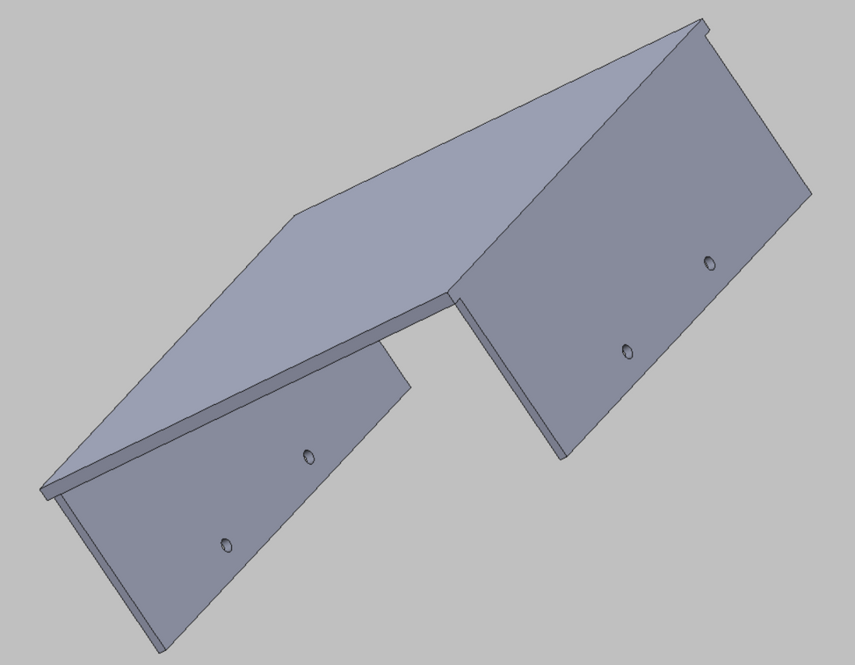
Enclosure

Slide 12
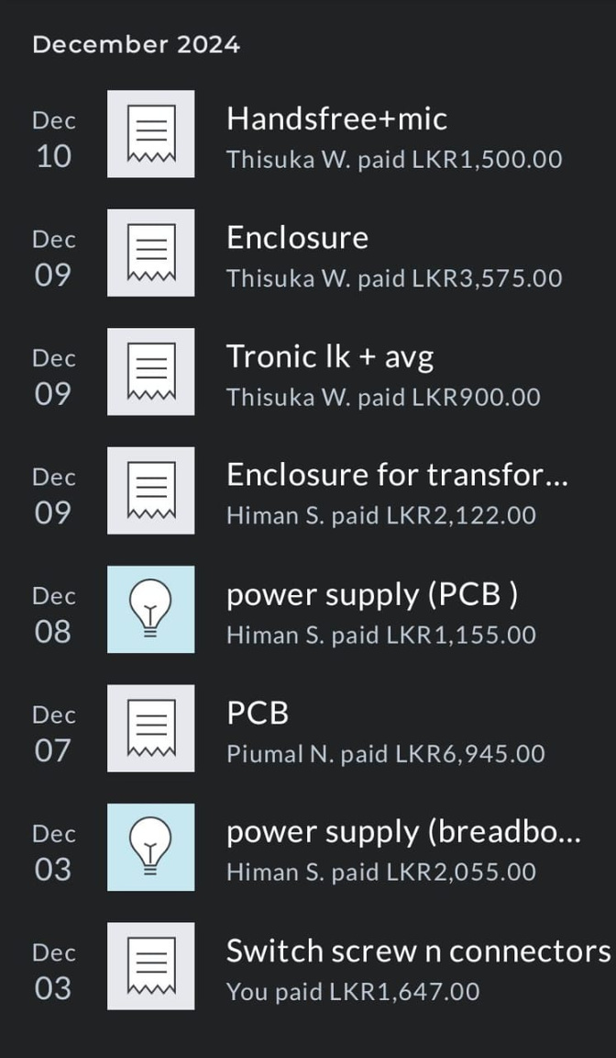
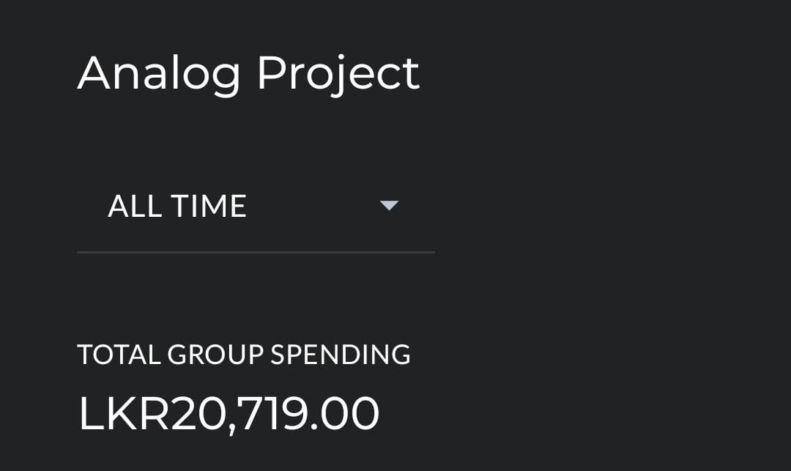

Slide 13
Thank you!!!
Team Syncronix,
Bandara.I.W.T.N 220061H
Wijenayaka.M.B.T.I 220711D
Senaweera.S.A.H.D 220596C
Sanjeewa.P.M.G.P.N 220577U

