Slide 1
Introduction to survival analysis
Day 2 Section 7

Slide 2
Topics Outline
Introduction
Methods of analysis
  Kaplan-Meier estimator
  Cox-regression analysis
  Parametric models
Key analysis issues
Example – Penetrance study
Literature reading tips
Day 2 Section 7

Slide 3
Introduction
Types of data we collect in research studies:
 | Recurrence
Post-Operative RT | Yes | No
Yes | 16 | 231
No | 38 | 11
Day 2 Section 7

Slide 4
Introduction …
 | WBC at 6 months post transplant
 | relapse | no relapse
mean | 123.11 | 127.36
(standard deviation) | (19.67) | (15.27)
Day 2 Section 7

Slide 5
Introduction …
Differences between groups for
Disease-specific survival
Relapse-free period
All-cause survival
Day 2 Section 7

Slide 6
Introduction …
Survival data has 3 features:
time of event (such as death, recurrence, new primary)
time variable does not follow a Normal distribution
events could not have happened yet (censored)
Day 2 Section 7

Slide 7
Introduction …
Survival data requires:
define event(s) of interest (such as death, recurrence, new primary)
specify start and end time of study’s observation period
select time scale
Day 2 Section 7

Slide 8
Introduction …
?
12/02
02/05
†
09/01
*
05/03
01/07
Months since diagnosis
† death from specific cancer ? lost to follow-up
↓ alive at last visit
time origin: date of diagnosis
time scale: months since diagnosis
event: death from specific cancer
Day 2 Section 7

Slide 9
Introduction …
Survival data involves both:
summarizing the survival experience of the study participants
evaluating the effect of explanatory variables on survival
Day 2 Section 7

Slide 10
Case study: penetrance estimation
Once a new gene has been discovered, it is important
to describe its population characteristics in terms of
the prevalence of its alleles and the associated risk
  Genetic relative risk (=ratio of age-specific incidence rates)
  Absolute risk functions by genotype (=penetrance)
  Variation of these two quantities according to other genes (G x G interactions) or environmental factors (G x E interactions)
  The population attributable risk (fct. of allele frequency and penetrance)
Day 2 Section 7

Slide 11
Penetrance estimation studies
Data are time-to-event and incomplete (censored, missing), so use survival methods for penetrance function estimation
Penetrance estimates in cancer critical for
  genetic counselling of carriers (screening, prophylactic surgery)
  ascribing attributable risk fraction
  suggesting presence of modifier genes or other major genes
  evaluating environmental factors
Day 2 Section 7

Slide 12
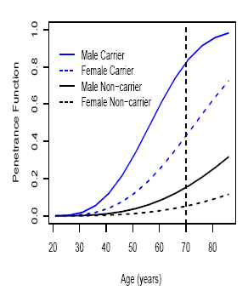
Example of penetrance estimates
Day 2 Section 7

Slide 13
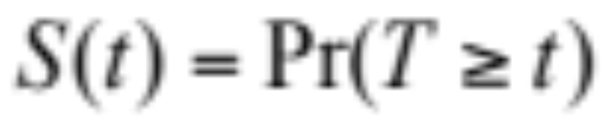
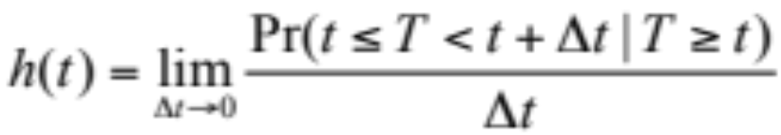
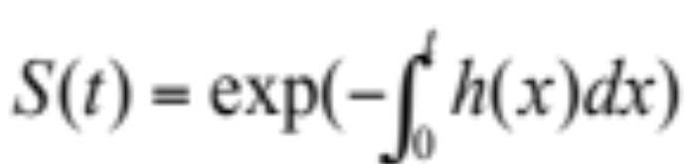
Methods
Survival data is described using:
survivor function
hazard function
related:
Day 2 Section 7

Slide 14
Methods of Analysis
Life tables
Survivor function estimators
Hazard function regression models (Cox Proportional Hazards regression, parametric regression models)
Day 2 Section 7

Slide 15
Life Tables
Oldest method (early 1900’s)
Describes the survival experience of a group of people/population
Create a frequency table of data that can handle censored values
Day 2 Section 7

Slide 16

Life Tables
0
1
2
3
# at risk at beginning of interval
# events
# withdrawals (censored events)
Day 2 Section 7

Slide 17
Life Tables
limited to grouped data
often assumes withdrawals (censored observations) occur halfway through an interval
Day 2 Section 7

Slide 18
Kaplan-Meier Curves
Kaplan-Meier (1958) or Product-Limit estimator:
  nonparametric estimate of the survivor function
  can accommodate missing data such as censoring & truncation
  estimate of absolute risk
  if largest observation censored, curve is undefined past this time point
Day 2 Section 7
Notes:
Edward Kaplan and Paul Meier were both PhD students of John Tukey in 1951
submitted manuscripts separately to JASA and asked to write joint paper by editors and their supervisor
referees were split on whether to publish (editor fortunately broke the tie!)

Slide 19
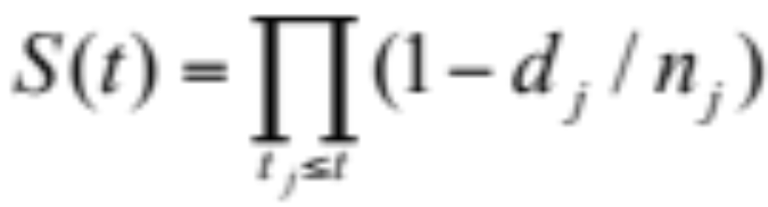
Kaplan-Meier Curves
Let t₁< t₂ < … < t_{M} denote distinct times at which deaths occur
d_{j} = # deaths that occur at t_{j}
n_{j} = # number at risk {alive & under observation just before t_{j}}
Day 2 Section 7

Slide 20
Kaplan-Meier Curves
Test whether groups have different survival outcomes, need to evaluate if estimated survival curves are statistically different
Usually employ a logrank test statistic or a Wilcoxon test statistic
Day 2 Section 7

Slide 21
Case Study: HNPCC Family Data
Hereditary nonpolyposis Colorectal Cancer (HNPCC)
  represents 2-10% of all colorectal cancers (CRC)
  generally young age-at-onset
  many relatives affected with CRC & other specific types of cancer
  autosomal dominant disease, with 6 known MMR gene mutations (MSH2 & MLH1 common)
  HNPCC carriers have 40% to 90% lifetime risk of developing CRC (vs. 6% general population)
Day 2 Section 7

Slide 22
NF HNPCC Family Data
Data set features:
  12 large families with up to 4 generations of phenotype information
  share a founder MSH2 mutation
  probands were identified after being referred to a medical genetics clinic
  considerable genotype information missing and many presumed carriers
Day 2 Section 7

Slide 23
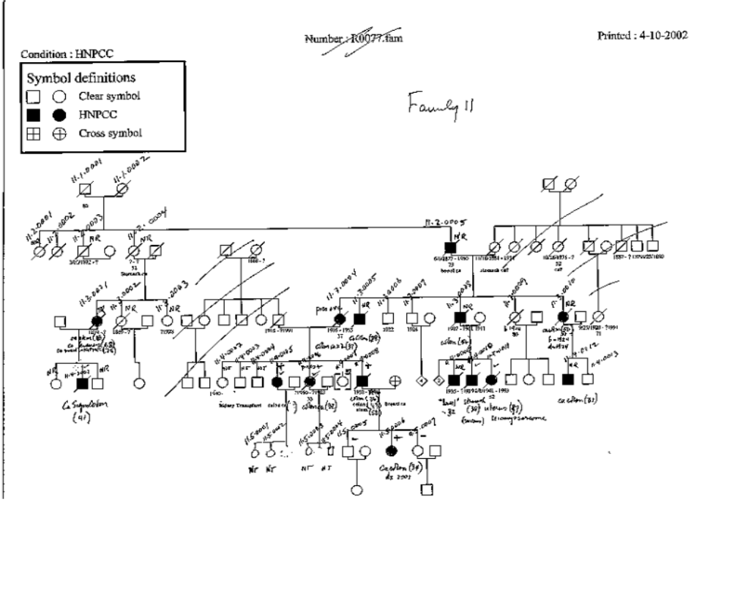
Example of HNPCC Family
Day 2 Section 7

Slide 24
NF HNPCC Family Data
Analysis done by Green et al. (2002)
Data analyzed: 302 individuals (148 Females + 154 Males)
New data set: 343 individuals (167 Females + 176 Males)
Number of events:
  CRC Deaths
Green et al. 58 53
New dataset 70 75
Day 2 Section 7

Slide 25
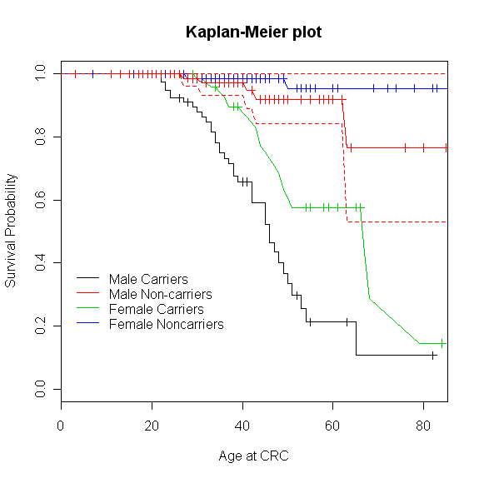
Case study: K-M penetrance estimate
R code:
KM.fit <- survfit(Surv(time,status)~mut+sex, data=CRC)
plot(KM.fit[3], conf.int=F, xlab="Age at CRC", ylab="Survival Probability", main="Kaplan-Meier plot")
lines(KM.fit[1], col=2, lty=1, type="l")
lines(KM.fit[4], col=3, lty=1, type="l")
lines(KM.fit[2], col=4, lty=1, type="l")
legend(1, 0.4, c("Male Carriers", "Male Non-carriers", "Female Carriers", "Female Noncarriers"),
col=1:4, lty=1, bty="n")
# Add confidence interval
lines(KM.fit[1], col=2, conf.int=T, lty=2, type="l")
R output
Day 2 Section 7

Slide 26
Case study: K-M penetrance estimate
R output
Day 2 Section 7

Slide 27
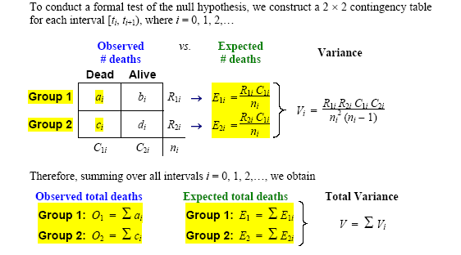
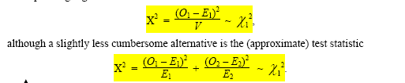
Testing diffence between groups
Log-rank test
Day 2 Section 7

Slide 28
Case study: log-rank test
R code:
survdiff(Surv(time,status)~mut, data=CRC)
survdiff(Surv(time,status)~mut+sex, data=CRC)
R output
N Observed Expected (O-E)^2/E (O-E)^2/V
mut=0 176 7 37.5 24.8 54.7
mut=1 167 63 32.5 28.5 54.7
Chisq= 54.7 on 1 degrees of freedom, p= 1.38e-13
R output
N Observed Expected (O-E)^2/E (O-E)^2/V
mut=0, sex=1 95 5 16.8 8.31 11.09
mut=0, sex=2 81 2 20.6 16.82 24.77
mut=1, sex=1 82 38 12.7 50.73 63.55
mut=1, sex=2 85 25 19.9 1.32 1.87
Chisq= 79.7 on 3 degrees of freedom, p= 0
Day 2 Section 7

Slide 29
Methods of Analysis
Other estimators:
  Empirical Survivor function (if no censored data)
  Nelson-Aalen estimator of cumulative hazard function (better properties for small sample sizes and gives a smooth estimate)
Day 2 Section 7
Notes:
H(t) is used to estimate h(t) and as a diagnostic tool for assessing model fit

Slide 30
Regression Models
Regression Models for Survival Data
adjust survival estimates for additional variables (essential step for non-randomized trials)
evaluate variables for their prognostic importance
Day 2 Section 7

Slide 31
Regression Models
semi-parametric model {Cox Proportional Hazards (PH) model}
parametric regression models {accelerated failure time (AFT) models}
Day 2 Section 7

Slide 32
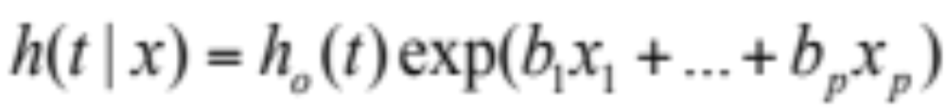
1. Cox PH Regression Models
Baseline is estimated separately
exp(b_{i}) is interpreted as a hazard ratio (or relative risk)
PH assumption requires that
exp(b_{i}) are constant across time, between groups
but more general models allow predictors to vary over time
Day 2 Section 7

Slide 33
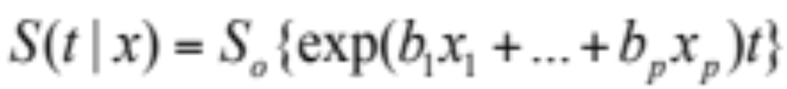
2. AFT Regression Models
survival curve is stretched or shrunk by effects of predictors
exp(b_{i}) is interpreted as a time ratio
distribution assumption needs to be assessed
predictors assumed to be constant
Day 2 Section 7

Slide 34
Regression Models
AFT or Cox PH regression model?
Cox PH regression models most popular
AFT can be more powerful (i.e. detect smaller effects)
different interpretations of exp(b_{i})
Day 2 Section 7

Slide 35
Regression Models
Key Analyses Issues
patients are independent
censoring is uninformative (e.g., not too sick to come in for follow-up visit)
study duration is appropriate (length of follow-up for median patient)
covariates must be used to adjust for possible survival differences which can bias results
Day 2 Section 7

Slide 36
Case study: Cox regression model
R code:
Cox.fit <- coxph( Surv(time, status)~ mut + sex, data=CRC)
plot( survfit(Cox.fit, newdata=list(mut=1, sex=1)),col=1, main="Cox PH model", xlab="Age at CRC",
ylab="Survival Probability")
lines( survfit( Cox.fit, newdata=list(mut=0, sex=1)), col=2)
lines( survfit( Cox.fit, newdata=list(mut=0, sex=1)), col=2,conf.int=T, lty=2)
lines( survfit( Cox.fit, newdata=list(mut=1, sex=2)), col=3)
lines( survfit( Cox.fit, newdata=list(mut=1, sex=2)), col=3, conf.int=T, lty=2)
lines( survfit( Cox.fit, newdata=list(mut=0, sex=2)), col=4)
lines( survfit( Cox.fit, newdata=list(mut=0, sex=2)), col=4, conf.int=T, lty=2)
legend(13, 0.3, c("Male Carriers", "Male Noncarriers", "Female Carriers", "Female Noncarriers"),
lty=1, col=1:4, bty="n" )
Day 2 Section 7

Slide 37
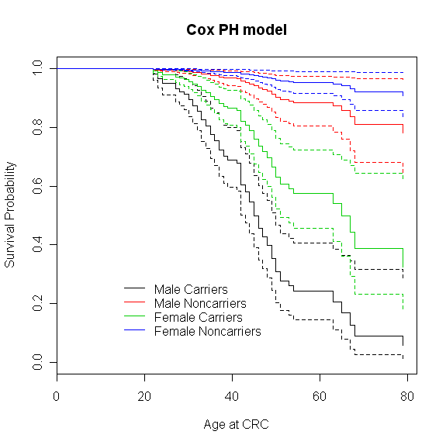
Case study: Cox regression model
Day 2 Section 7

Slide 38
Model Checking
Diagnostics for evaluating:
  undue influence of a few individuals’ data
  PH assumption
  omitted or incorrectly modelled prognostic factors
  competing risks
Plot model-predicted curve versus KM curve
Day 2 Section 7

Slide 39
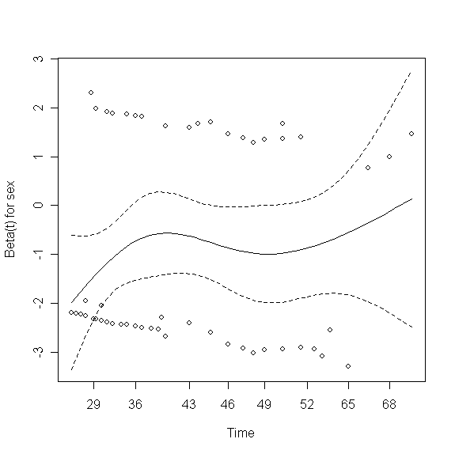
Case study: model assumptions
Checking the proportional hazards assumption of the COX model using Schoenfeld residuals:
R code:
Cox.resid<-cox.zph(Cox.fit)
plot(Cox.resid)
R output
rho chisq p
mut 0.105 0.798 0.372
sex 0.130 1.139 0.286
GLOBAL NA 2.025 0.363
Day 2 Section 7

Slide 40
Case study: stratification
If the assumption of proportional hazards is not met, it is possible to use some stratification:
R code:
Cox.strat.fit <- coxph( Surv(time, status)~ mut+strata(sex), data=CRC)
plot( survfit( Cox.strat.fit, newdata=list(mut=1))[1], main="Stratified Cox PH model")
lines( survfit( Cox.strat.fit, newdata=list(mut=1))[2], col="blue", main="Cox PH model")
#Add CIs
lines( survfit( Cox.strat.fit, newdata=list(mut=1))[1], conf.int=T, lty=2)
lines( survfit( Cox.strat.fit, newdata=list(mut=1))[2], conf.int=T, lty=2, col="blue", main="Cox PH model")
legend(13, 0.4, c("Male Carriers","Female Carriers"), col=c("black","blue"), lty=1, bty="n")
Day 2 Section 7

Slide 41
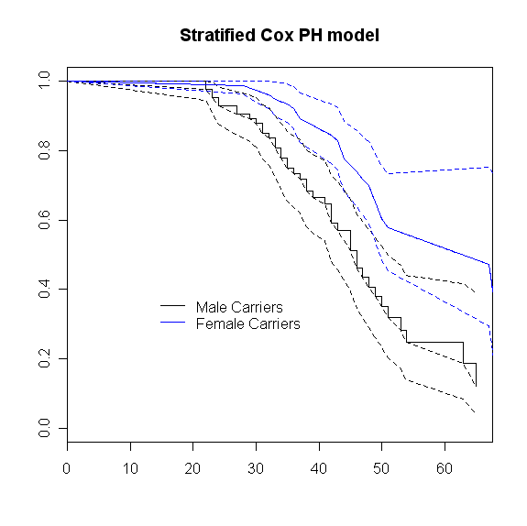
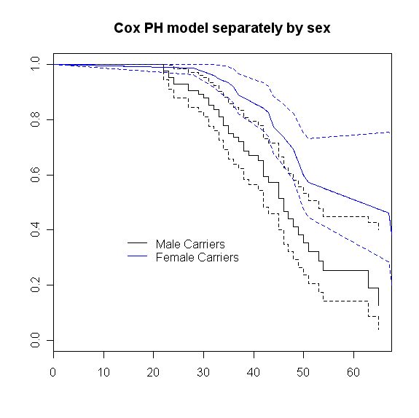
Case study: stratification
Day 2 Section 7

Slide 42
Case study: cluster effect
Individuals are not indepedent but correlated within families. We need to account for this correlation in the estimation procedure.
R code:
Cox.fit.cl <- coxph( Surv(time, status)~ mut+cluster(fam.ID), data=CRC)
R output
coef exp(coef) se(coef) robust se z p
mut 2.39 10.9 0.401 0.527 4.53 6e-06
Likelihood ratio test=61.4 on 1 df, p=4.55e-15 n=343 (280 observations deleted due to missingness)
Day 2 Section 7

Slide 43
Case study: parametric models
R code:
fit.wei <- survreg( Surv(time, status)~ sex+mut, dist="weibull", data=CRC)
fit.log <- survreg( Surv(time, status)~ sex+mut, dist="loglogistic", data=CRC)
fit <- fit.wei
lambda <- exp(-fit$coef[1])
rho <- 1/fit$scale
beta <- -fit$coef[-1]*rho
age <- 10:80
y.male.carr <- 1-exp(-(lambda*age)^rho*exp(1*beta[1] + 1*beta[2]))
y.male.noncarr <- 1-exp(-(lambda*age)^rho*exp(1*beta[1] + 0*beta[2]))
y.female.carr <- 1-exp(-(lambda*age)^rho*exp(2*beta[1] + 1*beta[2]))
y.female.noncarr <- 1-exp(-(lambda*age)^rho*exp(2*beta[1] + 0*beta[2]))
plot(age, y.male.carr, type="l", main="Weibull Model",
xlab="Age at CRC", ylab="Cumulative Probability")
lines(age, y.male.noncarr, lty=2, col="black")
lines(age, y.female.carr, lty=1, col="blue")
lines(age, y.female.noncarr, lty=2, col="blue")
legend(13,0.9, c("Male Carriers", "Male Noncarriers", "Female Carriers", "Female Noncarriers"),
lty=c(1,2,1,2), col=c("black","black","blue","blue"), bty="n")
Day 2 Section 7

Slide 44
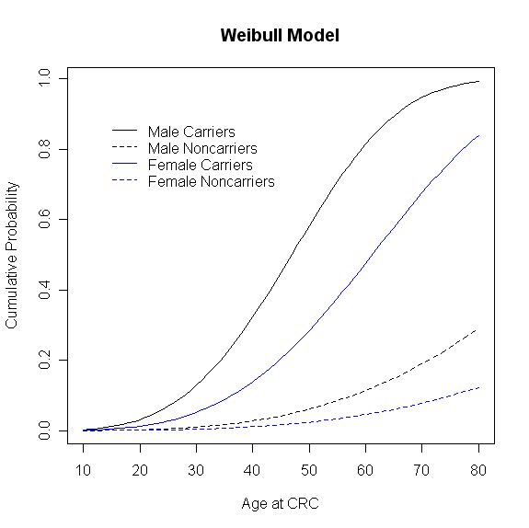
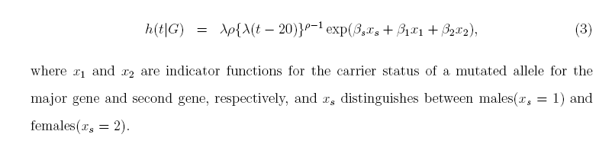
Case study: parametric models
Day 2 Section 7

Slide 45
Summary
evaluate all assumptions (proportional hazards, distributions)
assess regression model fit (influential observations, overall fit, predictors)
assess whether predictors are independent or vary jointly (interaction)
can get individual survival estimates using predicted values
Day 2 Section 7

Slide 46
Other points
Consider study design power
To detect effects depends on number of events, not number of patients
Rule of thumb is 10 events per predictor
Be aware of competing risks
Day 2 Section 7

