Slide 1

Infosys Springboard Internship 5.0
Presentation on
Voice-Based Patient Call System

Slide 2

Problem Statement
The initiative Healthcare: An Overview voice-activated patient call system utilizing Azure OpenAI to facilitate smooth communication between patients and nurses. Supported by Autonomous AI Agents, Speech Services, and NLP, the system handles patient requests, prioritizes them, and alerts nurses through a mobile app, enhancing response times and patient care.

Slide 3
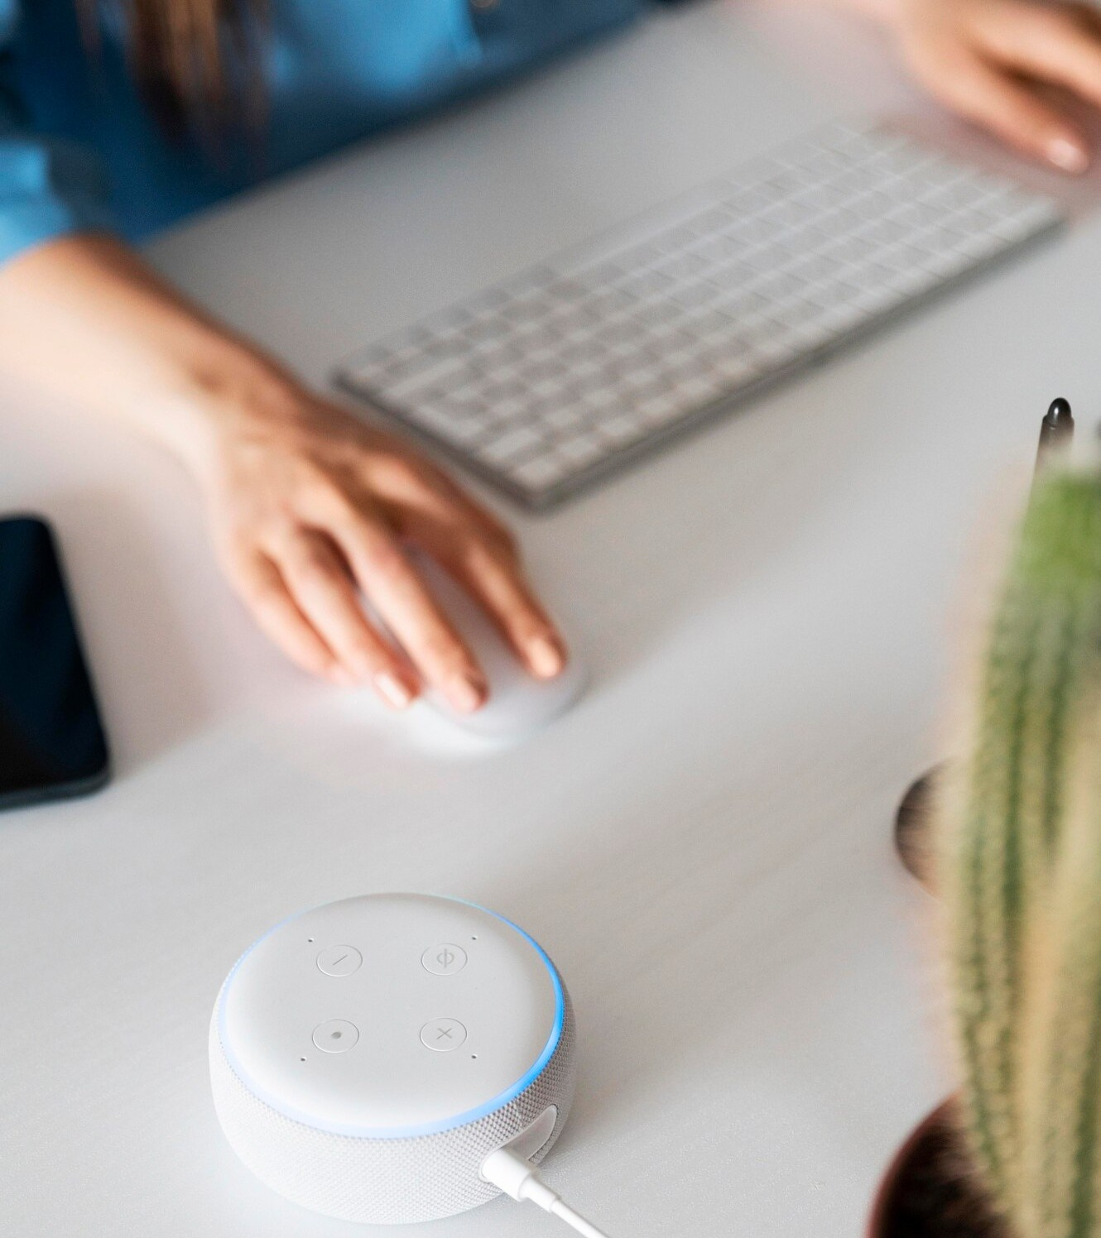
Motivation
Enhances communication in healthcare environments.
Accelerates response to urgent patient requirements.
Decreases nurse workload while improving the quality of patient care.
Offers a streamlined and easy-
to-use solution for medical institutions.

Slide 4
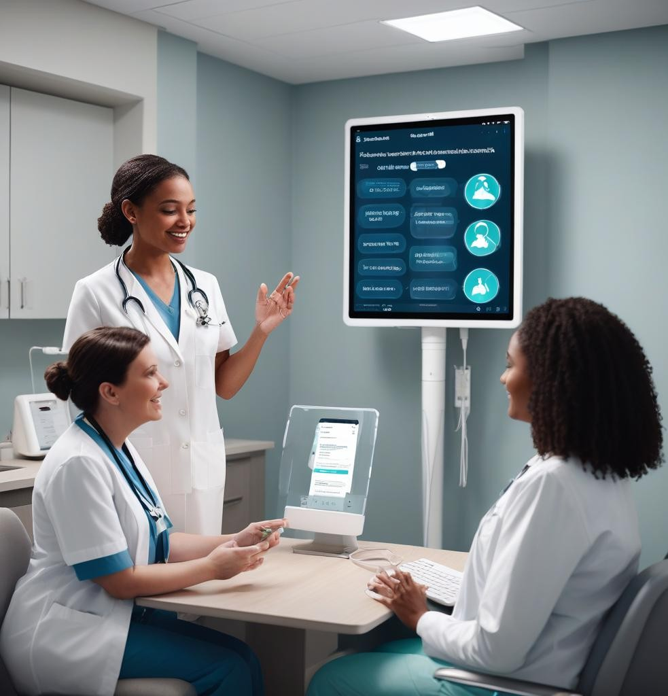
Objectives
Create an intuitive voice-activated for patients. Build an AI-driven system to manage and prioritize patient inquiries. Facilitate effective communication between patients and nursing staff.
Improve patient care and decrease
response times.

Slide 5
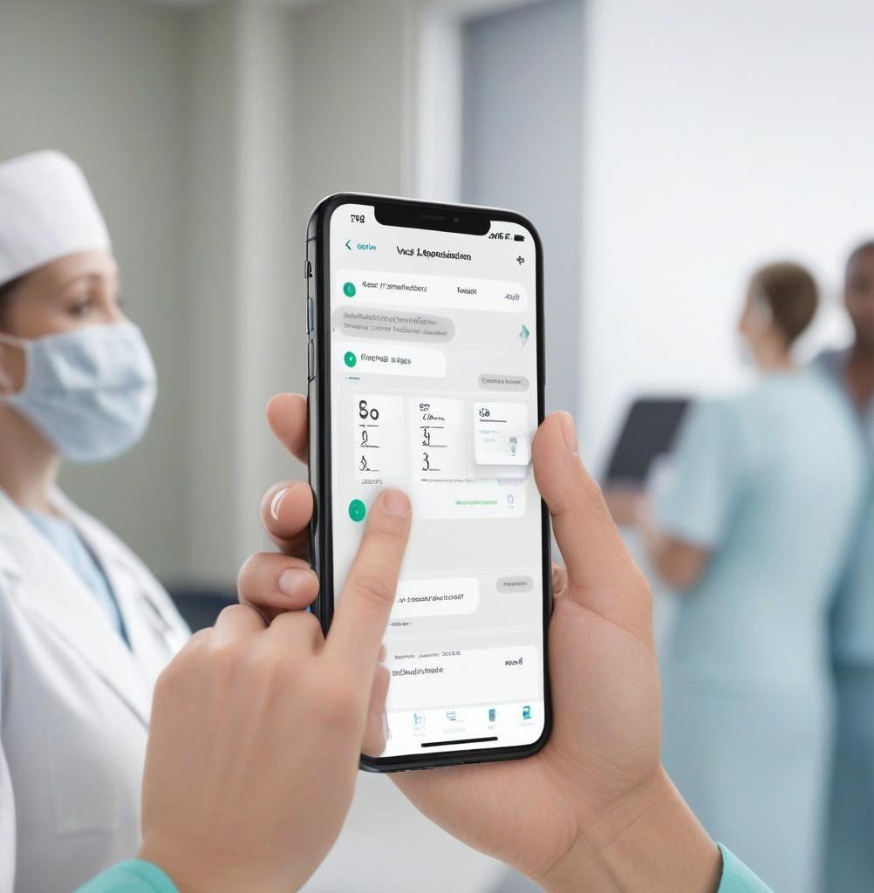
Key Features
AI-Powered Voice Recognition: Converting patient voice commands into actionable tasks.Smart Prioritization: Categorizing requests by urgency.Real-Time Notiﬁcations: Sending immediate updates to nurses via a mobile app.Admin Monitoring: Allowing administrative staff to track task status and escalate unattended
requests.

Slide 6
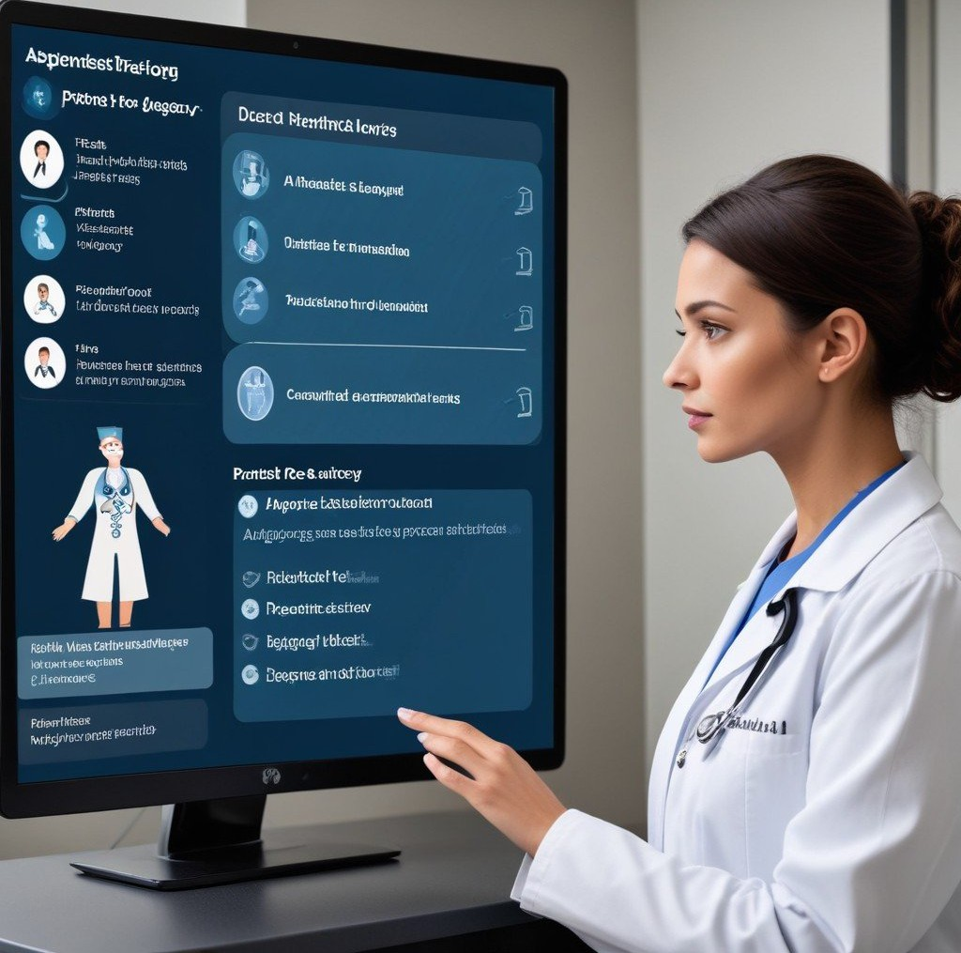
System Workflow
Patients use voice commands via the application to request assistance. The AI model processes this voice data using NLP techniques. Tasks are prioritized by urgency and assigned to the relevant staff. Nurses receive real- time alerts for immediate response to patient requests, while administrators oversee system performance and
address issues.

Slide 7
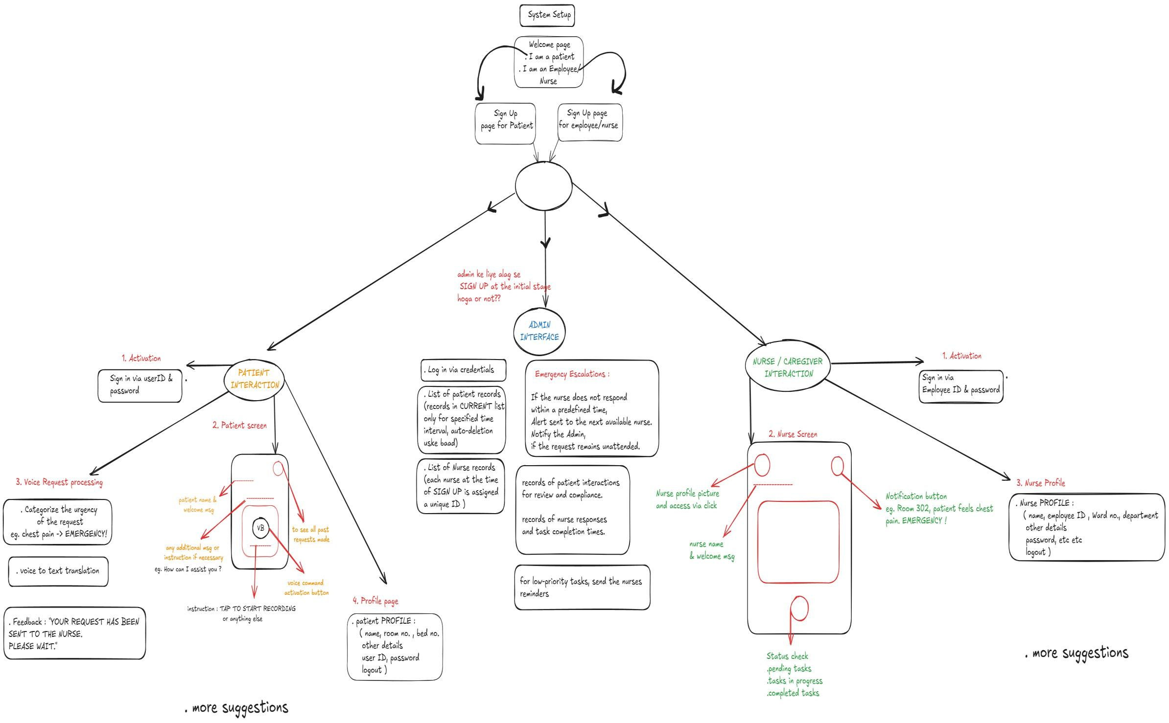
User Flowchart
An AI-powered voice communication system streamlines patient requests, nurse task management, and admin monitoring, ensuring faster response times in healthcare.

Slide 8
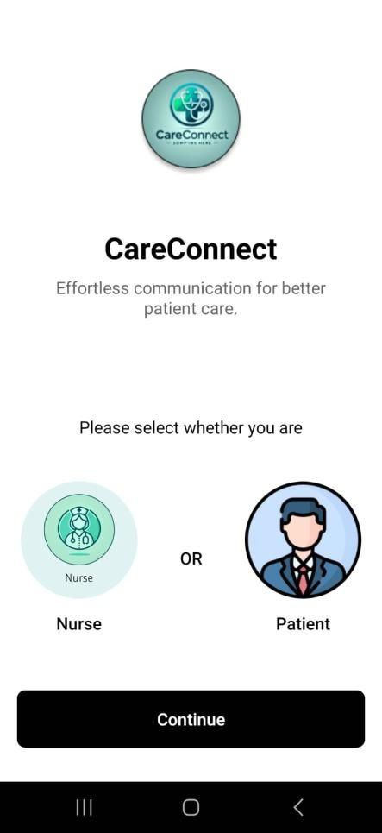
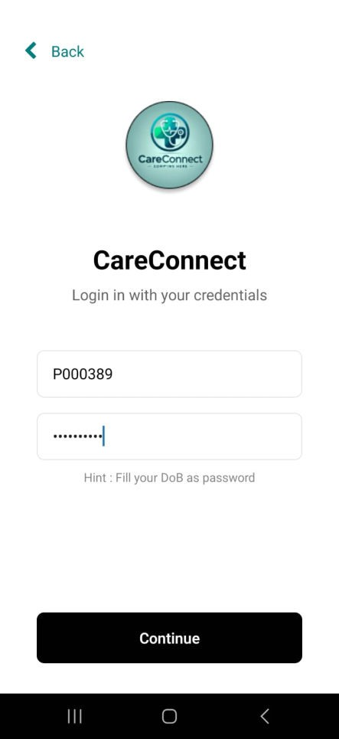
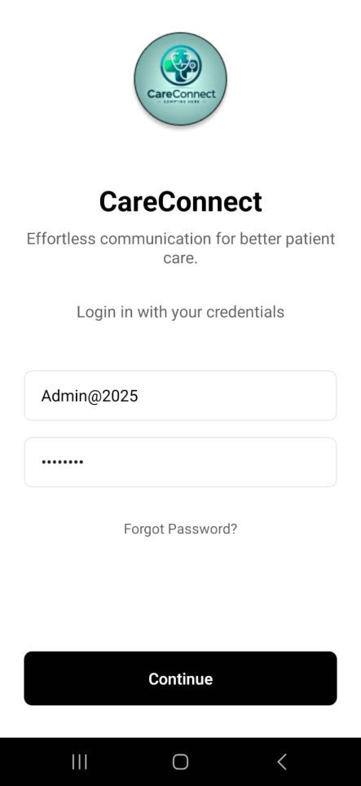
User Interfaces Samples
Presented below is a visual depiction of
the samples.

Slide 9


Future Trends in AI Voice Tech
The future of AI-powered voice communication in healthcare looks promising. Emerging trends include
, voice recognition advancements, and integration with services, paving the way for a more connected healthcare ecosystem.

Slide 10



Conclusion and Futurє Outlook
In conclusion, AI-powered voice communication systems hold immense potential to transform healthcare. By addressing challenges and focusing on ethical practices, we can leverage these technologies to create a more , , and
healthcare system.

