Slide 1
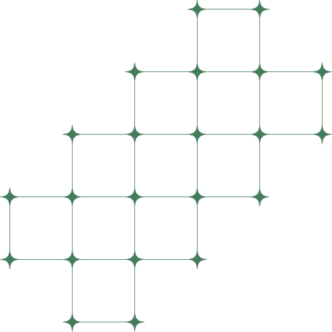


Walchand College of Engineering, Sangli
Dept. of Computer Science and Engineering, TY (A)
MINI PROJECT-I (7CS345) — FINAL EVALUATION,
2026-27
PROMPTOPT -
TOKEN-EFFICIENT PROMPT
OPTIMIZATION FOR LLMS
Team Members
Piush U. Gogi - 255200005
Nirzara A. Manade - 255200006
Siddhi S. Bolaikar - 255200008
Under the Guidance of -
Prof. A.S. Pawar
Notes:
Piush. Good morning. We are Piush, Nirzara and Siddhi; our guide is Prof. A. S. Pawar. PromptOpt takes a vague prompt, makes it clear and short for the AI you use, shows every change, and we measured that it saves tokens. We will follow one example prompt through the whole system.

Slide 2



AGENDA
1
The Problem
2
What Exists & the Gap
3
Our Goal
4
Our Data
5
One Example, Start to Finish
6
Results
7
Testing & the Working App
8
Challenges & Next Steps
Notes:
Piush. Problem, what exists, our goal and our data; then one example through every step; then results, testing, the app and what comes next.

Slide 3
THE PROBLEM
People type short, vague prompts. The AI has to guess, so it writes long answers nobody asked for, and every extra word costs tokens, time and money.
A REAL EXAMPLE
OUR SURVEY OF STUDENTS AND DEVELOPERS
The user types: “hey can you just tell me if this review is good or bad”
+ a short phone review
72%
run out of tokens very quickly
The AI answers with a whole page: a heading, positive points, negative points and a closing paragraph.
166 tokens in the answer alone
58%
need several prompts to get one answer
50%
often or very often ask the AI again
The user only wanted one word: good or bad.
Notes:
Piush. The problem in one line: vague prompts make the AI guess and write long answers, which costs tokens. Example: a student pastes a phone review and asks 'is this good or bad'. The AI writes a whole page, 166 tokens, when one word was enough. Our survey: 72% run out of tokens quickly, 58% need several prompts for one answer, half often ask again.

Slide 4
GAP ANALYSIS
Feature | PO.tools | Aiven | BenchLM | SiteGPT | PromptOpt
Rewrite prompts | ✓ | ✓ | ✓ | ✓ | ✓
Goal/Framework customization | Limited | ✓ | Limited | ✓ | ✓
Preserve constraints | ✗ | - | ✓ | - | ✓
LLM output evaluation | ✗ | ✗ | ✗ | ✗ | ✓
Token efficiency report | - | ✓ | - | - | ✓
Multi-stage pipeline | ✗ | ✗ | ✗ | ✗ | ✓
Comprehensive reporting | ✗ | ✗ | Partial | ✗ | ✓
Access | Free | Free | Limited | Free | Self-hosted
No automated Evaluation of optimized prompts to actual prompts
Limited or unclear handling of constraints and requirements
No systematic measurement of token efficiency with quality trade-offs
Absence of multi stage optimization pipeline combining rule based and Lora methods
Key Gaps Identified
Notes:
Piush. Existing tools rewrite prompts, but none checks the new prompt on a real AI, none reports input and output tokens together, and none mixes fixed rules with a small trained model. Those four gaps are what we built PromptOpt for.

Slide 5
OUR GOAL
1
To find what a prompt is missing
answer format, length, language, or which text “this” means
2
To fix it with simple rules
and show every change, before and after
3
To use a small AI model only when the rules are stuck
trained by us, checked before it is used
4
To write the prompt the way each AI likes it
GPT, Gemini or Claude: same content, their layout
5
To prove it with numbers
fewer tokens, same or better answers, on prompts never seen before
Notes:
Piush. Five goals: find what is missing, fix it with simple rules and show every change, call a small AI model only when the rules are stuck, write the prompt in the layout each AI prefers, and prove all of it with numbers on prompts the system never saw.

Slide 6

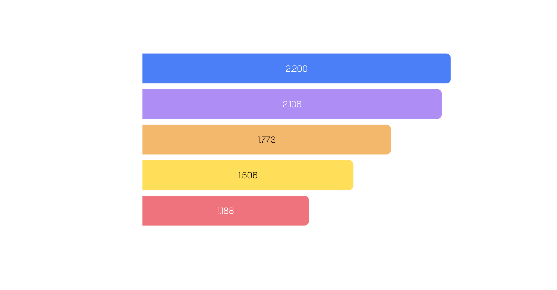
OUR DATA
1
Real requests
from two public datasets: Dolly (text tasks) and CodeAlpaca (code)
2
Vague + clear version
an AI wrote how a rushed user would type it, and a clear version
3
Checked by computer
drift, missing data, too long; dropped data put back
4
Checked by us
330 pairs read by the three of us and our guide: 295 kept
5
Split once
4,509 to learn from · 149 to tune · 482 to test, used only once
Notes:
Piush. No dataset pairs a vague prompt with a clear one, so we built it. We took real requests from Dolly and CodeAlpaca; an AI wrote a vague and a clear version of each; the computer checked them and put back data that was dropped; and we three plus our guide read 330 pairs and kept 295. Result: 5,184 pairs, about 1,000 per task type. 482 are kept aside and used only once, for the final test.

Slide 7
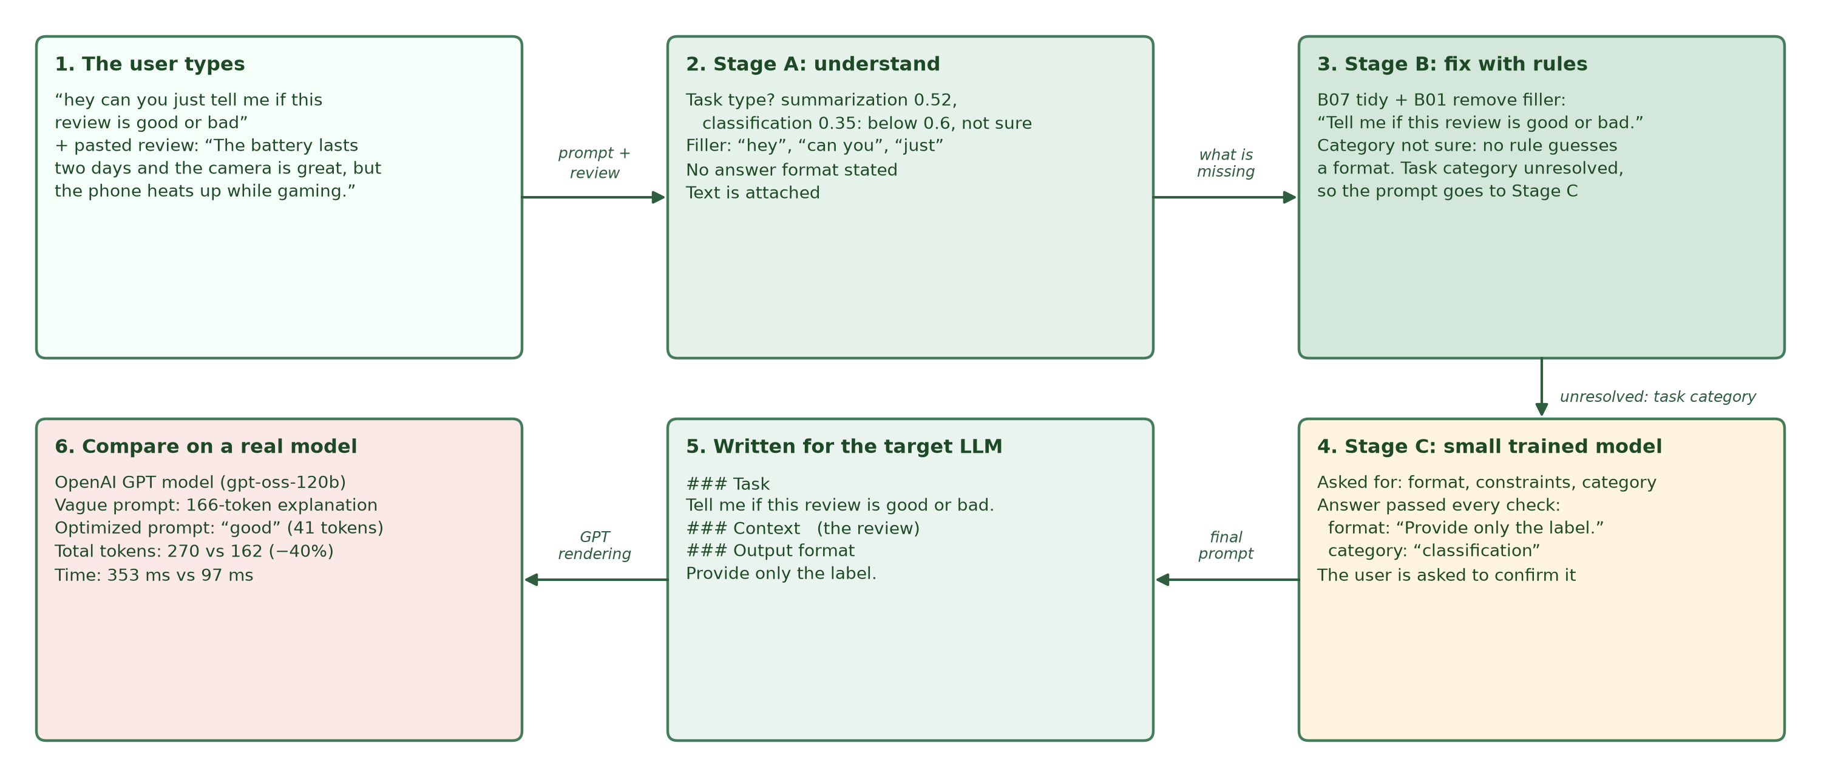






ONE EXAMPLE, START TO FINISH
Notes:
Nirzara. Here is the whole journey of our example. 1, the user types the vague prompt with the review. 2, Step A understands it. 3, Step B fixes it with rules. 4, Step C, a small model, fills what the rules could not. 5, the prompt is written for GPT. 6, Compare runs both prompts on the same AI. Let us go step by step.

Slide 8
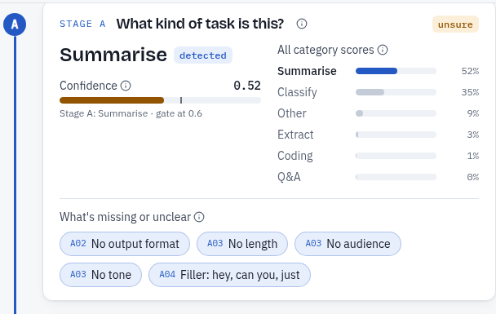
STEP A: UNDERSTAND THE PROMPT
What kind of task is it?
Summary 52%, sorting into a label 35%. Below 60% means “not sure”, so nothing will be guessed.
What is missing?
No answer format. Filler words: “hey”, “can you”, “just”.
How does it decide?
It compares the prompt with 9,000+ example prompts from our data and checks it with word rules.
Notes:
Nirzara. Step A only reads. It asks: what kind of task is this? It thinks 'summary' at 52% and 'sorting into a label' at 35%. Below 60% we call it not sure, and we do not guess. It also finds what is missing: no answer format, and filler words like 'hey can you just'. It decides by comparing with over 9,000 example prompts from our data, plus word rules.

Slide 9
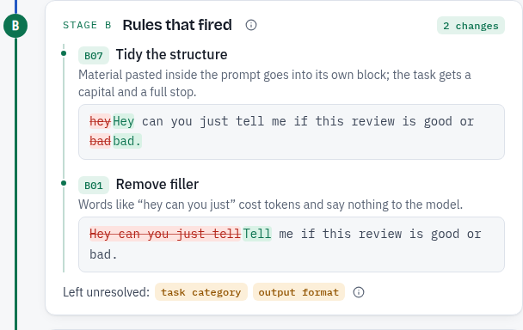
STEP B: FIX WITH SIMPLE RULES
BEFORE
hey can you just tell me if this review is good or bad
AFTER
Tell me if this review is good or bad.
15 SMALL RULES, EACH ONE TESTED
remove filler
remove repeats
move pasted data
add answer format
add length
add language
list the labels
answer from the text
attachments
Not sure of the task? Then no rule adds a format. The question goes to Step C.
Notes:
Nirzara. Step B fixes with fixed rules, and shows every change. Here two rules fired: tidy the sentence, and remove 'hey can you just'. We have 15 rules, each a small tested function: add an answer format, a length, a programming language, the list of labels, and so on. But because Step A was not sure of the task, no rule guesses a format. That open question goes to Step C.

Slide 10
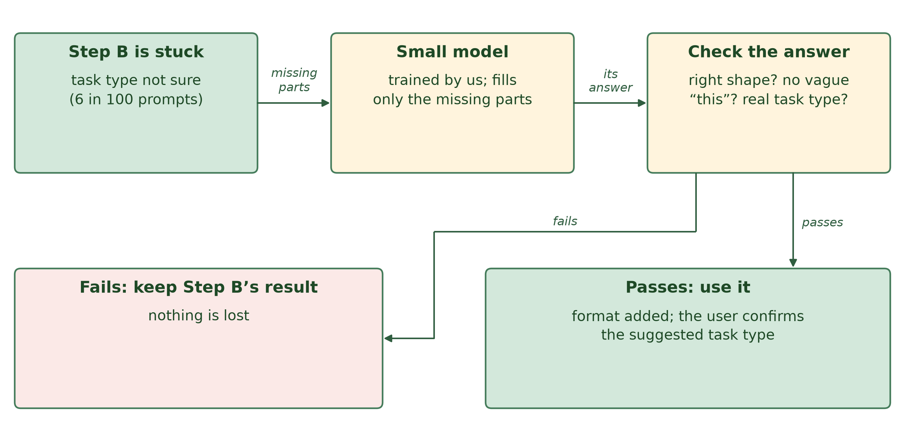
STEP C: A SMALL MODEL, ONLY WHEN STUCK
6 in 100
prompts need Step C; the rules handle the rest
ANSWERS THAT PASS THE CHECK
5 / 100
before training
98 / 100
after our training
51 min
For our example it added “Provide only the label.” and suggested “sort into a label”. The app asks the user to confirm.
to train on a 4 GB laptop GPU
Notes:
Nirzara. Step C is a small AI model, Qwen 0.5B, that we trained ourselves with LoRA on a laptop GPU in 51 minutes. It is called only when the rules are stuck: 6 in 100 prompts. It may fill only the missing parts; everything else is locked. Its answer is checked; if the check fails, we keep Step B's result. Without our training only 5 in 100 answers passed the check; after training 98 in 100. For our example it added 'Provide only the label' and suggested the task type, which the user confirms.

Slide 11
STEP D: WRITTEN FOR YOUR AI
Claude
GPT
Gemini
<context>
<document>
The battery lasts two
days and the camera is
great, but the phone
heats up while gaming.
</document>
</context>
<task>
Tell me if this review
is good or bad.
</task>
<output_format>
Provide only the label.
</output_format>
### Task
Tell me if this review
is good or bad.
### Context
Document:
```
The battery lasts two
days and the camera ...
```
### Output format
Provide only the label.
Task: Tell me if this
review is good or bad.
Output format: Provide
only the label.
Context:
Document:
```
The battery lasts two
days and the camera ...
```
Same content for every AI, in the layout its makers recommend. Our prompt for GPT: 50 tokens, counted exactly.
Notes:
Nirzara. Step D writes the same content in the layout each AI prefers: XML tags with the document first for Claude, headed sections for GPT, plain labels with the instruction first for Gemini. Our tests read every version back to make sure nothing is lost.

Slide 12
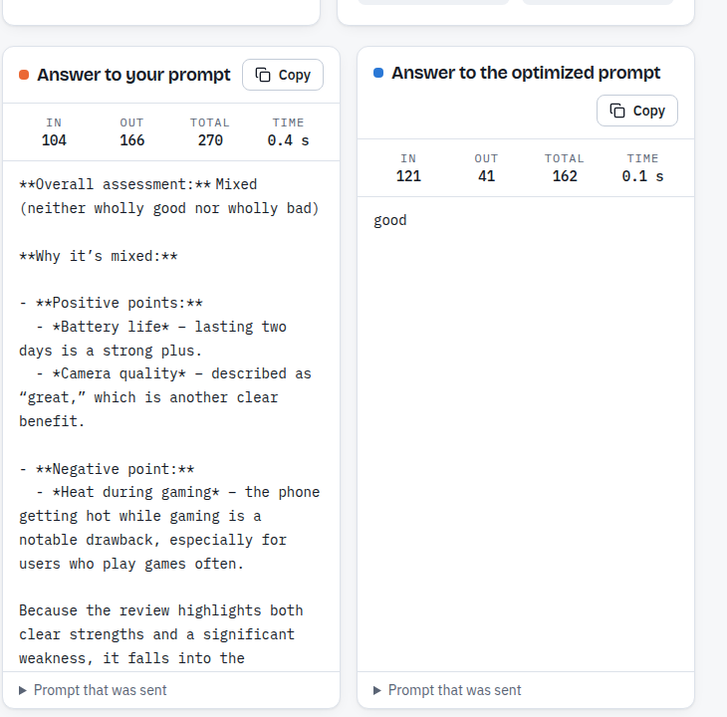





THE RESULT FOR OUR EXAMPLE
Total tokens
270
162
vague prompt
optimized
Tokens in the answer
166
41
vague prompt
optimized
Answer
a page
“good”
vague prompt
optimized
Same AI for both: OpenAI's GPT model (gpt-oss-120b)
Notes:
Nirzara. We sent both prompts to the same AI, OpenAI's GPT model gpt-oss-120b. The vague prompt cost 270 tokens in total, the optimized one 162: 40% fewer. The answer itself went from 166 tokens to 41: the word 'good'. And it came back in 97 ms instead of 353. The vague answer said 'mixed', a fair reading, but the user asked good or bad, and the optimized prompt answers exactly that question.

Slide 13
DOES IT WORK ON 482 NEW PROMPTS?
39% fewer
total tokens per prompt (482 test prompts)
Answer format stated
3 in 100
95 in 100
vague prompt
optimized
Quality, blind judge (0-10)
8.2
9.0
vague prompt
optimized
Task done right: 67% vs 85%
Notes:
Siddhi. One example is not proof, so we tested on 482 prompts the system never saw, using one AI, OpenAI's GPT model. The optimized prompt is slightly longer, 226 to 241 tokens, but the answers are much shorter, 682 to 165. Total: 39% fewer tokens per prompt. The answer format is stated in 95 of 100 prompts instead of 3, and a blind judge scored quality 9.0 instead of 8.2. Honest limit: 87 of the 482 prompts cost a little more, because their answer was already short.

Slide 14
TESTING
UNIT
INTEGRATION
SYSTEM
798
42 / 50
13 / 13
automatic tests, all pass
real-life questions right (vague: 37)
browser tests of the whole app pass
● every rule tested on its own
● 4 sample cases per module in the report
● 10 per task type
● 29.6% fewer tokens
● 482 test prompts run once
● frozen code checked byte by byte
Notes:
Siddhi. Three levels. Unit: 798 automatic tests, every rule on its own, all pass. Integration: 50 new real-life questions, 10 per task type, each with a known right answer; the optimized prompts got 42 right, the vague ones 37, with 30% fewer tokens. System: 13 browser tests drive the real app, all pass; the 482 test prompts were run once at the end, and a check proves the code we measured never changed.

Slide 15
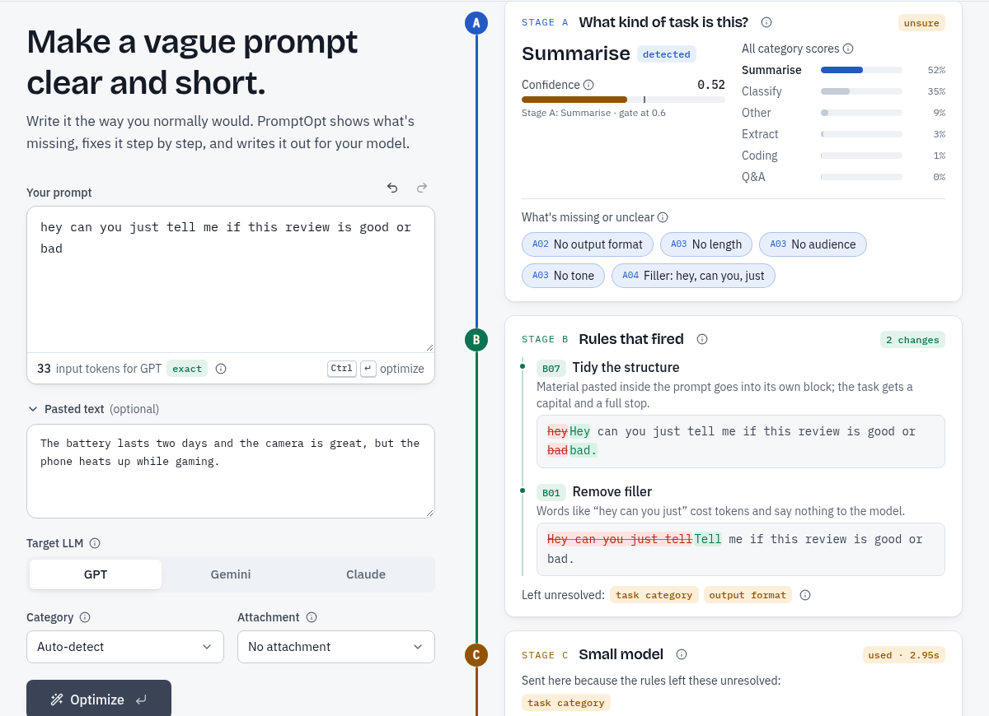
THE WORKING APP
LIVE DEMO
1
Optimize
our review example: every step on screen
2
Compare
both prompts on a real AI
3
History
past prompts, deleted after 30 days
4
Test suite
the 50 real-life questions
Notes:
Siddhi. The app: FastAPI and React, running on our laptop. Live demo: Optimize our review example and watch each step; Compare both prompts on a real AI; History, where prompts are deleted after 30 days; and the test suite. If the network fails, Compare shows saved past runs.

Slide 16
CHALLENGES AND NEXT STEPS
WHAT WAS HARD, AND WHAT WE DID
NEXT STEPS
AI-written data dropped facts
1
Lean mode
computer checks, repair, and we read 330 pairs
add less when the answer is already short
The small model made things up
2
Real GPT, Claude, Gemini
training (5 to 98 in 100) and a check before use
with paid API keys
Free AI limits per day
3
Bigger tests
a usage log, pacing, runs that resume next day
more real-life questions, written by outsiders
4 GB laptop GPU
4
Research paper
memory-saving training: 51 minutes
on the method and results
Notes:
Siddhi. What was hard: AI-written data that dropped facts, a small model that made things up before training, daily limits on free AI services, and a 4 GB laptop GPU. Next: a lean mode for prompts whose answer is already short, tests on real GPT, Claude and Gemini, bigger tests written by people outside the team, and a research paper.

Slide 17
THANK YOU
Notes:
Siddhi. Thank you. We are happy to take questions. (Appendix slides follow for questions.)

Slide 18








TECH STACK
Layers
Technologies
Frontend
React
Tailwind CSS
Backend & Database
Fast API
PostgreSQL
LLM & Finetuning
Hugging Face Transformer
PEFT(LoRA)
NLP & Feature Detection
spaCy
Regex
Tokenization
Hugging Face Tokenizer
Tiktonken
Dataset
Dolly
CodeAlpaca
Alpaca
Notes:
Appendix. Tech stack, from LA-1.

Slide 19
LITERATURE REVIEW
A Systematic Survey of Automatic Prompt OptimizationTechniques
Towards LLMs Robustness to Changes in Prompt Format Styles
CAPO: Cost-Aware Prompt Optimization
Surveys and defines Automatic Prompt Optimization as a field, offering a taxonomy of existing approaches, but proposes no method of its own or lightweight, self-hosted solution.
Shows that prompt formatting alone significantly affects LLM output quality, but focuses on training models to be robust, not on optimizing the prompt itself.
Uses evolutionary search to balance prompt quality against length and cost, but the approach is computationally expensive, unsuitable for lightweight or self-hosted use.
~Ramnath et al. (2025)
~Ngweta et al. (2025)
~Zehle et al. (2025)
Notes:
Appendix. Literature review, from LA-1.

Slide 20
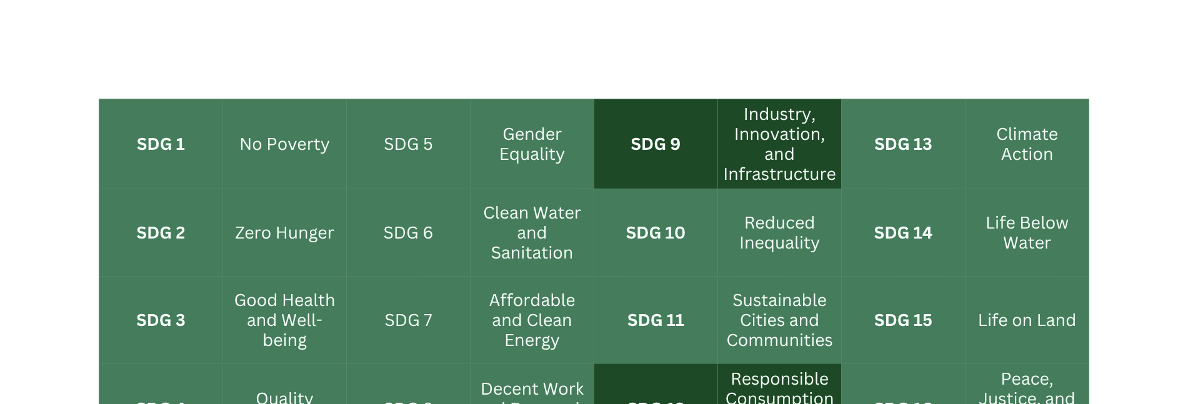
SDG ALIGNMENT
Notes:
Appendix. SDG alignment, from LA-1.

Slide 21




PROMPTOPT – MINI PROJECT-I GANTT CHART
Work Done
Future Work
Task
Jul 2026
Aug 2026
Sep 2026
Oct 2026
1
Problem Identification & Customer Connect
2
Literature Review & Gap Analysis
3
Survey & Interviews
4
Dataset Collection & EDA
5
SRS Development
6
System Design & Architecture
7
Prototype Development (Frontend + Backend)
8
Model Development (Rules + LoRA)
9
Evaluation & Testing
10
Final Demo & Documentation
Notes:
Appendix. Timeline, from LA-1.

Slide 22
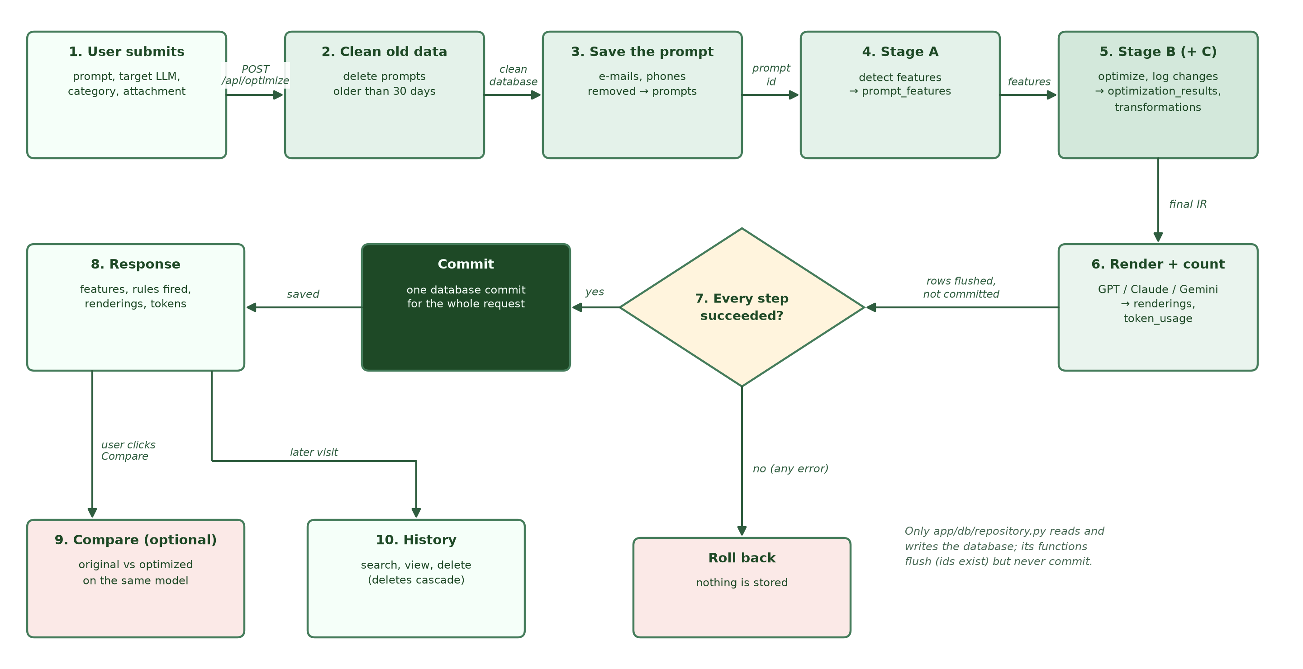
APPENDIX: PIPELINE FLOW OF ONE REQUEST
Notes:
Appendix. One request is one database transaction: steps 1-6 write, step 7 commits only if every step succeeded, otherwise nothing is stored.

Slide 23

REFERENCES
Ramnath, K., Zhou, K., Guan, S., et al. (2025). A Systematic Survey of Automatic Prompt Optimization Techniques.
Proceedings of the 2025 Conference on Empirical Methods in Natural Language Processing (EMNLP), Association for Computational Linguistics. https://aclanthology.org/2025.emnlp-main.1681/
Ngweta, L., Kate, K., Tsay, J., & Rizk, Y. (2025). Towards LLMs Robustness to Changes in Prompt Format Styles. Proceedings
of the 2025 Conference of the North American Chapter of the Association for Computational Linguistics: Student Research Workshop (NAACL-SRW). https://aclanthology.org/2025.naacl-srw.51/
Zehle, T., Schlager, M., Heiß, T., & Feurer, M. (2025). CAPO: Cost-Aware Prompt Optimization. Proceedings of the Fourth International Conference on Automated Machine Learning (AutoML), PMLR 293. https://proceedings.mlr.press/v293/zehle25a.html
Taori, R., et al. (2023). Alpaca: A Strong, Replicable Instruction-Following Model. Stanford CRFM. https://github.com/tatsu-lab/stanford_alpaca
Databricks (2023). Databricks Dolly 15k Dataset. https://huggingface.co/datasets/databricks/databricks-dolly-15k
HuggingFace PEFT Documentation — Parameter-Efficient Fine-Tuning (LoRA). https://huggingface.co/docs/peft
Notes:
Appendix. References, from LA-1.

