Slide 1

Walchand College of Engineering, Sangli
(Government Aided Autonomous Institute) · Department of Computer Science and Engineering
TY CSE · Mini Project-I (7CS345) · LA-2 Evaluation (Release 2), 2026-27
PromptOpt
Token-efficient prompt optimization for LLMs: rewrite vague prompts, explain every change, and measure that it helps
Team
Guide
Piush U. Gogi · 255200005
Nirzara A. Manade · 255200006
Siddhi S. Bolaikar · 255200008
Prof. A. S. Pawar
15 October 2026
Notes:
Presenter: Piush. Greet the panel, introduce the team and the guide. One line: PromptOpt rewrites a vague prompt into a clear, model-specific one, shows every change, and we measured that it saves tokens. Today: Release 2 in the order of the LA-2 checklist, then a live demo.

Slide 2
Release 2 at a glance
-39.2%
95.0%
798
42/50
total tokens, 482 test prompts
state an output format (was 3.1%)
pytest tests passing + 13/13 UI tests
correct vs 37/50 vague (correctness suite)
What this review covers
1 Core modules: Stage A, B, C, IR + renderers, image mode, attachments, Compare, web app, database
2 Transaction flow: submit → optimize → store (one commit) → Compare → History → retention
3 Unit testing · 4 Integration & system testing · 5 Working prototype
6 Test cases with real results, including honest failures
7 Git / GitHub · 8 Challenges and fixes · 9 Plans · Live demo
Notes:
Presenter: Piush. Four numbers to remember. -39.2% total tokens on 482 held-out test prompts (95% CI 35.9-42.5%). 95% of optimized prompts state an output format, vs 3.1% before. 798 automated tests plus 13 browser tests, all passing as of yesterday. Correctness: 42 of 50 vs 37 of 50, with 29.6% fewer tokens. Then name the order of the talk: modules, transactions, testing, prototype, Git, challenges, plans, demo.

Slide 3
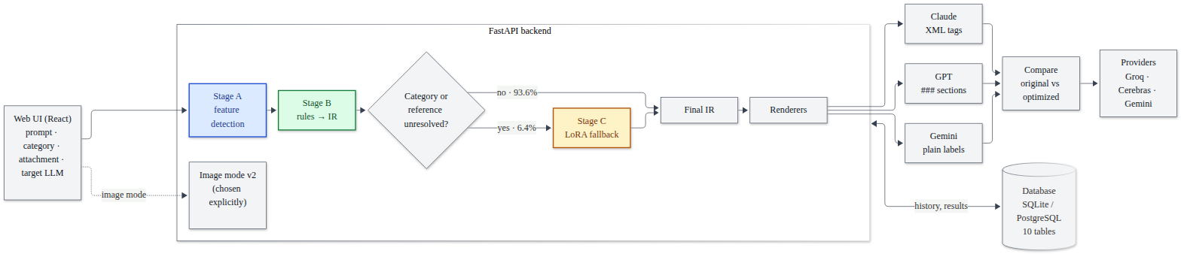
System architecture
Stage A
Stage B
Stage C
Output
spaCy + regex + sentence-embedding classifier: category, missing format/constraints, filler, ambiguous refs
15 deterministic rules B01-B15, every change logged; category rules only at confidence ≥ 0.6
Qwen2.5-0.5B + LoRA, called only for unresolved fields; validated, else Stage B kept
IR rendered per target LLM with token counts; Compare, History, 30-day retention
Notes:
Presenter: Piush. Walk the diagram left to right: the React UI sends prompt, target LLM, category and attachment type. Stage A detects what is missing, Stage B fixes it with rules and builds the IR. Only if the category or a reference is still unresolved (6.4% of test prompts) does Stage C, the LoRA model, run. Renderers write the same IR for Claude, GPT or Gemini. Compare runs both prompts on a real model. Everything is stored through one repository module. Image mode is a separate path the user picks.

Slide 4
Stage A detects, Stage B fixes with 15 rules
Stage A · feature detection
Stage B · rules (each a unit-tested function)
Task category + confidence (embedding classifier, keyword fallback)
A02 missing output format
A03 missing length / tone / audience / language
A04 filler and repetition
A05 ambiguous reference ("summarize this")
B01 Remove filler
B02 Remove duplicates
B03 Output format
B04 Length limit
B05 Programming language
B06 Label set
B07 Structure / data block
B08 Group fallback
B09-B15 Attachment modifiers
74.7%
category accuracy on 482 test prompts (coding F1 0.98, classification 0.94)
3.1% → 95.0%
of test prompts state an output format after Stage B; 6.4% (31 of 482) are routed to Stage C
Notes:
Presenter: Piush. Stage A on the test split: 74.7% category accuracy; coding and classification are near perfect, the closed QA / extraction / summarization group is hard on degraded prompts. Stage B: each rule is a separate unit-tested function. Example: 'write code to get all permutations of a string' gets B07 tidy, B05 'Use Python', B03 'Return only the code, in a single code block'. Result: an output format is stated in 95% of prompts instead of 3.1%. Below 0.6 confidence, B08 handles the text group without guessing the category.

Slide 5
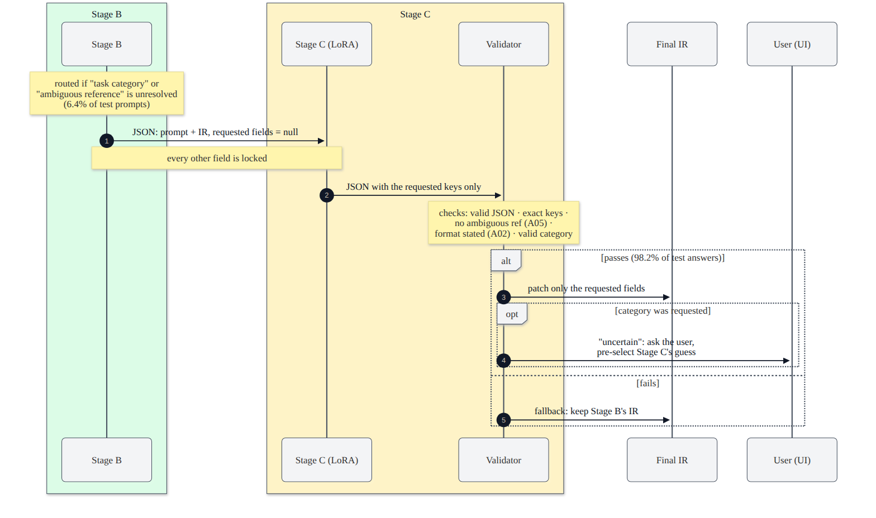
Stage C: a small LoRA model, only where rules stop
5% → 98%
22.6 → 90.3%
answers pass validation: base vs LoRA
format stated on routed prompts
0.74 s
6.4%
median per call, RTX 3050 (CPU 4.55 s)
of test prompts routed to Stage C
Forced on every prompt, Stage C lowers task intent (0.886 → 0.769), so it stays a fallback. Its category is only a suggestion: the UI asks the user.
Notes:
Presenter: Piush. Stage C is Qwen2.5-0.5B-Instruct with a LoRA adapter, trained on our 4 GB laptop GPU in 51 minutes. It runs only when Stage B leaves the category or an ambiguous reference unresolved. It must answer with JSON containing exactly the requested keys; we check it with Stage A's own detectors and keep Stage B's result if it fails. Without fine-tuning only 5% of answers pass; with LoRA 98.2%. On routed prompts the format is stated in 90.3% instead of 22.6%. Forcing every prompt through Stage C hurts task intent (0.886 to 0.769), so it stays routed-only. Median 0.74 s on GPU.

Slide 6
IR, renderers, attachments and image mode
Claude
GPT
Gemini
Image mode (separate, user-selected)
<task>Write code to get all
permutations of a string.</task>
<constraints>- Use Python.
</constraints>
<output_format>Return only
the code ...</output_format>
### Task
Write code to get all
permutations of a string.
### Constraints
- Use Python.
### Output format
Return only the code ...
Task: Write code to get all
permutations of a string.
Constraints: Use Python.
Output format: Return only
the code ...
Held-out CLIP vs the user's prompt (30 prompts)
original
33.08
v1 defaults
30.78 (worse, p=0.043)
Same content, layout per model · every rendering parsed back in the tests
v2 suggestions
32.77 (no sig. harm)
Attachments B09-B15: image, PDF, PPTX, DOCX, spreadsheet, code, other; fire only with an attachment · 30/30 hand-made prompts correct
Style kept in 12/12 styled prompts with v2
Notes:
Presenter: Nirzara. One intermediate representation, three layouts. Claude gets XML tags with context first, GPT gets ### sections, Gemini gets plain labels with the instruction first; tests parse every rendering back to prove no field is lost. GPT tokens are exact with tiktoken, Claude and Gemini approximate and labelled. Attachments are modifiers: B09-B15, one rule per file type, 30 of 30 hand-made prompts correct. Image mode v2 keeps the user's words and offers missing attributes as suggestions; v1, which inserted defaults, made images worse.

Slide 7
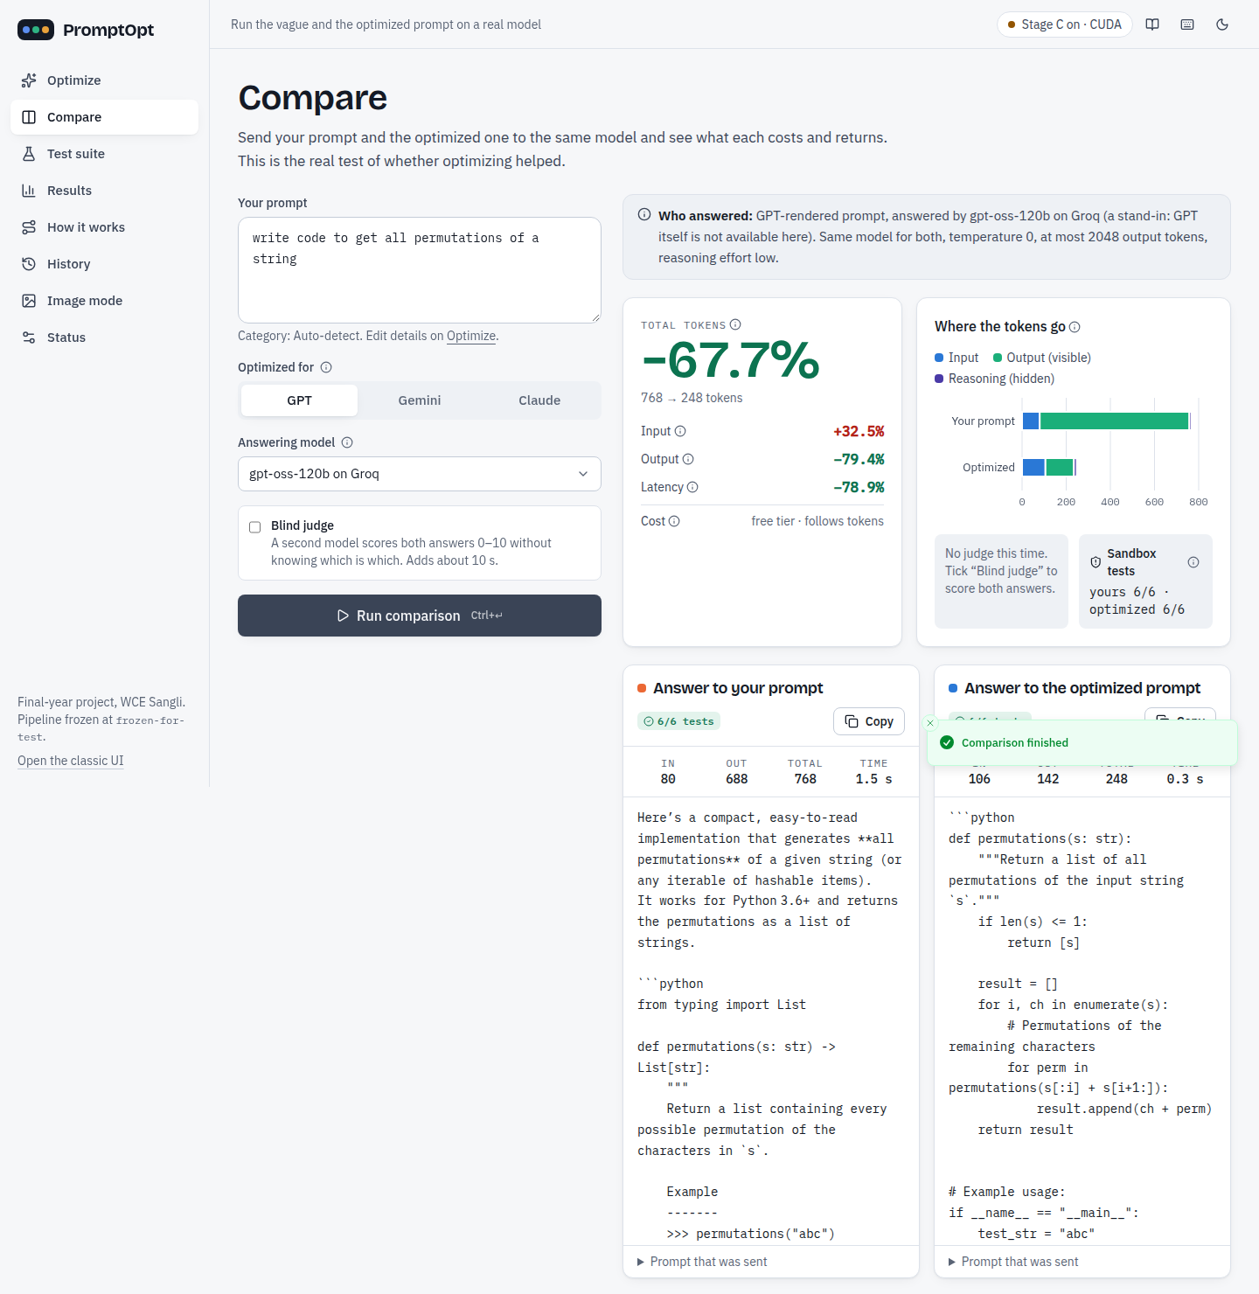
Web app and Compare on a real model
-67.7%
6/6 = 6/6
total tokens: 768 → 248 (live, gpt-oss-120b)
sandbox tests pass for both answers
What the app does
Optimize: every stage shown, rule by rule, with before/after text
Compare: same model, temperature 0, tokens, latency, tests, optional blind judge
History: search, view, delete; prompts expire after 30 days
Status: providers' 24-hour usage, Stage C on CUDA, sandbox
Notes:
Presenter: Nirzara. FastAPI back end with a React + TypeScript front end: Optimize, Compare, Test suite, Results, How it works, History, Image mode, Status. The screenshot is a live Compare on gpt-oss-120b: the vague permutations prompt used 768 tokens, the optimized one 248, minus 67.7%, both passing 6 of 6 sandbox tests. Every result says which model actually answered; GPT and Claude themselves need paid keys, so gpt-oss is labelled as a stand-in.

Slide 8
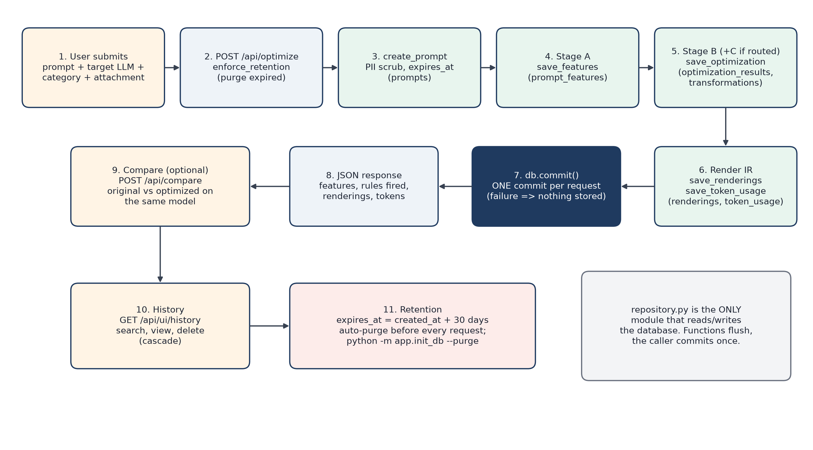
Transaction flow: one request, one commit
Notes:
Presenter: Nirzara. Follow the numbers. The endpoint first purges expired prompts. create_prompt scrubs emails and phone numbers and sets expires_at. Stage A results go to prompt_features, Stage B and C to optimization_results and one transformations row per change, renderings and token_usage per target. All through repository.py: its functions flush but never commit; the endpoint commits once, so a failure half-way stores nothing. Then Compare, History, and retention close the loop.

Slide 9
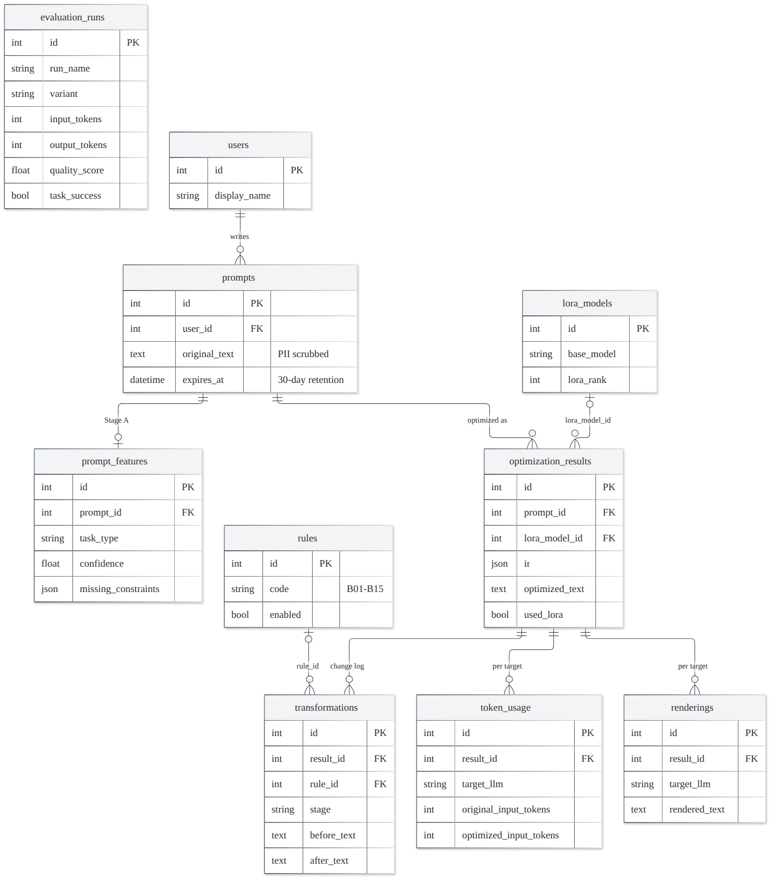
Database layer: 10 tables, repository only
Written in one optimize transaction
Table | Repository call | Stores
prompts | create_prompt | PII-scrubbed text, expires_at
prompt_features | save_features | category, confidence, gaps
optimization_results | save_optimization | IR, optimized text, used_lora
transformations | save_optimization | one row per change, rule_id
renderings | save_renderings | prompt per target LLM
token_usage | save_token_usage | tokens per target
Cascade on delete · PII scrubbed before storing · 30-day retention enforced before every request
Notes:
Presenter: Nirzara. SQLAlchemy 2.0, SQLite in development, PostgreSQL in deployment. The six tables on the right are written in one optimization transaction. Children cascade on delete, so the retention purge removes everything derived from an expired prompt. evaluation_runs is deliberately not linked to prompts so benchmark results are never purged. Constraints live in the schema: confidence between 0 and 1, a Stage B step must name a rule, one rendering per target.

Slide 10
Unit testing: 798 tests, all passing
Run
cd backend
source .venv/bin/activate
python -m pytest -q
→ 798 passed in 24.6 s
Real examples
test_b05_defaults_to_python
test_pii_is_scrubbed_before_storage
test_retention_purge_cascades
test_blank_prompt_is_rejected_with_422_not_500
test_invalid_answers_fall_back_to_stage_b
Notes:
Presenter: Siddhi. We ran the full suite yesterday, 14 October: 798 passed in 25 seconds, offline, because providers are faked or replayed from recordings. Biggest groups: image mode 215, Stage B 123, dataset tooling 107, rendering and pipeline 77. Every Stage B rule has its own tests. Example: test_pii_is_scrubbed_before_storage stores 'mail rahul.k@example.com or call 98765 43210' and checks one [EMAIL] and two [PHONE] tags. Command: python -m pytest -q in backend.

Slide 11
Integration and system testing
Freeze check
UI end-to-end
API end-to-end
BYTE-IDENTICAL
13 / 13
pytest
482 test prompts, Stage A+B vs tag frozen-for-test (sha256 35f7d4dc…)
Playwright + Chrome: optimize, compare, suite, history, image mode, no console errors
FastAPI TestClient: Stage C on/off, 422 errors, retention, PII-scrubbed Compare
Full pipeline
Coding sandbox
Correctness suite
482 + 44
20.7 → 34.5%
37 → 42 / 50
test split run once (2 Oct) · benchmark with real LLM + blind judge
pass@1 strict, 29 Python items; bubblewrap: no network, read-only
hand-written cases with verifiable answers, gold human-reviewed
Notes:
Presenter: Siddhi. Beyond unit tests: the freeze check recomputes Stage A and B on all 482 test prompts and compares a sha256 with the frozen-for-test tag; yesterday it was byte-identical. Thirteen Playwright tests drive the real app in Chrome, 13 of 13 pass. API tests go end to end through FastAPI. The full pipeline ran once on the 482-prompt test split and the 44-prompt benchmark. Coding answers run in a bubblewrap sandbox with no network. And the 50-case correctness suite checks real answers.

Slide 12
Test cases and correctness, including failures
ID | Case | Input | Result | Status
TC04 | B01 removes filler | "hey can you please summarize the text for me?" | "Summarize the text." | PASS
TC16 | PII scrubbed | mail rahul.k@example.com … 98765 43210 | 1 [EMAIL], 2 [PHONE] | PASS
TC26 | Freeze check | 482 test prompts | byte-identical | PASS
TC31 | cqa-01 hostel fee | "if i pay on 18 july how much total??" | 80300 (vague said 85300) | PASS
TC34 | cls-09 attendance | "mark each student safe warning or detained" | got a Python script | FAIL
TC37 | cod-10 recipe scaler | "write the scale fn for recipe app" | 4/8 asserts | FAIL
42/50
-29.6%
Fixed 9 · broke 4 · McNemar p = 0.267 (not significant at n = 50)
Failures: Stage A misread a table as code (cls-09); two summaries 2-3 words over the limit; a Stage C coding case 4/8 asserts.
optimized (vague 37)
total tokens
Notes:
Presenter: Siddhi. The report has 38 test cases; here are six. The correctness suite: 50 new hand-written cases. Vague prompts 37 correct, optimized 42, with 29.6% fewer tokens. Optimization fixed 9 answers and broke 4; McNemar p = 0.267, so not significant at n = 50, and on Cerebras it was 43 vs 41. Be honest about the failures: cls-09, Stage A read an attendance table as code so the model wrote a script; two summaries went 2-3 words over the limit; one Stage C coding case failed 4 of 8 asserts.

Slide 13
Results: -39.2% total tokens on 482 test prompts
682 → 165
output tokens per prompt (input 226 → 241)
8.2 → 9.0
benchmark quality; task success 67% → 85%
Limitation: 87 of 482 prompts cost more (short answers, mostly extraction)
Notes:
Presenter: Siddhi. The headline: across the 482-prompt test split, total tokens drop 39.2% per prompt, CI 35.9 to 42.5%, Wilcoxon p below 0.001. The optimized prompt is a bit longer, 226 to 241 input tokens, but answers shrink from 682 to 165 because the format and length are stated. Every category saves on average; the limitation is that 87 of 482 short-answer prompts cost more, which is why lean mode is our first next step. On the benchmark with a blind judge, quality went 8.2 to 9.0 and task success 67 to 85%.

Slide 14
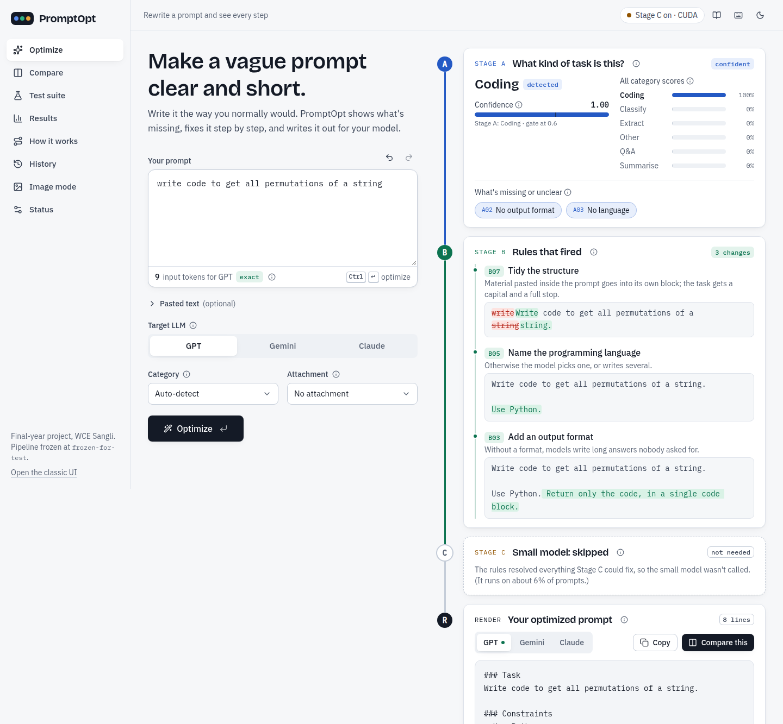
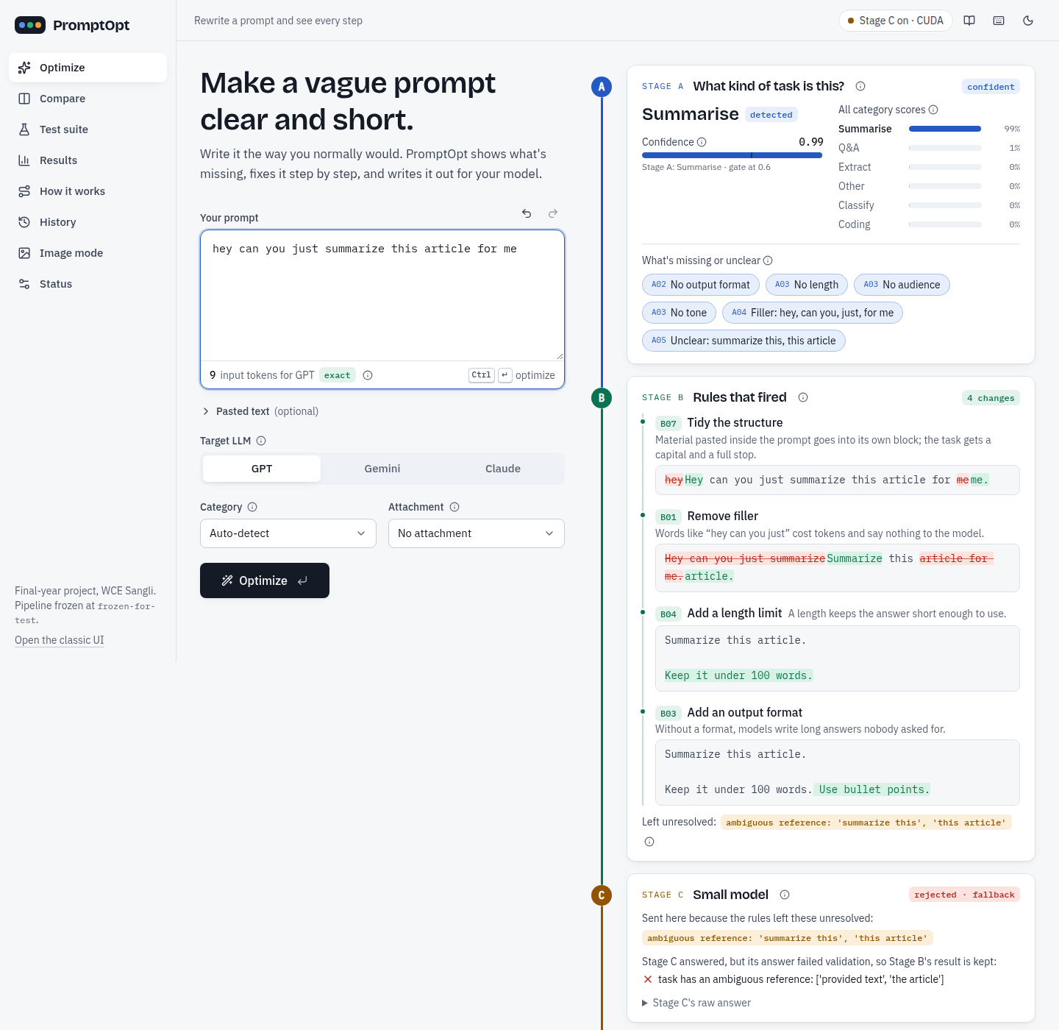
Working prototype
Notes:
Presenter: Nirzara. Left: Optimize on the permutations example, every stage visible, rules with before and after text, the rendered prompt and validated tests. Right: a prompt with an ambiguous reference, 'summarize this article', routed to Stage C; Stage C's answer failed validation, so the app kept Stage B's result and says so. This honesty is on purpose. The app runs on the laptop as a service and is reachable on the LAN.

Slide 15
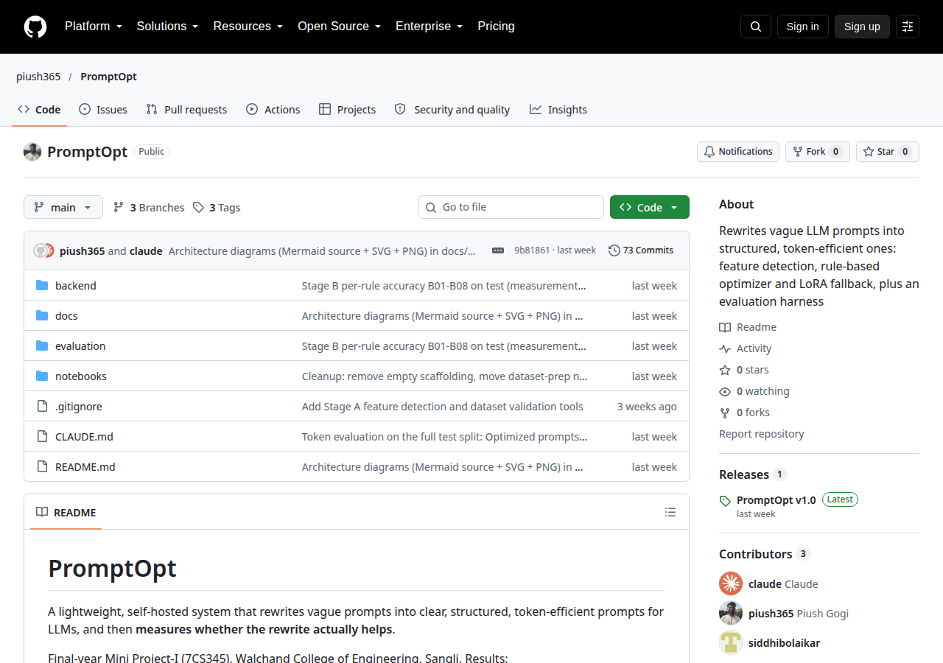
Git and GitHub
92
3
4
commits
branches
tags · 1 release
frozen-for-test (27 Sep): code for the final numbers
final-for-test (2 Oct): test split run once
v1.0 (8 Oct): release + Stage C adapter
Commits/month: Aug 7 · Sep 38 · Oct 47
Tracking: roadmap + phase tables in CLAUDE.md, tags, release (no Issues/Projects used)
github.com/piush365/PromptOpt
Notes:
Presenter: Nirzara. All numbers are from git. 92 commits between 13 August and 10 October, on three branches: main, ui-v2 and correctness-suite. Tags were our evaluation checkpoints: frozen-for-test marks the code for the final numbers, final-for-test the one-time test run, v1.0 the release with the Stage C adapter attached. We did not use GitHub Issues or Projects; we tracked work with the roadmap and phase tables in the repository and with tags. Many commits were written with an AI coding assistant credited as co-author.

Slide 16
Challenges and how we solved them
Dataset generation bugs
Kappa paradox
API quota limits
Stage C hallucination
LLM targets dropped data → deterministic repair: 349 prompts fixed, all logged
90% agreement, kappa 0.065 → report Gwet's AC1 0.92-0.96 too
Groq 200k tokens/day → 24-h usage ledger, 70% budget rule, resumable runs
base model 5% valid → LoRA 98.2%, strict JSON contract, fallback to Stage B
Image mode v1 failure
Label / regex edge cases
4 GB GPU training
Rule: report it, don't hide it
defaults turned watercolor into photo → v2: suggestions only
"thank you so much" in a button → a unit test per edge case, B16 in the app
micro-batch 1 × 16, bf16, checkpointing: 51 min; models loaded once
After the freeze, bugs were reported, not fixed; failures are in the results.
Notes:
Presenter: Piush. Seven problems, seven fixes. LLM-written targets dropped data, so we built a deterministic repair with a log. Raters agreed on 90% of rows but kappa was near zero: the kappa paradox, so we report Gwet's AC1 too. Free API quotas: a rolling usage ledger and a 70% budget rule. Stage C invented fields zero-shot, so we fine-tuned and validate every answer. Image v1 made pictures worse; v2 suggests instead of inserting. Regex edge cases got their own tests. And the model trained on a 4 GB GPU with gradient accumulation.

Slide 17
Plans for the upcoming phases
1
Lean mode
2
Smarter routing
add only the format line when the answer is short
send label-set and typo prompts to Stage C
3
Spelling normalisation
4
Blind user tests
user-confirmed fixes before optimizing
prompts written outside the team
5
Real GPT / Claude / Gemini
6
Larger correctness suite
Compare with paid API keys
more cases and providers for significance
7
Deployment
PostgreSQL, HTTPS, login, beyond the LAN
Notes:
Presenter: Siddhi. In priority order. Lean mode, because 87 short-answer prompts cost more. Route label-set and typo prompts to Stage C, and let users confirm spelling fixes. Blind tests with prompts written by people outside the team. Compare on real GPT, Claude and Gemini once we have paid keys. A larger correctness suite so the gain can reach significance. Then deployment with PostgreSQL, HTTPS and login.

Slide 18
Live demo
1
Optimize: "write code to get all permutations of a string"
2
Stage C: "hey can you just summarize this article for me"
3
Compare on gpt-oss-120b: tokens, latency, tests
4
Image mode: "oil painting of a sailboat in a storm"
5
History, Test suite and Results pages
Thank you · questions welcome
Notes:
Presenter: Piush drives the laptop; Nirzara narrates Optimize and Compare, Siddhi narrates Test suite and Results. Follow DEMO_LA2.md. If the network fails, Compare shows the cached past comparisons table; if the GPU fails, the app falls back to Stage A + B and says Stage C is unavailable. End with thanks and questions.

