Slide 1
Algorithm Engineering
Homework #1
Modeling real-world problem
Valentin L’Homel

Slide 2
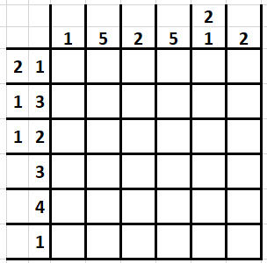
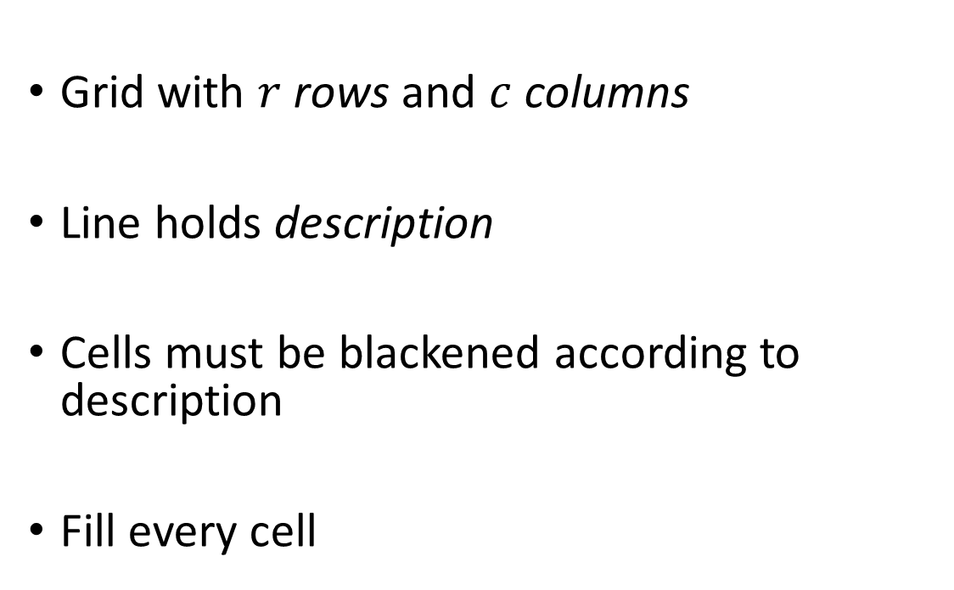
Study case: Nonogram
Grid with $r$ rows and $c$ columns
Line holds description
Cells must be blackened according to description
Fill every cell

Slide 3
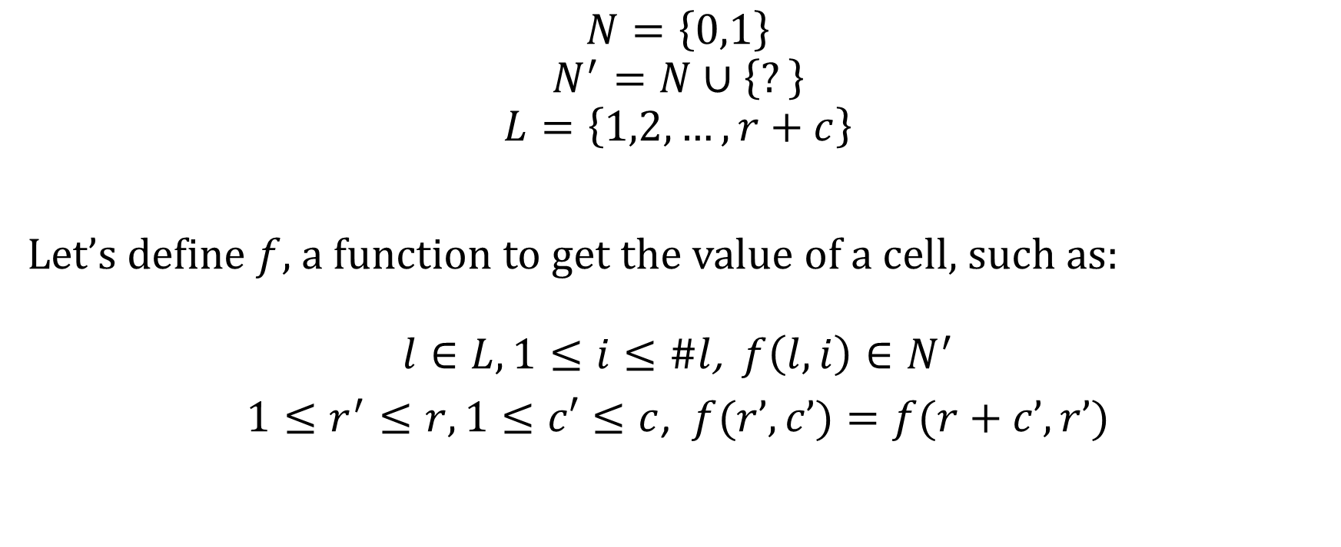
Modeling
$$N=\left\{0,1\right\}$$
$$N^{′}=N∪\left\{?\right\}$$
$$L=\left\{1,2,…,r+c\right\}$$
Let’s define $f$, a function to get the value of a cell, such as:
$l∈L, 1≤i≤\#l$, $f\left(l,i\right)∈N^{′}$
$1≤r^{′}≤r,1≤c′≤c$, $f(r’,c’)=f(r+c’,r’)$

Slide 4

Modeling
Let’s define $δ^{l}$ the definition of line $l$
$$δ^{l}=\{\left(x_{i},a_{i},b_{i}\right) :1≤i≤\#l\}$$
Where:
$$x∈N$$
$$0≤a≤b≤\#l$$
For any $l∈L$:
$1≤i≤\#l$, $f(l,i)∈N$
$$\sum_{i=0}^{\#l}{x_{i}^{l}a_{i}^{l}≤\sum_{i=0}^{\#l}{f(l,i)}≤\sum_{i=0}^{\#l}{x_{i}^{l}b_{i}^{l}}}$$

Slide 5
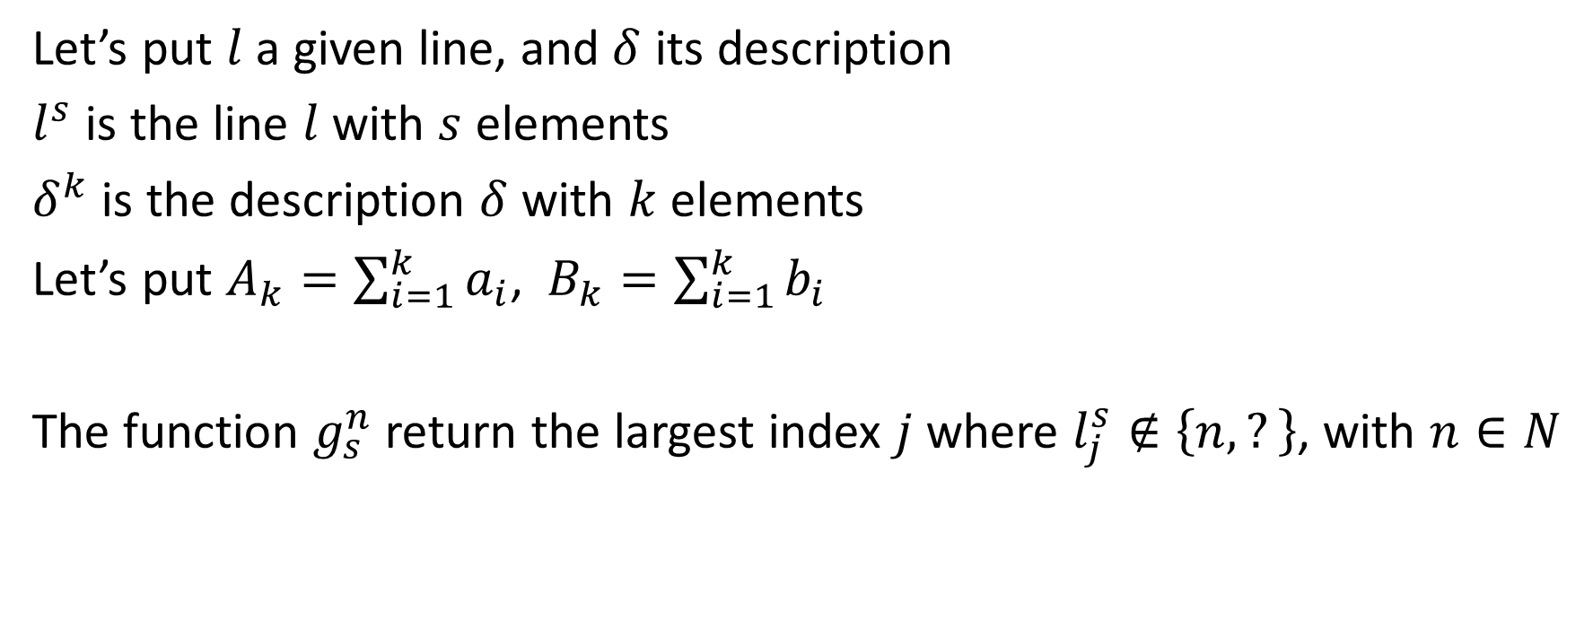
Solution approach
Let’s put $l$ a given line, and $δ$ its description
$l^{s}$ is the line $l$ with $s$ elements
$δ^{k}$ is the description $δ$ with $k$ elements
Let’s put $A_{k}=\sum_{i=1}^{k}{a_{i}}$, $B_{k}=\sum_{i=1}^{k}{b_{i}}$
The function $g_{s}^{n}$ return the largest index $j$ where $l_{j}^{s}∉\left\{n,?\right\}$, with $n∈N$

Slide 6
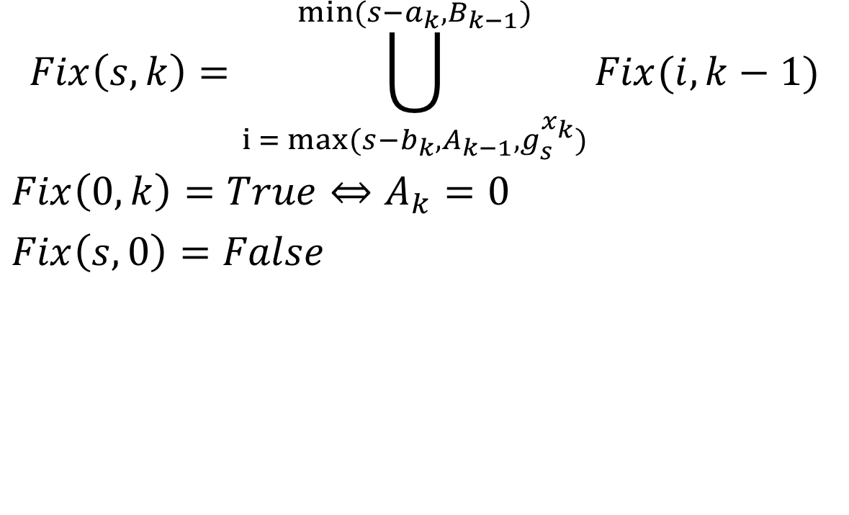
Solution approach
$$Fix\left(s,k\right)=\bigcup_{i = max⁡(s−b_{k},A_{k−1},g_{s}^{x_{k}})}^{min⁡(s−a_{k},B_{k−1})}{Fix(i,k−1)}$$
$Fix\left(0,k\right)=True⇔A_{k}=0$
$Fix\left(s,0\right)=False$

Slide 7
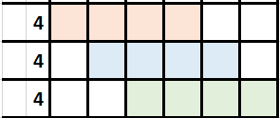
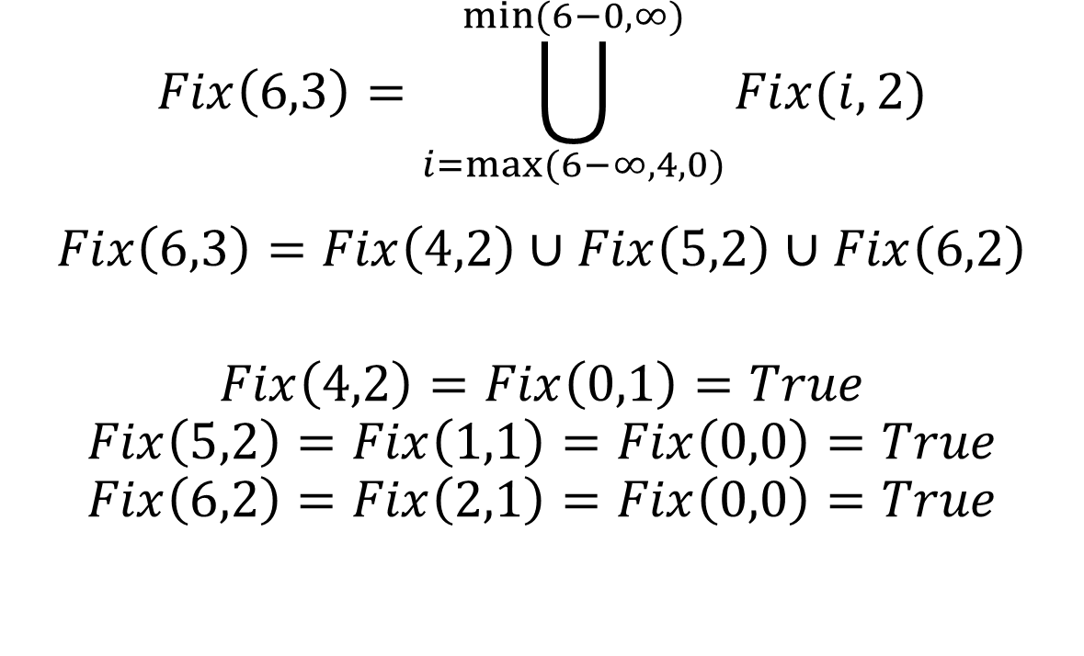
Solution approach
$$Fix\left(6,3\right)=\bigcup_{i=max⁡(6−∞,4,0)}^{min⁡(6−0,∞)}{Fix(i,2)}$$
$$Fix\left(6,3\right)=Fix\left(4,2\right)∪Fix\left(5,2\right)∪Fix\left(6,2\right)$$
$$Fix\left(4,2\right)=Fix\left(0,1\right)=True$$
$$Fix\left(5,2\right)=Fix\left(1,1\right)=Fix\left(0,0\right)=True$$
$$Fix\left(6,2\right)=Fix\left(2,1\right)=Fix\left(0,0\right)=True$$

